Slide 1
Mold Making & Slipcasting

Slide 2
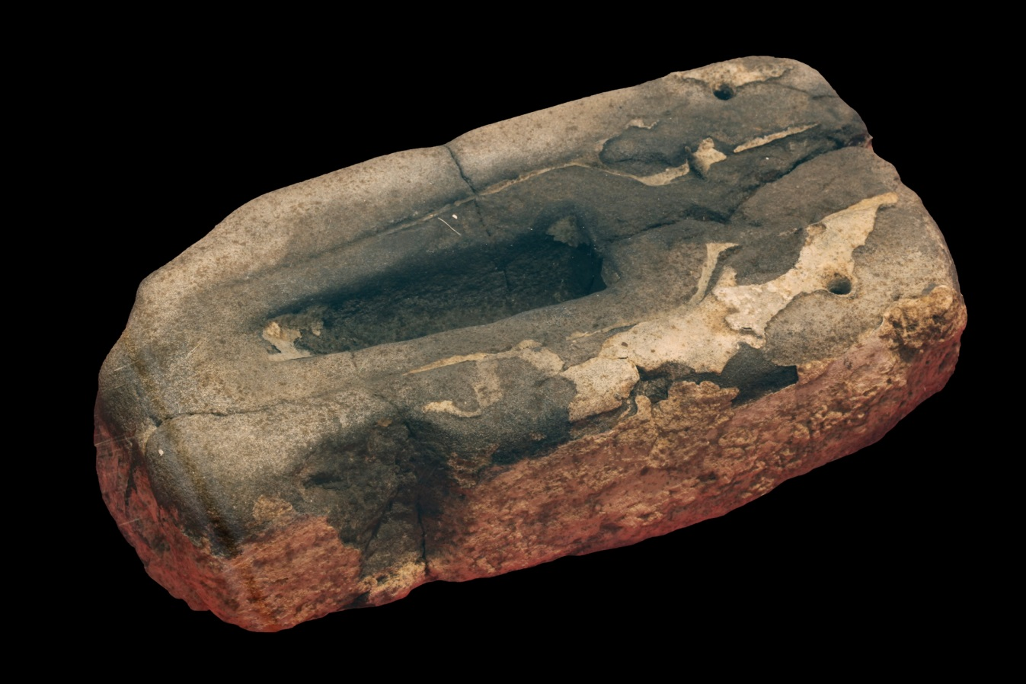
Mold Making
An ancient manufacturing process using liquid or pliable materials formed around a frame or mold. A mold (or hollowed out form) in the negative shape of an object is made. Then a liquid material is poured into the mold and left to harden. The resulting positive form is called a casting.

Slide 3
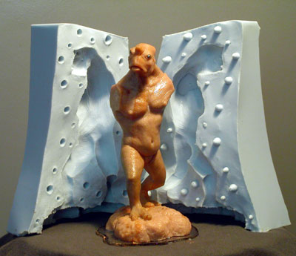
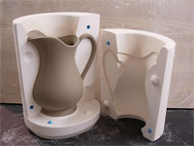
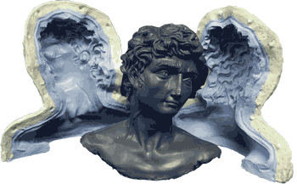
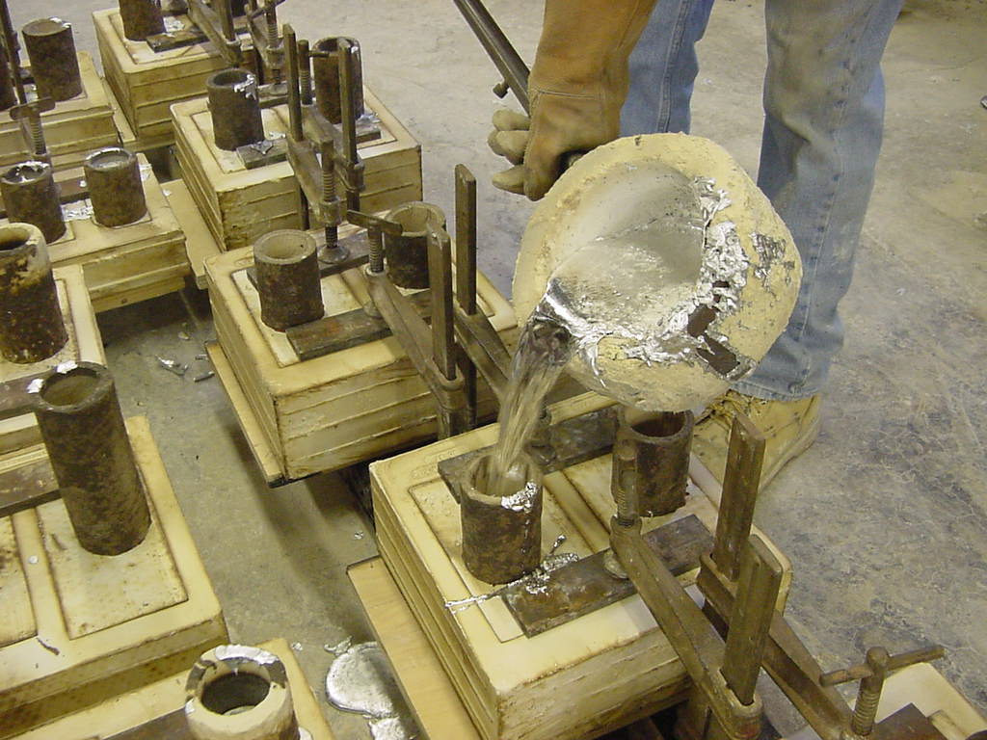

Slide 4
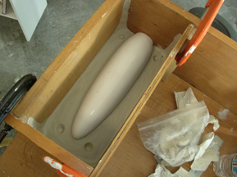
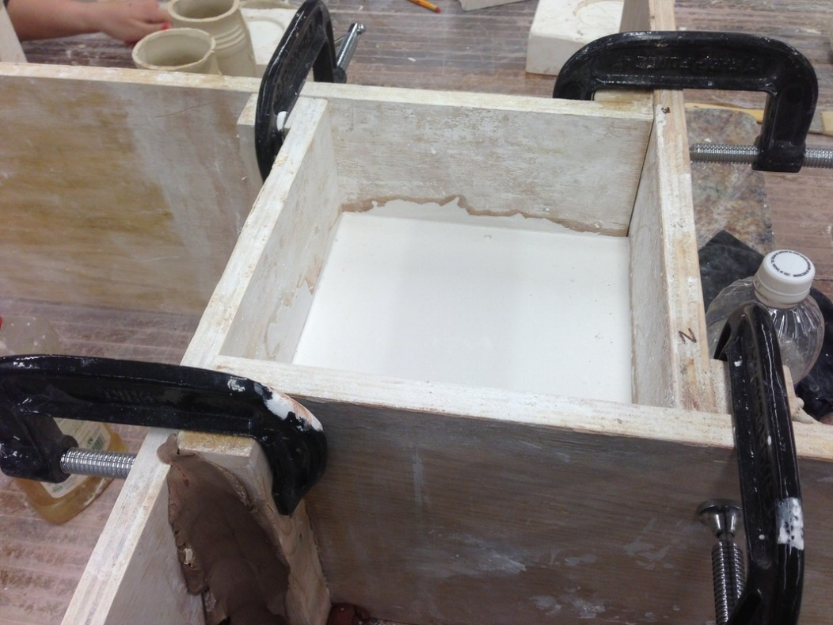
Common Techniques for Making Plaster Molds:
Cottle Boards:

Slide 5
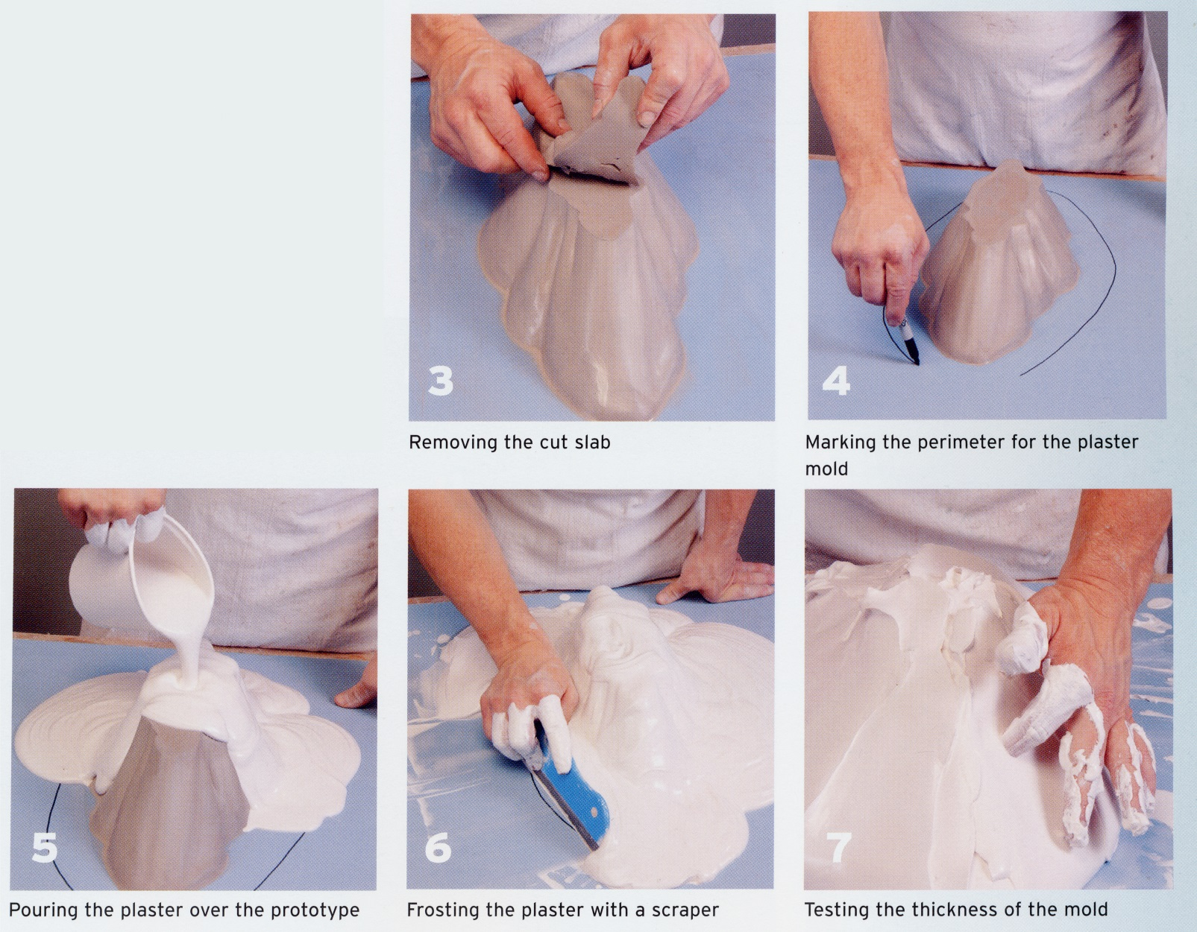
Frosting:

Slide 6
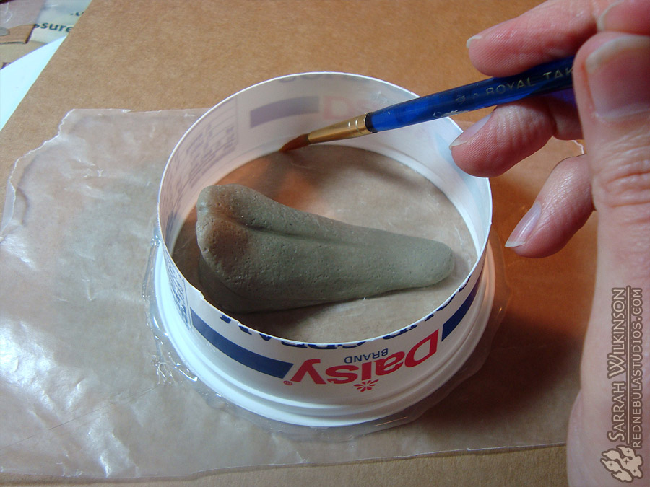
Using Plastic Tub:

Slide 7
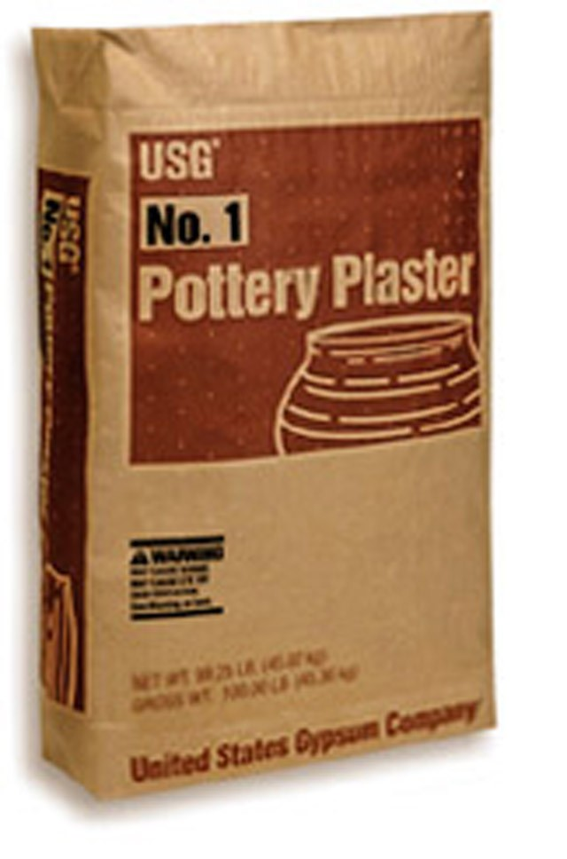
USG No. 1 Pottery Plaster
Gypsum plaster or “Plaster of Paris” is a powdered soft sulfate mineral (gypsum) that hardens once mixed with H20.
We will use USG No.1 Pottery Plaster to make our molds.
Plaster must be mixed correctly in order for it to be used in the slip casting process. If the plaster is too dense or too porous the capillary action required for casting won’t work.
Plaster starts to “set up” (harden) as soon as it is mixed

Slide 8
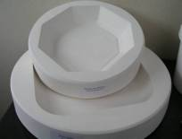
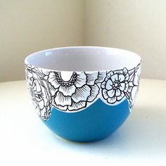
One Piece Molds:
No Overhangs or Undercuts!

Slide 9
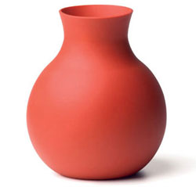
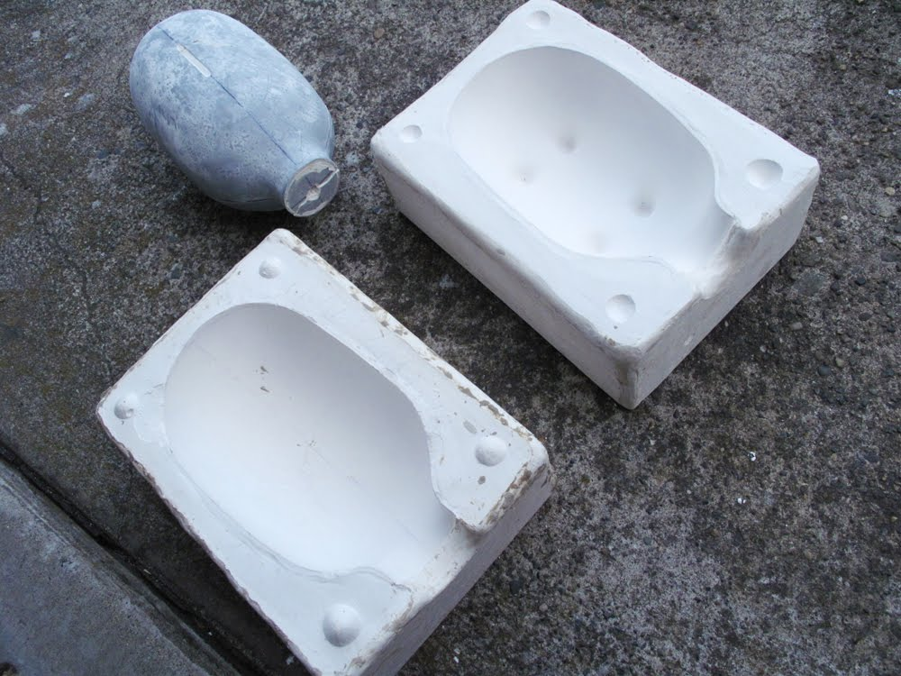
Two Piece Molds:
Can have overhangs and undercuts

Slide 10
Slipcasting
Slipcasting is an ancient manufacturing process used for the mass-production of ceramic objects.
Slip is specially formulated liquid clay.
Slip contains a deflocculent which prevents the clay particles from sticking together. Because of this slip can be mixed using very little H2O which is critical to its function. Too much water in your slip and your castings will never setup.
Slipcasting relies entirely on the capillary action of plaster.
Slip is poured into a plaster mold wherein the plaster sucks the water out of the slip and begins to solidify around the edge. Once a thickness is achieved the remaining liquid clay is poured out. After some time the “casting” in the mold hardens and can be removed.

Slide 11
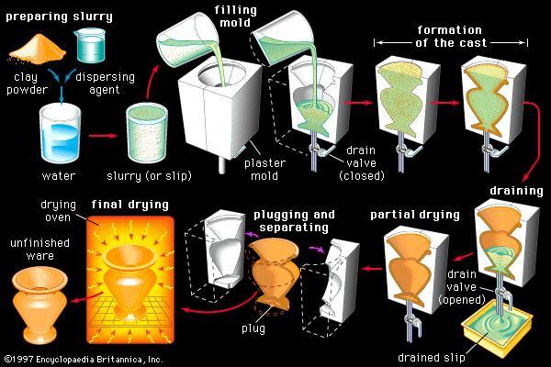

Slide 12
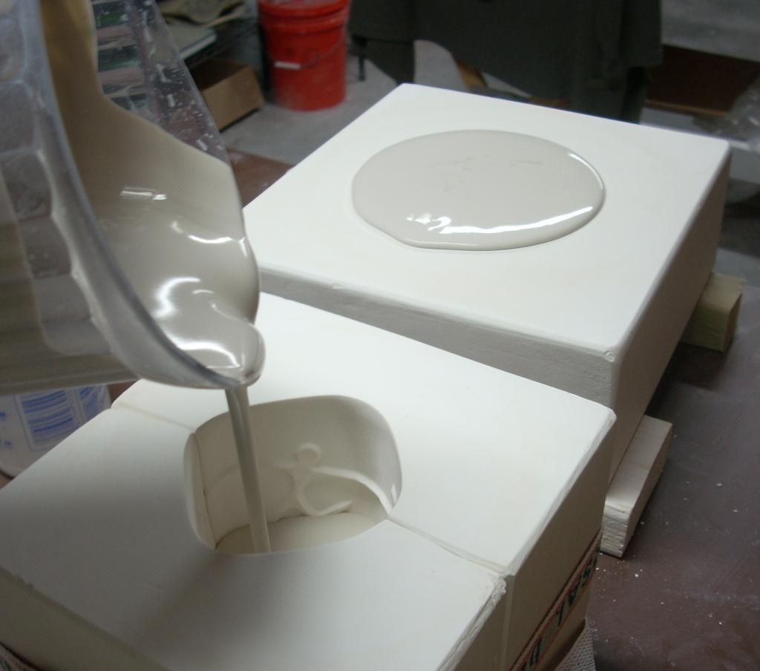
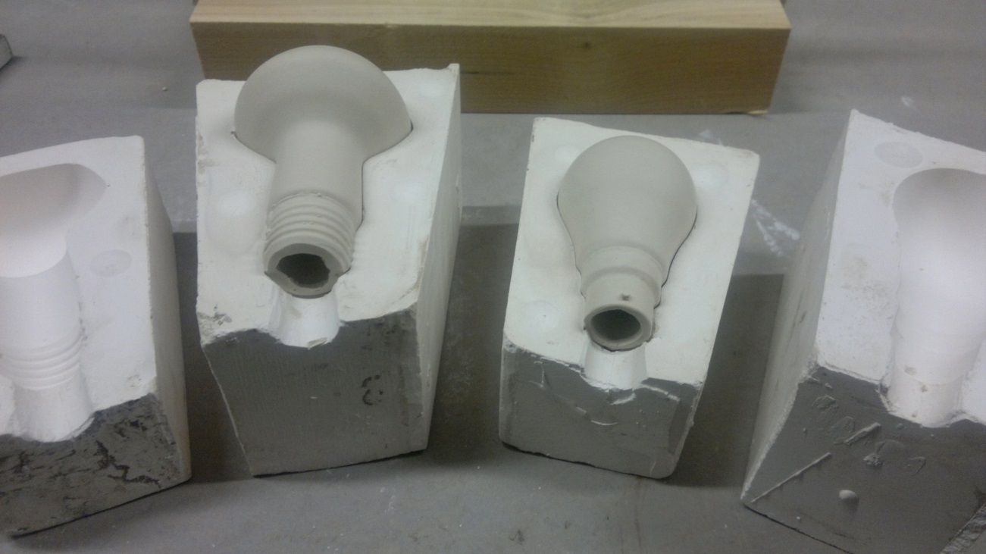

Slide 13
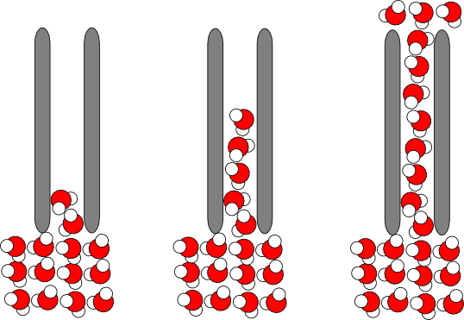
Capillary Action is the ability of liquids to flow in narrow spaces without or even against external forces. Like paper towels sucking up a spill.

Slide 14
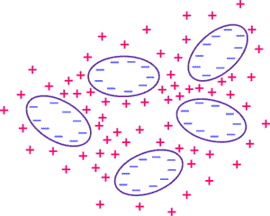
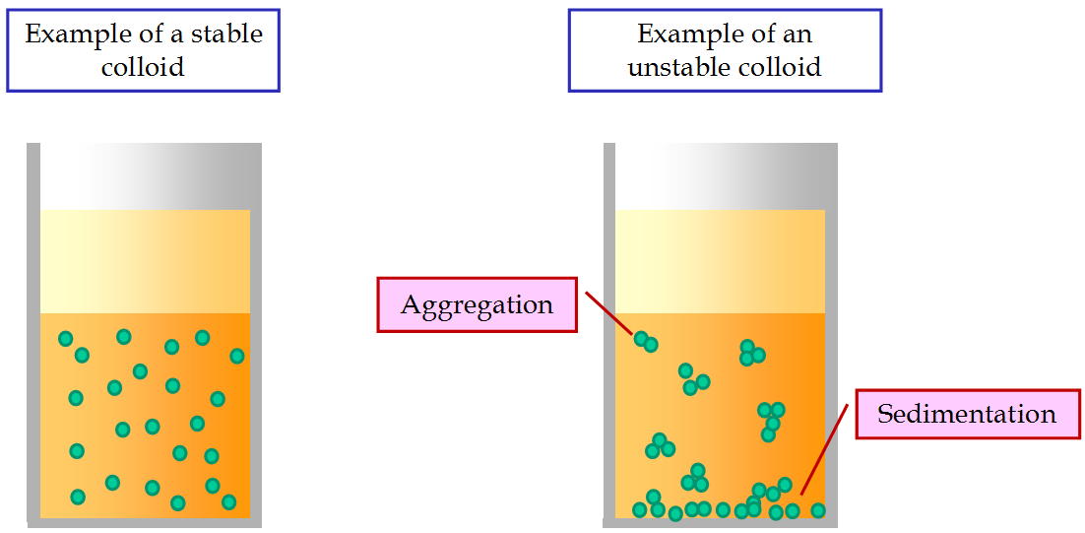
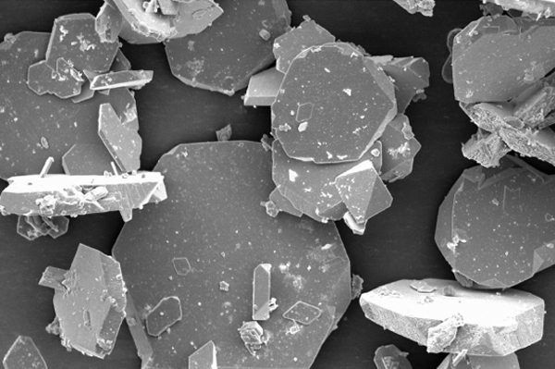
Deflocculent
Deflocculents hold materials in suspension, preventing them from clumping together. It is critical that the clay particles be held in suspension in slip, it allows slip to have liquid properties with the minimum amount of H2O added.

