Slide 1
Ceramic Basics

Slide 2
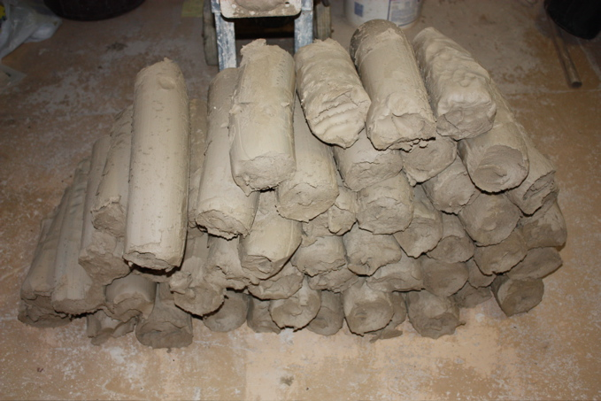
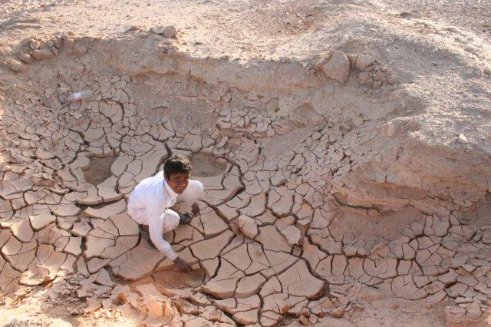
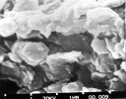
What is Clay?
Clay is a fine-grained natural rock or soil material that combines one or more clay minerals with traces of metal oxides and organic matter. Our word “ceramic” comes from the Greek “keramikos” meaing pottery.

Slide 3
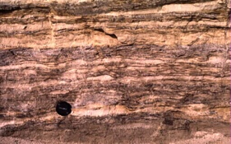
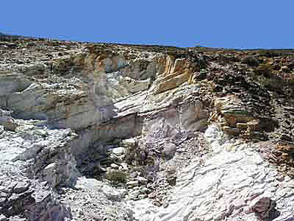
How is it Made?
Clay is made through natural processes of erosion and weathering of rock, specifically granite.
Primary Clays: clays that formed at the source. Kaolins (which we use to make porcelain) is white in color and not very plastic.
Secondary Clays: clays that were formed at the source but then moved by wind or water and which collect in sedimentary rock layers. Red clays and ball clays which create stoneware and earthenware clays are secondary. Secondary clays tend to be more plastic due to smaller particle size. Secondary clays come in a variety of colors due to other compounds picked up along the way.

Slide 4
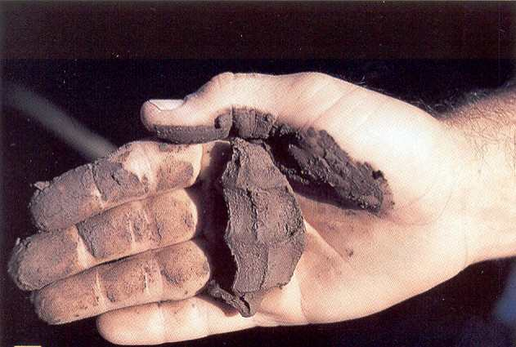
Why is Clay Unique?
Unlike mud or sand clay is unique in its physical properties. Clay is malleable (which means you can squish and squeeze it into a shape and it will retain that shape) because of it’s ability to retain water. In ceramics we call this property of clay “plastic.”
When clay is subjected to heat it
undergoes a physical/chemical
change that hardens the clay into
“ceramic,” when clay has become
hardened by heat we call it
“fired.” This ability of clay to be
plastic when wet and be hardened
by fire is one of the unique qualities
of clay.

Slide 5
Clay + Heat + Chemistry = Magic
Clay molecules are shaped like sheets or plates and they arrange themselves into layers.

Slide 6
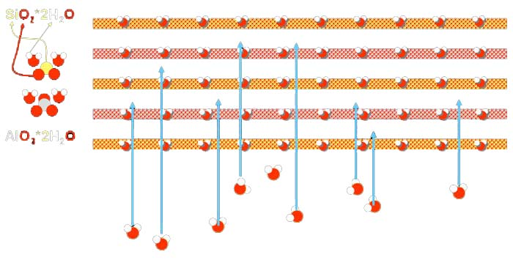
Water molecules get in between the layers and act like ball bearings, this allows the clay to be plastic or malleable.

Slide 7
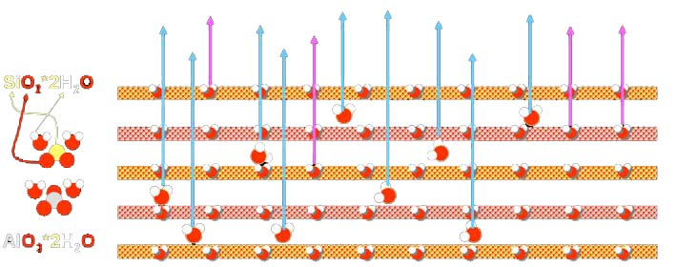
When the clay is air dried the physically bonded water evaporates. When the clay is subjected to high temperatures the chemically bonded water is driven off. During firing the clay sinters and vitrifies. Once clay has been fired it is called “ceramics” since it cannot be made soft again.

Slide 8
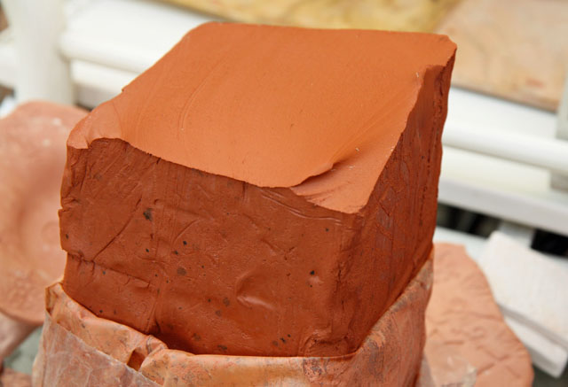
Types of Clays
There are many scientific categories for clay (kaolinite, montmorillonite-smectite, illite) but for our purposes there are fewer and more broad categories:
-Earthenware
-Stoneware
-Porcelain

Slide 9
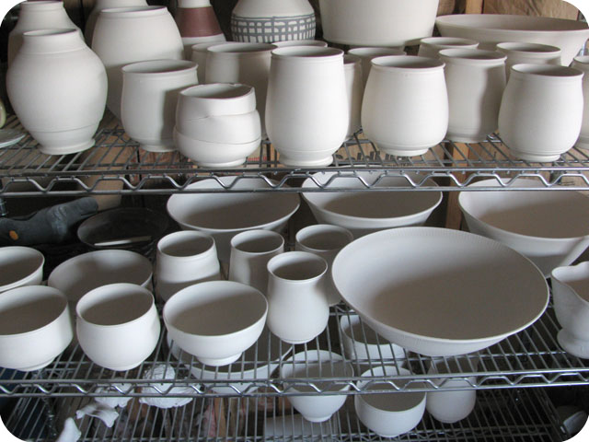
States of Clay
Clay has a few different stages it goes through before it becomes a final finished piece of ceramics. It is critical that the stages be followed in the correct order:
-Greenware (fragile)
-green (wet)
-leatherhard (soft enough
to carve, hard enough to
handle)
-bone-dry (all physically
bonded water is gone)
-Bisqueware (first firing)
-Glazeware (second firing)

Slide 10
States of Clay
Bisqueware:
-fired to a lower temp then final firing, less brittle then greenware, is porous so it can accept glaze. Pale pink/white color, chalky feel.
Glazeware:
-fired to top cone temp, vitrified, most dense, non porous, glassy (silica) surface fused with clay body, gives pot its color, seals surface. Glaze colors come from chemical reactions not pigments so they cannot be mixed like paint.
Green/Red – copper
Blue – cobalt
Yellow – rutile
Red/Black – iron oxide
Glaze can be applied by brushing, dipping, spraying, Glazes can be matte or glossy.
“When applying glaze you’re either puttin’ it on or takin’ it off”

Slide 11
Cone Temps
In ceramic work it is critical that clay be fired to the correct temperature in a kiln. Those temperatures are dependent on the clay body and/or the glaze and are designated by a “cone” number. Close attention needs to be paid to the clay bodies cone and the glaze cone. Firing at the wrong temp (too high or too low) will cause the ceramic piece to fail.
Cone temps are divided into 3 main categories:
-Low fire (cone 04-05)
-Mid range (cone 6)
-High fire (cone 9-10)

Slide 12
Cone Chart

Slide 13
Cone Temps
Clay wants to be fired to its top cone temp which will make it “vitrified” and therefore most dense and durable. Ceramic ware fired correctly can last 25,000 years. Glaze wants to be fired to its top cone temp so that the chemicals in the glaze react appropriately.
Be aware of the cone temp of your clay (in this course we are using a cone 6-10 white stoneware).
You can fire clay to a lower temp but NEVER a higher temp then it is designed for.
Glazes need to be fired to there given cone temp.

Slide 14
Types of Firing
Clay can be fired in two main ways:
Oxidation: ware fired with plenty of oxygen in the kiln environment. Normally fired in an electric kiln. Low fire and/or commercial glazes are fired in oxidation.
Reduction: ware fired in a kiln environment that is starved of oxygen. Oxygen needed for combustion is “stolen” from glaze and clay body. Normally fired in a gas kiln.

Slide 15
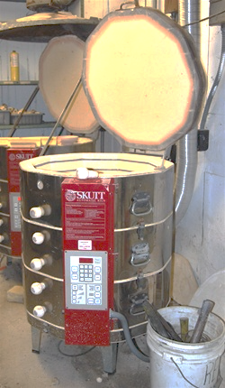
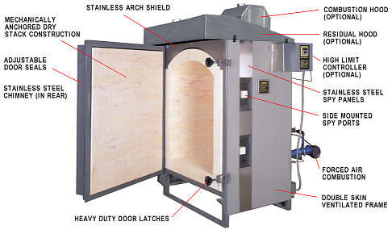
Kiln Types
There are many different types of kiln design. Two most common are:
Top loading electric kiln
Front loading gas kiln

Slide 16
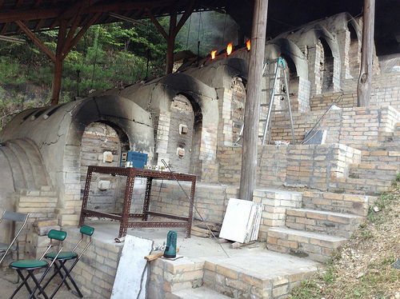
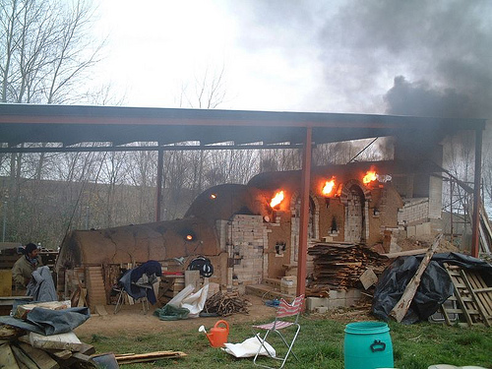
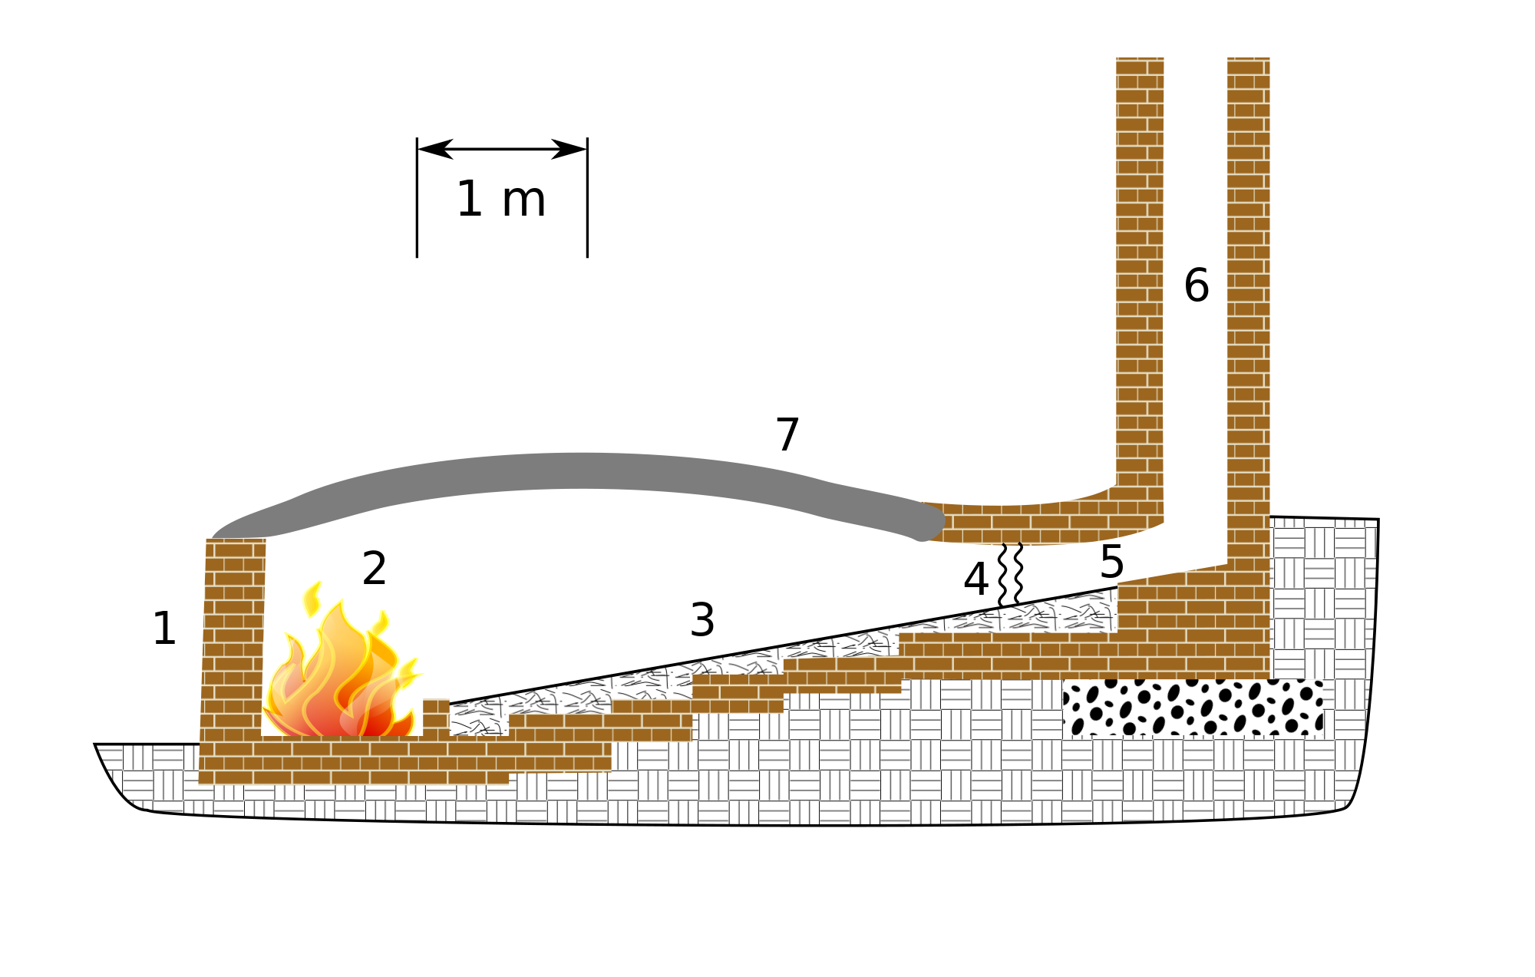
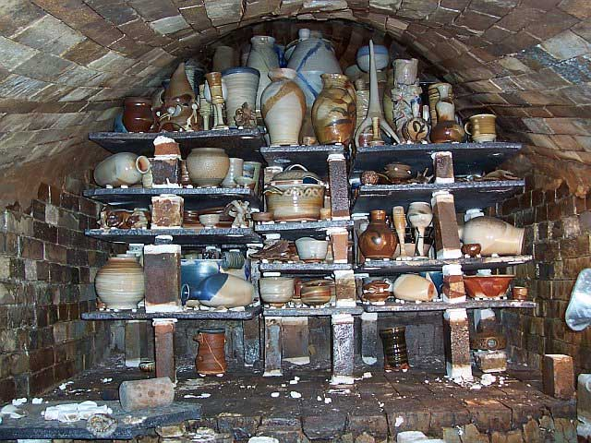
Noborigama Kilns
Anagama Kiln Plan

Slide 17
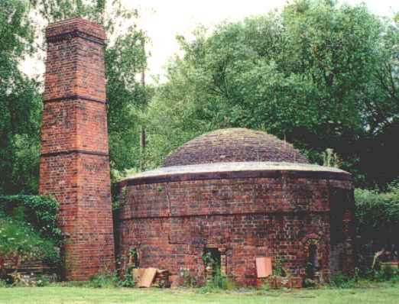
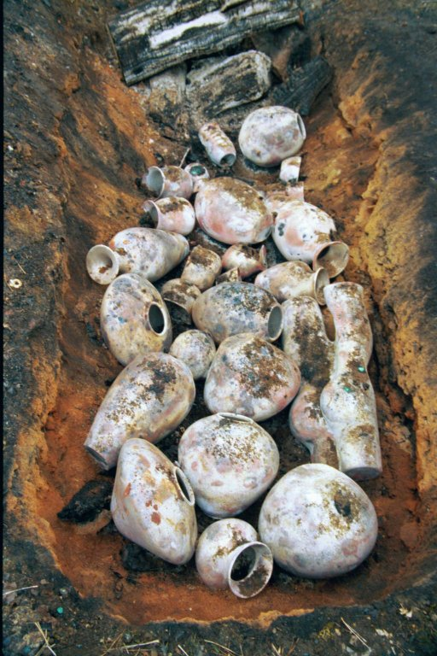
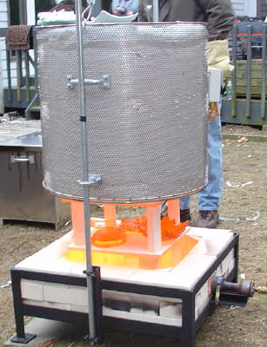
Pit Firing
Beehive Kiln
Top Hat or Raku Kiln

Slide 18
Our Course
Cone 6-10 White Stoneware:
-bisque fire to cone 04-05
-can use any glaze
-PAY ATTENTION TO THE CONE TEMP OF GLAZE
USED!
-Glaze fire to the correct cone temp for that glaze
-DO NOT GLAZE BOTTOM (“dry foot”, can use wax resist on
bottom)
-Ware that is ready for firing has to be put on correct rack. DOUBLE CHECK TO AVOID DISASTER!

Slide 19
Parts of a Pot

Slide 20
Pots vs. Ceramic Sculpture: Aesthetics in Clay Ware
Work made in clay can be divided into two broad categories:
Functional or Utilitarian generally referred to as “pots” are designed for use (cups, bowls, plates, vases.)
Fine-Art or Sculptural generally referred to as “ceramic sculpture” are made as aesthetic art objects like painting or marble sculpture.
There is no hierarchy, both types of clay work are equally important and often cross over. Most functional ware is decorated with imagery and symbolism and many ceramic sculptures reference pots.
Ceramic sculpture has the same formal foundations as painting or marble sculpture; composition, symmetry, pattern, visual lightness, gravitas, color, and conceptual value to name a few.

Slide 21
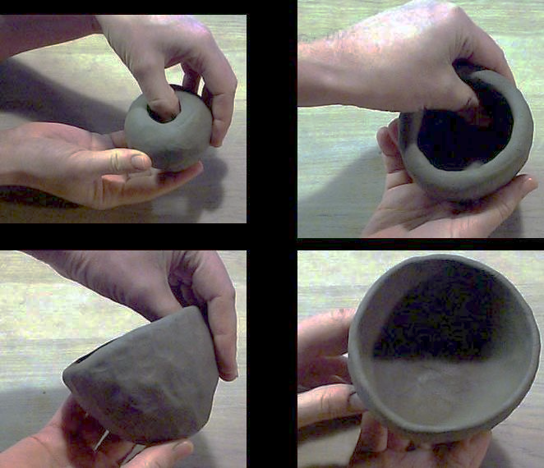
Building Techniques
Pinch: Stick your finger in it and pinch out a shape. Pinch in small steps, keep walls even, make a flat bottom.

Slide 22
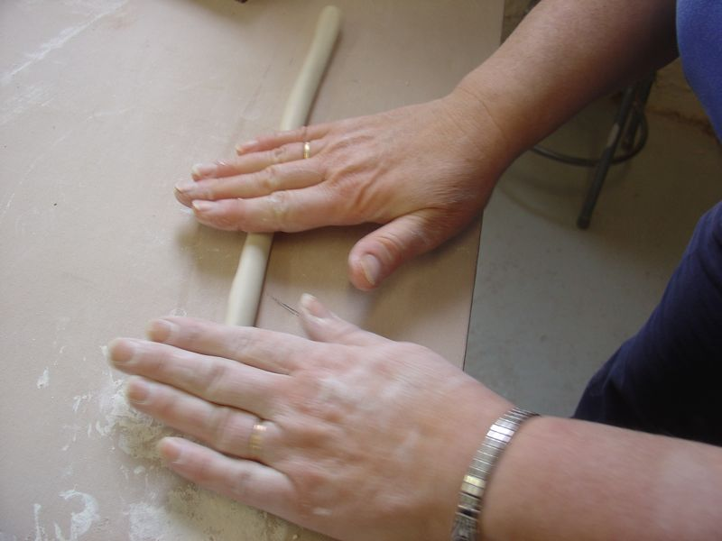
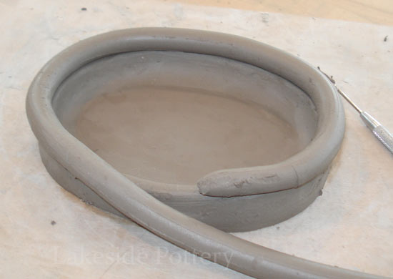
Building Techniques
Coil: Use coils (or ropes/snakes) of clay. Stack coils one upon another to build height. Slip & score each layer to ensure of solid attachment. Smooth the outside (or don’t).

Slide 23
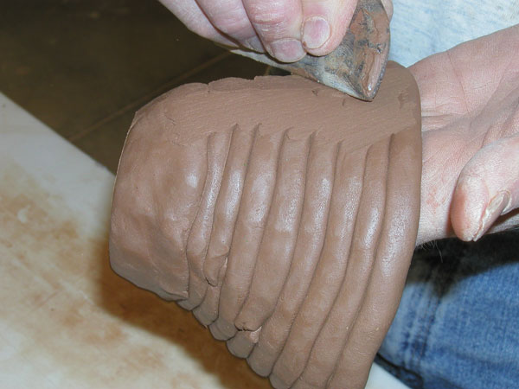
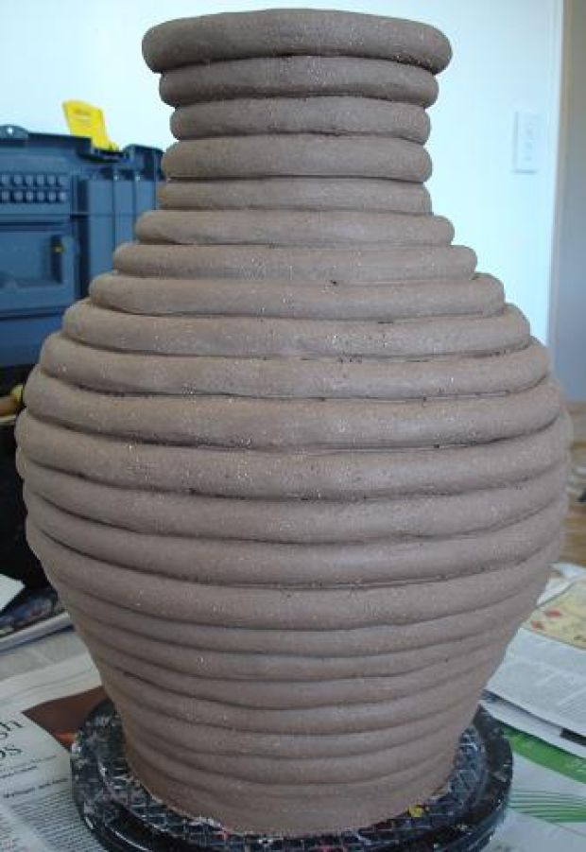
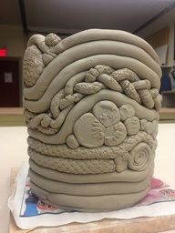

Slide 24
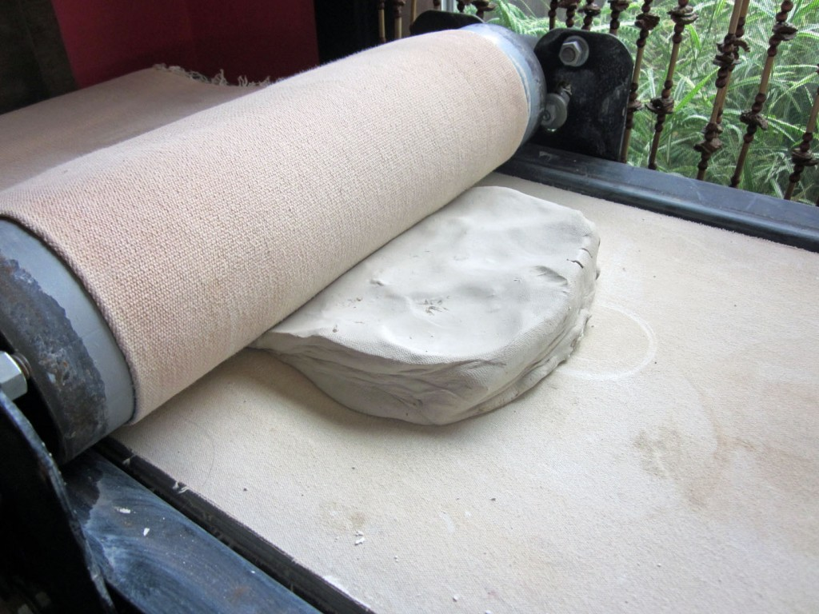
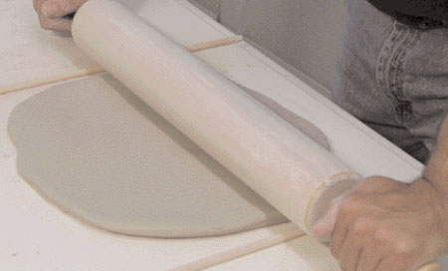
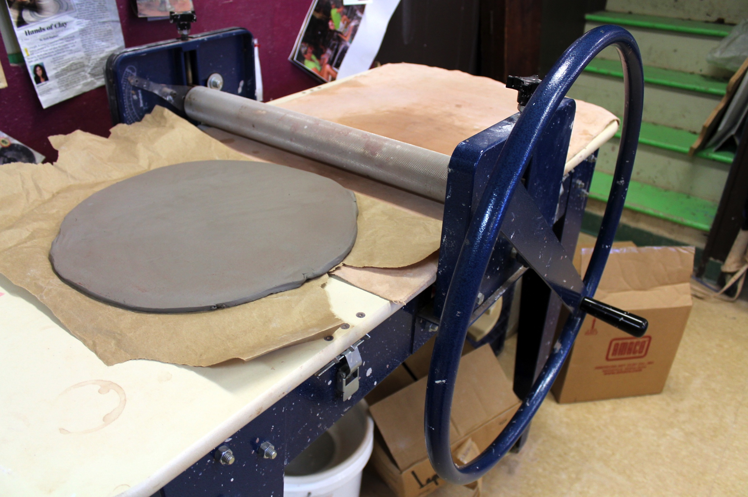
Building Techniques
Slab: Make flat slabs of clay, cut into shapes, and connect shapes together. Slip & score joints to ensure sold connection.

Slide 25
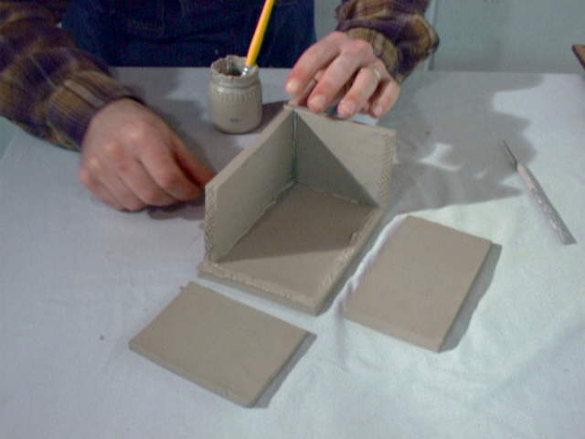
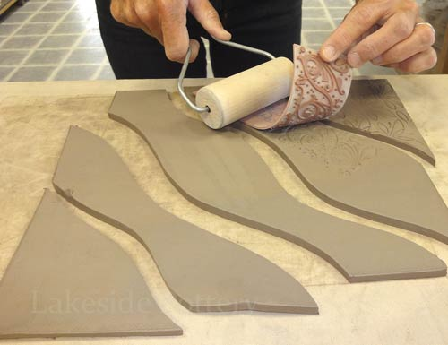

Slide 26
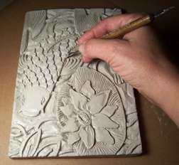
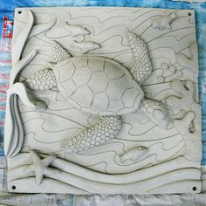

Slide 27
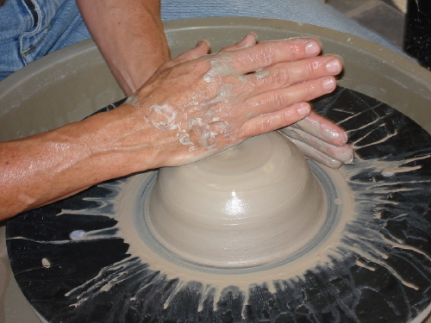
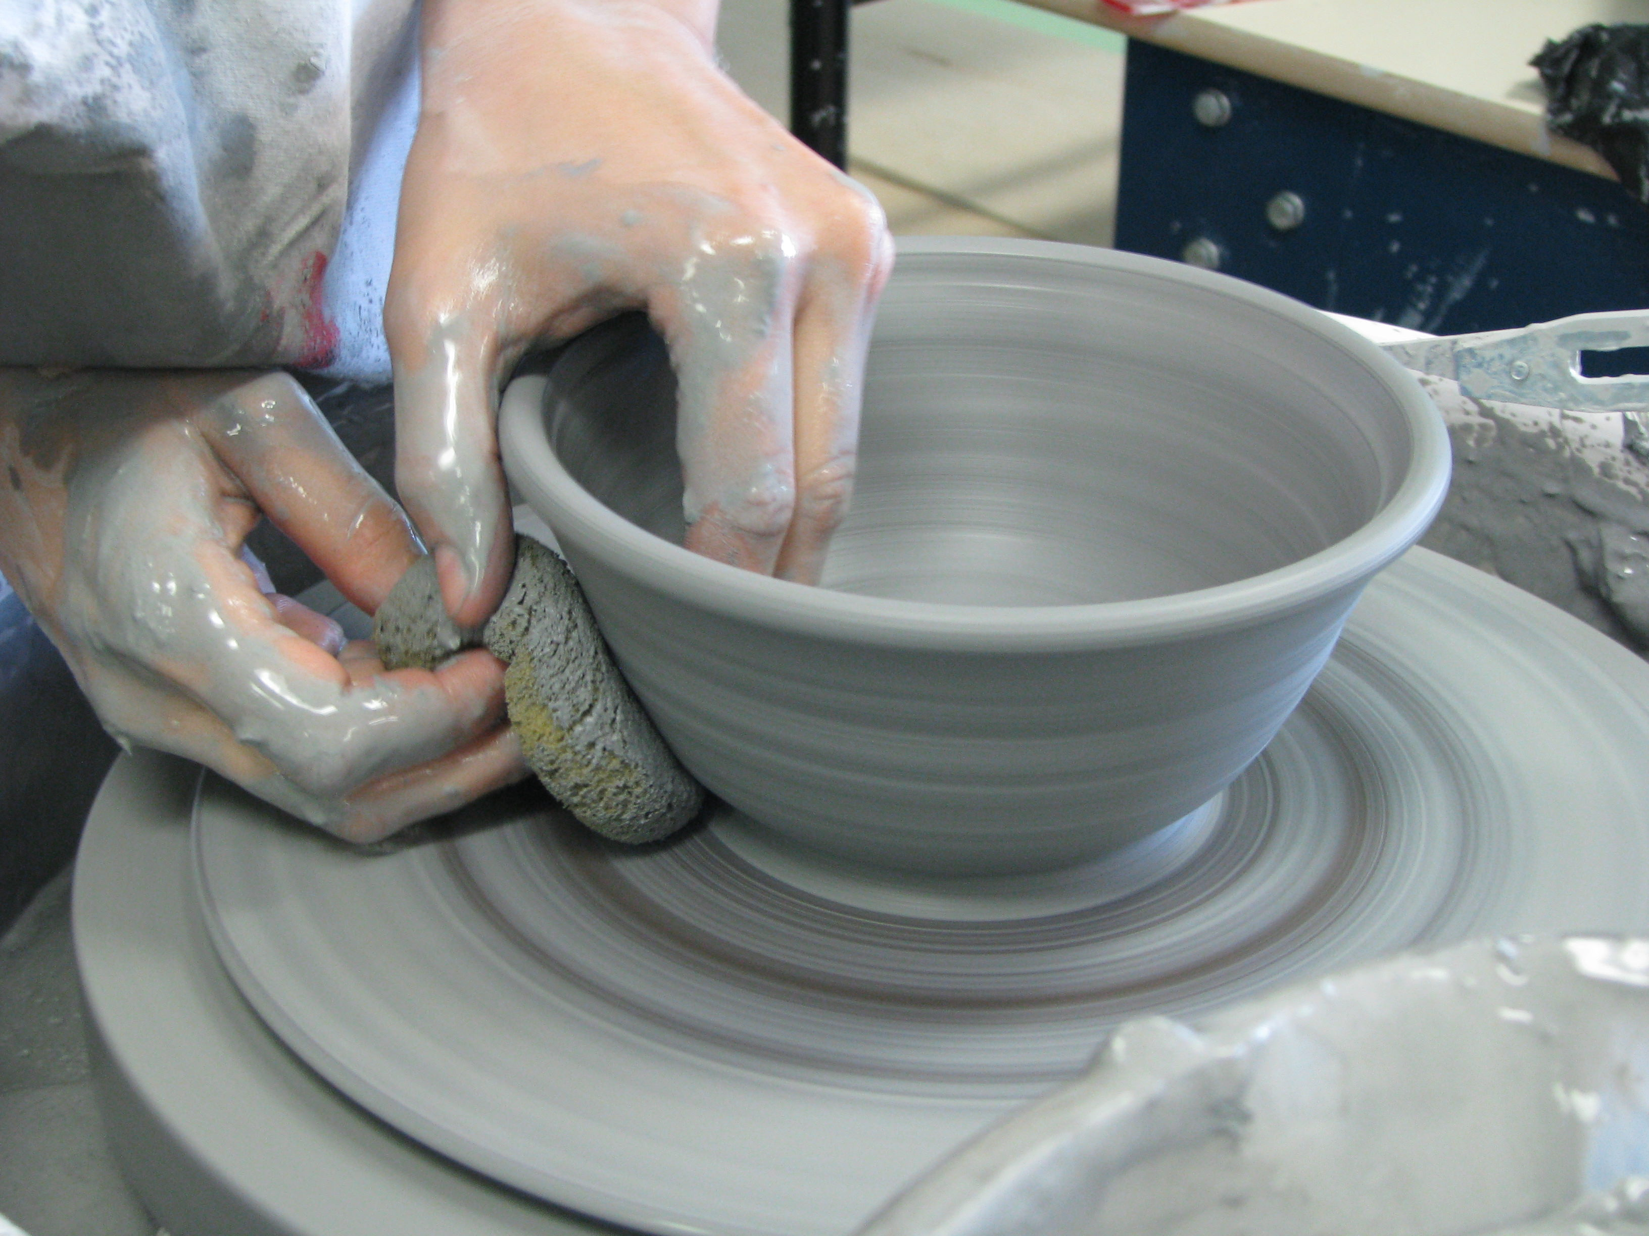
Building Techniques
Wheel Thrown: Use wheel to turn clay into shape. Carefully make sure clay is centered. Open clay up even and steady motion. Compress bottom. Use as little water as possible, just enough to keep clay surface slippery. Make even pulls, fingers directly opposite each other, from bottom to top. Compress rim after each pull.

Slide 28
