Slide 1
A Brief History of Ceramics

Slide 2
How did we discover Clay?
Early people discovered the unique qualities of clay since it was clearly different from mud or dirt. Prehistoric people carved pseudo-religious figures out of clay. It is believed that a prehistoric person threw a clay object into the fire (also often the garbage) and later discovered the object had changed when heated. Thus the first fired ceramic object was discovered. Fired clay had many characteristics that previous tech didn’t have.

Slide 3
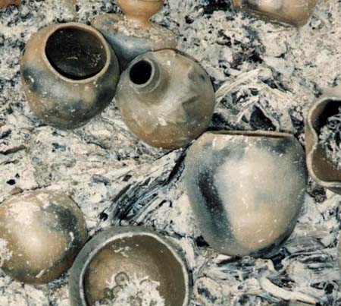
How did we discover Clay?
Before we settled into agrarian communities we were hunter-gatherers. We used mostly animal skin bags, hollowed gourds, wood bowls, stone bowls, and baskets to carry stuff. Baskets were an imperfect solution for storage and travel of goods. It is believed that early people coated the inside of their baskets with clay. Along with the discovery of fired ceramics the resulting invention of pottery seems clear.

Slide 4
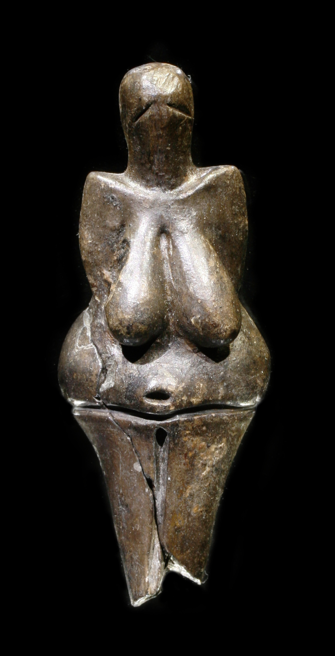
Prehistoric Clay Sculpture
The earliest know use of clay was during the Paleolithic period and has been dated to 29,000 BCE. They were small devotional figurines, some in the shape of animals and others as Venus fertility symbols.
Venus of Dolní Věstonice made by the Gravettian culture found in modern day Czech Republic.

Slide 5
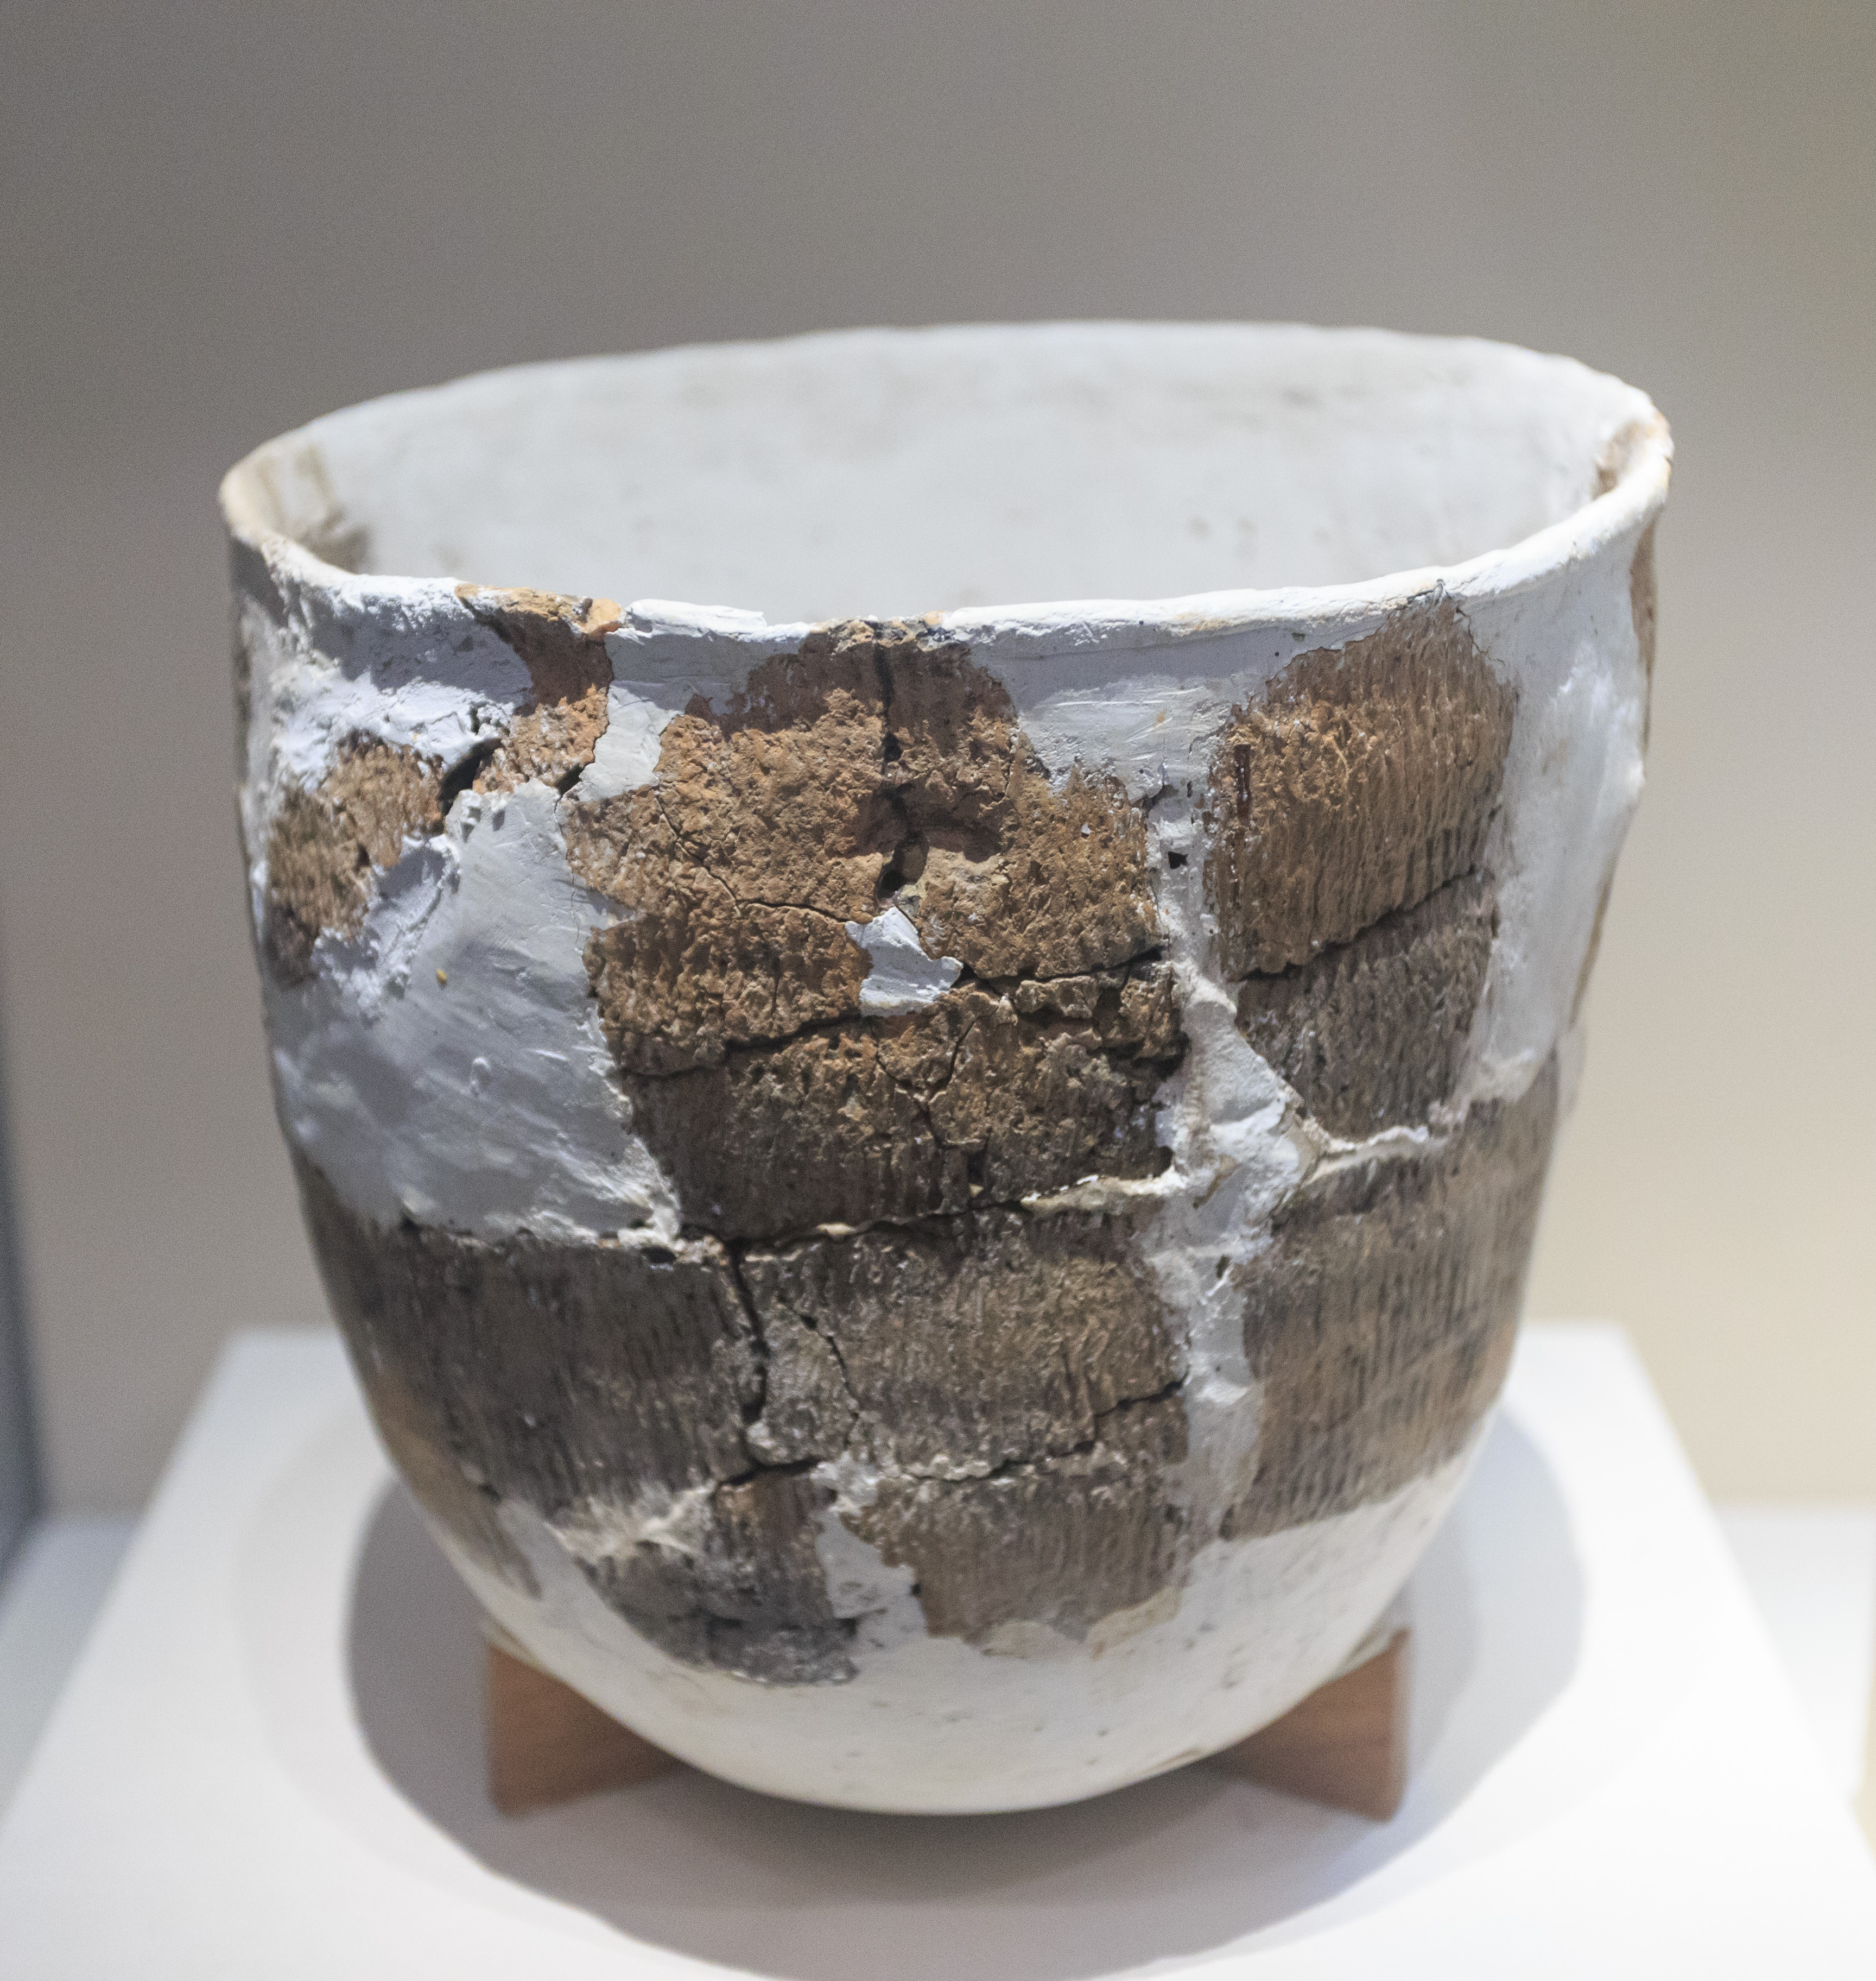
Earliest Pottery
The discovery of pottery was one of the first great technological advancements of humankind. It allowed containers to hold liquid, withstand weather and pests and keep food through harsh seasons and times of famine. Without this discovery humankind very likely would have gone extinct. Pottery was discovered independently in a number of places in the world but the earliest pottery shards come from China.
Pottery shards found in Xianrendong cave in Jiangxi, China
20,000 BCE

Slide 6
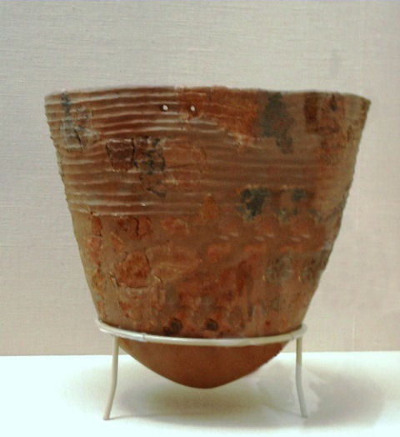
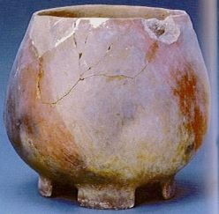
Early Pottery
Most early pots were coiled and decorated with geometric designs or with objects (like rope) pressed into the clay surface.
Pottery from Catal Huyuk in Turkey 6500 BCE
Jōmon pottery vessel, Japan 10,000-8,000 BC

Slide 7
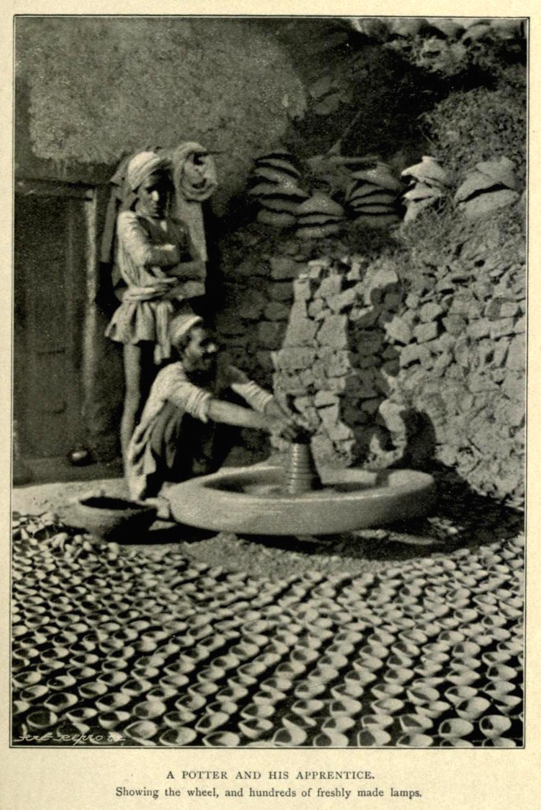
Potters Wheel
The potters wheel is believed to have been invented in Mesopotamia around 6000 BCE and revolutionized pottery production. It is thought to be invented along side the wheeled cart.
Prehistoric pottery has been found in every corner of the globe.

Slide 8
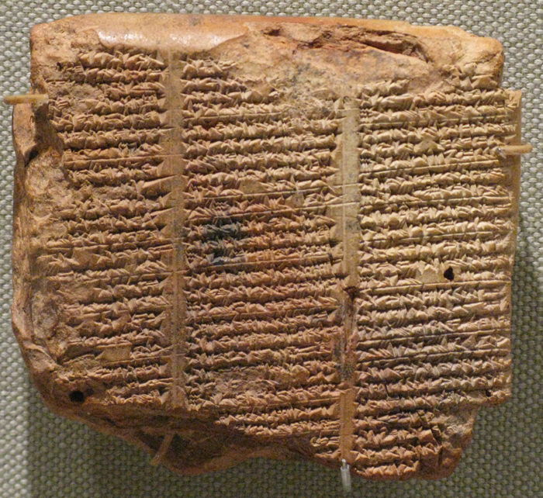
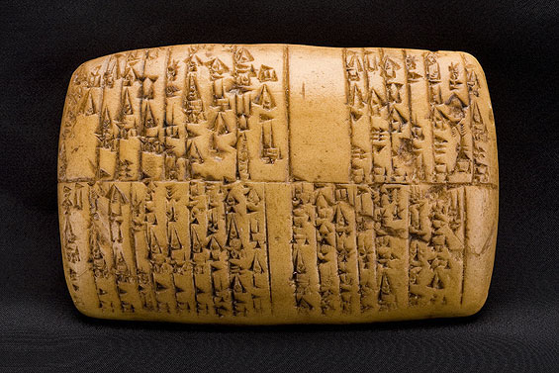
Cuneiform Tablets
An early Mesopotamian civilization, the Sumerians, invented a primitive form of writing which they recorded by pushing the symbols into clay tablets. This early system of writing is called cuneiform.
Sumerian cuneiform tablets
3500 BCE

Slide 9
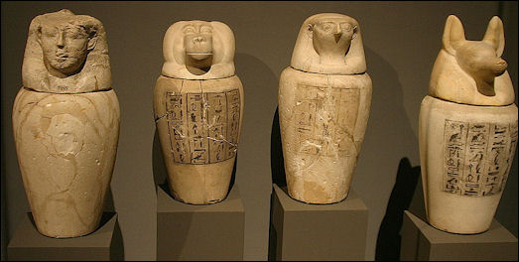
Egyptian Pottery
Ancient Egyptians made great advances in pottery, especially in glazing. 3000 – 1200 BCE
Canopic Jars

Slide 10
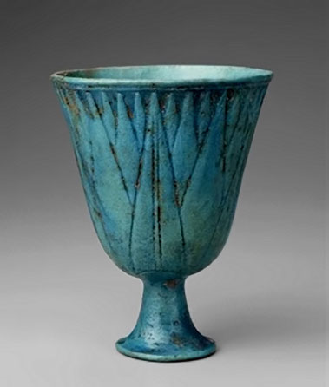
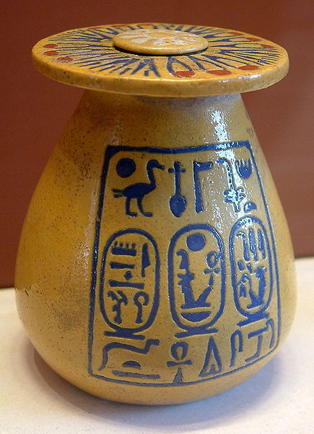
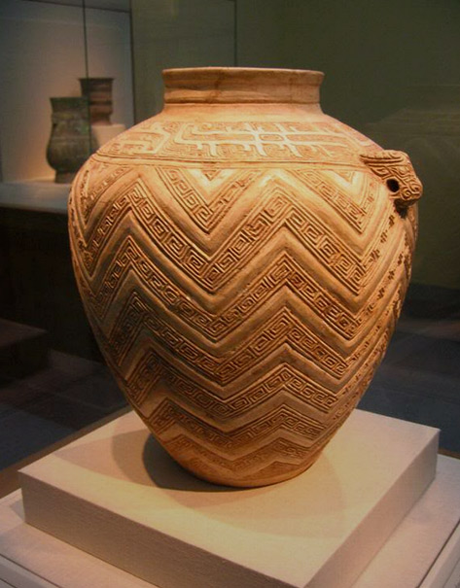

Slide 11
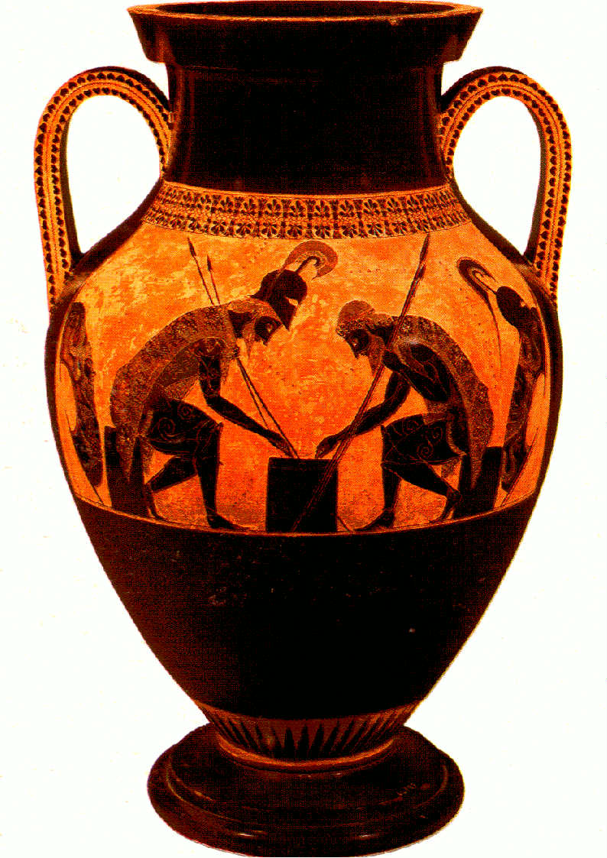
Greek Pottery
Early Greek civilizations were masters at pottery making and created beautiful pieces of pottery in dozens of designs all for specific purposes. They are most known for thier Black Figure and Red Figure decorating technique. 550 – 480 BCE

Slide 12
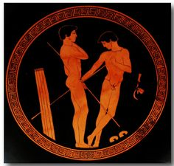
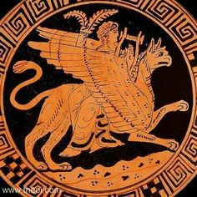
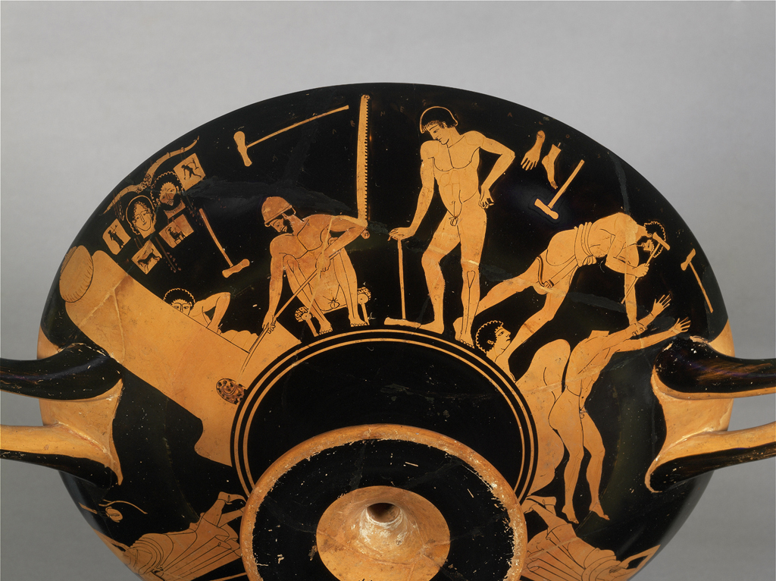

Slide 13
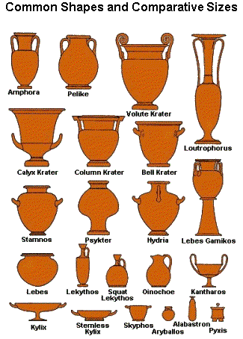
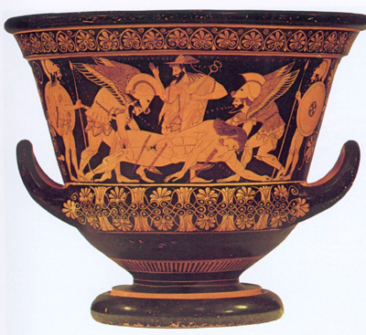

Slide 14
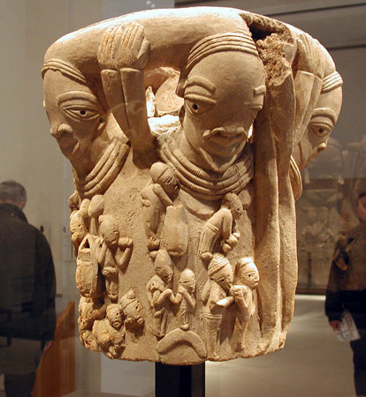
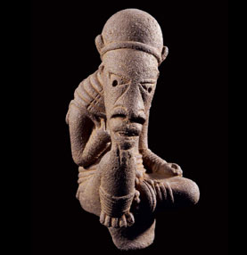
Nok Pottery
An early West African people called the Nok made incredible figures out of terracotta. 500 BCE

Slide 15
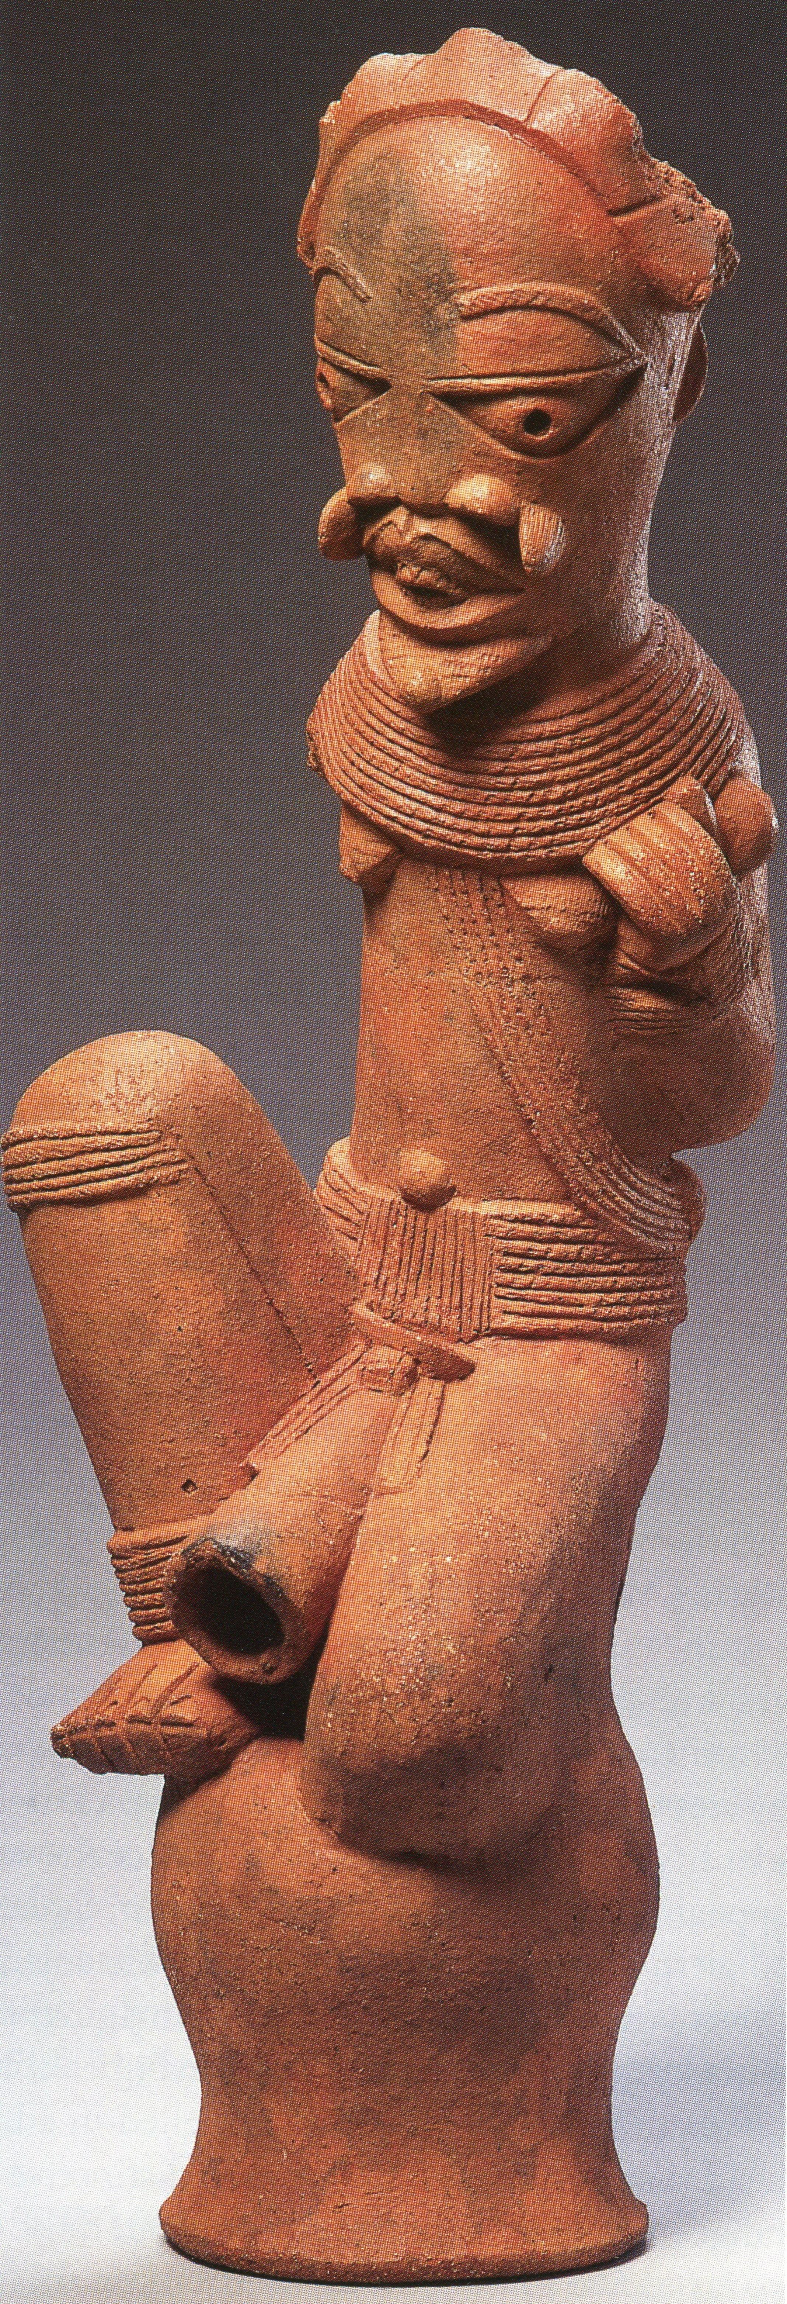
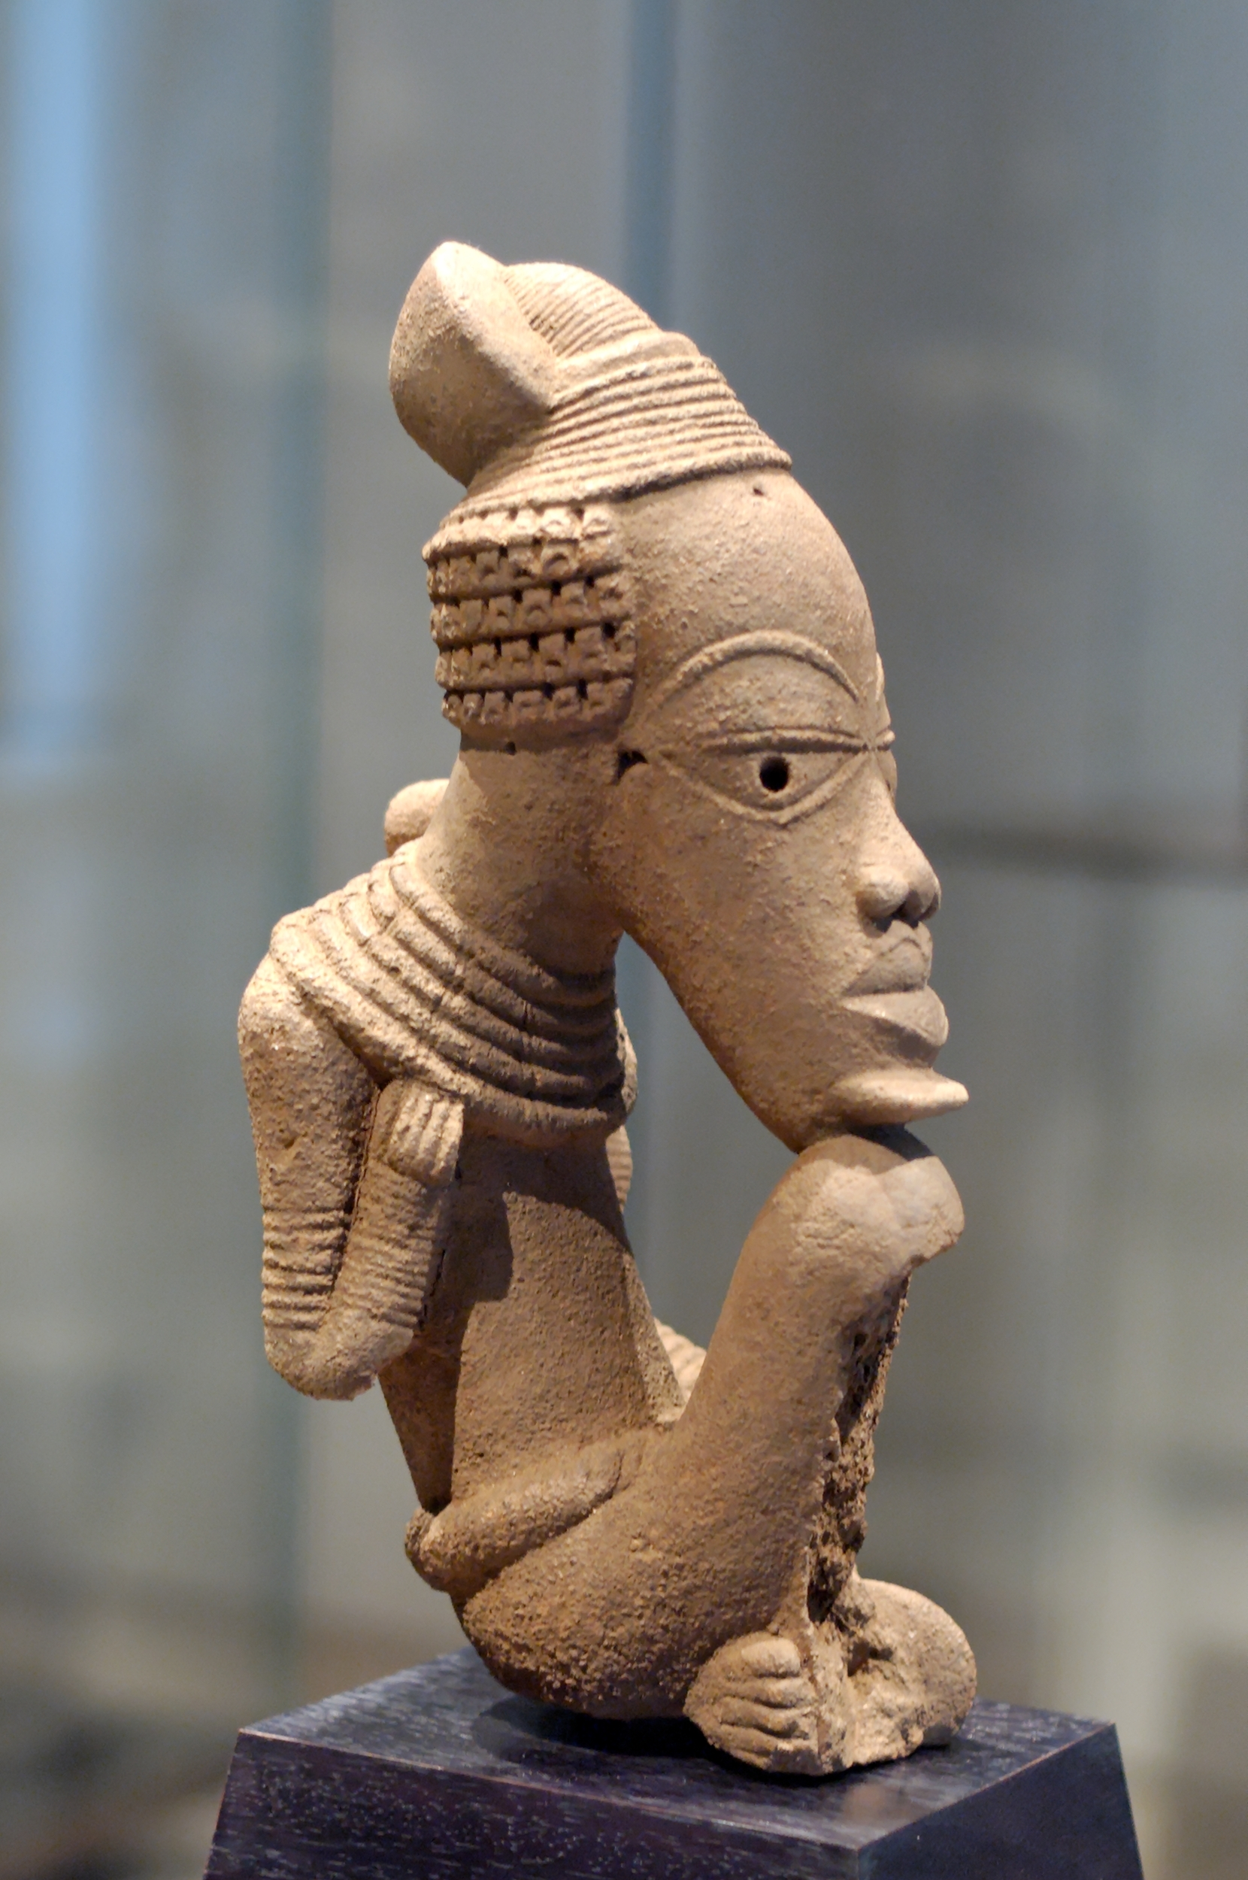

Slide 16
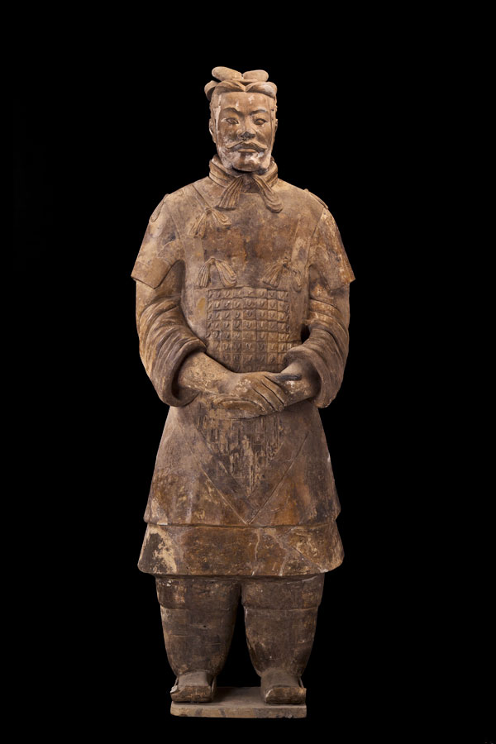
Terracotta Army
The Terracotta Army is an awe inspiring collection of statues found in Shaanxi province, China and created for the tomb of Qin Shi Huang, the first Emperor of China, buried with him 209-210 BCE. It is composed of thousands of full size soldiers, servants, horses, chariots, officials, acrobats, strongmen and musicians.

Slide 17
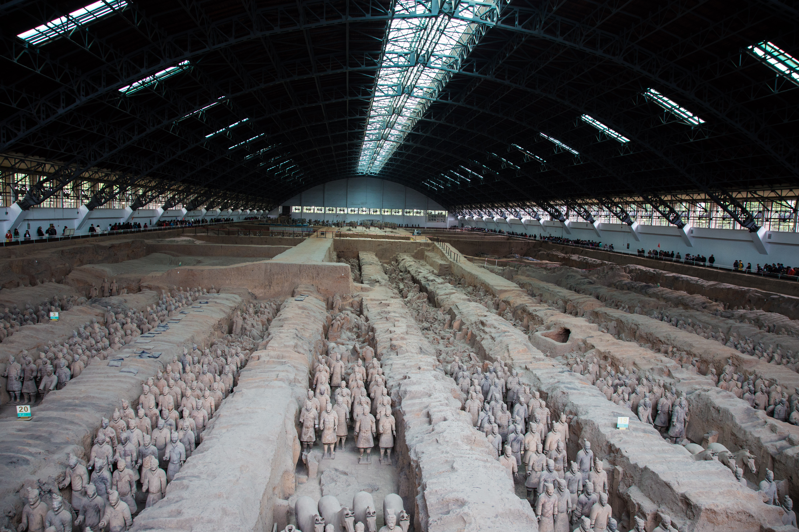

Slide 18
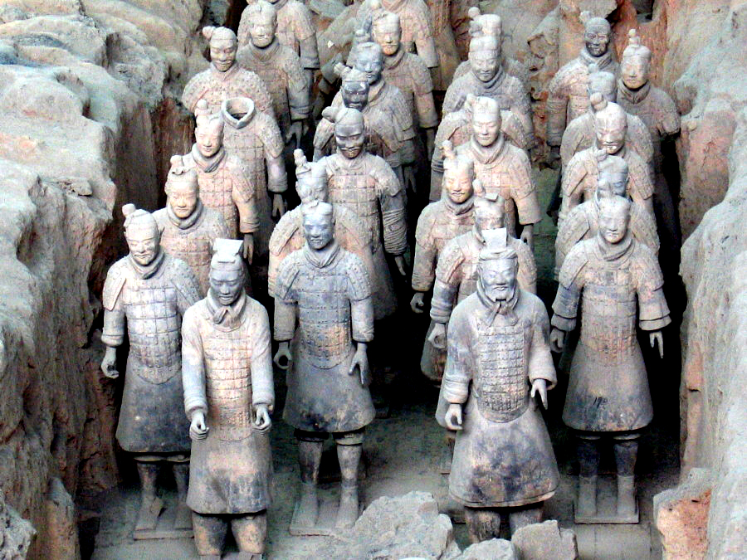
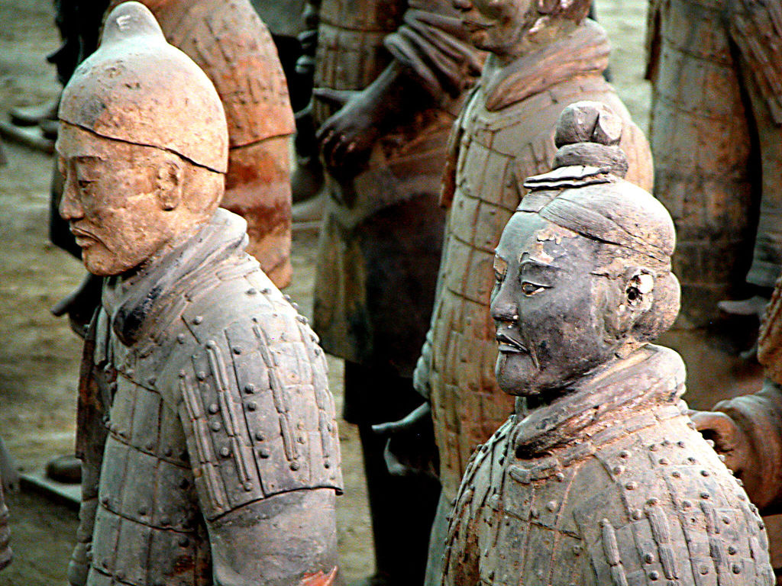
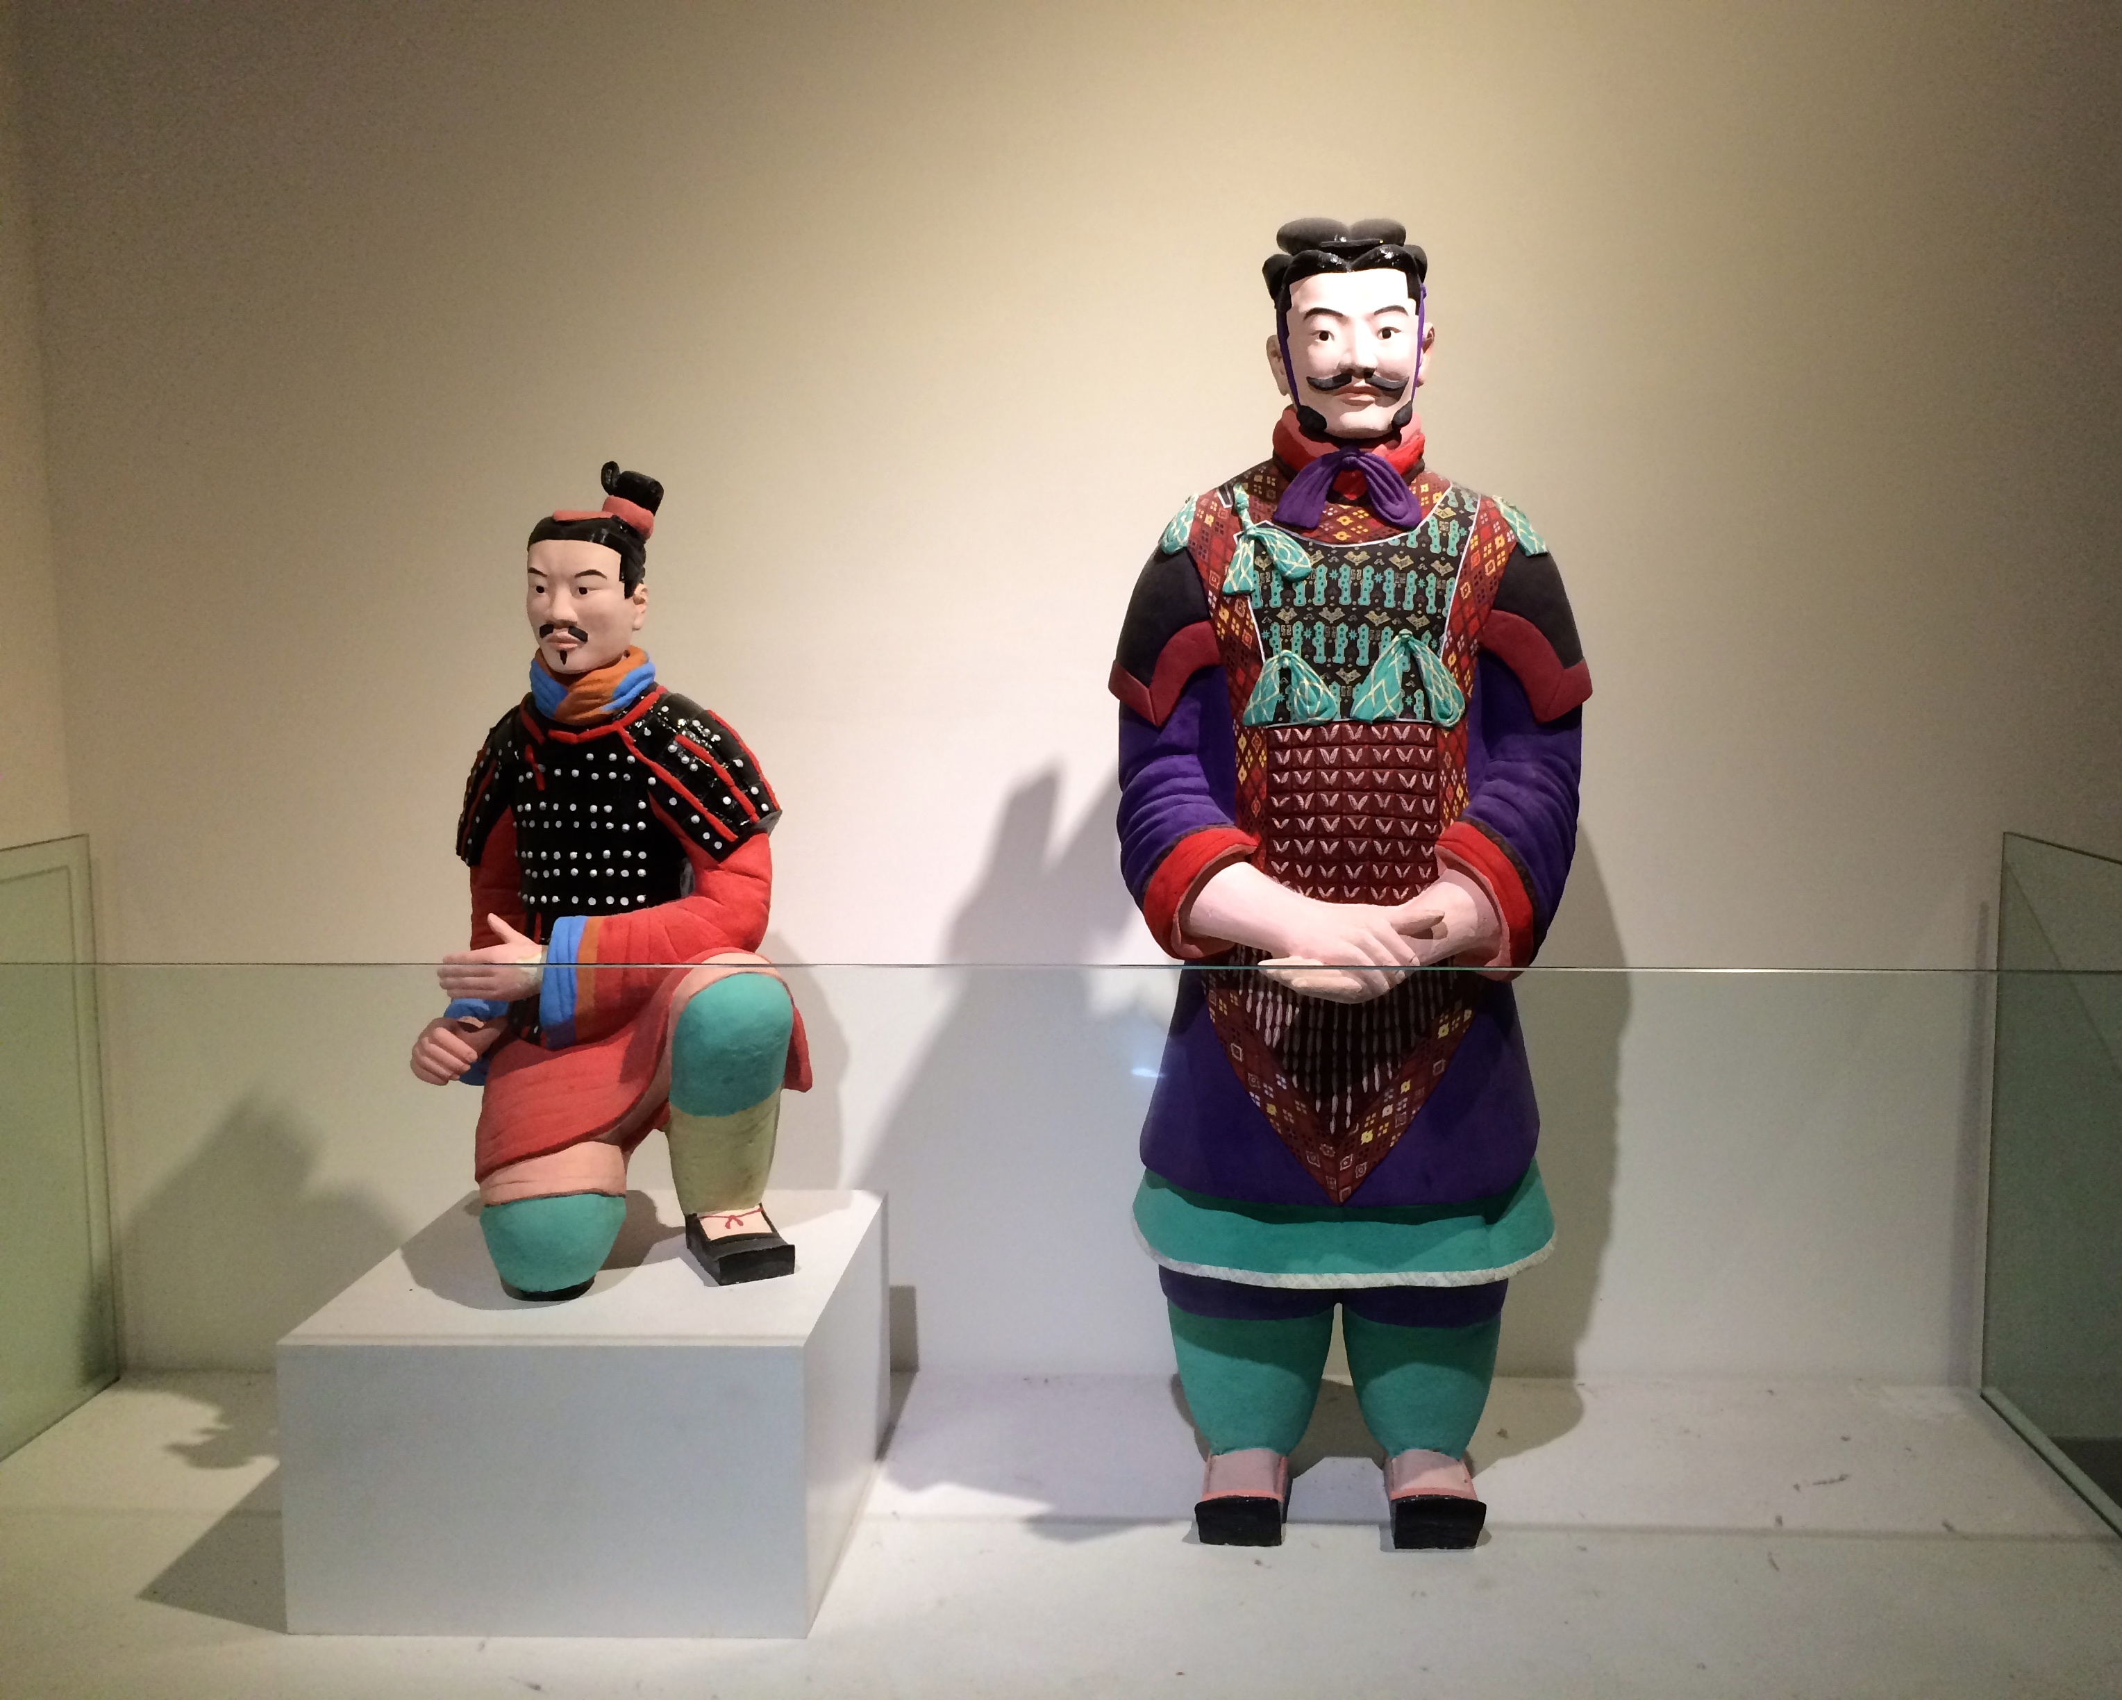
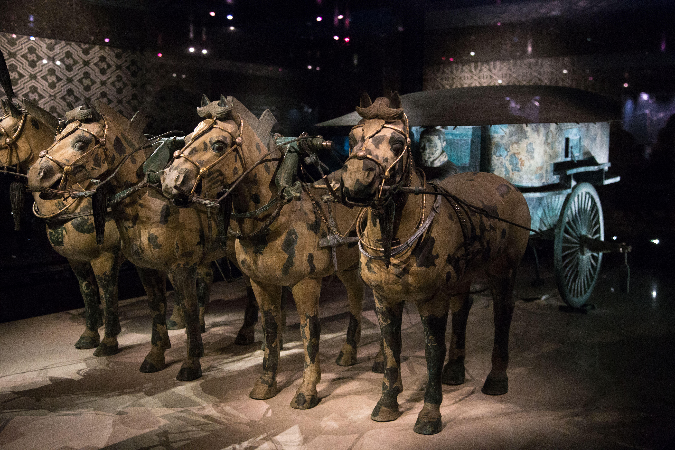

Slide 19
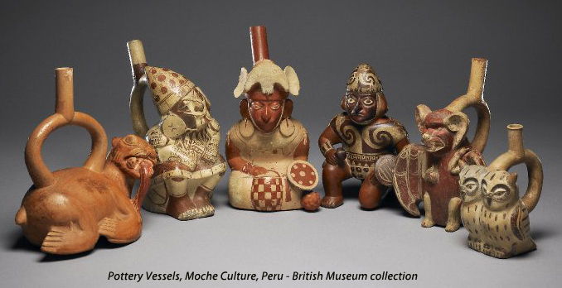
Moche Pottery
The Moche people lived in what today is northern Peru and are known for their portrait pottery. They made extensive use of molding and so mass produced their pottery. 100 - 800 AD

Slide 20
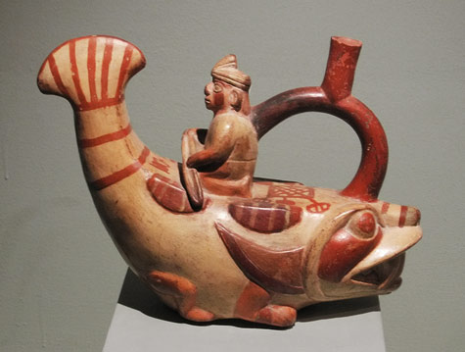
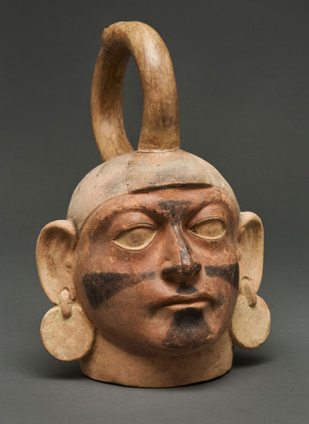
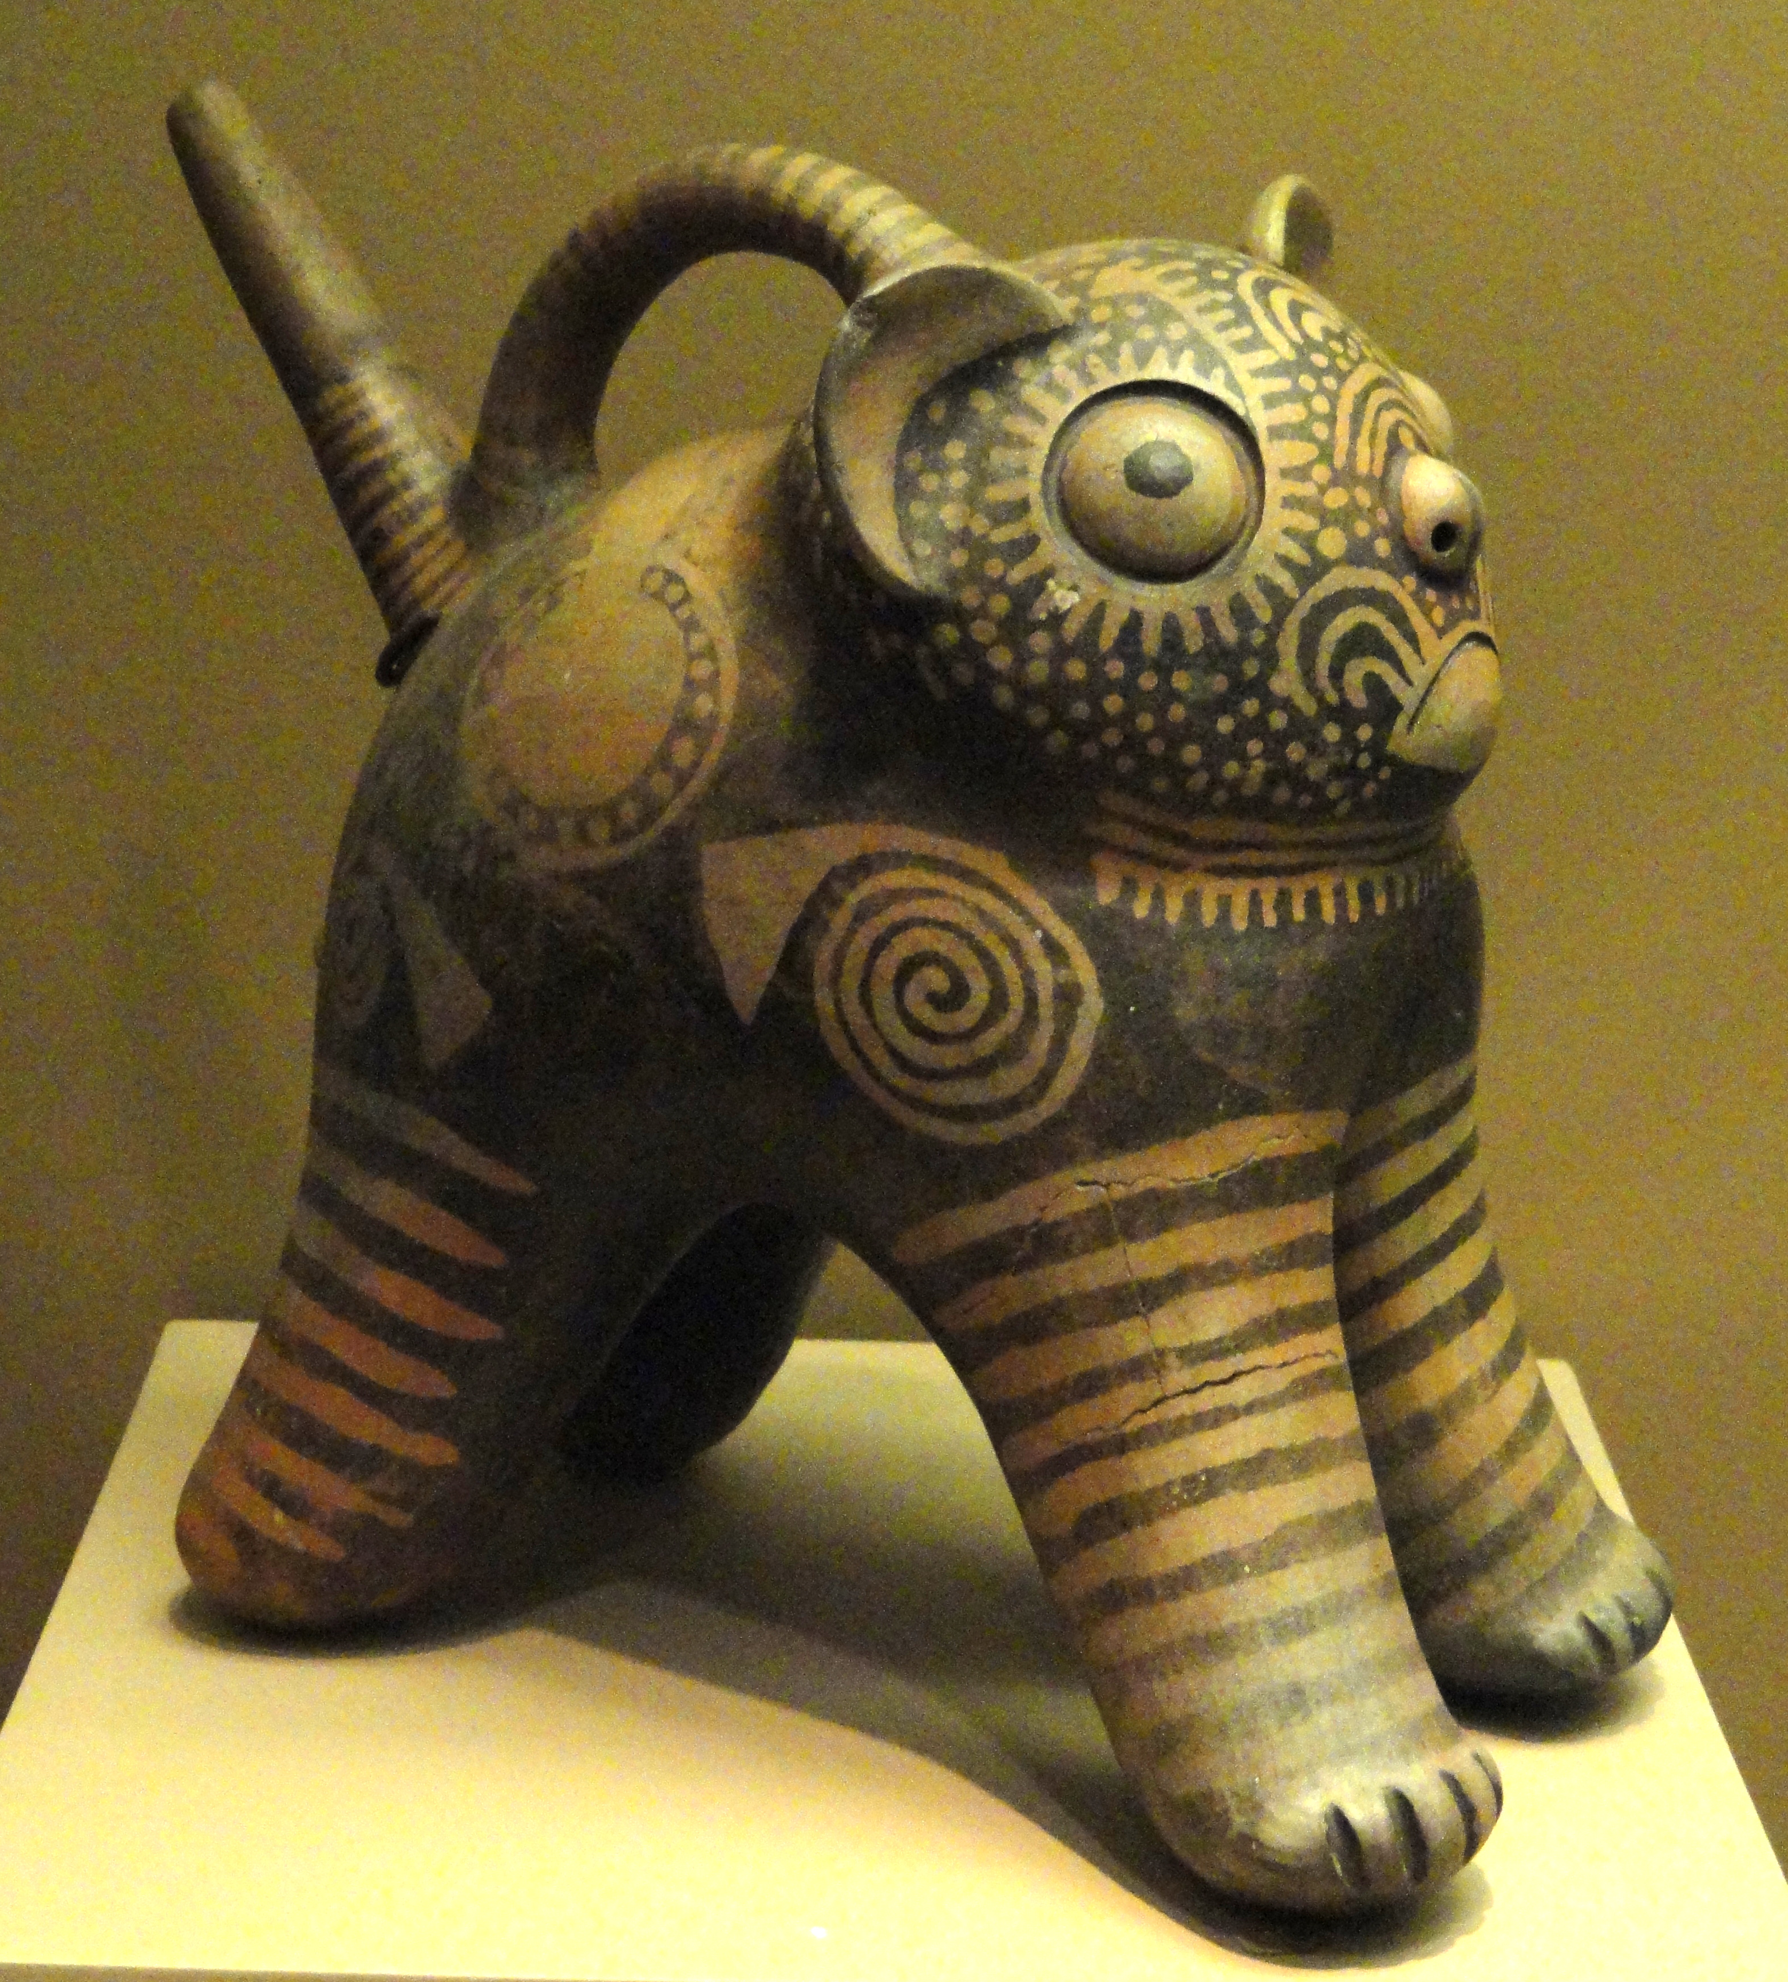

Slide 21
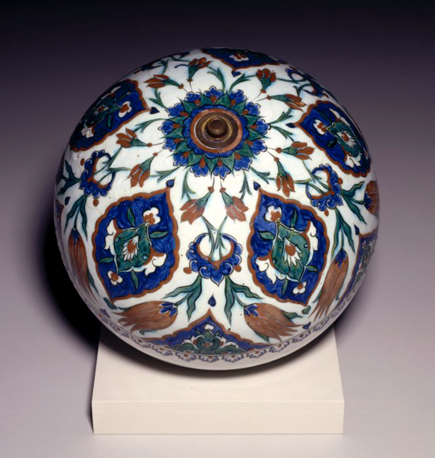
Islamic Pottery
Islamic pottery is notable for its intricate decoration. Islamic potters developed new glazing methods that would eventually move into the Western world and become maiolica, a colorful glazing palette atop a white base, that would become the basis for much of the European ceramics of that time. In general the potters of the Near East and Far East had an immense influence on later European potters. 800 – 1100 AD

Slide 22
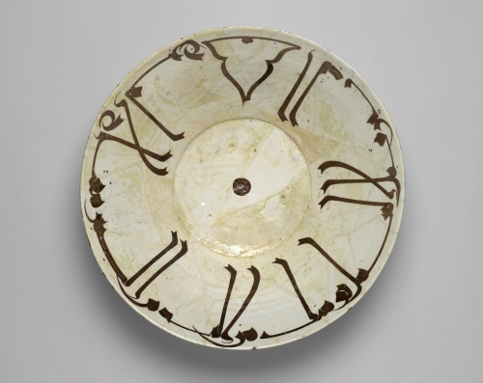
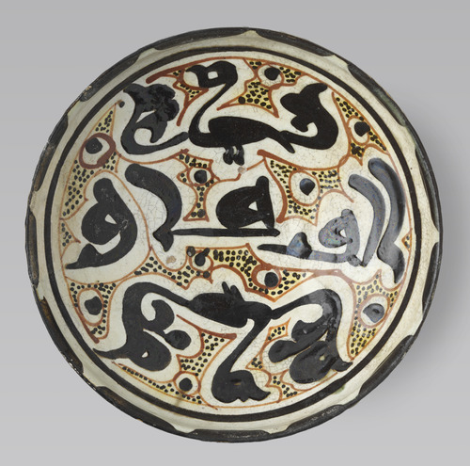
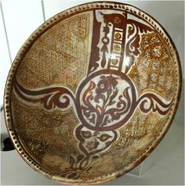

Slide 23
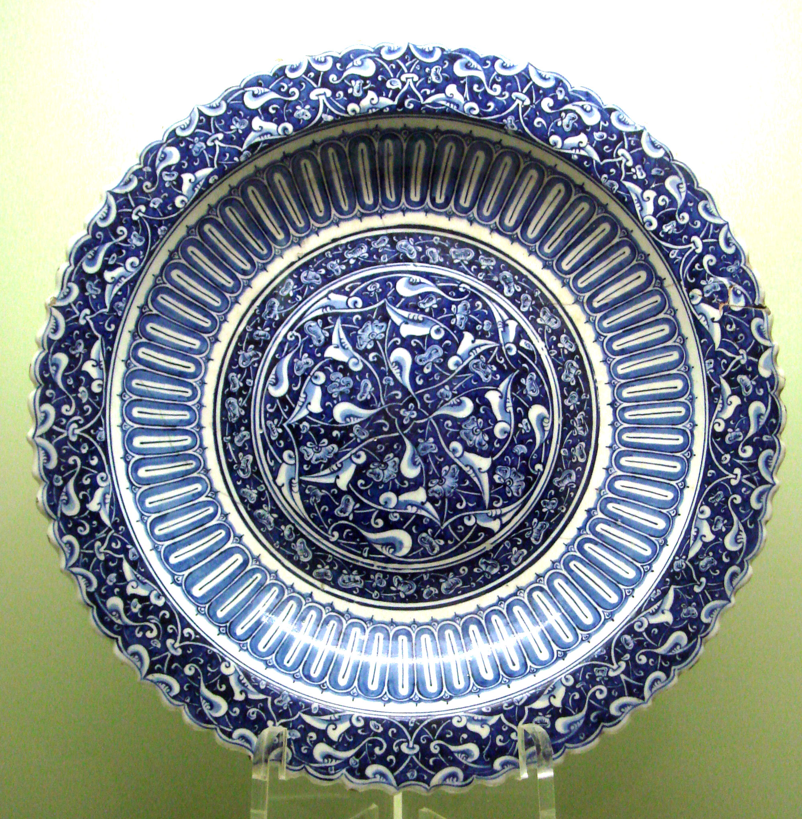
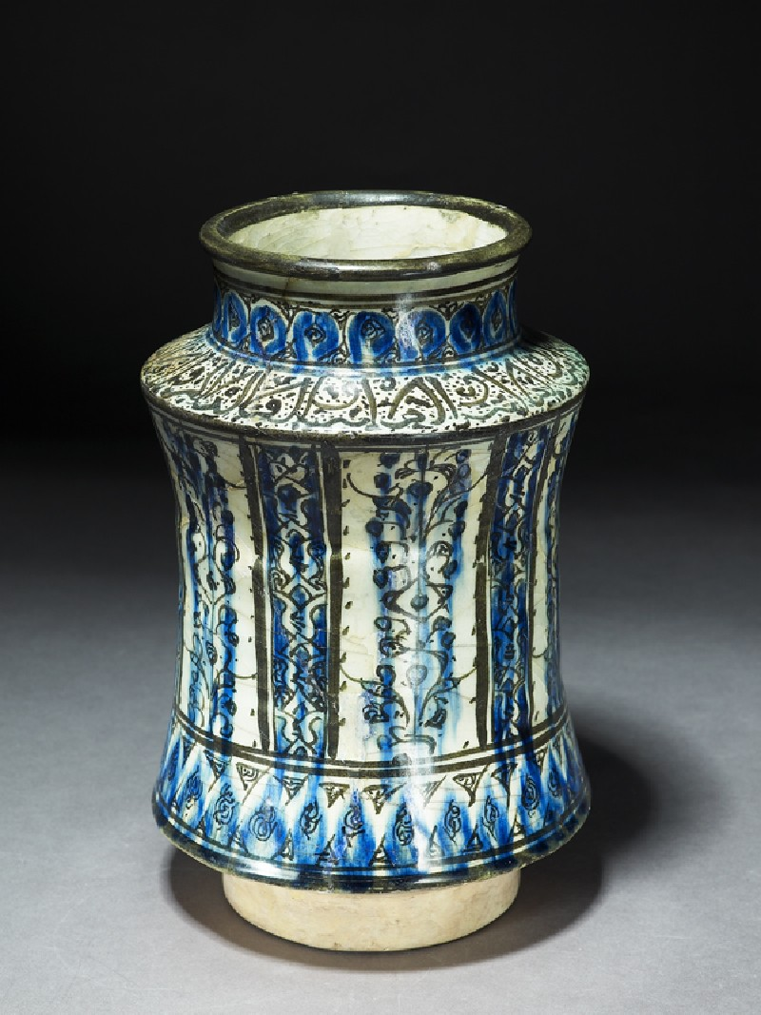

Slide 24
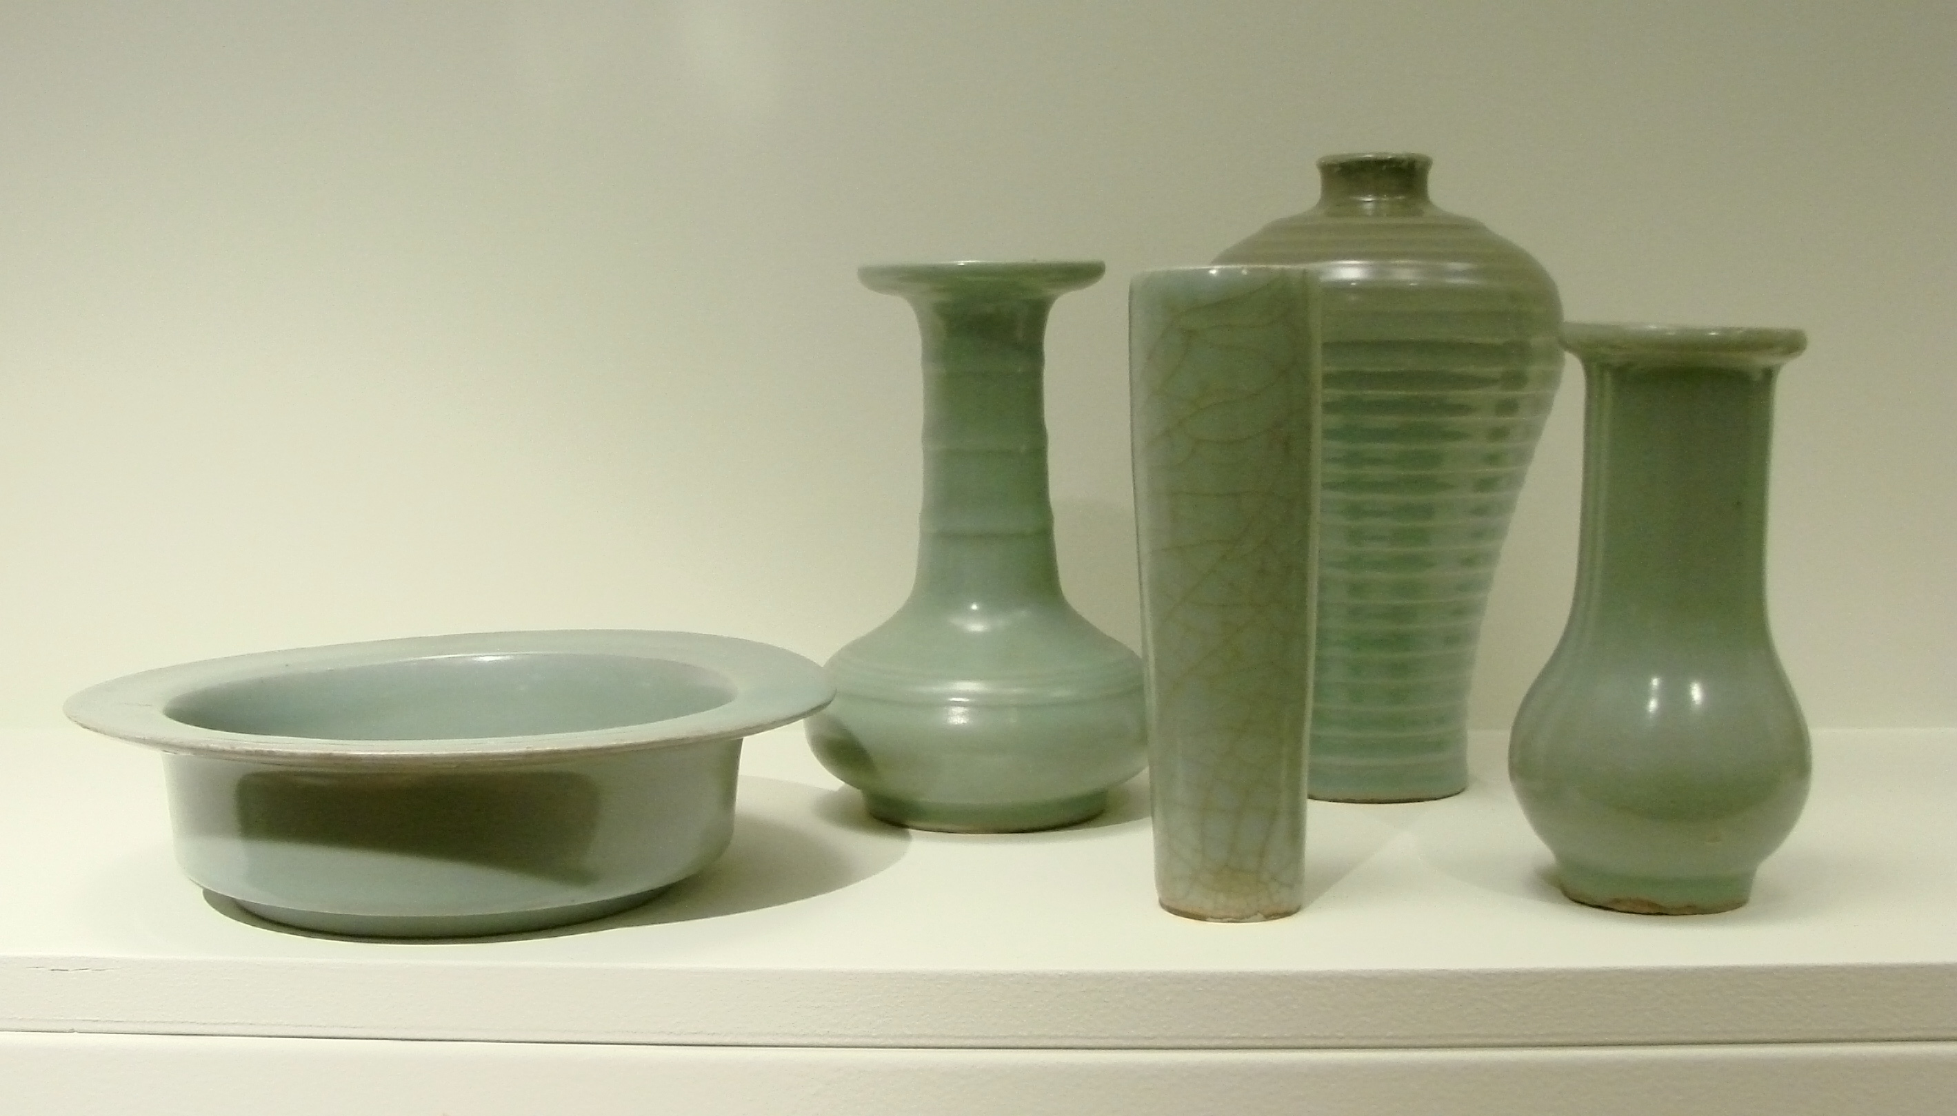
Song Dynasty
Song Dynasty potters in China are best known for their simple, elegant shapes and delicate monochromatic glazes most notably celadon and temmoku. 900-1200 AD

Slide 25
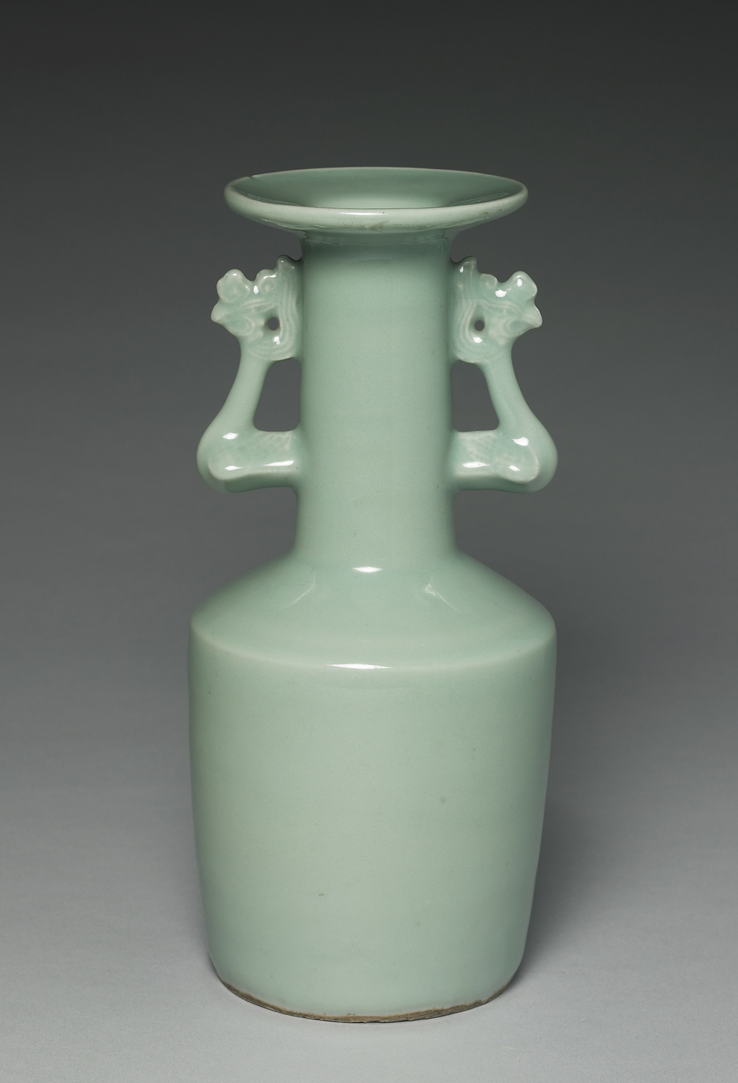
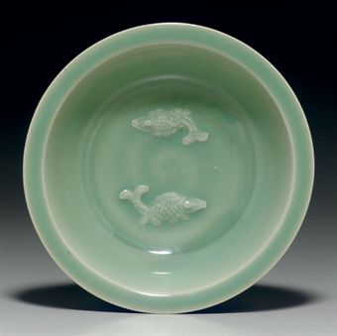
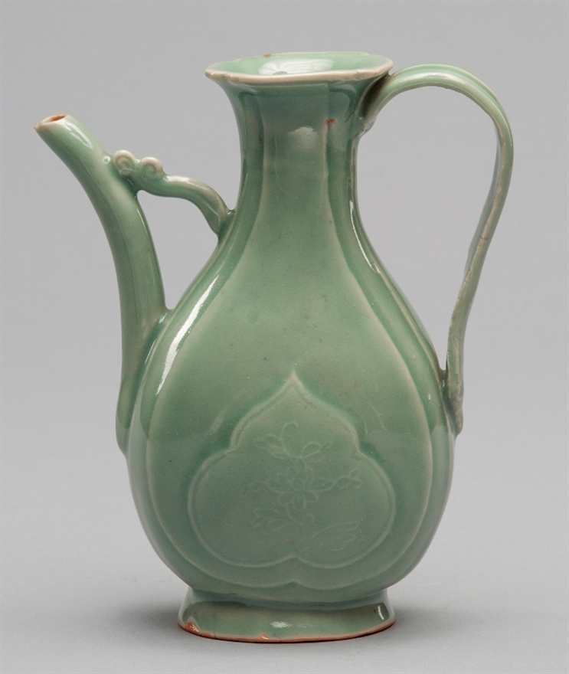

Slide 26
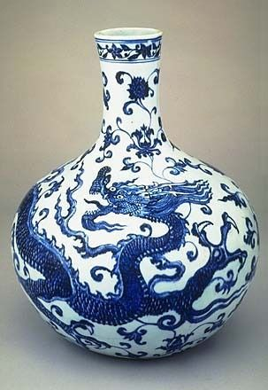
Ming Dynasty
Ming Dynasty potters in China made masterfully decorated cobalt blue on porcelain pots. This ware reached Europe and became very popular. It is where the term “fine china” comes from. 1368 – 1644 AD

Slide 27
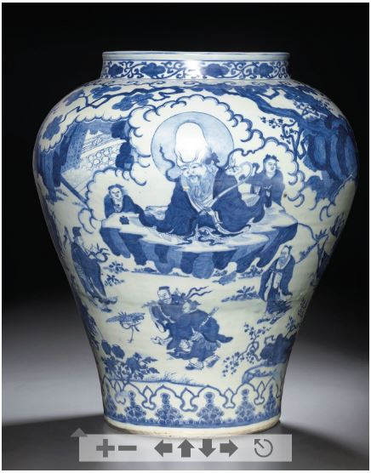
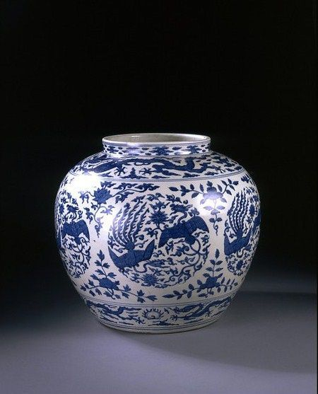

Slide 28
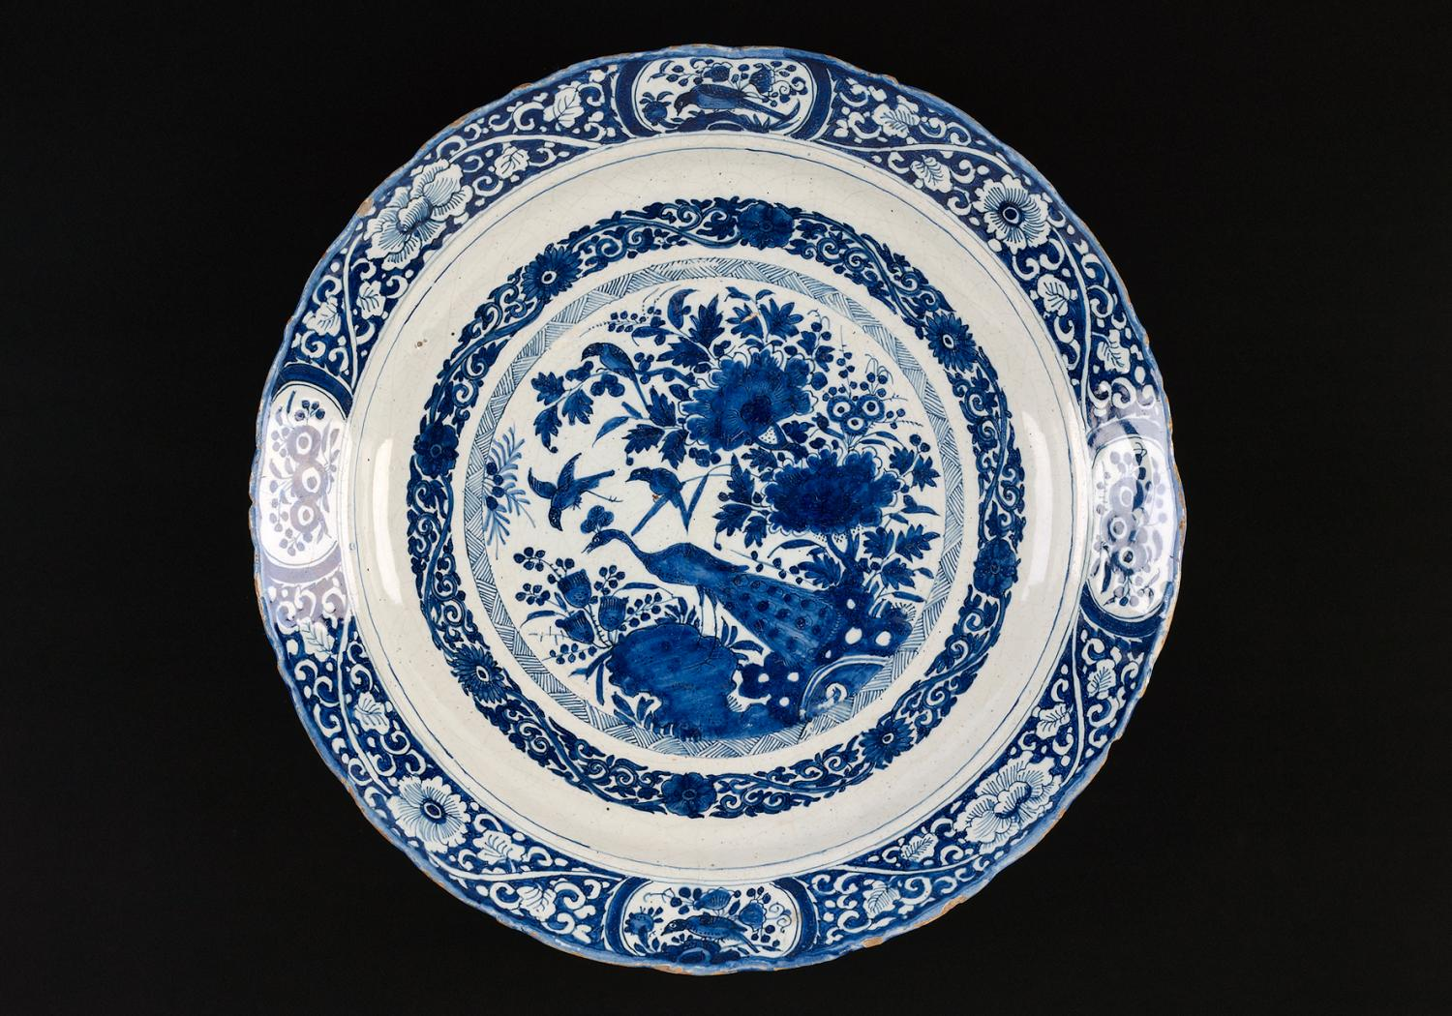
Delftware
As Europeans (specifically the Dutch) came in contact with the skillfully made pottery of the East they tried to copy it. It took them quite awhile before they got it. You can see the influence of Ming Dynasty pottery. 1500 – 1750 AD

Slide 29
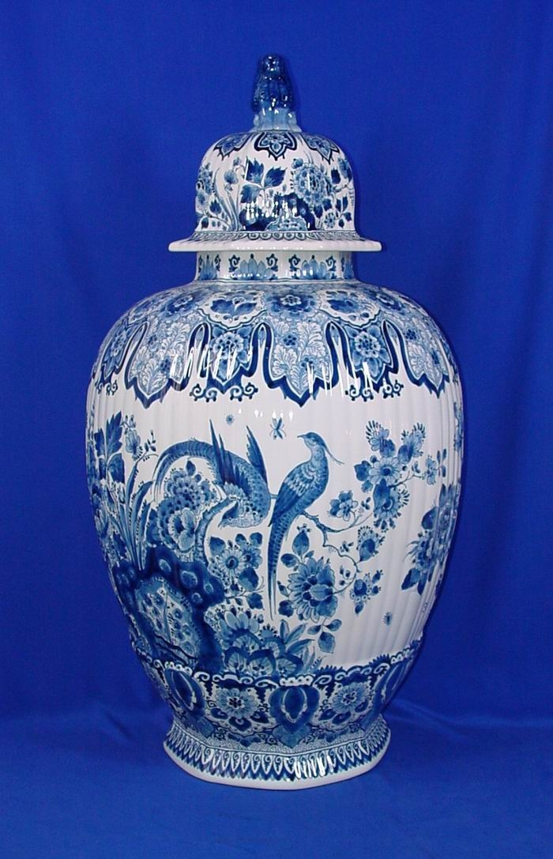
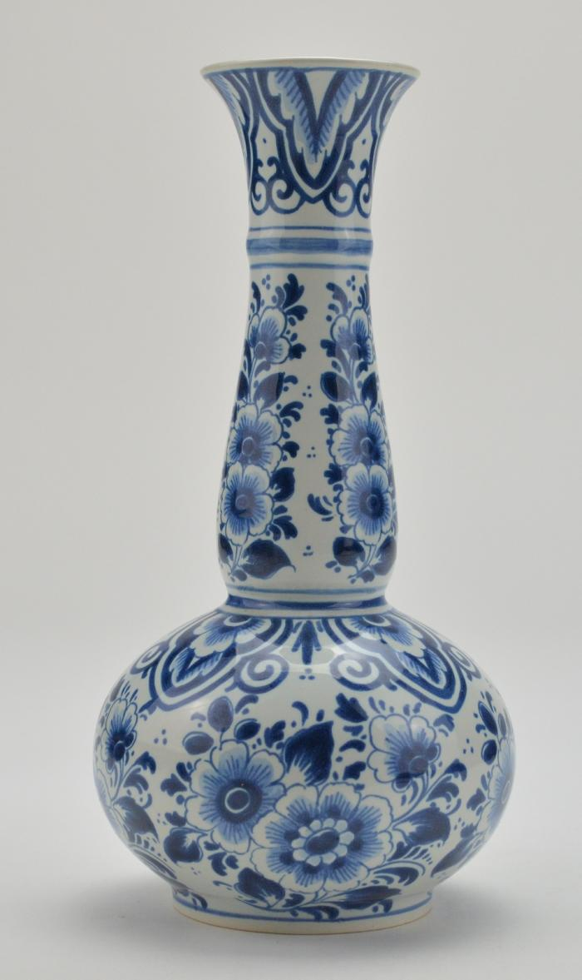
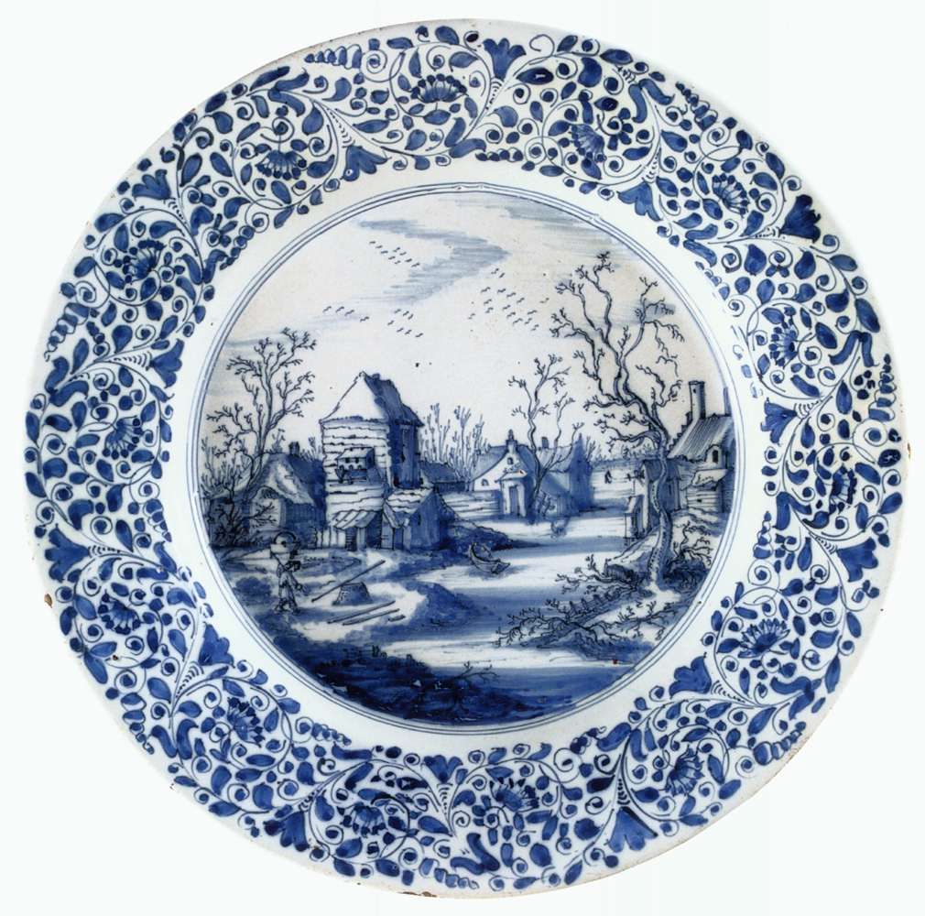

Slide 30
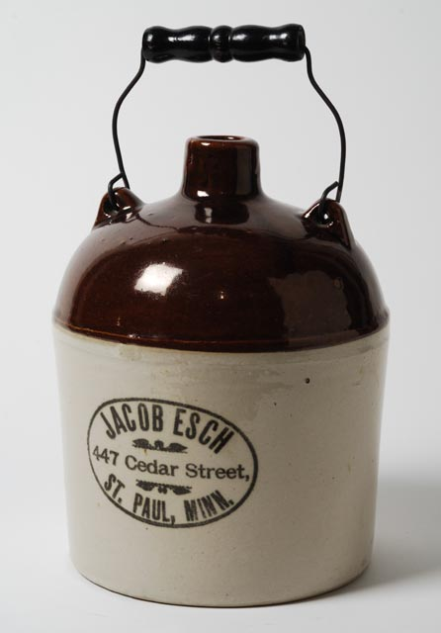
North American
Most North American pottery was influenced by European ceramics given most early North Americans were European immigrants. New England pottery has it’s own style as does pottery from the American South. 1700 – 1900 AD

Slide 31
Dave Drake – “Dave the Slave”
South Carolina, 1820 - 1860 AD

Slide 34
Clay Today
Today we use clay for many different purposes. Not only for pots but for toilets, bathtubs, sinks, bricks, and tiles. We use it as a fine-art sculpture material. Because of Clays particular properties it is also used in ceramic engineering. Today industry uses clay for makeup, insulators, protective tiles on space shuttles (mainly because of clays refractory properties, that is its resistant to heat), ball bearings, knife blades, bullet proof vests, medicine, food, and electronics to name a few.

