Slide 1
Carrie Mae Weems
Born 1953 in Portland, Oregon
Lives and works in Syracuse, NY
Her photographs, films, textiles, and videos focus on issues that face African Americans today, such as racism, gender relations, politics, and personal identity.
"Let me say that my primary concern in art, as in politics, is with the status and place of Afro-Americans in our country…but Black experience is not really the main point; rather, complex, dimensional, human experience and social inclusion ... is the real point.”
Her self-described ambition as an artist is to “make art . . . that adds and reveals; to beautify the mess of a messy world, to heal the sick and feed the helpless; to shout bravely from the roof-tops and storm barricaded doors and voice the specifics of our historic moment.”
Was named a MacArthur “Genius” Fellow in 2013

Slide 2
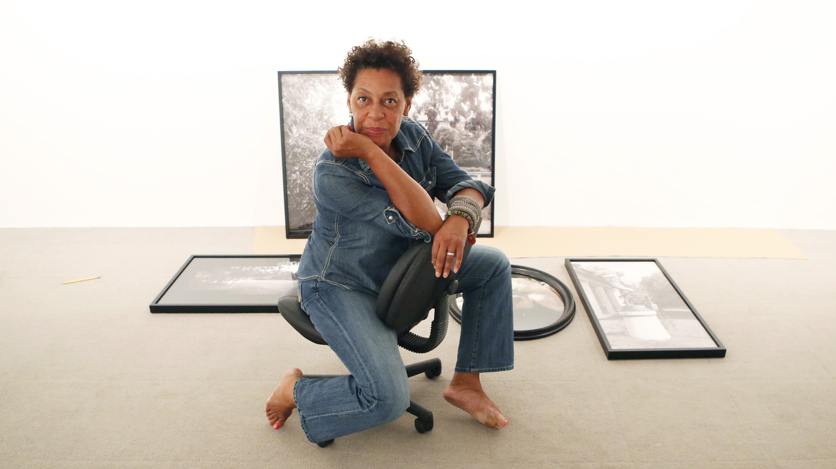

Slide 4
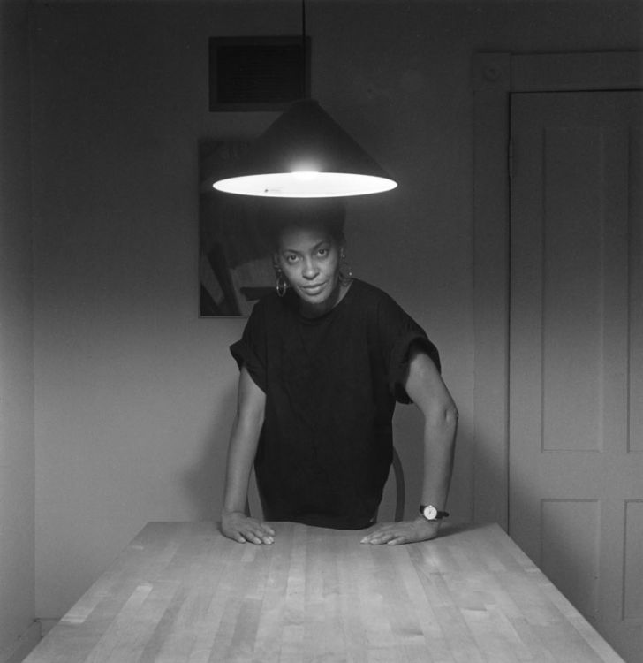
The Kitchen Table Series (1990)
“Tells the story of a strong-willed black woman and her relationships with a man, a daughter, and female friends.”

Slide 5
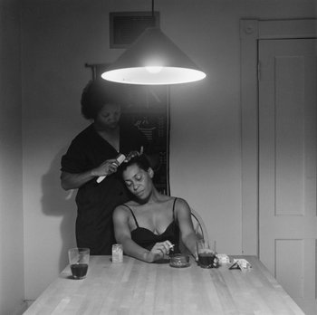

Slide 6
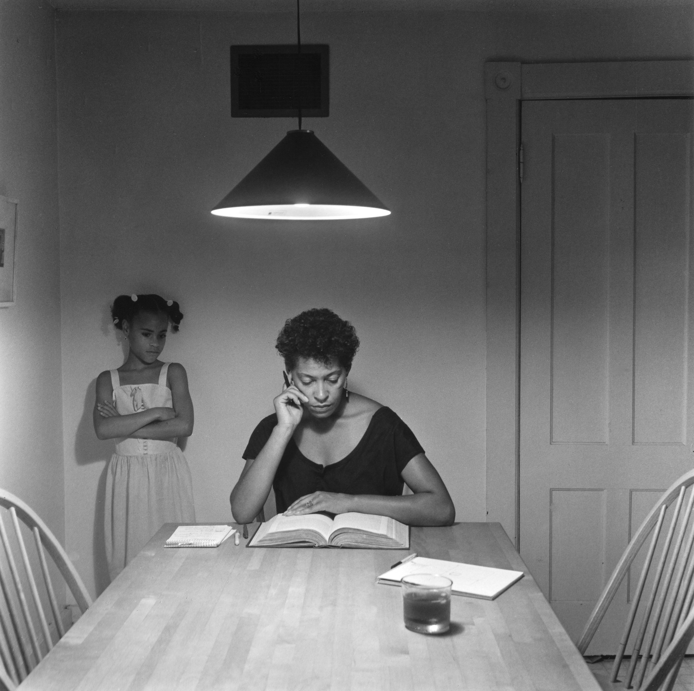

Slide 7
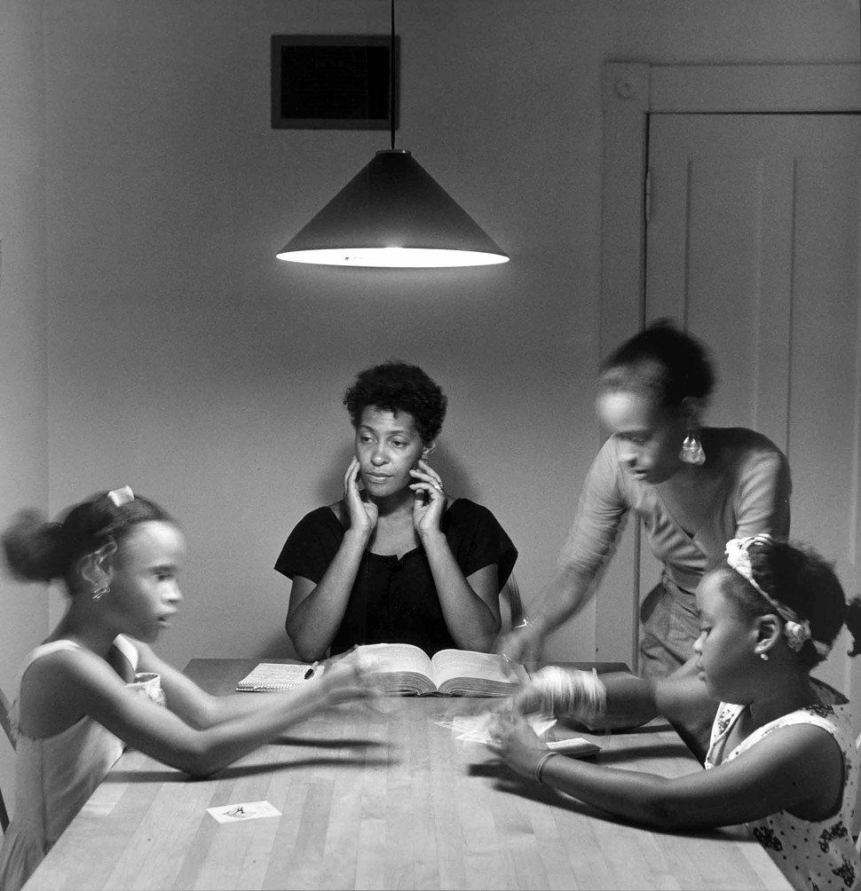

Slide 8
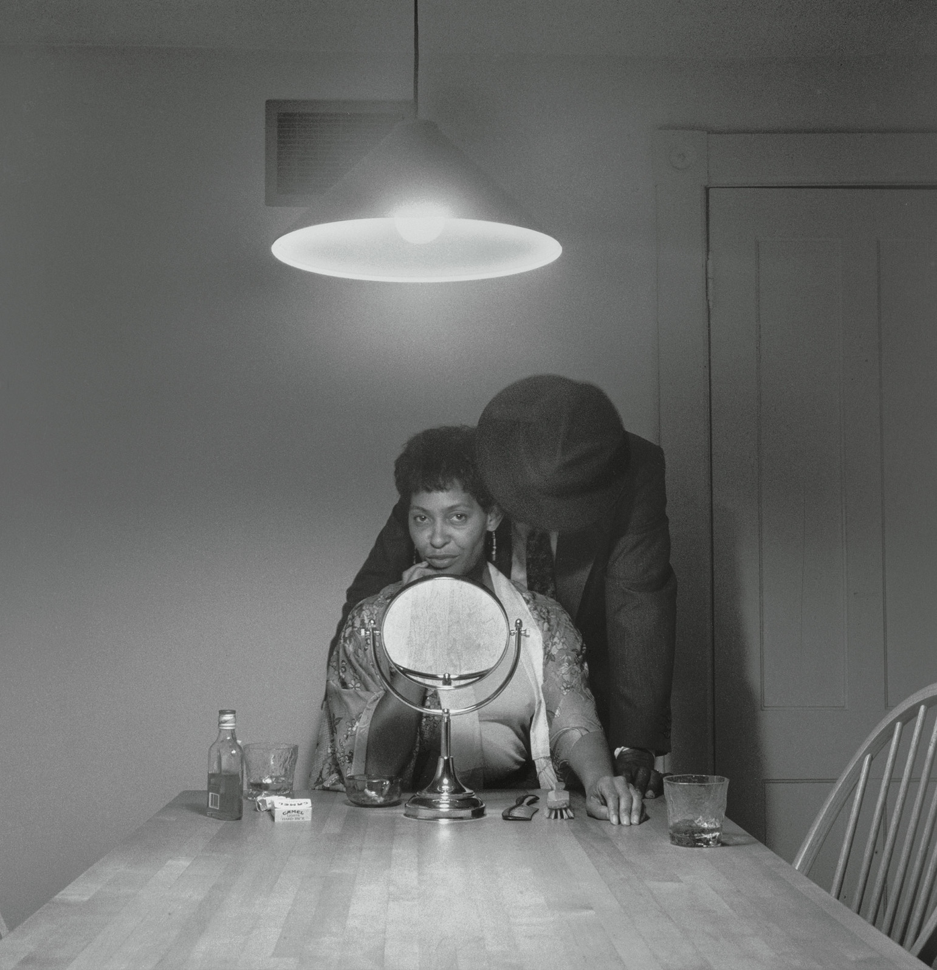

Slide 9
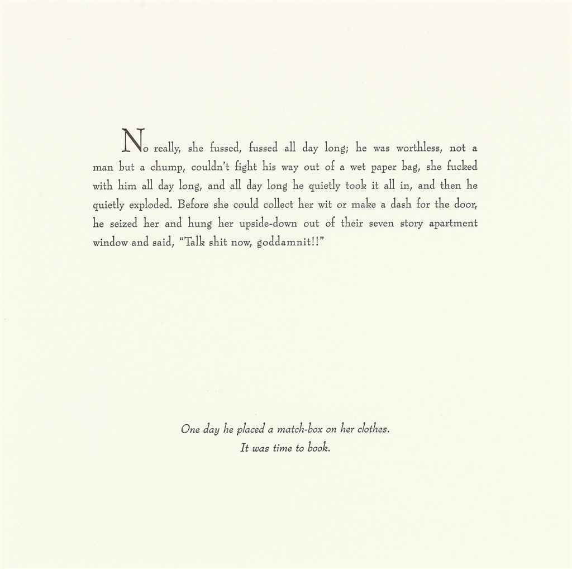

Slide 10
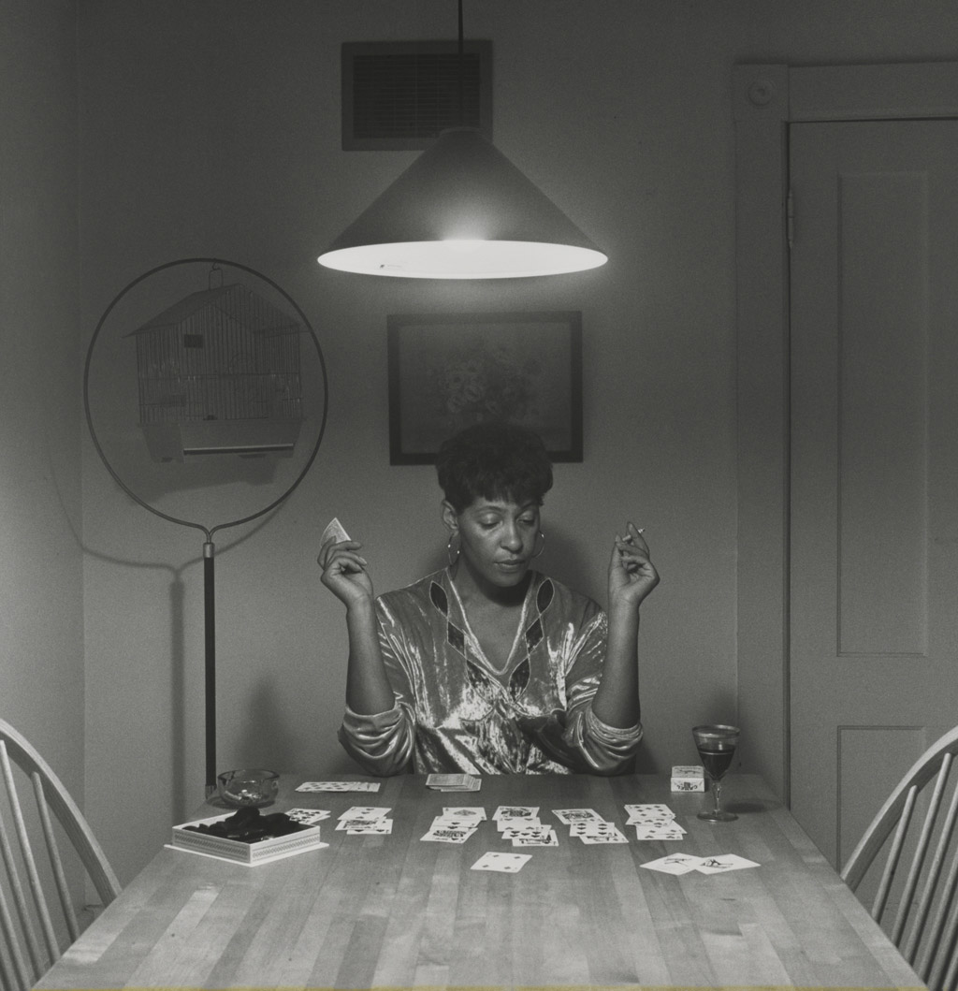

Slide 11
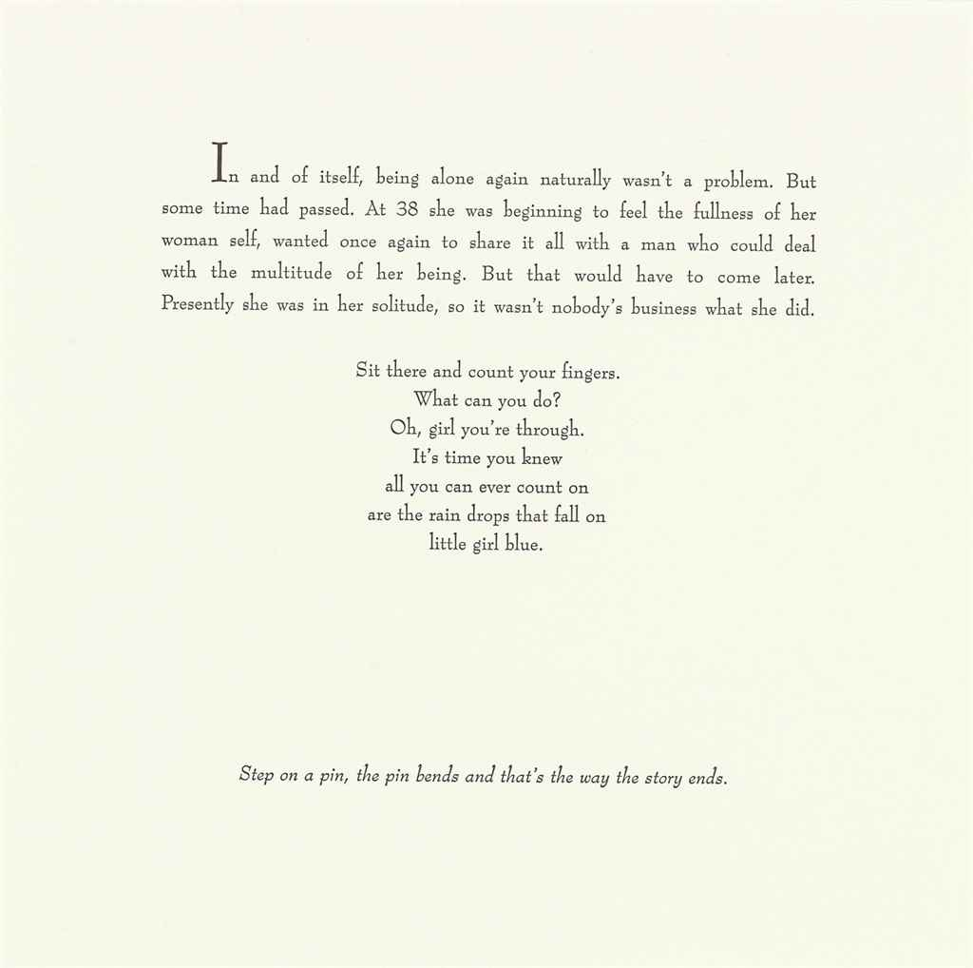

Slide 12
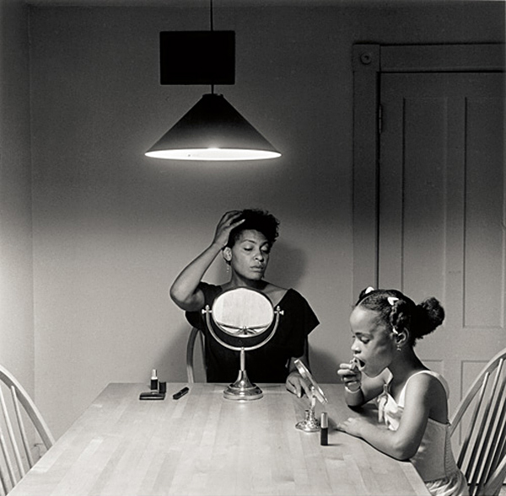

Slide 13
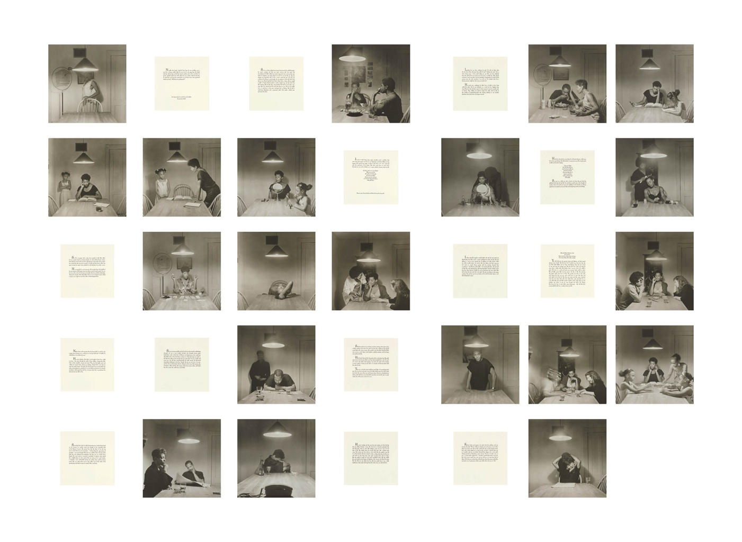

Slide 14
Ain't Jokin’ (1987-1988)
“Weems uses racist jokes as a tool to deconstruct white perceptions of blacks.”

Slide 15
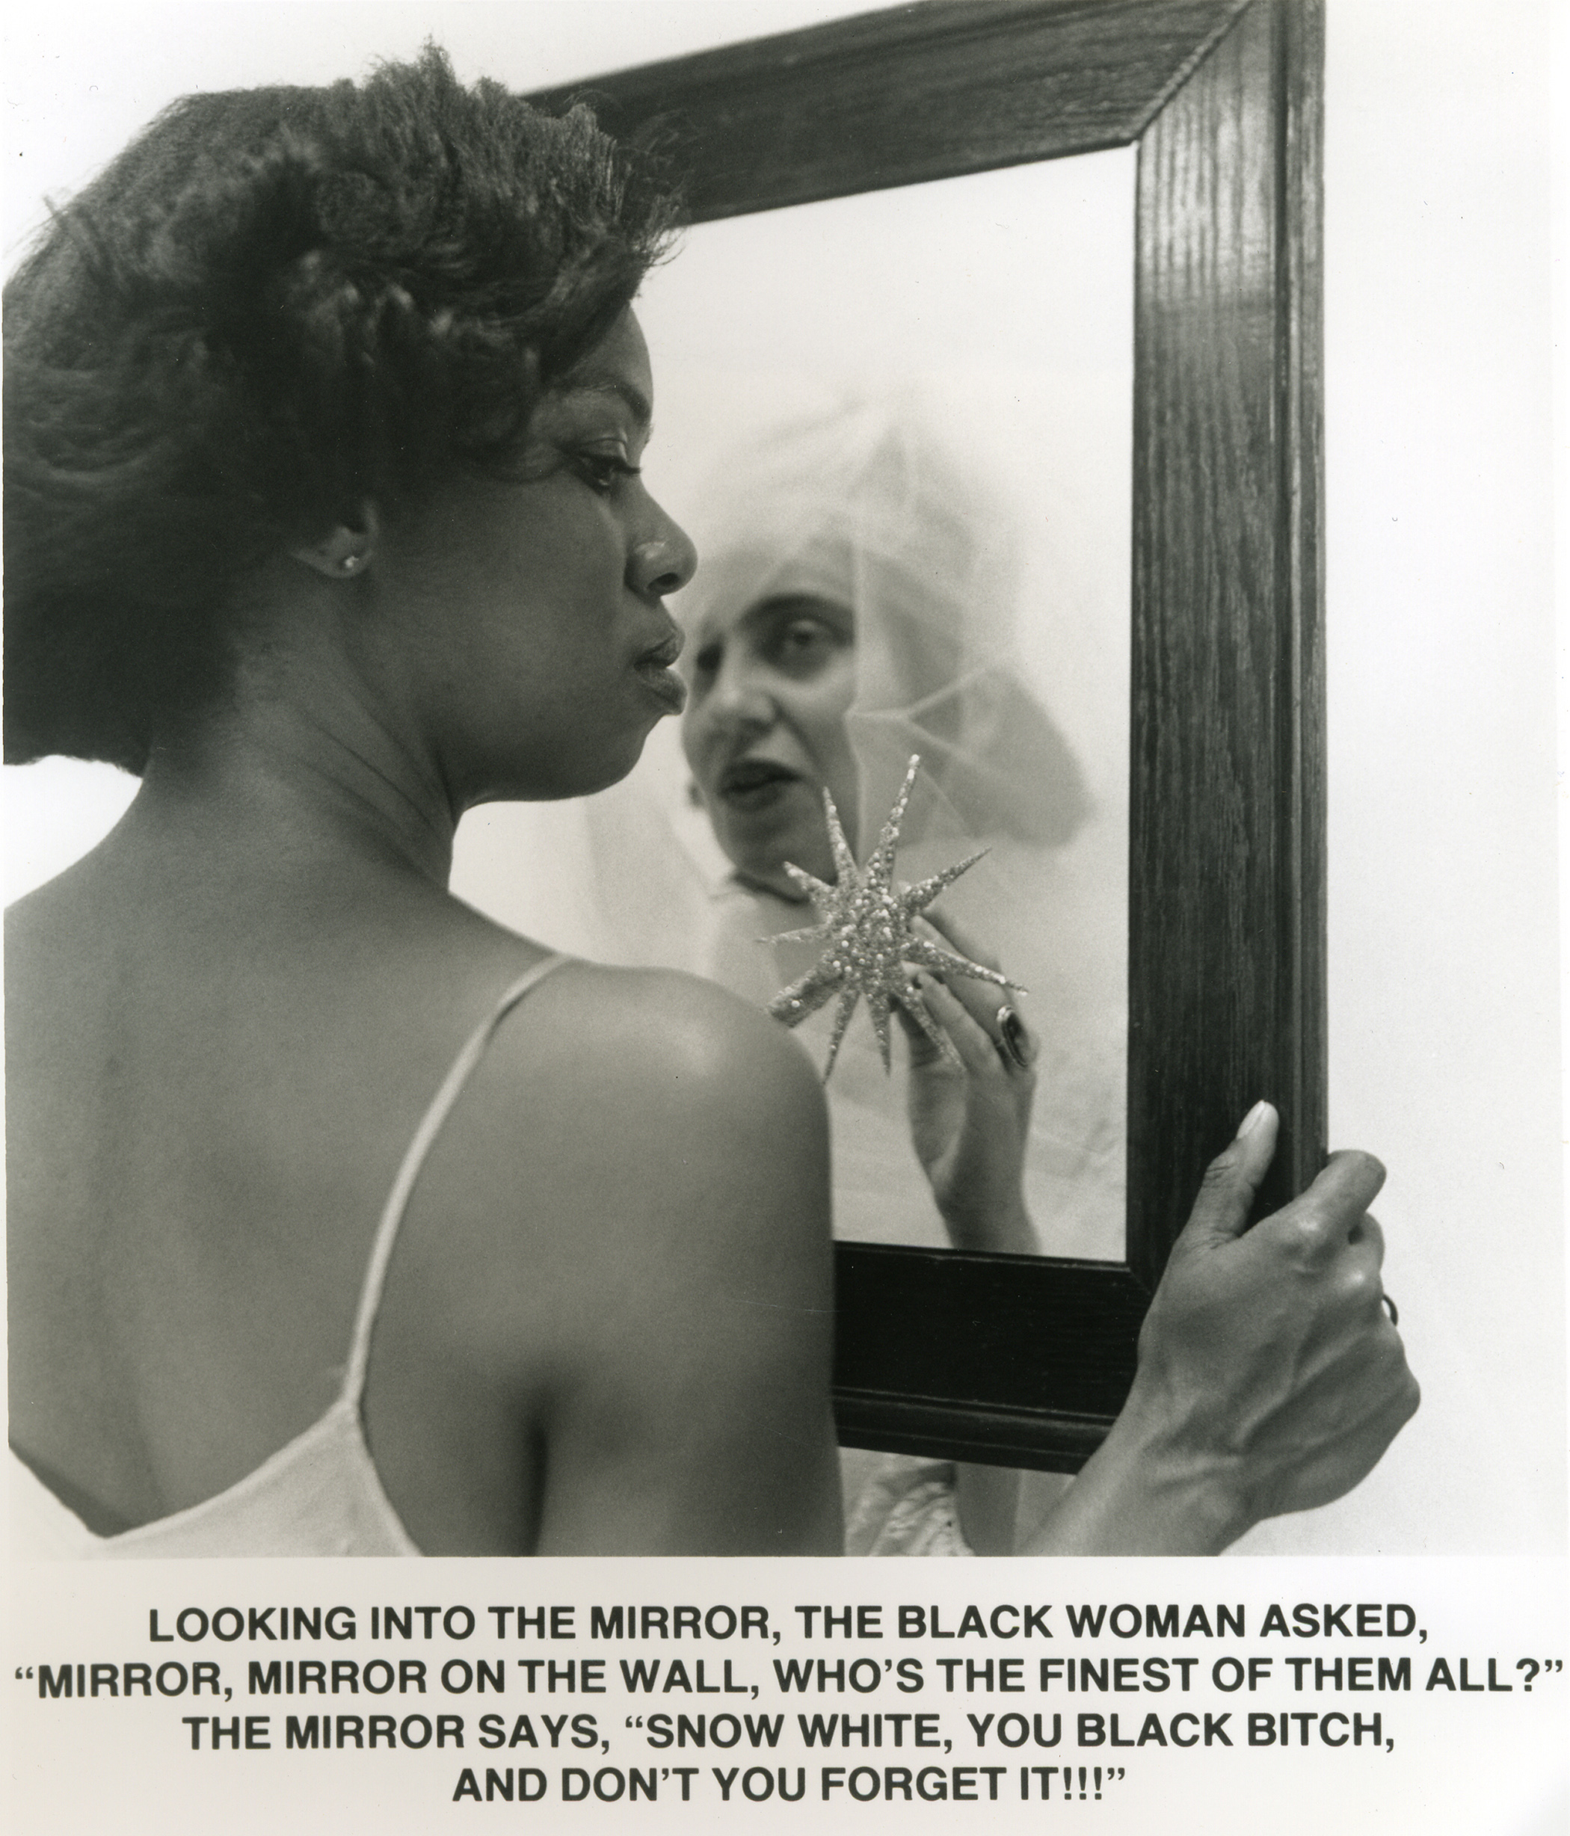

Slide 16
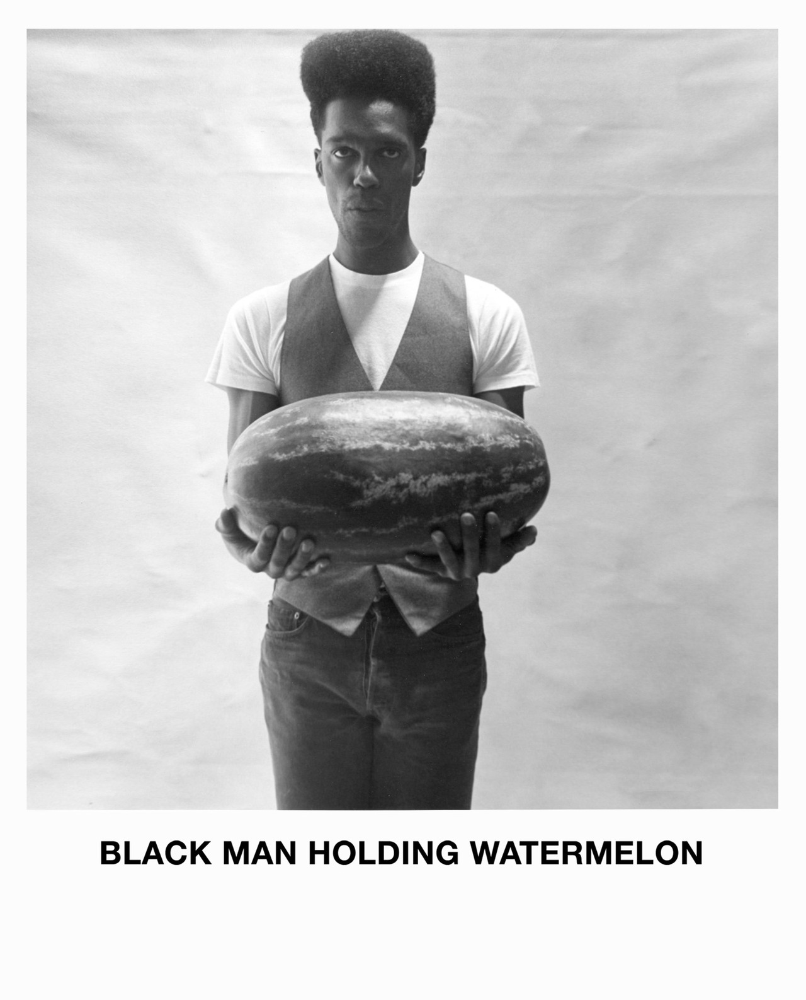

Slide 17
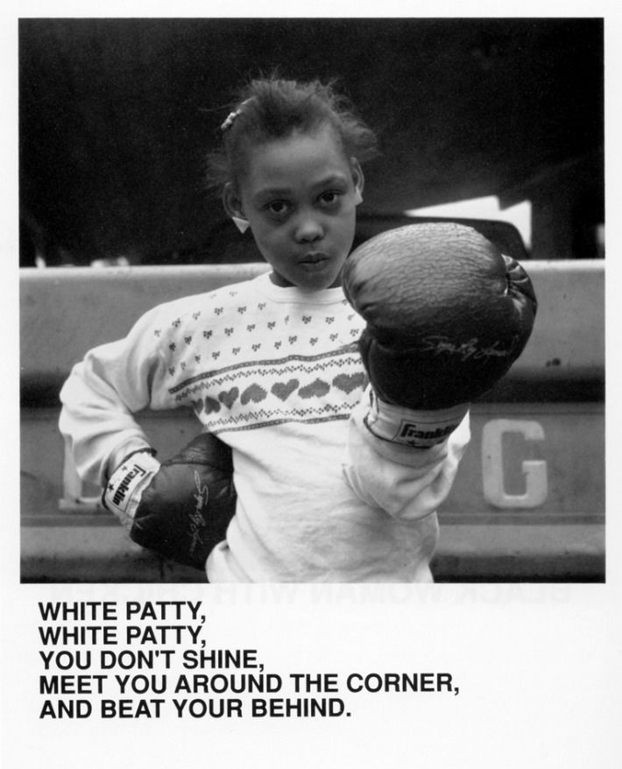

Slide 19
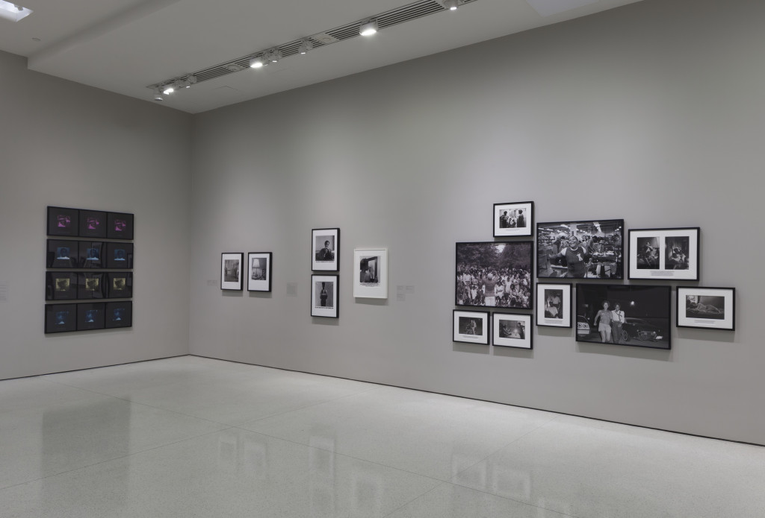

Slide 20
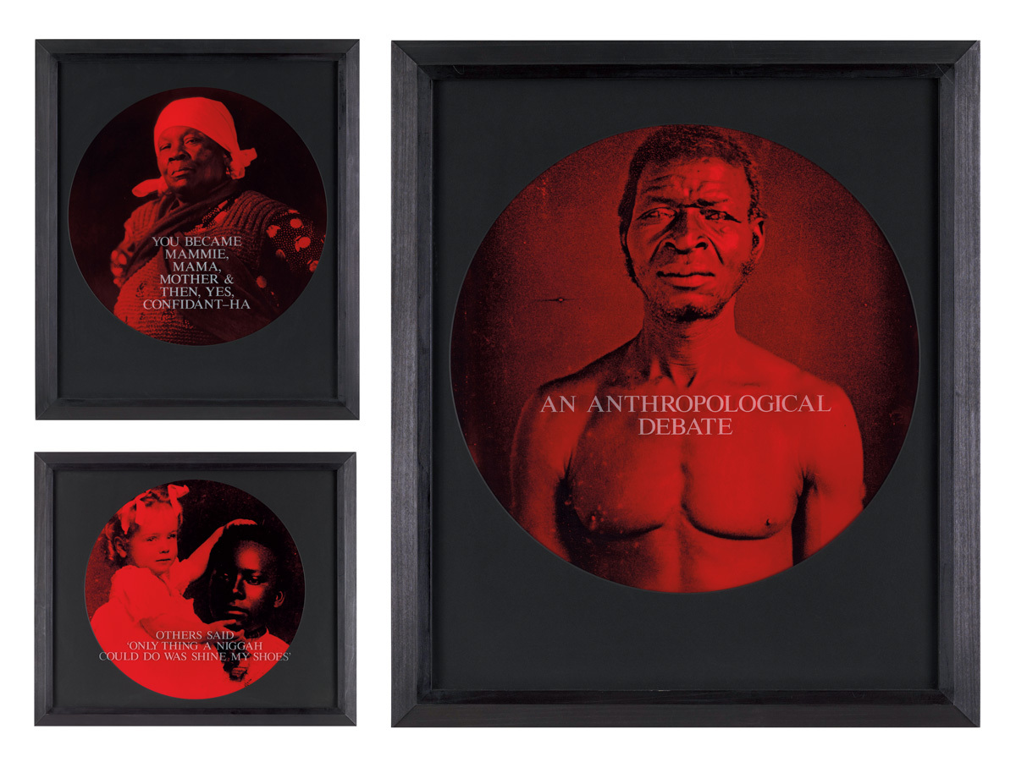
From Here I Saw What Happened and I Cried (1995-1996)
Weems delves into some of the most racist and hurtful historical representations of African Americans…through this series, Weems poignantly rescues a photographic history of African Americans from stereotypical conventions and gives voice to the disempowered.

Slide 21
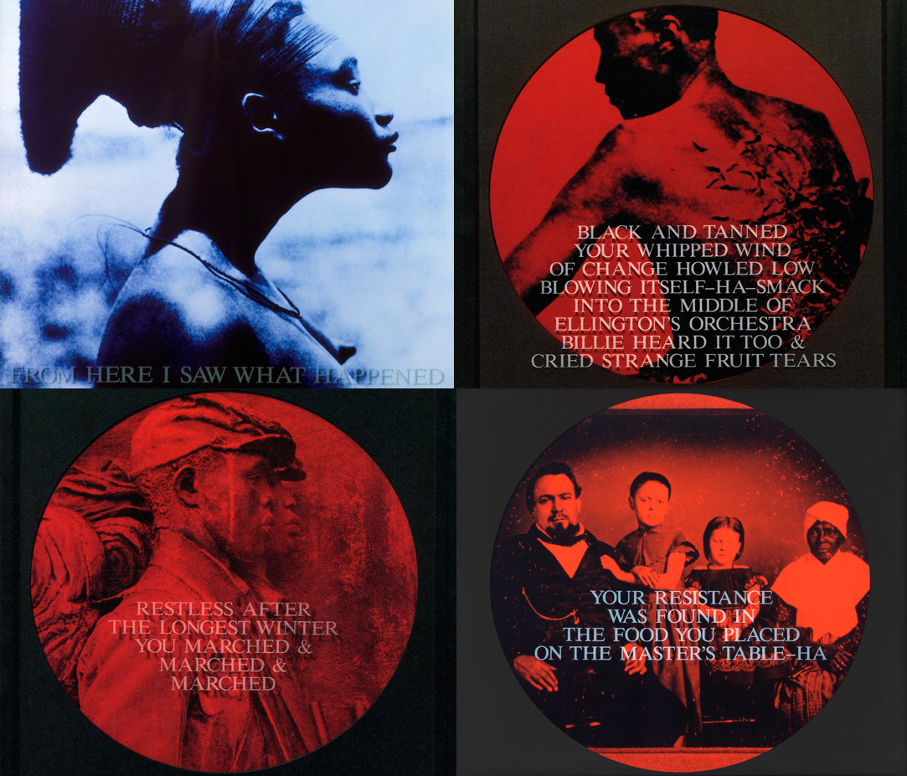

Slide 22
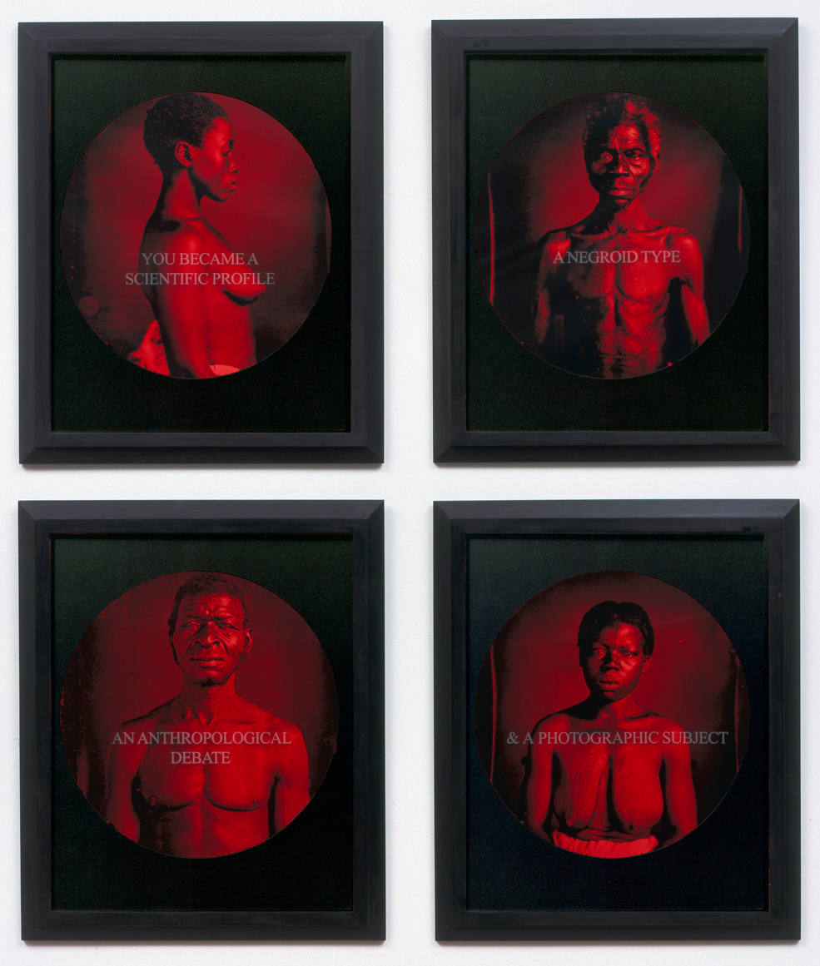

Slide 23
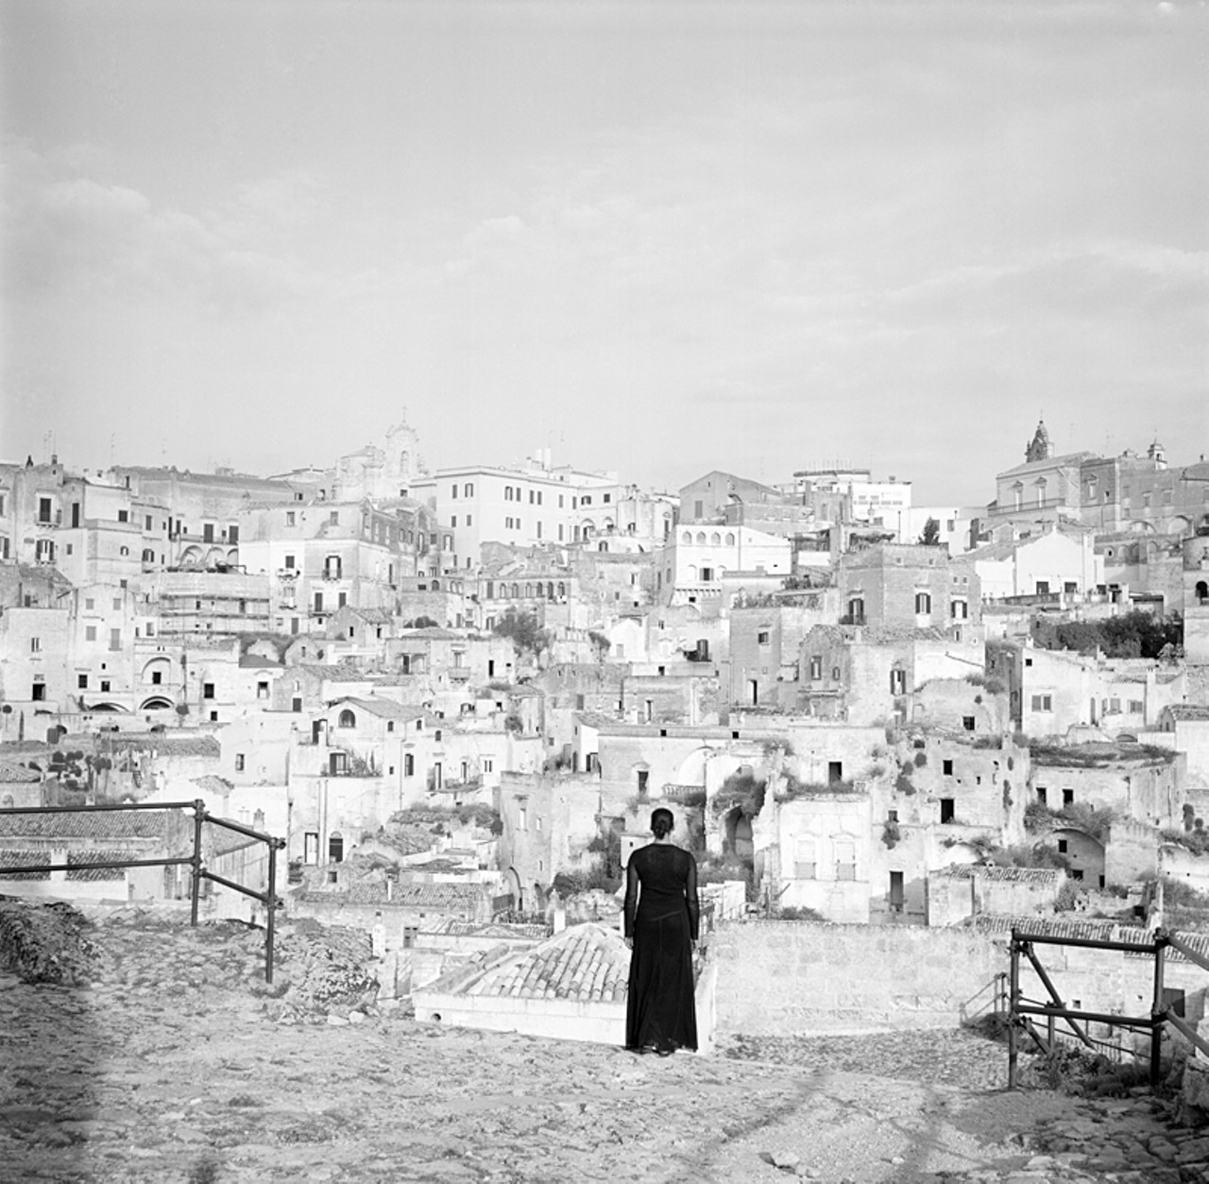
Roaming (2006)
“…the notion of having people of color stand for the multitudes…especially successful in this series where she wanders through the streets of Rome and other Italian sites pondering humanity’s collective past and present condition.”

Slide 24
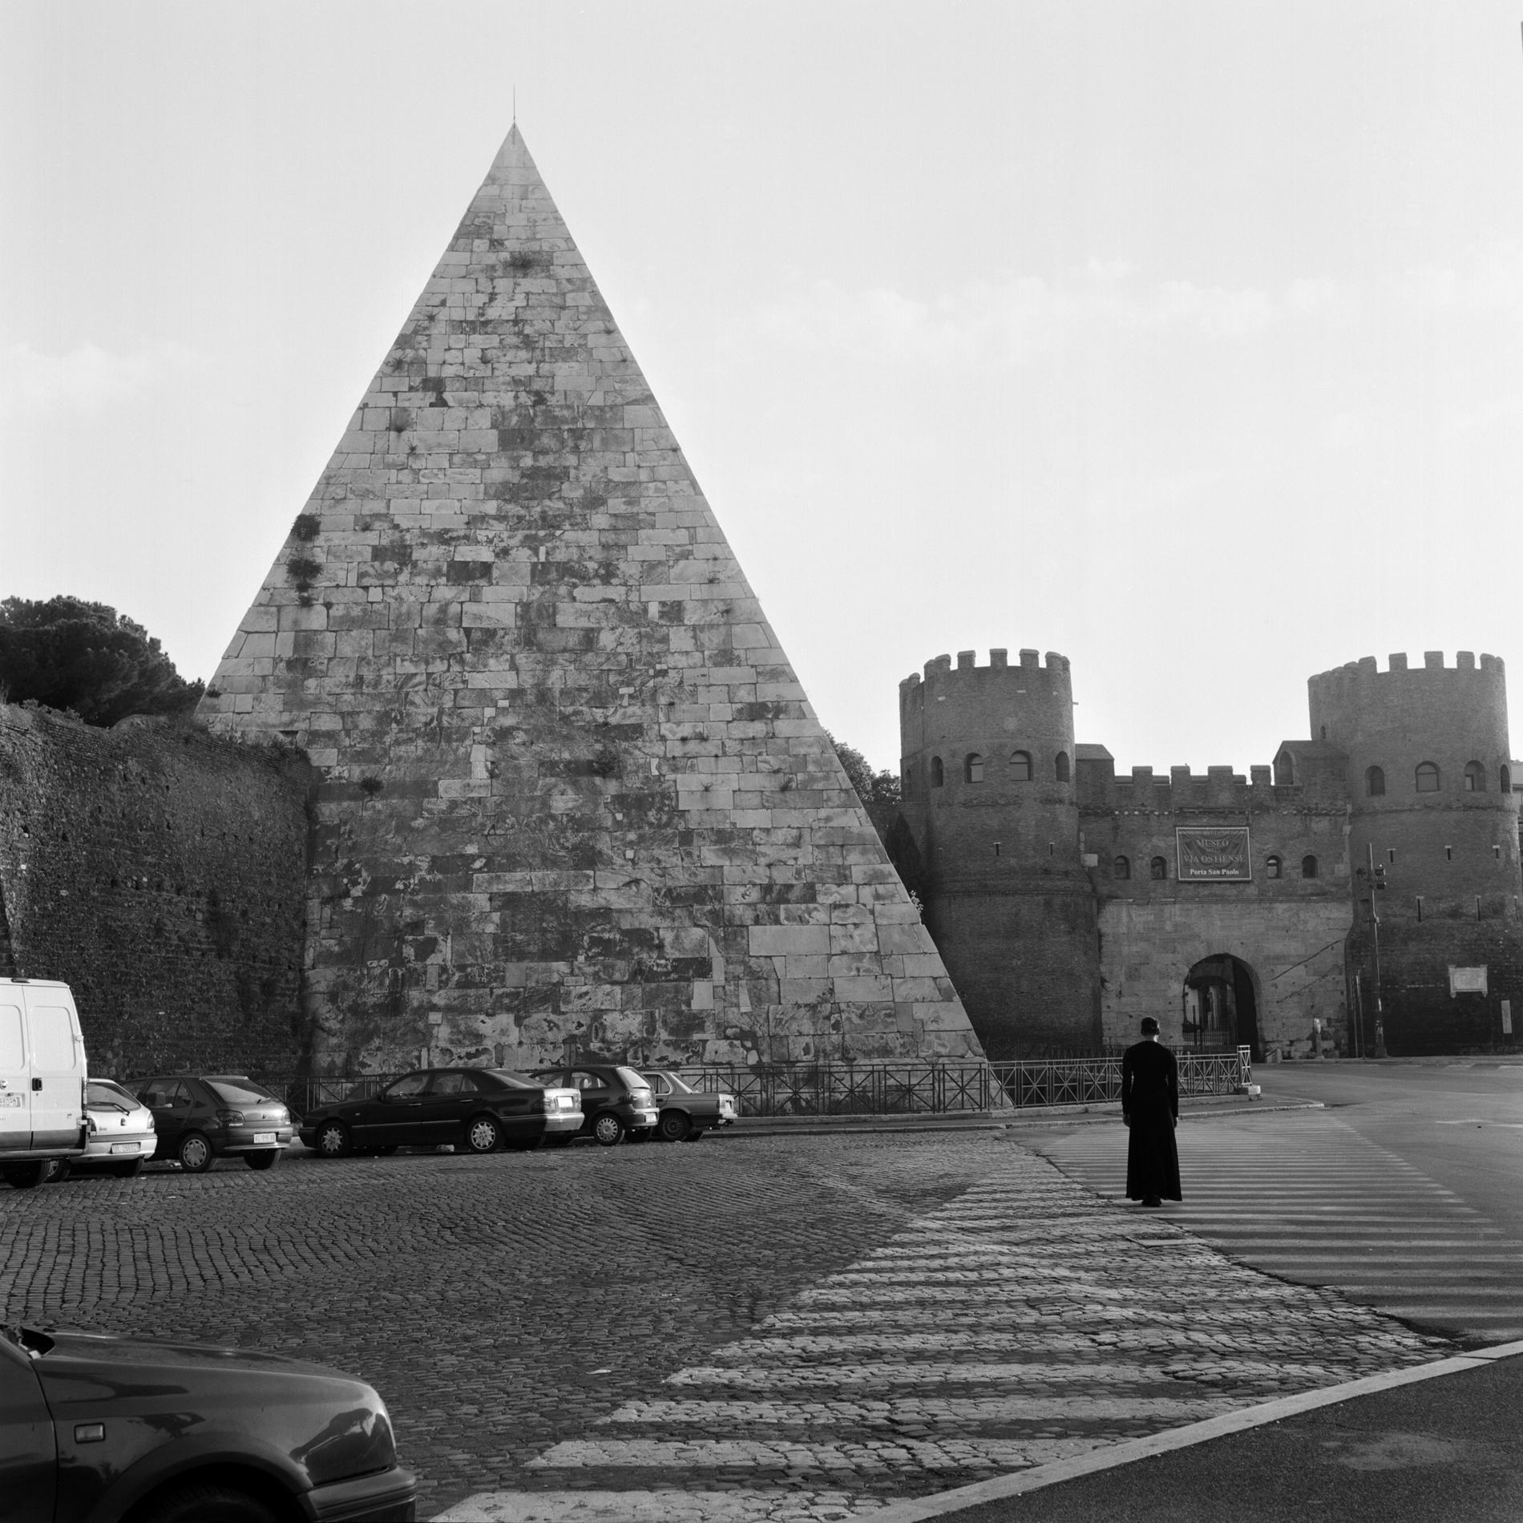

Slide 25
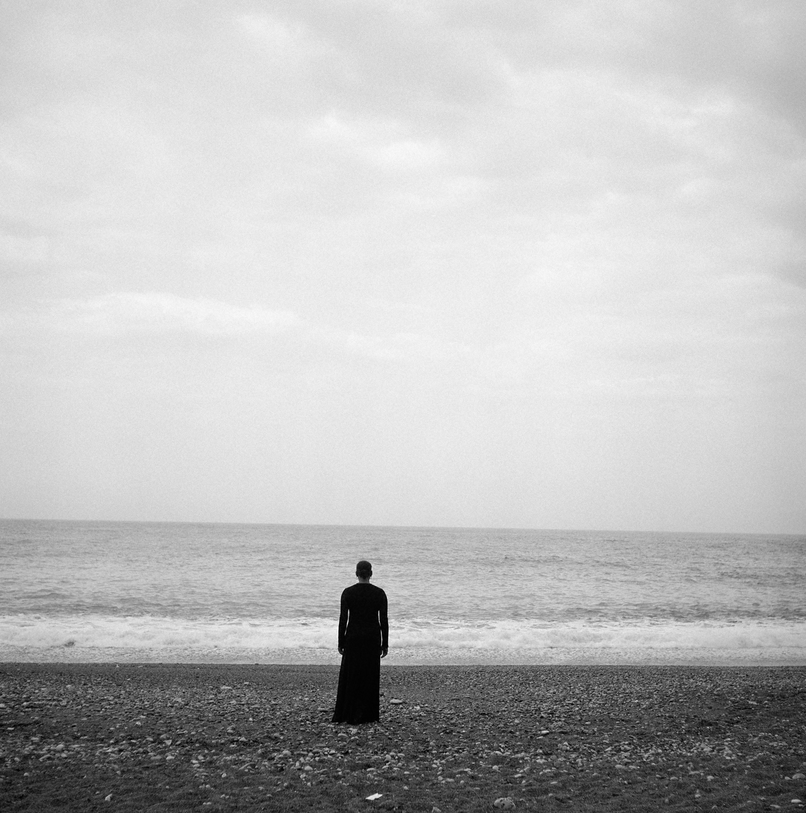

Slide 26
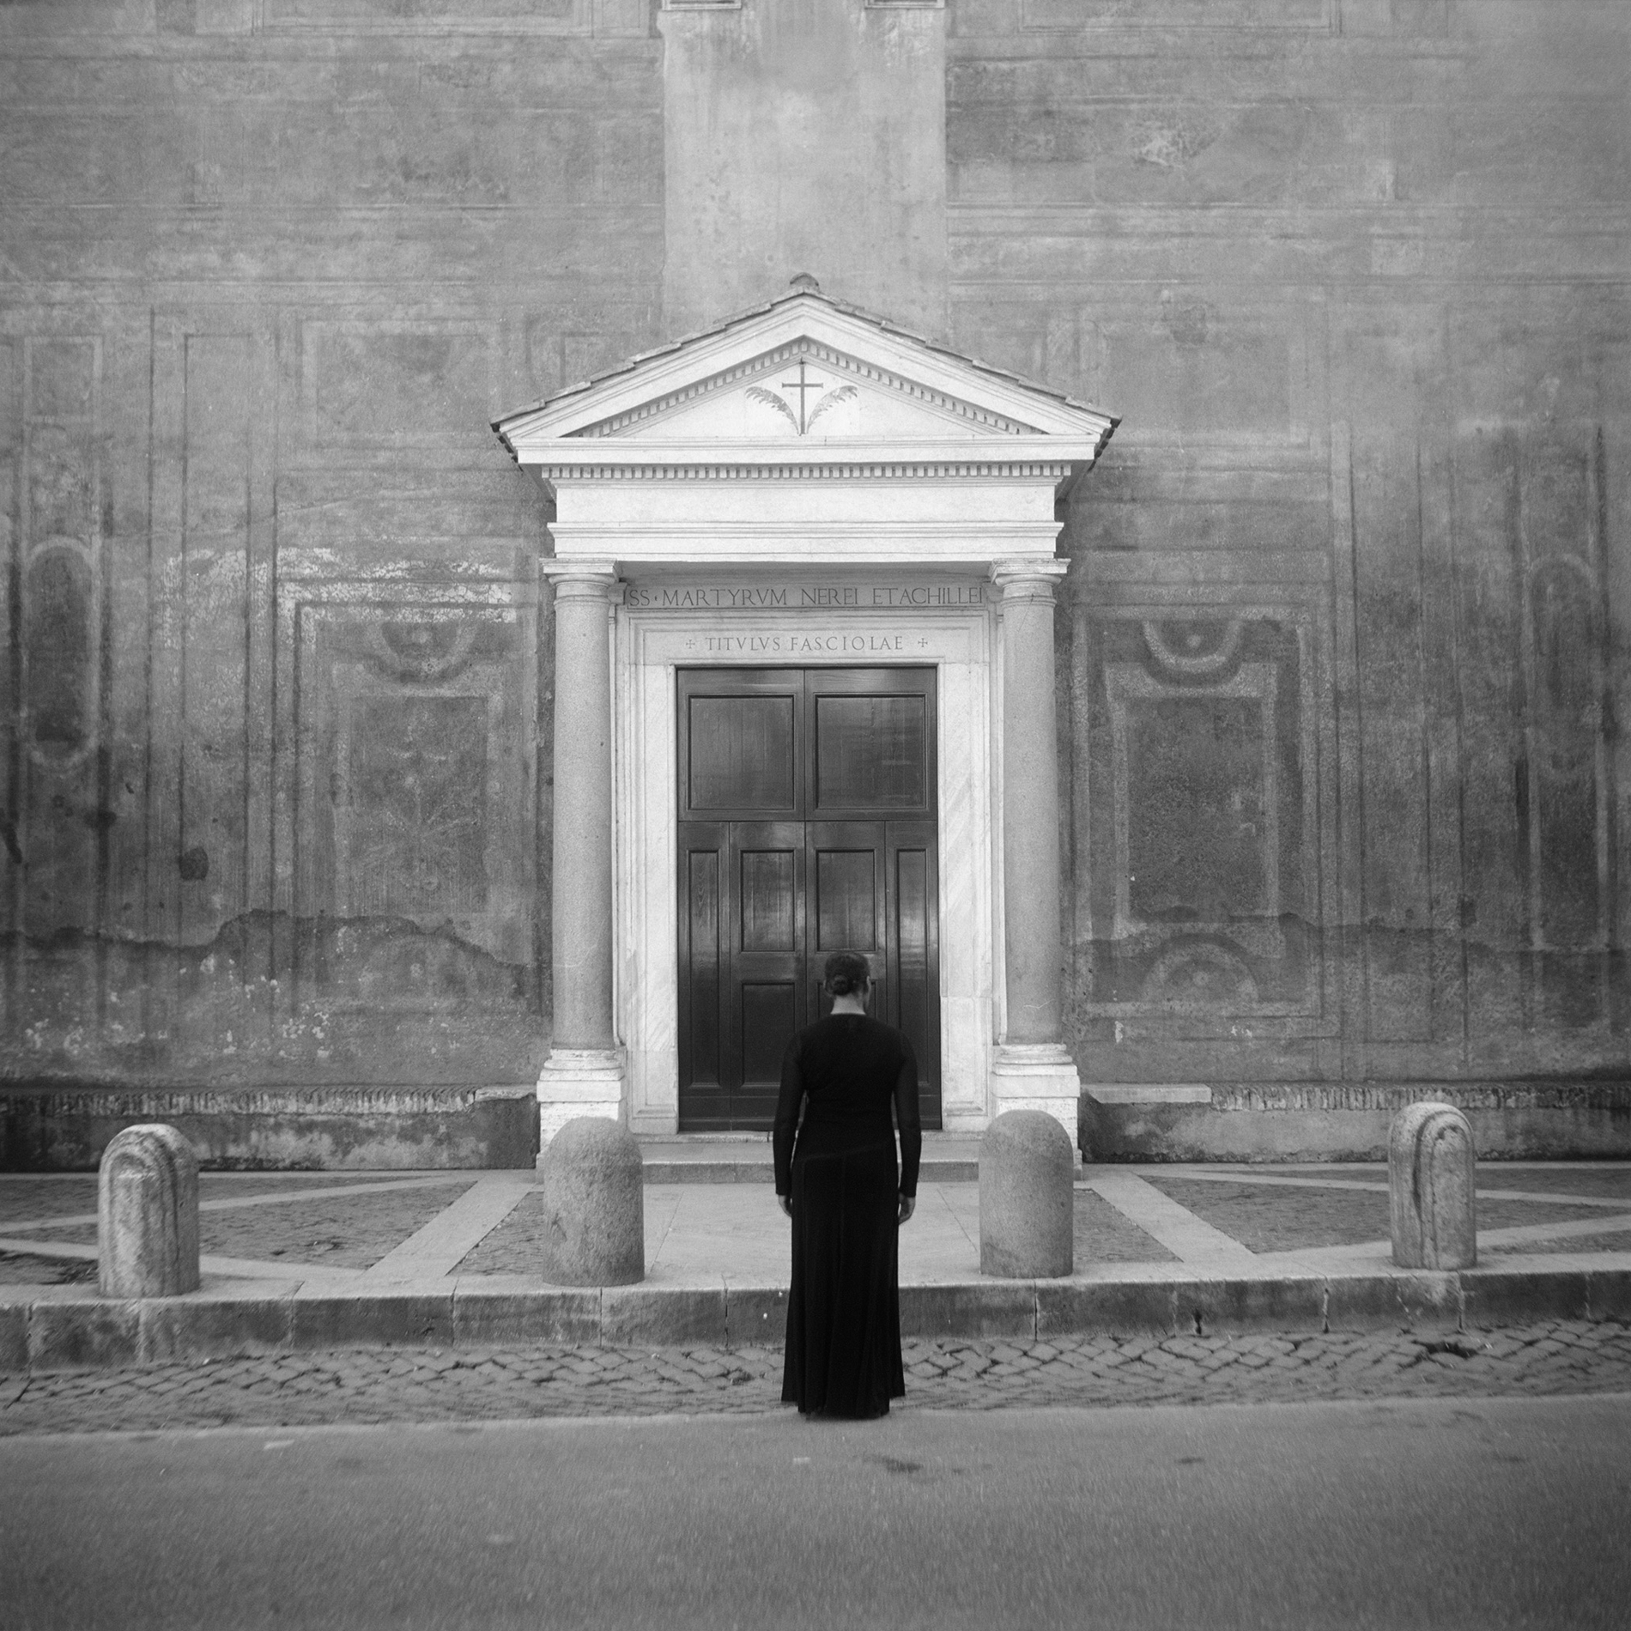

Slide 27
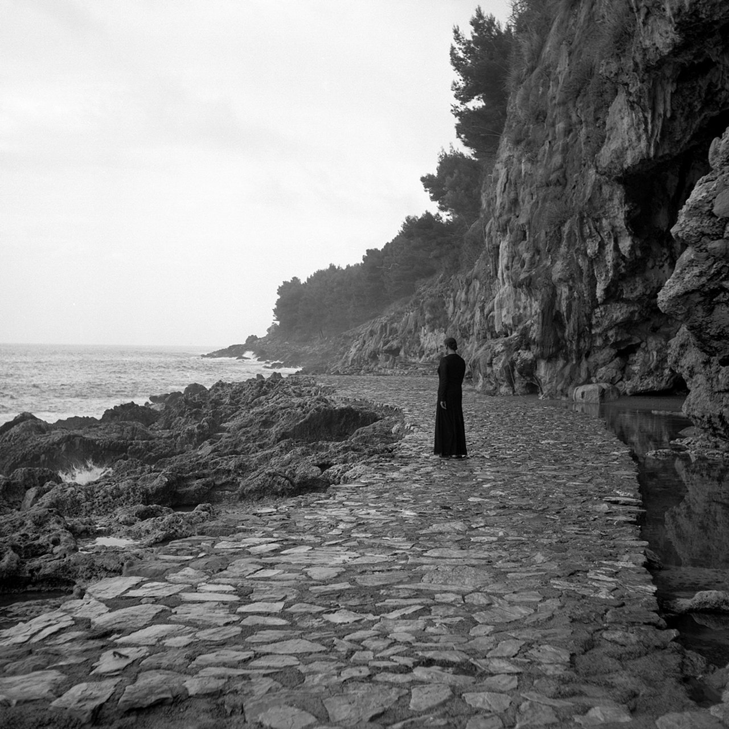

Slide 28
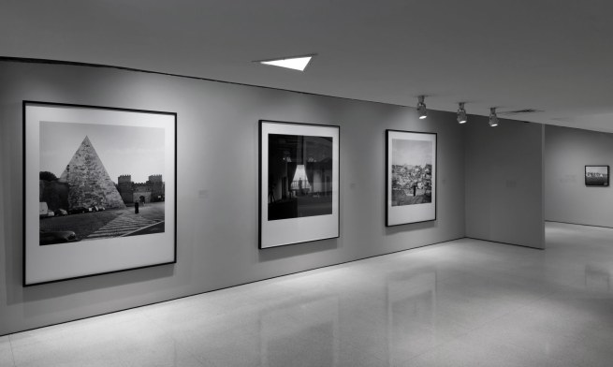

Slide 29
Blue Notes (2014–2015)
“Weems overlays images of celebrities (Basquiat, Lennear) with blocks of color. Signaling the influence of minimalists Mark Rothko and Ellsworth Kelly, Blue Notes offer a portal for projecting desire and sensual expression, while acknowledging the shaded, vital dimensions of race.”

