Slide 1
James Presley Ball
1825-1904, born in Virginia, died in Hawaii.
Prominent African-American abolitionist, entrepreneur, and daguerreotypist.
Worked primarily in Cincinnati, Ohio where he opened at least two successful studios. Also lived and opened studios in Mississippi, Louisiana, Missouri, Minnesota, and Montana.
Photographed: Queen Victoria, Charles Dickens, Frederick Douglass, and Jenny Lind amongst other famous individuals.
Had tremendous influence on American culture by recording the images of children, blacks, whites, Chinese, and the poor as well as the privileged.
When James Presley Ball moved to Richmond, Va., in 1846, an observer wrote: ''The Virginians rushed in crowds to his room; all classes, white and black, bound and free sought to have their lineaments stamped by the artist who painted with the Sun's rays.''

Slide 3
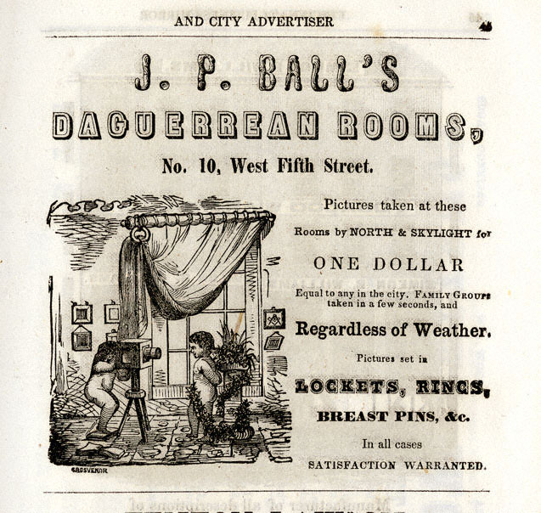

Slide 4
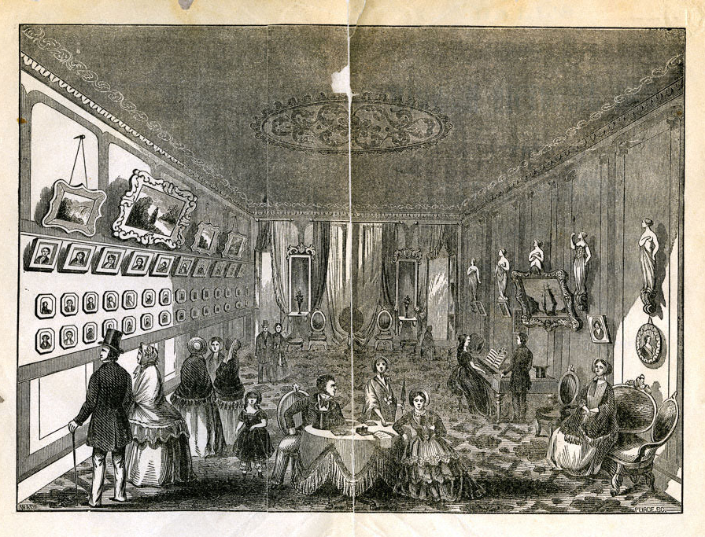
This drawing of James Presley Ball's “Great Daguerrean Gallery of the West,” at 28 W. Fourth St. Cincinnati, OH. 1854

Slide 5
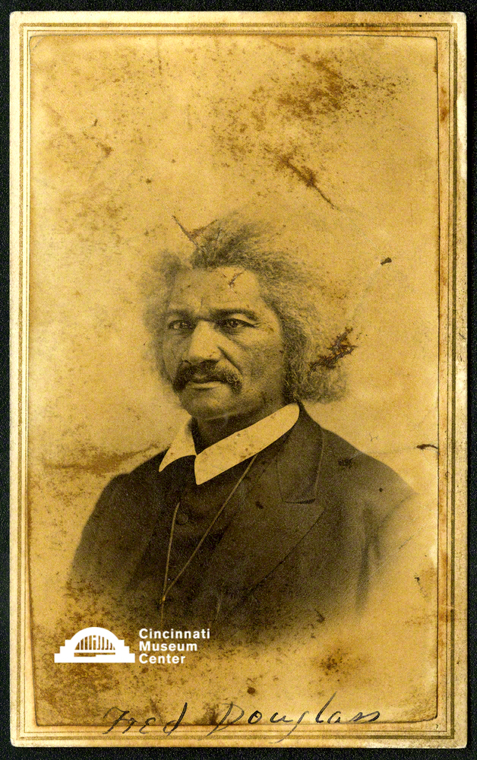
Frederick Douglas
(ca. 1867)

Slide 6
US Sen. Lee Mantle
(ca. 1895)

Slide 7
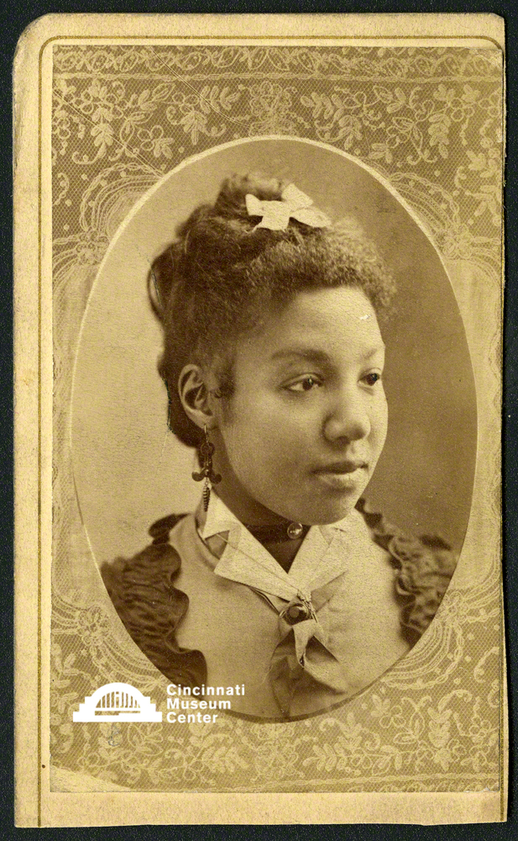
Miss Mattie Allen
(ca. 1874-1877)

Slide 8
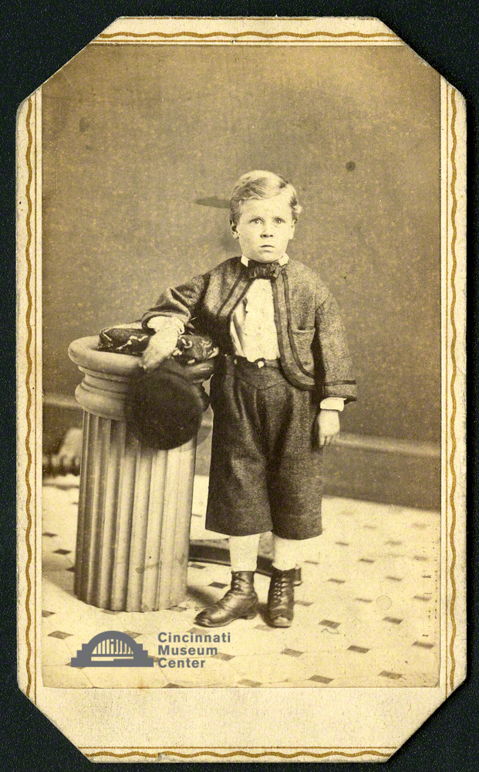
Alfred Berton Meader
(ca. 1864)

Slide 9
Portrait of a Mulatto Woman
(ca. 1850)

Slide 10
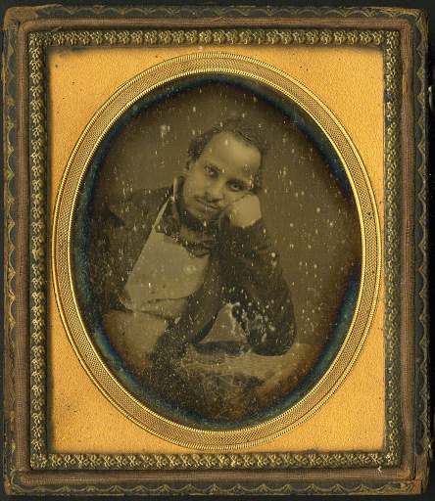
Alexander Thomas
(ca.1851 – 1859)

Slide 11
Unidentified boy
(James Polk?)
(ca. 1874-1877)

Slide 12
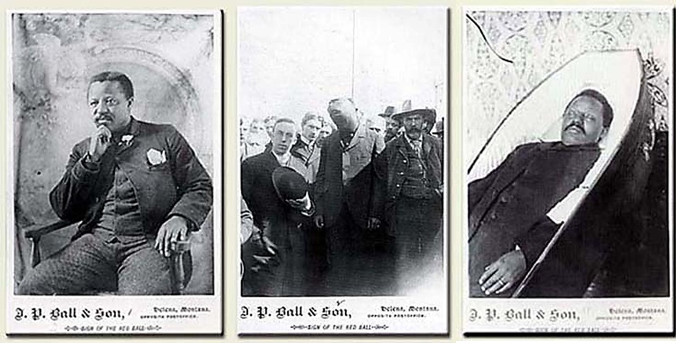
William Biggerstaff (ca. 1895) Prominent Montana businessman; killed a man in an altercation, found guilty, and hung. Biggerstaff readily admitted guilt, had a fair and impartial trial, and accepted punishment. While one might think this series is critical of racial biased it is more likely that Ball used this to show equal treatment of all Montanians regardless of race. He created similar series of the execution of at least two white men confirming equal justice.

Slide 13
Portrait of Three Girls
(ca. 1893)

Slide 14
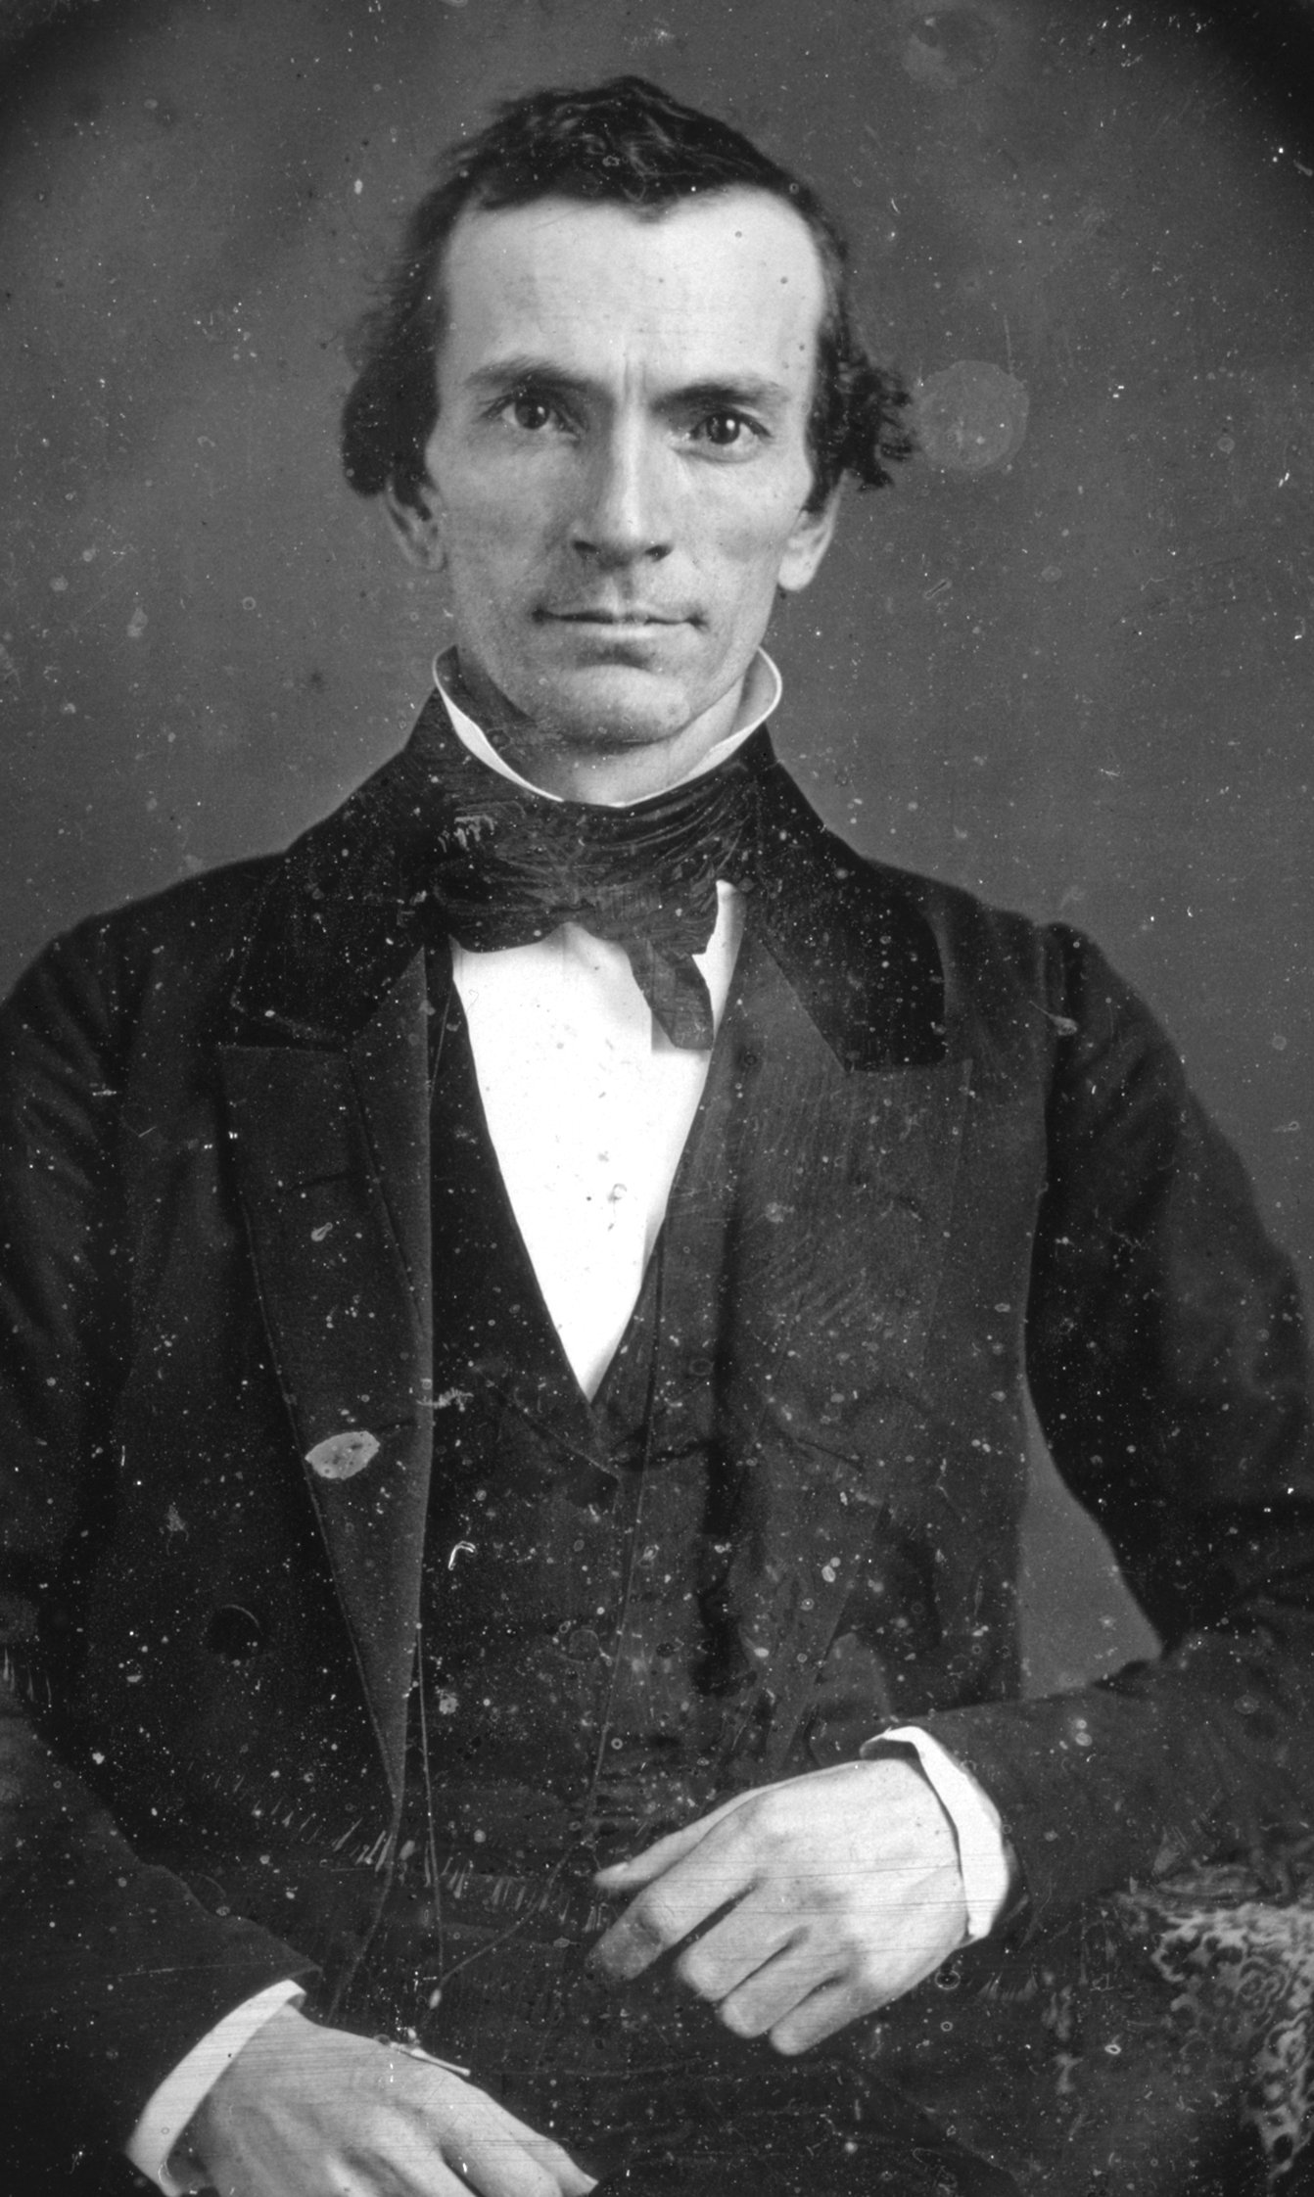
Oliver Cowdery
(ca. 1840)

Slide 15
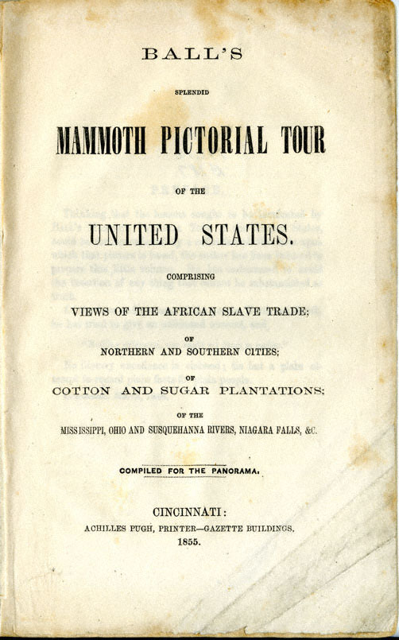
In 1855, Ball, along with a team of African American artists, embarked on a large panorama titled Mammoth Pictorial Tour of the United States Comprising Views of the African Slave Trade; of Northern and Southern Cities; of Cotton and Sugar Plantations; of the Mississippi, Ohio and Susquehanna Rivers, Niagara Falls & C.
The mural consisted of 2,400-square-yards of canvas. Ball wrote an accompanying pamphlet detailing "the horrors of slavery from capture in Africa through middle passage to bondage." The panorama, first exhibited in Cincinnati at the Ohio Mechanic's Institute, was also shown in Boston.

