Slide 1
Ceramic Basics

Slide 2
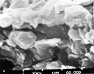
What is Clay?
Clay is a fine-grained natural rock or soil material that combines one or more clay minerals with traces of metal oxides and organic matter.

Slide 3
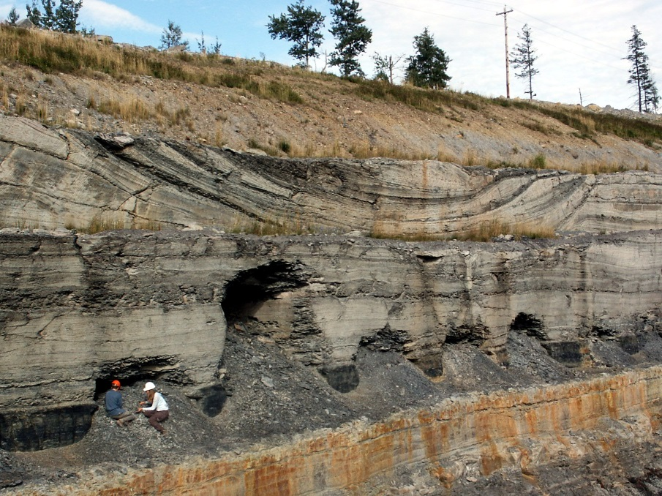
How is it Made?
Clay is made through natural processes of erosion and weathering of rocks. Different clays come from the erosion of different types of rocks.

Slide 4
Why is Clay Unique?
Unlike mud or sand clay is unique in its physical properties. Clay is malleable (which means you can squish and squeeze it into a shape and it will retain that shape) because of it’s ability to retain water. In ceramics we call this property of clay “plastic.”
When clay is subjected to heat it undergoes a physical/chemical change that hardens the clay into “ceramic,” when clay has become hardened by heat we call it “fired.”
This ability of clay to be plastic when wet and be hardened by fire is one of the unique aspects of clay.

Slide 5
Types of Clays
There are many scientific categories for clay ( kaolinite, montmorillonite-smectite, illite ) but for our purposes there are fewer and more broad categories:
-Earthenware
-Stoneware
-Porcelain

Slide 6
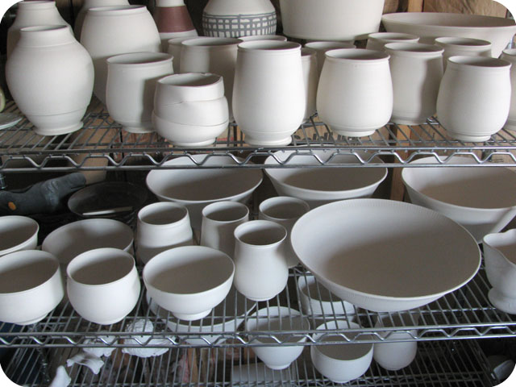
States of Clay
Clay has a few different stages it goes through before it becomes a final finished piece of ceramics. It is critical that the stages be followed in the correct order:
-Greenware
-green (wet)
-leatherhard
-bone-dry
-Bisqueware (first firing)
-Glazeware (second firing)

Slide 7
States of Clay
Bisqueware:
-fired to a lower temp then final firing, less brittle then greenware, porous
Glazeware:
-fired to top cone temp, vitrified, most dense, non porous, glassy colored coating. Glaze colors come from chemical reactions not pigments.
Green/Red – copper
Blue – cobalt
Yellow – rutile
Red/Black – iron oxide
Glaze can be applied by brushing, dipping, spraying
“When applying glaze you’re either puttin’ it on or takin’ it off”

Slide 8
Cone Temps
In ceramic work it is critical that clay be fired to the correct temperature in a kiln. Those temperatures are dependent on the clay body and/or the glaze. Close attention needs to be paid to the clay bodies cone and the glaze cone. Firing at the wrong temp (too high or too low) will cause the ceramic piece to fail.
Cone temps are divided into 3 main categories:
-Low fire (cone 04-05)
-Mid range (cone 6)
-High fire (cone 9-10)

Slide 9
Cone Chart

Slide 10
Cone Temps
Clay wants to be fired to its top cone temp which will make it “vitrified” and therefore most dense and durable. Glaze wants to be fired to its top cone temp so that the chemicals in the glaze react appropriately.
Be aware of the cone temp of your clay (in this course we are using a cone 10 porcelain casting slip).
You can fire clay to a lower temp but NEVER a higher temp then it is designed for.
Glazes need to be fired to their given cone temp.

Slide 11
Our Course
Cone 10 Porcelain Slip:
-bisque fire to cone 04-05
-can use any glaze
-PAY ATTENTION TO THE CONE TEMP OF GLAZE USED!
-Glaze fire to the correct cone temp for that glaze
-DO NOT GLAZE BOTTOM
-Ware that is ready for firing has to be put on correct rack. DOUBLE CHECK TO AVOID DISASTER!

