Slide 1
What in the
Rocinante
Is 3D Printing?

Slide 2
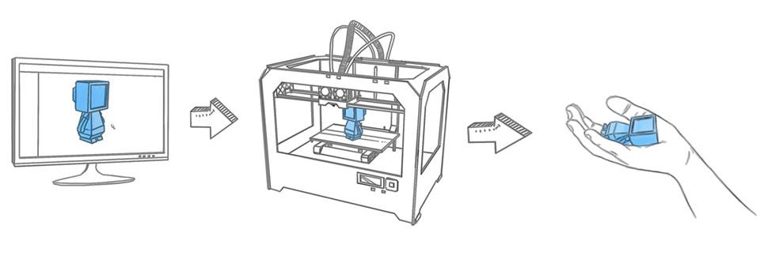
-3D printing is an additive manufacturing process that creates 3 dimensional objects from 3 dimensional digital information.
-3 dimensional digital models are “sliced” into many 2 dimensional cross-sections that are then “printed” one on top of the other.
-There are other 3D printers that are a subtractive manufacturing process (CNC, milling) but these are usually considered a separate group and are often referred to as “machining.”

Slide 3
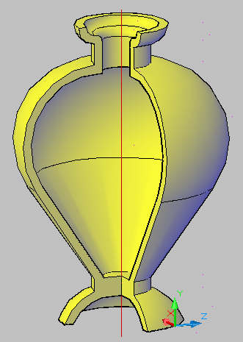
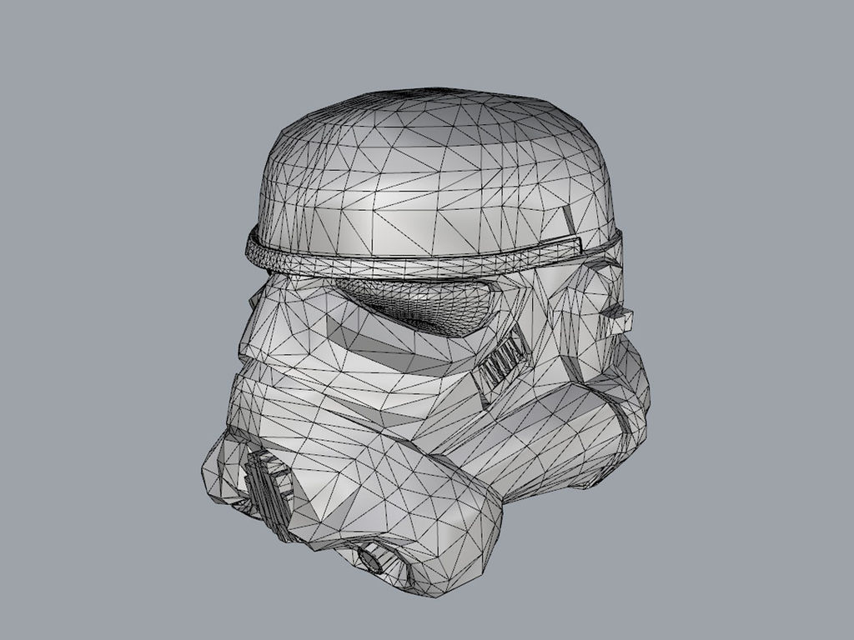
First you start with a 3D model; you can model it in 3D software, scan an object with a 3D scanner, or download an already made file.

Slide 4
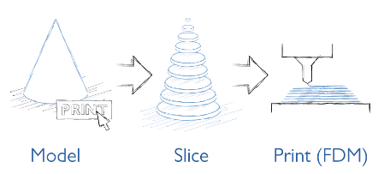
Then 3D printing software “slices” the model into many 3D cross-sections.

Slide 5
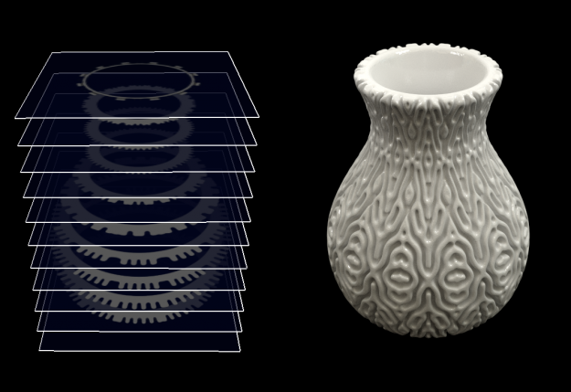

Slide 6
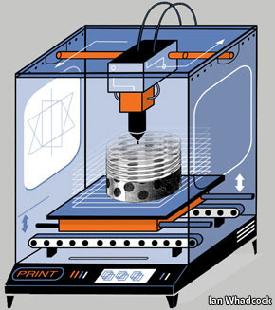
Once the 3D model is sliced the data is sent to a 3D printer which recreates the object one layer at a time, stacking consecutive layers atop one another.
3D printers move along 3 axis – X,Y, and Z
X- left to right
Y- back and forth
Z – up and down
This is a FDM printer

Slide 7
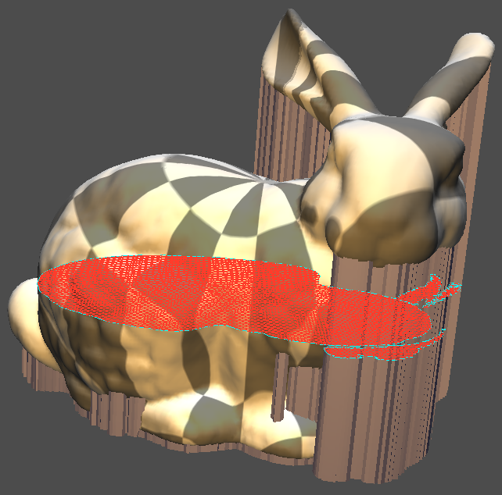

Slide 8
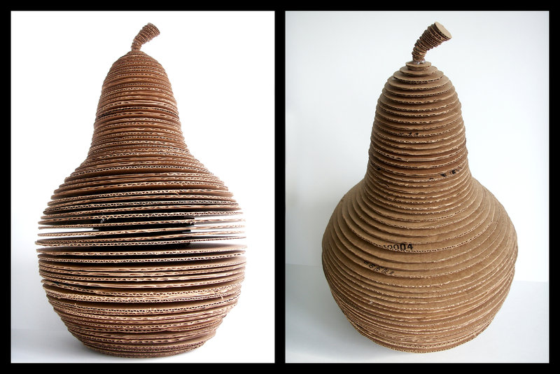

Slide 9
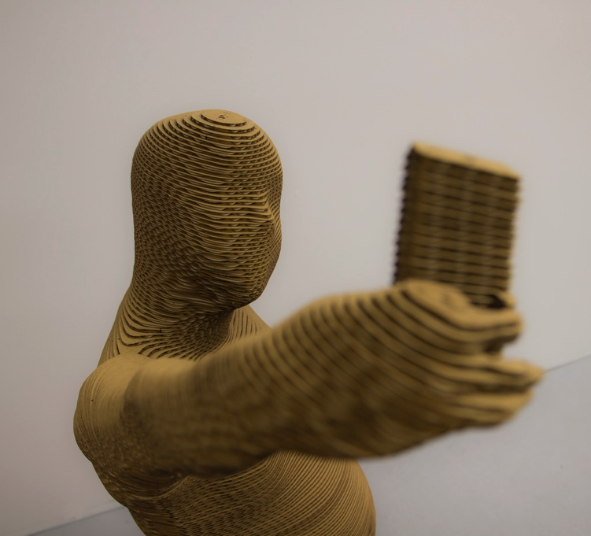
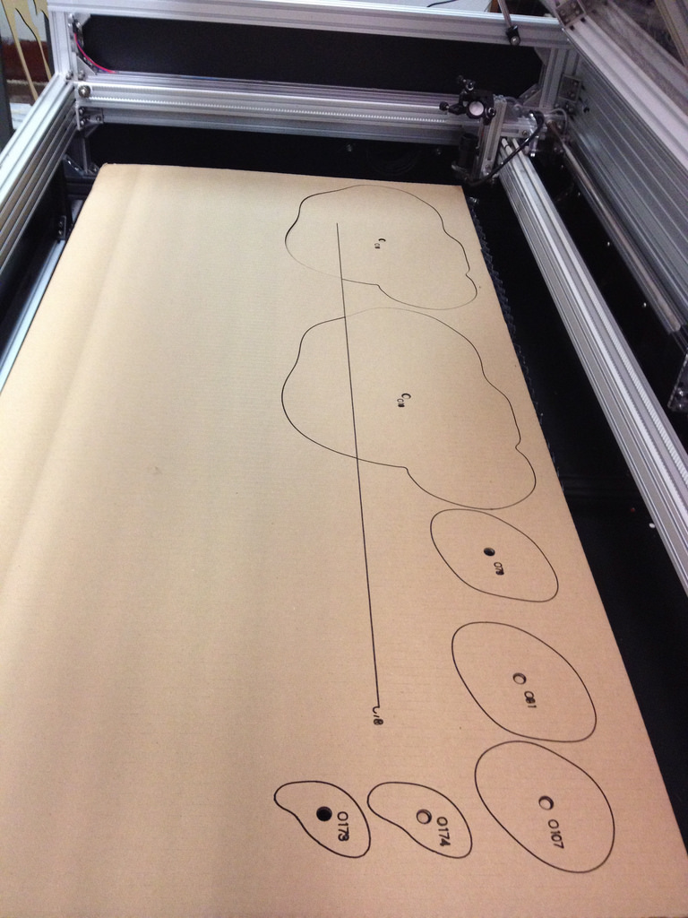
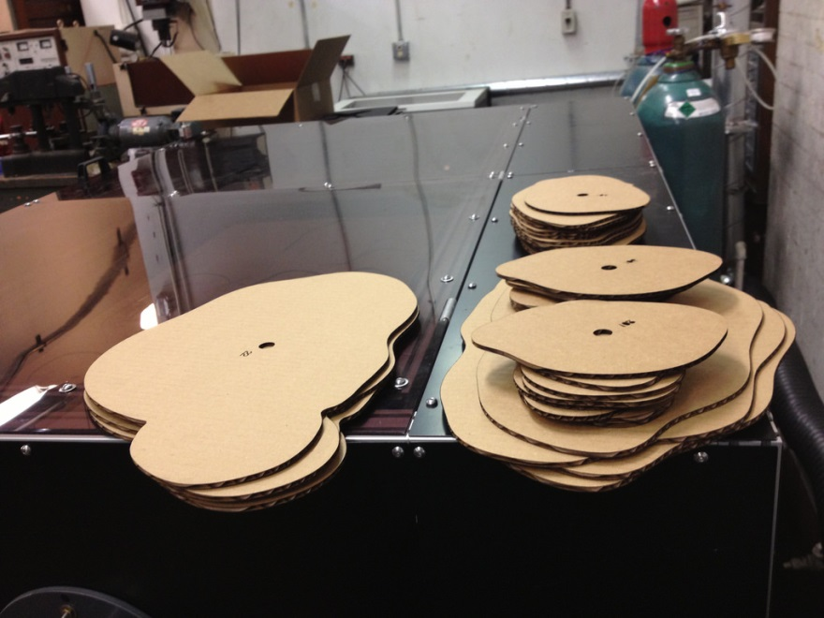

Slide 10
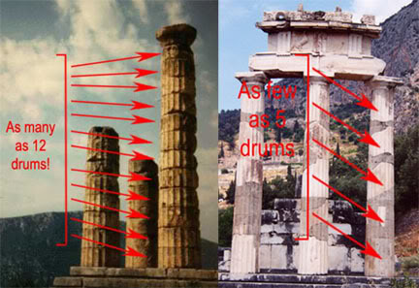
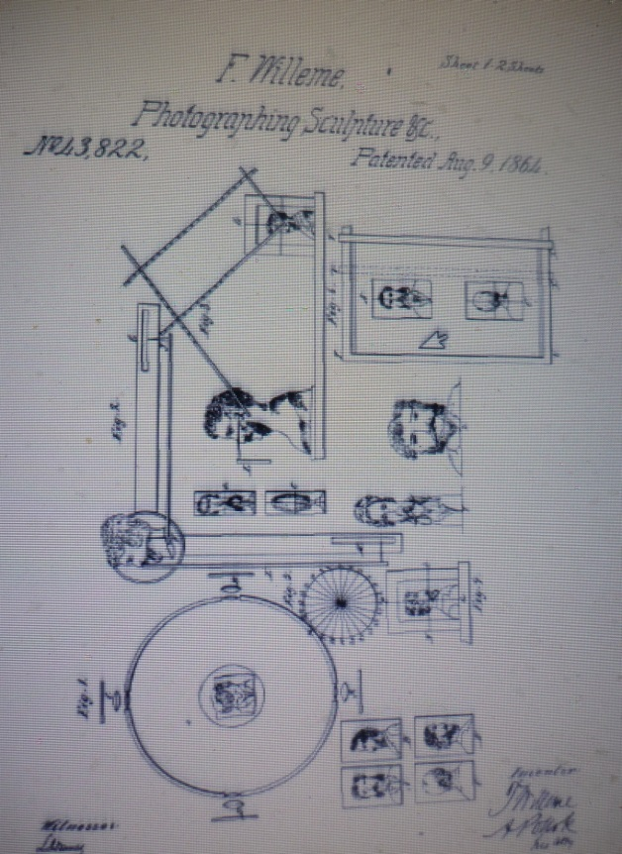
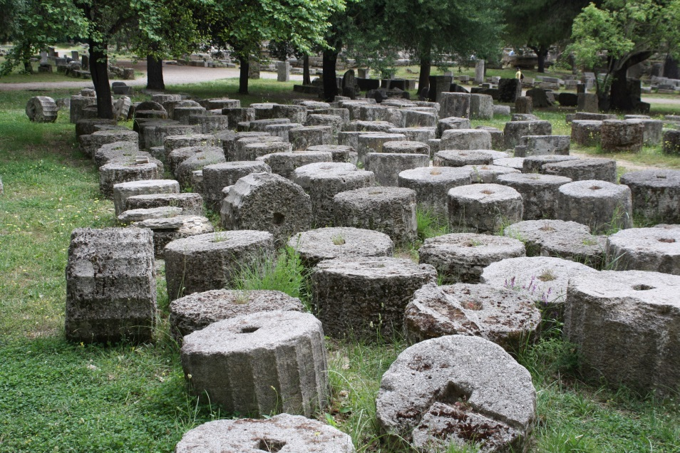
Where did this come from? When was it invented?
The “idea” of 3D printing has existed for centuries, millennia maybe. If you look at how ancient Greeks built columns or look at François Willème 1806s work on “Photosculpture” you can see the beginnings of the idea.

Slide 11
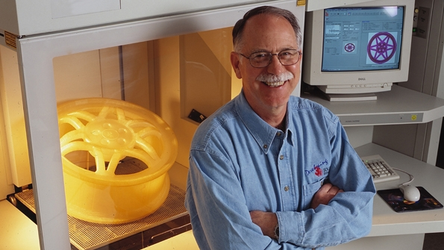
Our Origin Story - Heroes
1981 - Hideo Kodama of Nagoya Municipal Industrial Research Institute in Japan was first to publish paper outlining a working 3D printer.
3D printing or “rapid prototyping” is used in manufacturing to create models and prototypes quickly. Although tradition manufacturing processes, like injection molding, are cheaper per unit they are expensive and time consuming to setup (tooling) and so a quick alternative was needed.
1984 – Charles “Chuck” Hull of 3D Systems develops first prototype 3D printer. He called it stereolithography and developed the STL file format widely used today.

Slide 12
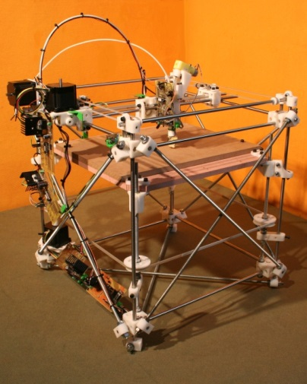
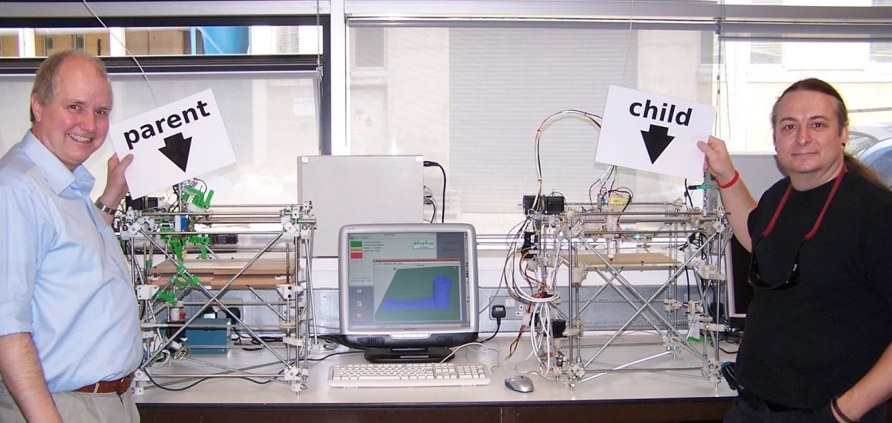
Why am I hearing so much about this now?
RepRap Project: Adrian Bowyer
2005 - A collaborative challenge to create a self-replicating machine!
Help Us Neo!
Using 3D printed parts, other commonly found components, and open source GNU software licensing it allowed individual users to drive innovation.
Up until this point 3D printing was very expensive and, for the most part, available only to the mfg industry.
Beside the RepRap what else made it more available?
-cheaper tech
-patent expiration
-open source

Slide 13
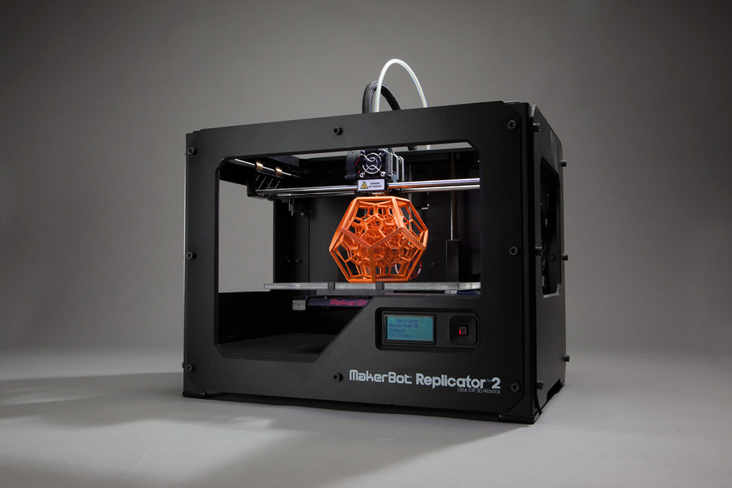
2009 -Yeah Makerbot!!! 3D Printers for Everyone!!
Building on knowledge gained from the RepRap Project.

Slide 14
Variations of 3D Printing Technology:
SLA – Stereolithography
-UV light used to “cure” (harden) photosensitive resins or “photopolymers.”
FDM, FFF, PJP – Fused Deposition Modeling, Fused Filament Fabrication, Plastic Jet Printing
-Melted plastic filament pushed through a nozzle or “extruder.” Common plastics are ABS (acrylonitrile butadiene styrene, Legos) and PLA (polylactic acid, a bioplastic and the kind our Makerbot uses)
Powdered Bed – SLS or Selective Laser Sintering is most common
-A granular bed of materials are selectively fused together by a laser. Various materials; metal alloys, metal powders, thermoplastics, ceramic powders.

Slide 15
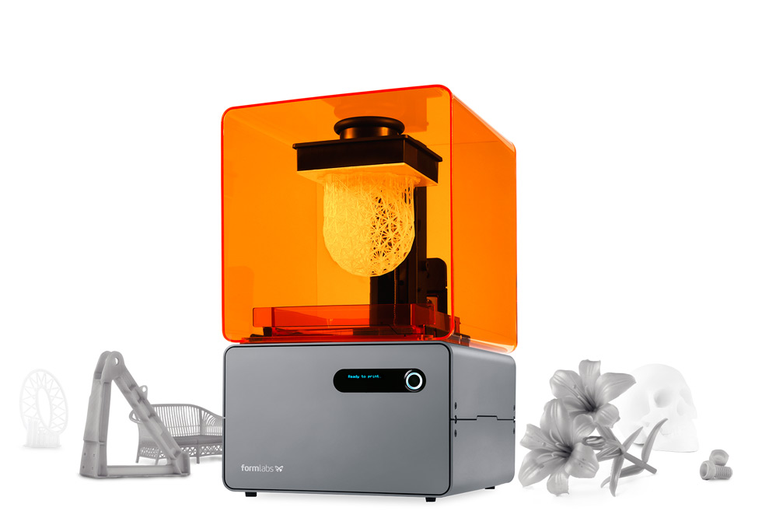
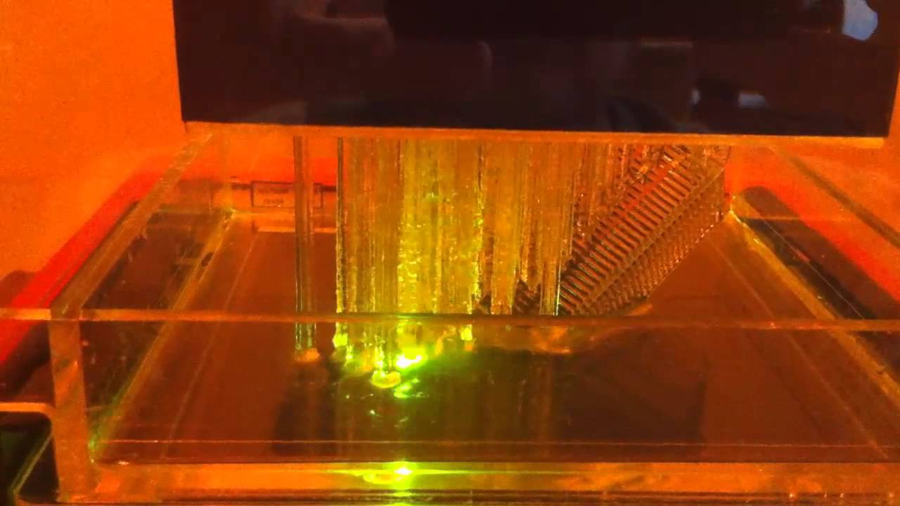
Stereolithography

Slide 16
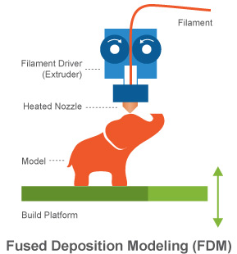
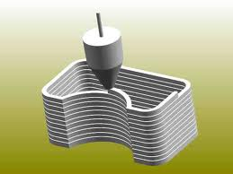
FDM

Slide 17
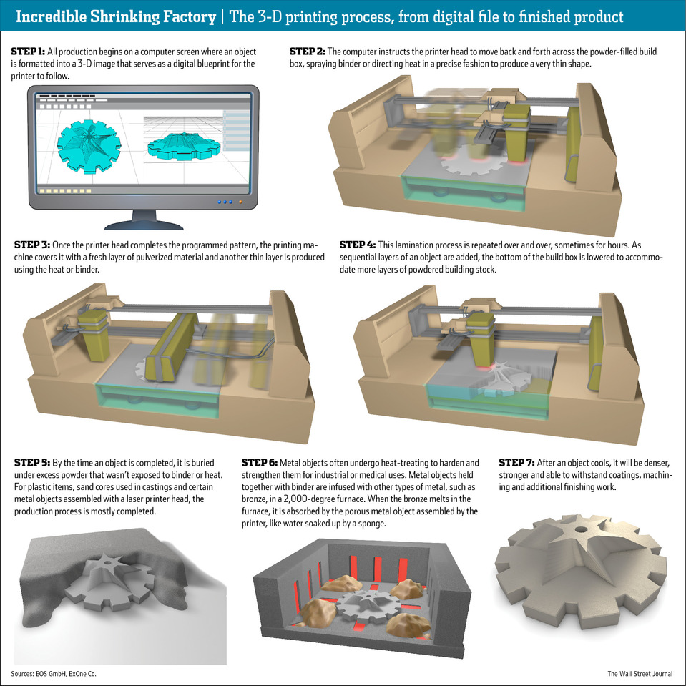
Powdered Bed

Slide 18
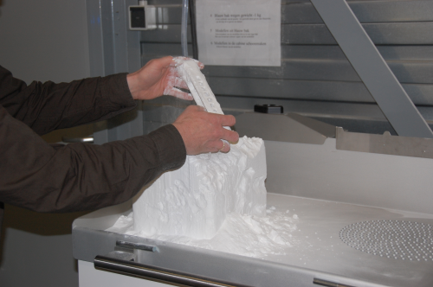

Slide 19
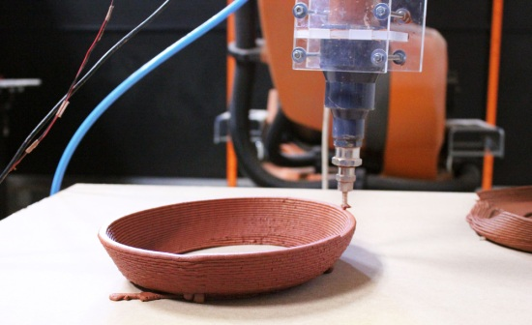

Slide 20
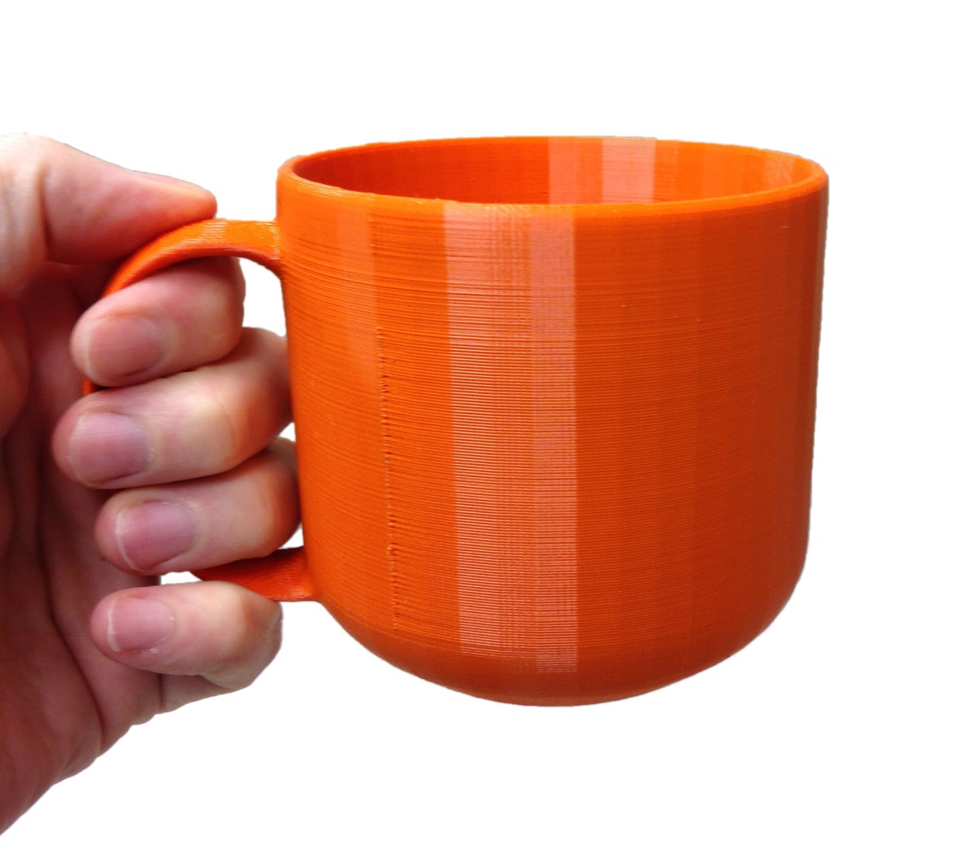

Slide 21
Creating 3D Models
CAD – Computer Aided Design
Solids vs. Meshes; modeling in solids is advantageous for 3D printing
since models will be manifold. All models are exported to meshes before
printing.
Solid Modelers:
-Auto CAD
-SolidWorks
-123D Design
-TinkerCAD
Mesh Modelers:
-Blender
-Rhyno
-Z Brush
Parametric Modelers: using a set of rules to define an object

Slide 22
Meshes: made up of points, vertices, and faces

Slide 23
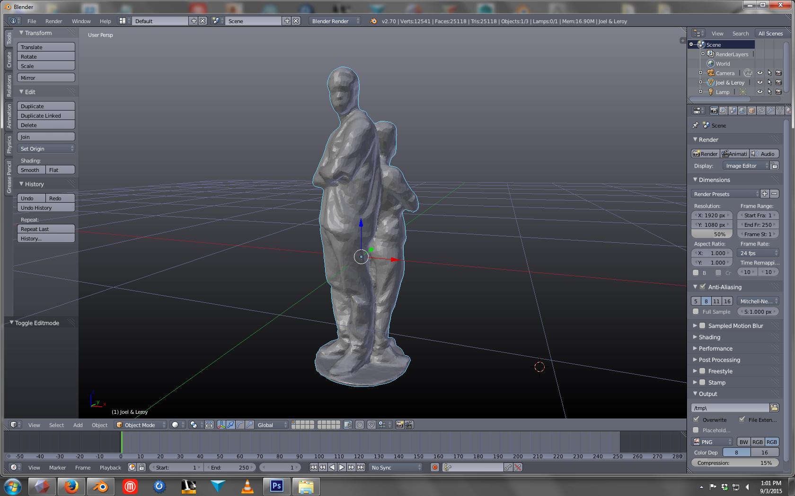

Slide 24
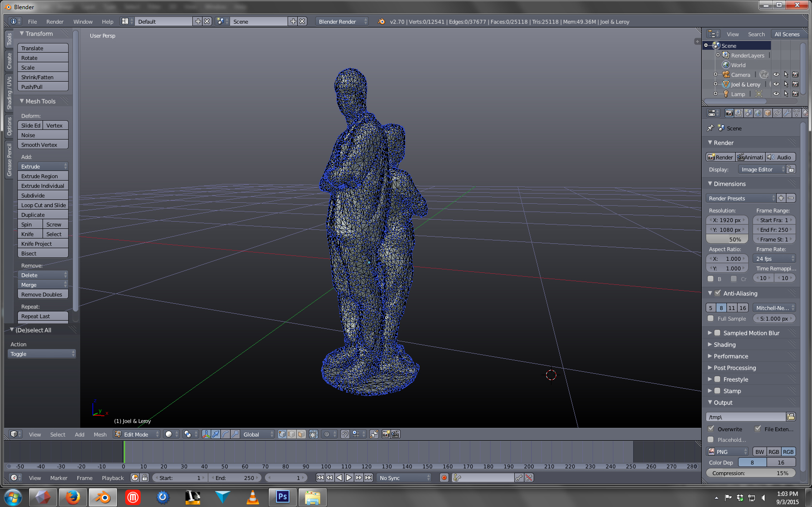

Slide 25
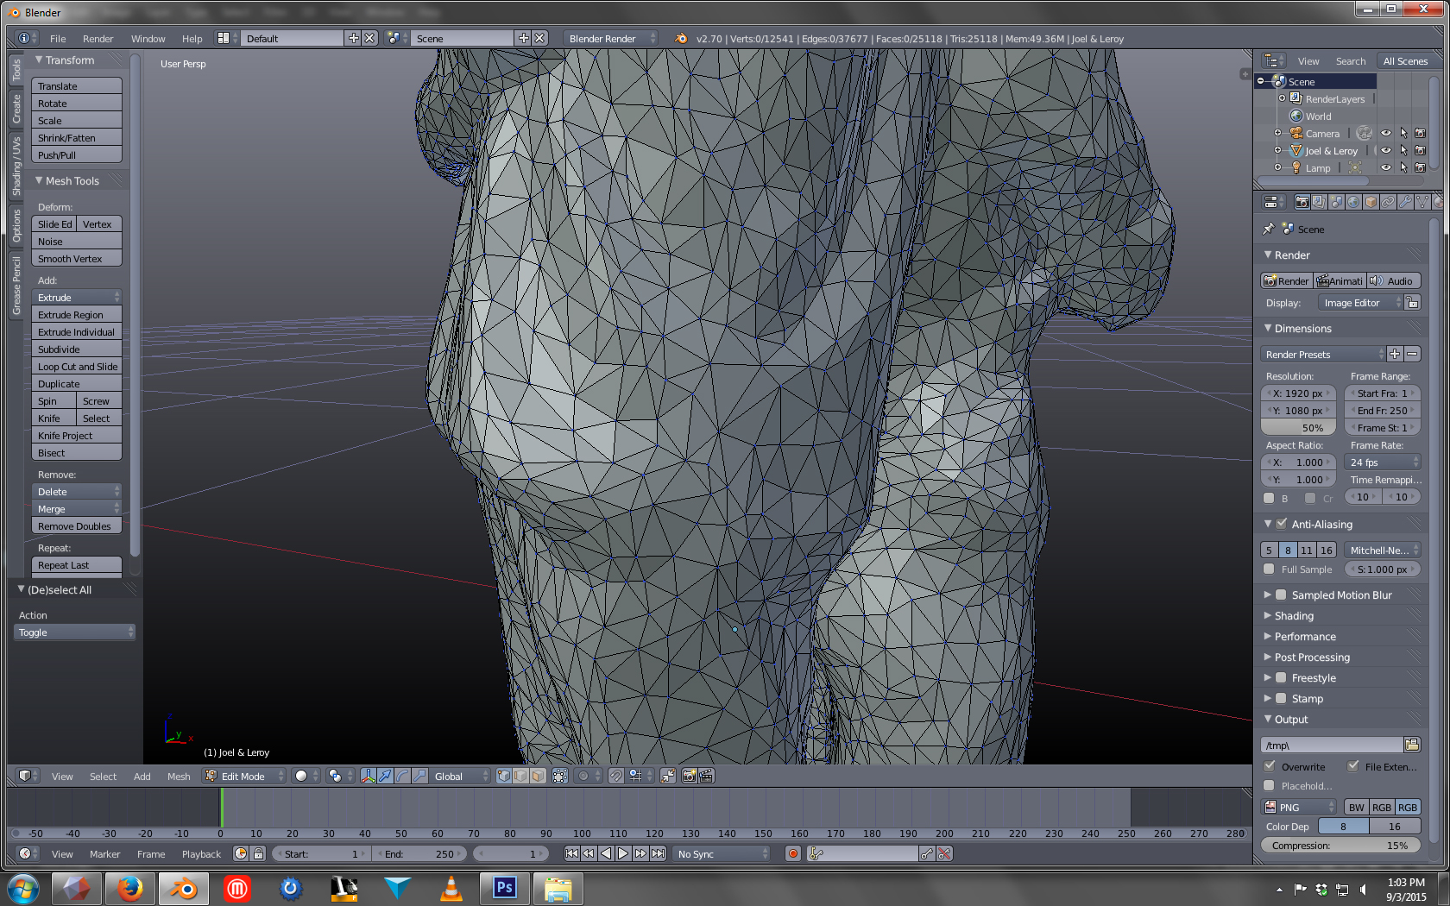

Slide 26
Preparing you files for 3D Printing
Files must be:
-STL or OBJ format
-Manifold (watertight, no holes)
Cannot have:
-Overhangs
-Loose Faces
-Inverted Normals
-Intersecting Geometry

Slide 27
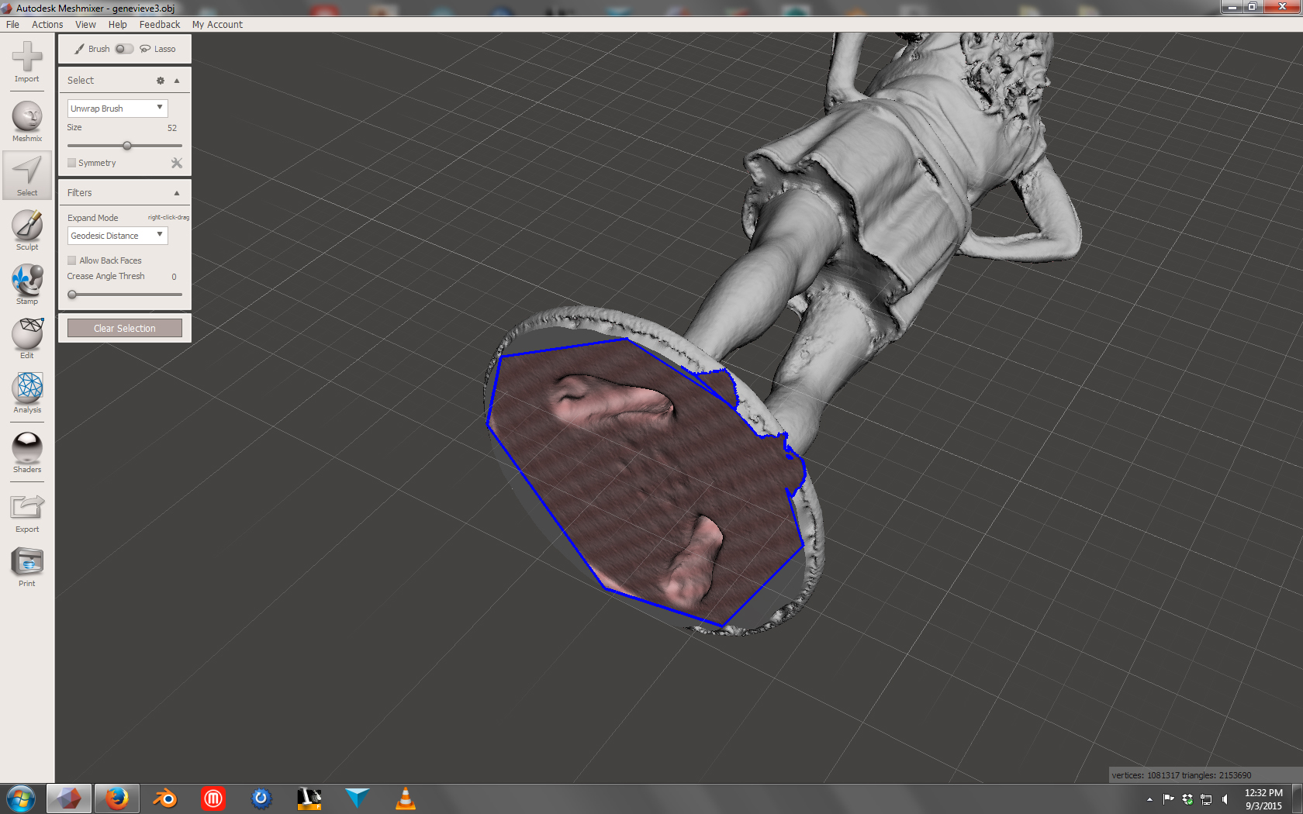
Manifold Models, aka Watertight aka Has No Holes

Slide 28
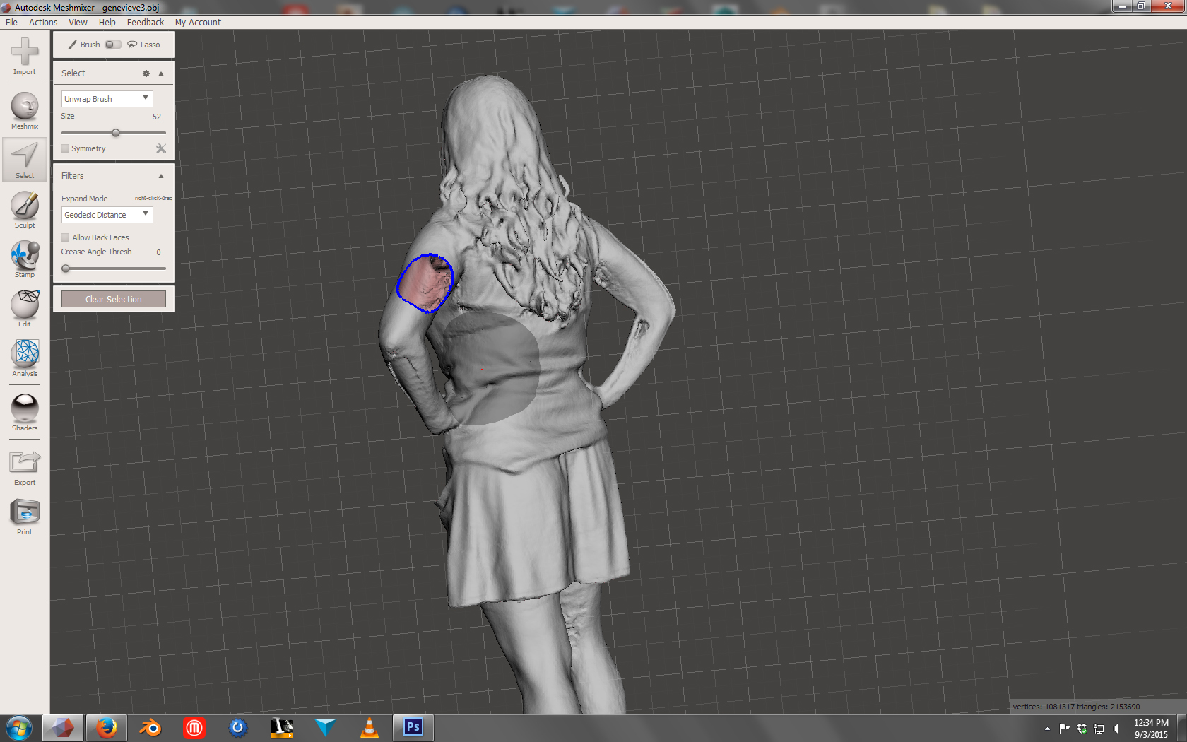

Slide 29
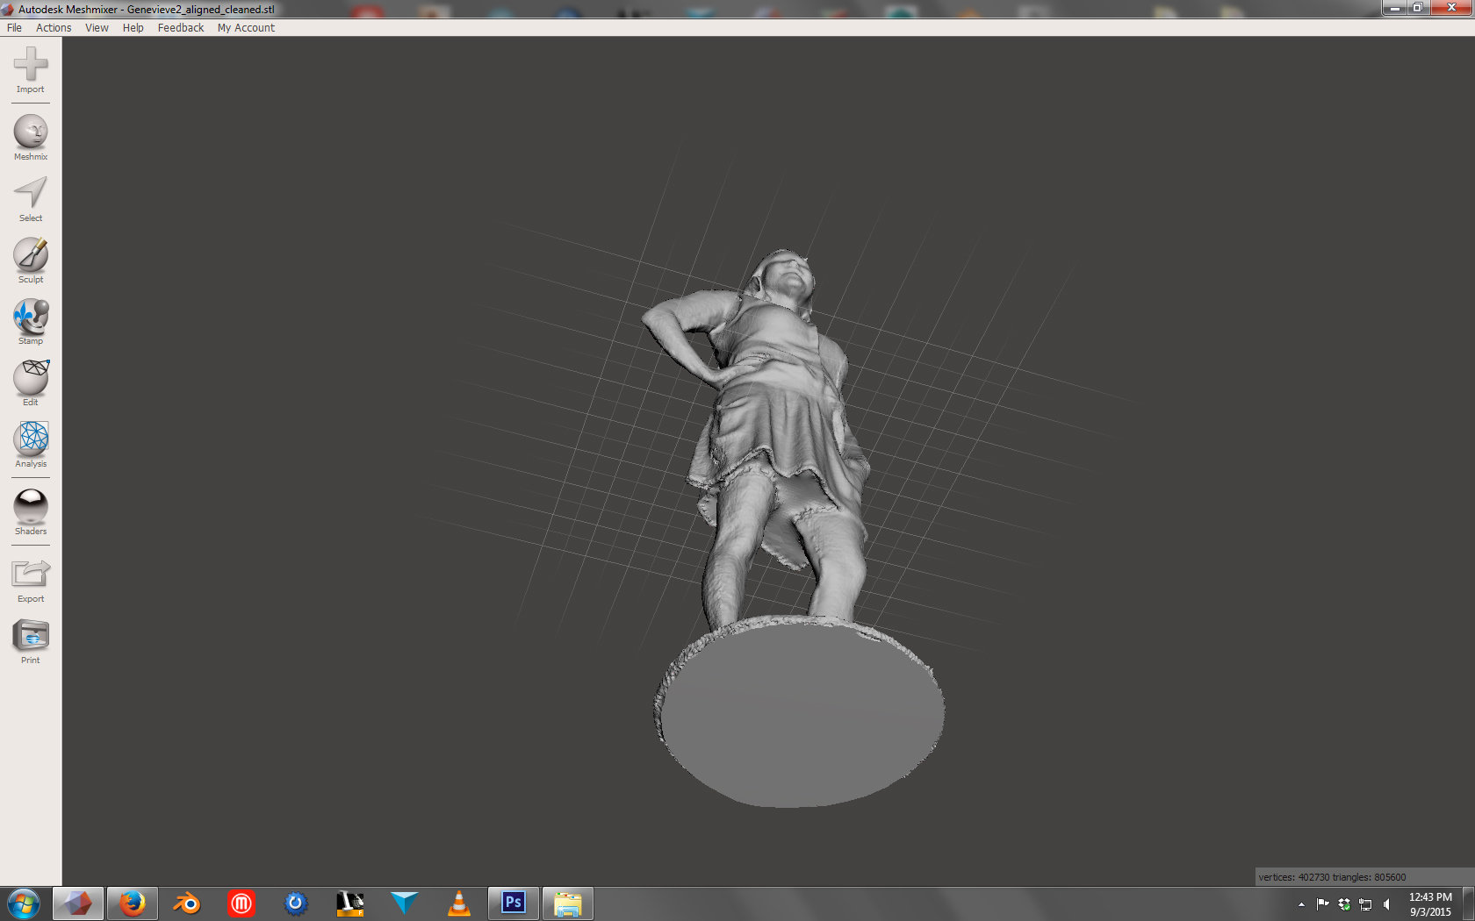

Slide 30
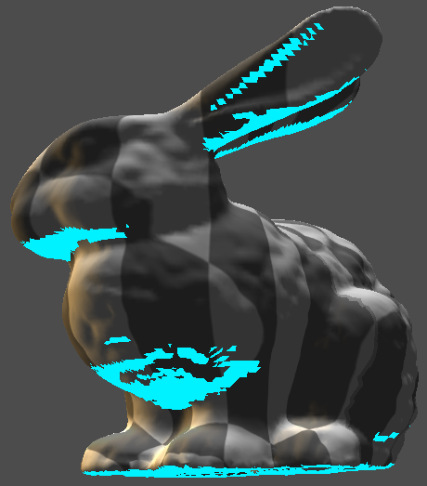
Overhangs & Supports

Slide 31
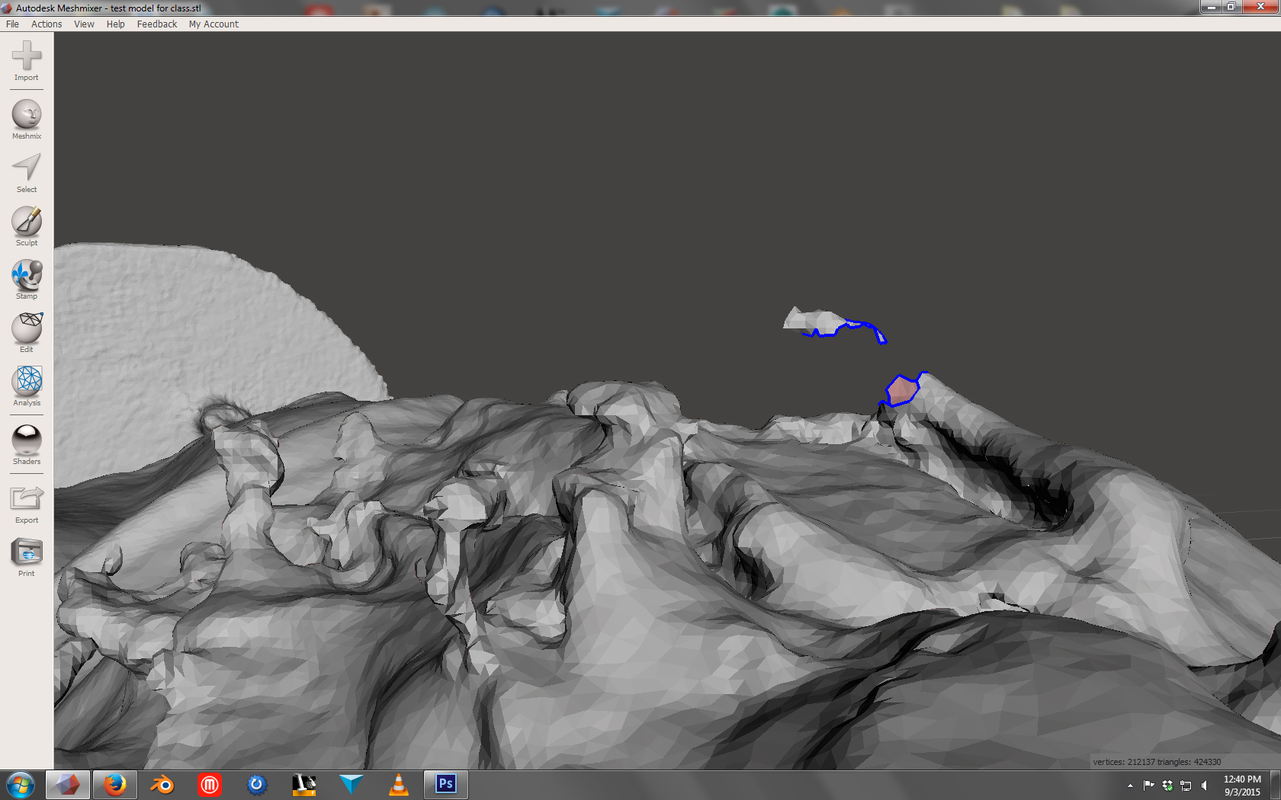
Loose Faces

Slide 32
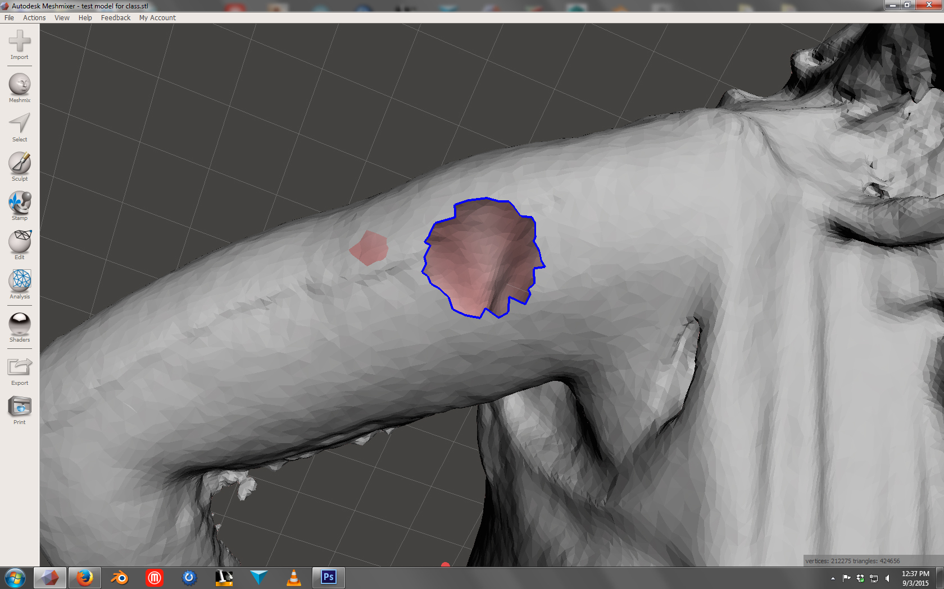
Inverted Normals

Slide 33
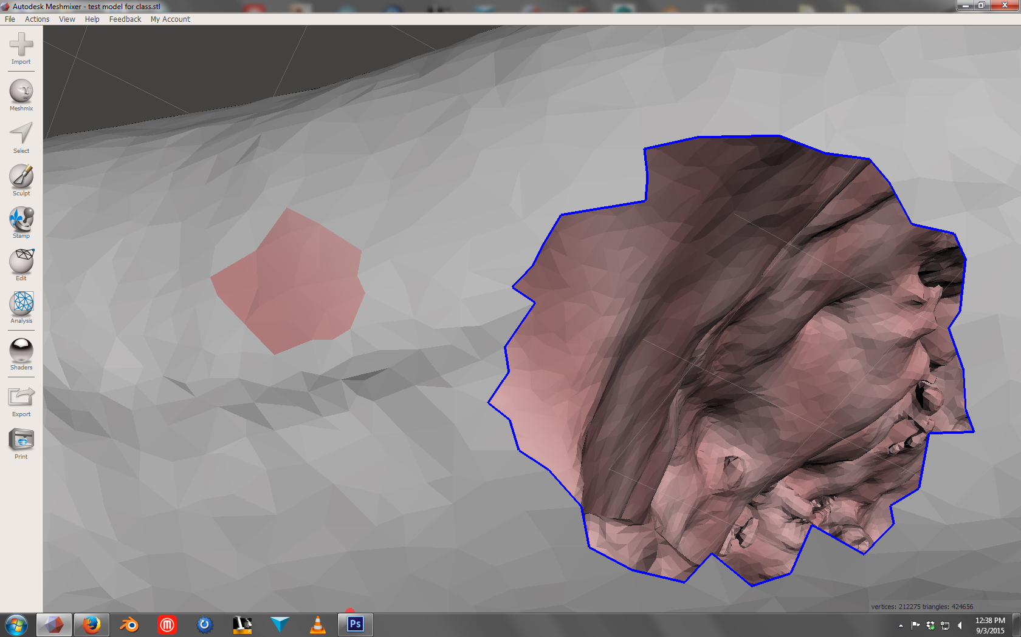

Slide 34
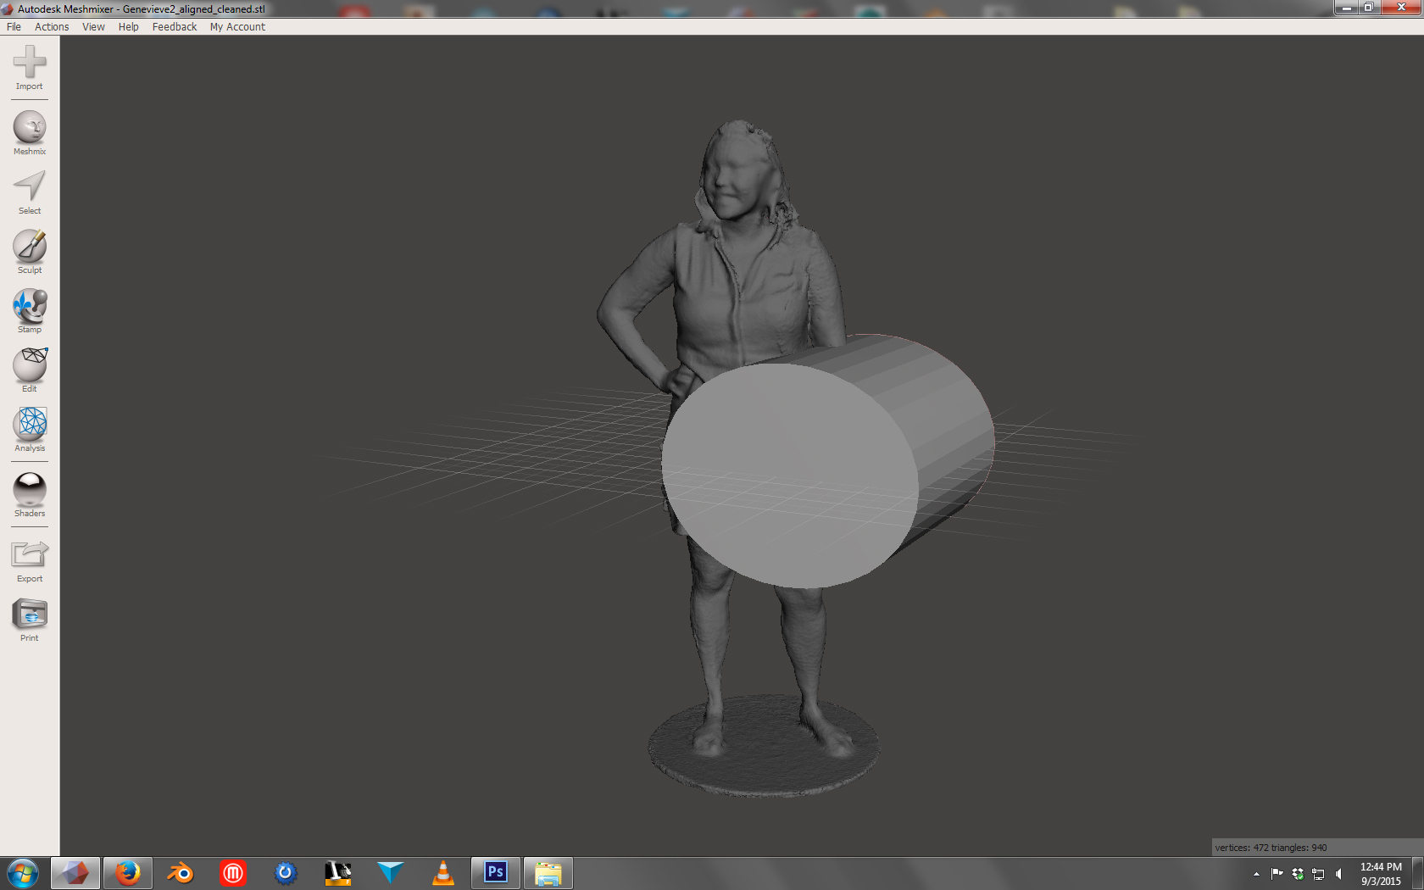
Intersecting Geometry

Slide 35
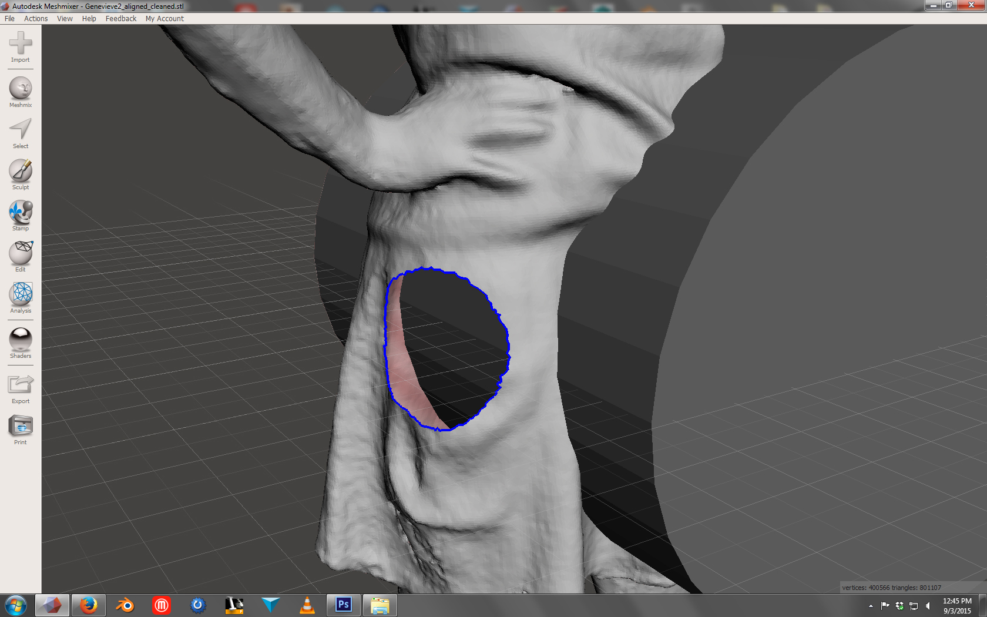

Slide 36
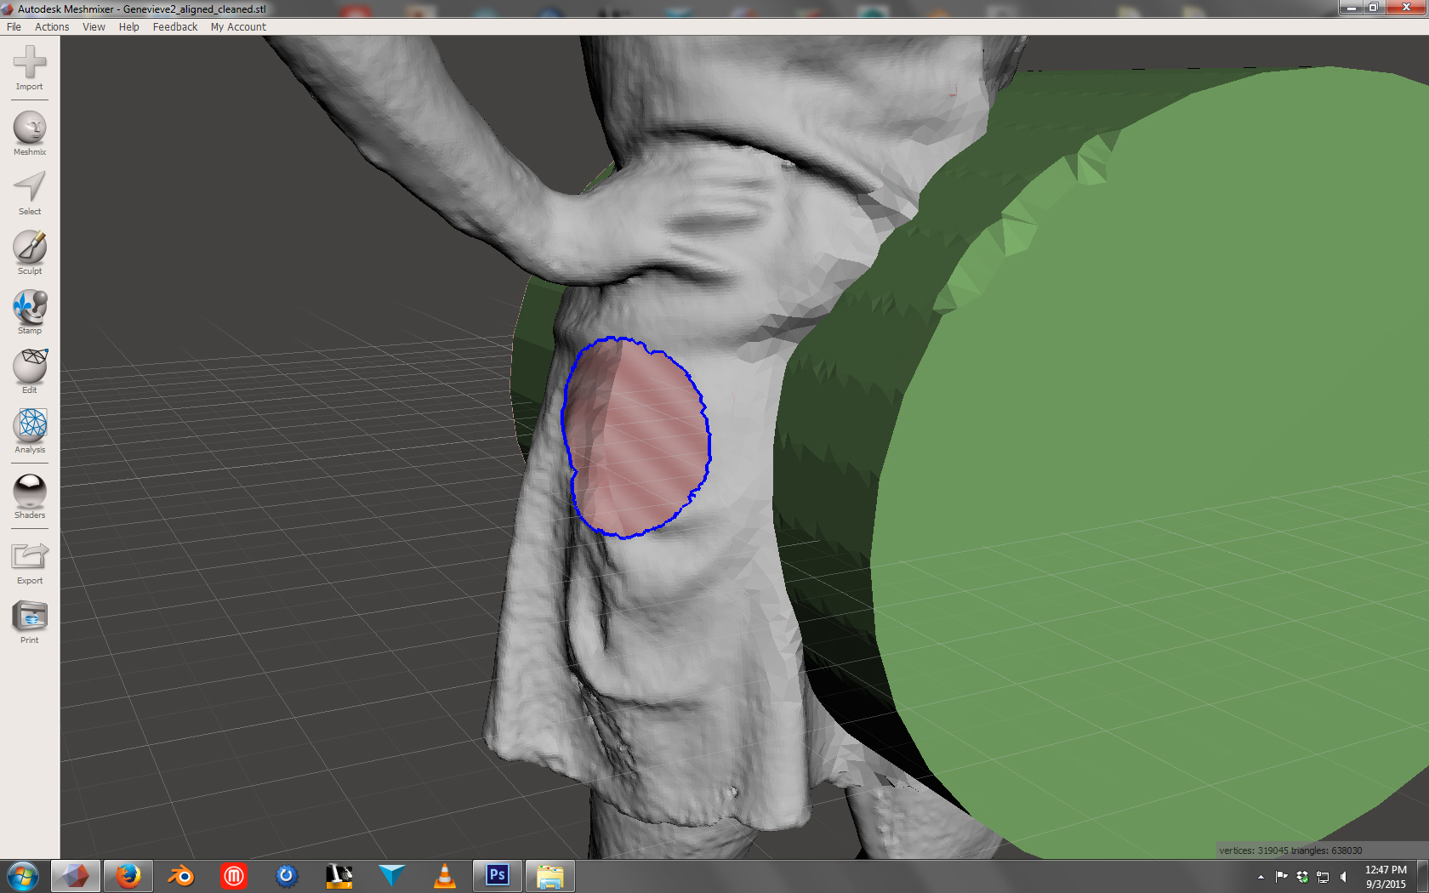
After “combining” the two separate meshes the model becomes one mesh

Slide 37
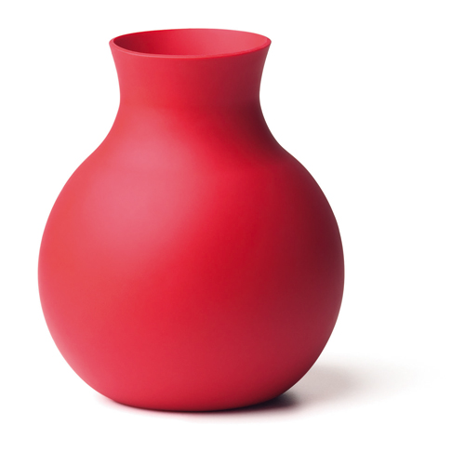
When modeling your cup and bowl remember:
One Part Mold – No Undercuts –
Flairs Out at Top
Two Part Mold – Has Undercuts

