Slide 1
Intermediate & Advanced Photography

Slide 2
It all starts with light… and ends with light

Slide 3
PHOTOGRAPHY begins with understanding the nature of light, how it reflects (and absorbs), and the ways we capture that reflected light.

Slide 4
17th Century Sketch of a Camera Obscura (from Latin, meaning “darkened room”)

Slide 5
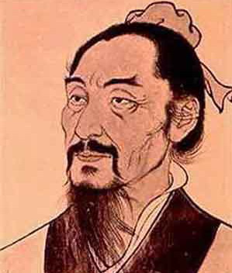
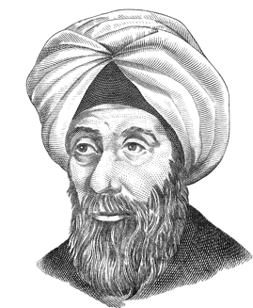
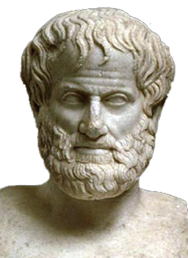
Camera Obscura from the Latin: “Dark Room”
Ibn al-Haytham knew it, clearly described it and actually made one (Arabia c1000 AD)
Mozi knew it first
(China c400 BC)
Aristotle knew it
(Greek c350 BC)

Slide 6
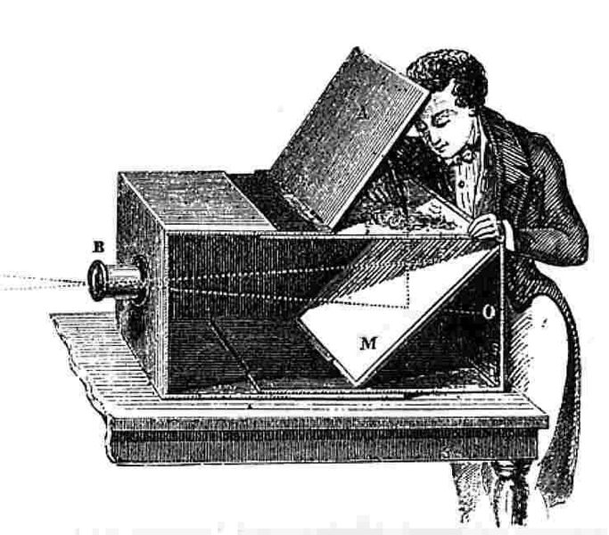
Camera Obscura circa 1750

Slide 7
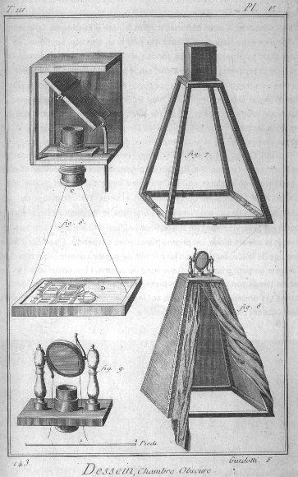
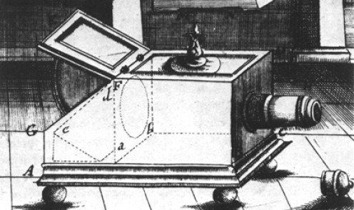
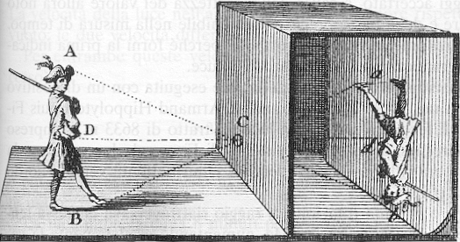
17^{th &} 18th Century Camera Obscuras

Slide 8
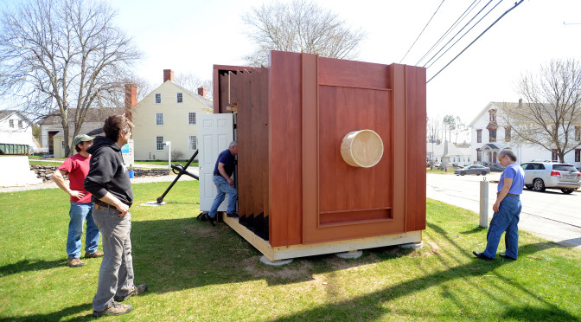
Room Size Camera Obscura

Slide 9
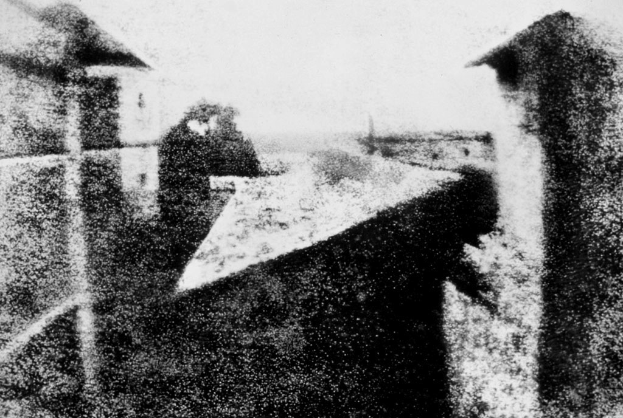
Thought to be first permanant photograph:
View from the Window at Le Gras (France)
By Joseph Nicéphore Niépce 1826

Slide 10
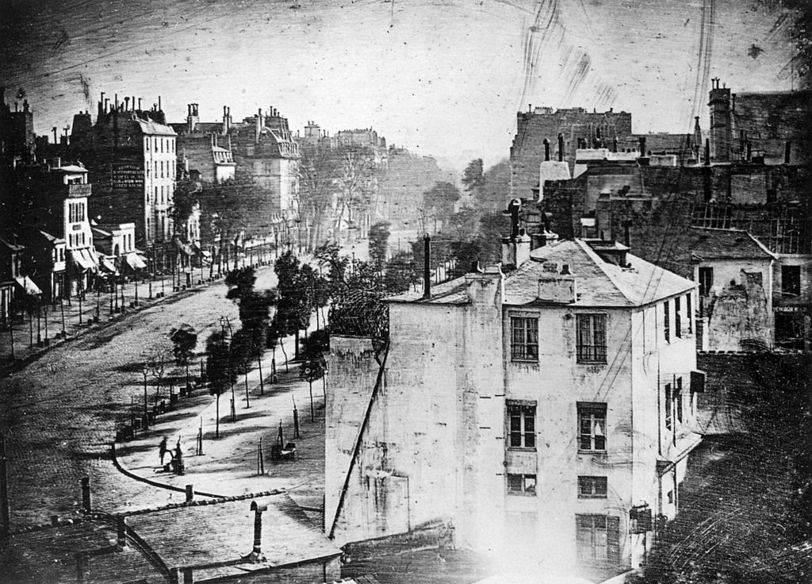
Boulevard du Temple, Paris
By Louis Daguerre in late 1838 or early 1839

Slide 11
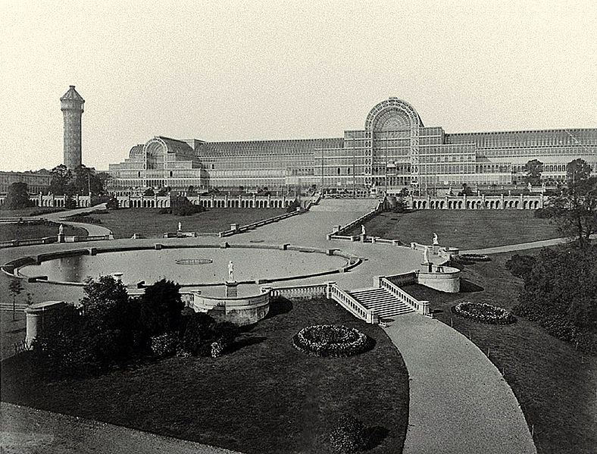
The Crystal Palace at The Great Exhibition, London
by Philip Henry Delamotte, 1854

Slide 12
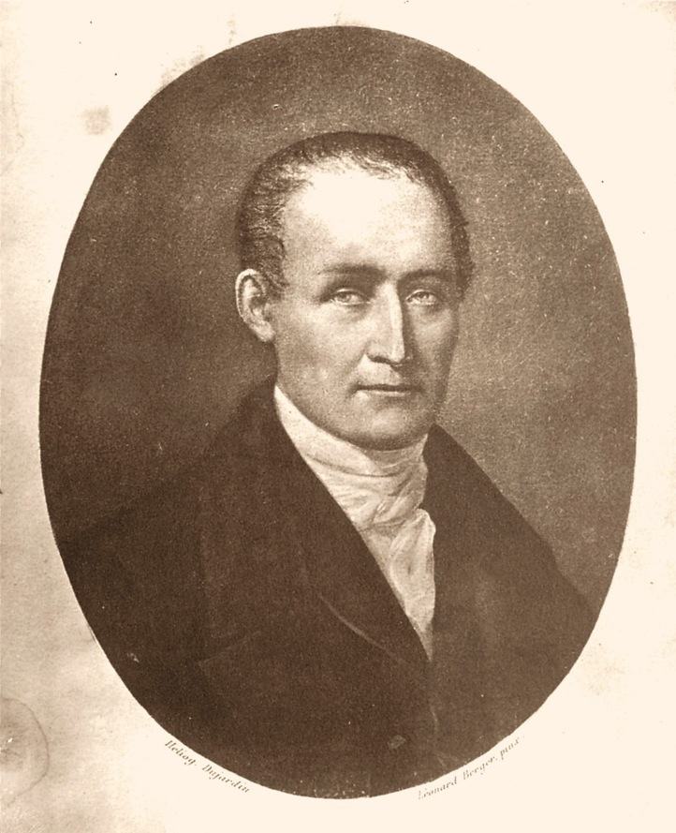
Joseph Nicéphore Niépce (1765 – 1833)

Slide 13
Louis Daguerre (1787-1851)

Slide 14
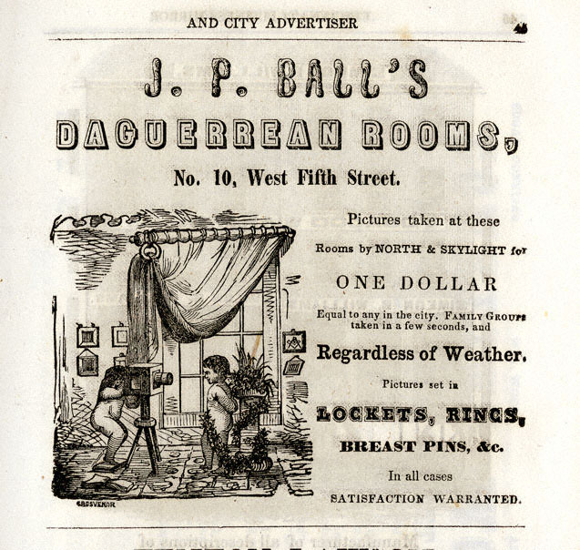
James Presley Ball (1825-1904) Prominent African-American abolitionist, entrepreneur, and Daguerreotypist.

Slide 15
Sir John Frederick William Herschel (1792-1871)

Slide 16
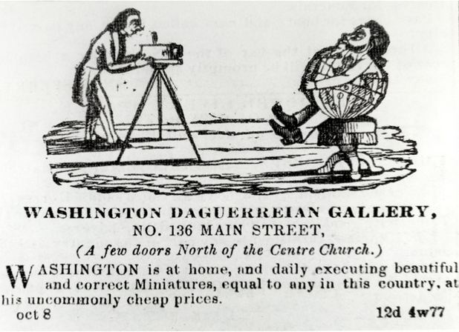
Augustus Washington (c. 1820 – June 7, 1875) was an American photographer and daguerreotypist. He was born in New Jersey as a free person of color and immigrated to Liberia in 1852. He is one of the few African-American daguerreotypists whose career has been documented. Portrait of Joseph Jenkins Roberts (c. 1854)

Slide 17
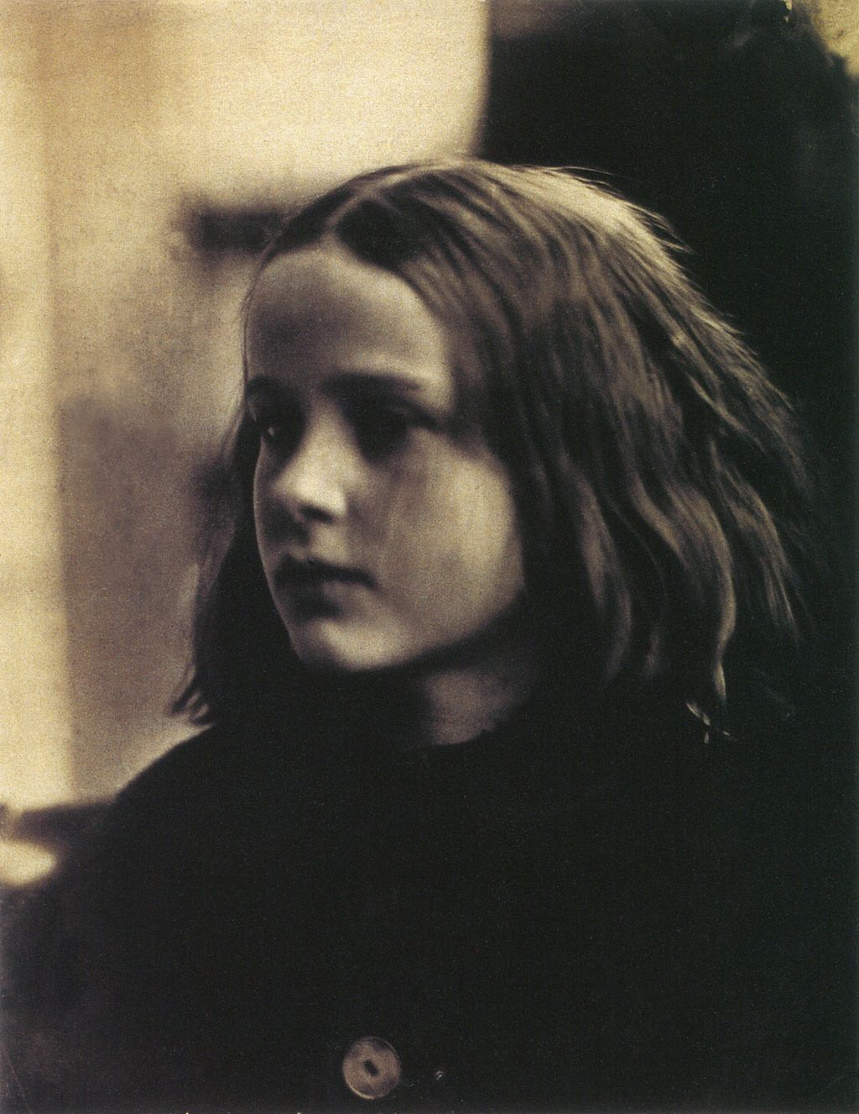
Julia Margaret Cameron (1815 – 1879) was a British photographer who is considered one of the most important portraitists of the 19th century. She is known for her soft-focus close-ups of famous Victorian men and for illustrative images depicting characters from mythology, Christianity, and literature. She also produced sensitive portraits of women and children.
(c. 1864 portrait of Annie Philpot by
Julia Margaret Cameron)
(c. 1870 by Henry Herschel Hay Cameron)

Slide 18
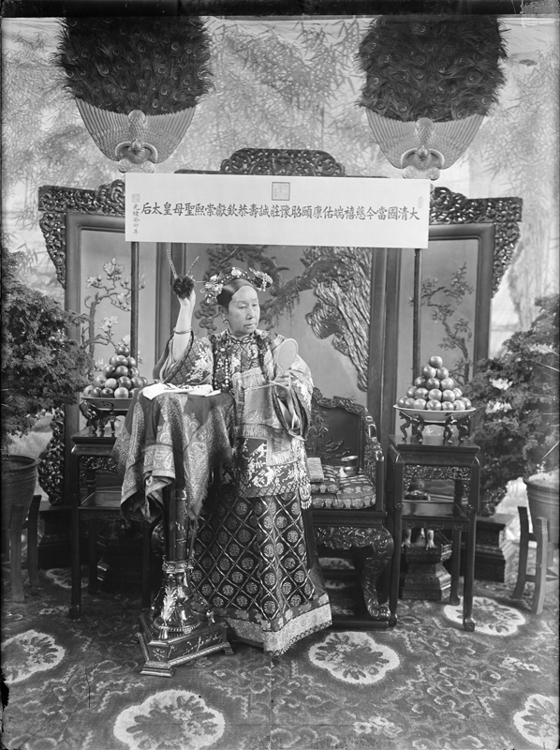
Yu Xunling (裕 勋 龄; Yù Xūnlíng ; 1880–1943) was a Chinese photographer, and the widow Empress Cixi's court photographer during the late Qing Dynasty. He was the only photographer allowed by the widowed empress to photograph her.
Few photographs remain of the Empress Dowager Cixi (1835–1908), China’s notorious head of state during the final decades of the imperial era. Cixi used photographs to model perceptions of her character at the very moment photography was becoming a mass-media vehicle and the Qing dynasty (1644 to 1912) was struggling to survive in a hostile imperialistic world.

Slide 19
Roger Fenton (1819-1869) Early War Photographer (Crimean War)

Slide 20
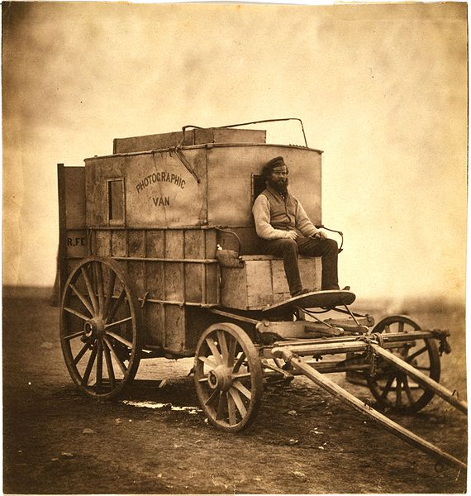
Roger Fenton's photographic van
c1855

Slide 21
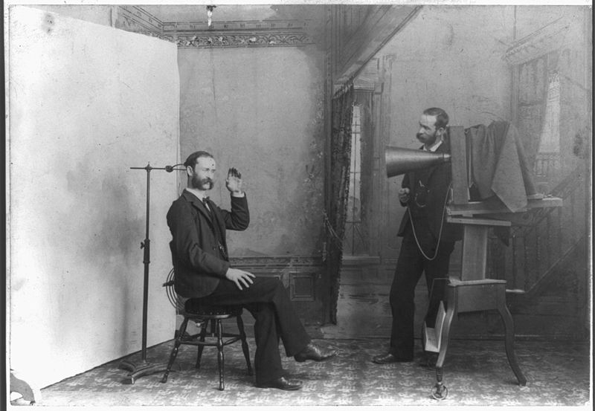
Photographer’s Studio circa 1895

Slide 22
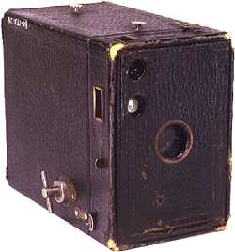
Eastman Kodak Brownie Camera, circa 1900

Slide 23
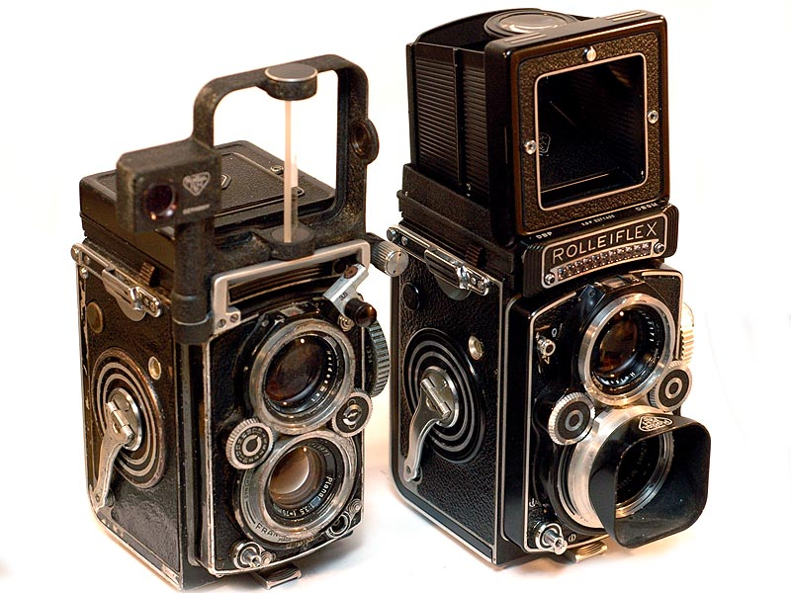
TLR - Twin Lens Reflex

Slide 24
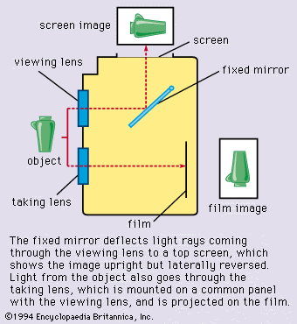

Slide 25
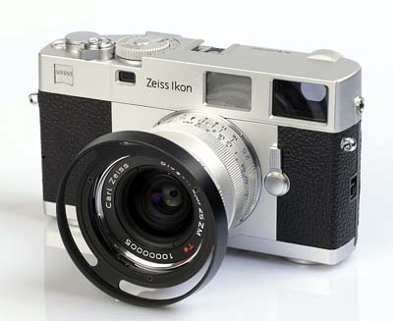
Rangefinder

Slide 26
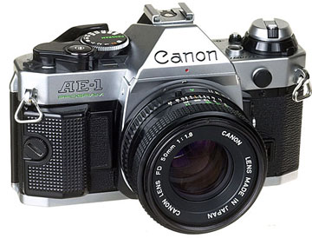
SLR - Single Lens Reflex

Slide 27
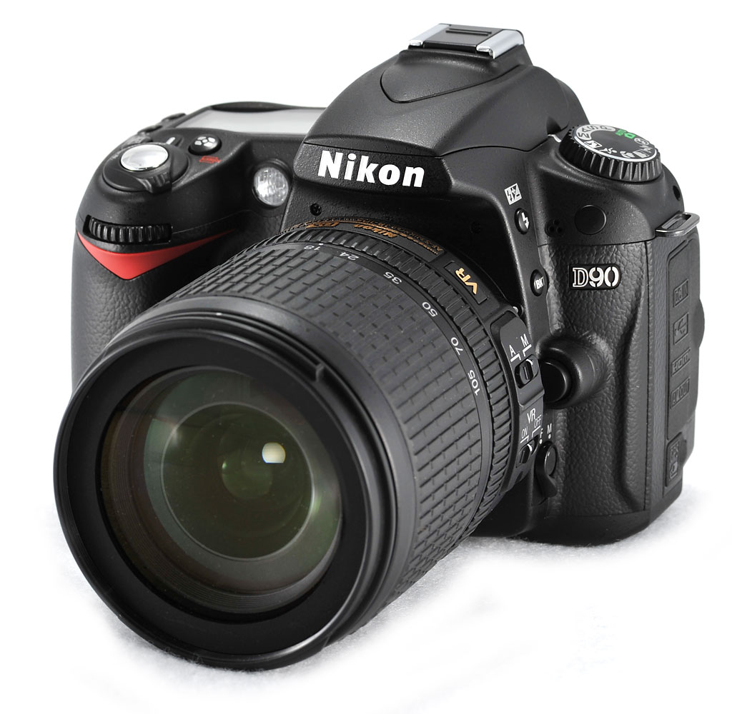
DSLR - Digital Single Lens Reflex

Slide 28
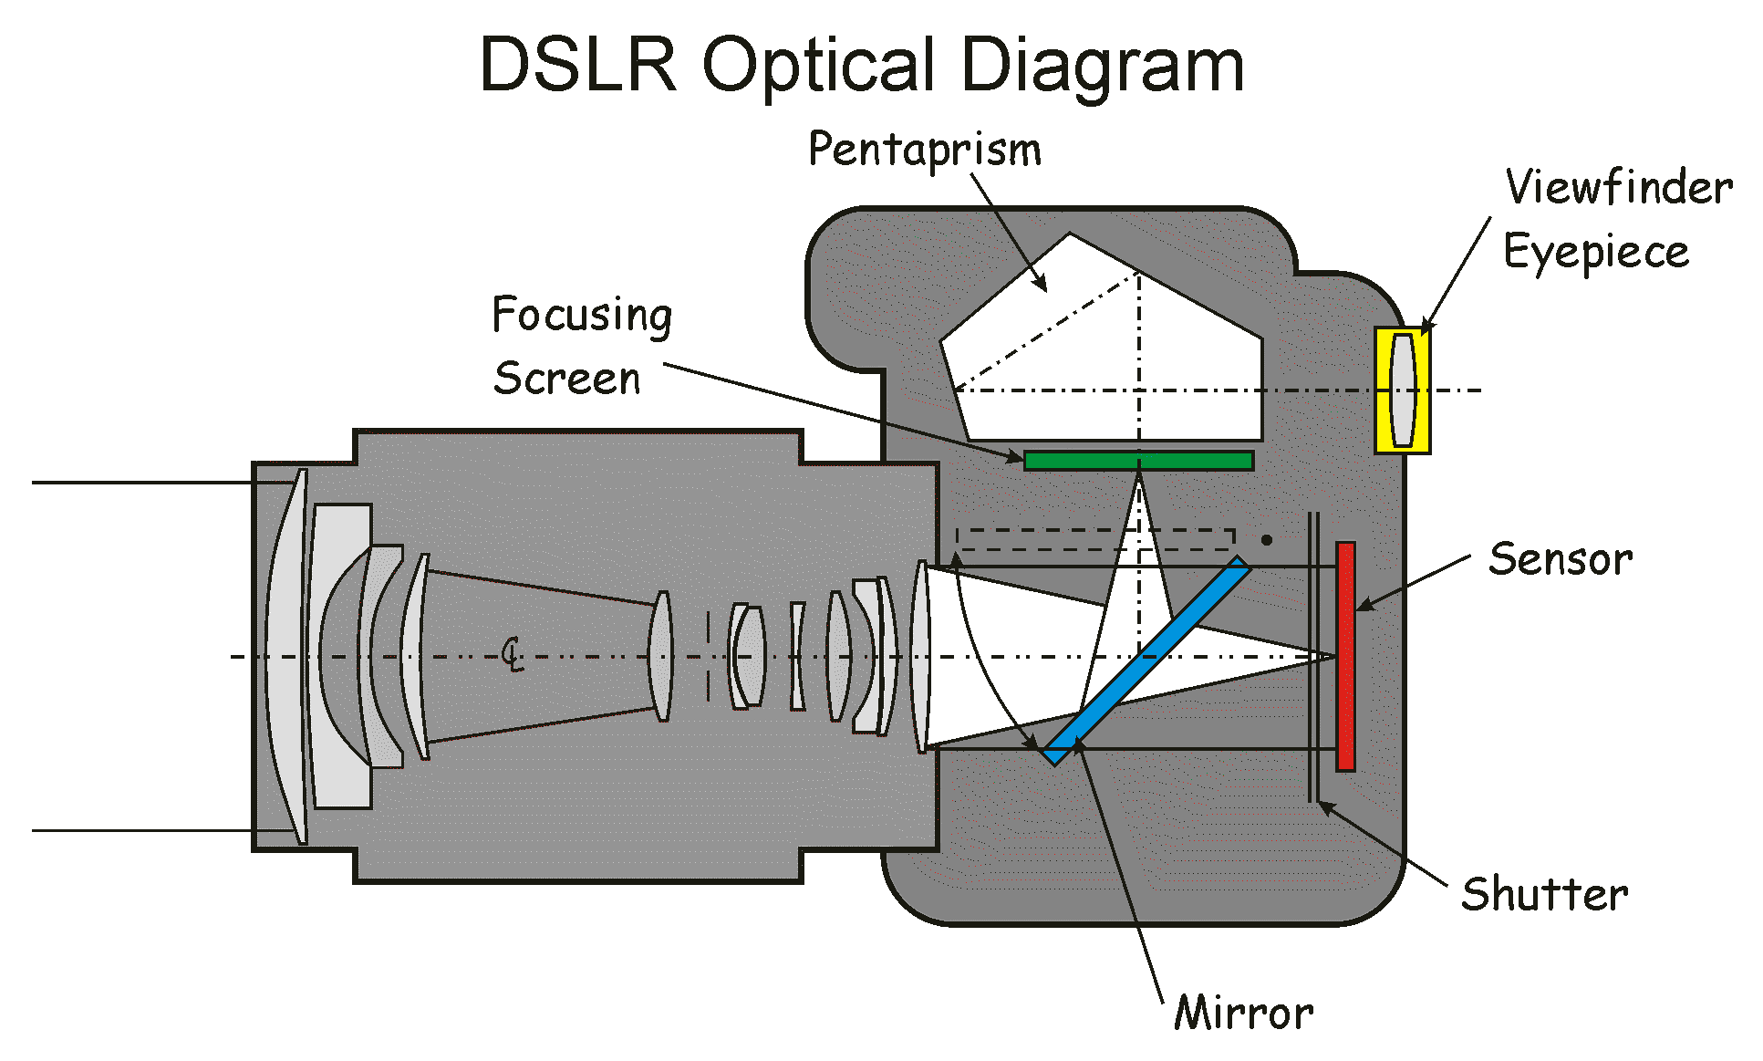

Slide 29
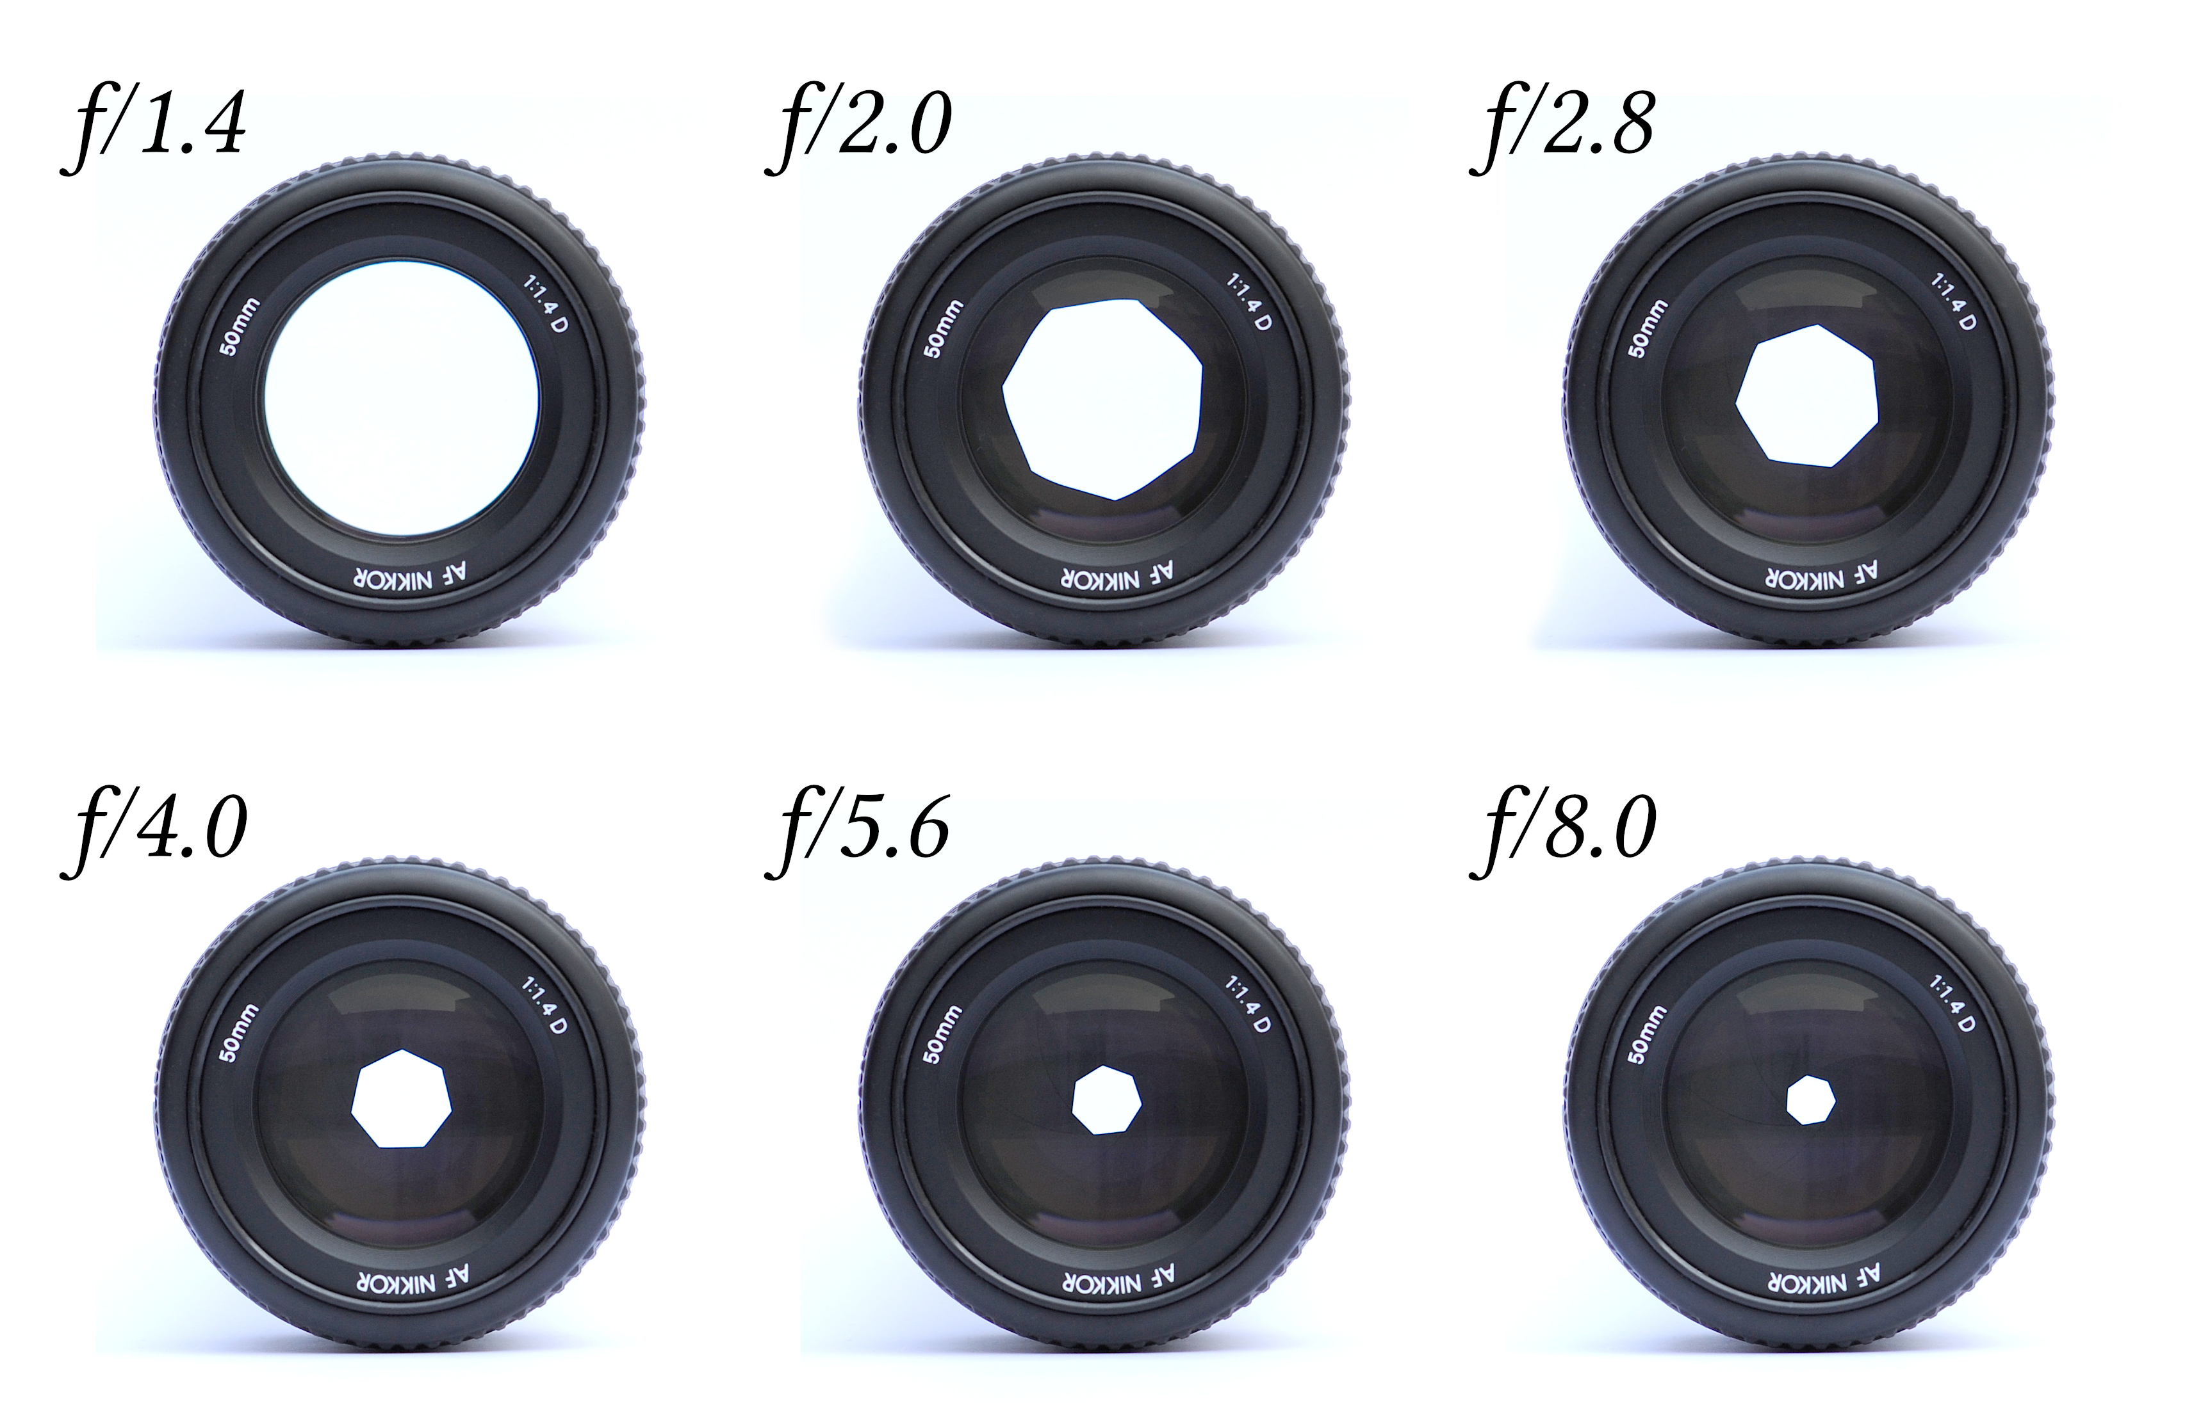

Slide 31
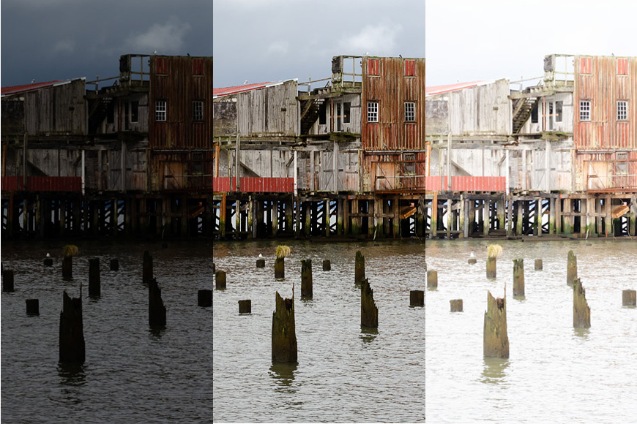

Slide 32
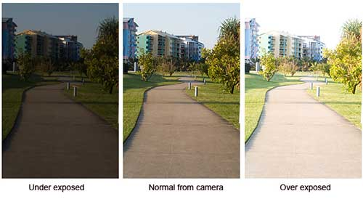
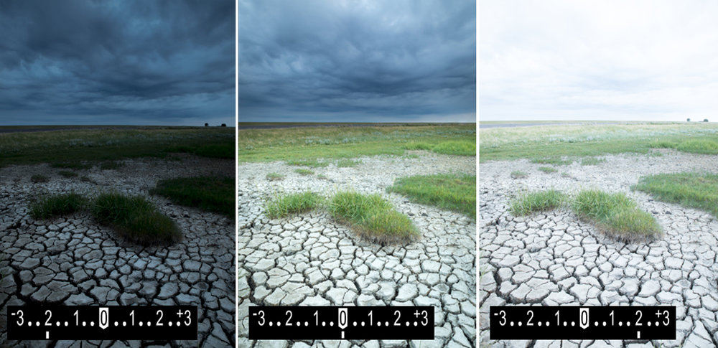

Slide 33
Standard Shutter Speeds:
1/4 1/8 1/15 1/30 1/60 1/125 1/250 1/500 1/1000
Standard f-stops:
1.4 2.0 2.8 4 5.6 8 11 16 22
Shutter Speed
1/8 1/15 1/30 1/60 1/125 1/250 1/500 1/1000
f/stop
f/32 f/22 f/16 f/11 f/8 f/5.6 f/4 f/2.8

Slide 34
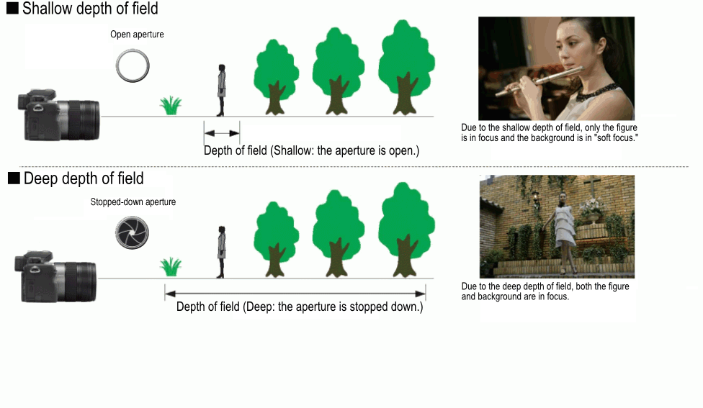
Depth of Field

Slide 35
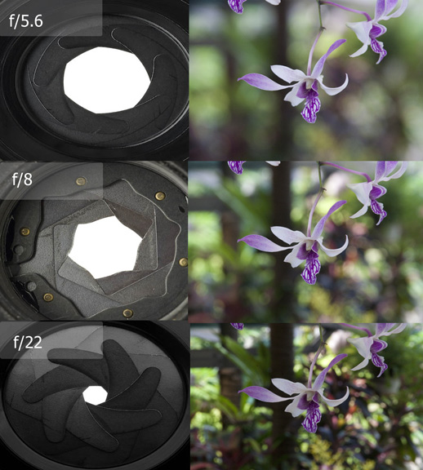
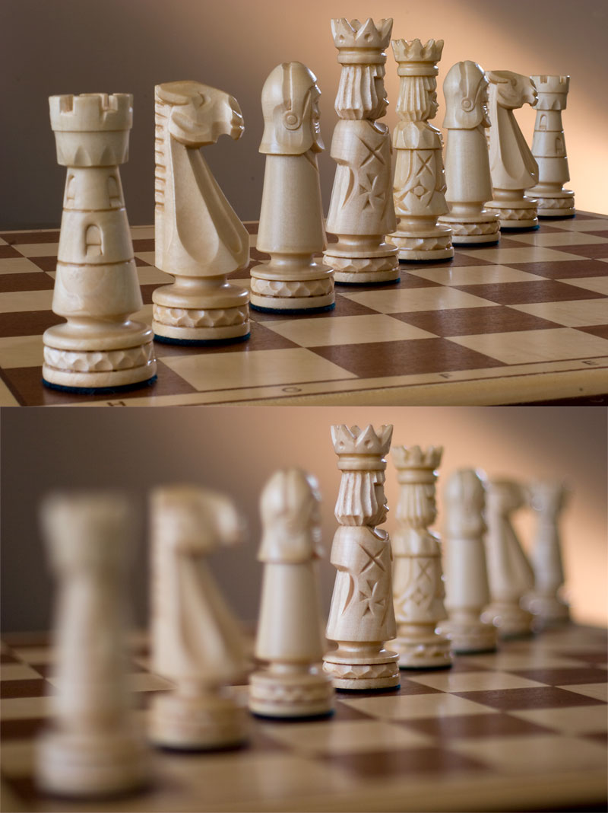
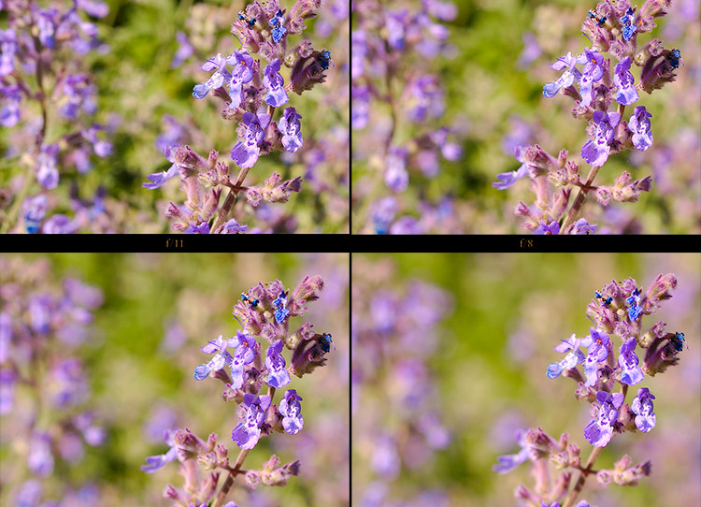

Slide 36
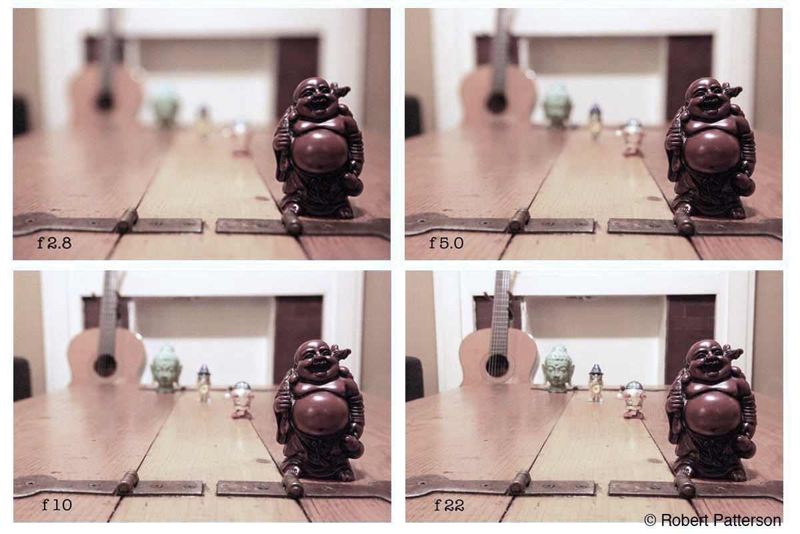

Slide 37
Shutter Speed’s Effect on Motion

Slide 38
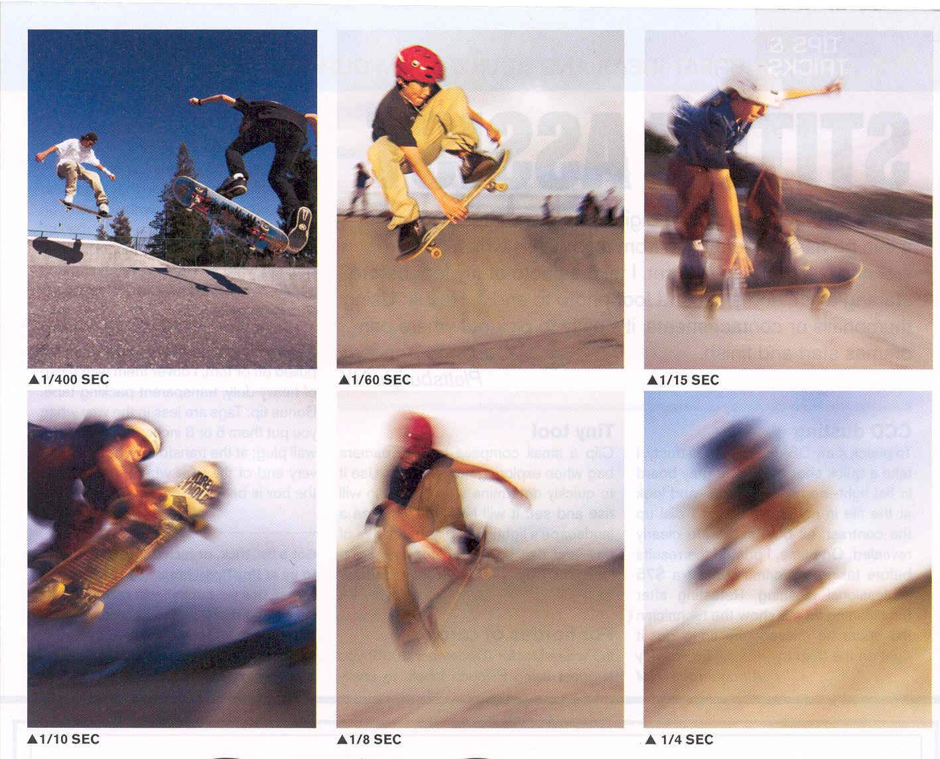

Slide 39
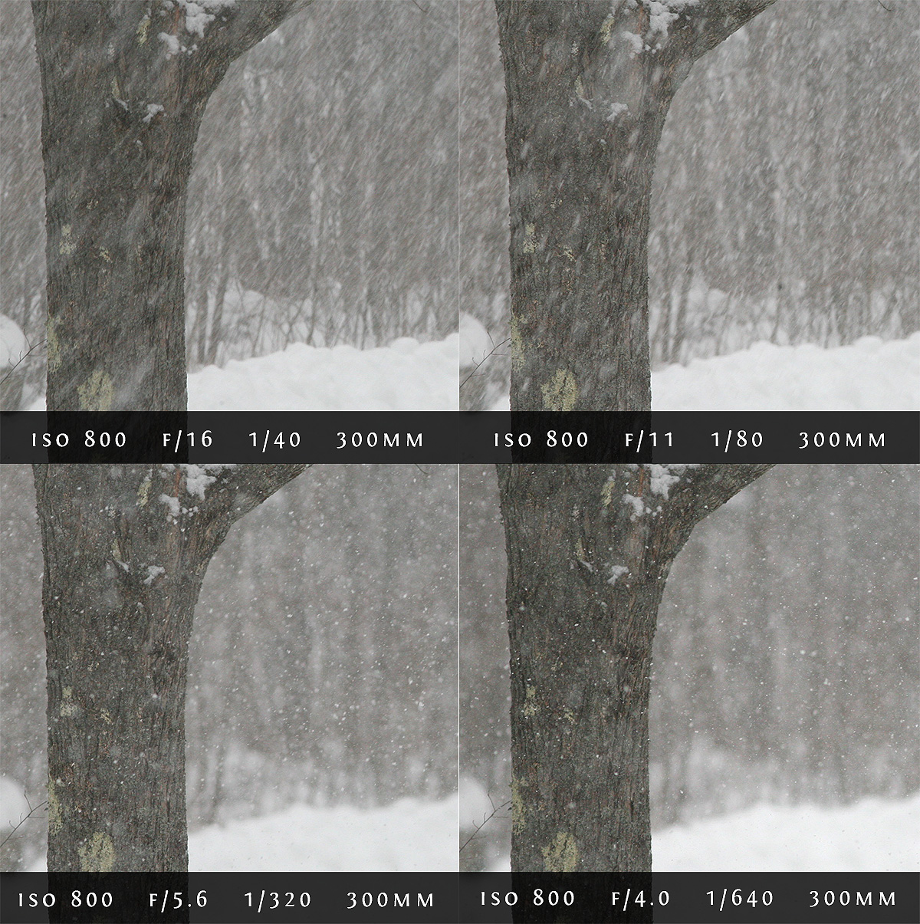

Slide 40
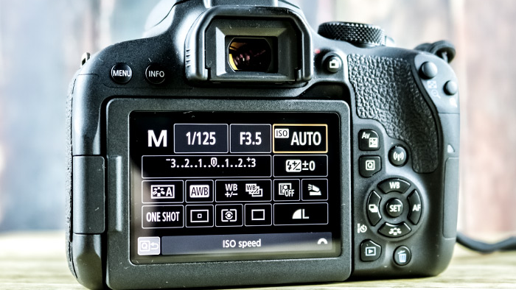

Slide 41
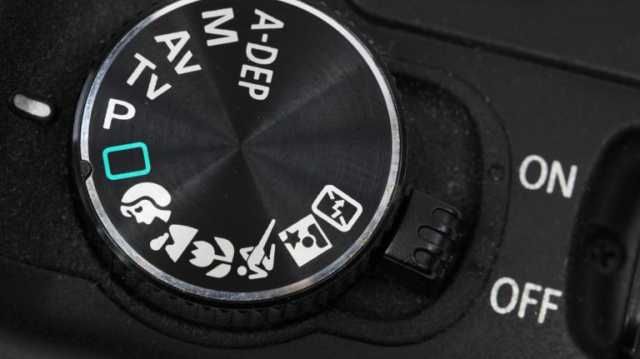

Slide 42
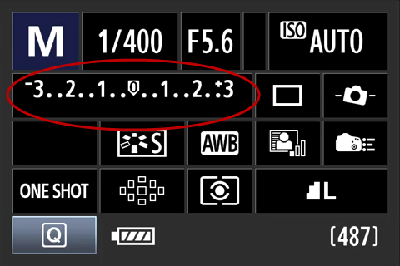
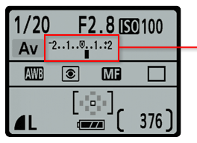
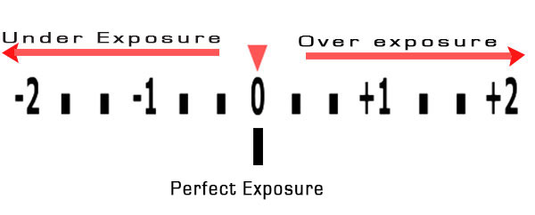

Slide 43
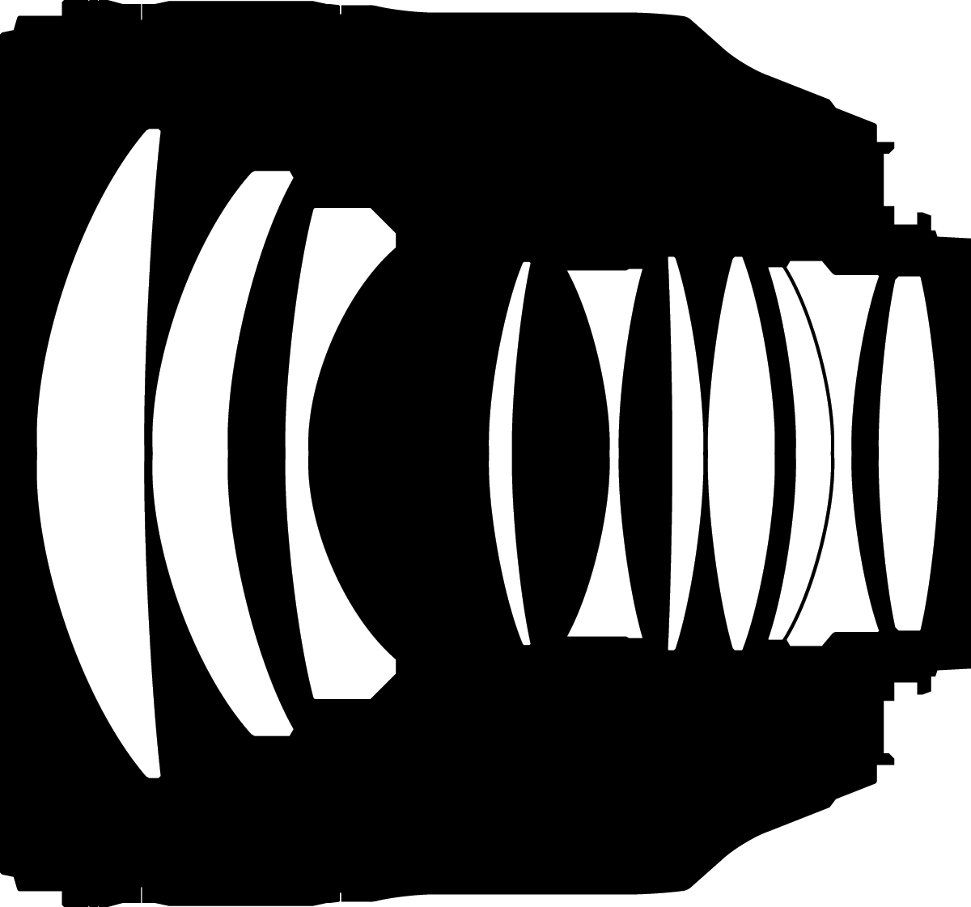

Slide 44
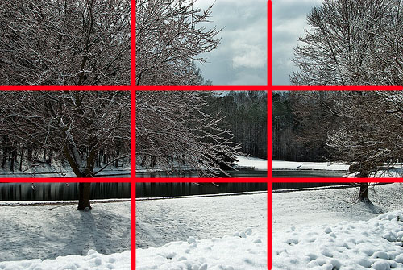
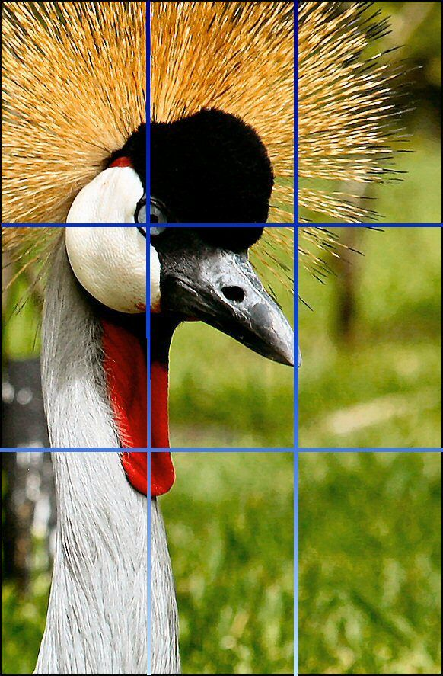
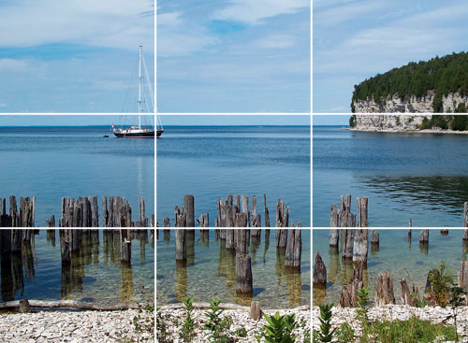
Rule of Thirds Example

Slide 45
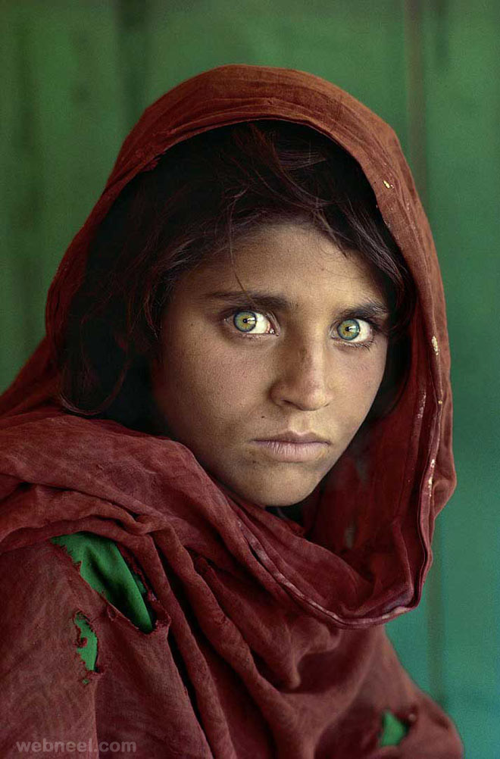
Steve
McCurry
b.1950

Slide 46
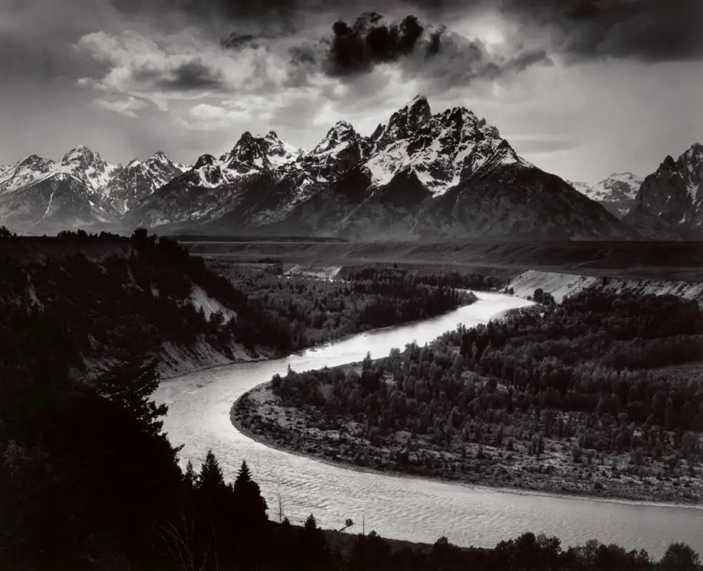
Ansel
Adams
b.1902

Slide 47
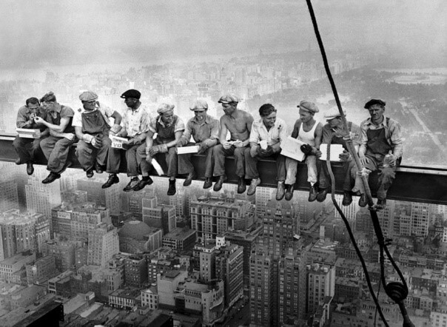
Charles Ebbets b.1905

Slide 48
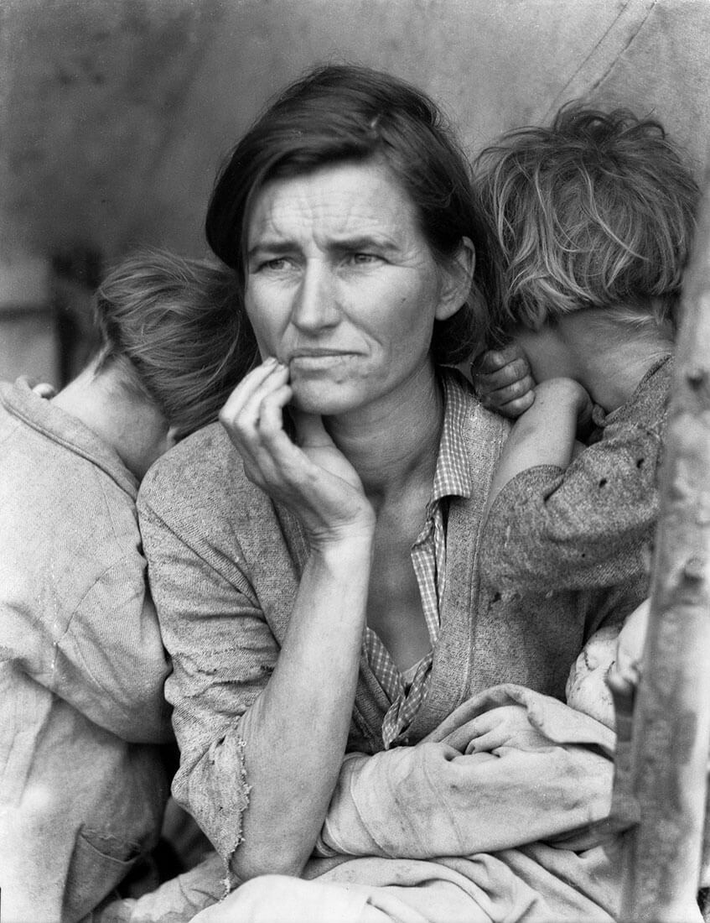
Dorothea Lange
b.1895

Slide 49
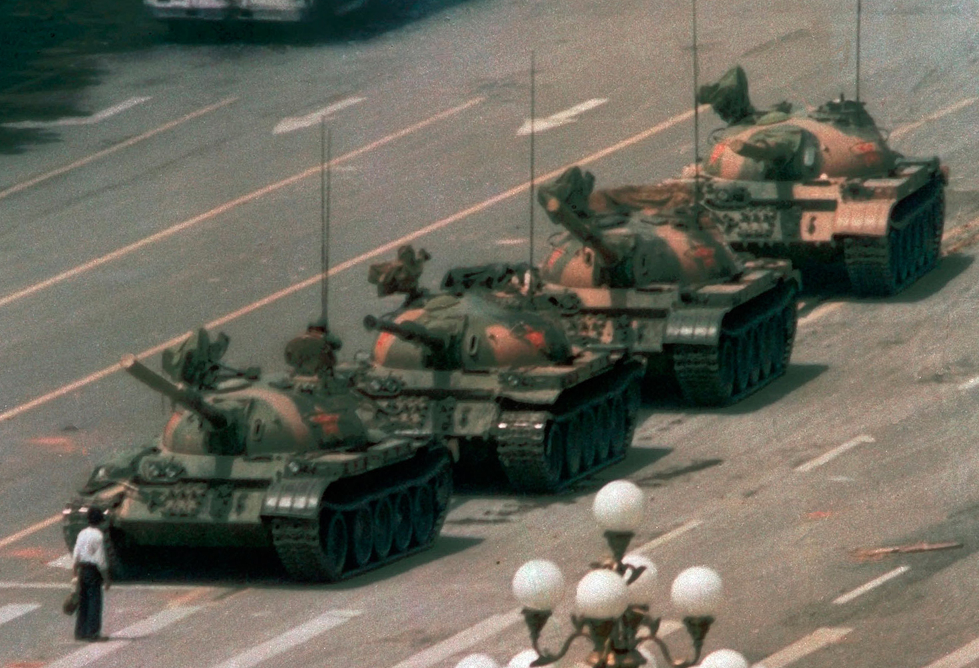
Charlie Cole b.1955

Slide 50
Christian Aslund born c.1970s

Slide 51
Akasha Rabut born c.1980

Slide 52
Andreas Gursky b.1955

Slide 53
Diane Arbus
b.1923

Slide 54
Henri Cartier Bresson
b.1908

Slide 55
Aïda Muluneh
b.1974

Slide 56
Walker Evans b.1903

Slide 57
Focal Length

Slide 59
Aspect Ratio

