Slide 1
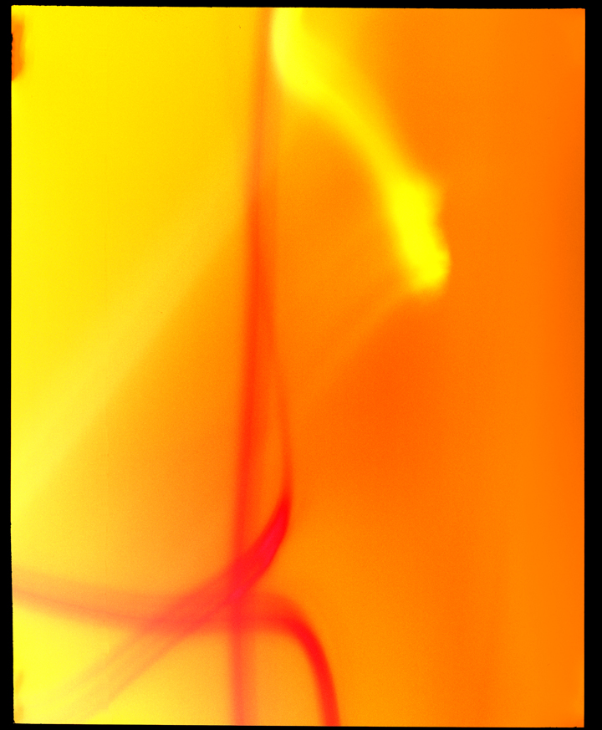
Pinhole, Abstract, & Mixed-Media Photography

Slide 2
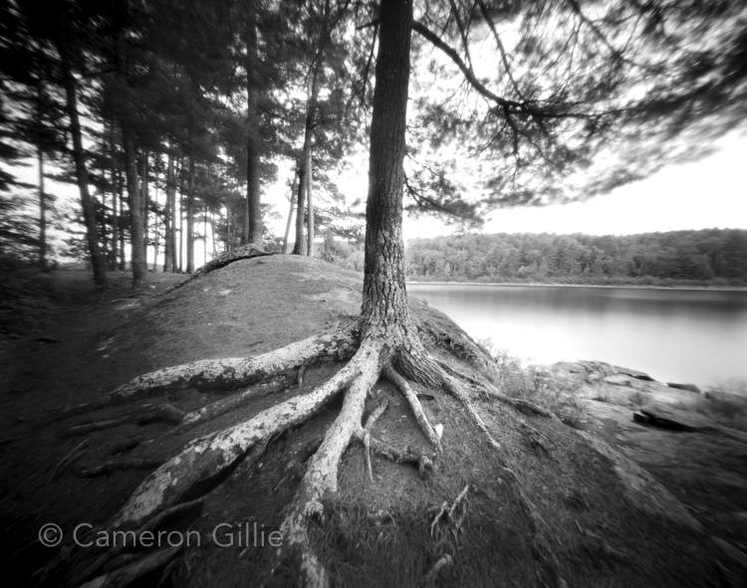
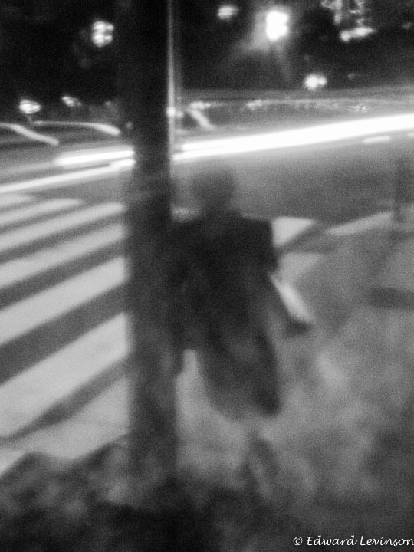
Pinhole Photography
Pinhole photography is one of the simplest forms of photography and derives much of its aesthetic qualities from the rudimentary nature of the process.

Slide 3
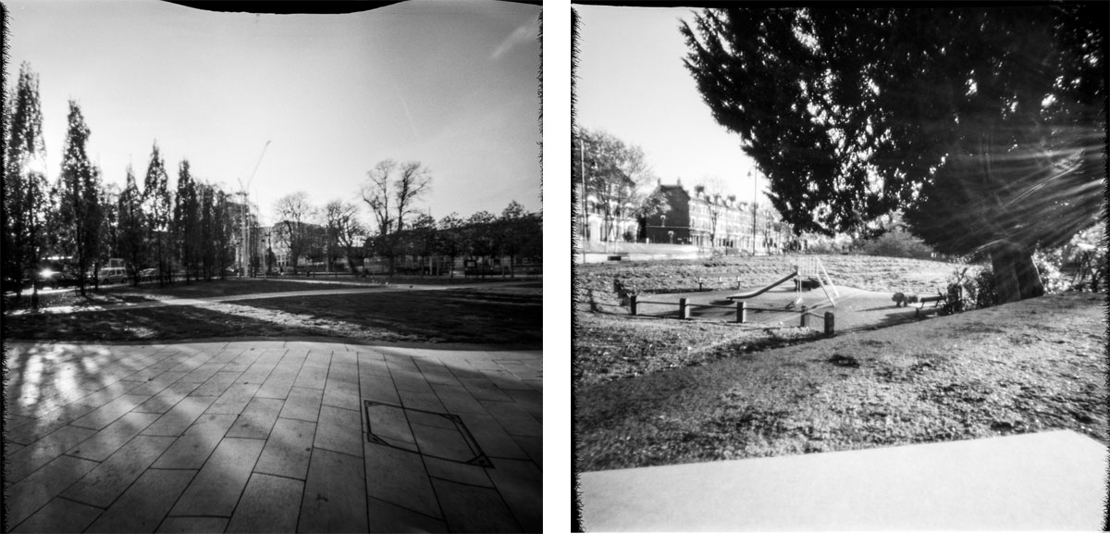
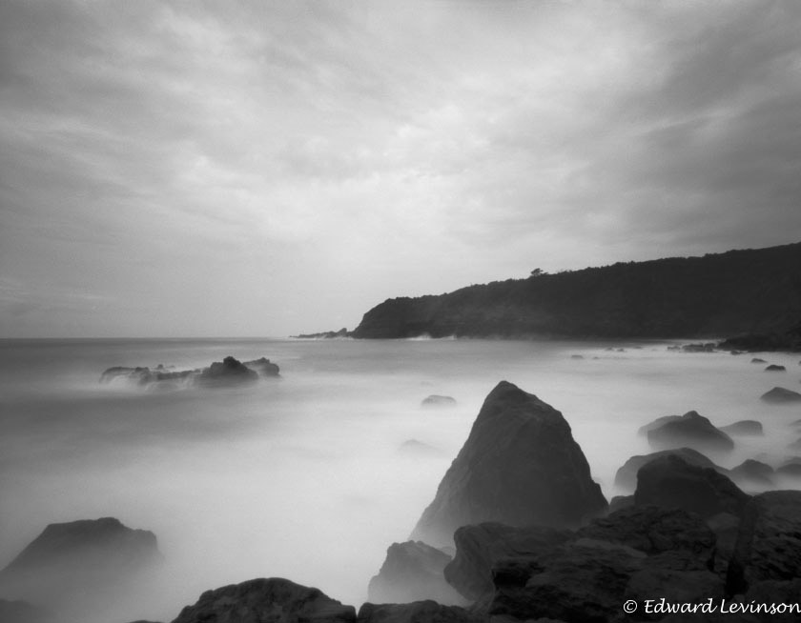
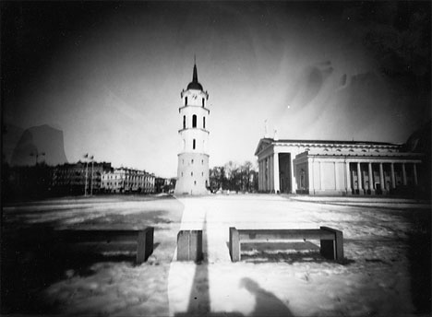
Pinhole photographs are recognized for their softness, their funkiness, their vignettes, and their gritty simplicity.

Slide 4
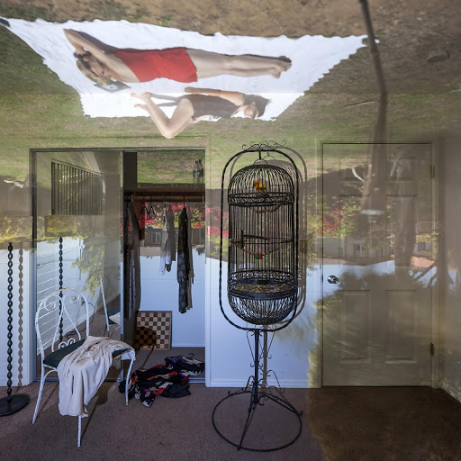
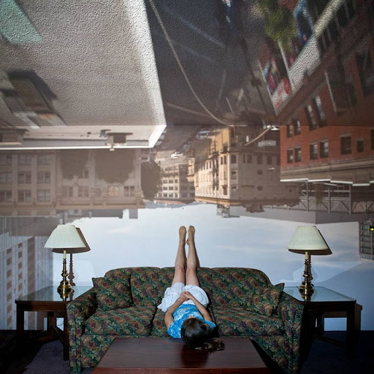
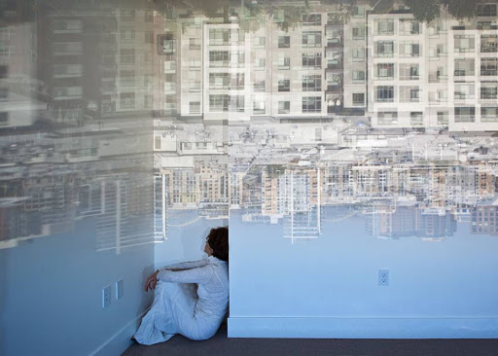
Darius kuzmickas
His subjects, whether inside or outside the room, are carefully positioned to interact with the pinhole projection.

Slide 5
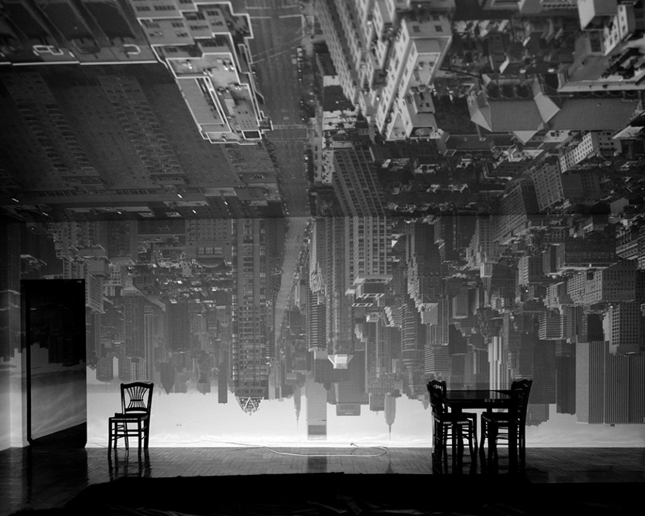
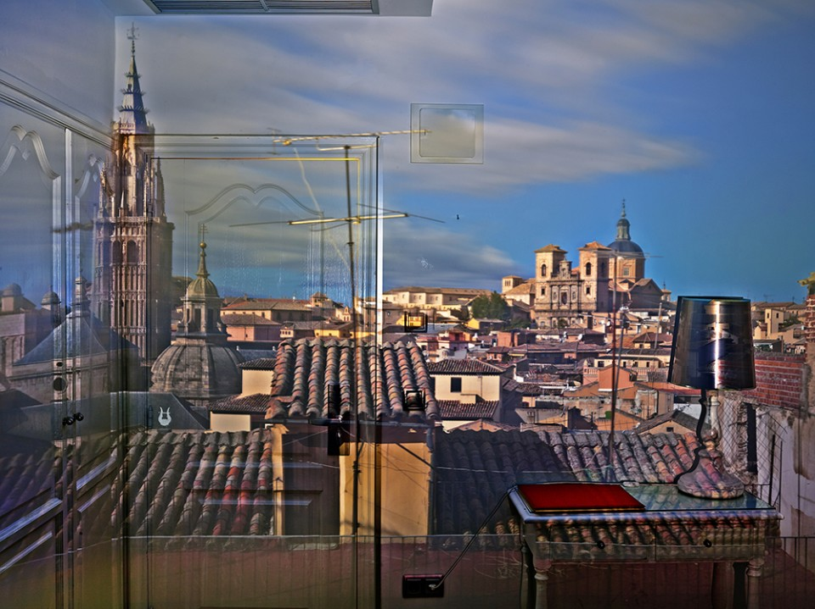
abelardo morell
Notice the use of objects, and parts of the room itself, as compositional elements.

Slide 6
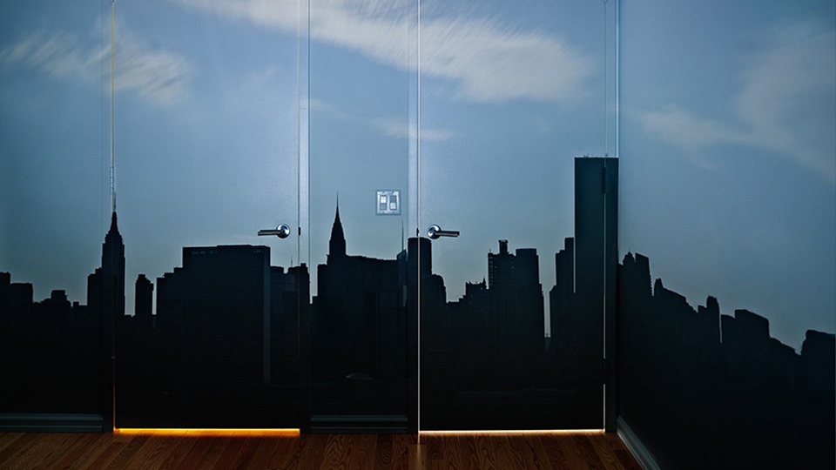
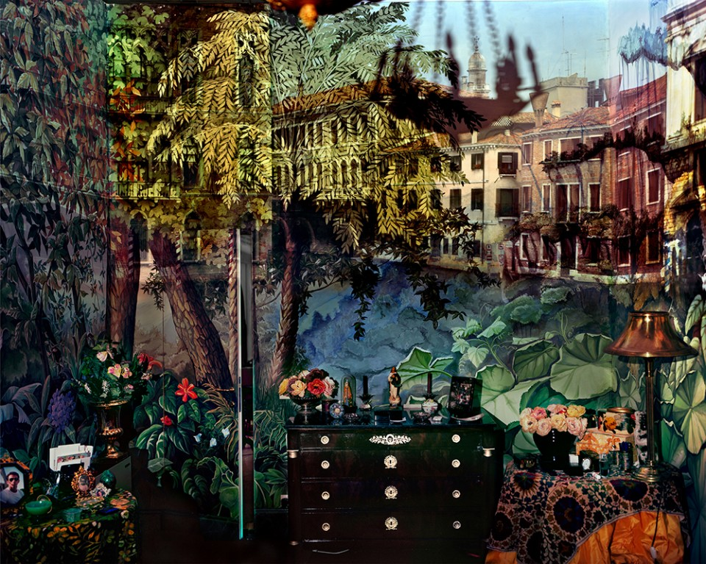
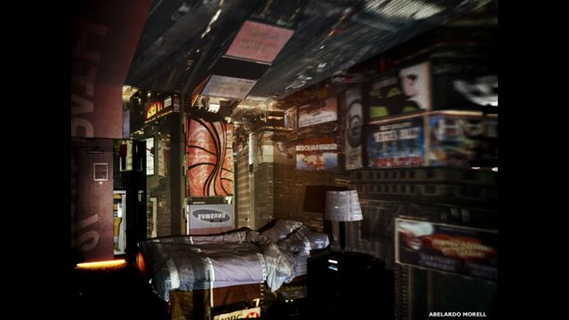
Kuzmikas & Morell create room sized pinhole cameras and photograph the rooms, populated with various persons/things, with the pinhole image projected over the room's entirety.

Slide 7
What is the Pinhole Aesthetic?
One of the advantages of pinhole photography is its nostalgic, dreamlike quality.
- Amy Schwartz
This characteristic of equal but overall soft focus is a strong identifying characteristic of the then (1880's) new school of Impressionistic painting. - Richard Vallon Jr.
…vignetting and lack of absolute sharpness adding to the slightly mysterious atmosphere they induce.
- PETER HARVEY
Pictorial photographers found a useful tool in the pinhole. Soft focus was a standard aesthetic of Pictorialism and was created by special soft-focus lenses. In his early pictorialist phase Edward Steichen gave the admonition to rap on the legs of the tripod with a wrench during a long exposure to destroy the inherent sharpness of the lens produced photograph. - Richard Vallon Jr.
…the camera’s depth of field is nearly infinite, wide angle images appear almost distortion-free.
- Greg Osborne

Slide 8
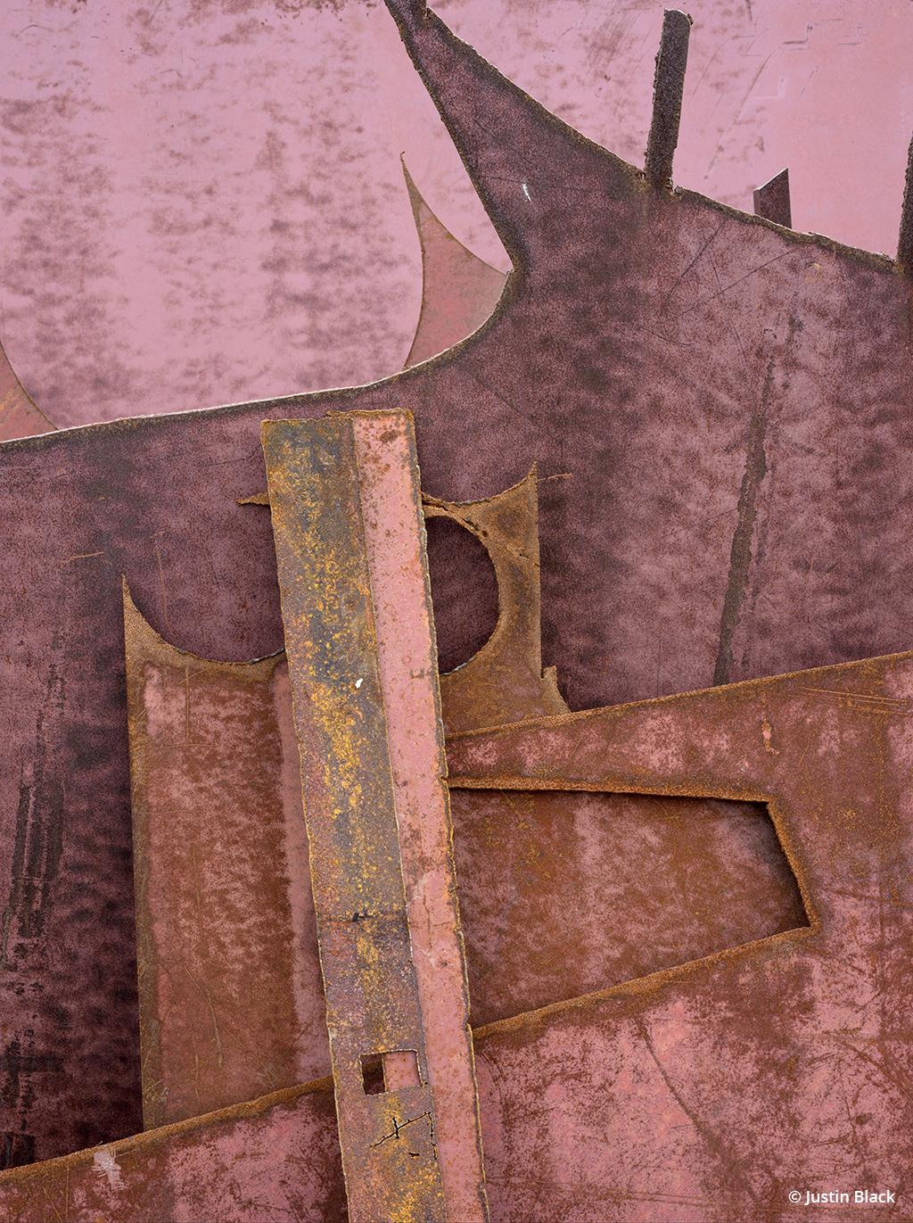
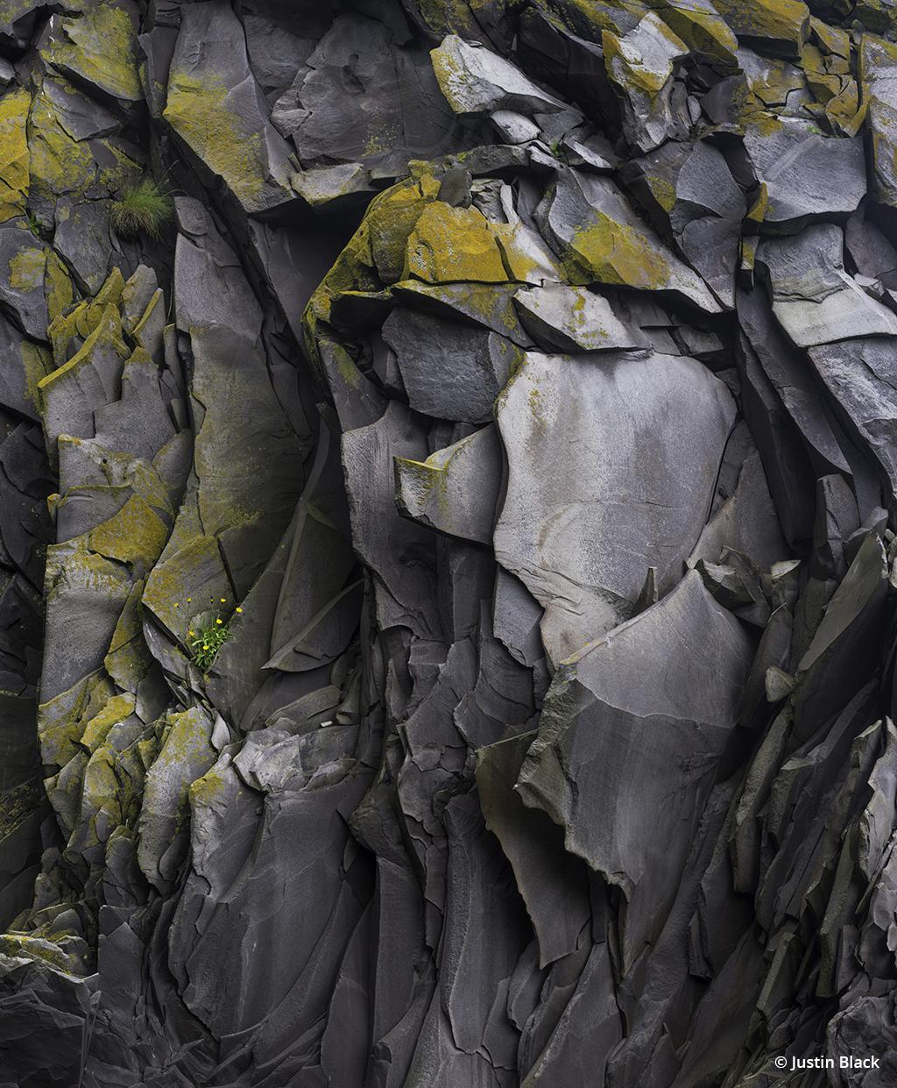
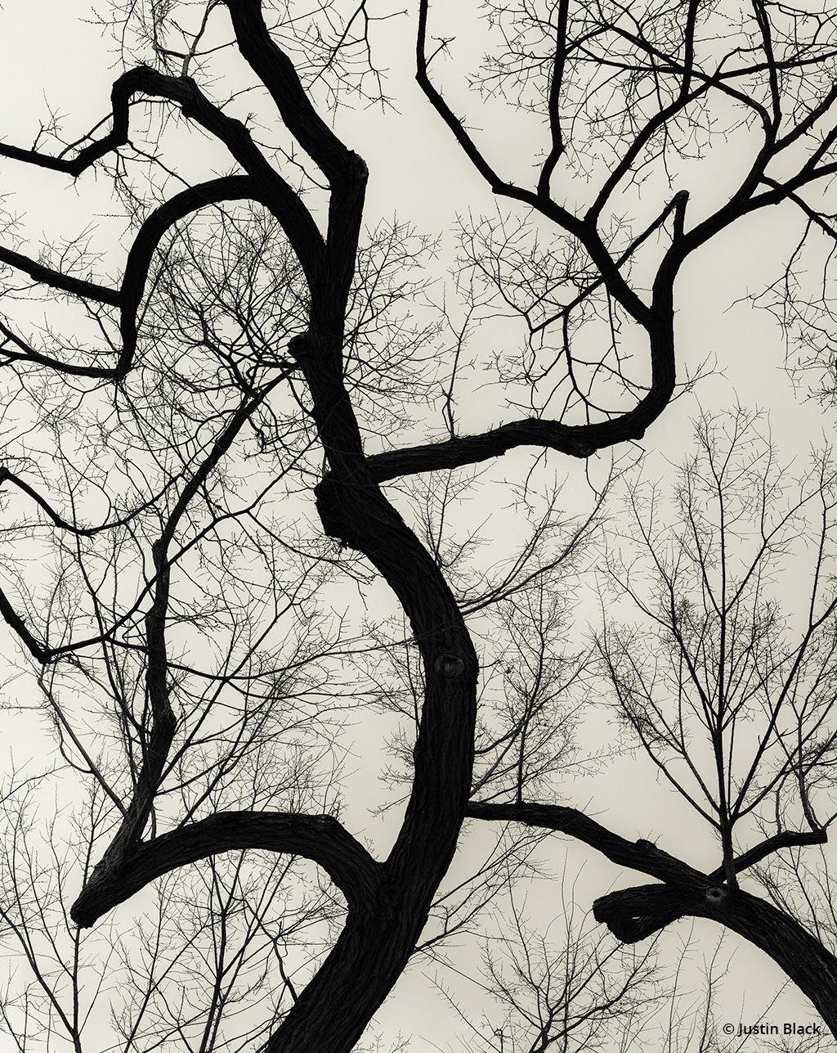
Abstract photography

Slide 9
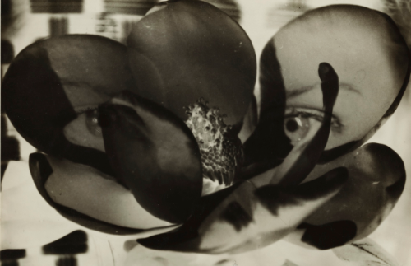
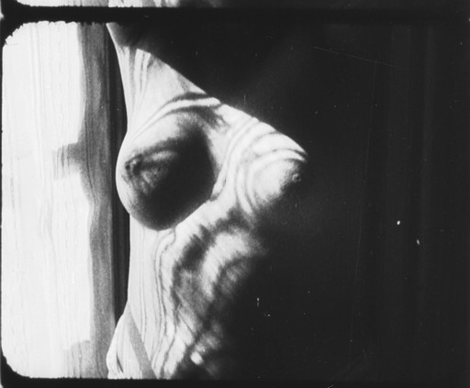
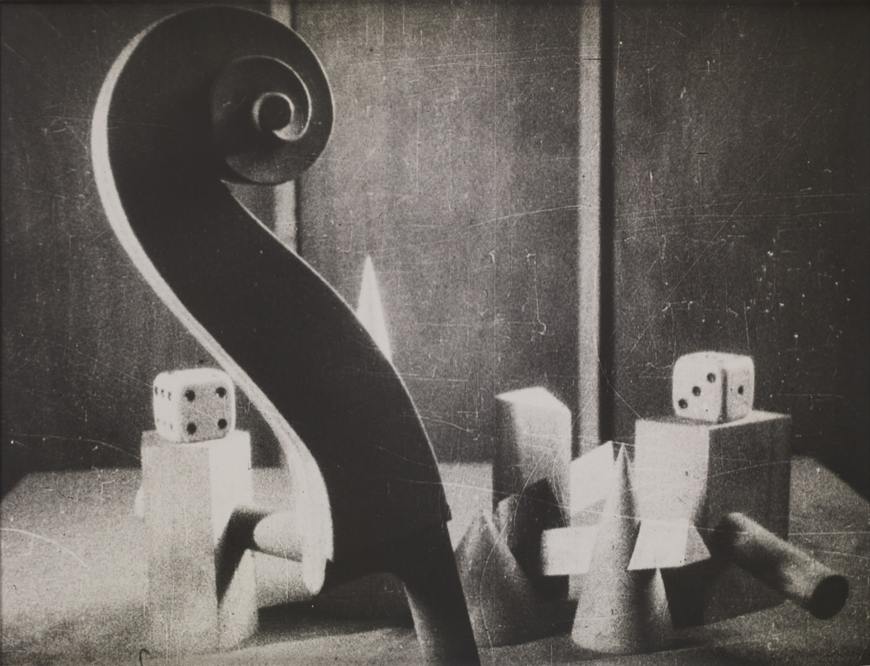
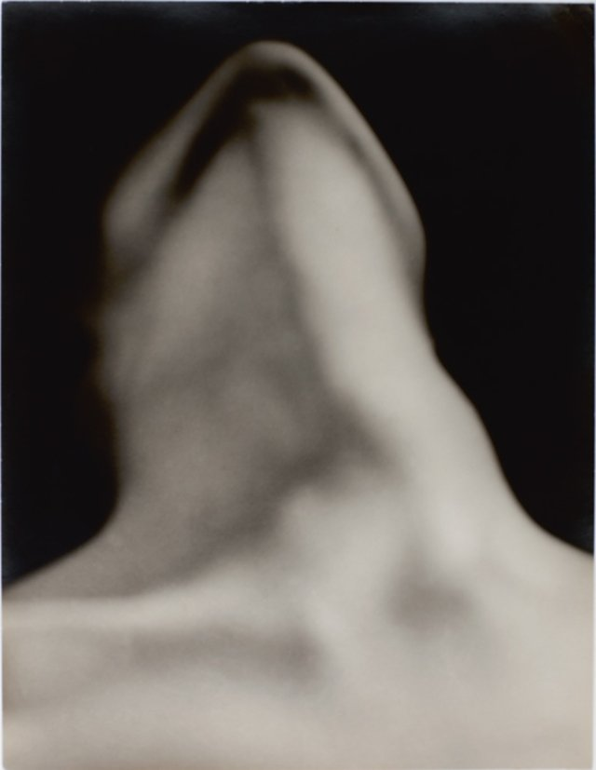
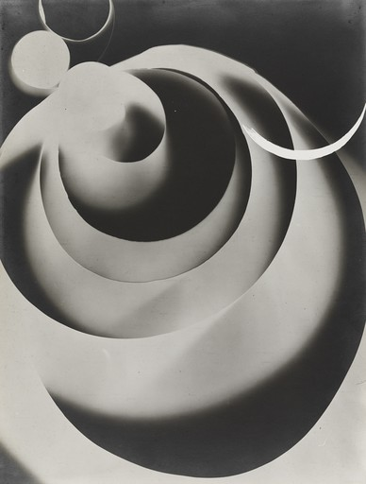
Man Ray (Emmanuel Radnitzky)

Slide 10
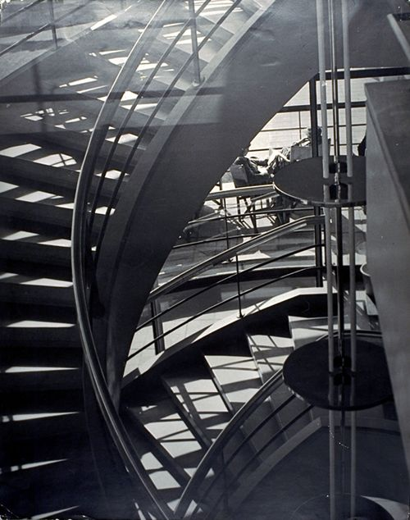
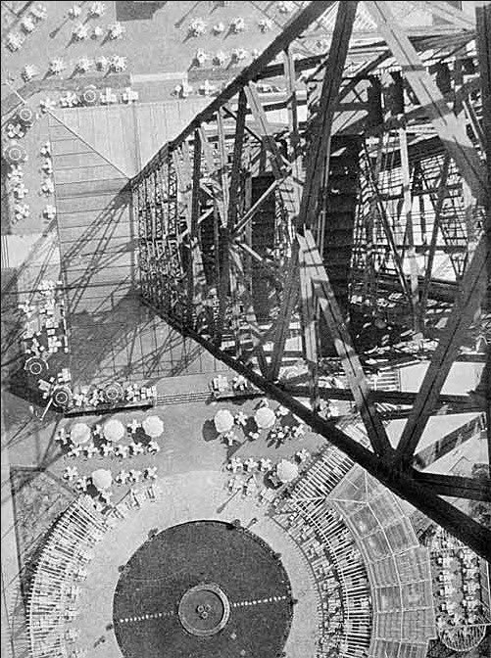
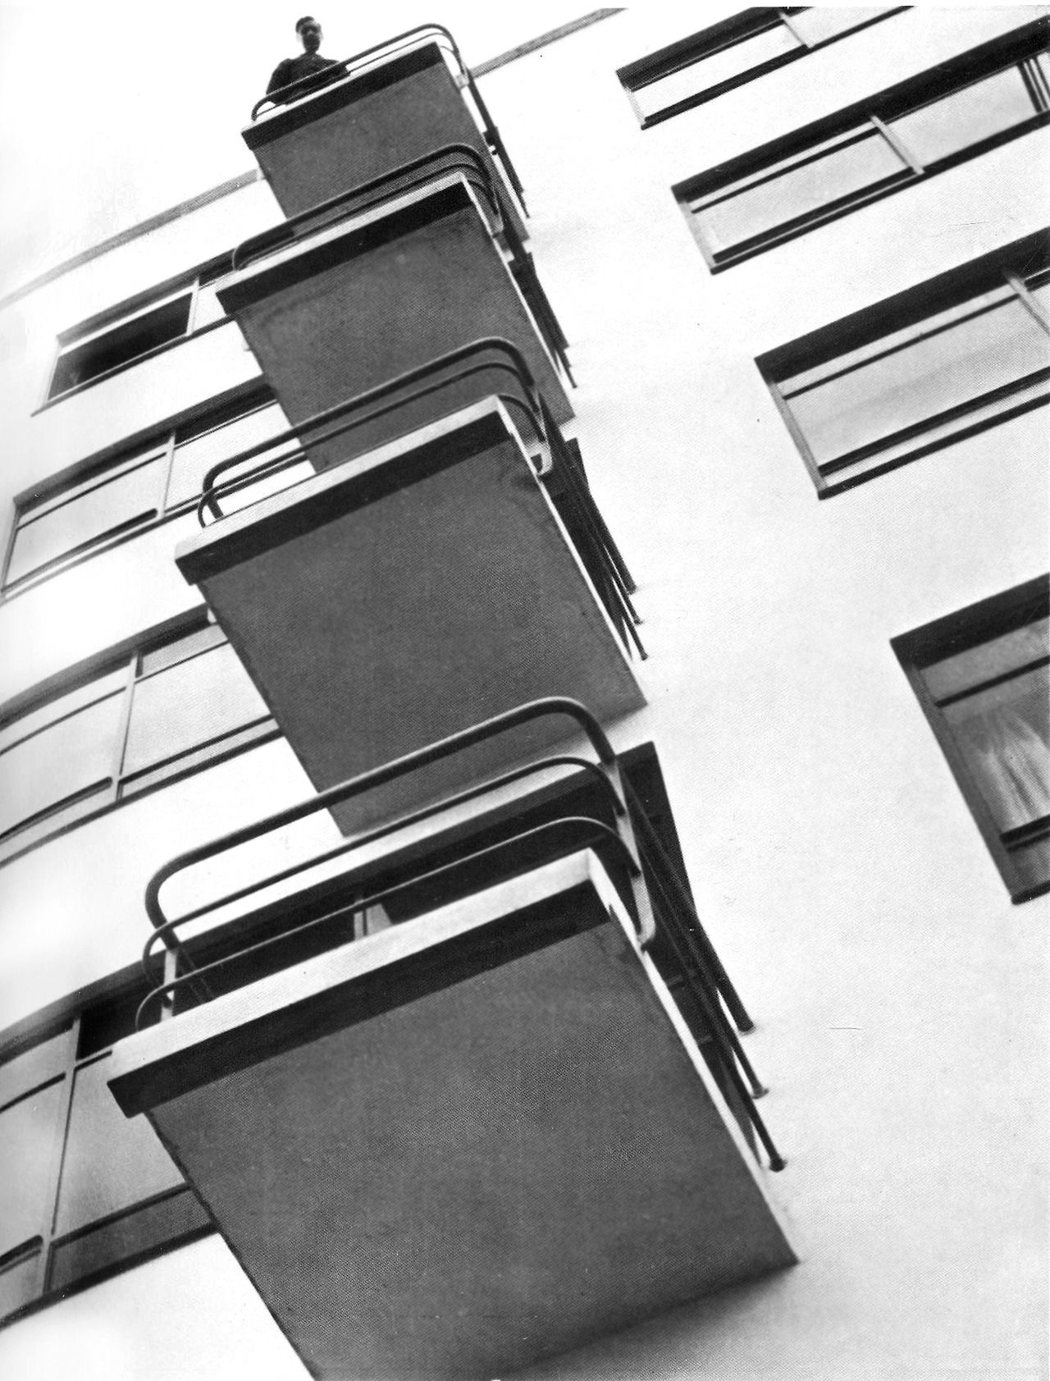
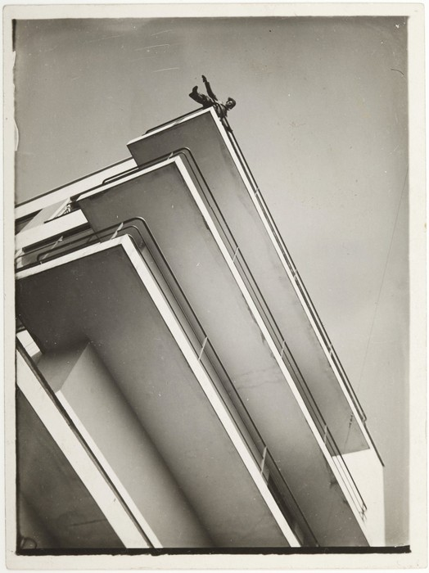
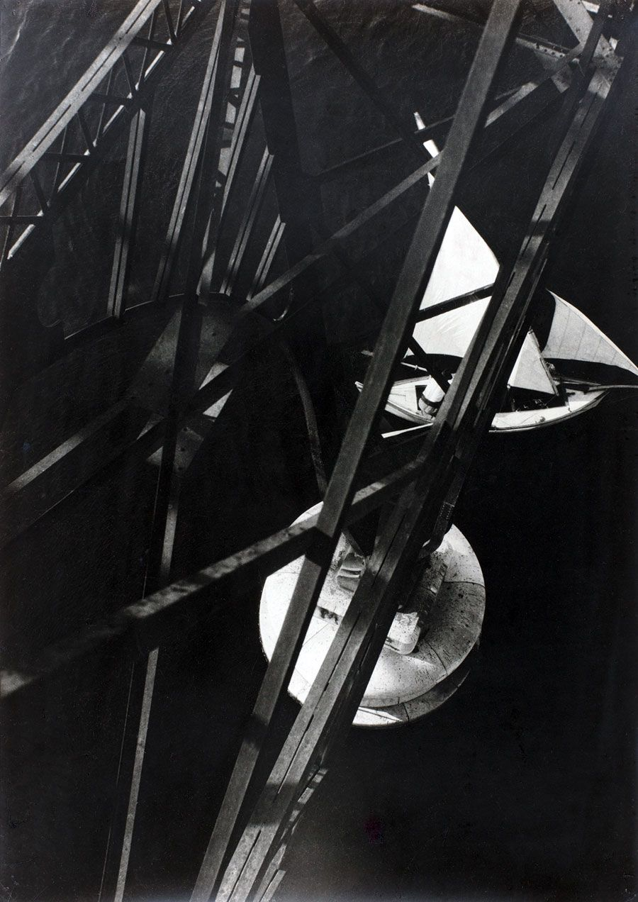
laszlo moholy-nagy

Slide 11
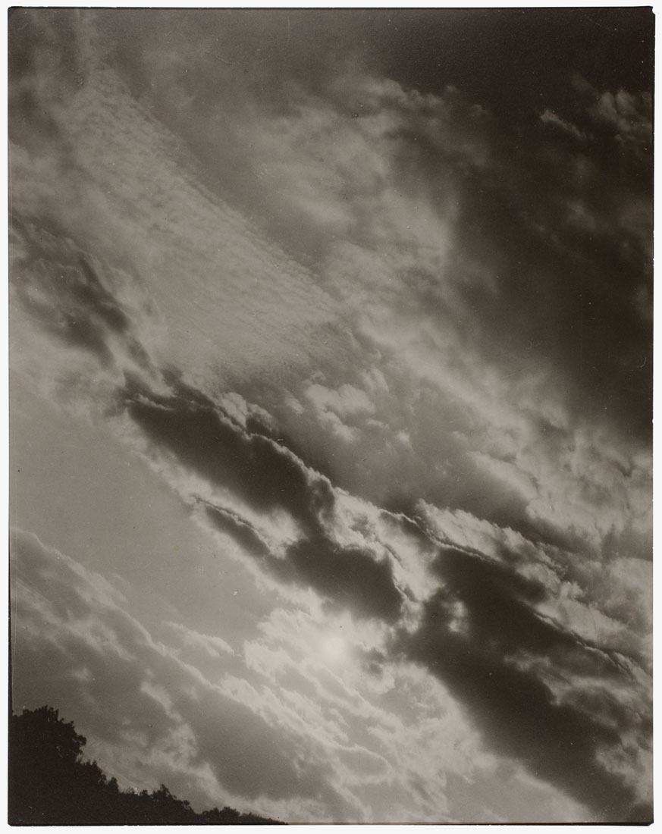
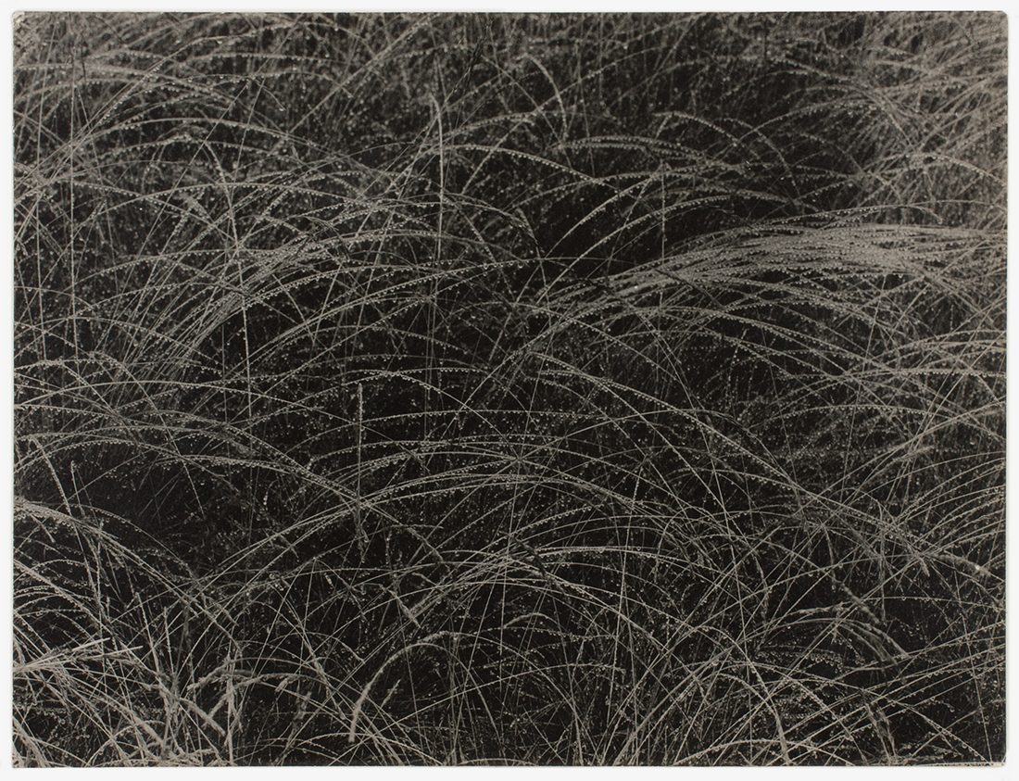
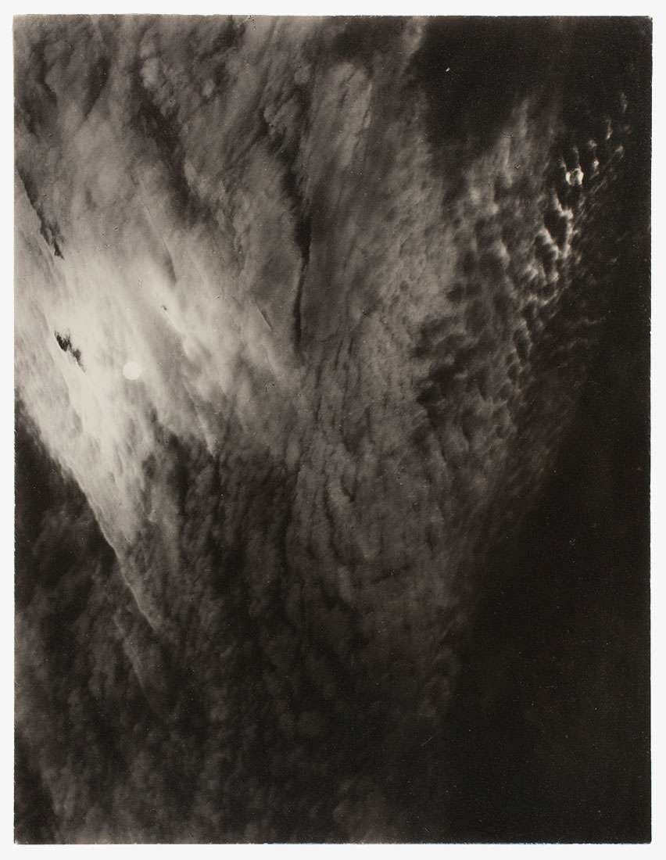
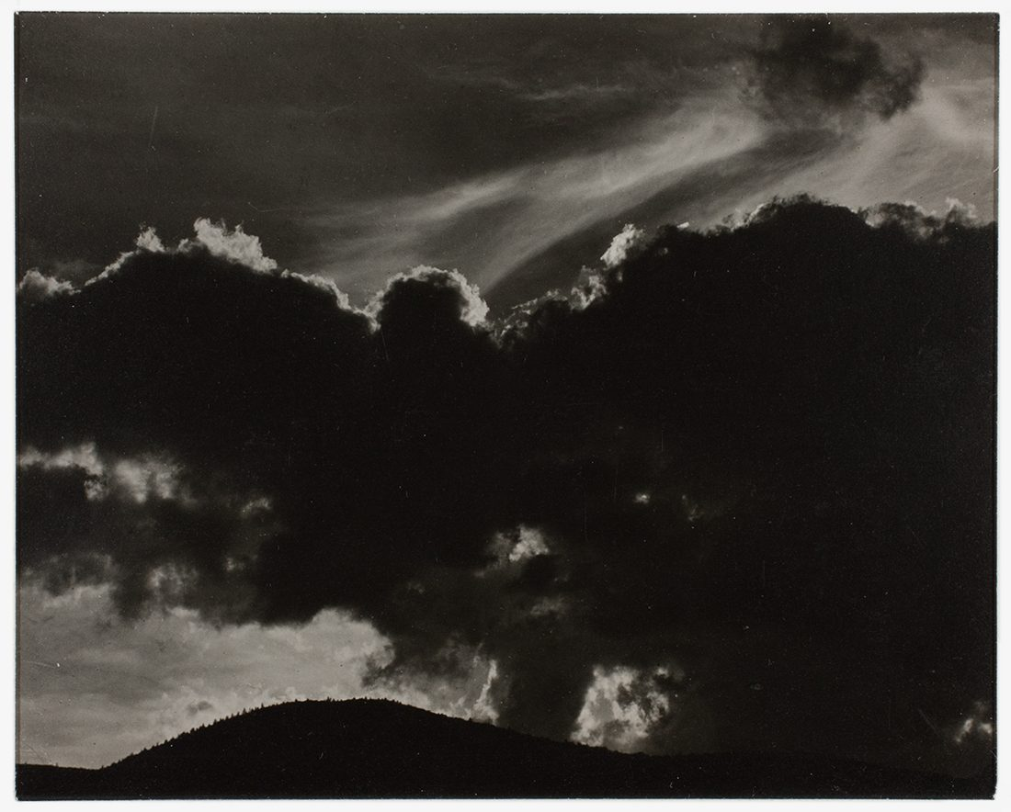
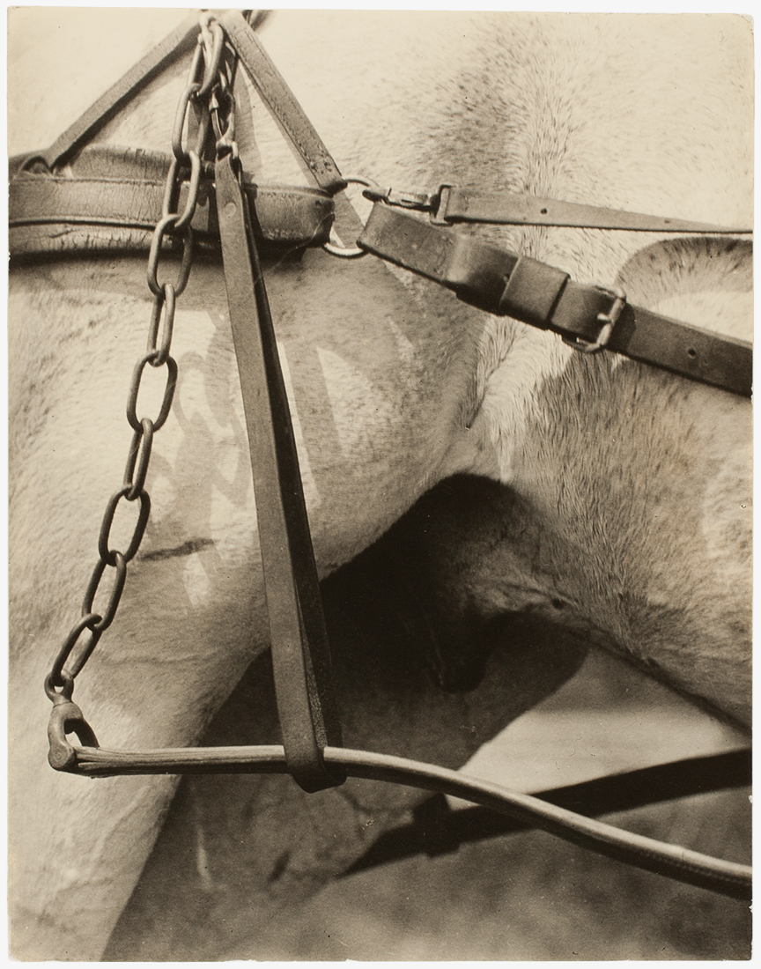
alfred stieglitz

Slide 12
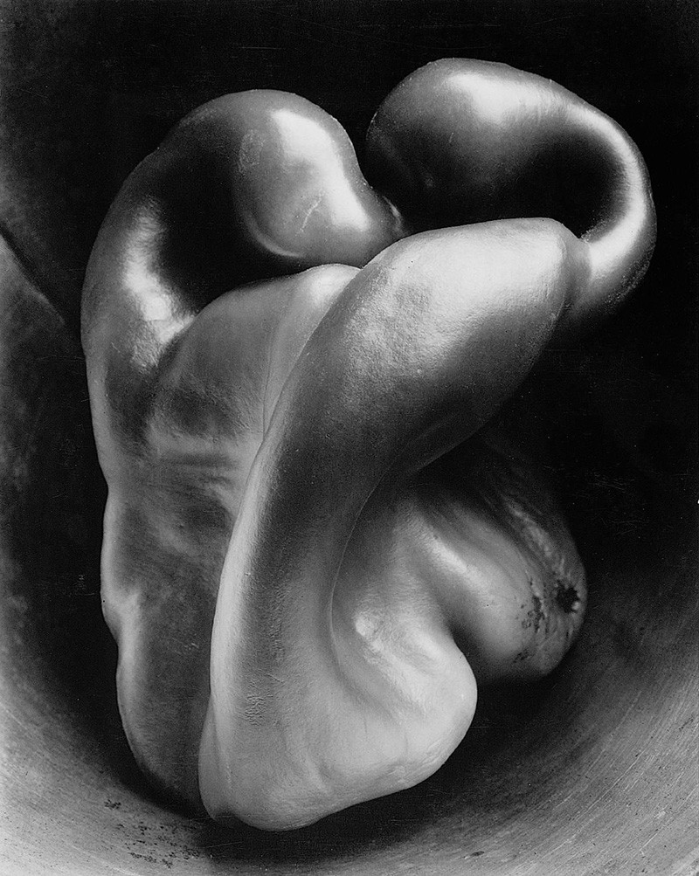
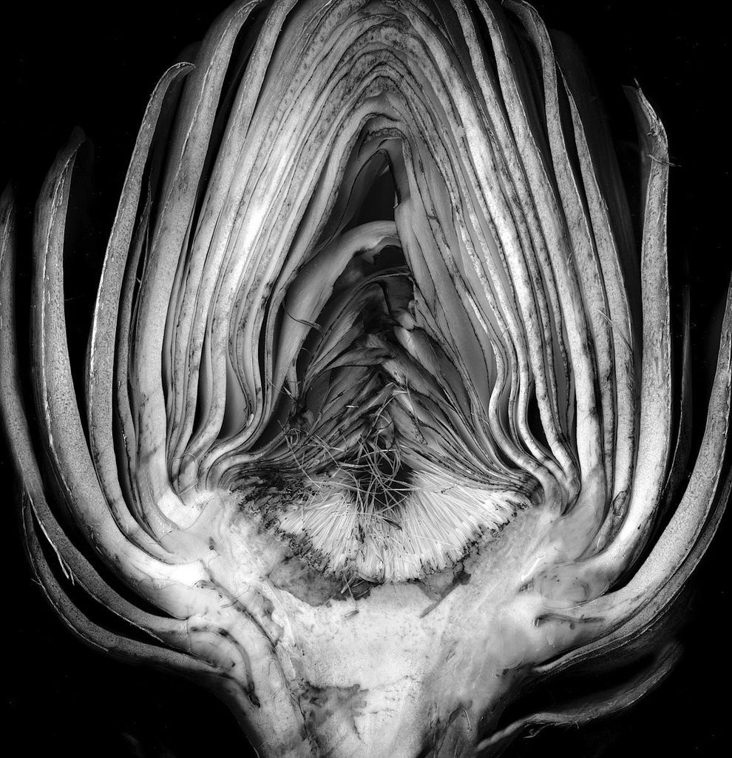
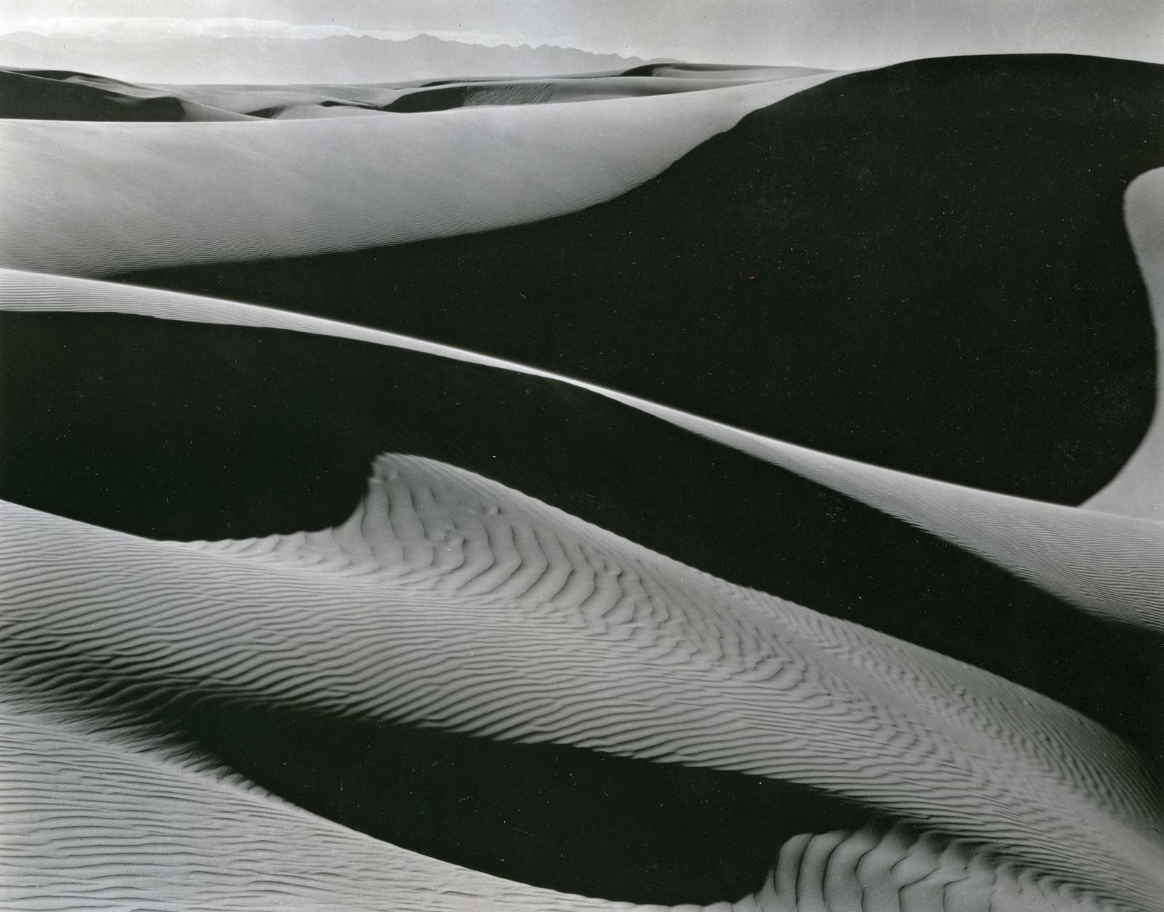
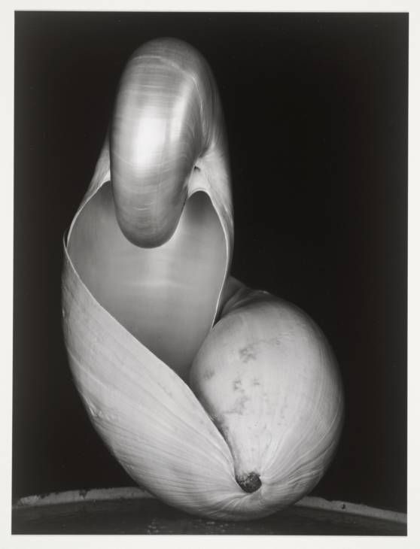
edward weston

Slide 13
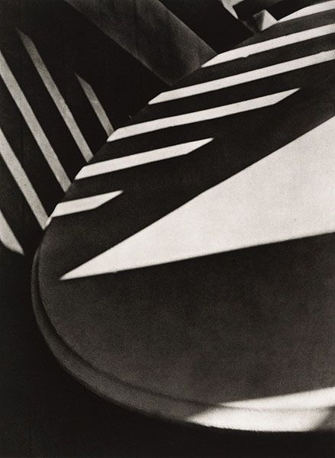
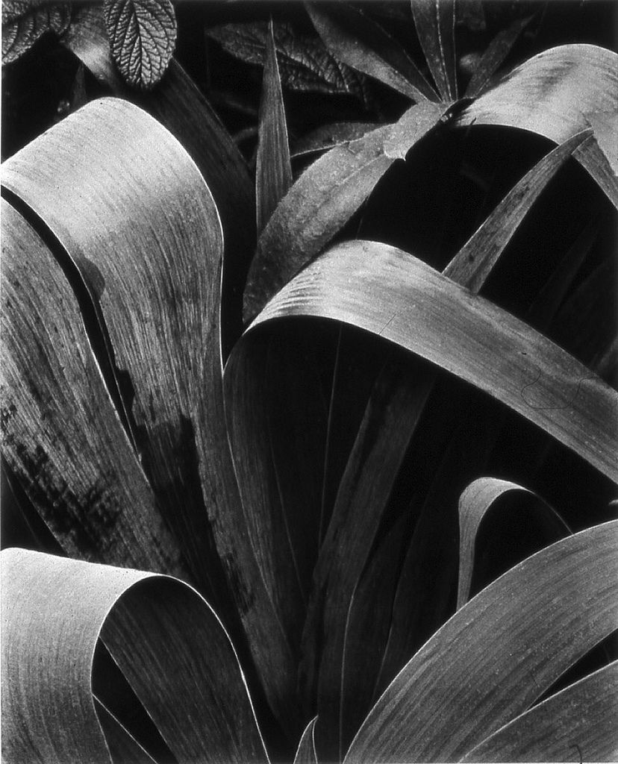
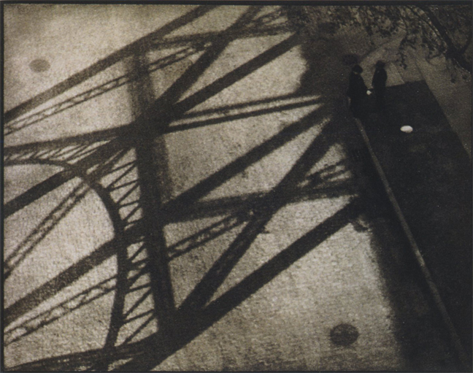
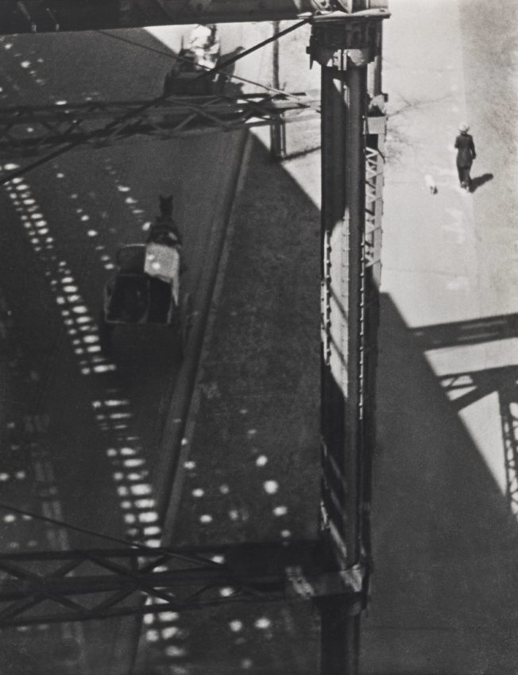
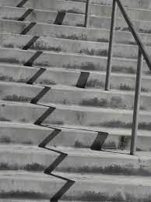
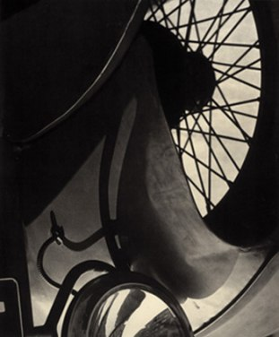
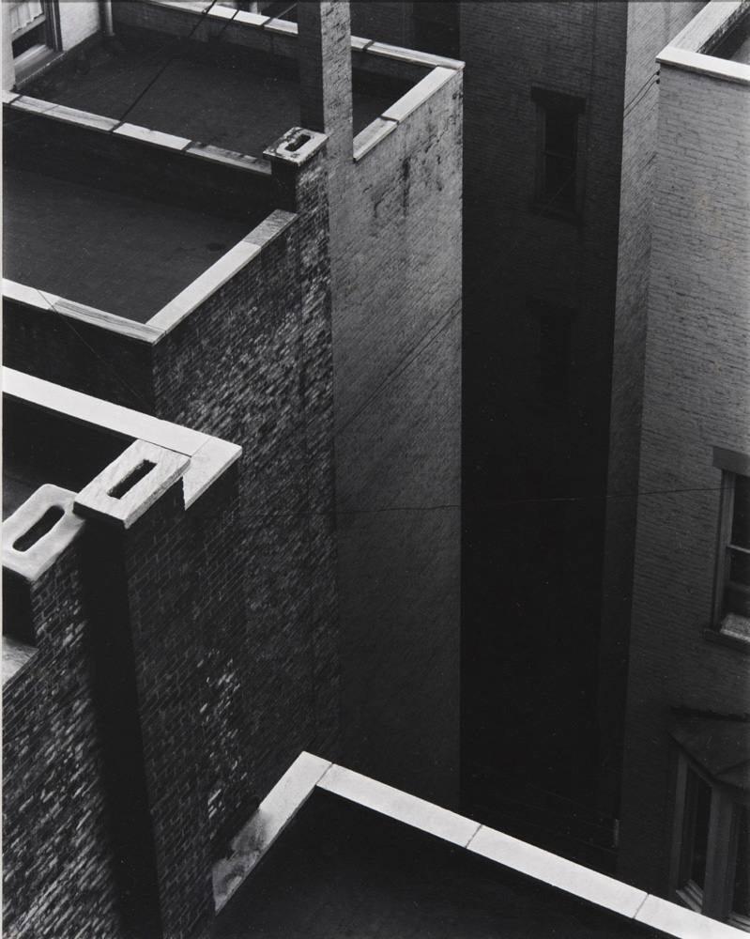
paul strand

Slide 14
But just what is it that makes a photograph abstract? It can seem difficult to pin down an exact definition, but there are many characteristics that make up abstract photography. Most commonly, abstraction takes place when a photographer focuses in on a fragment of a natural scene, isolating it from its context.
By zeroing in on the color, texture, line, shape, geometry, symmetry, or reflection of a scene, that photographer warps our perception of the real world and familiar objects. For instance, if you take a picture of a green apple, but zoom in on just a drop of water running down the bright green peel in a way that a viewer doesn't immediately recognize the object, but is more driven by the sensation, then you've taken a shot at abstraction.
- Jessica Stewart

Slide 15
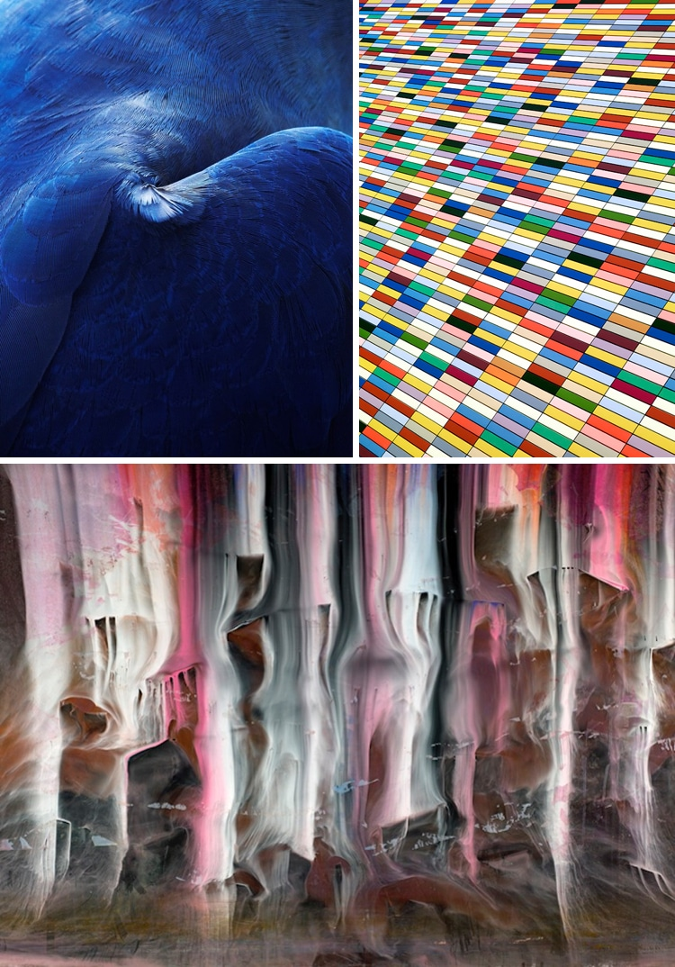
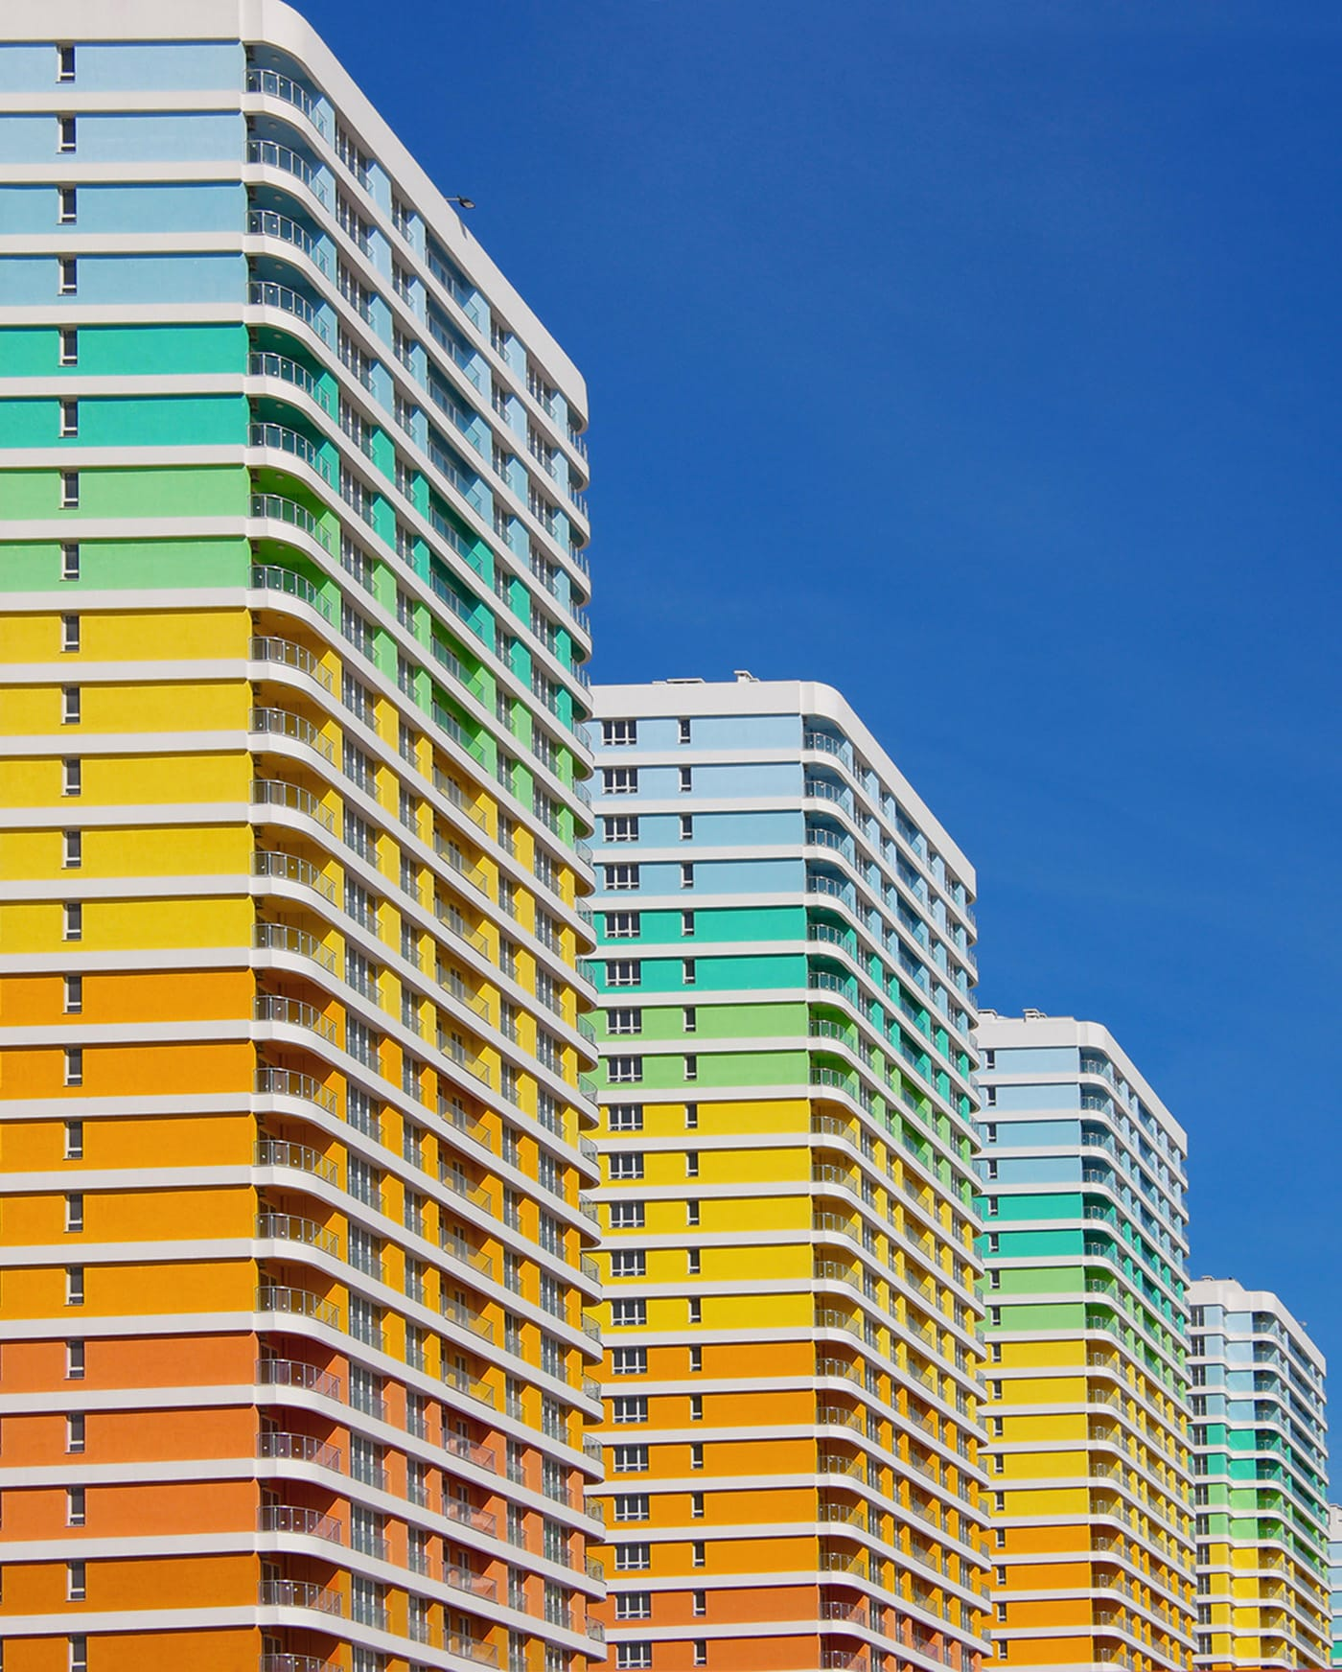

Slide 16
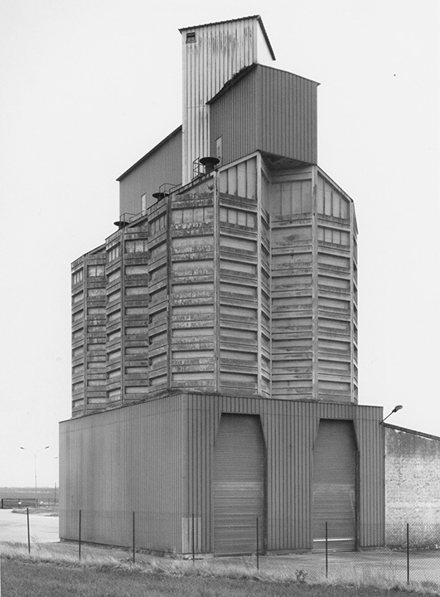
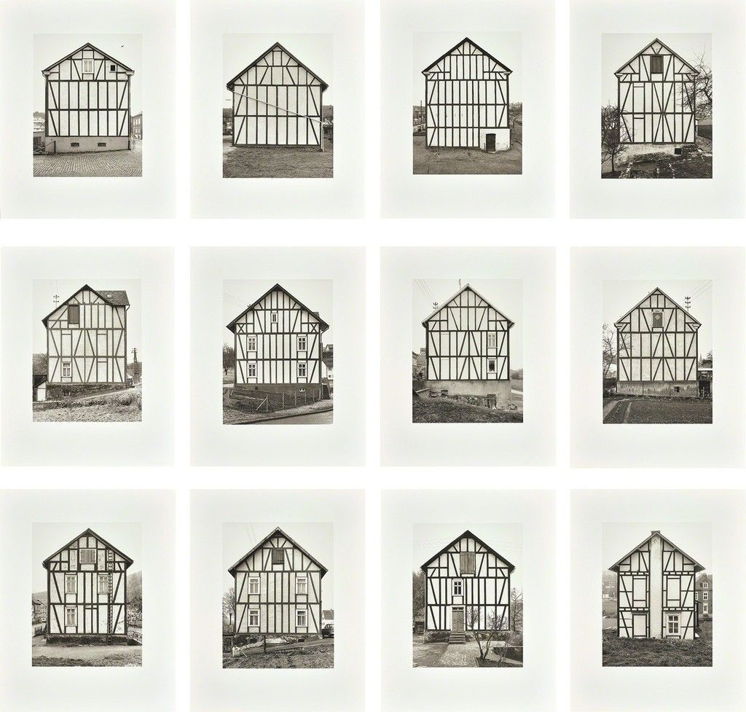
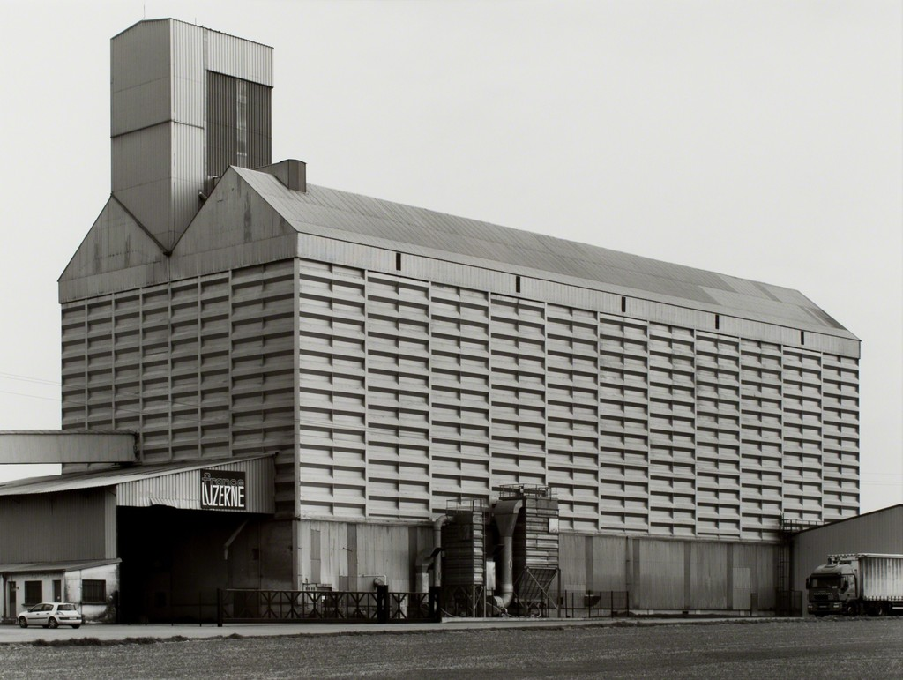
Hilla and Bernd Becher

Slide 17
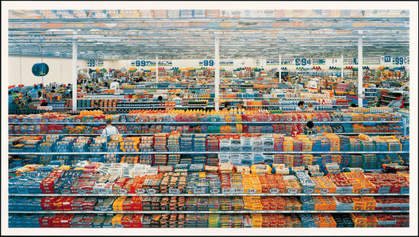
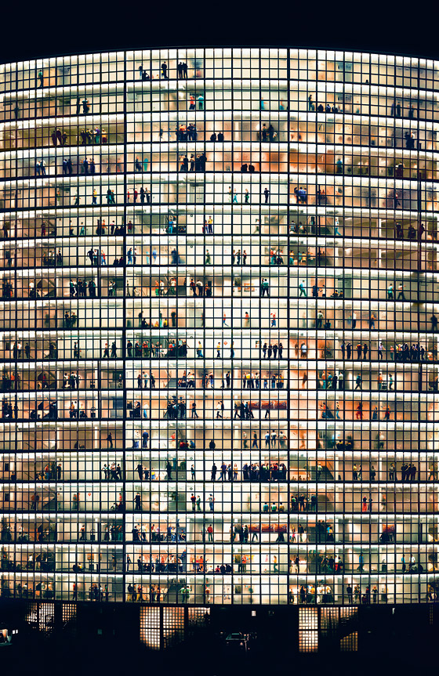
Andreas Gursky

Slide 18
Mixed-media photography
Em Rooney

Slide 19
Sara Lando
Mixed-Media artwork broadly defines any work made using more than one media. If one of those media is photography you could call it mixed-media photography.
Tyler Spangler
Jisoo Im

Slide 20
Em Rooney
Annegret Soltau
Matt Greco

Slide 21
Vic Muniz
Sara Fahling
Materials have their own character and workability, within this is an inherent history and meaning. You can use these common aspects to further meaning in your work. By combining photography with other media, you create a synergy with the two. Check out Vic Muniz’s work for a great example of this.
Ricardo Candia Hernández
Vic Muniz

Slide 22
MATTHEW BRANDT
Using his surroundings as an additive medium, Brandt’s printed photographs are bathed in a mixture of water collected from the site in which the composition was derived. Through this experimental process, the artist becomes closer to his specific subjects and gains a better understanding of his surroundings as a whole.

Slide 23
SZYMON ROGINSKI

Slide 24
Sofia Borges

