Slide 1
PHOTOGRAPHY from the Greek Photos: Light Graphe: Draw

Slide 2
It all starts with light… and ends with light

Slide 3
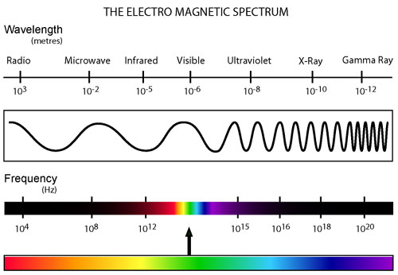

Slide 4
17th Century Sketch of a Camera Obscura

Slide 5
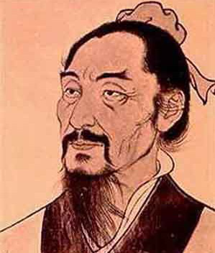
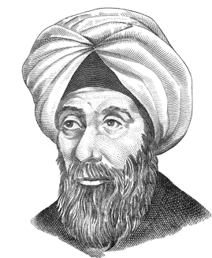
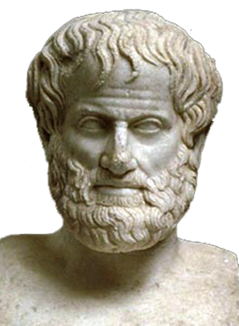
Camera Obscura from the Latin: “Dark Room”
Ibn al-Haytham knew it, clearly described it and actually made one (Arabia c1000 AD)
Mozi knew it first
(China c400 BC)
Aristotle knew it
(Greek c350 BC)

Slide 6
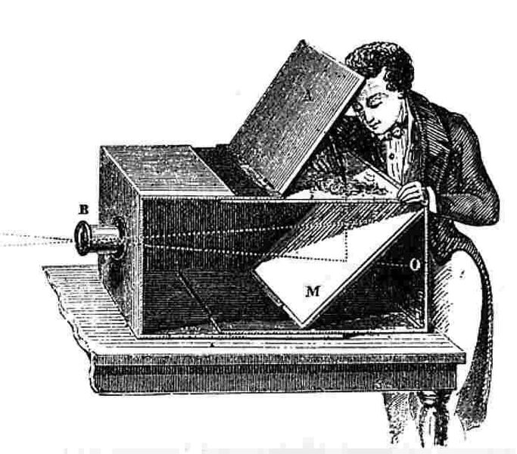
Camera Obscura circa 1750

Slide 7
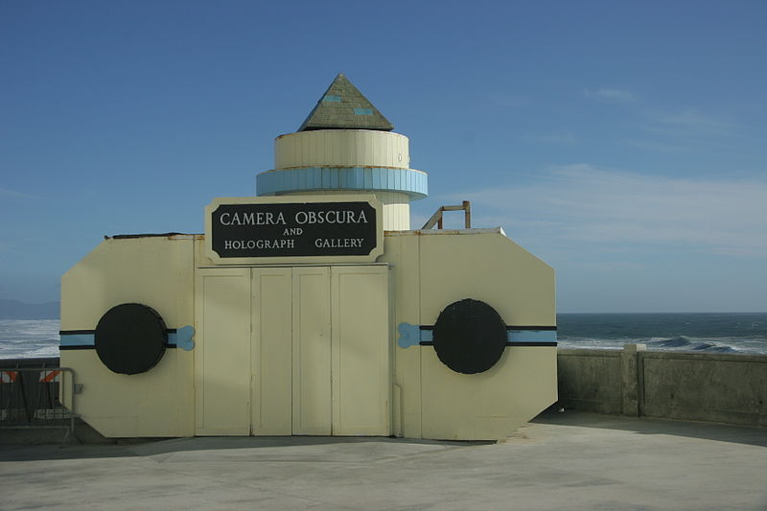
Room Size Camera Obscura, San Francisco California

Slide 8
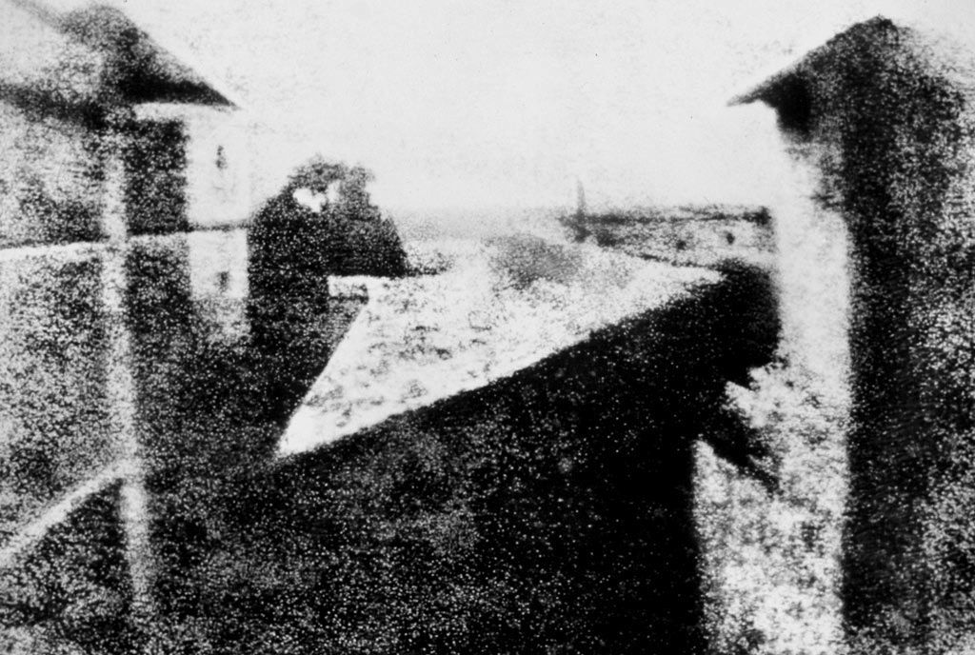
Joseph Nicéphore Niépce 1826

Slide 9
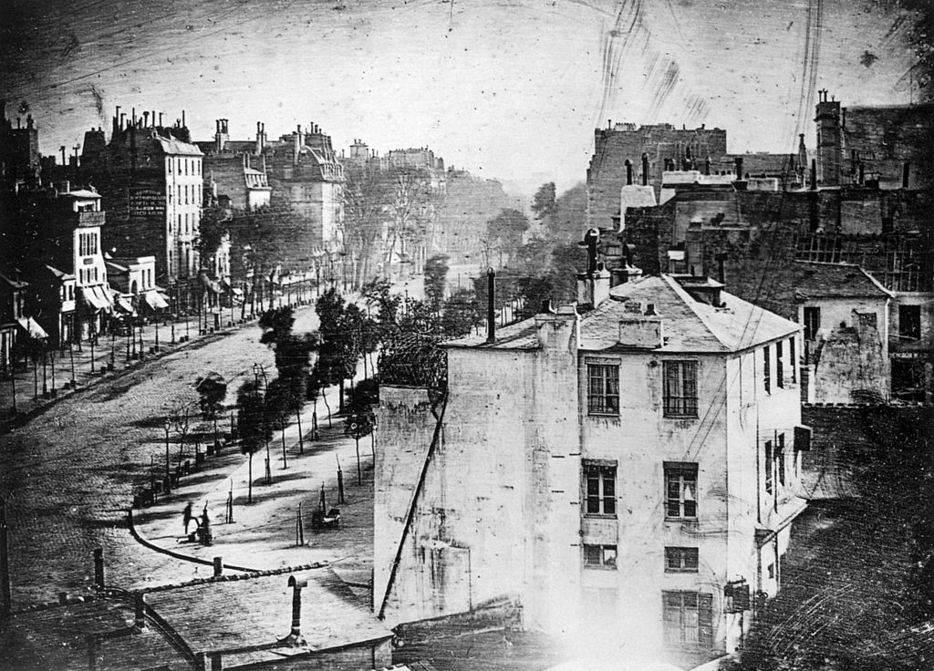
Boulevard du Temple, Paris, Louis Daguerre in late 1838 or early 1839

Slide 10
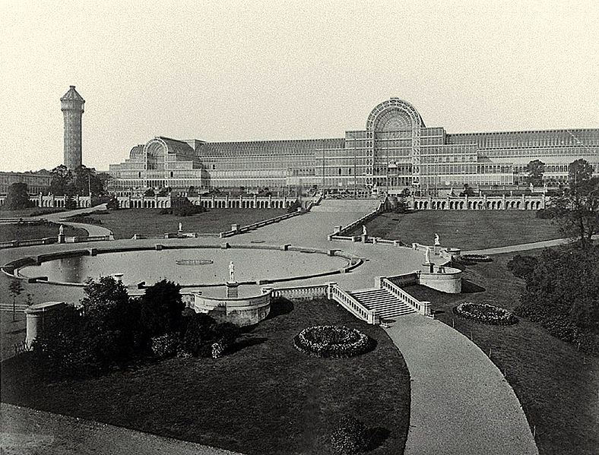
The Crystal Palace at The Great Exhibition, by Philip Henry Delamotte, 1854

Slide 11
Joseph Nicéphore Niépce (1765 – 1833)

Slide 12
Louis Daguerre (1787-1851)

Slide 13
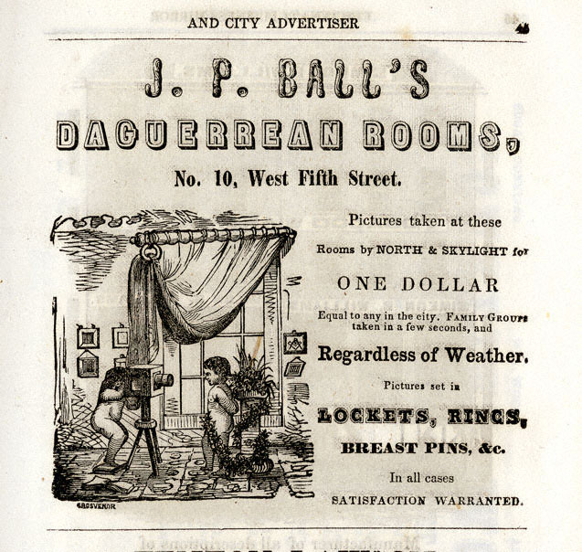
James Presley Ball (1825-1904) Prominent African-American abolitionist, entrepreneur, and Daguerreotypist.

Slide 14
William Henry Fox Talbot (by John Moffat c. 1864)

Slide 15
Sir John Frederick William Herschel (1792-1871)

Slide 16
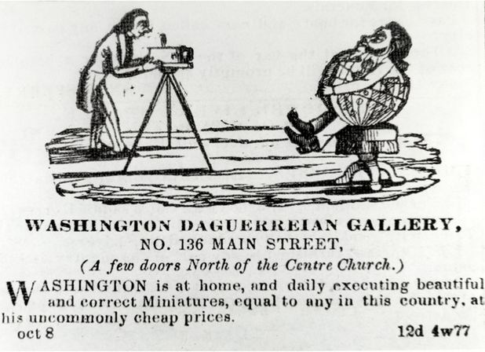
Augustus Washington (c. 1820 – June 7, 1875) was an American photographer and daguerreotypist. He was born in New Jersey as a free person of color and immigrated to Liberia in 1852. He is one of the few African-American daguerreotypists whose career has been documented. Portrait of Joseph Jenkins Roberts (c. 1854)

Slide 17
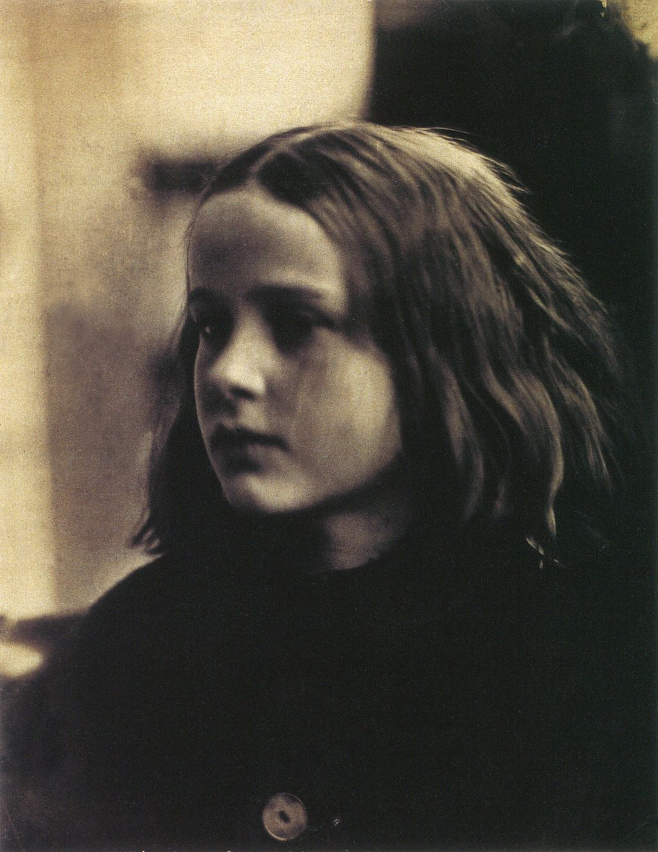
Julia Margaret Cameron (1815 – 1879) was a British photographer who is considered one of the most important portraitists of the 19th century. She is known for her soft-focus close-ups of famous Victorian men and for illustrative images depicting characters from mythology, Christianity, and literature. She also produced sensitive portraits of women and children.
(c. 1870 by Henry Herschel Hay Cameron)
(c. 1864 portrait of Annie Philpot by
Julia Margaret Cameron)

Slide 18
Roger Fenton (1819-1869) Early War Photographer (Crimean War)

Slide 19
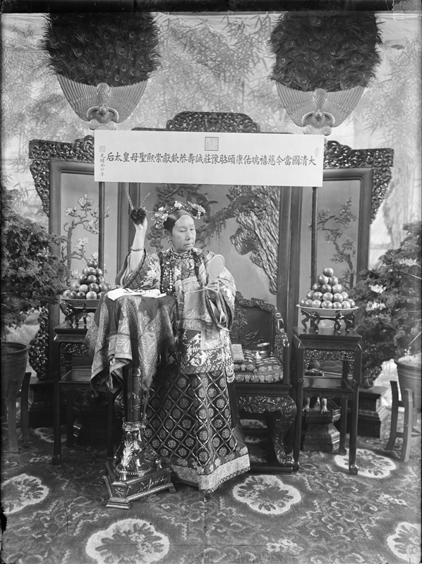
Yu Xunling (裕 勋 龄; Yù Xūnlíng ; 1880–1943) was a Chinese photographer, and the widow Empress Cixi's court photographer during the late Qing Dynasty. He was the only photographer allowed by the widowed empress to photograph her.
Few photographs remain of the Empress Dowager Cixi (1835–1908), China’s notorious head of state during the final decades of the imperial era. Cixi used photographs to model perceptions of her character at the very moment photography was becoming a mass-media vehicle and the Qing dynasty (1644 to 1912) was struggling to survive in a hostile imperialistic world.

Slide 20
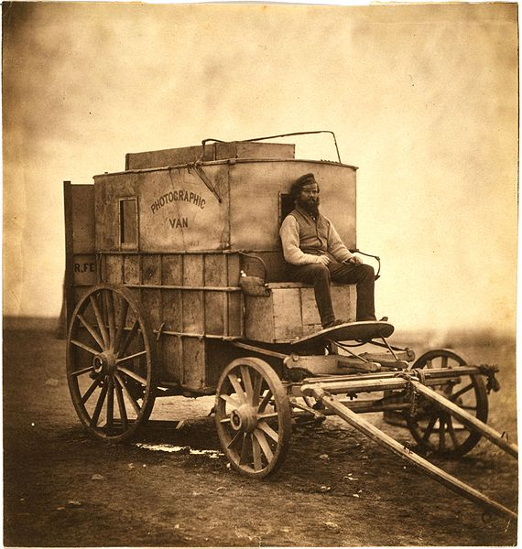
Roger Fenton's photographic van, circa 1855

Slide 21
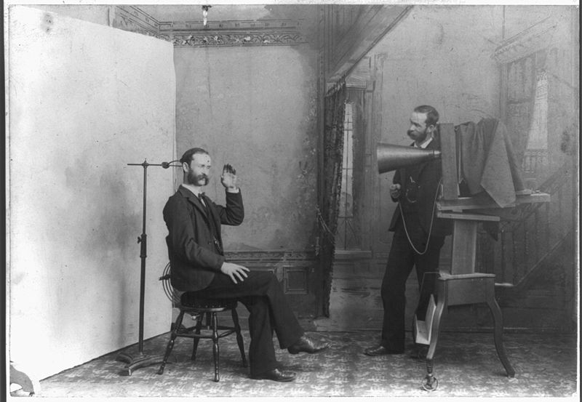
Photographer’s Studio circa 1895

Slide 22
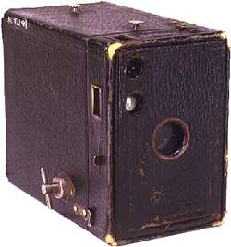
Eastman Kodak Brownie Camera, circa 1900

Slide 23
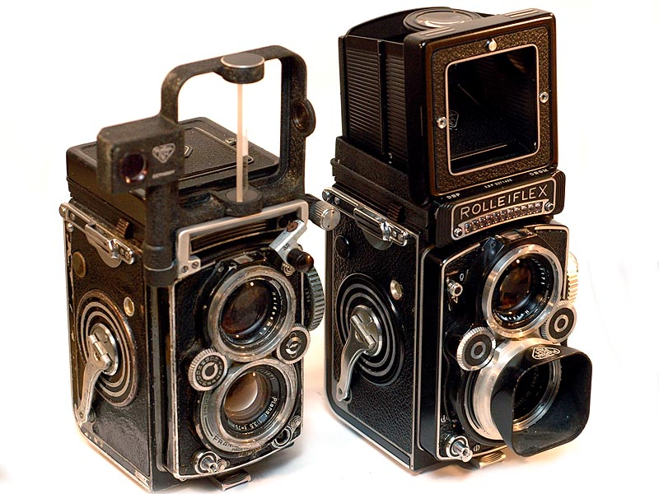

Slide 24
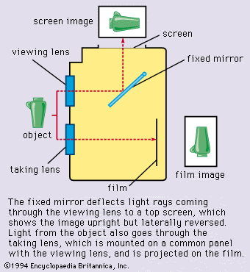

Slide 25
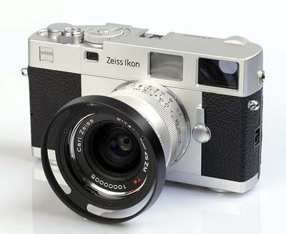

Slide 26
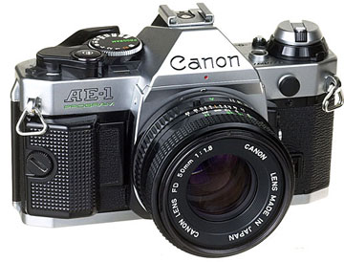

Slide 27
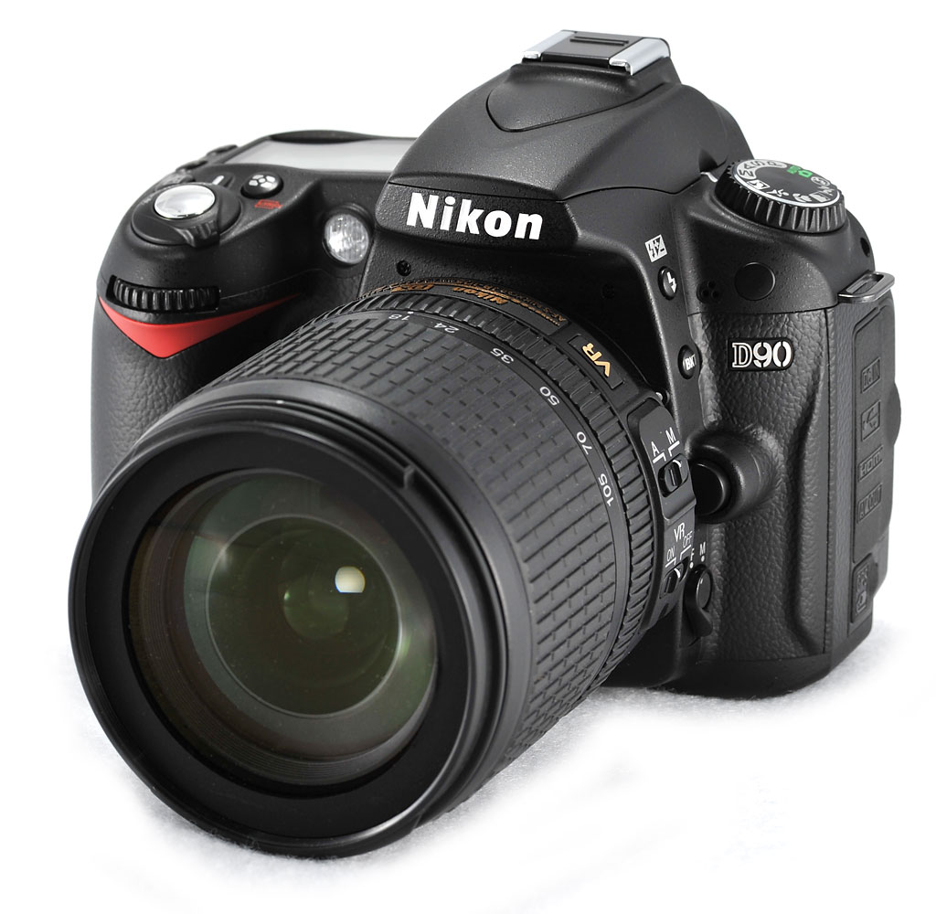

Slide 28
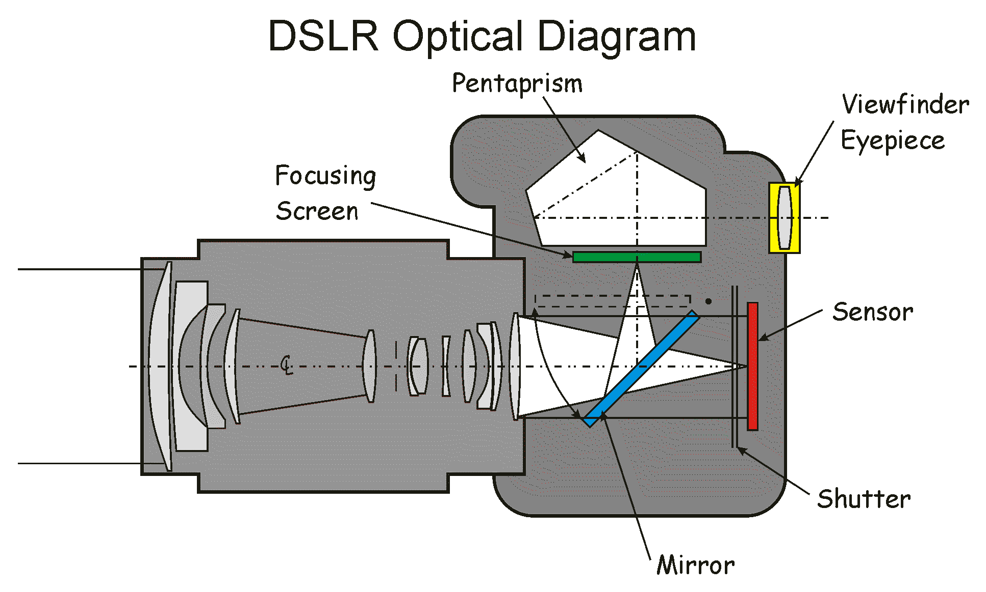

Slide 29
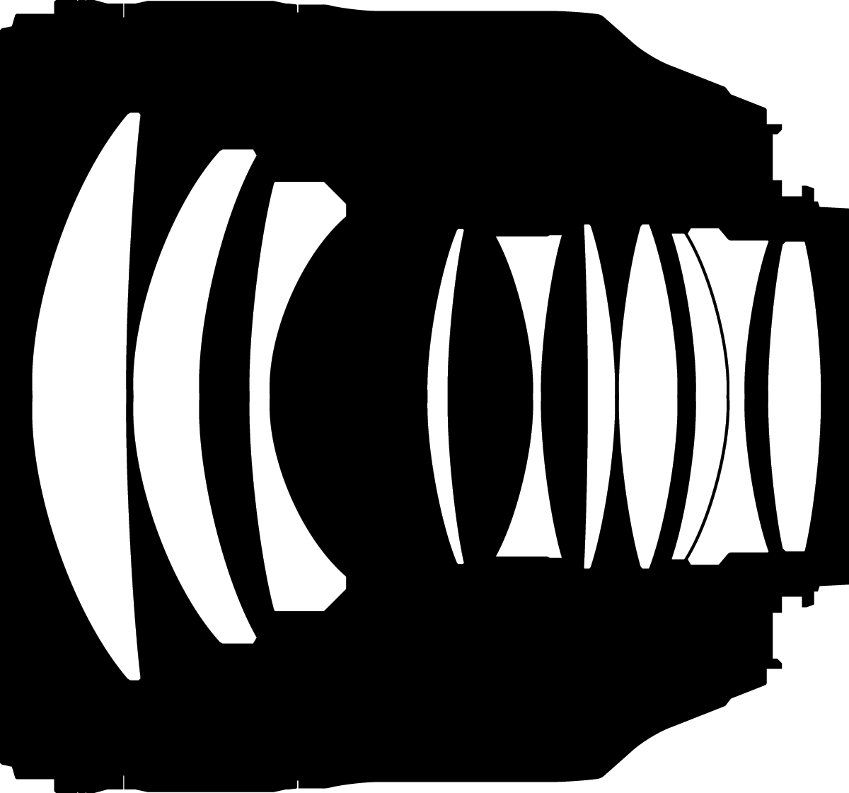

Slide 30
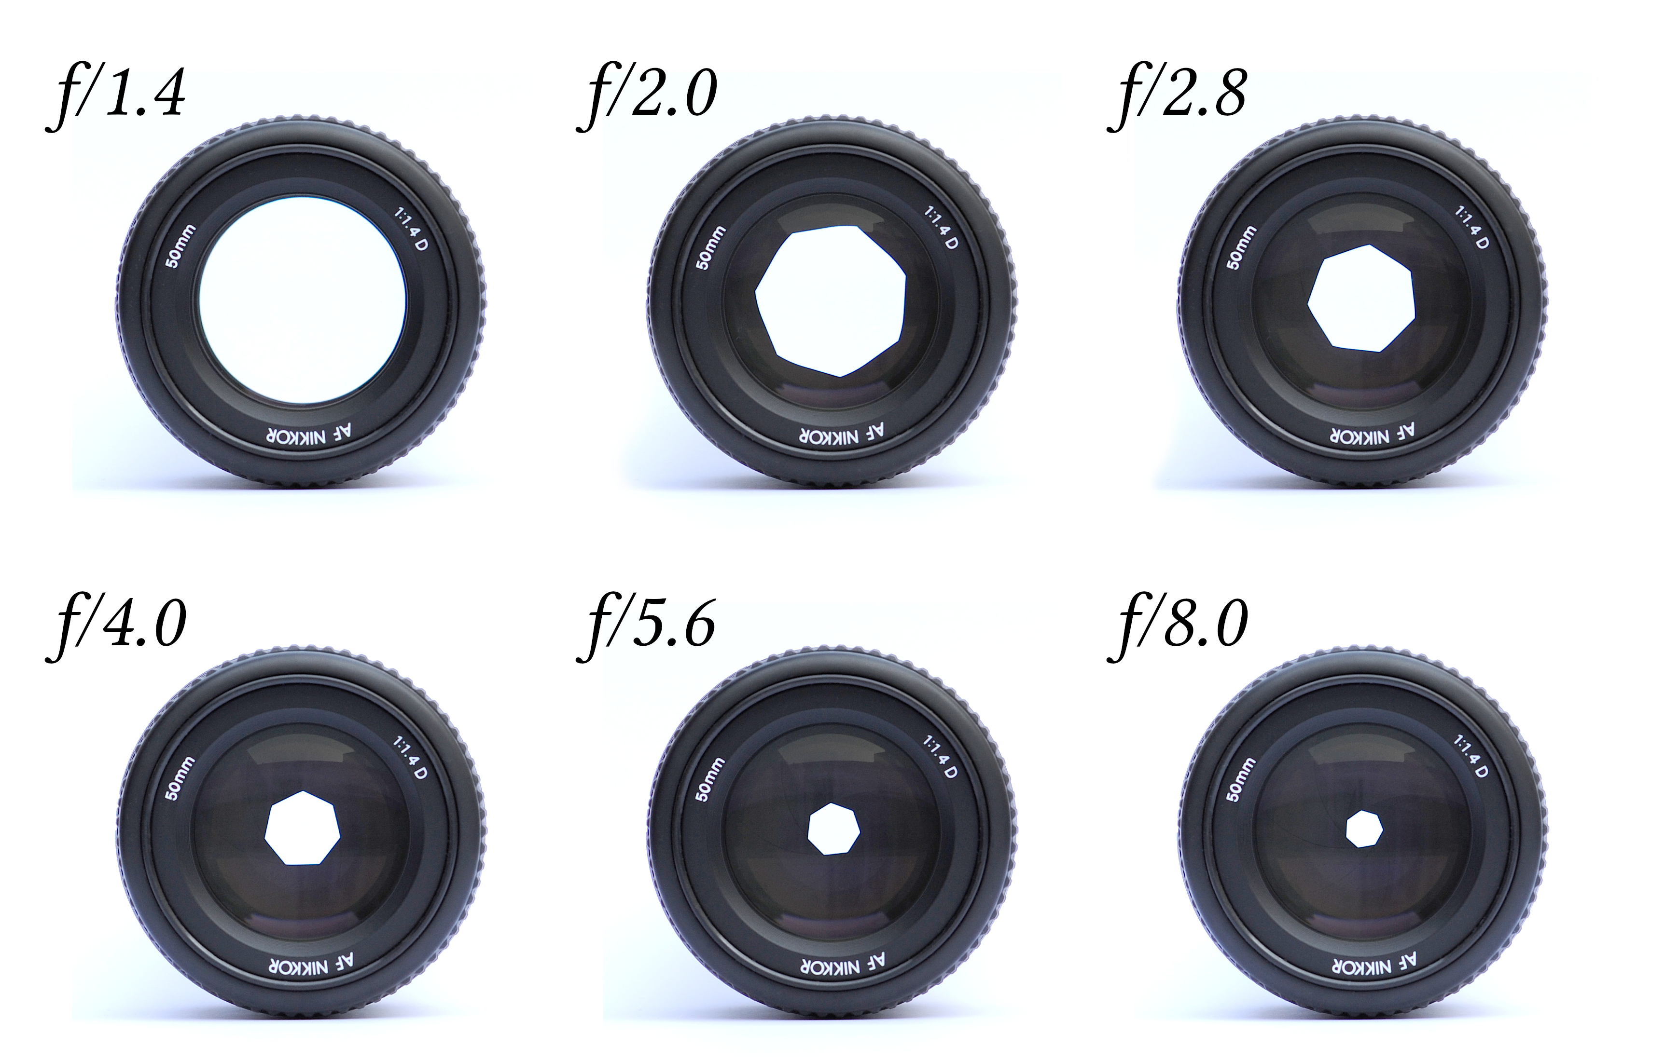

Slide 32
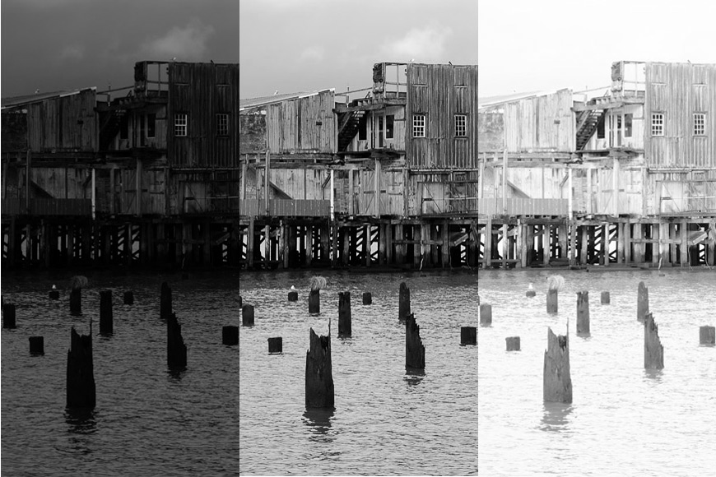

Slide 33
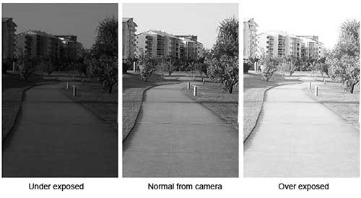
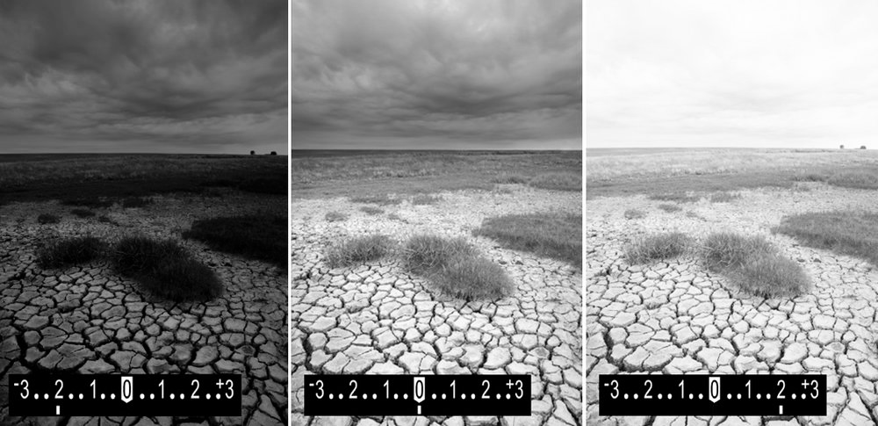

Slide 34
Standard Shutter Speeds:
1/4 1/8 1/15 1/30 1/60 1/125 1/250 1/500 1/1000
Standard f-stops:
1.4 2.0 2.8 4 5.6 8 11 16 22
Shutter Speed
1/8 1/15 1/30 1/60 1/125 1/250 1/500 1/1000
f/stop
f/32 f/22 f/16 f/11 f/8 f/5.6 f/4 f/2.8

Slide 35
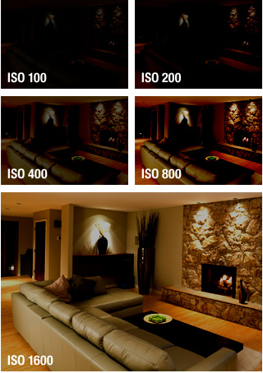
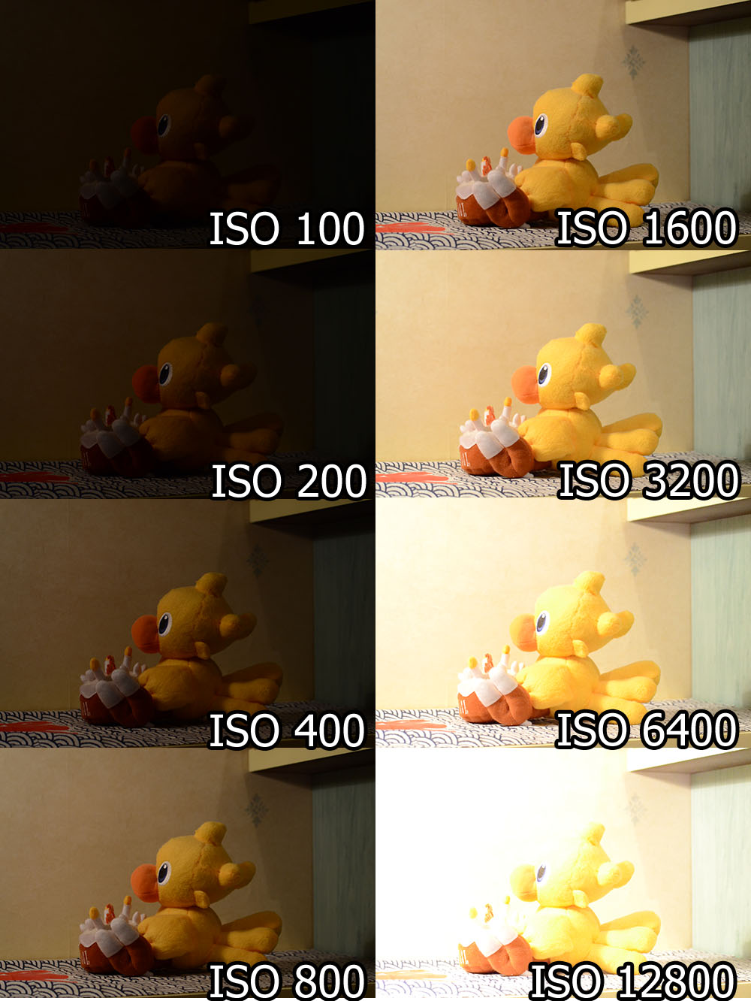
Sensor Sensitivity aka ISO or ASA

Slide 36
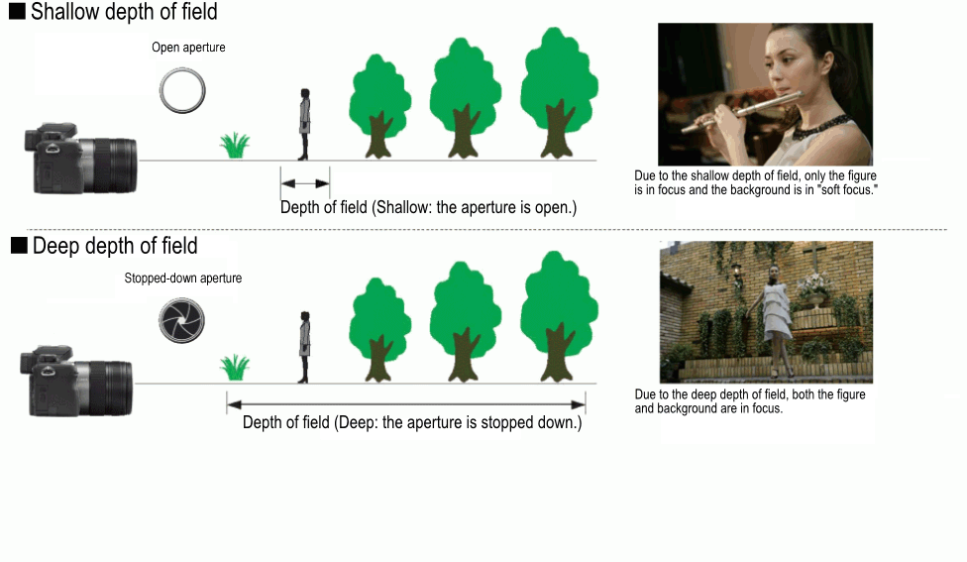
Depth of Field Example

Slide 37
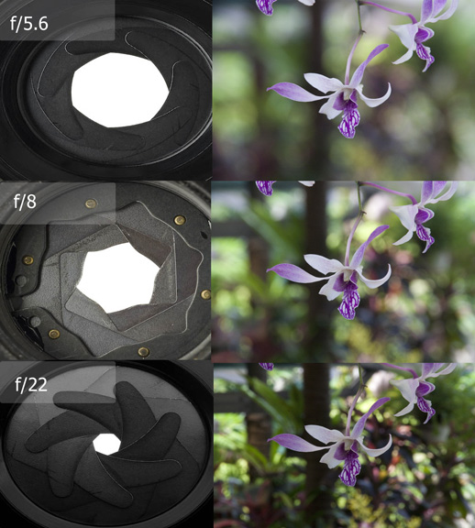
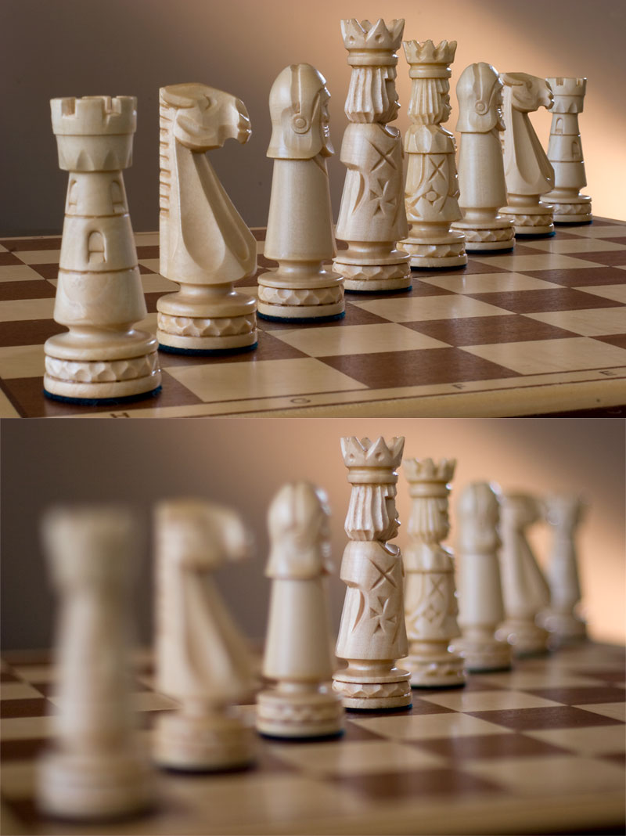
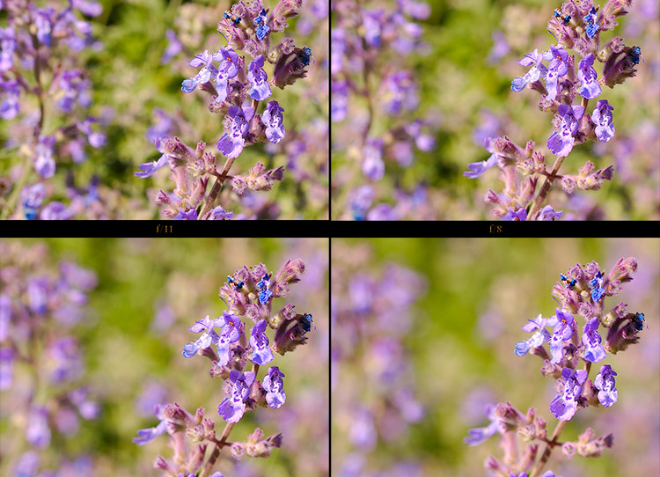

Slide 38
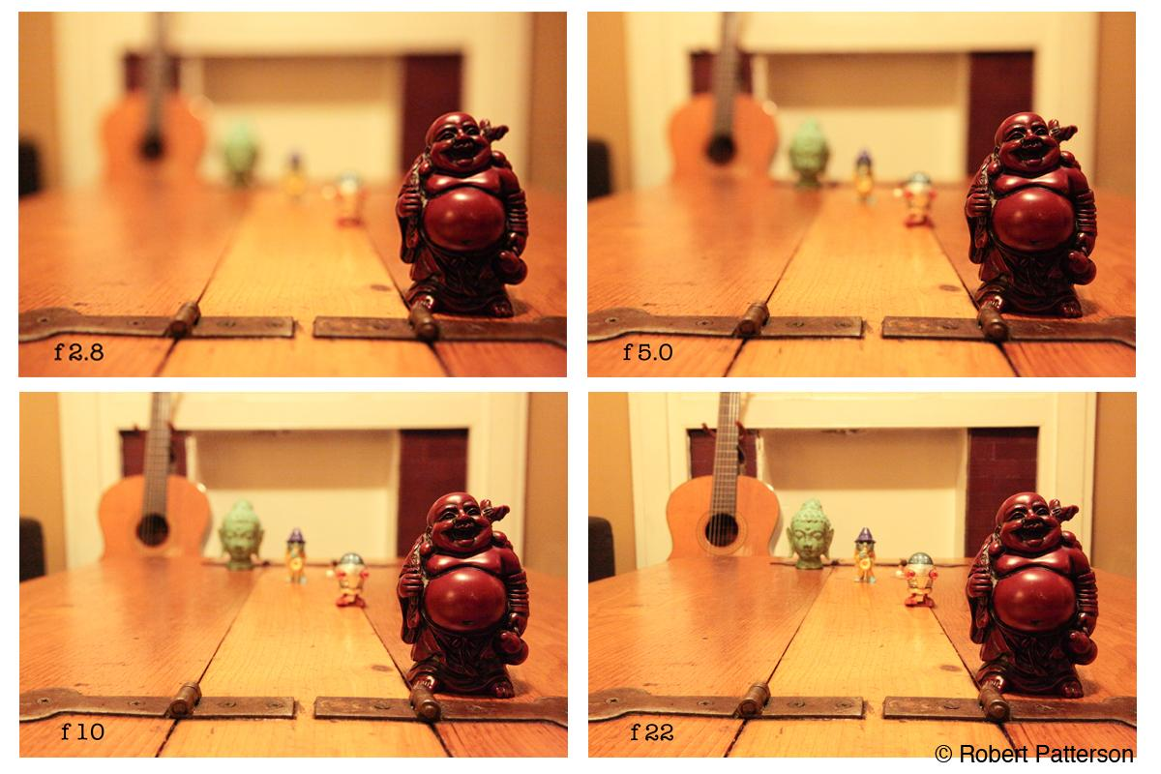

Slide 39
Shutter Speed’s Effect on Motion

Slide 40
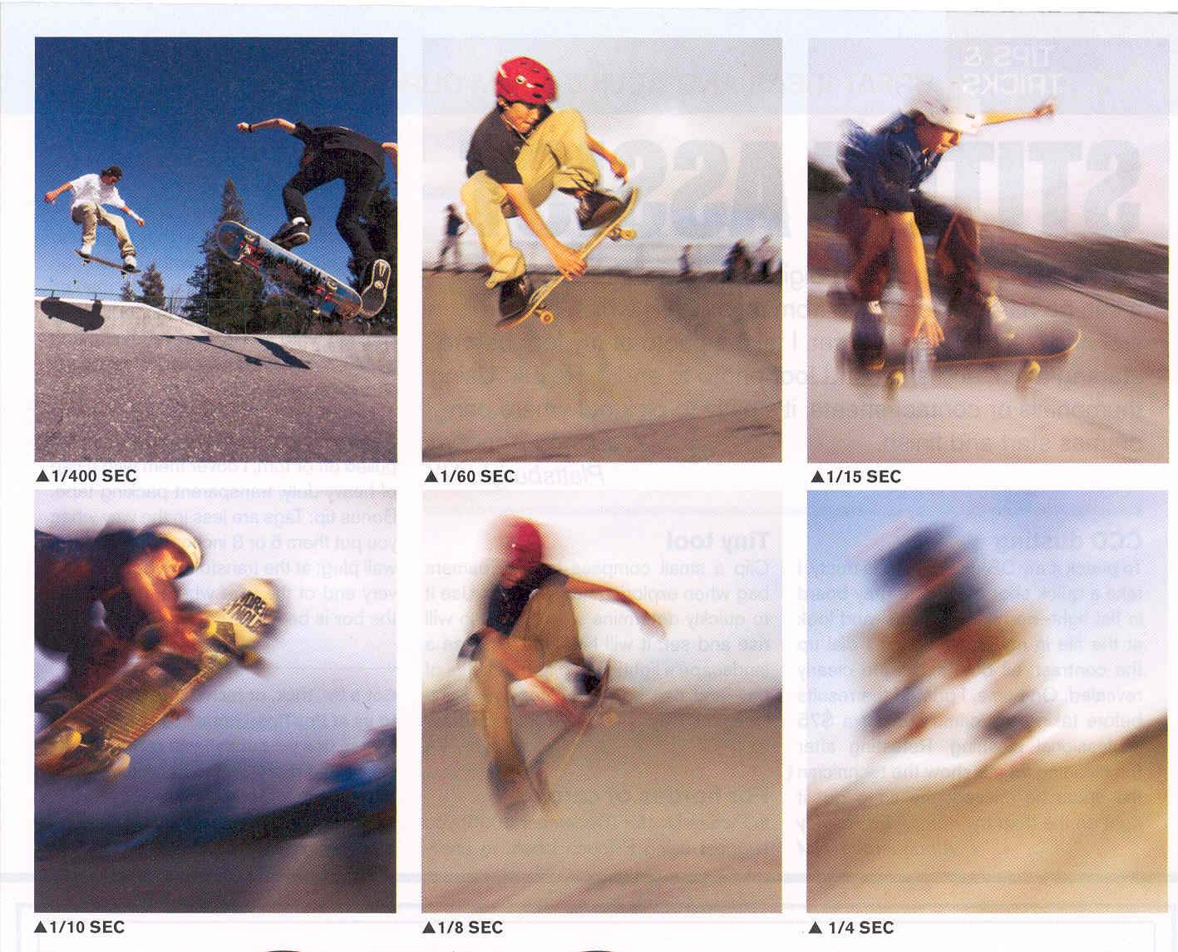

Slide 42
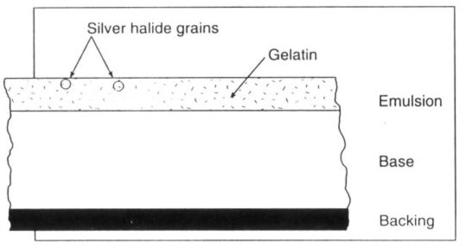

Slide 43
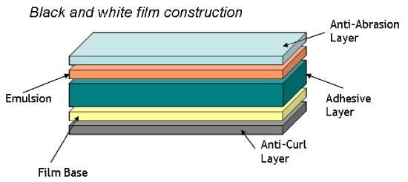

Slide 44
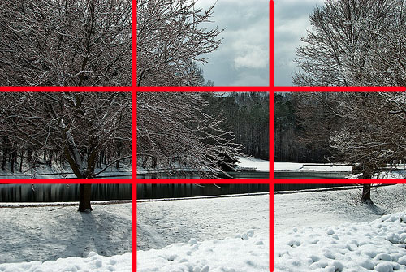
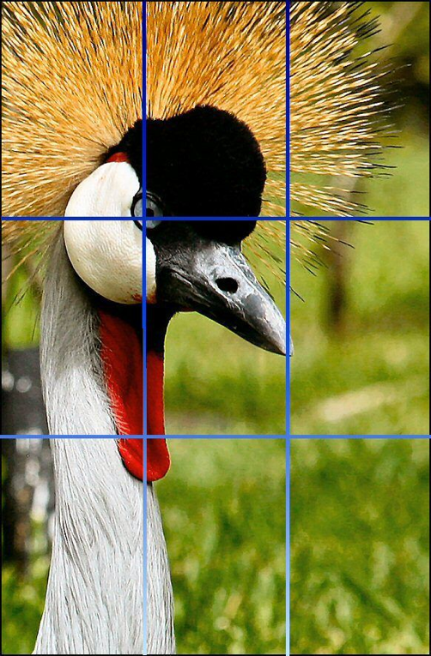
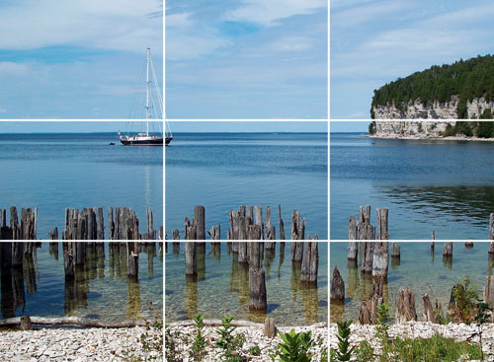
Rule of Thirds Example

Slide 45
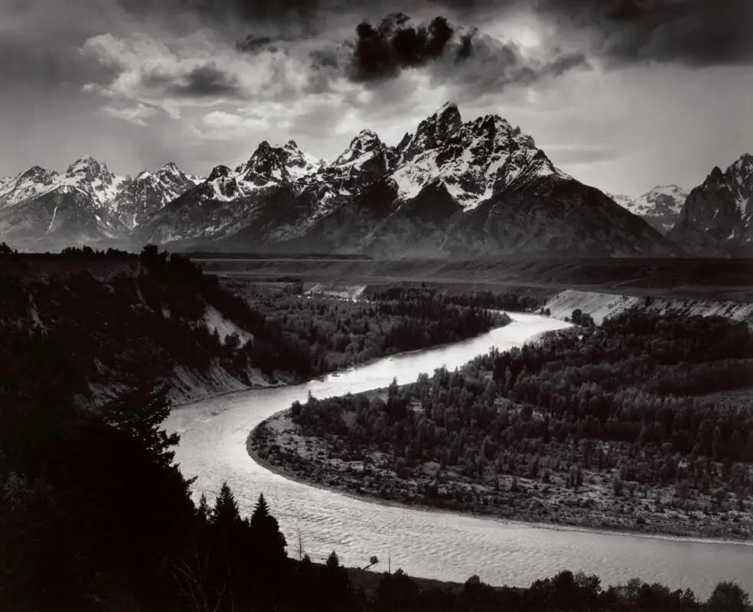
Ansel
Adams
b.1902

Slide 46
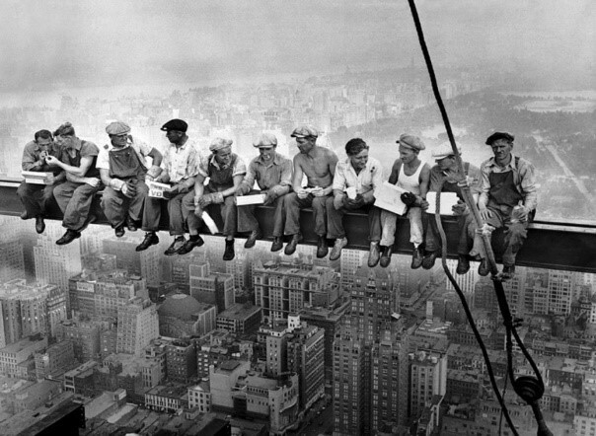
Charles Ebbets b.1905

Slide 47
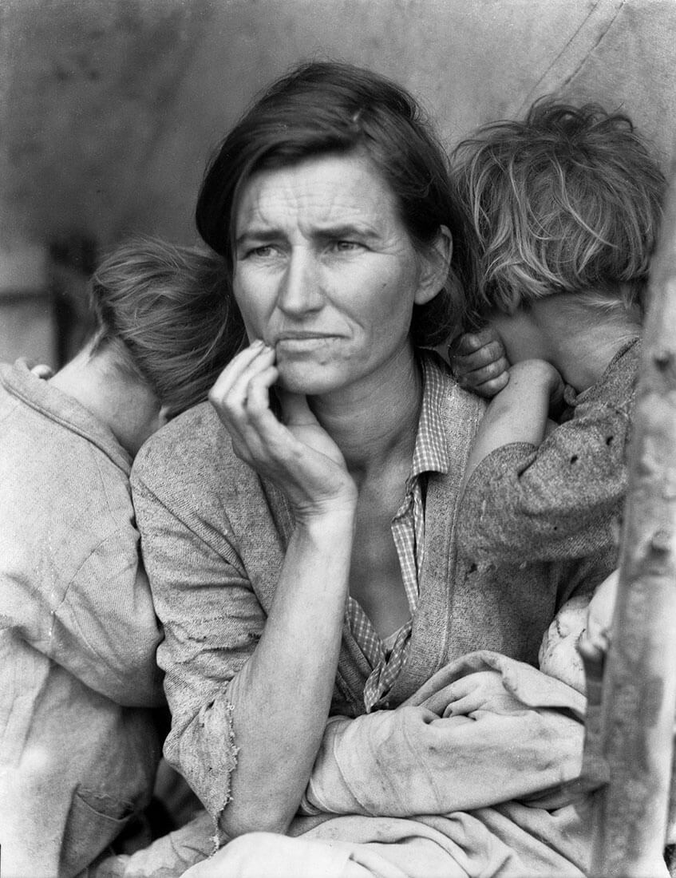
Dorothea Lange
b.1895

Slide 48
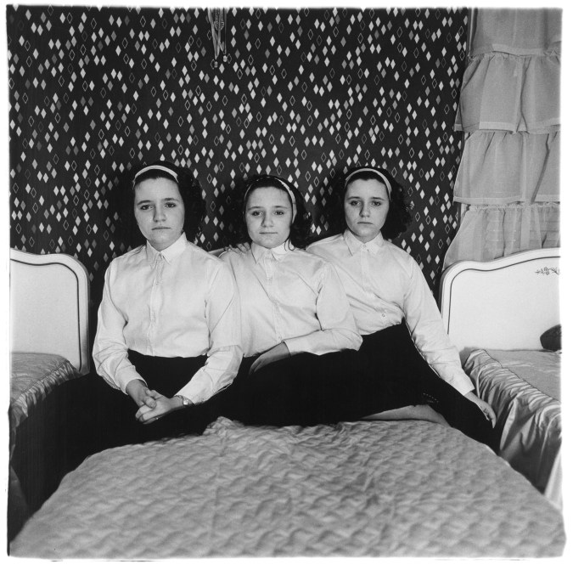
Diane Arbus
b.1923

Slide 49
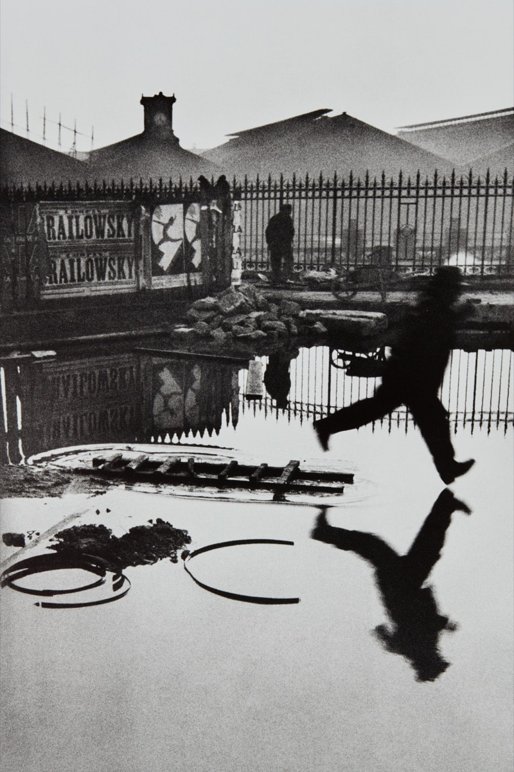
Henri Cartier Bresson
b.1908

Slide 50
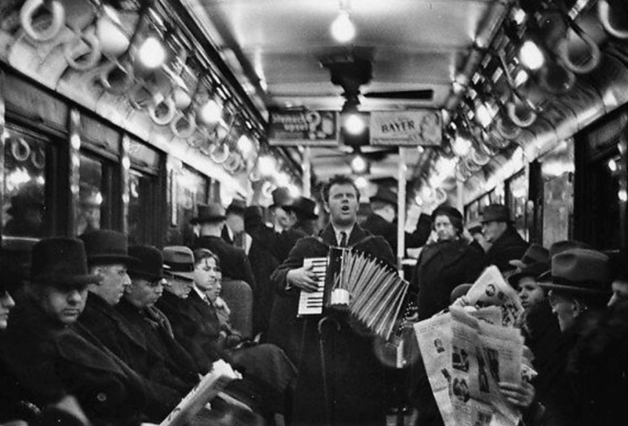
Walker Evans b.1903

Slide 51
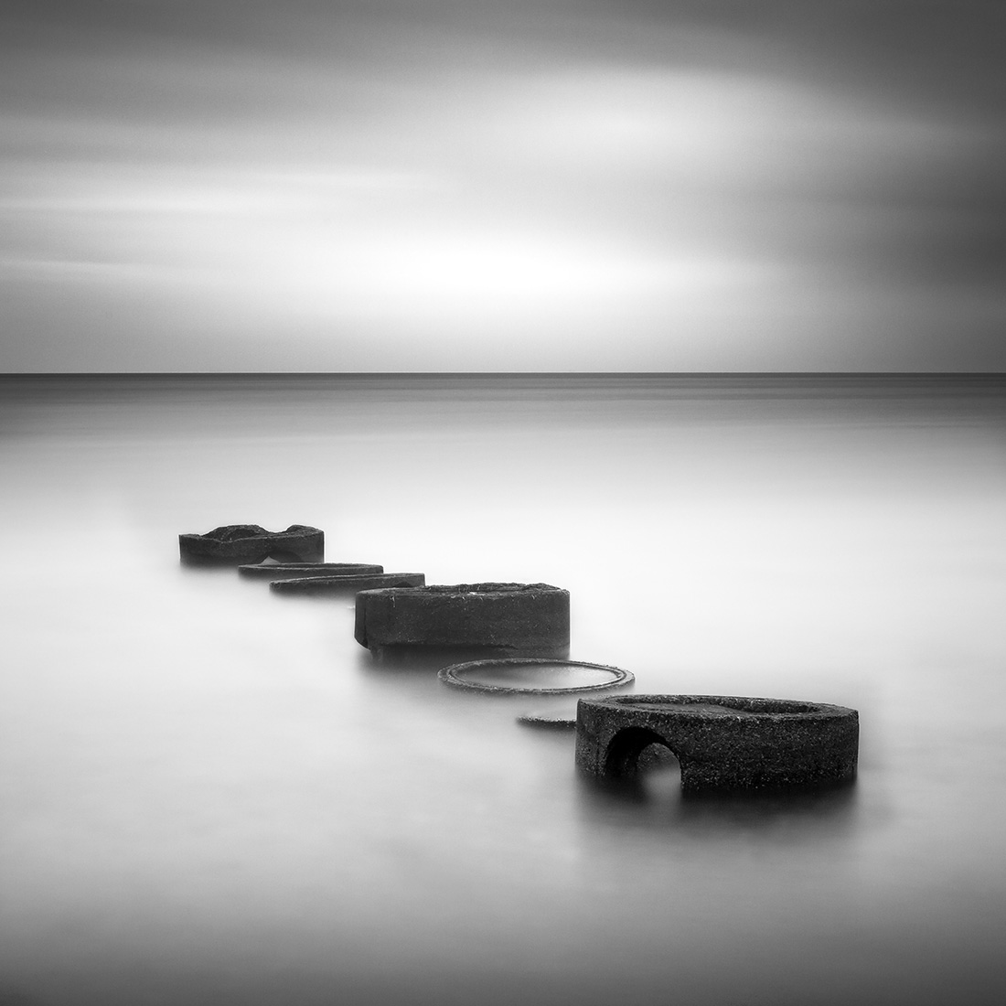
Michael Bille

Slide 52
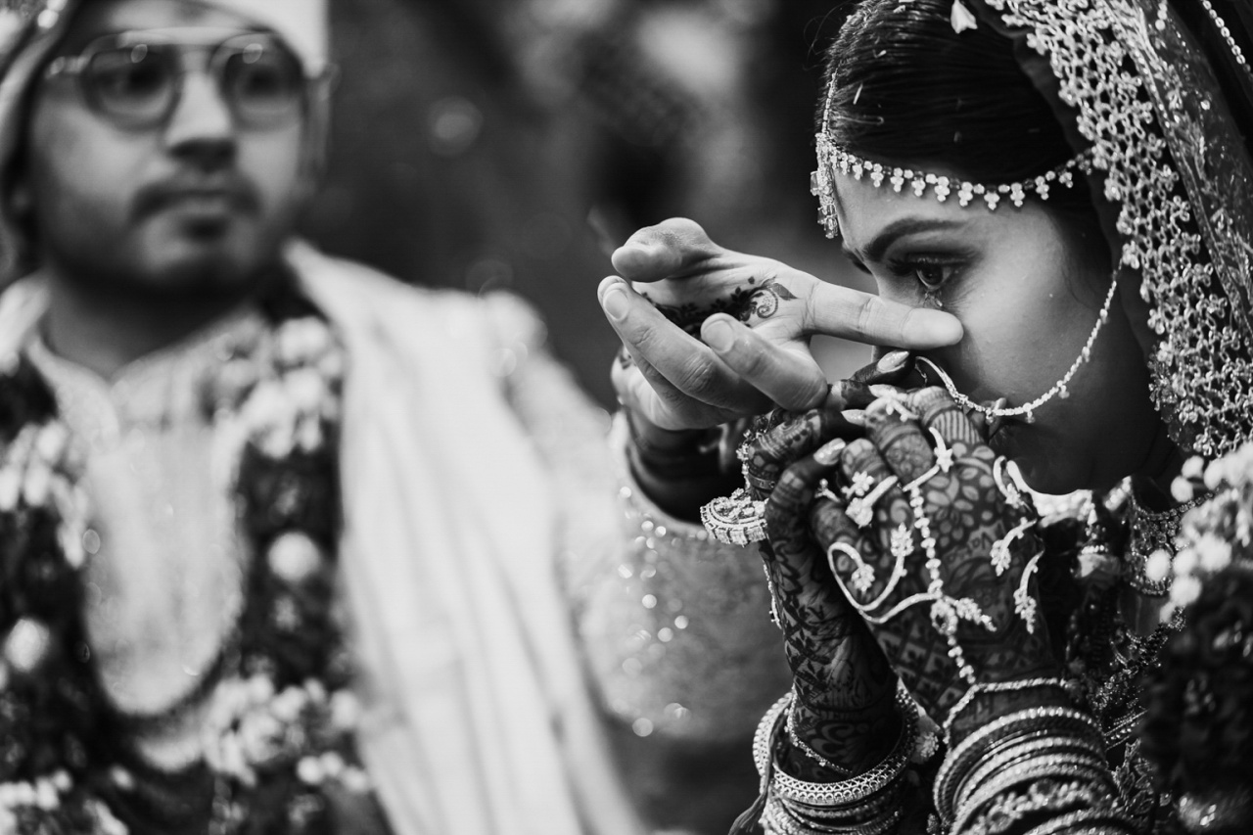
Mohamed Jameer

Slide 53
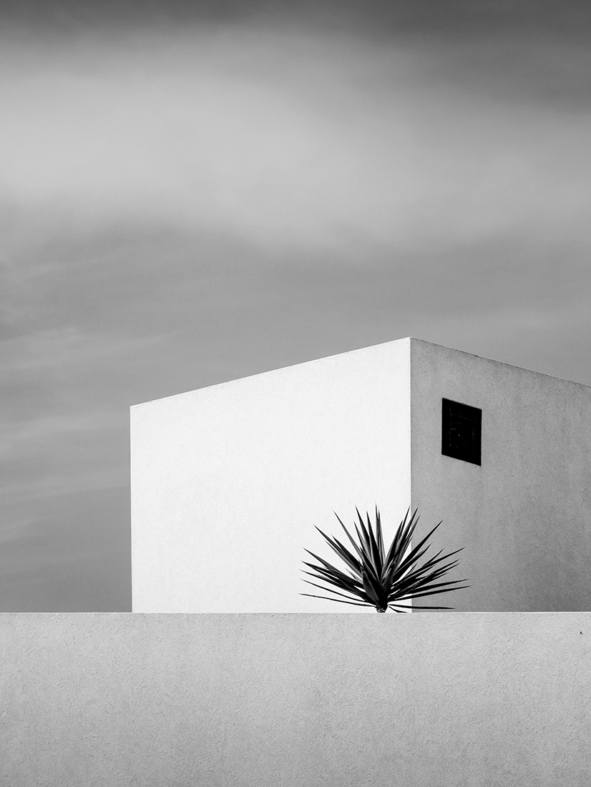
Renate Wasinger

