Slide 1
PHOTOGRAPHY from the Greek Photos: Light Graphe: Draw

Slide 2
It all starts with light… and ends with light

Slide 3
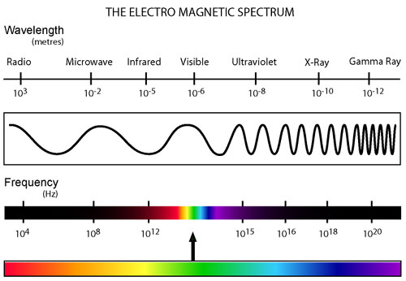

Slide 4
17th Century Sketch of a Camera Obscura

Slide 5
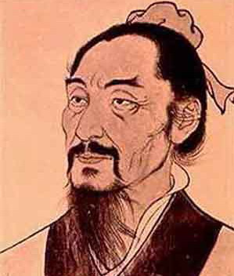
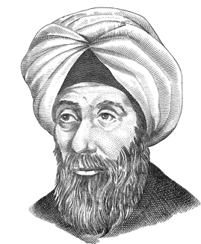
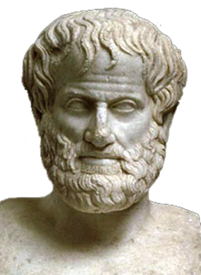
Camera Obscura from the Latin: “Dark Room”
Ibn al-Haytham knew it, clearly described it and actually made one (Arabia c1000 AD)
Mozi knew it first
(China c400 BC)
Aristotle knew it
(Greek c350 BC)

Slide 6
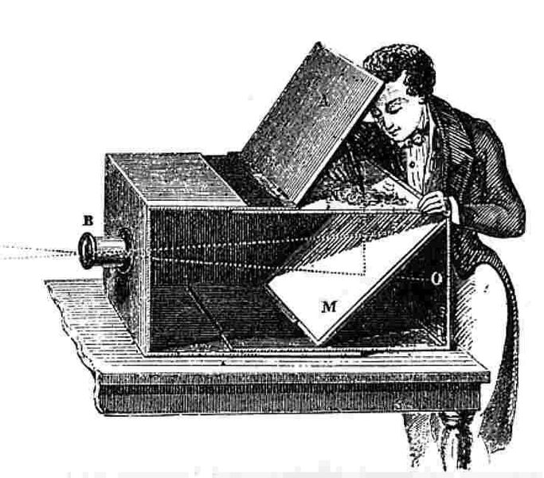
Camera Obscura circa 1750

Slide 7
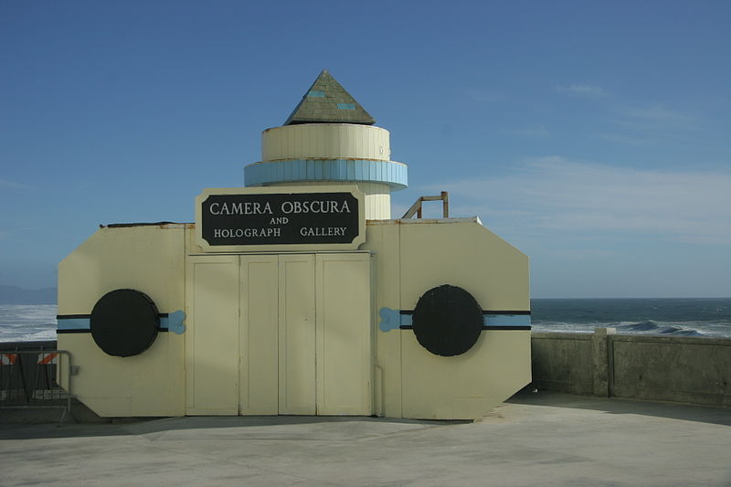
Room Size Camera Obscura, San Francisco California

Slide 8
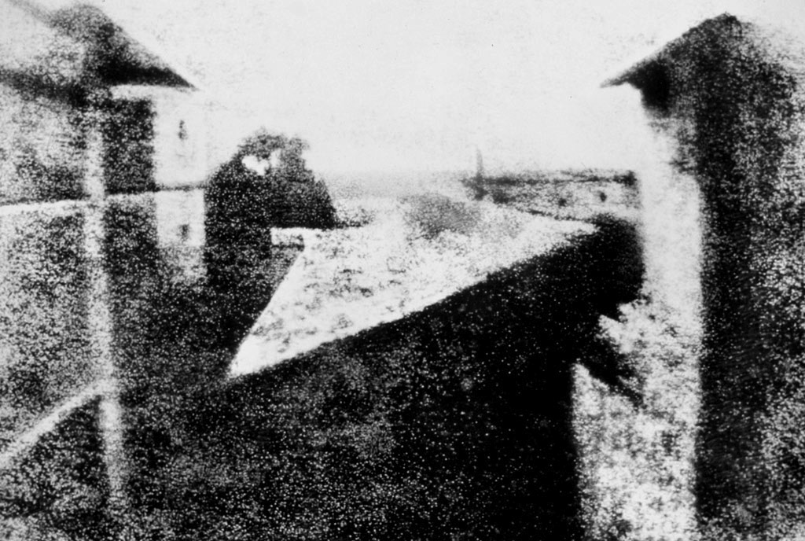
Thought to be first permanant photograph:
View from the Window at Le Gras (France)
By Joseph Nicéphore Niépce 1826

Slide 9
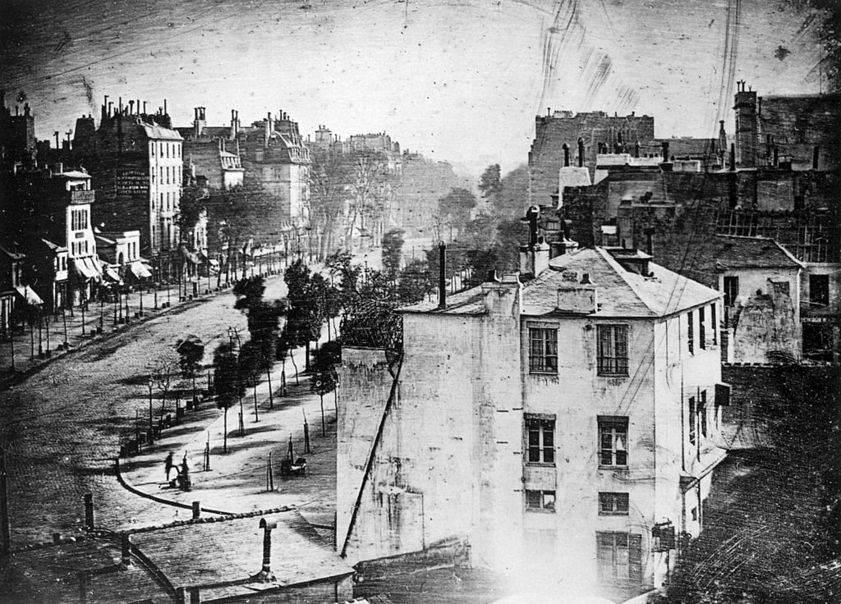
Boulevard du Temple, Paris
By Louis Daguerre in late 1838 or early 1839

Slide 10
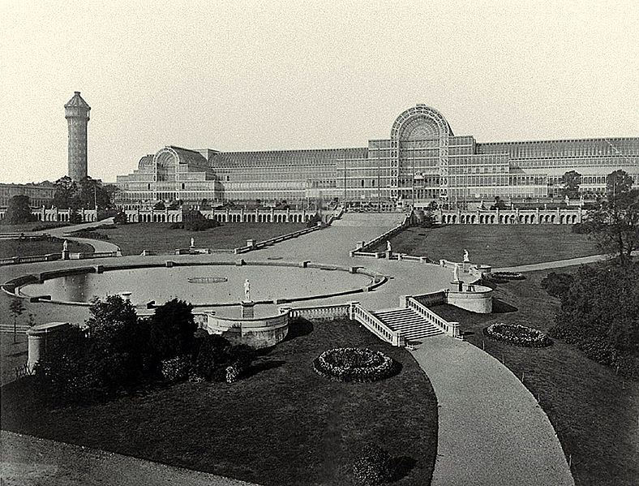
The Crystal Palace at The Great Exhibition, London
by Philip Henry Delamotte, 1854

Slide 11
Joseph Nicéphore Niépce (1765 – 1833)

Slide 12
Louis Daguerre (1787-1851)

Slide 13
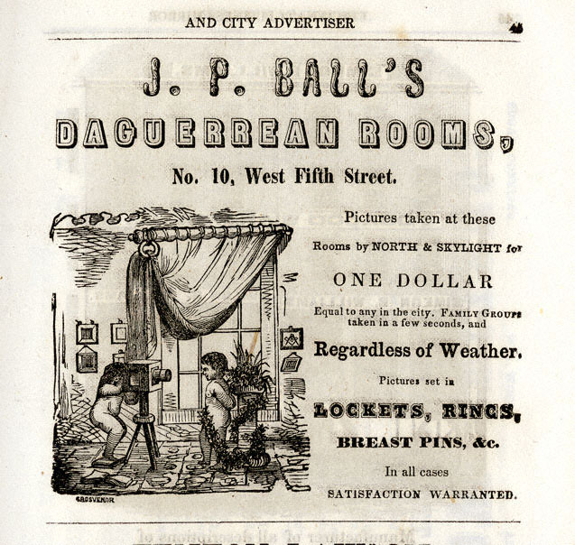
James Presley Ball (1825-1904) Prominent African-American abolitionist, entrepreneur, and Daguerreotypist.

Slide 14
William Henry Fox Talbot by John Moffat c. 1864

Slide 15
Sir John Frederick William Herschel (1792-1871)

Slide 16
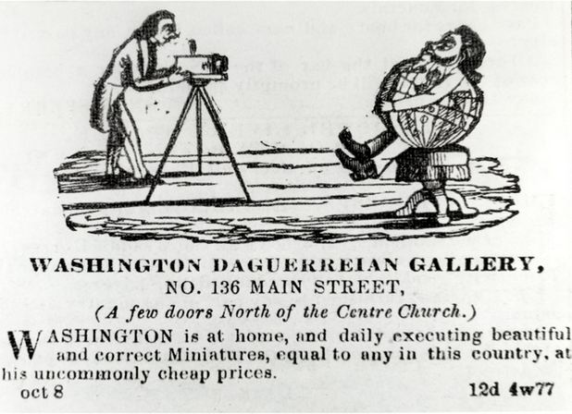
Augustus Washington (c. 1820 – June 7, 1875) was an American photographer and daguerreotypist. He was born in New Jersey as a free person of color and immigrated to Liberia in 1852. He is one of the few African-American daguerreotypists whose career has been documented. Portrait of Joseph Jenkins Roberts (c. 1854)

Slide 17
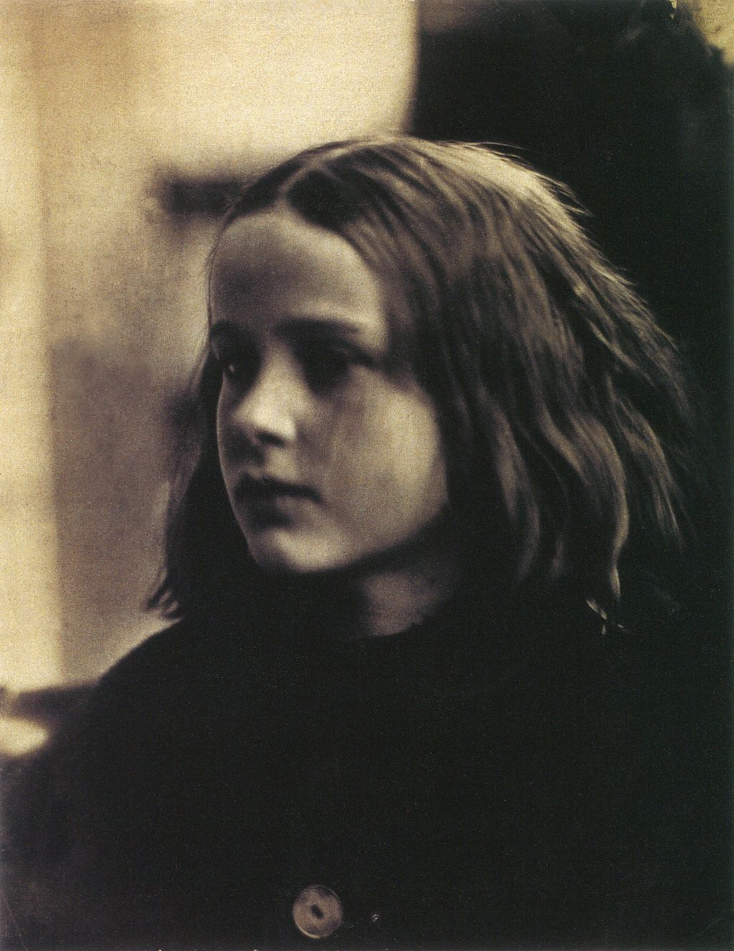
Julia Margaret Cameron (1815 – 1879) was a British photographer who is considered one of the most important portraitists of the 19th century. She is known for her soft-focus close-ups of famous Victorian men and for illustrative images depicting characters from mythology, Christianity, and literature. She also produced sensitive portraits of women and children.
(c. 1870 by Henry Herschel Hay Cameron)
(c. 1864 portrait of Annie Philpot by
Julia Margaret Cameron)

Slide 18
Roger Fenton (1819-1869) Early War Photographer (Crimean War)

Slide 19
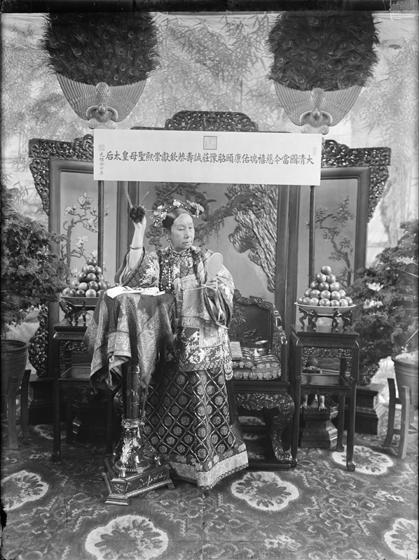
Yu Xunling (裕 勋 龄; Yù Xūnlíng ; 1880–1943) was a Chinese photographer, and the widow Empress Cixi's court photographer during the late Qing Dynasty. He was the only photographer allowed by the widowed empress to photograph her.
Few photographs remain of the Empress Dowager Cixi (1835–1908), China’s notorious head of state during the final decades of the imperial era. Cixi used photographs to model perceptions of her character at the very moment photography was becoming a mass-media vehicle and the Qing dynasty (1644 to 1912) was struggling to survive in a hostile imperialistic world.

Slide 20
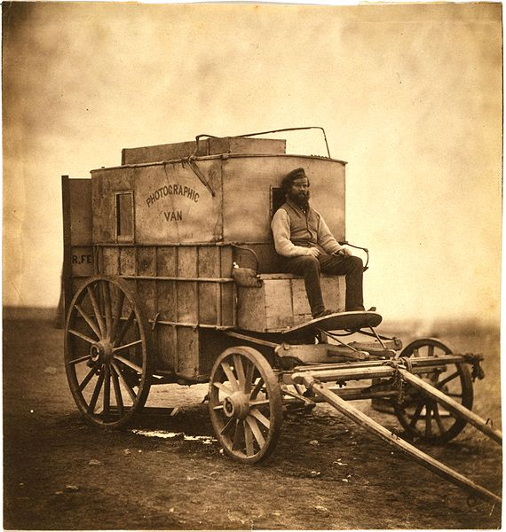
Roger Fenton's photographic van
c1855

Slide 21
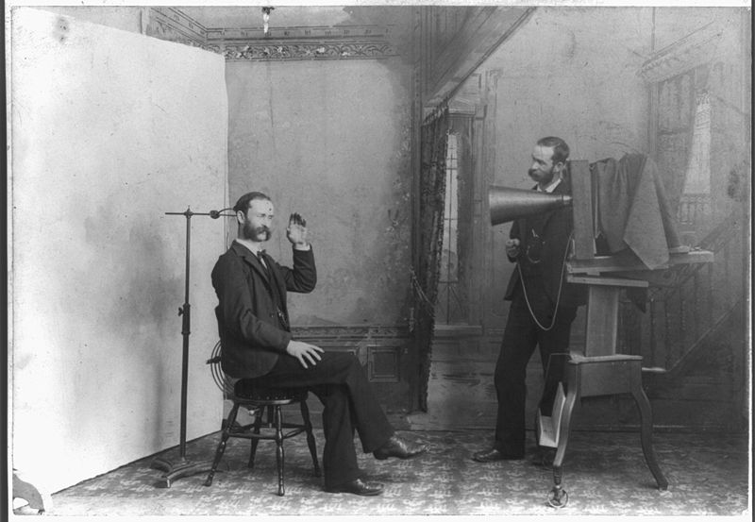
Photographer’s Studio circa 1895

Slide 22
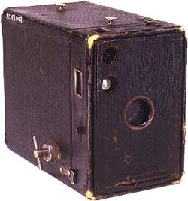
Eastman Kodak Brownie Camera, circa 1900

Slide 23
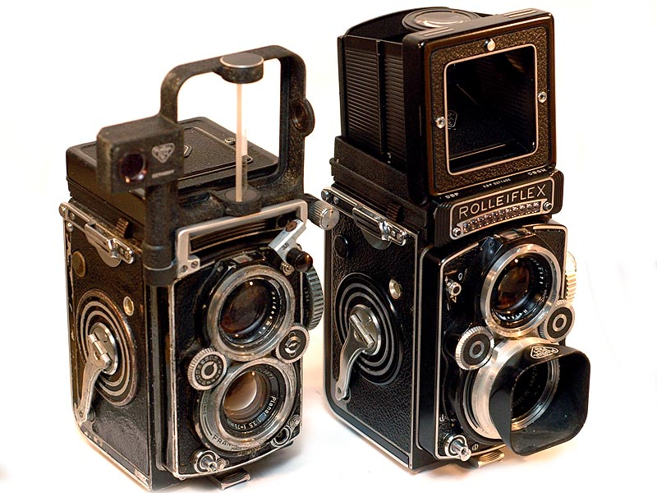
Twin Lens Reflex

Slide 24
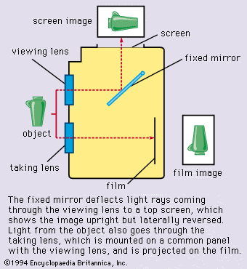

Slide 25
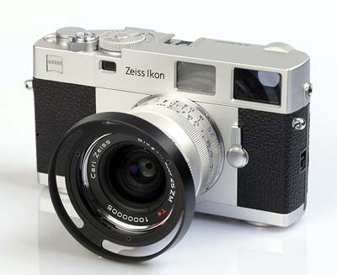
Rangefinder

Slide 26
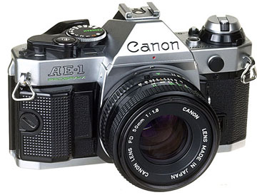
Single Lens Reflex (SLR)

Slide 27
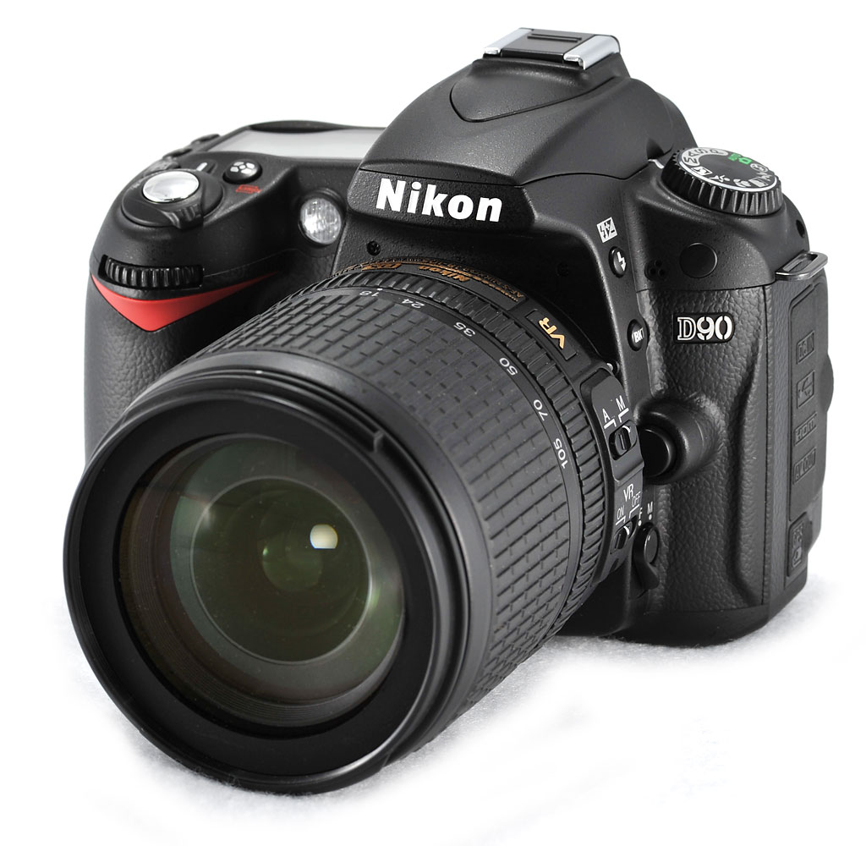
Digital Single Lens Reflex (DSLR)

Slide 28
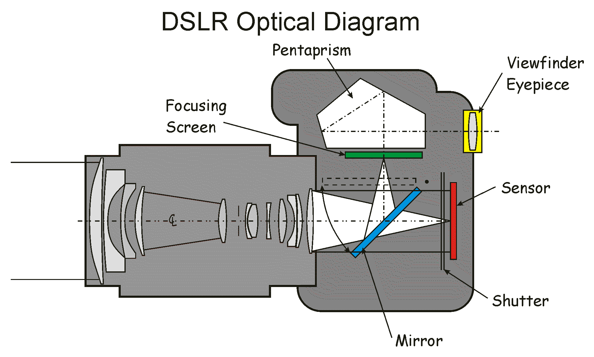

Slide 29
The Slow Mo Guys
How a SLR Works (and a bit about shutter speed)
https://www.youtube.com/watch?v=CmjeCchGRQo
Cool Slow Mo Stuff
https://www.youtube.com/watch?v=j_OyHUqIIOU
More Cool Slow Mo Stuff
https://www.youtube.com/watch?v=ewGAmiLuYCw
More Cool Slow Mo Stuff (but w/ Will Smith)
https://www.youtube.com/watch?v=OkZ9Eq0DQqQ

Slide 30
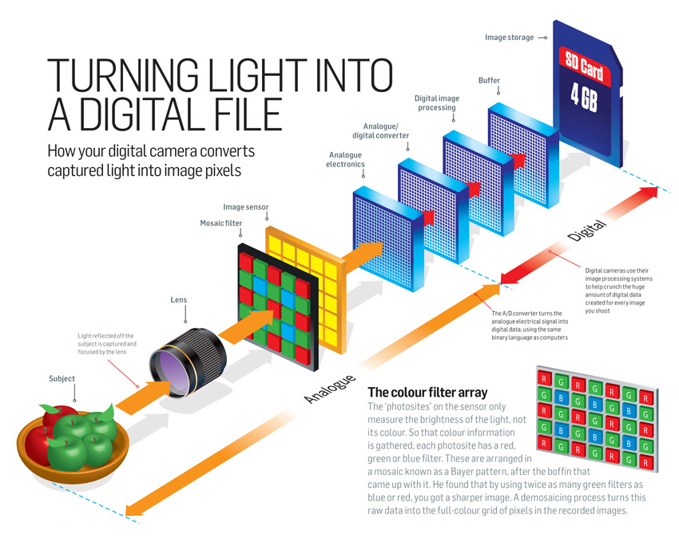

Slide 31
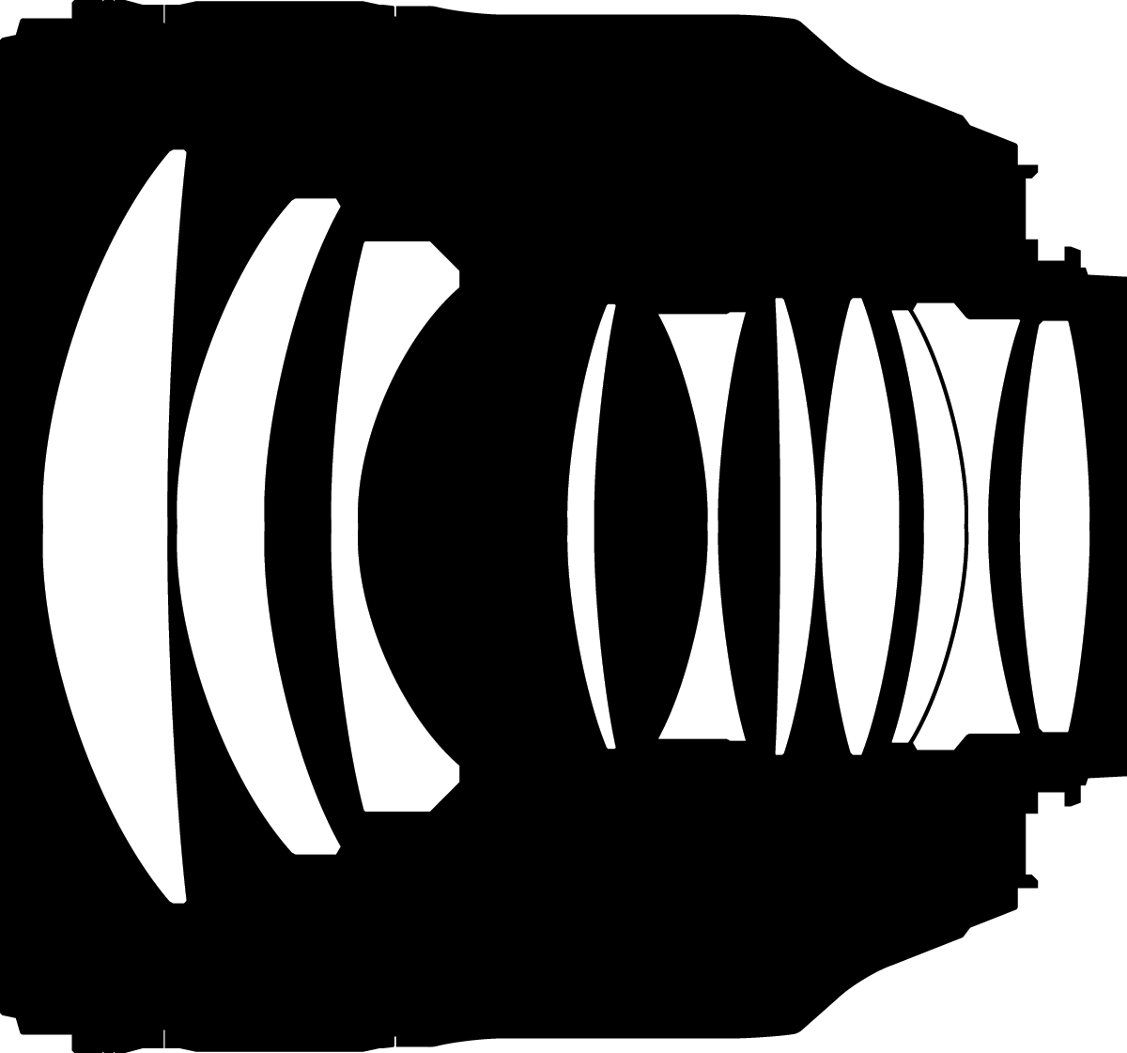

Slide 32
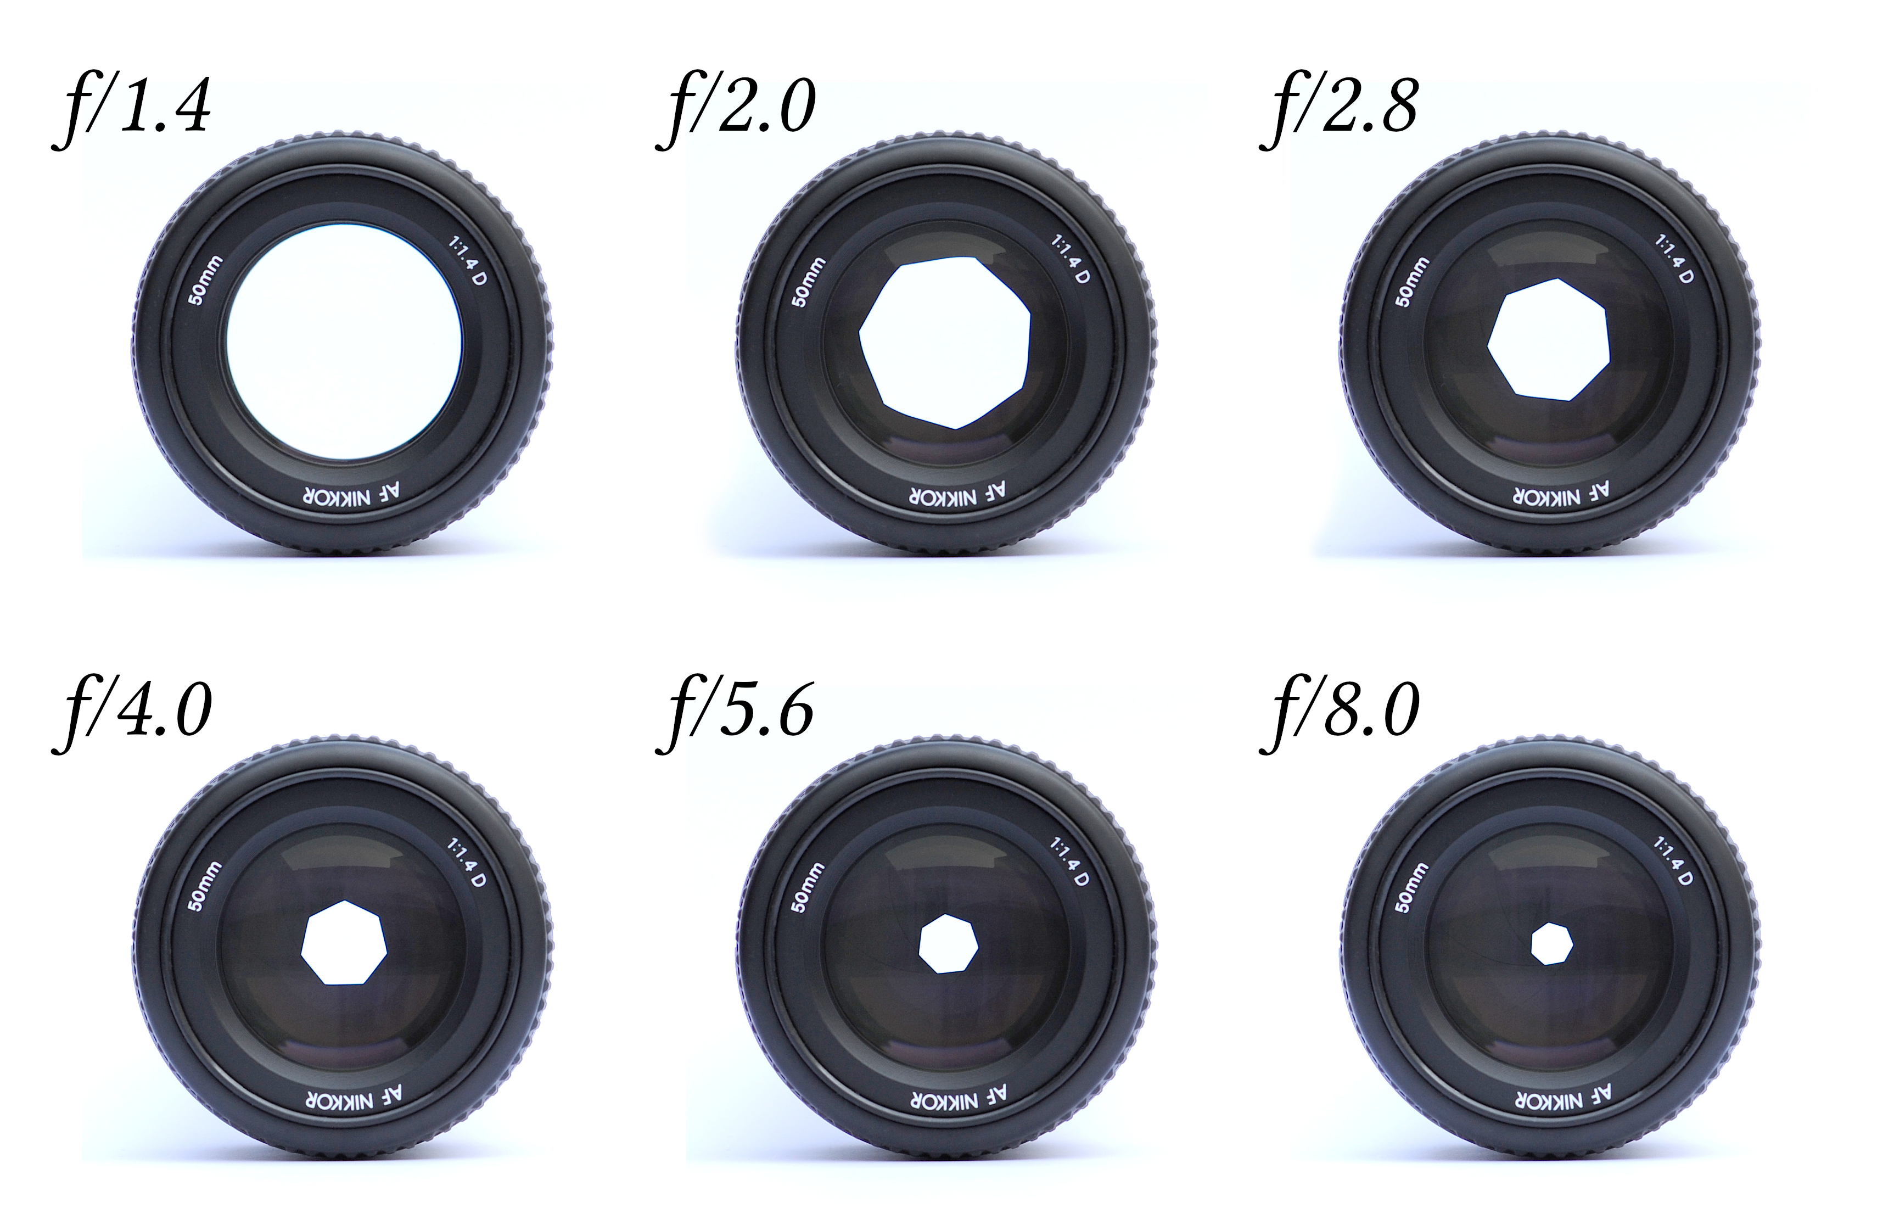

Slide 34
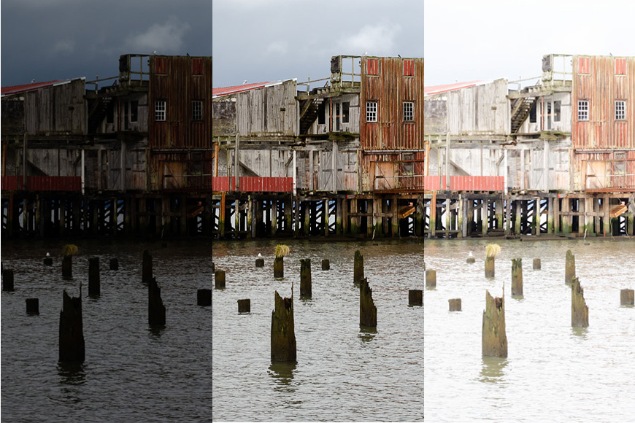

Slide 35
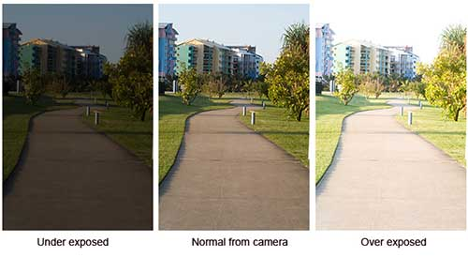
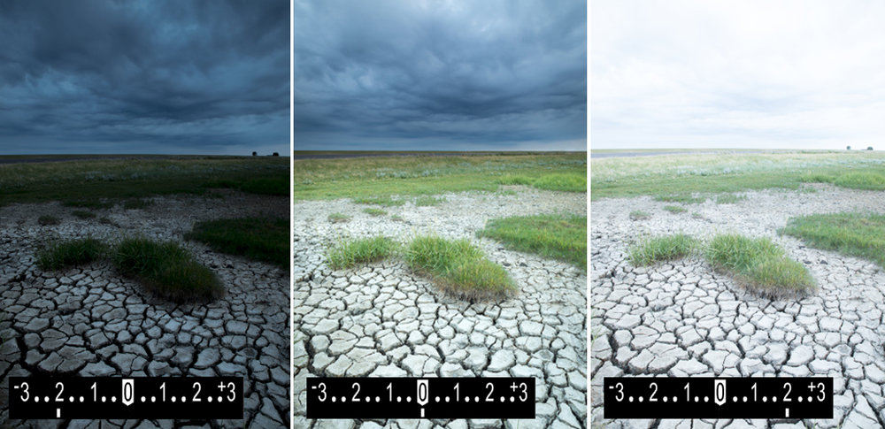

Slide 36
Standard Shutter Speeds:
1/4 1/8 1/15 1/30 1/60 1/125 1/250 1/500 1/1000
Standard f-stops:
1.4 2.0 2.8 4 5.6 8 11 16 22
Shutter Speed
1/8 1/15 1/30 1/60 1/125 1/250 1/500 1/1000
f/stop
f/32 f/22 f/16 f/11 f/8 f/5.6 f/4 f/2.8

Slide 37
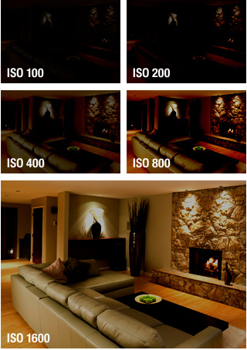
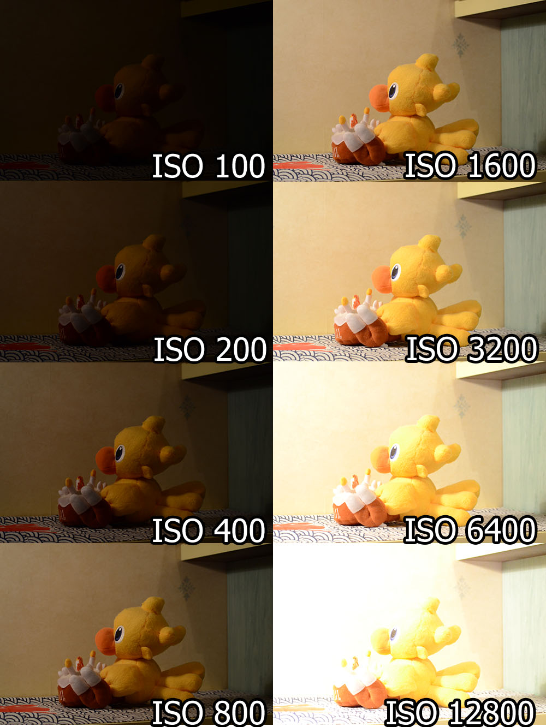
Sensor Sensitivity aka ISO or ASA

Slide 38
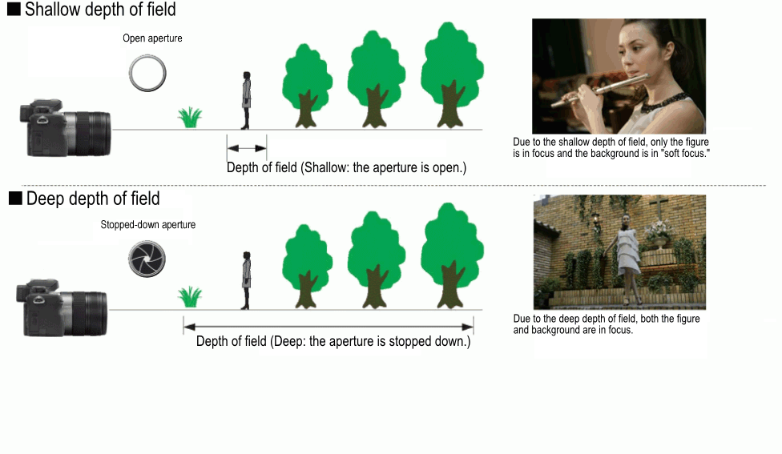
Depth of Field Example

Slide 39
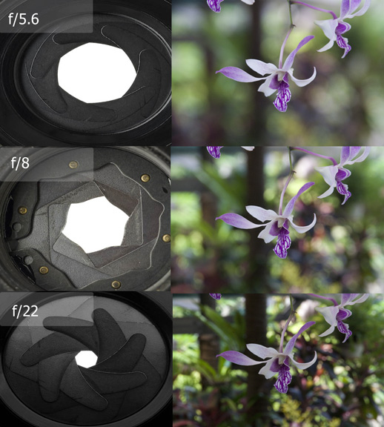
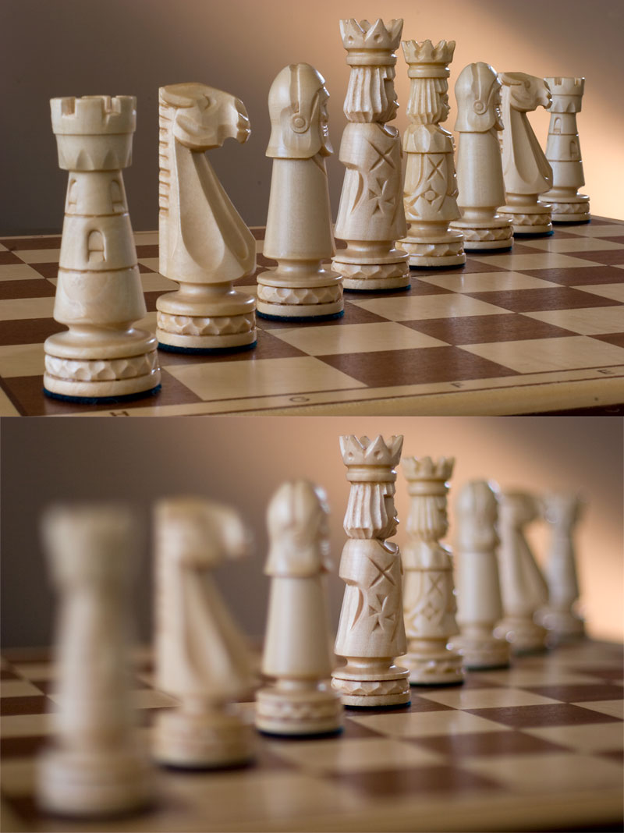
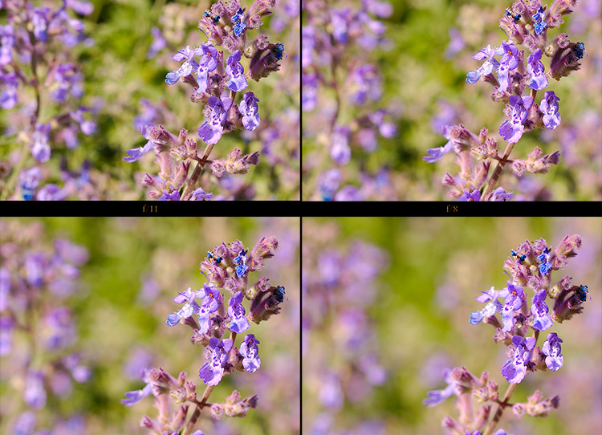

Slide 40
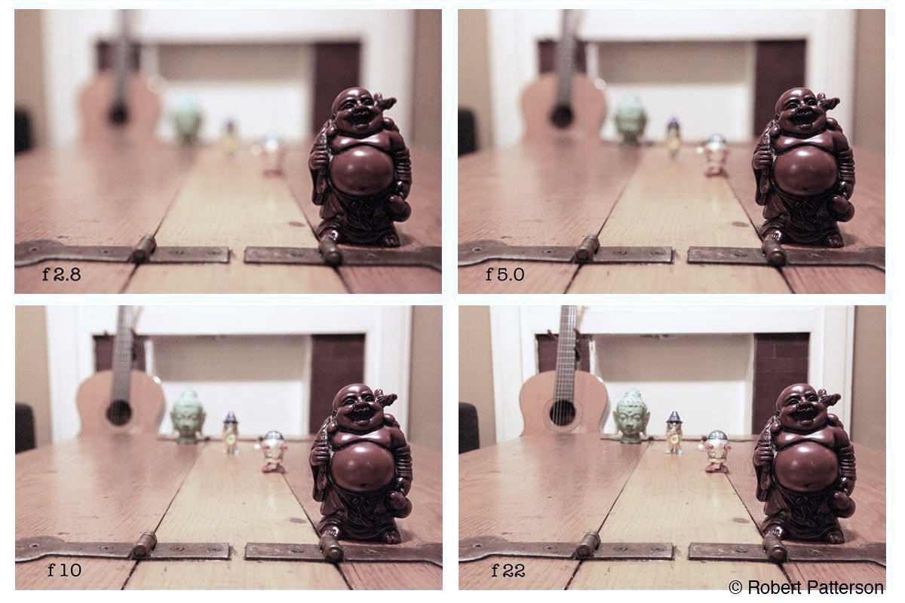

Slide 41
Shutter Speed’s Effect on Motion

Slide 42
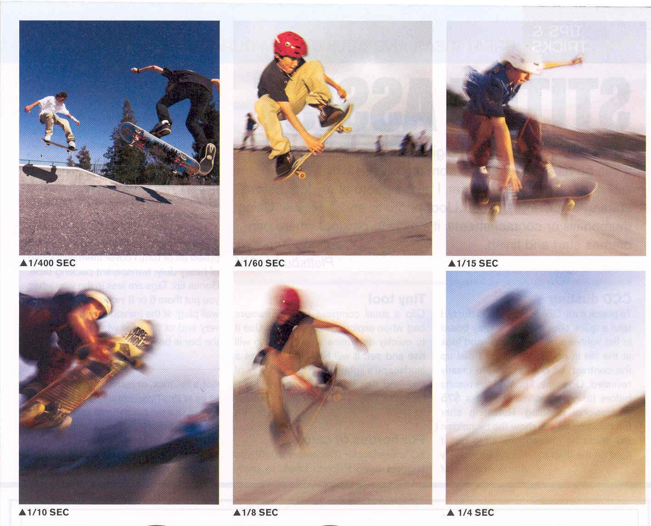

Slide 43
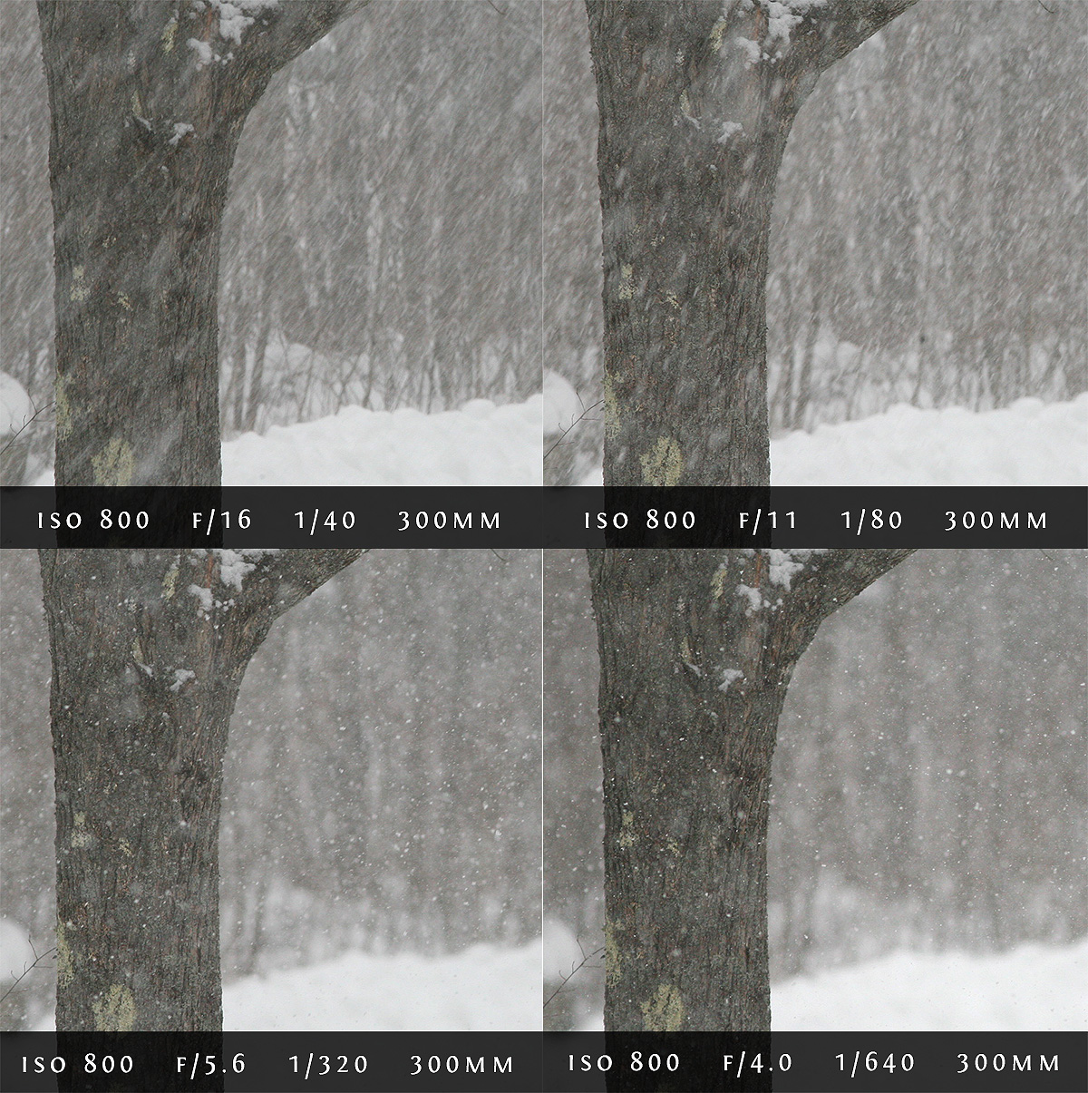

Slide 44
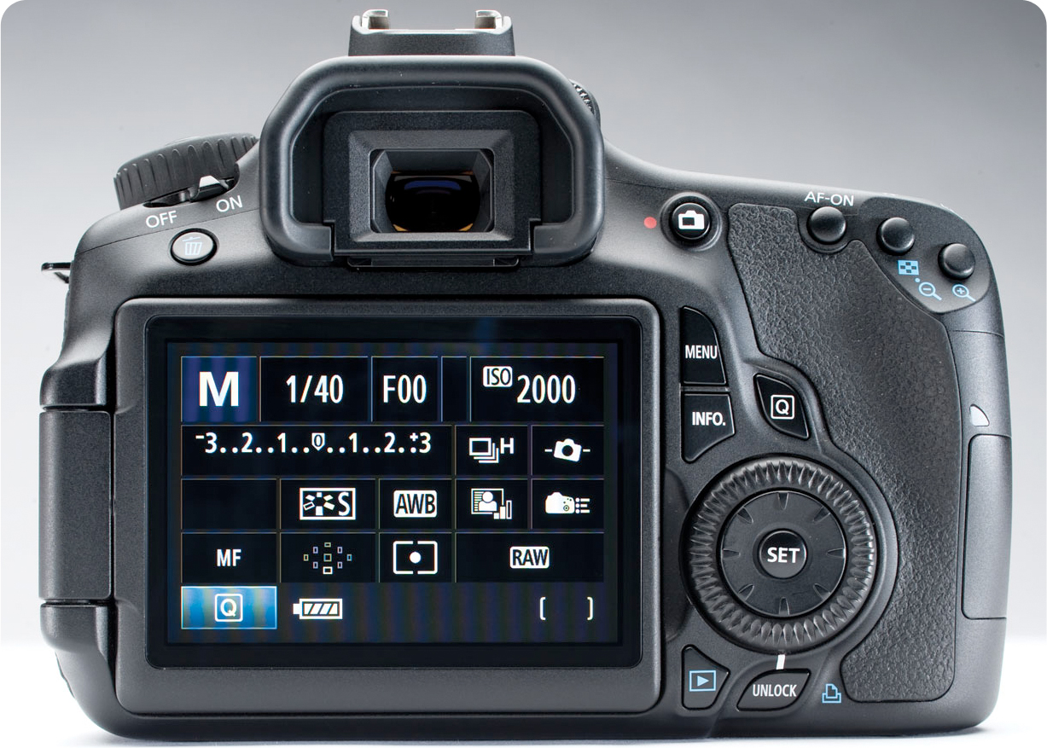
The Light Meter

Slide 45
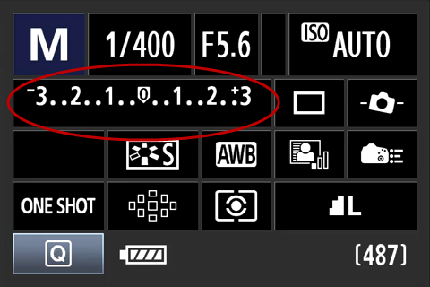
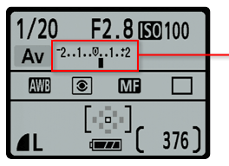
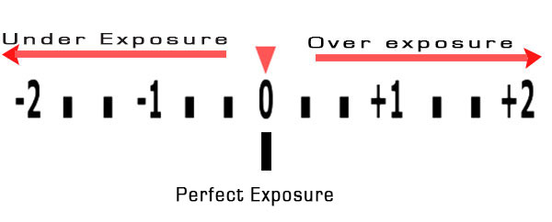

Slide 46
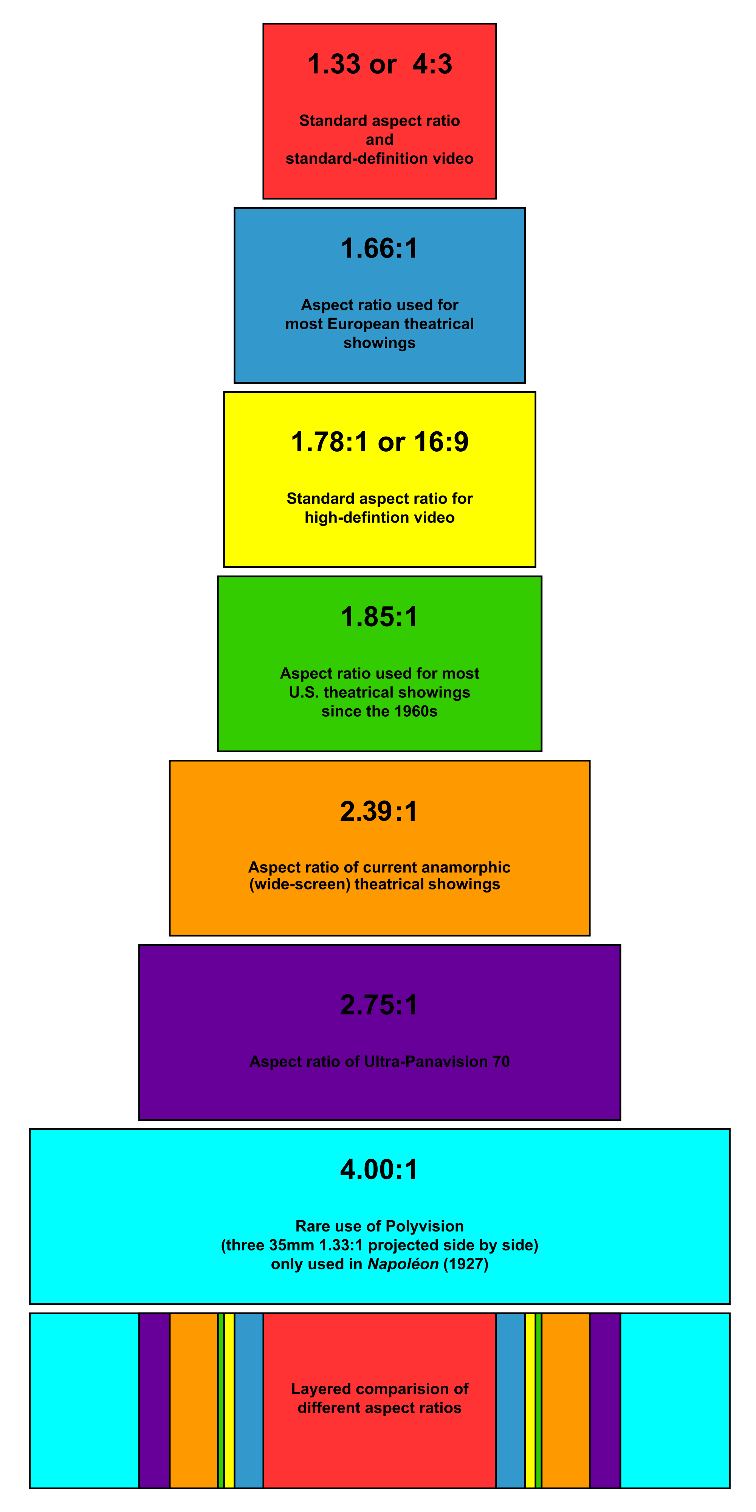
Aspect Ratio

Slide 47
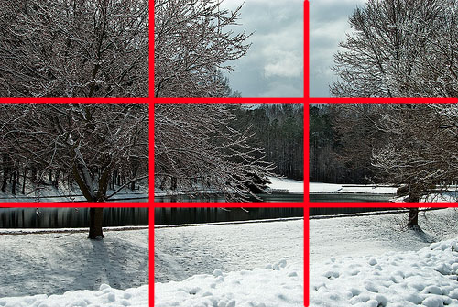
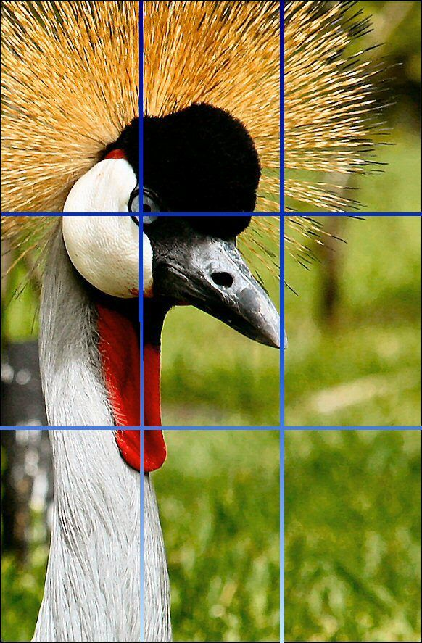
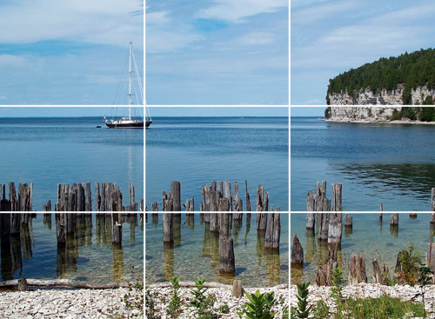
Rule of Thirds Example

Slide 48
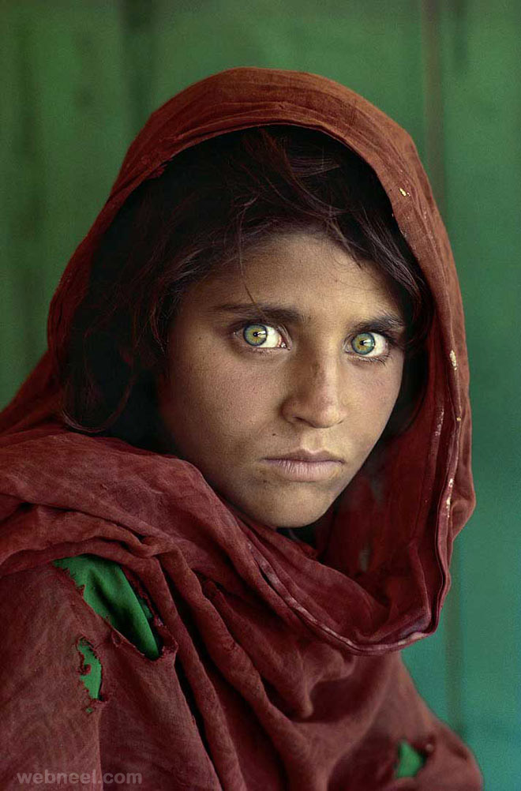
Steve
McCurry
b.1950

Slide 49
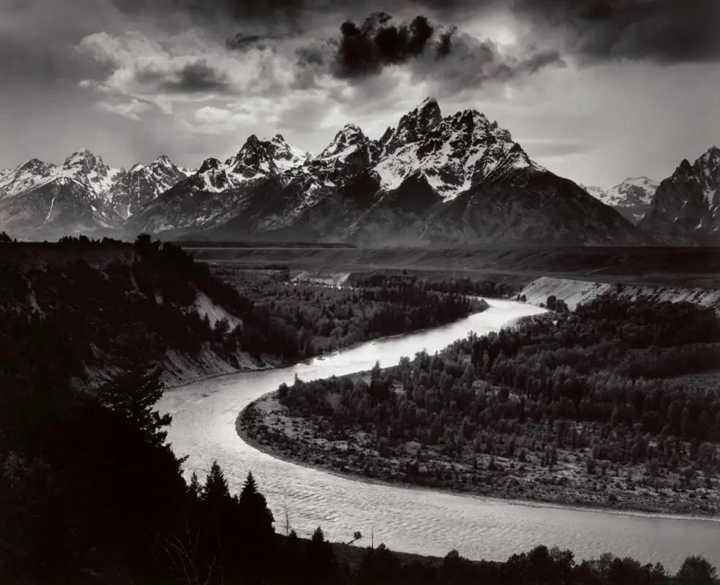
Ansel
Adams
b.1902

Slide 50
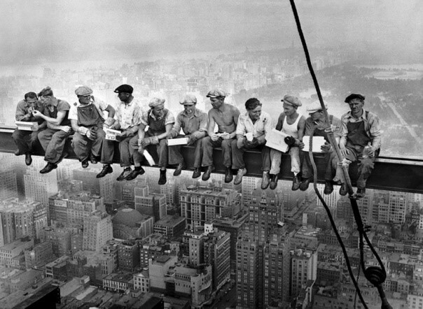
Charles Ebbets b.1905

Slide 51
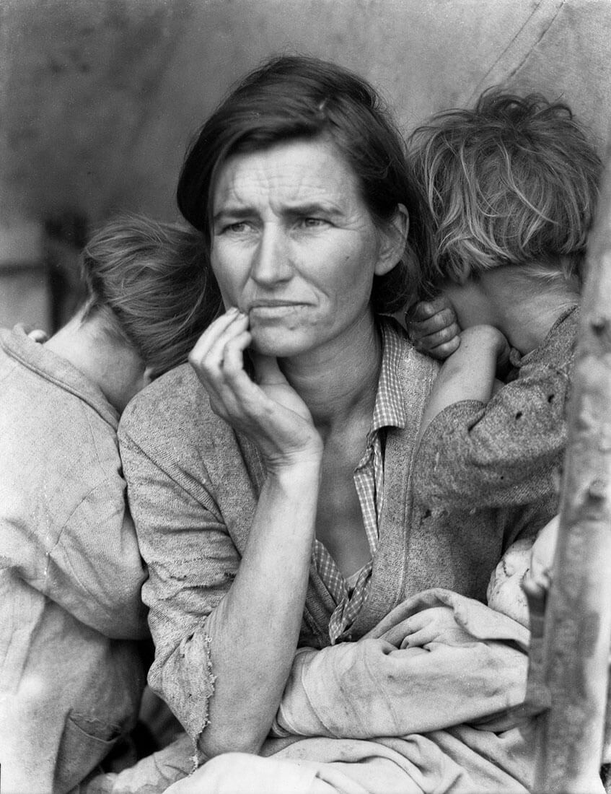
Dorothea Lange
b.1895

Slide 52
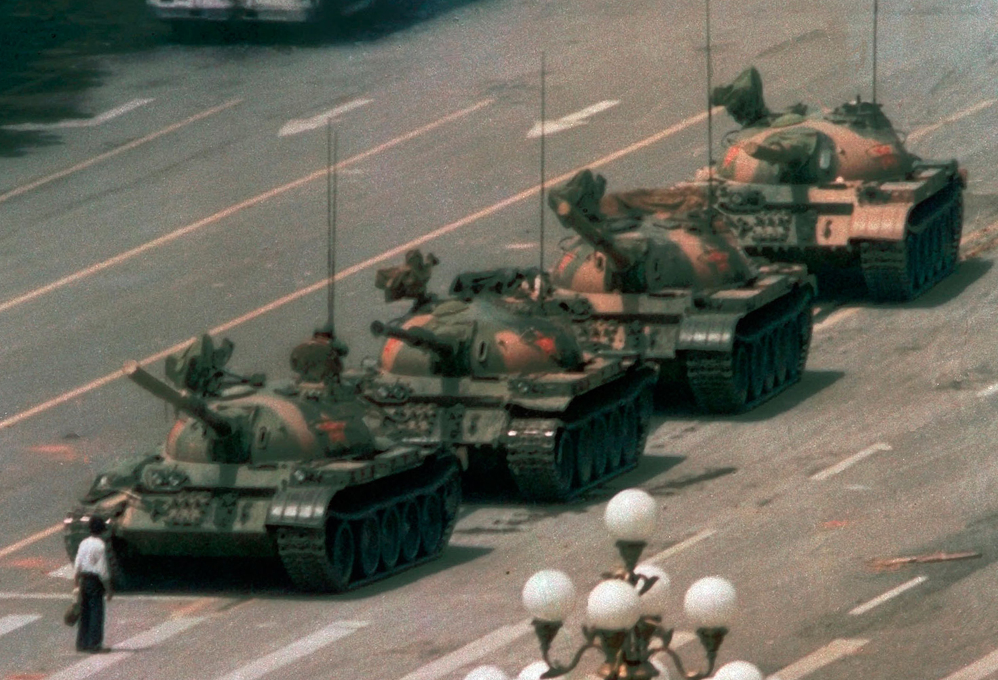
Charlie Cole b.1955

Slide 53
Christian Aslund born c.1970s

Slide 54
Akasha Rabut born c.1980

Slide 55
Andreas Gursky b.1955

Slide 56
Diane Arbus
b.1923

Slide 57
Henri Cartier Bresson
b.1908

Slide 58
Aïda Muluneh
b.1974

Slide 59
Walker Evans b.1903

