Slide 1
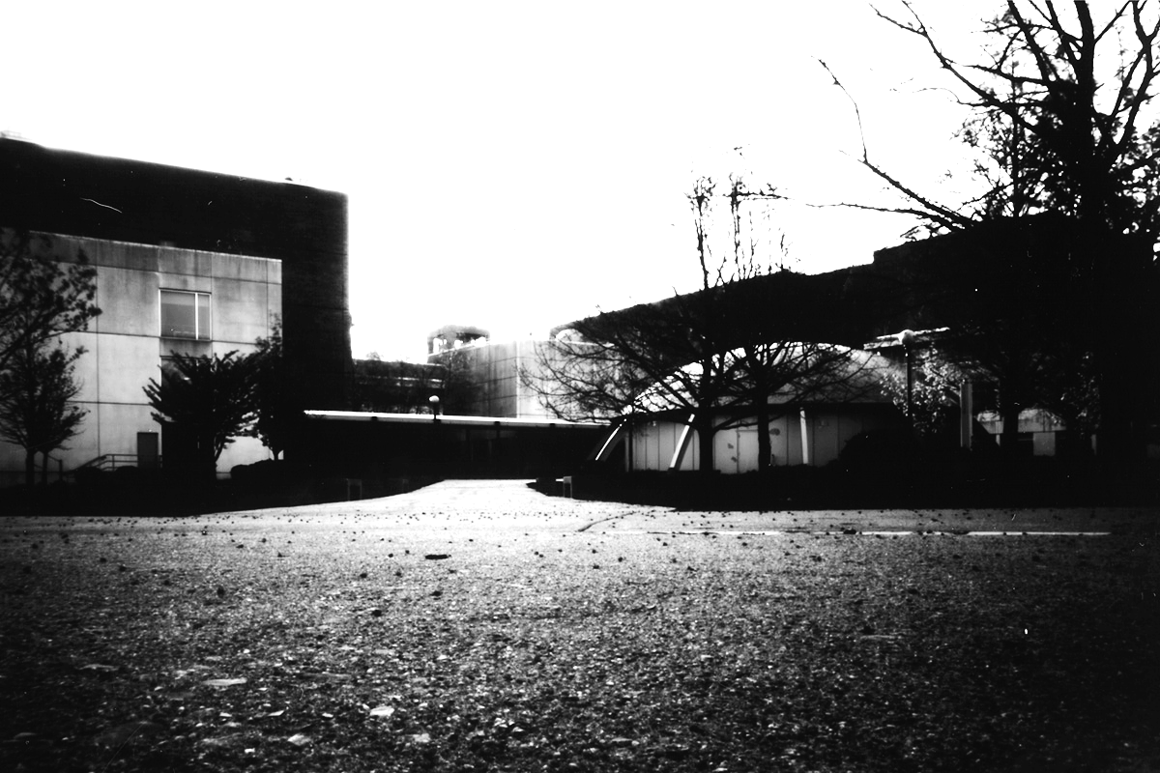
Early Photography, Pinhole Cameras, & Laser Cutters

Slide 2
It all starts with light… and ends with light

Slide 3
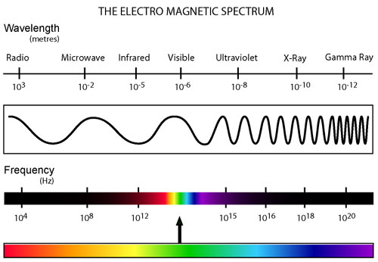

Slide 4
17th Century Sketch of a Camera Obscura (from Latin, meaning “darkened room”)

Slide 5
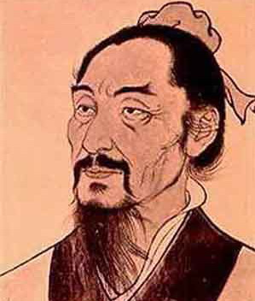
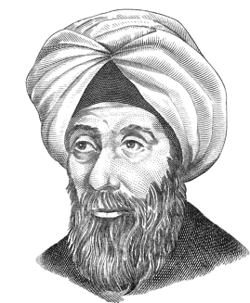
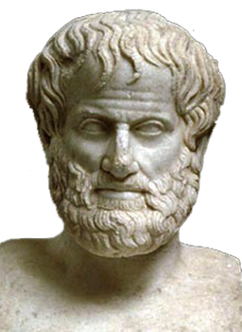
Camera Obscura from the Latin: “Dark Room”
Ibn al-Haytham knew it, clearly described it and actually made one (Arabia c1000 AD)
Mozi knew it first
(China c400 BC)
Aristotle knew it
(Greek c350 BC)

Slide 6
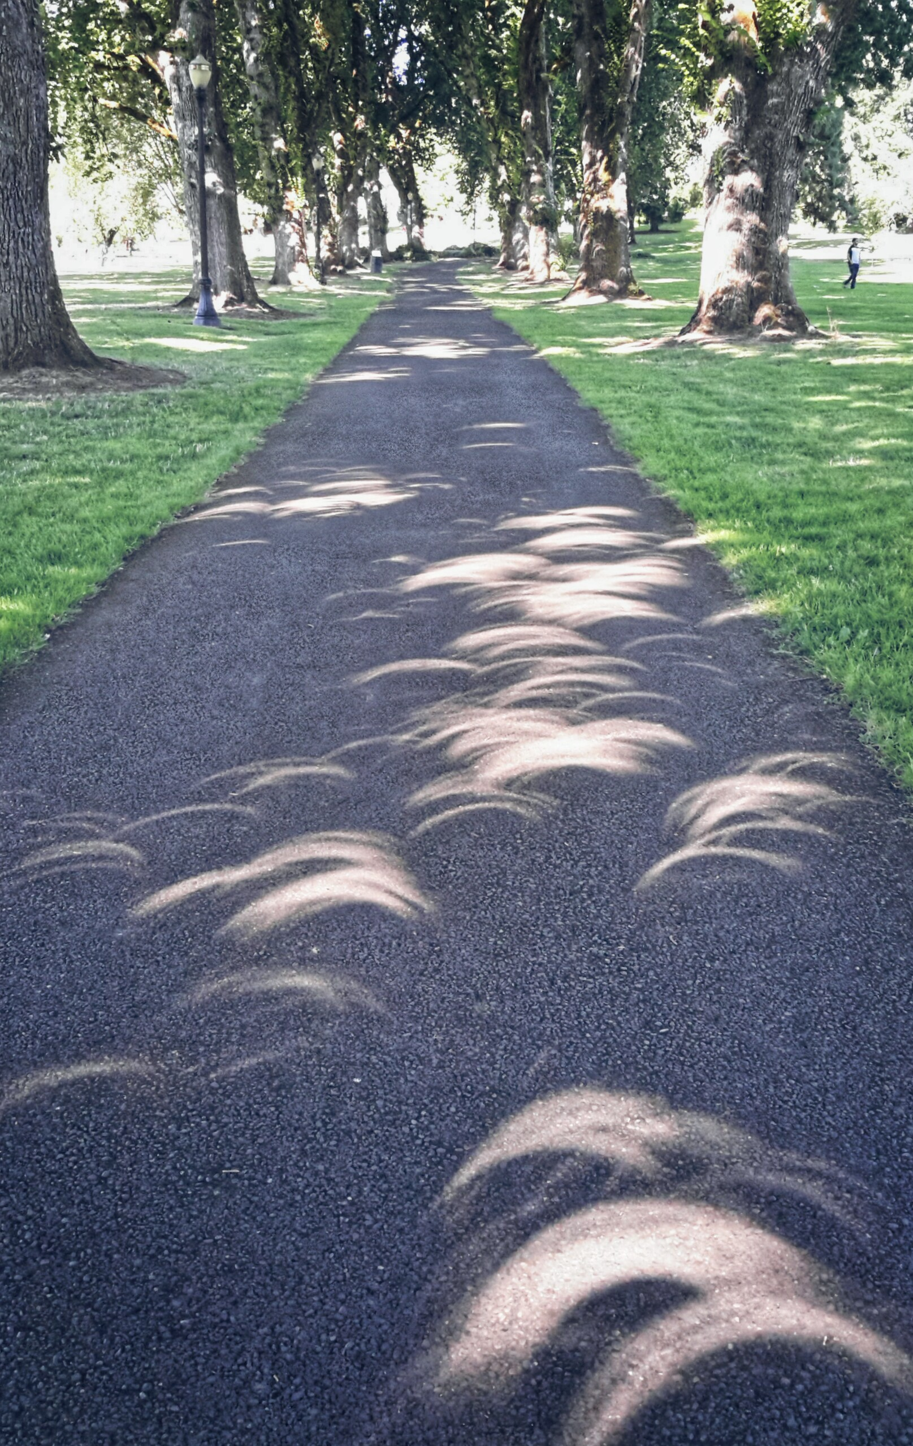
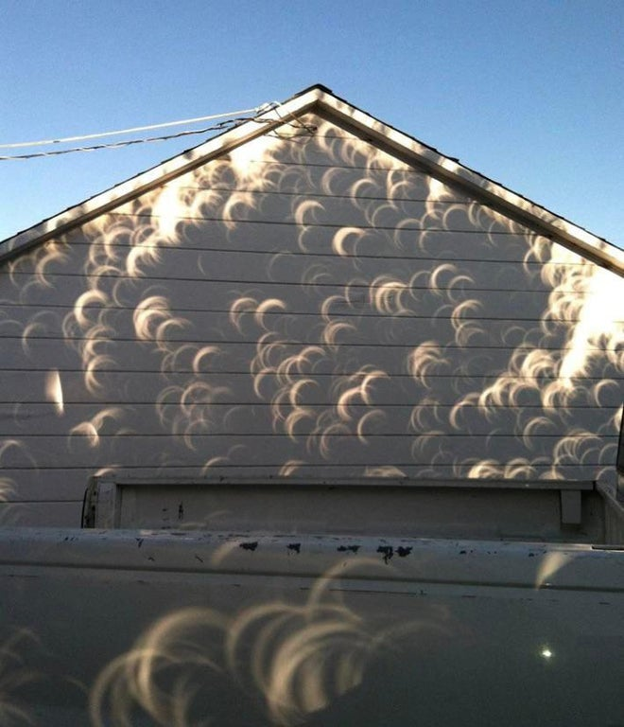

Slide 7
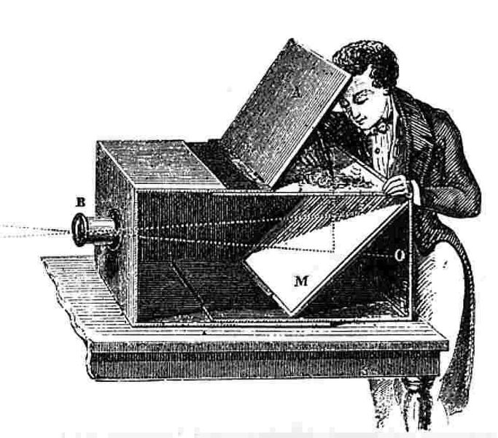
Camera Obscura circa 1750

Slide 8
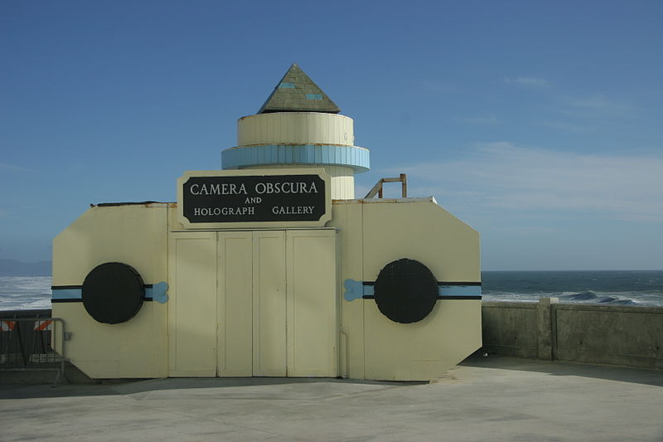
Room Size Camera Obscura: San Francisco, California

Slide 9
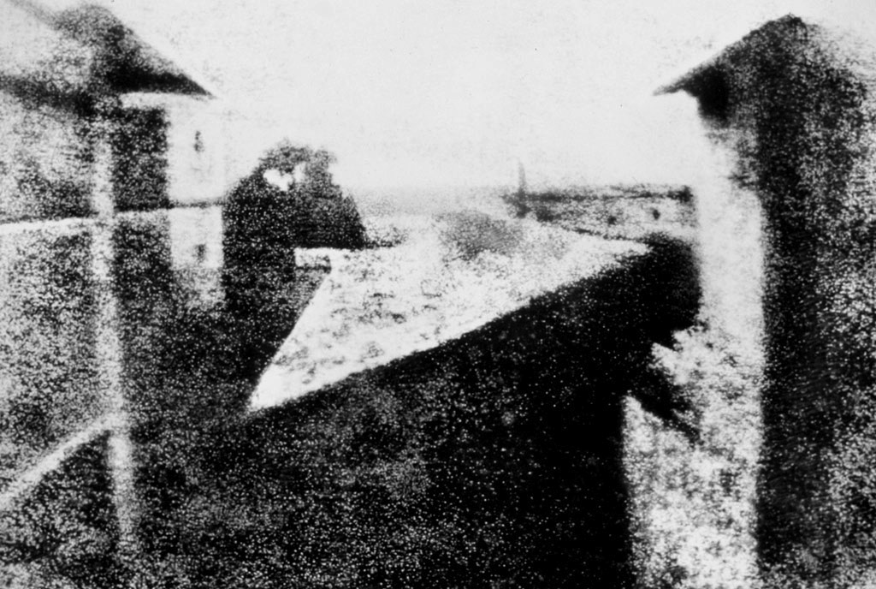
Thought to be first permanant photograph:
View from the Window at Le Gras (France)
By Joseph Nicéphore Niépce 1826

Slide 10
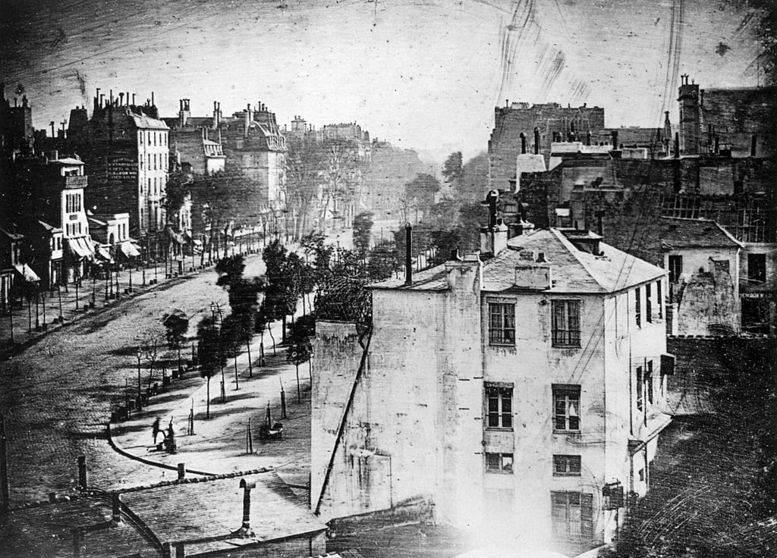
Boulevard du Temple, Paris
By Louis Daguerre in late 1838 or early 1839

Slide 11
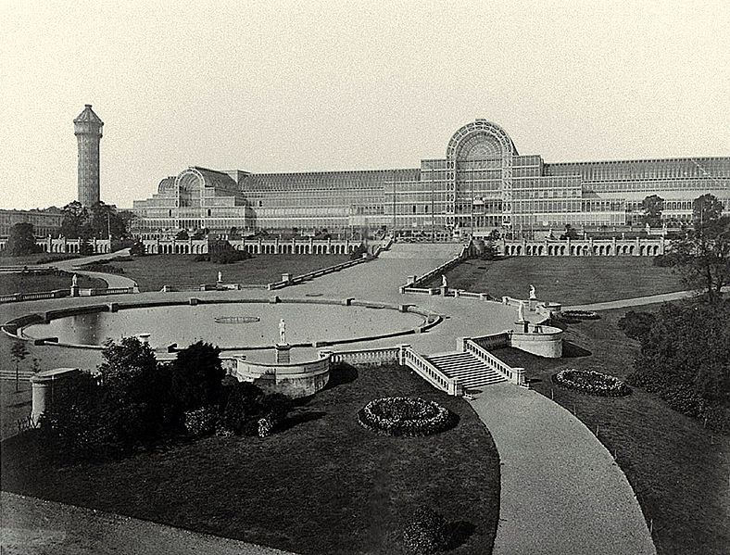
The Crystal Palace at The Great Exhibition, London
by Philip Henry Delamotte, 1854

Slide 12
Joseph Nicéphore Niépce (1765 – 1833)

Slide 13
Louis Daguerre (1787-1851)

Slide 14
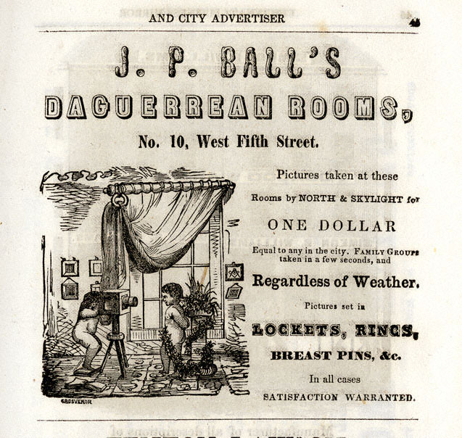
James Presley Ball (1825-1904) Prominent African-American abolitionist, entrepreneur, and Daguerreotypist.

Slide 15
Sir John Frederick William Herschel (1792-1871)

Slide 16
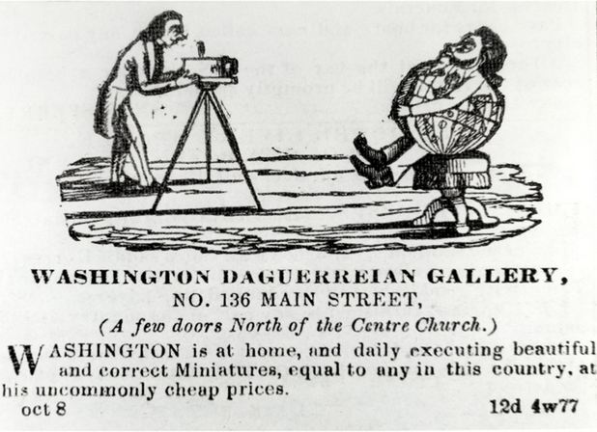
Augustus Washington (c. 1820 – June 7, 1875) was an American photographer and daguerreotypist. He was born in New Jersey as a free person of color and immigrated to Liberia in 1852. He is one of the few African-American daguerreotypists whose career has been documented. Portrait of Joseph Jenkins Roberts (c. 1854)

Slide 17
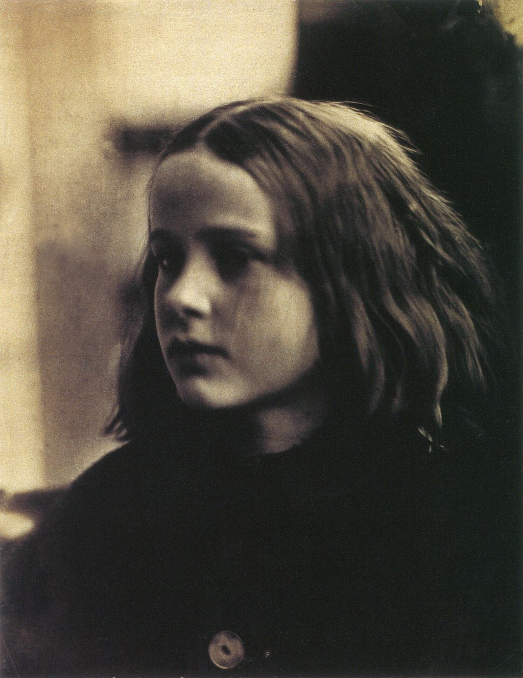
Julia Margaret Cameron (1815 – 1879) was a British photographer who is considered one of the most important portraitists of the 19th century. She is known for her soft-focus close-ups of famous Victorian men and for illustrative images depicting characters from mythology, Christianity, and literature. She also produced sensitive portraits of women and children.
(c. 1870 by Henry Herschel Hay Cameron)
(c. 1864 portrait of Annie Philpot by
Julia Margaret Cameron)

Slide 18
Roger Fenton (1819-1869) Early War Photographer (Crimean War)

Slide 19
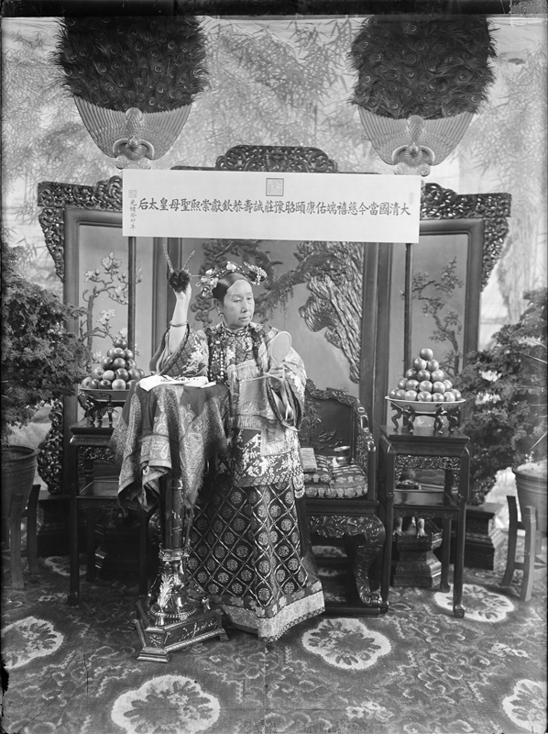
Yu Xunling (裕 勋 龄; Yù Xūnlíng ; 1880–1943) was a Chinese photographer, and the widow Empress Cixi's court photographer during the late Qing Dynasty. He was the only photographer allowed by the widowed empress to photograph her.
Few photographs remain of the Empress Dowager Cixi (1835–1908), China’s notorious head of state during the final decades of the imperial era. Cixi used photographs to model perceptions of her character at the very moment photography was becoming a mass-media vehicle and the Qing dynasty (1644 to 1912) was struggling to survive in a hostile imperialistic world.

Slide 20
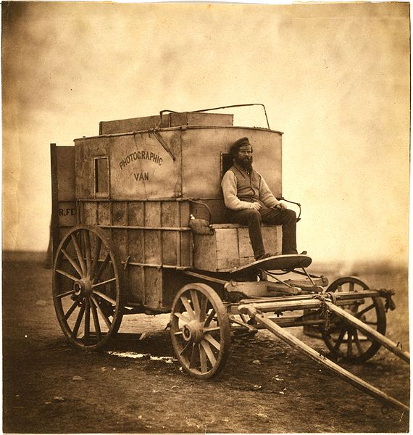
Roger Fenton's photographic van
c1855

Slide 21
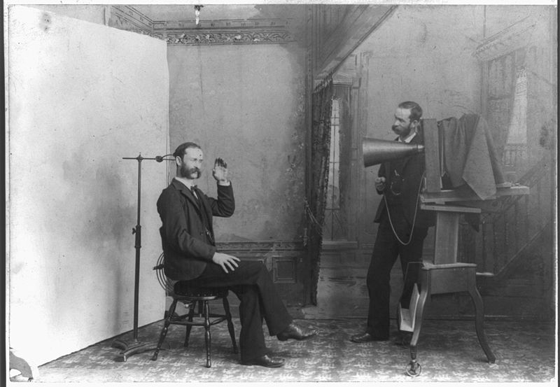
Photographer’s Studio circa 1895

Slide 22
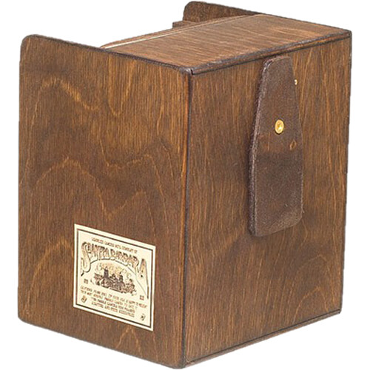
Let’s Explore Pinhole
Cameras
A Little Further

Slide 23
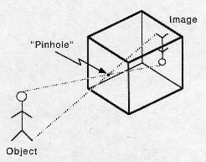
Camera Obscura
(from Latin, meaning “darkened room”)

Slide 24
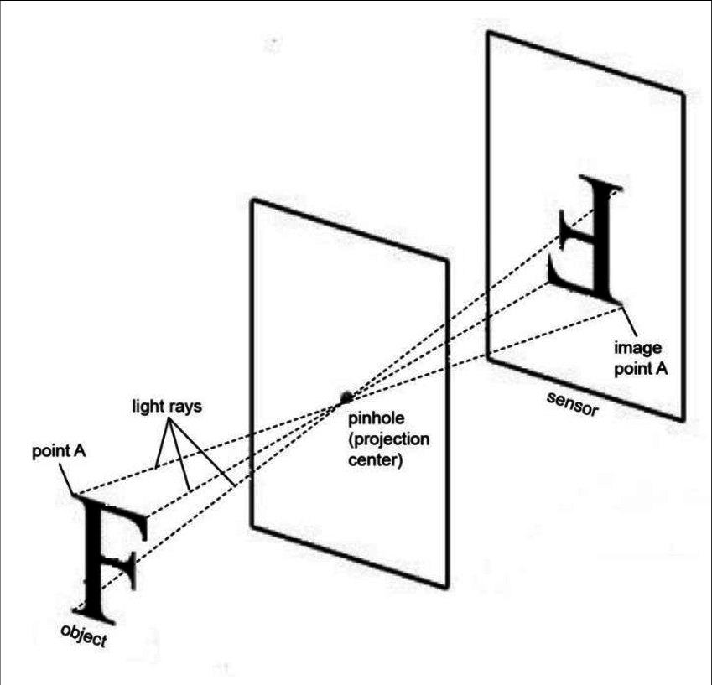
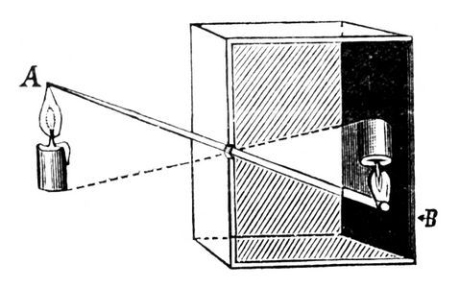
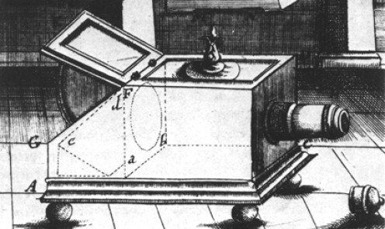
The very beginnings of modern photography and based on the fundamentals of light and how it behaves.
Oldest mention of its effect is by Mozi, Chinese philosopher and the founder of Mohism, during the 5th century BC.

Slide 25
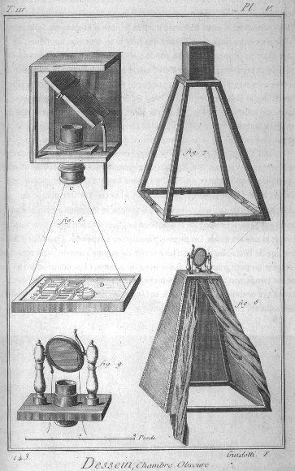
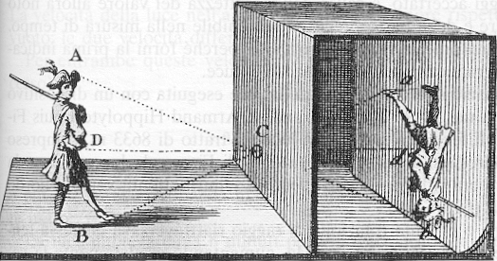
Often called lens-less Cameras;
Later, more complex cameras, used mirrors to project images upwards and right-side up and later used lenses to better control the light.
Anthemius of Tralles, who designed the Hagia Sophia, used a type of camera obscura in his experiments in 6th century.
17^{th &} 18th Century Camera Obscuras

Slide 26
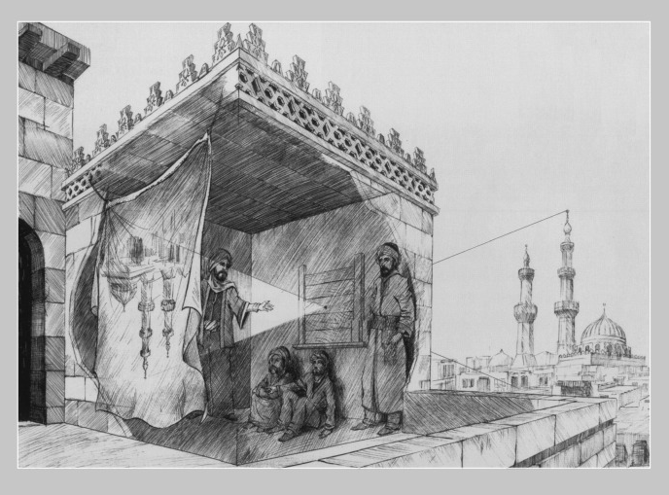
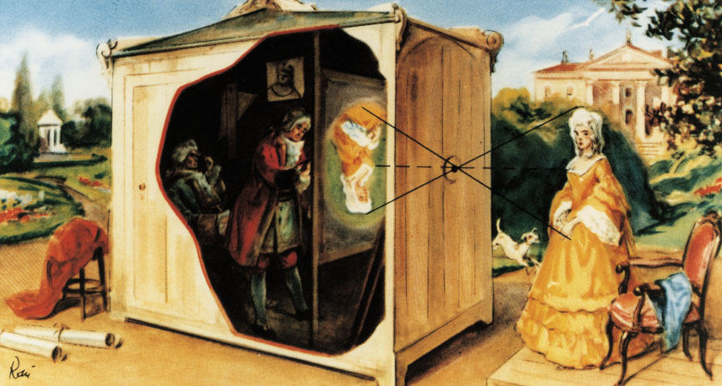
First one to do so was Alhazen (also known as Ibn al-Haytham) in 11th century. He was a scientist, mathematician, astronomer and philosopher, he wrote the Book of Optics and, among other things, he invented camera obscura and pinhole camera.
Arnaldus de Villa Nova, an alchemist, astrologer and physician, used camera obscura at the same time as a projector for entertainment.

Slide 27
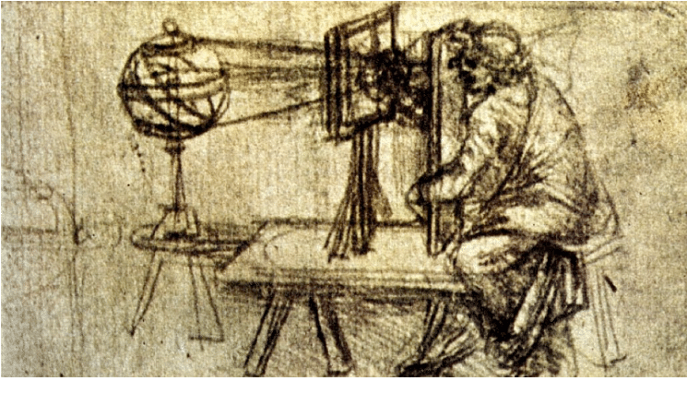
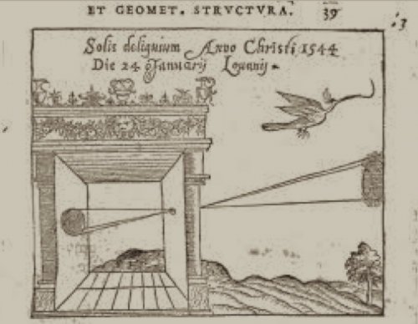
Artists started using camera obscura in 15th century.
Leonardo da Vinci talks about camera obscura in his Codex Atlanticus c.1478, a twelve-volume bound set of his drawings and writings where he also talked about flying machines, weaponry and musical instruments.

Slide 28
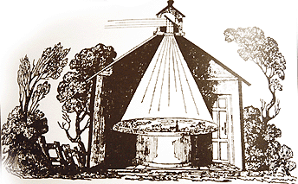
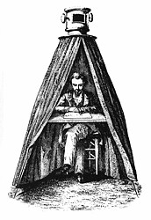
German astronomer Johannes Kepler uses term camera obscura for the first time in history in 1604.
Early models were large and consisted of a literal room or a tent (Johannes Kepler used a tent one.)

Slide 29
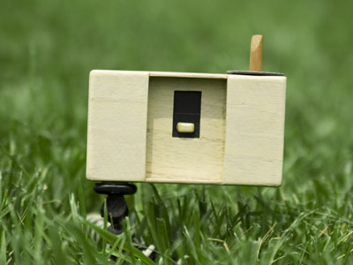
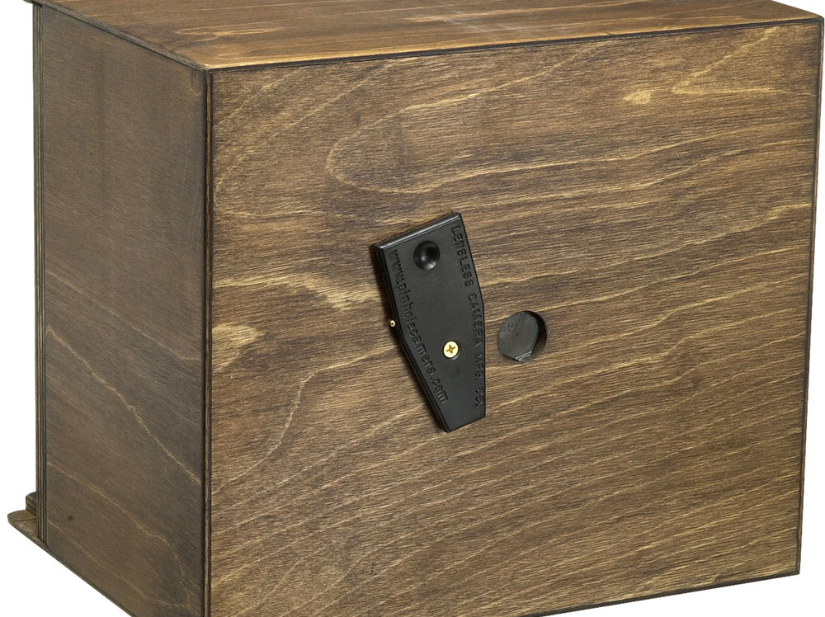
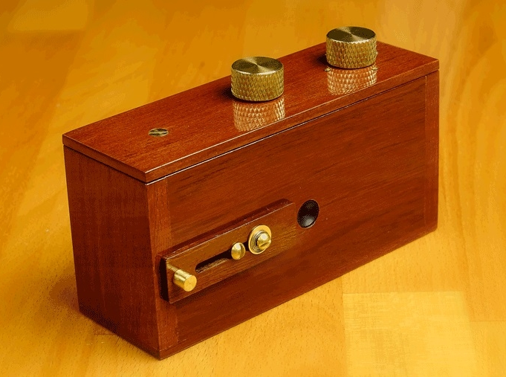
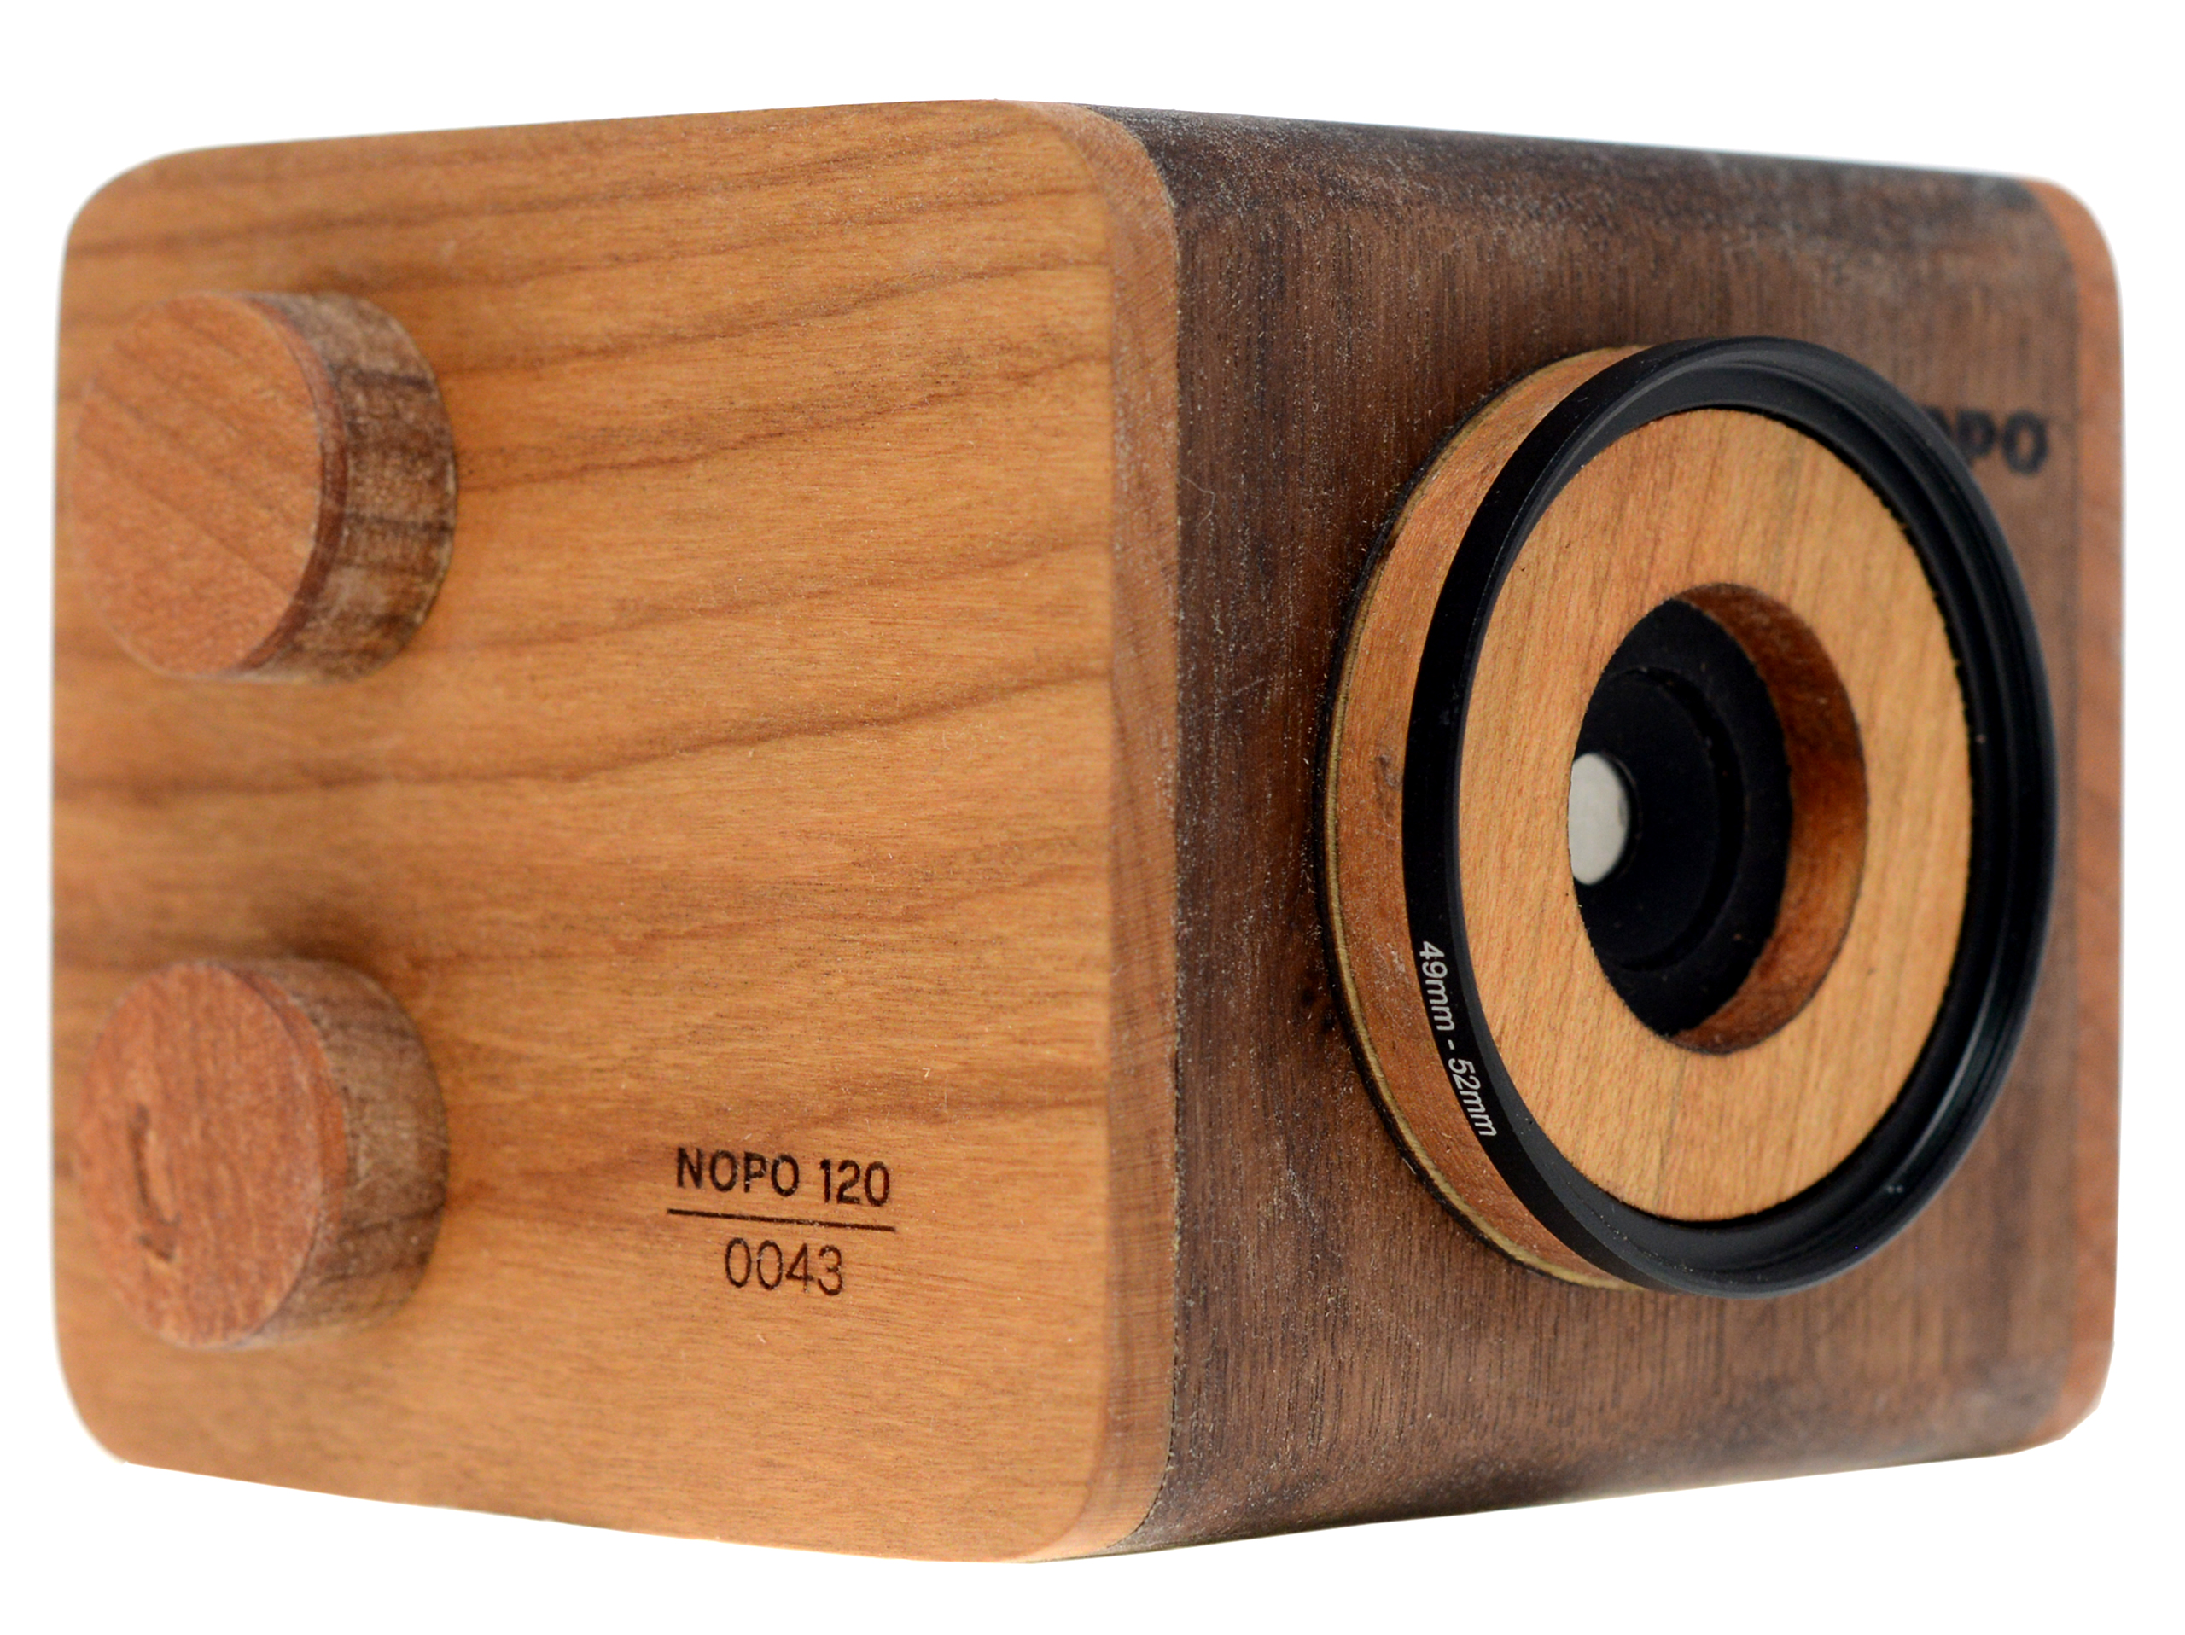

Slide 30
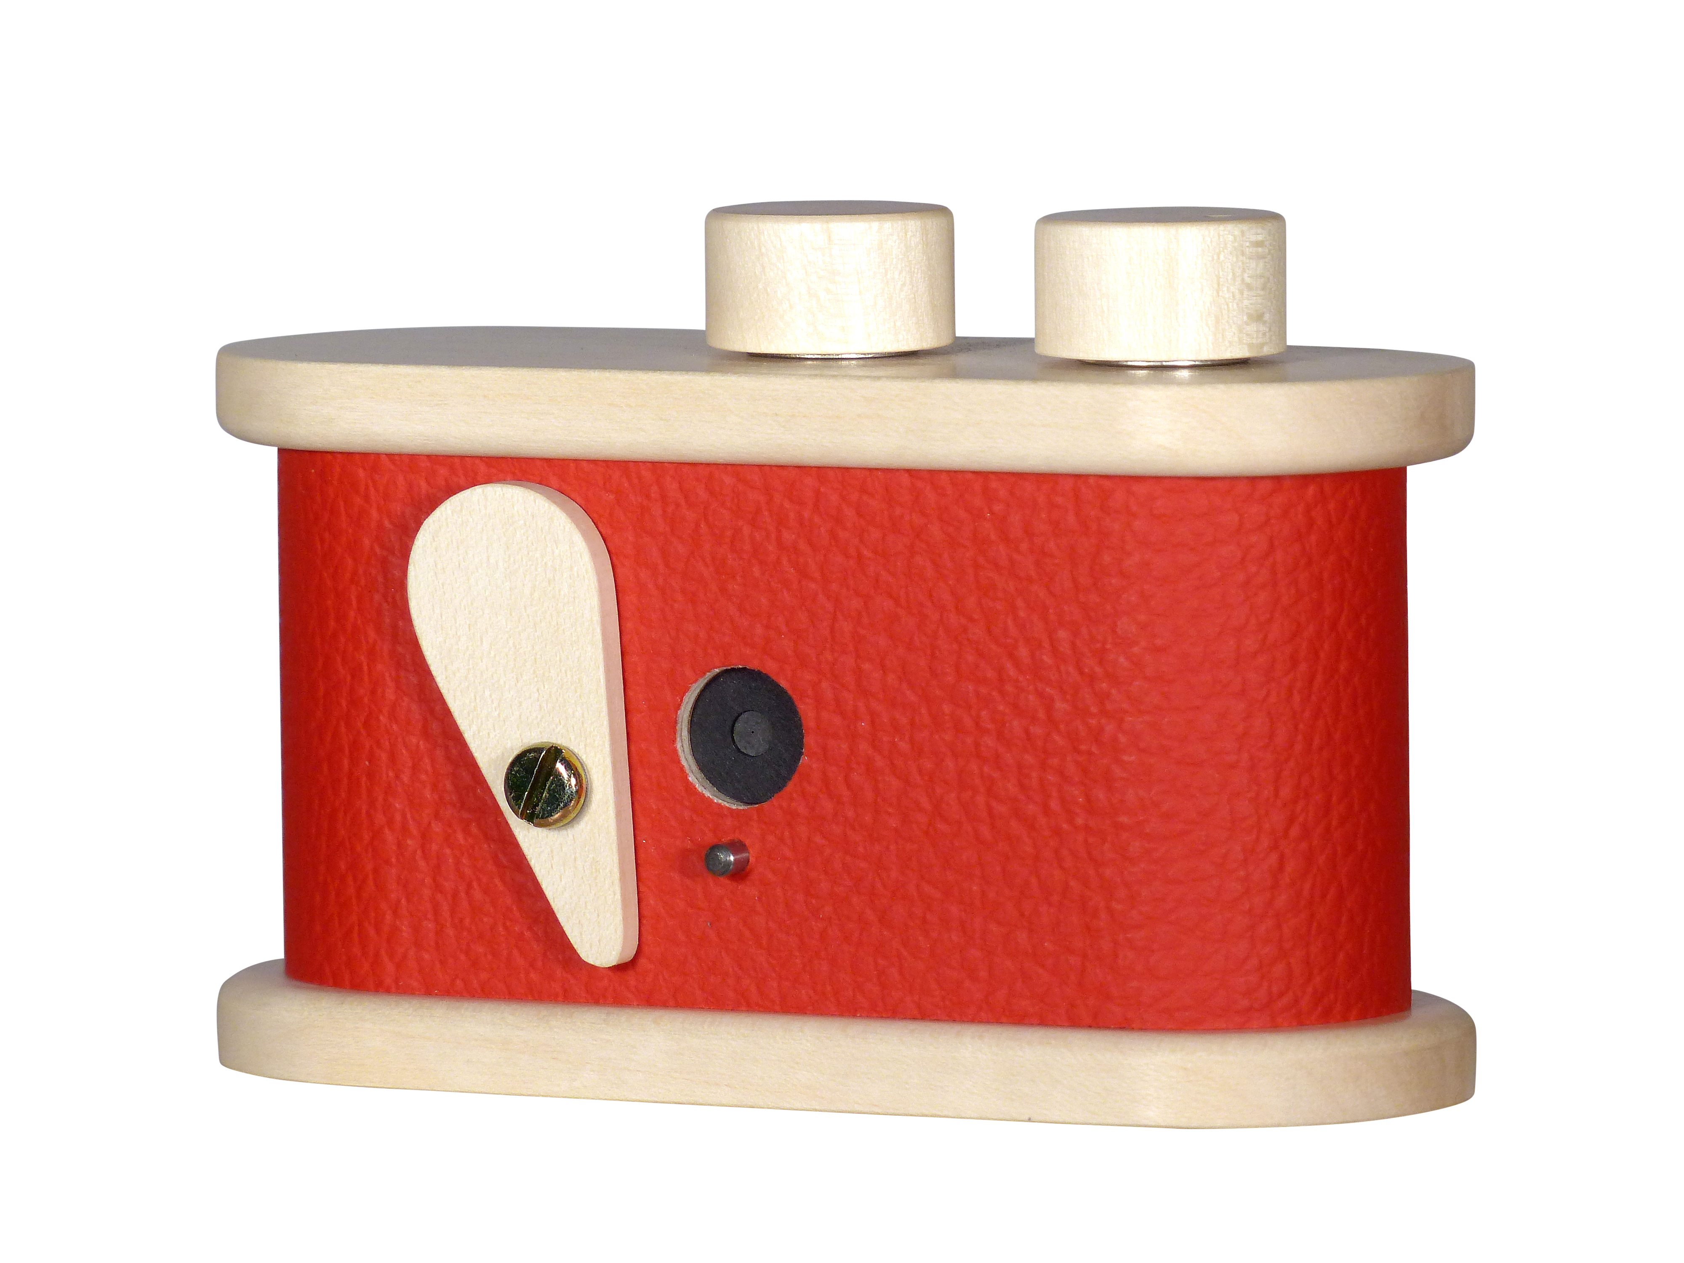
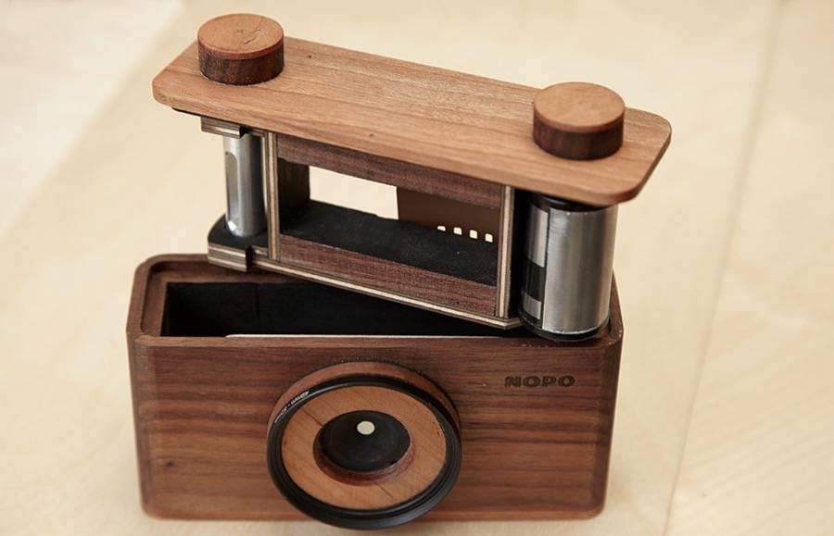
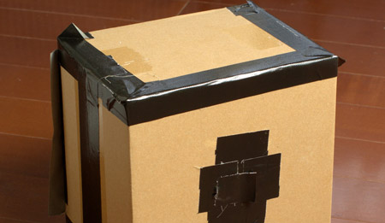
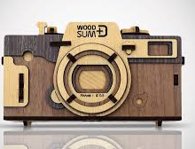

Slide 31
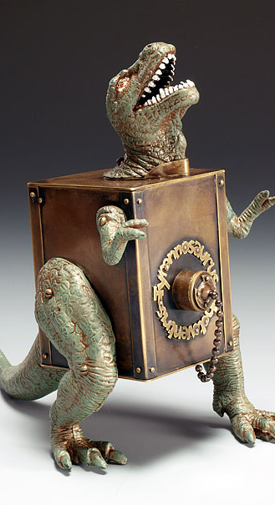
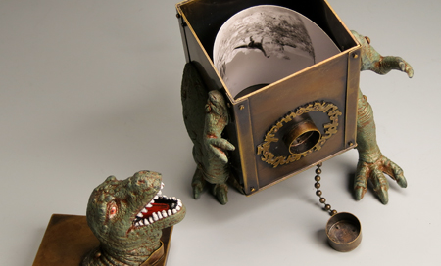
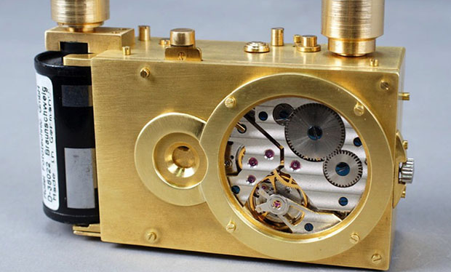

Slide 32
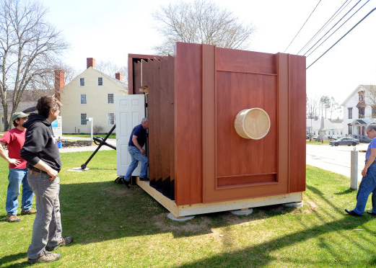
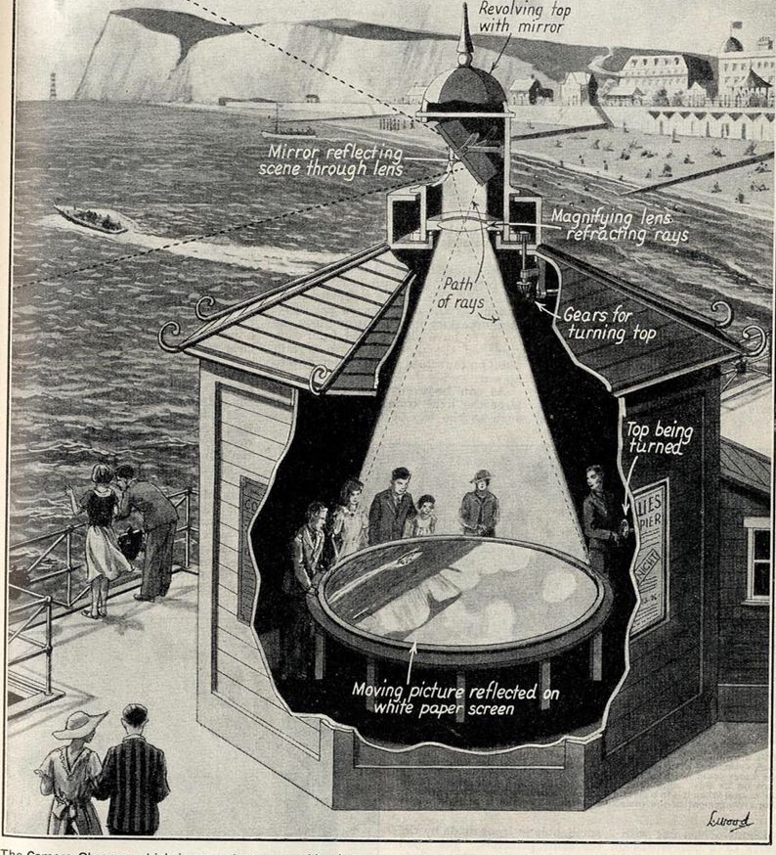
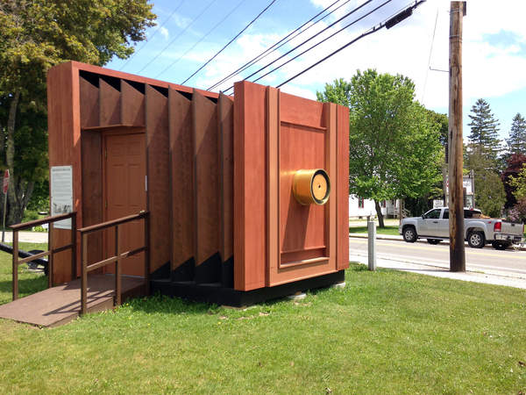
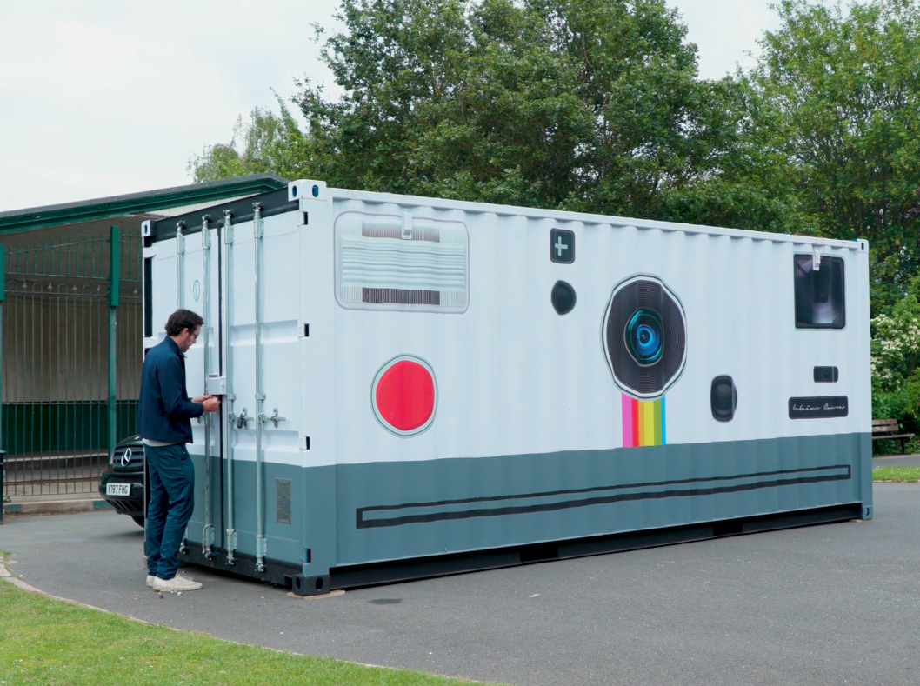

Slide 33
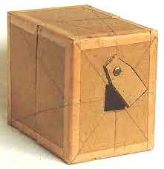
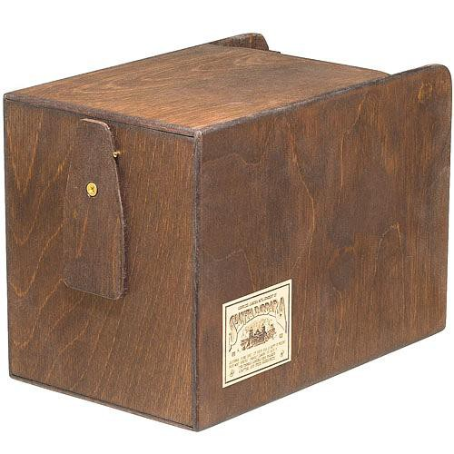
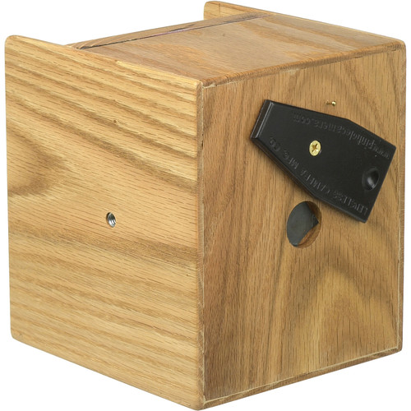
Let’s look at how we will design,
fabricate, and test our cameras.

Slide 34
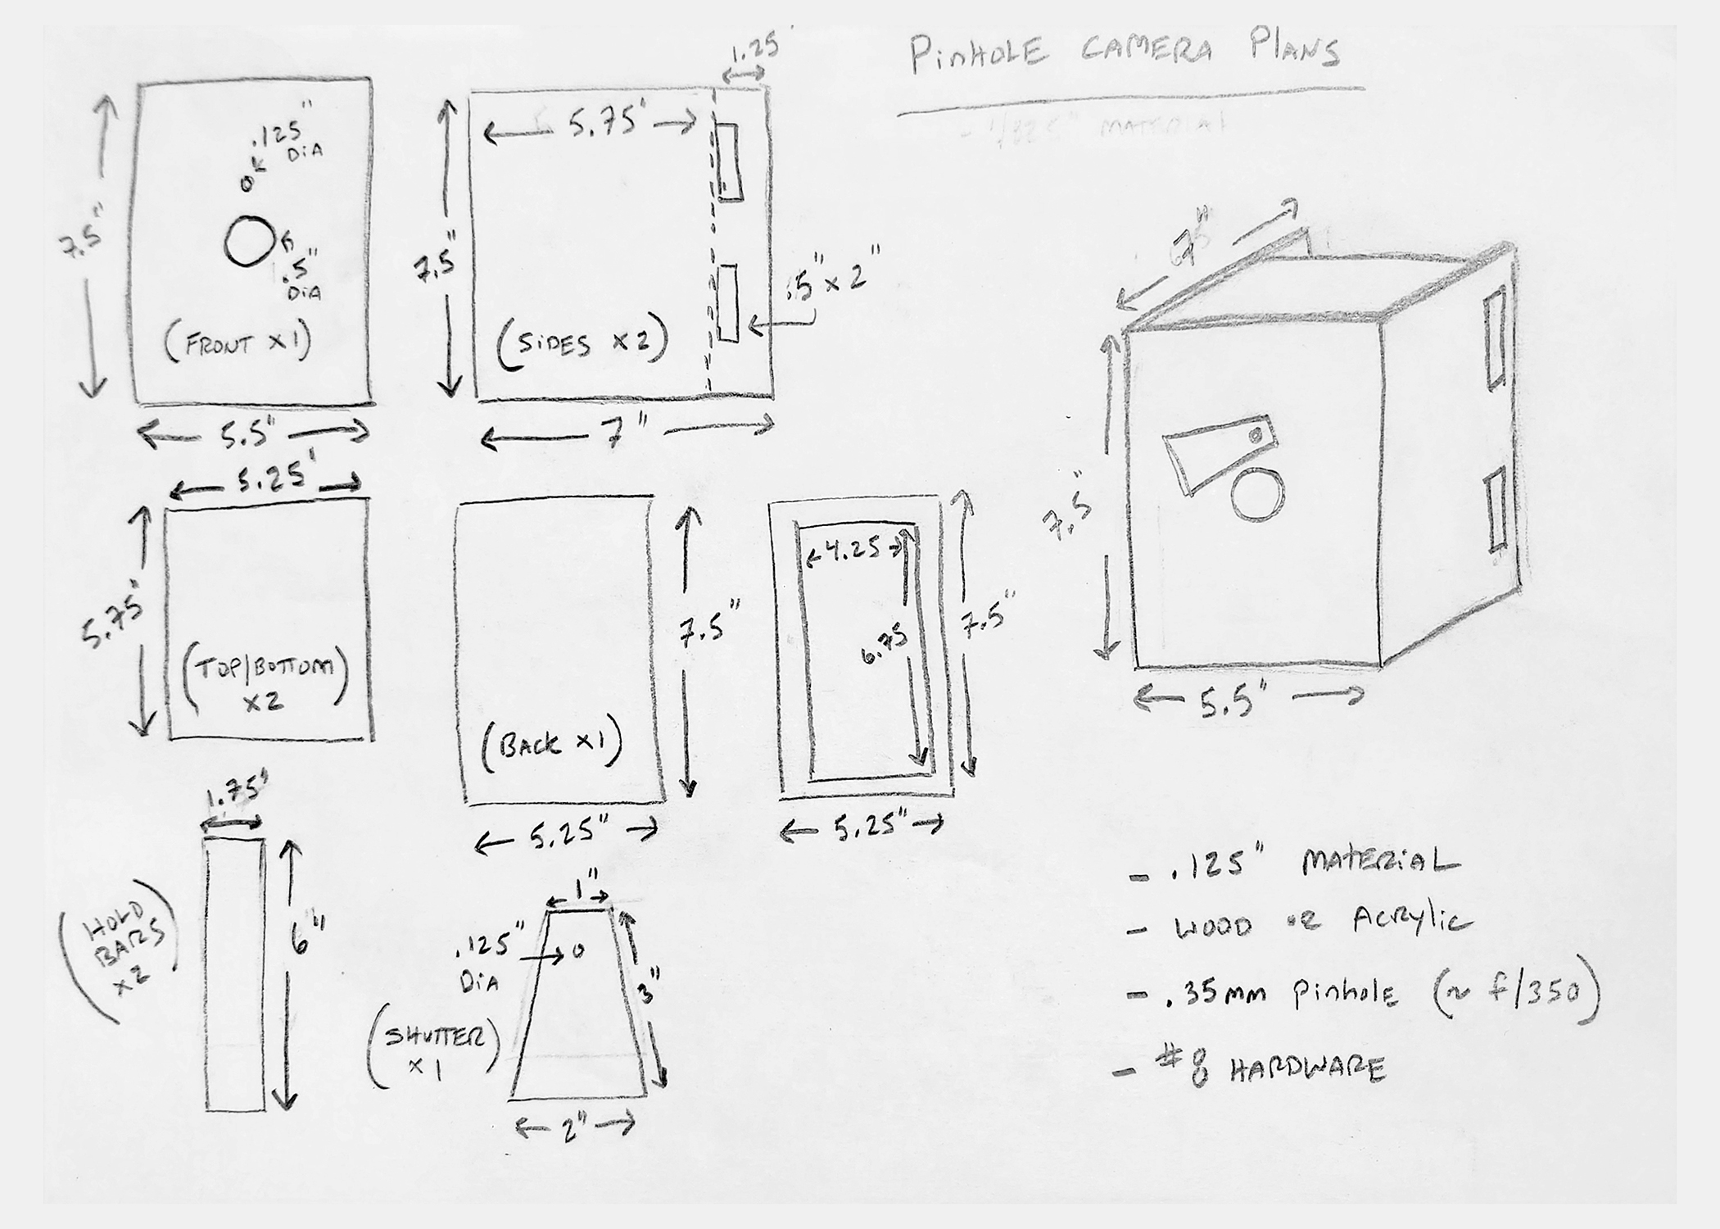

Slide 43
1917
Albert Einstein theorized the principle of a laser. He described a theory of "stimulated emission of radiation.”
What is stimulated emission of radiation?
To understand this, we need to understand electrons,
energy levels, and photons. According to the Bohr model,
we know that an atom looks something like this:
Moving between energy levels involves photons (we'll learn about that
soon). A photon is essentially a particle of light, or a packet of light energy.
Electromagnetic radiation travels in the form of photons.
1959
Gordon Gould, a graduate student of Columbia University, proposed that stimulated emission could be used to amplify light. He described a theory of Light Amplification by Stimulated Emission of Radiation. (The term “LASER” is an abbreviation for this!)
What is light amplification by stimulated emission of radiation?
This is how a laser works!
A laser beam is a very concentrated light beam. From what we learned of spontaneous and stimulated emission of radiation, light (in the form of photons) can be emitted by excited electrons. So to produce an extremely strong beam of light, we need (1) a lot of atoms with excitable electrons in some medium AND (2) something to stimulate, or excite, the atoms with.

Slide 45
1960 The first ever working laser was built by Theodore Maiman at Hughes Research Laboratories in California. The laser medium used was synthetic ruby, and this laser emitted a deep red beam. However, the news of the development of a laser was met with skepticism, and the laser was described as “a solution looking for a problem.” 1964 The CO2 laser and gas laser cutting process using a CO2 mixture was invented by Kumar Patel at Bell Labs in New Jersey. The CO2 laser was found to be cheaper and more efficient than the ruby laser. The crystal laser and crystal laser cutting process was also invented at Bell Labs in this year by J. E. Geusic. (Also, James Bond was nearly sliced in half by a laser in Goldfinger.) 1967 - 1979 Lasers gained popularity throughout the world and among manufacturers, including Western Electric and Boeing. Laser cutting, one of the first uses of laser beams that was discovered, was adopted on a much wider scale by the British. In this period of the late 1960s and early 1970s, gas laser cutting continued to advance and was used to cut through new materials such as metal. 1980s By now, about 20,000 laser cutting machines, which were collectively worth about $7.5 billion, had been installed throughout the world for various industries.

Slide 46
1991 Professor William Steen commented in his book, Laser Material Processing, about how humans had entered a new industrial revolution since the invention of the laser. 2008 What are the different types of laser cutting? Well, lasers are classified based on the state of their laser medium. A solid-state laser uses a solid (glass or crystal) as its laser medium and a light source (e.g., flashtube, flash lamps, etc.) as its energy pump. A gas laser uses a gas mixture as its laser medium and an electric current as its energy pump. A liquid laser uses a liquid as its laser medium and a light source as its energy pump. Gas laser cutting (AKA CO2 laser cutting): This type of cutting involves a gas laser. The laser medium is a CO2 mixture which is electrically stimulated by an electric current discharged through it. Crystal laser cutting: This type of cutting involves a solid-state laser. The laser medium is a crystal (e.g., ruby). Crystal laser cutting is useful for cutting both metals and nonmetals. Fiber laser cutting: This type of cutting involves a solid-state laser. The laser medium is made of optical fibers. Fiber laser cutting is the newest method of laser cutting! It is used on both metals and nonmetals. 2018 Three scientists received the Nobel Prize in physics for advancing the science of lasers and creating useful tools out of laser beams (such as optical tweezers, AKA laser tweezers). They were Arthur Ashkin, Gerard Mourou, and Donna Strickland. Donna Strickland was the 3rd woman to ever win a Nobel Prize in physics and the first woman to do so in 55 years!

Slide 47
How To: Epilog Laser

Slide 48
Laser Cut Paper - Intricate Lace Pattern with an Epilog Laser

