Slide 1
3D Printing and the Basic Aesthetic Values of Sculpture

Slide 2
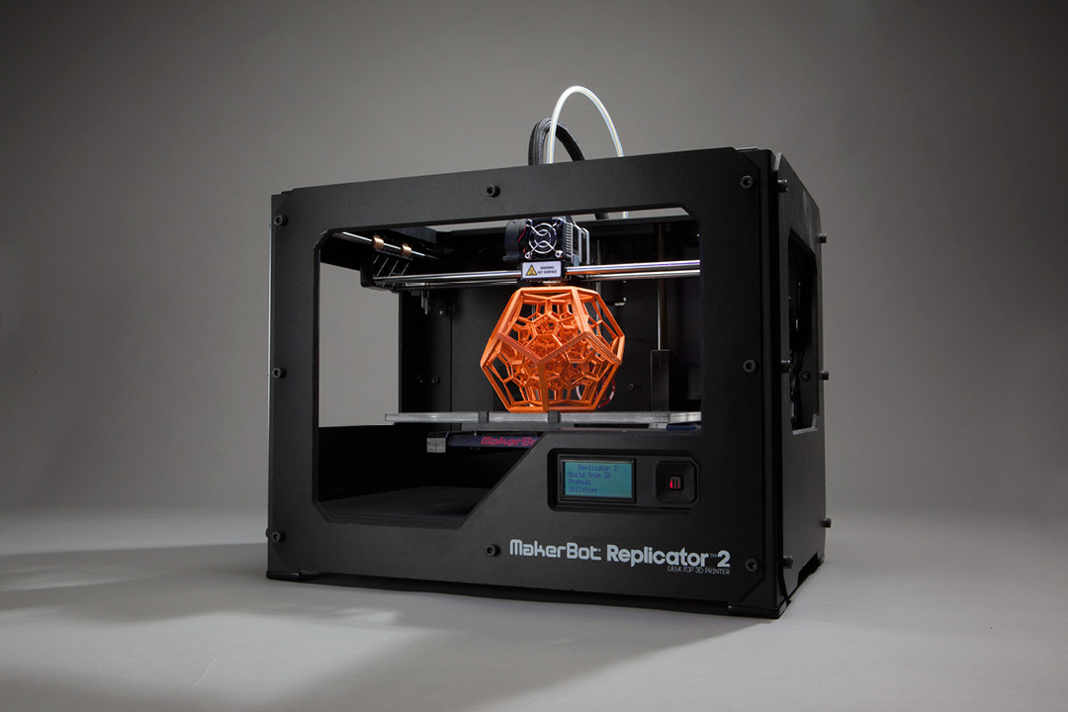

Slide 3
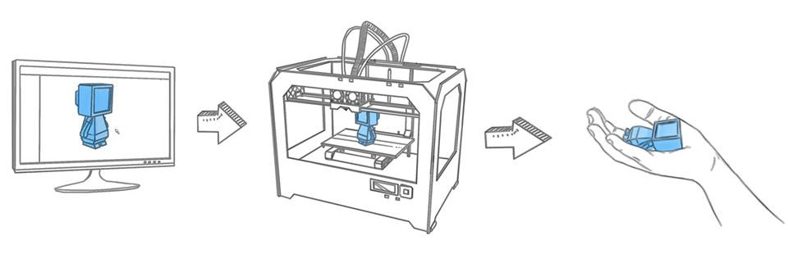
-3D printing is an additive manufacturing process that creates 3-dimensional objects from 3-dimensional digital information.
-There are other 3D printers that are a subtractive manufacturing process (CNC, milling) but these are usually considered a separate group and are often referred to as “machining.”

Slide 4
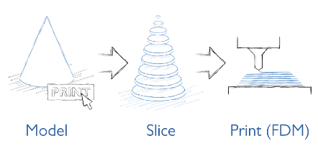
3D printing software splits the model into many cross-sections. These sections are called “slices.” Each slice is printed one atop the next to recreate the object.

Slide 5
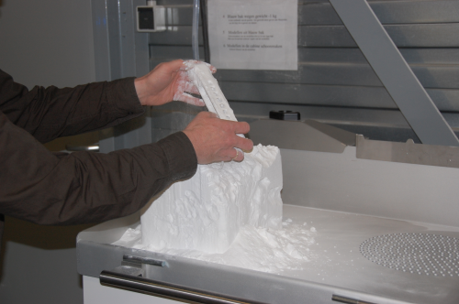
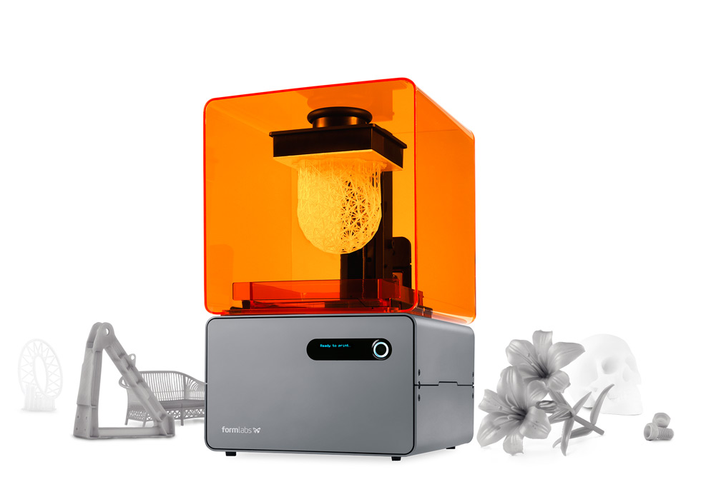
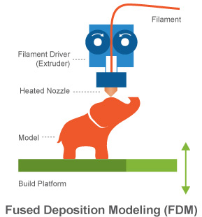
Powdered Bed (SLS – Select Laser Sintering)
Stereolithography (SLA)
Fused Deposition Modeling (FDM)

Slide 6
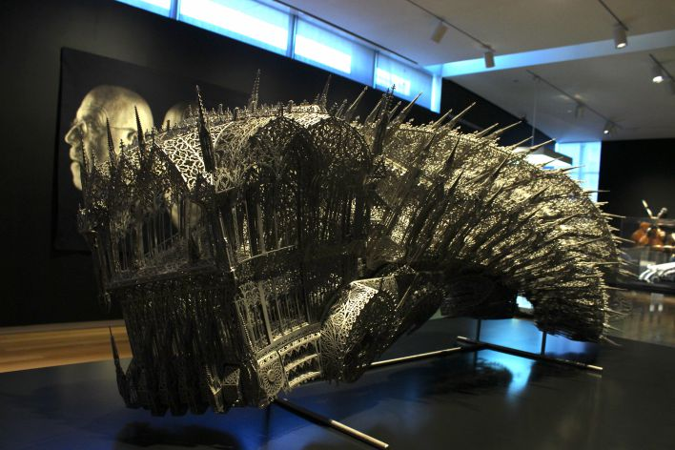
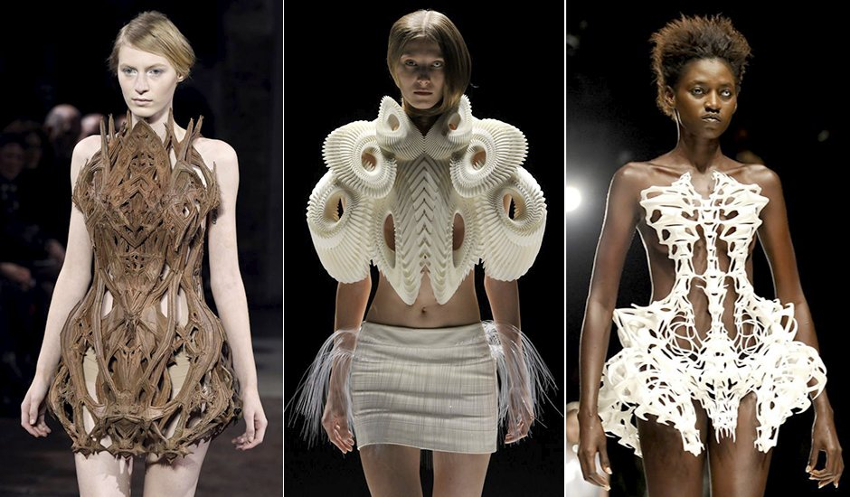
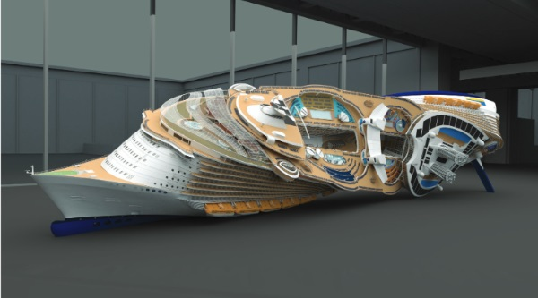
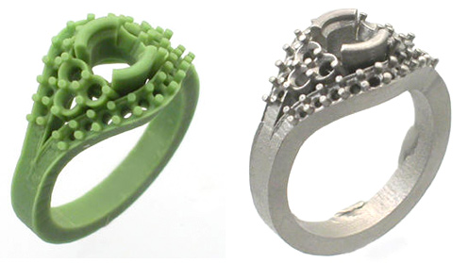

Slide 7
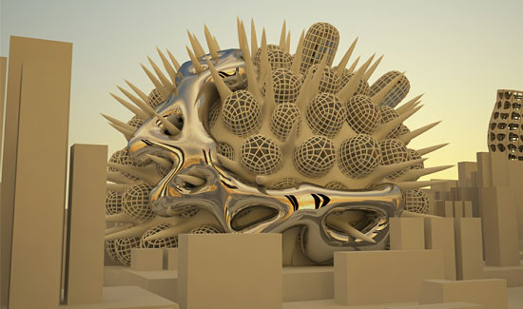

Slide 8
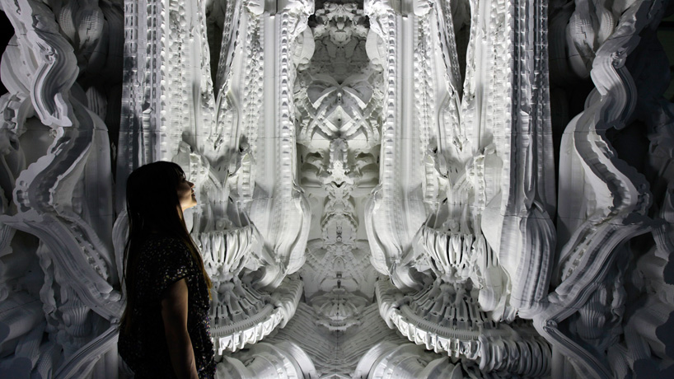
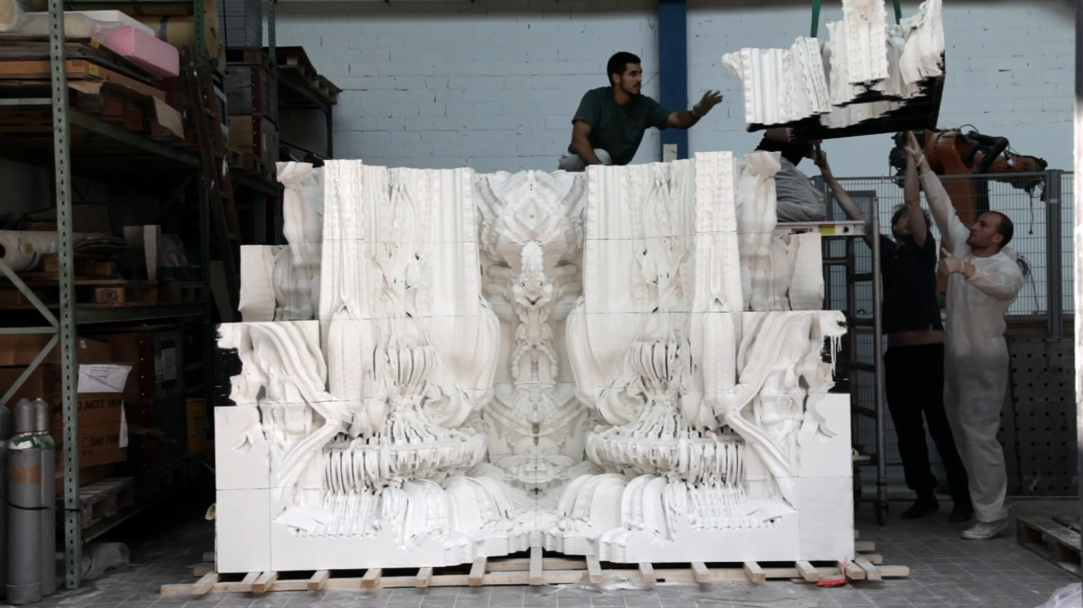

Slide 9
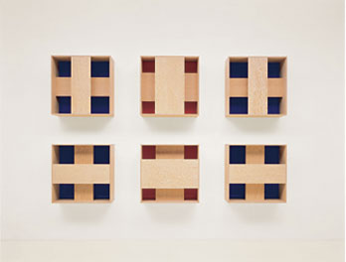
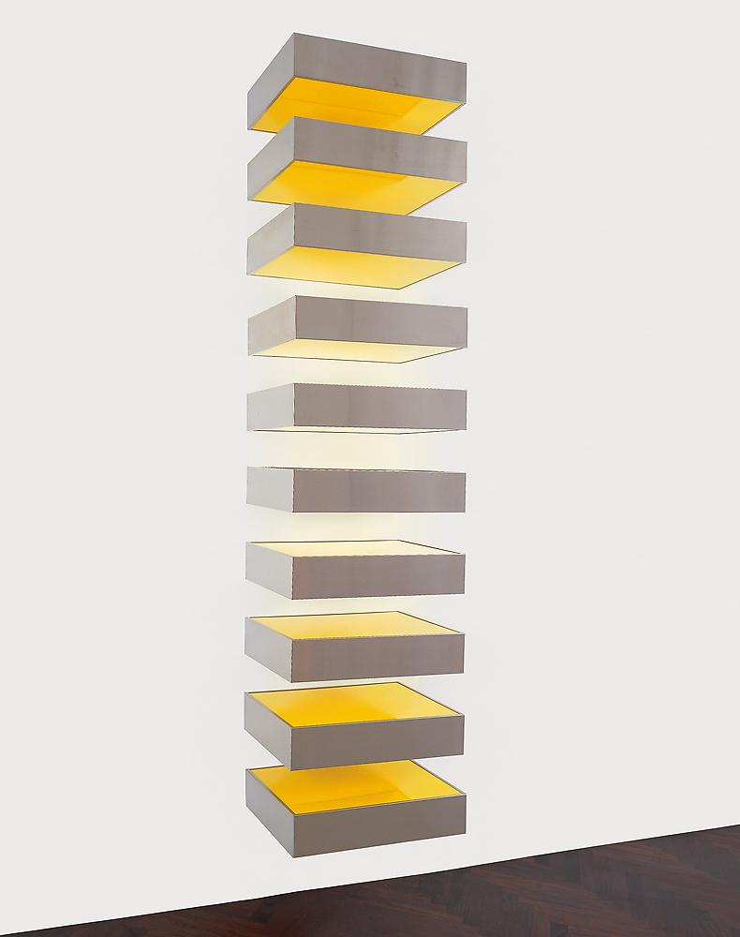
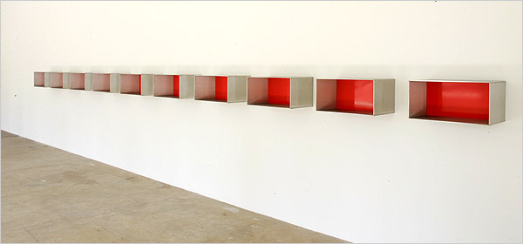
Simple, geometric
Repetition, regular, organized
Rhythm
Minimalism
Donald Judd

Slide 10
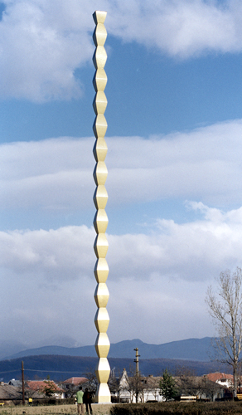
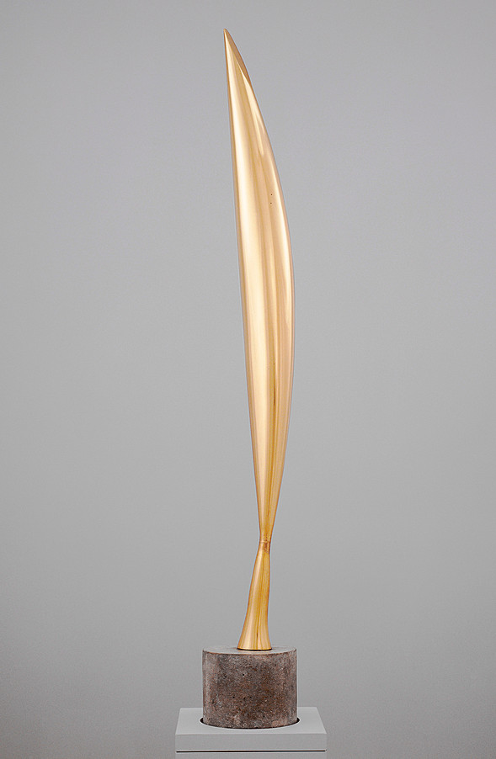
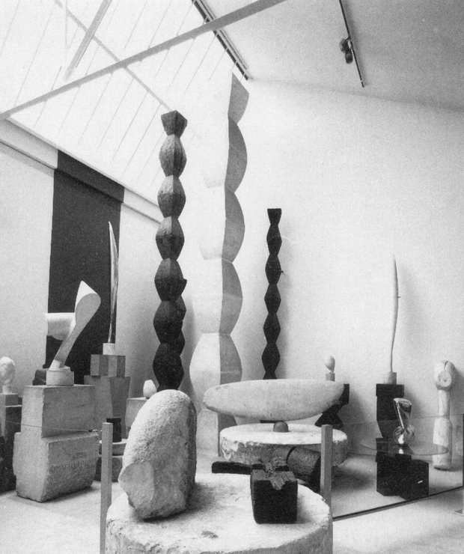
Verticality
Repetition, regular
Flight, lift, push, thrust
Constantin Brancusi

Slide 11
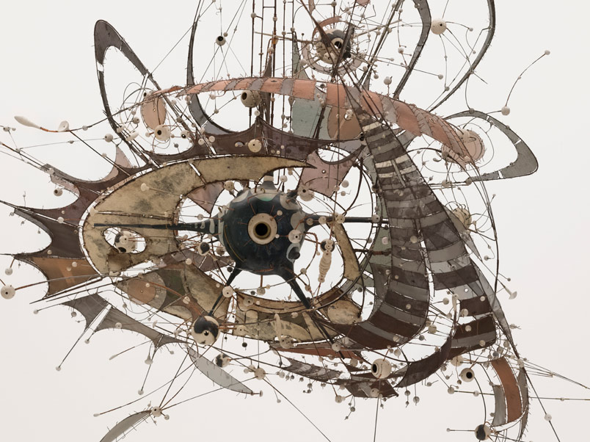
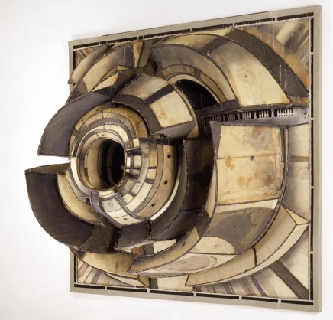
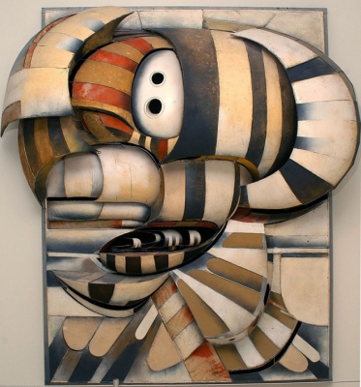
Push and Pull
Push out from center, pull in from center
Voids, layers, movement
Orbits
Explosive, expansive
Lee Bontecou

Slide 12
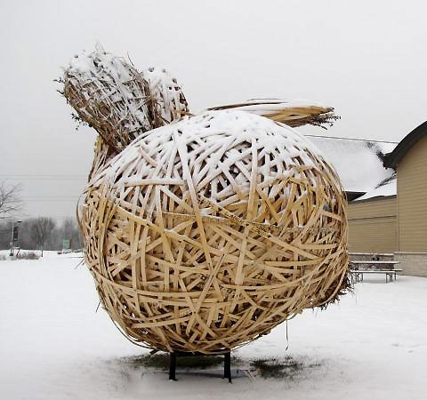
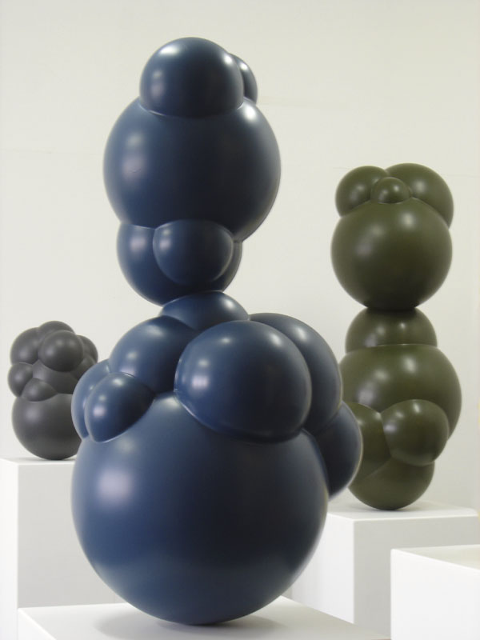
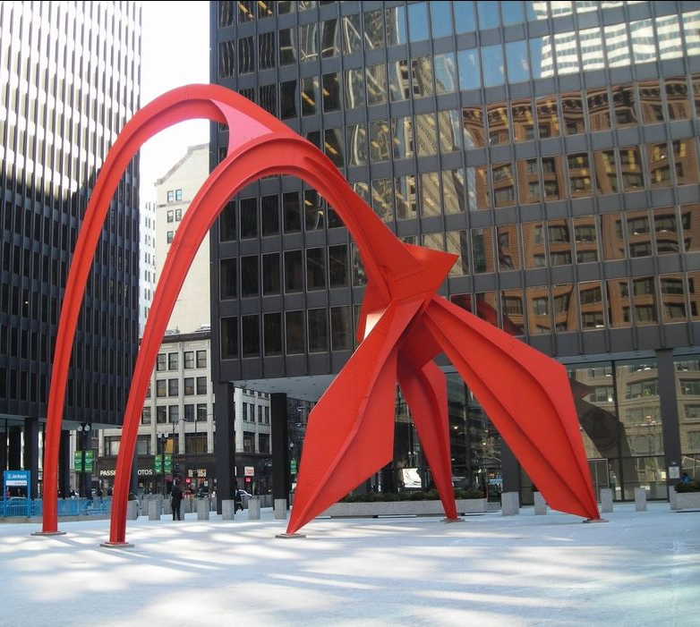
- Wrapped up
Roped in
Contained
Pushing out
Mass built up through individual elements
Reaching over
Covering up
Piercing
Creating interior space
Creating negative space
Organic, curvature
Bubbling up
Pushing out
Repeated elements of varying scale

Slide 13
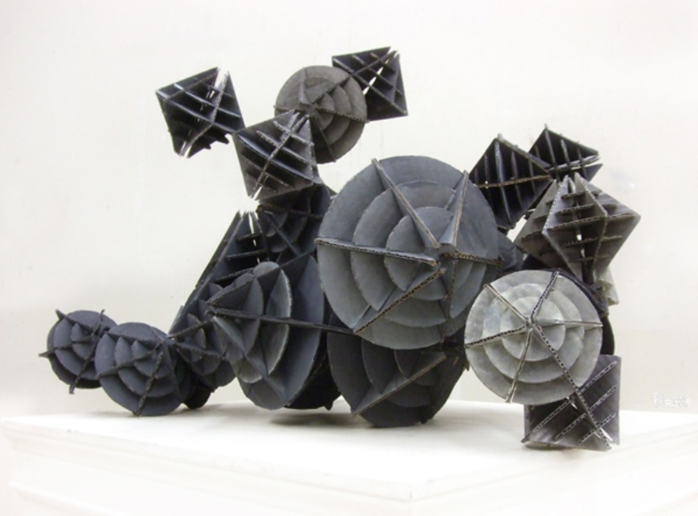
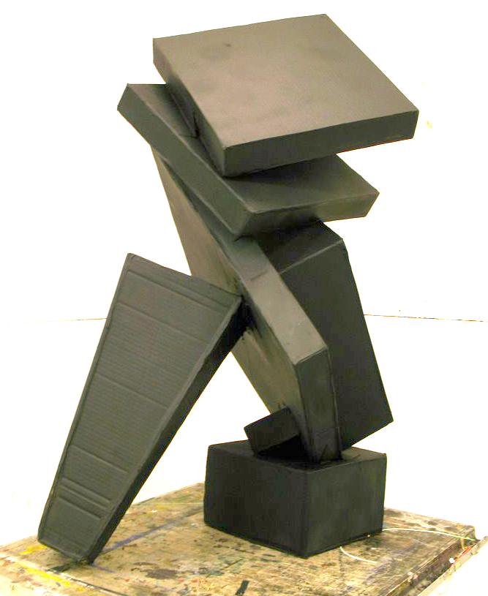
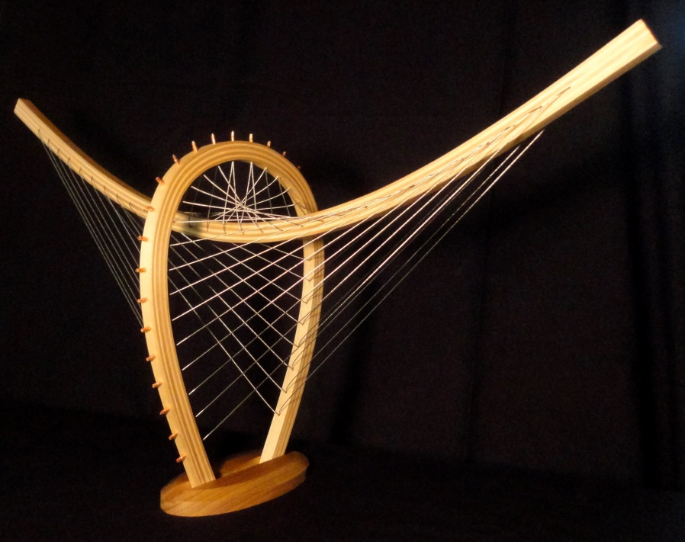
Geometric elements repeated
Elements vary in scale
Bacterial or crystal growth
Stretched, suspended, taught
Negative space
Comparison of heavy and light elements

Slide 14
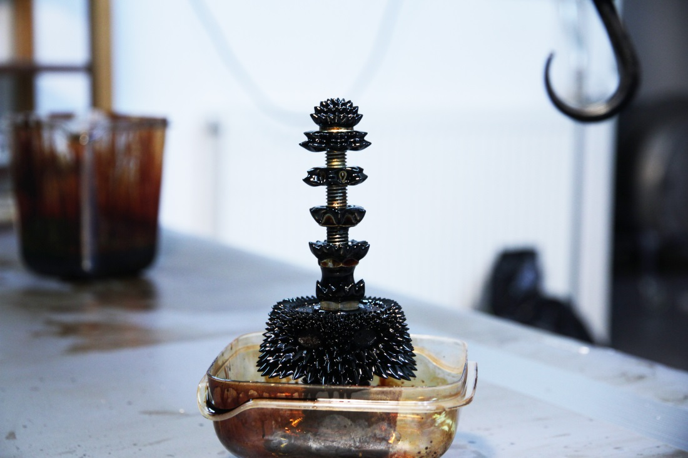
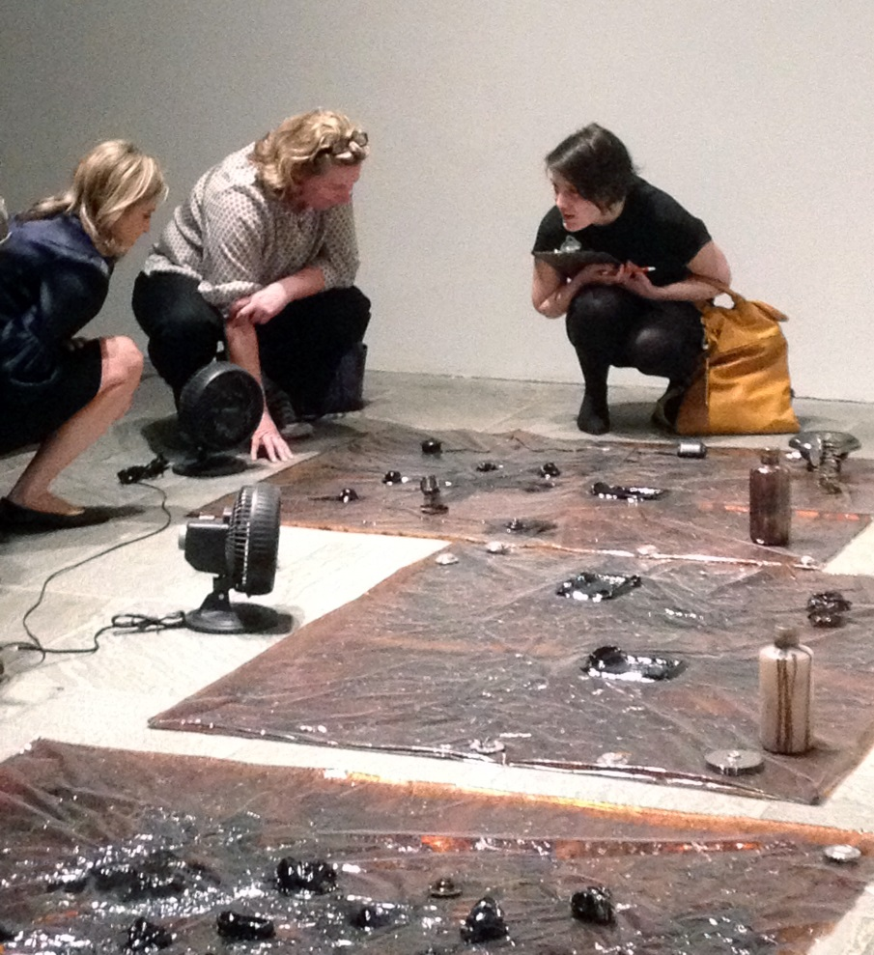
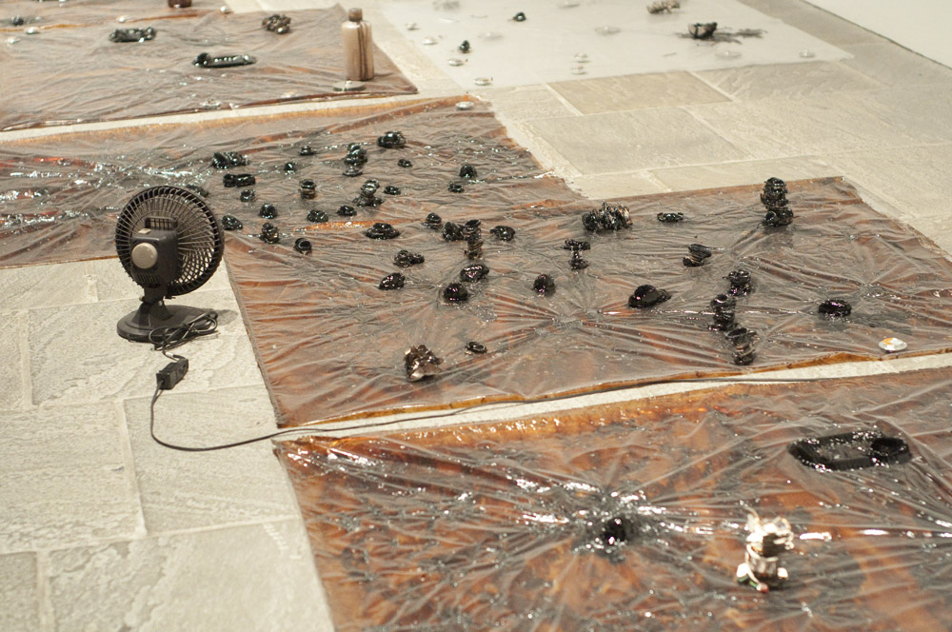
Ferrofluid
Find inspiration in nature
Repeating patterns
Scaling similar elements

Slide 15
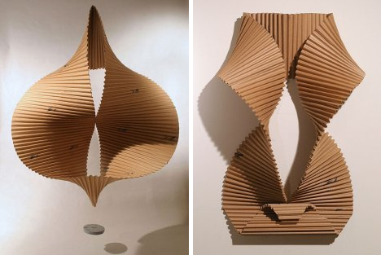
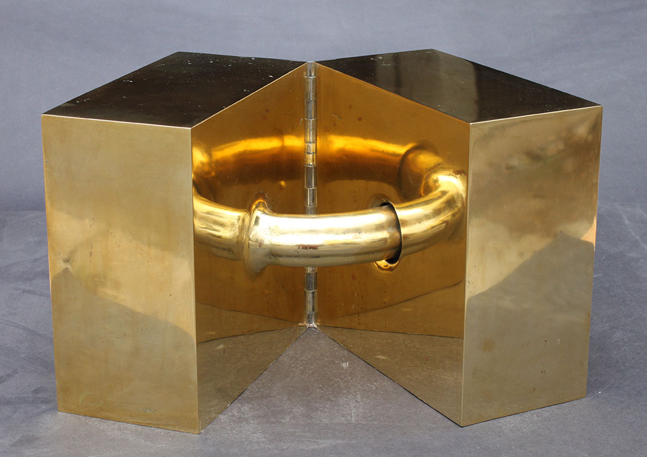
Folded plane
Textured surface
3D from 2D form through bending and folding
Similar elements rearranged differently
Movement
Opposing forces
One into other
Visual illusion
Connection
Simple forms compared/contrasted

