Slide 1
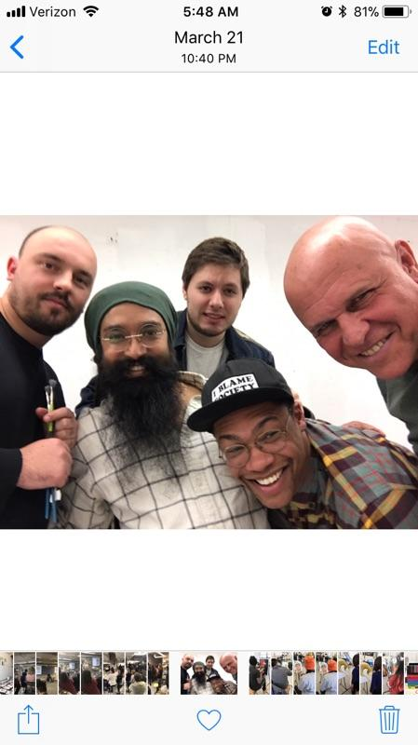
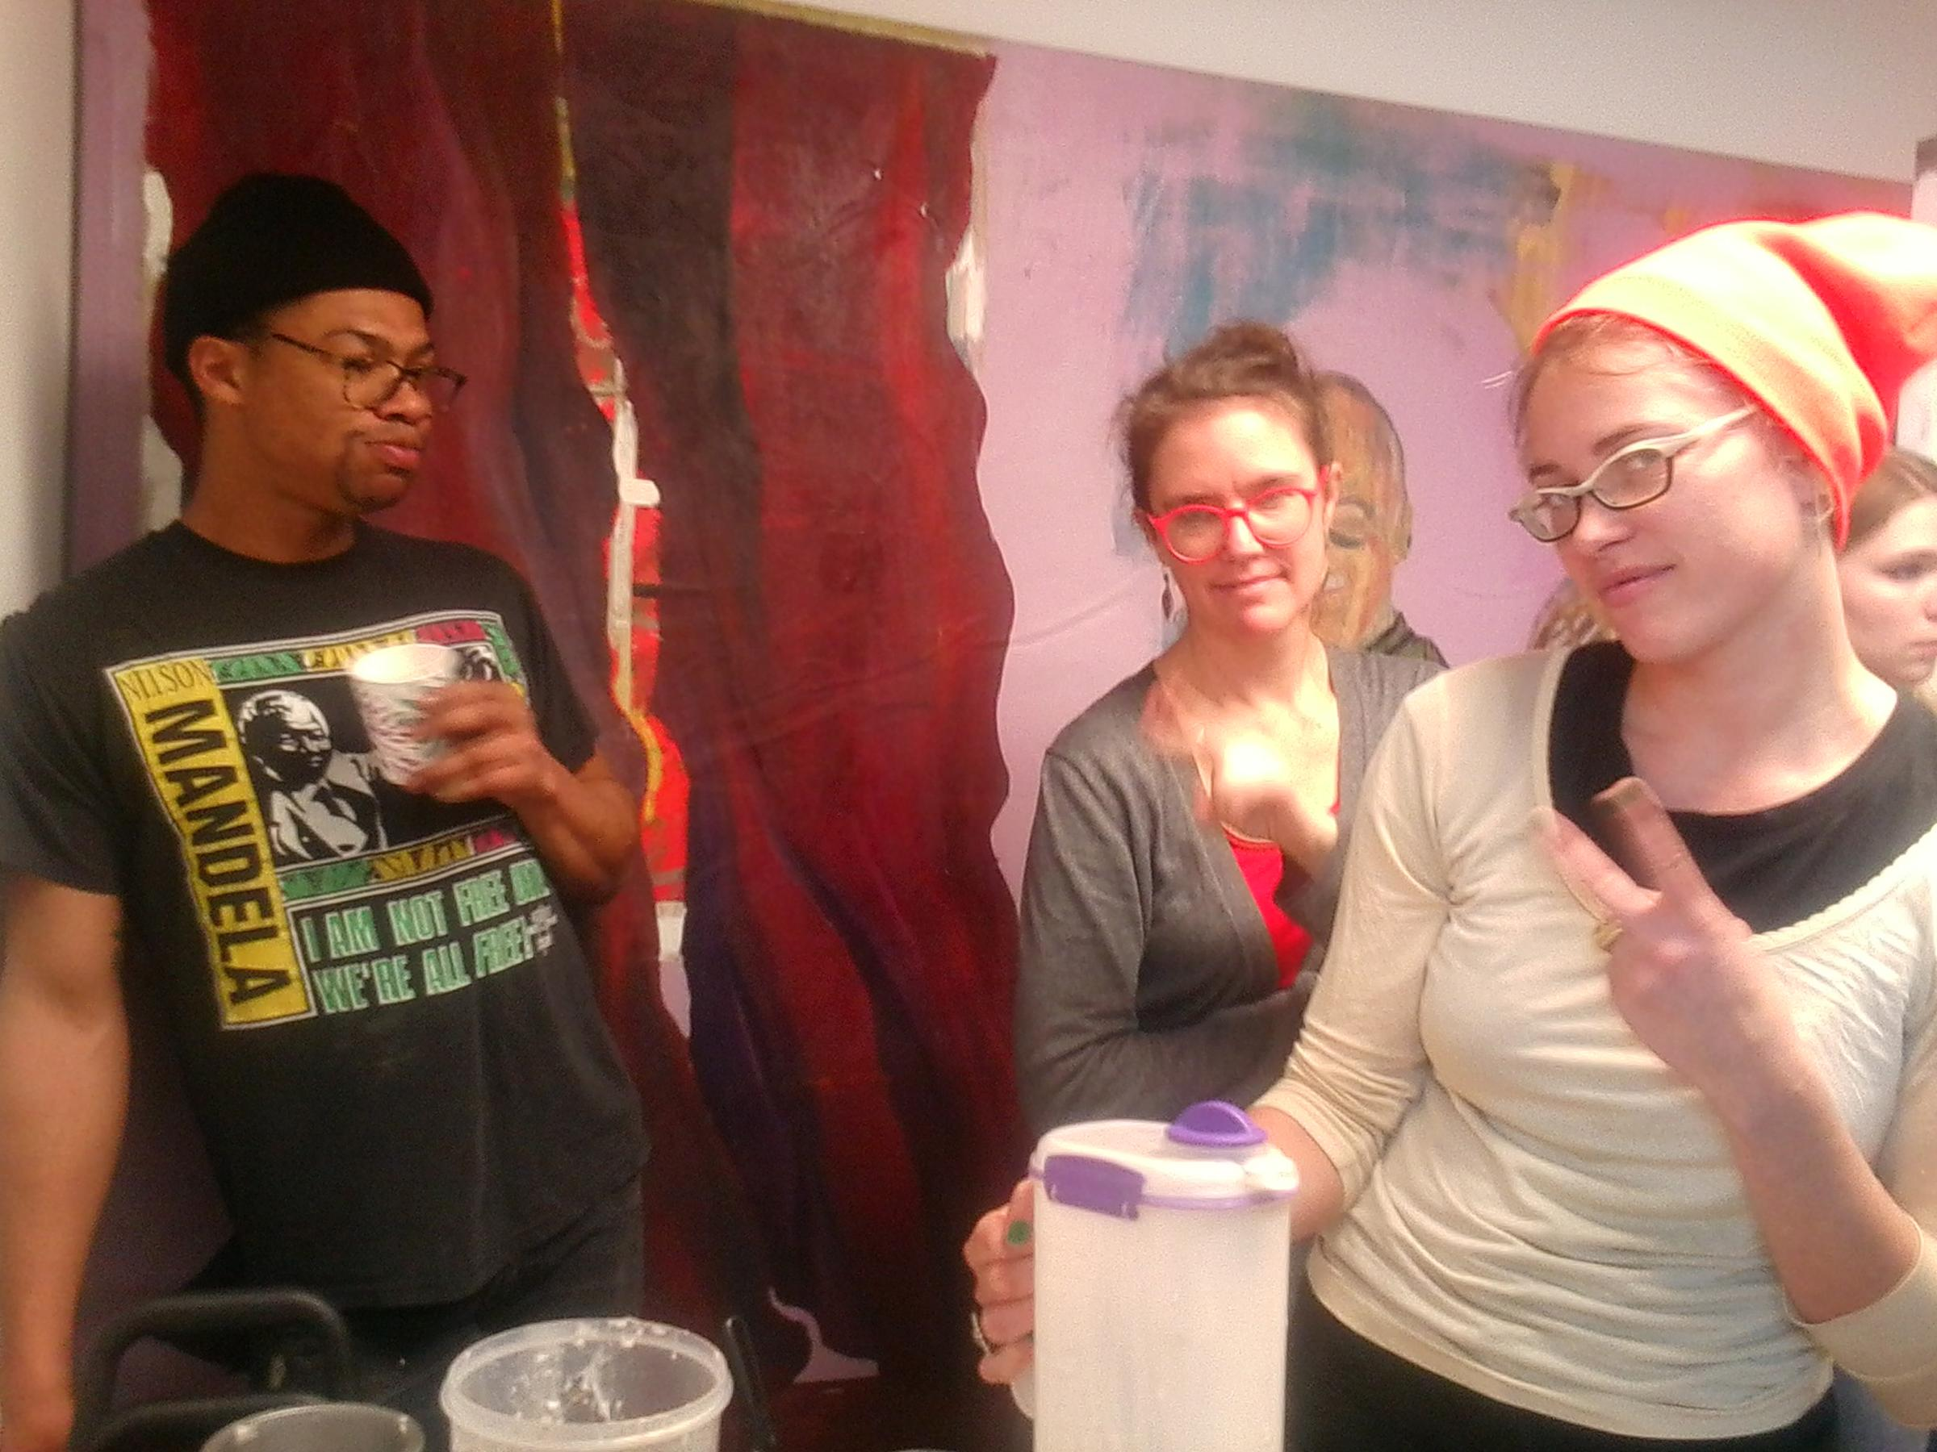

Slide 2
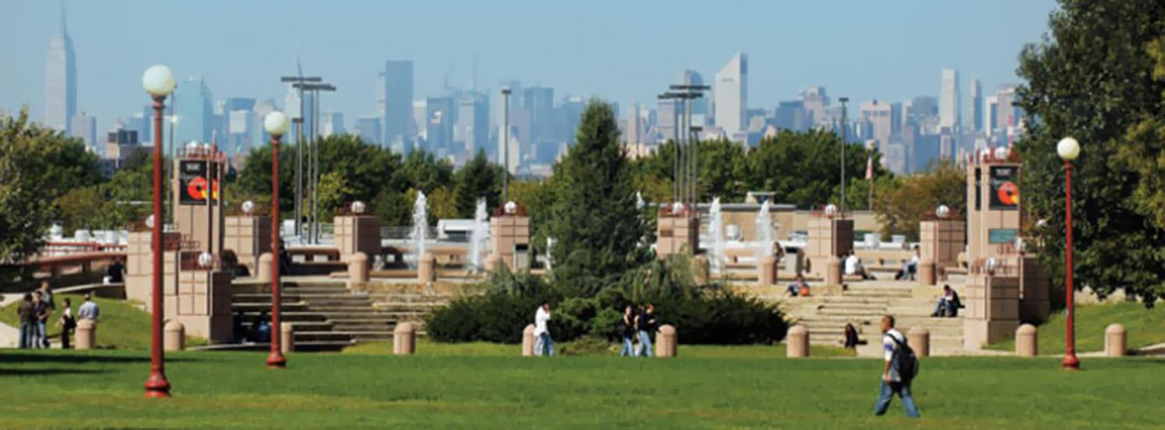
Queens College CUNY
The View From Queens College Campus Quad!
Space, Freedom, Proximity, & Cost

Slide 3
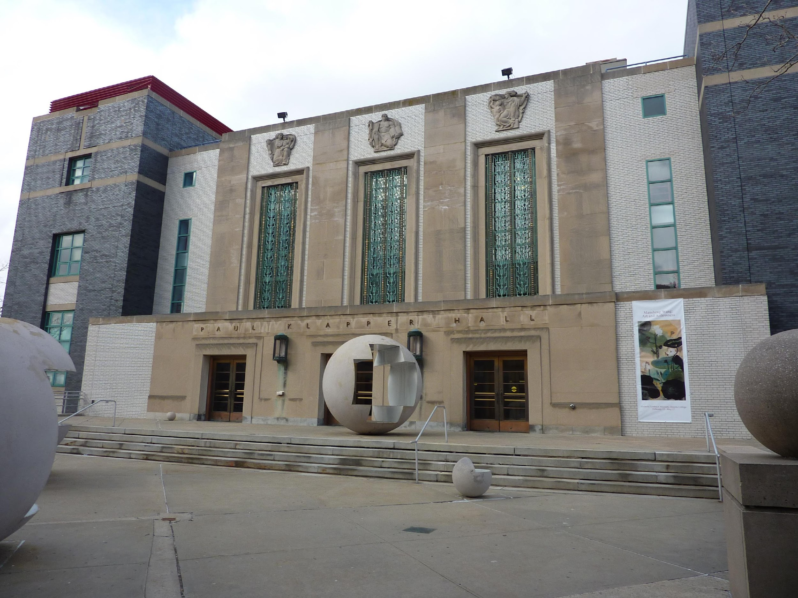
Klapper Hall Art Dept.
with sculptures by Vito Acconci

Slide 4
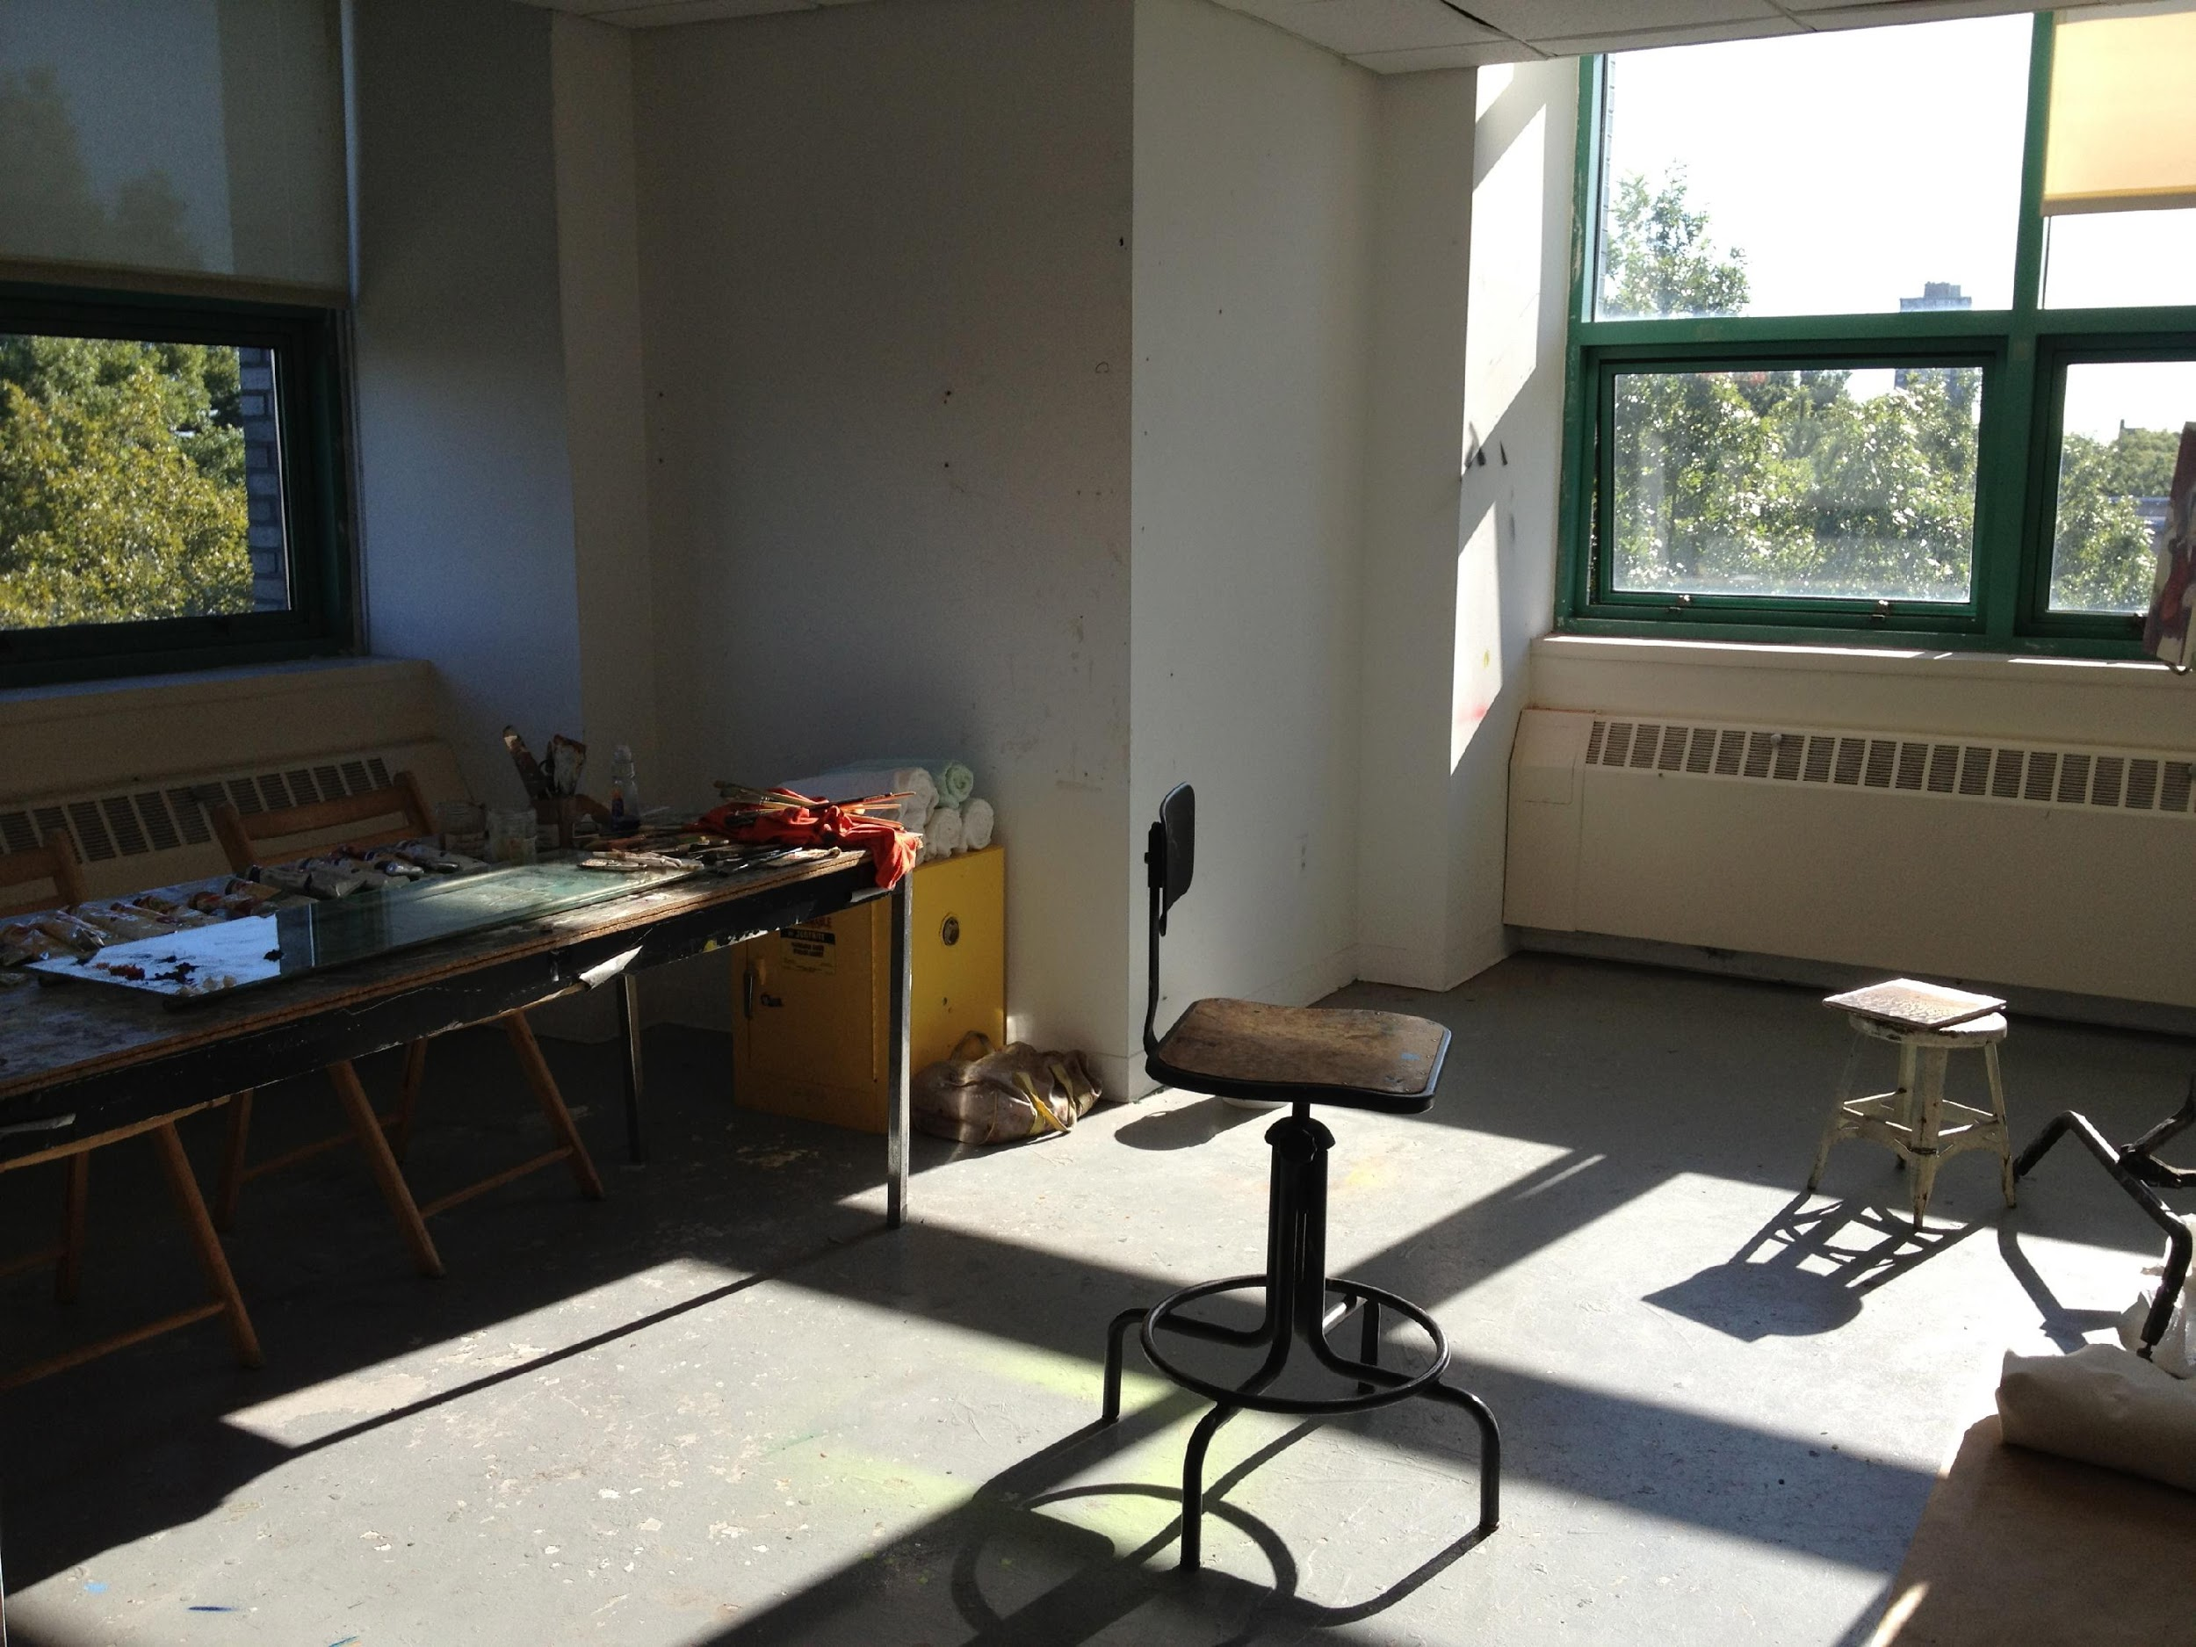
Private Studio Space (smaller size)

Slide 5
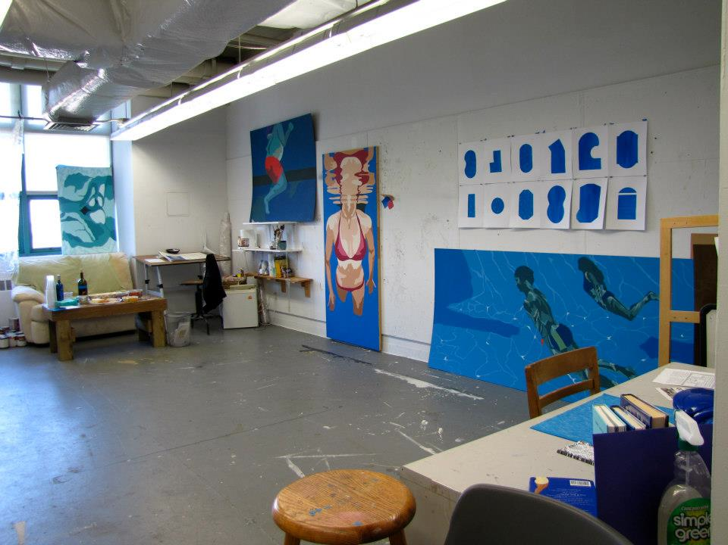
Large Private Locked Studio Space (MFA)

Slide 6
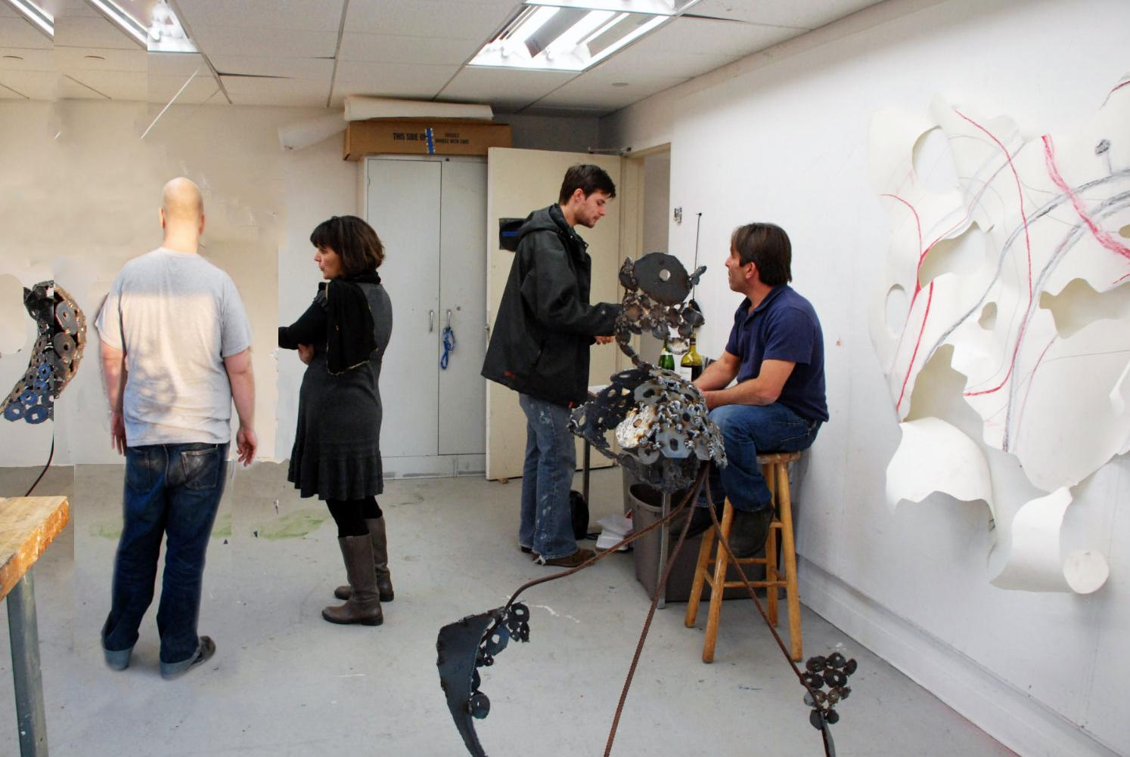

Slide 7
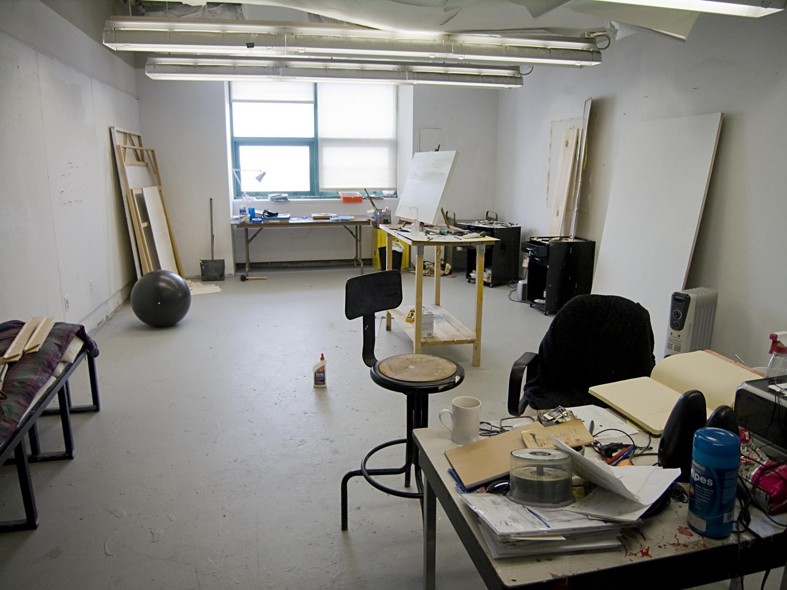

Slide 8
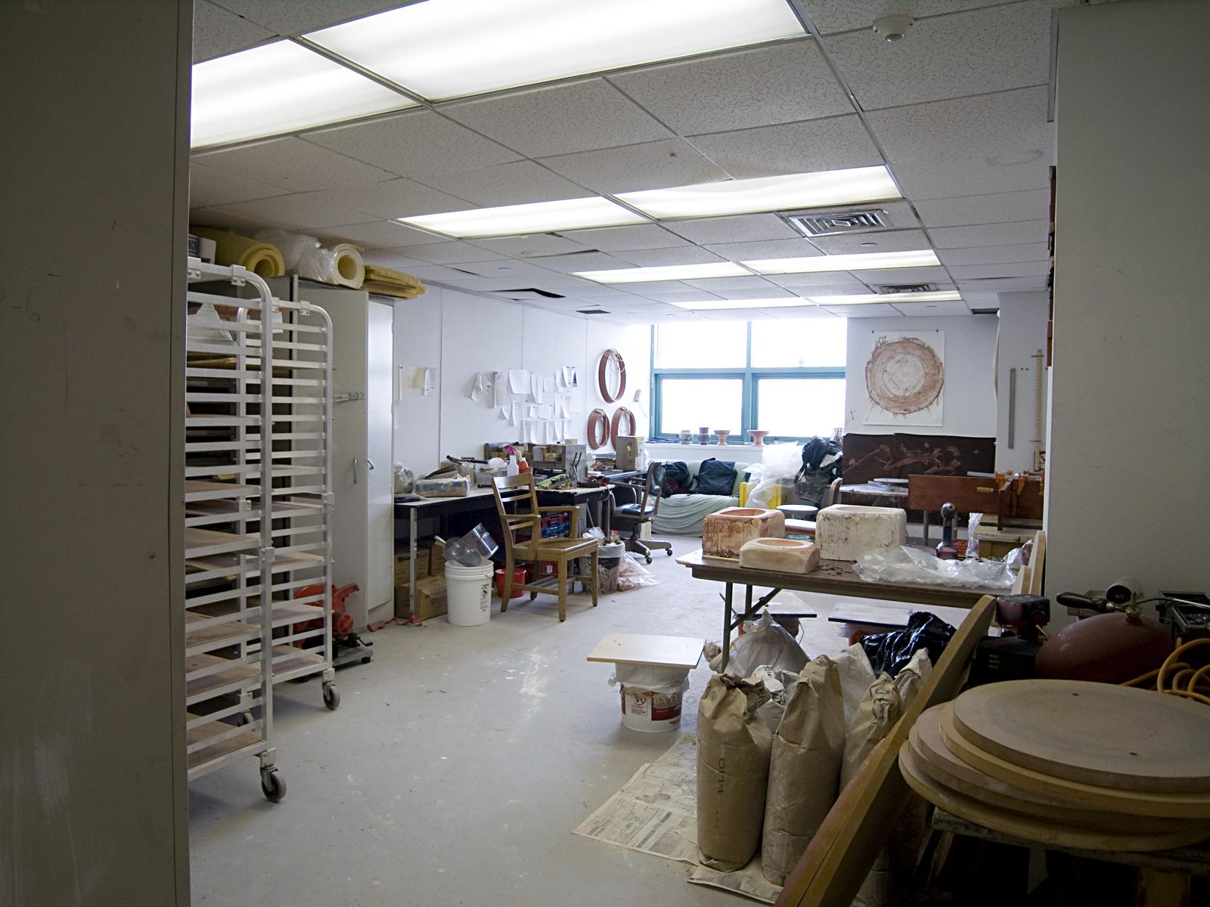

Slide 9
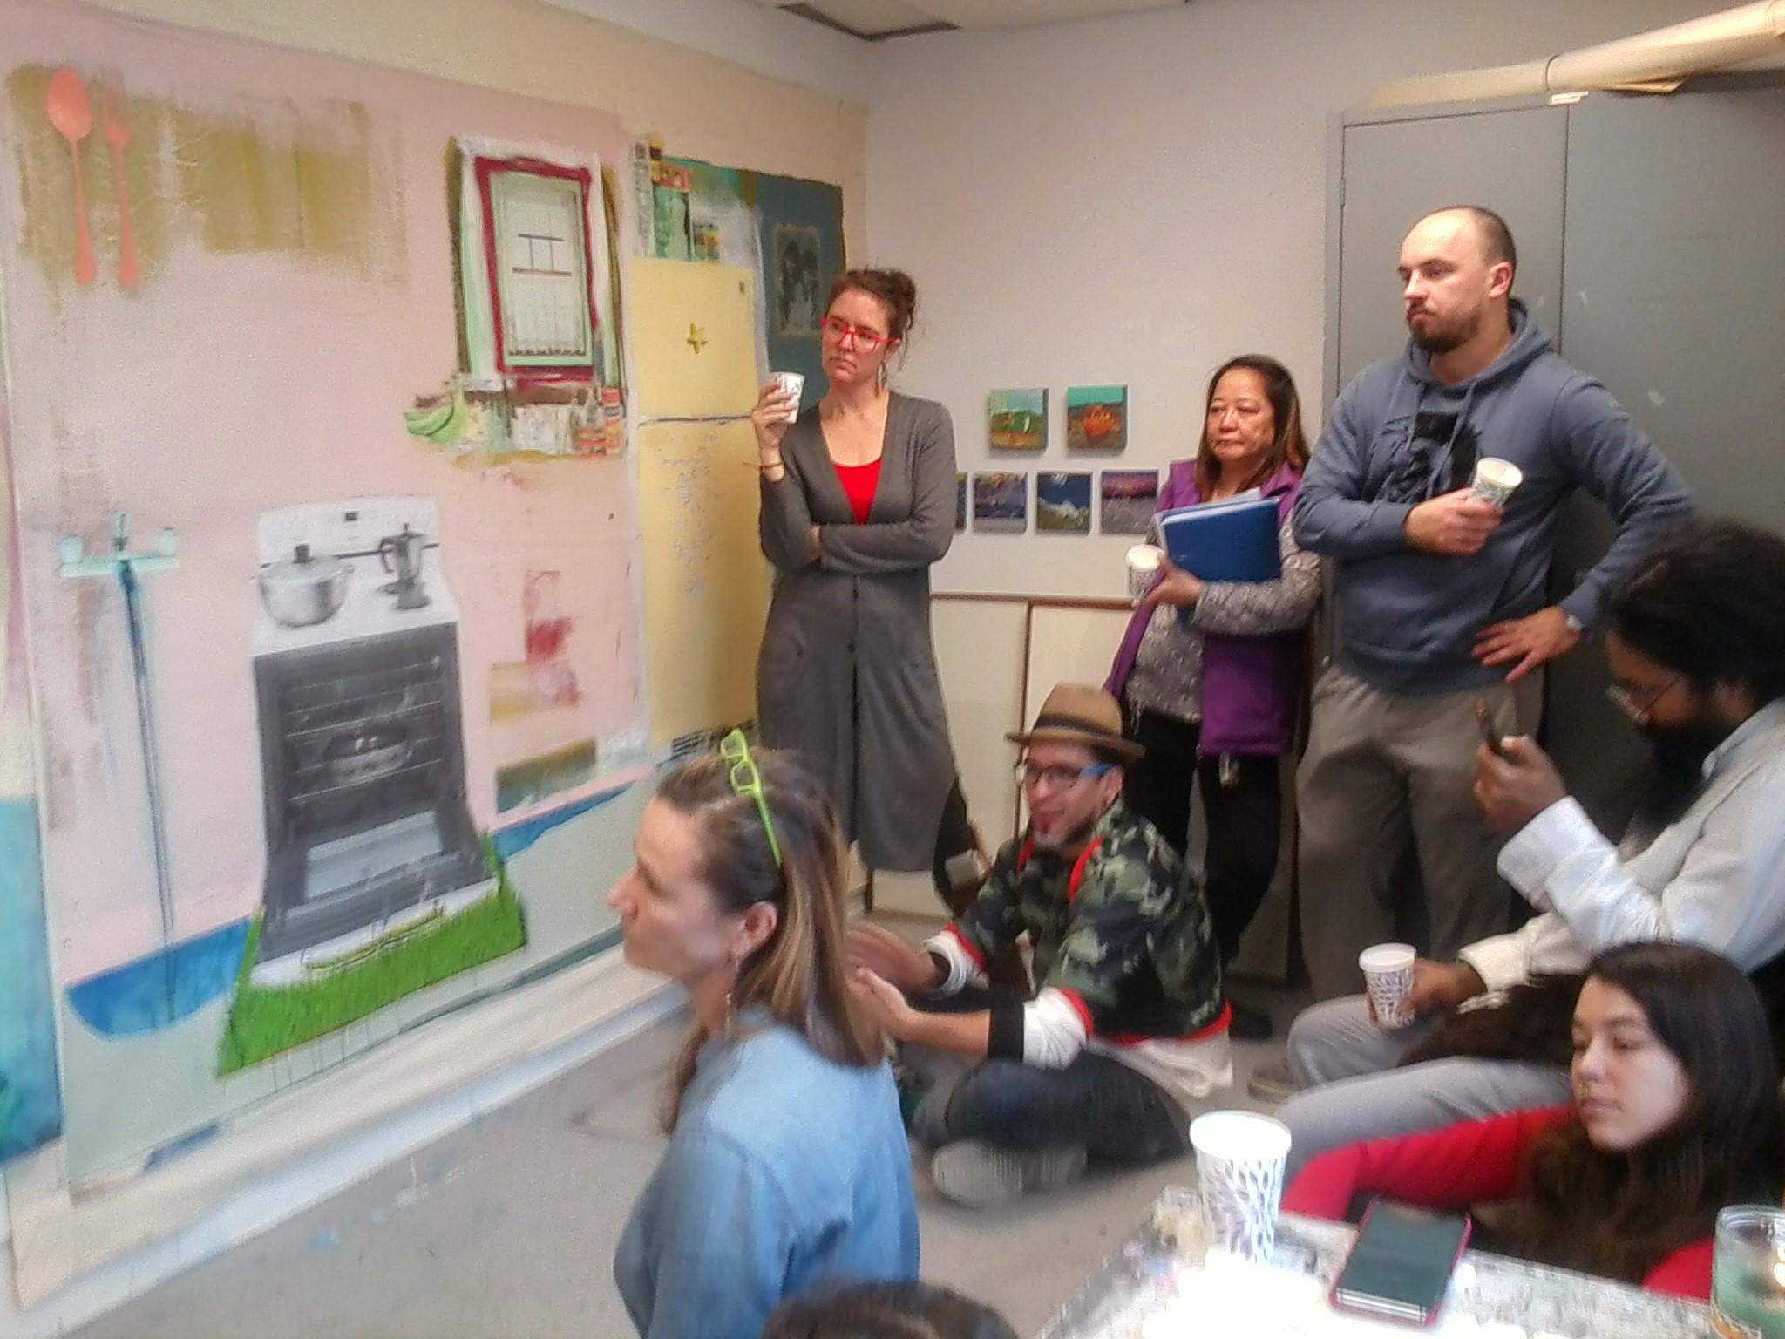
Group Crit / Studio Visits with
Irish artist Elaine Byrne

Slide 10
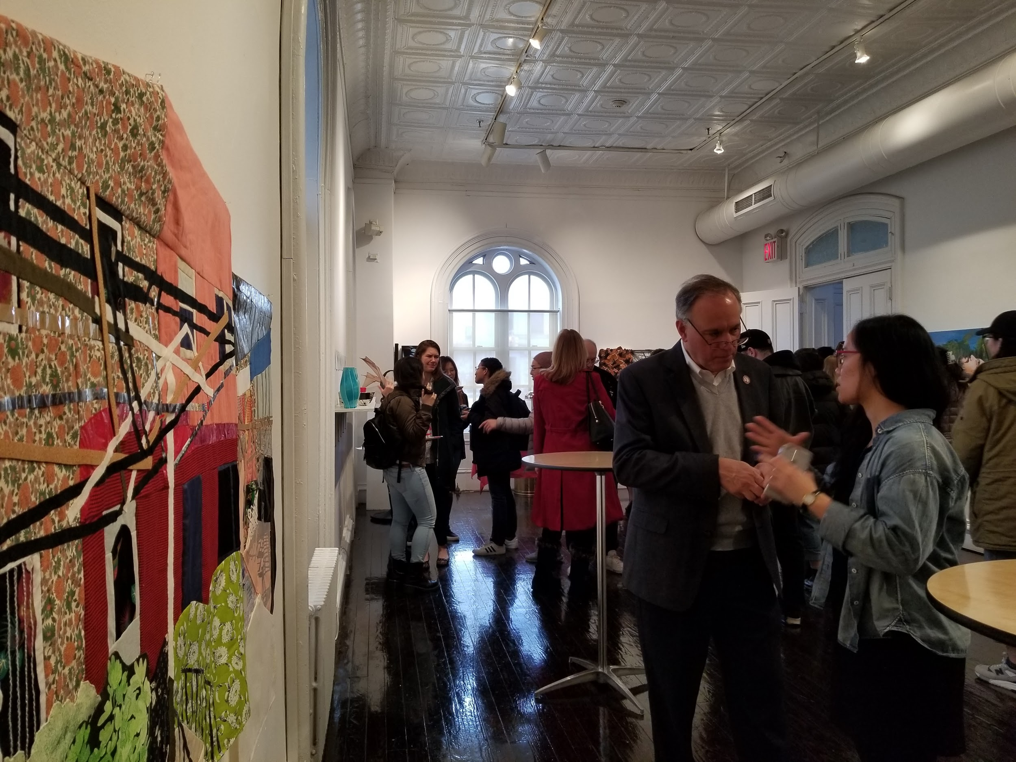
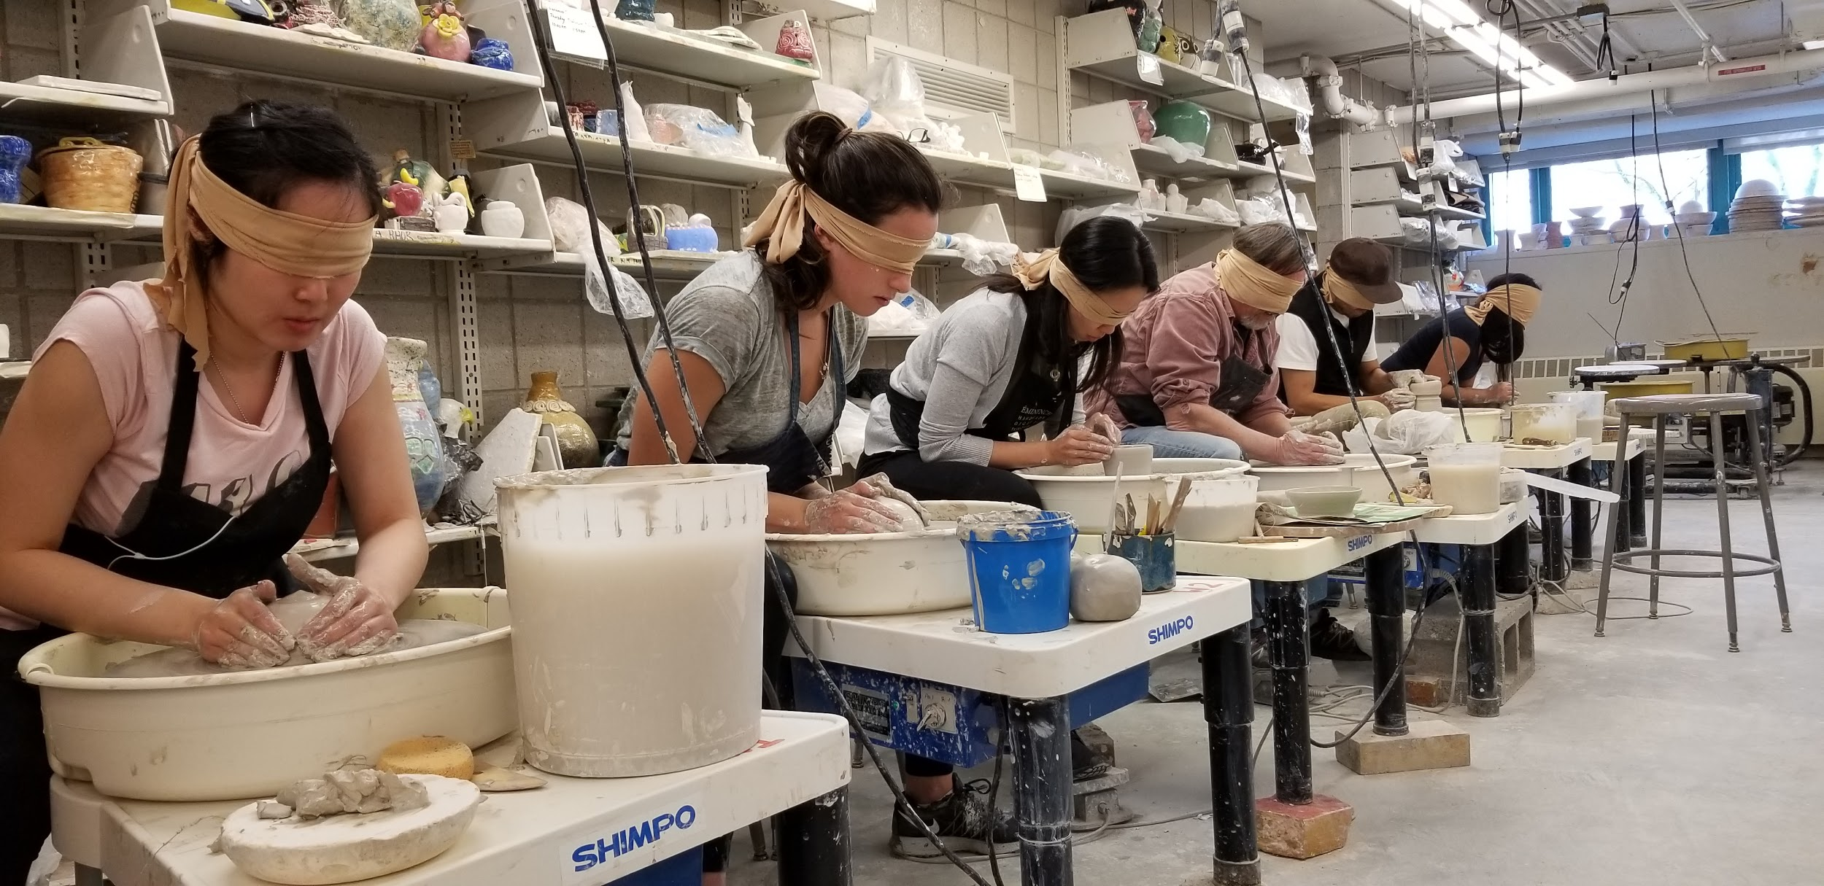
Art Department Biennial exhibition at
Flushing Town Hall

Slide 11
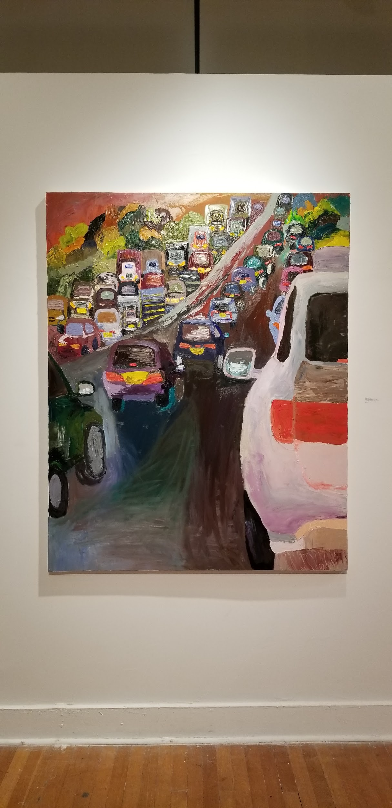
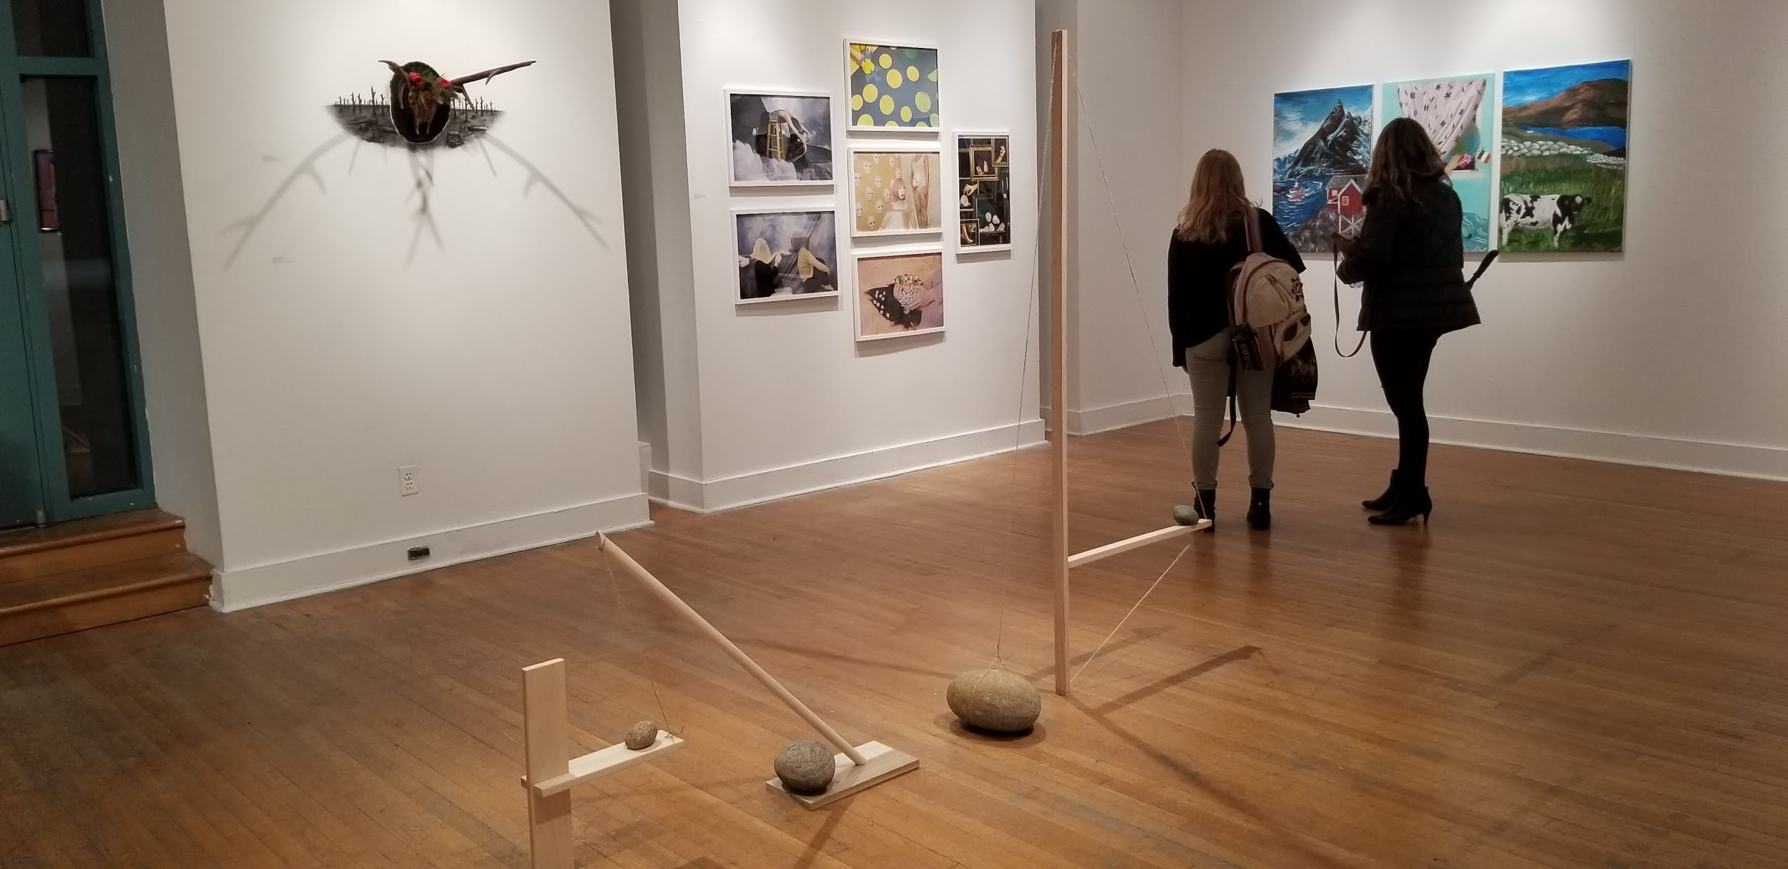
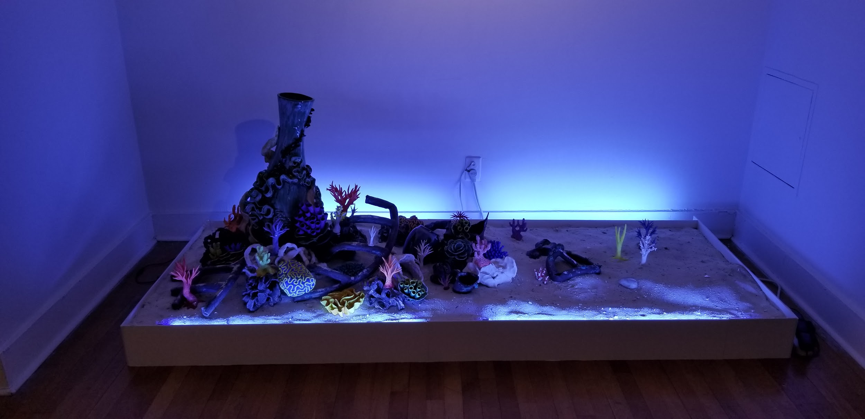
Senior Project exhibition
QC Klapper Hall Gallery

Slide 12
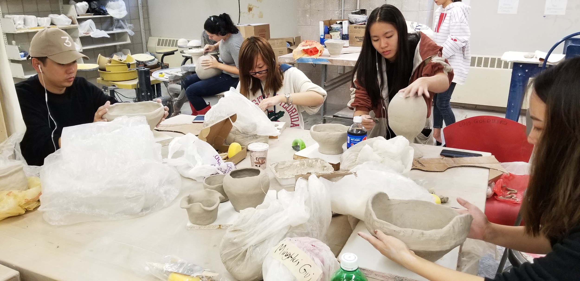
Ceramics Studio

Slide 13
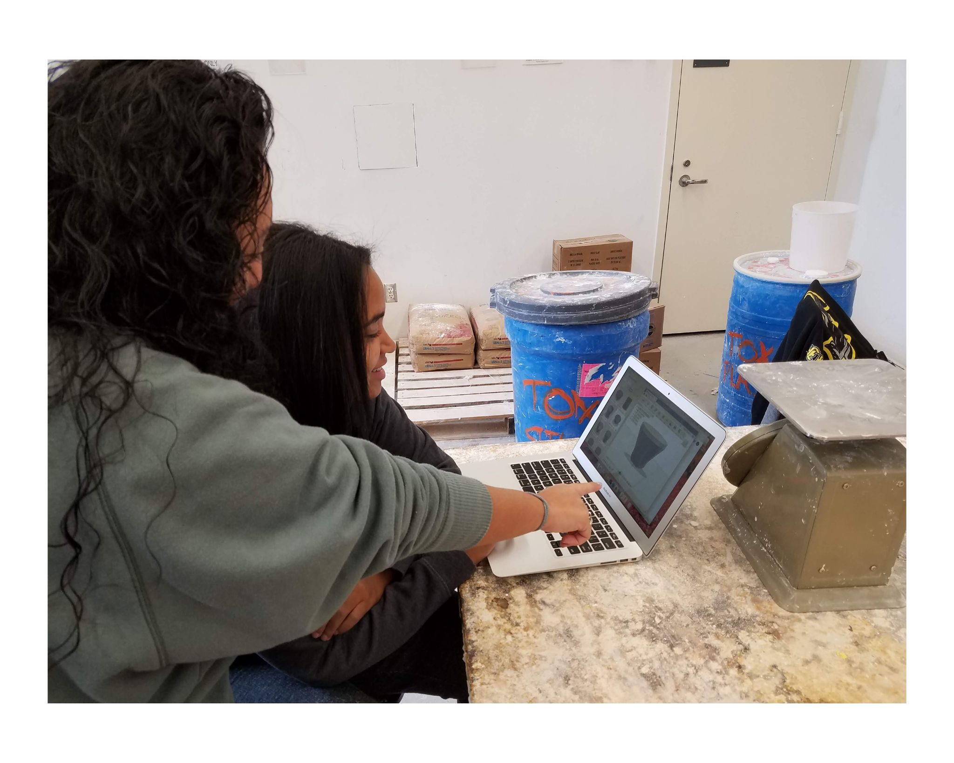
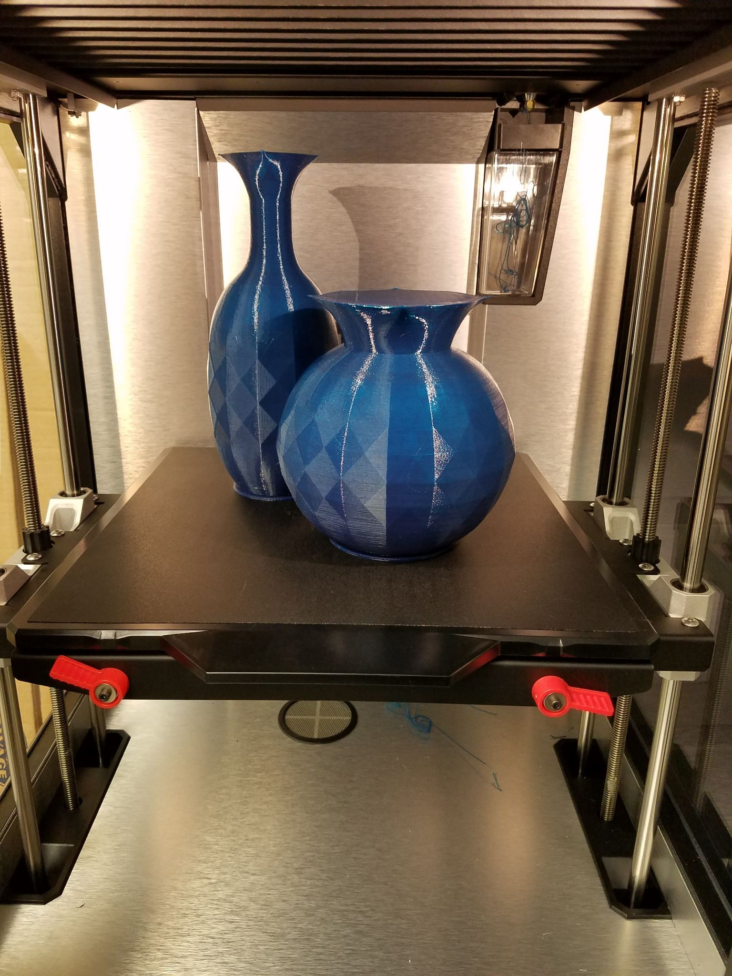
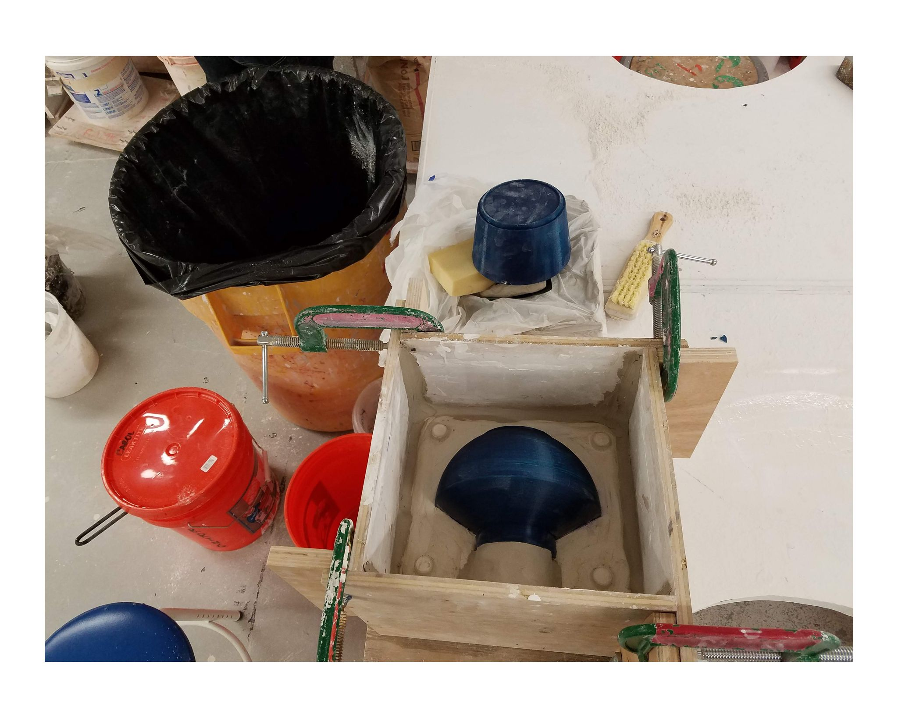
3D Printing & Mold Making

Slide 14
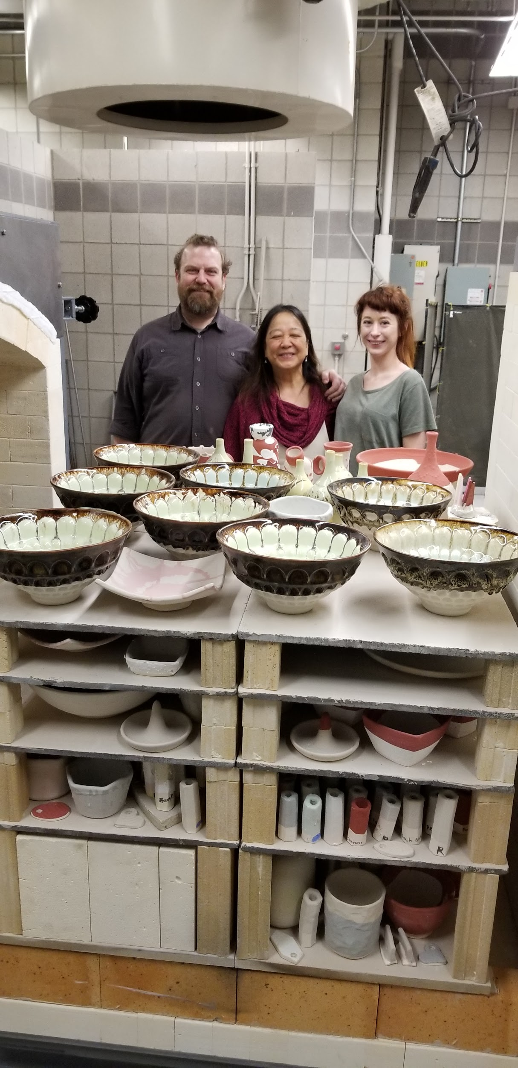
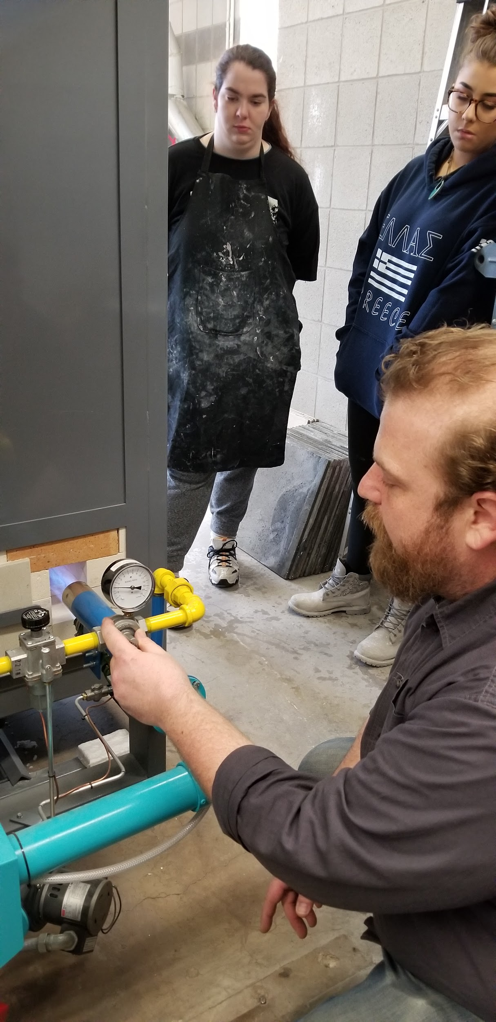
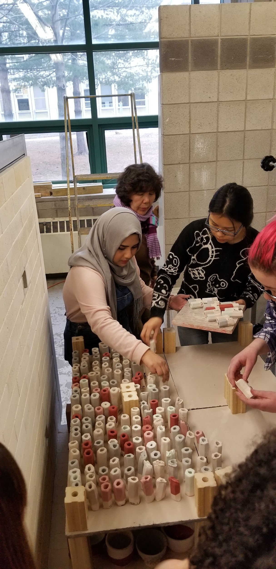
Kiln Firing - Ceramics & Bronze Casting

Slide 15
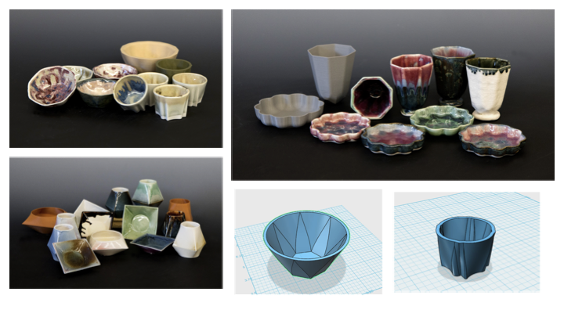
Work made in Prof. Greco’s 3D Modeling, Printing,
& Slip Casting Course

Slide 16
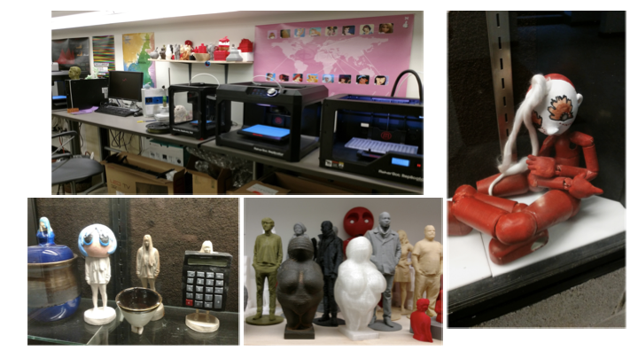
3D Printing & 3D Scanning Facilities - Ceramic and Bronze work produced using new 3D printing and scanning technologies.
Examples of ceramic slip casting and examples of translation of materials - original to 3D scan to 3D print then invested and cast in bronze.

Slide 17
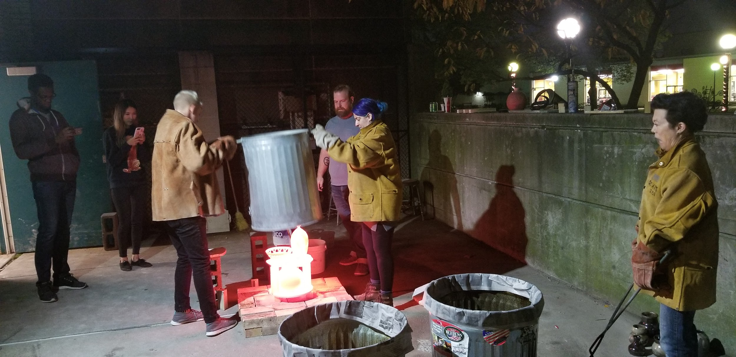
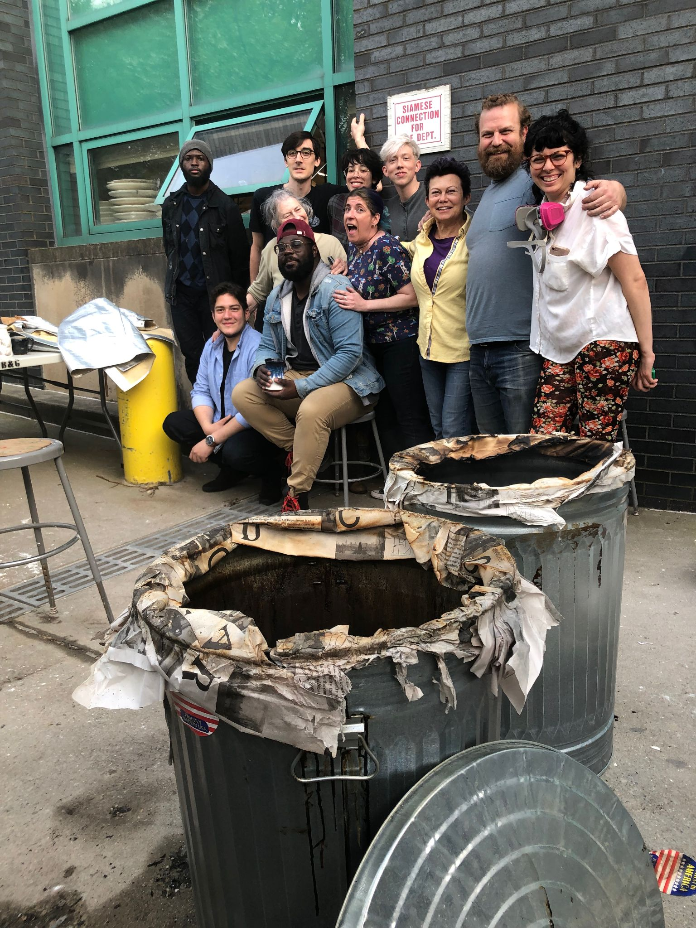
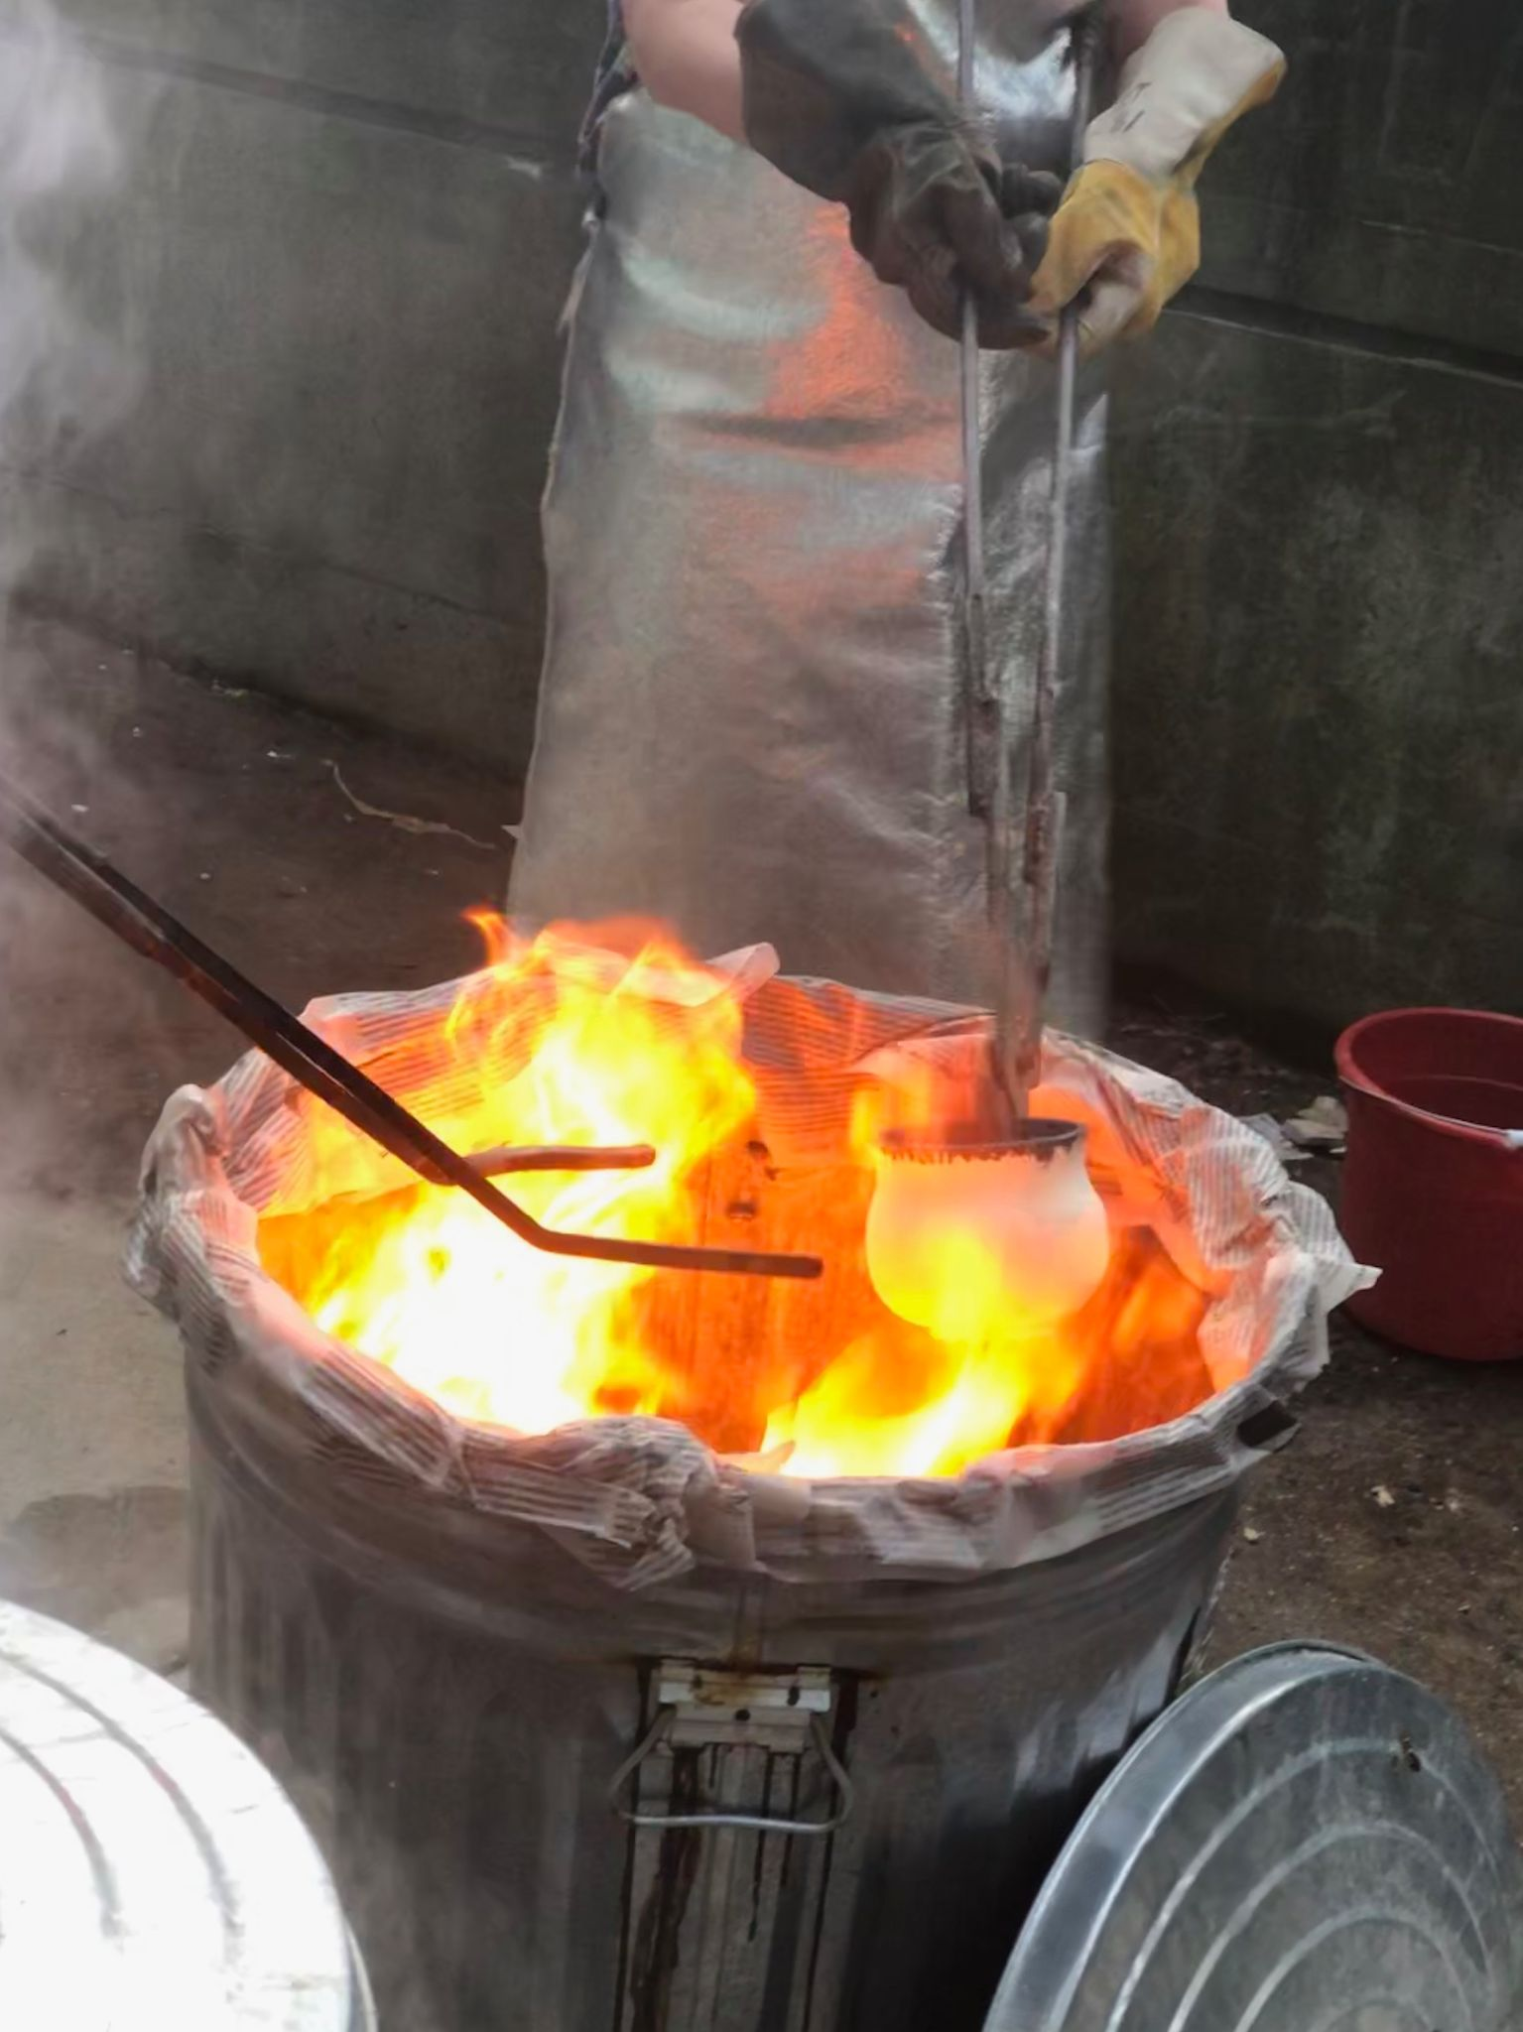
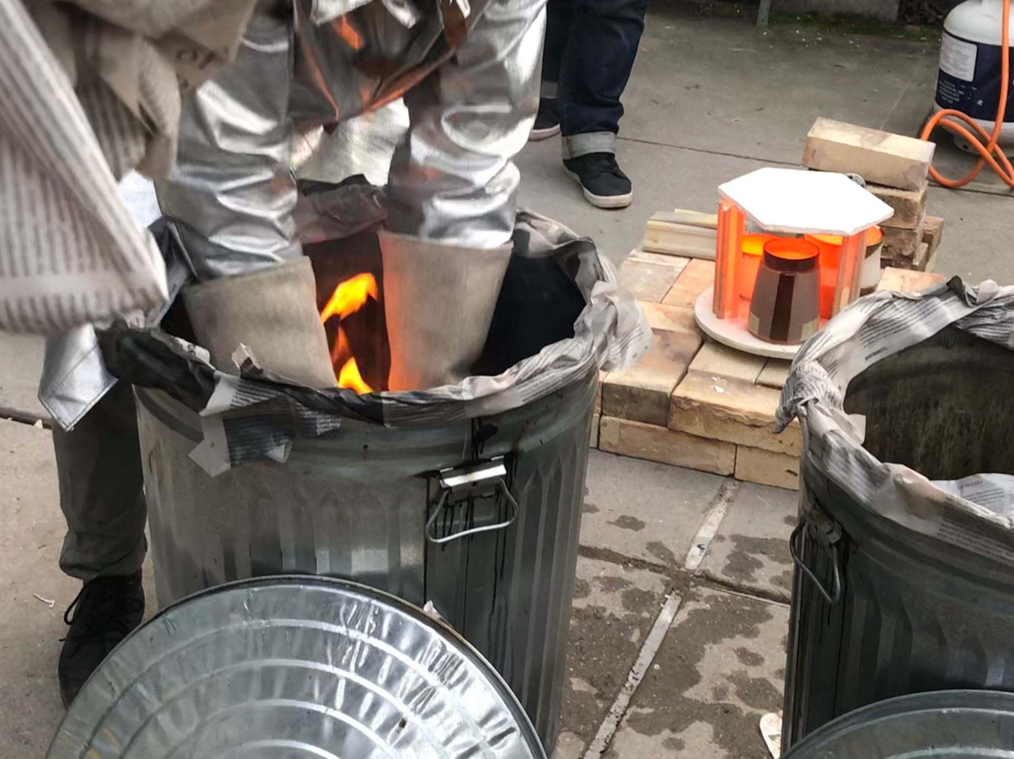
Ceramics club on site activity: Raku firing

Slide 18
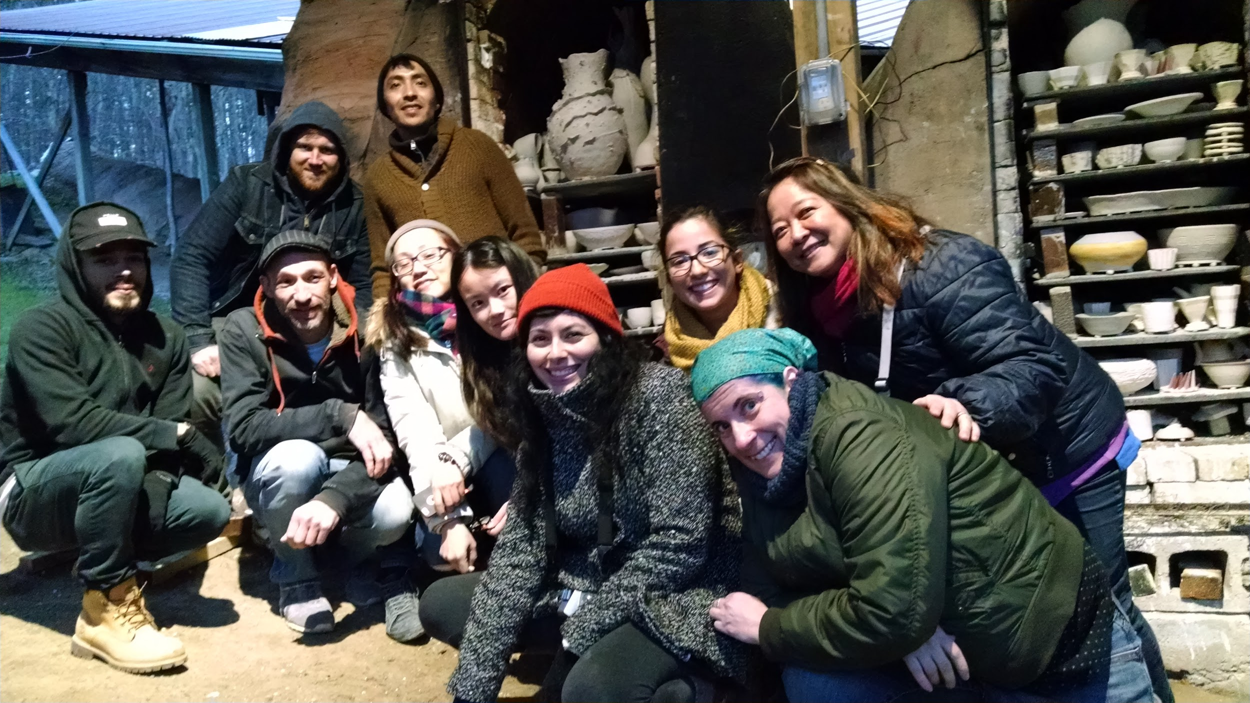
Ceramics Club Offsite Wood Firing

Slide 19
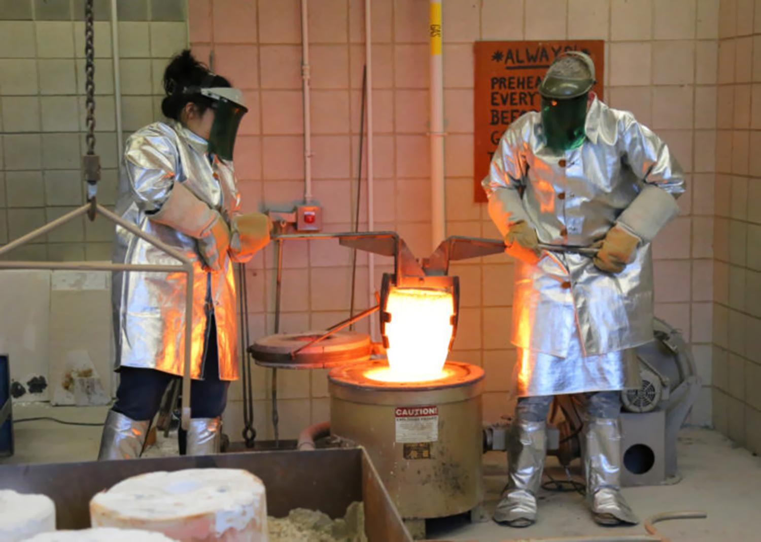
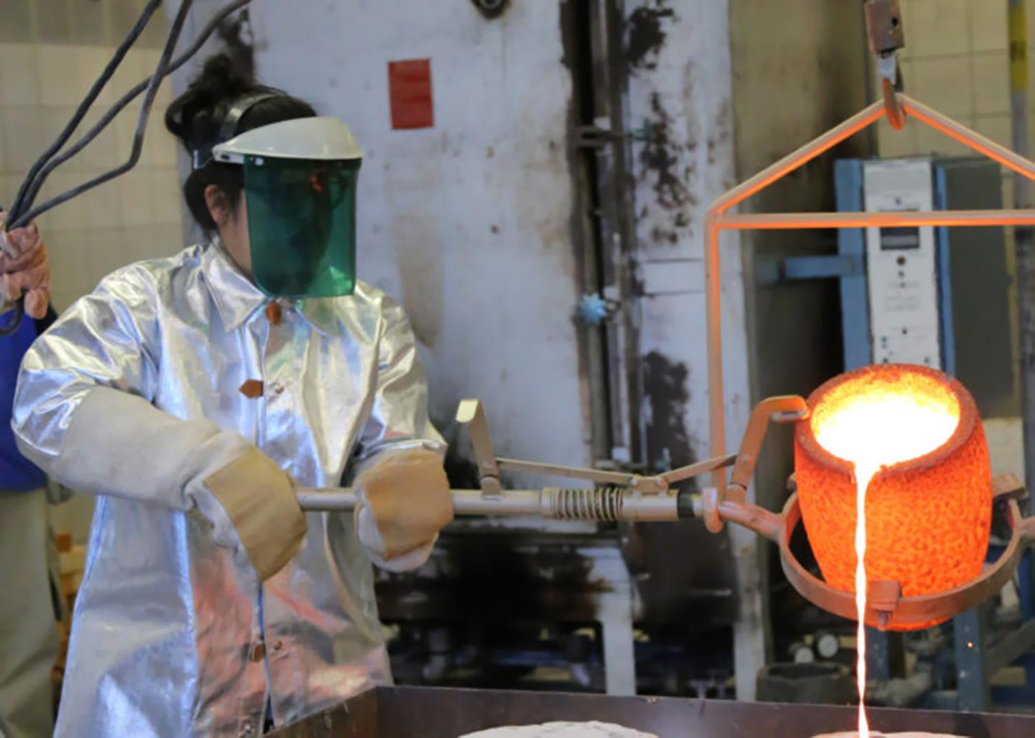
On-site Bronze Foundry

Slide 20
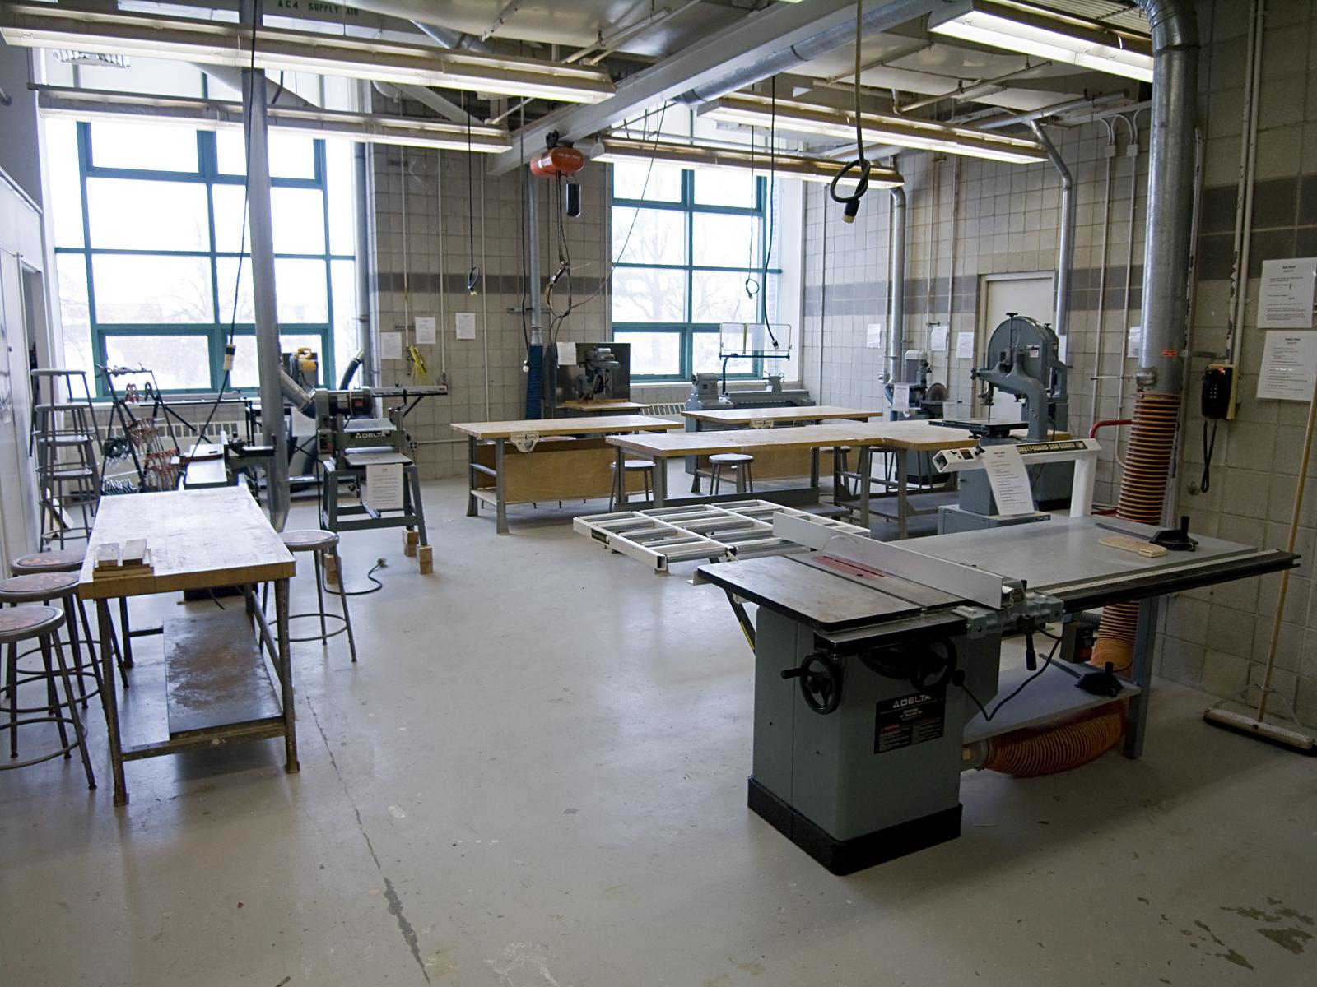
One of two wood shops
Klapper Hall, QC

Slide 21
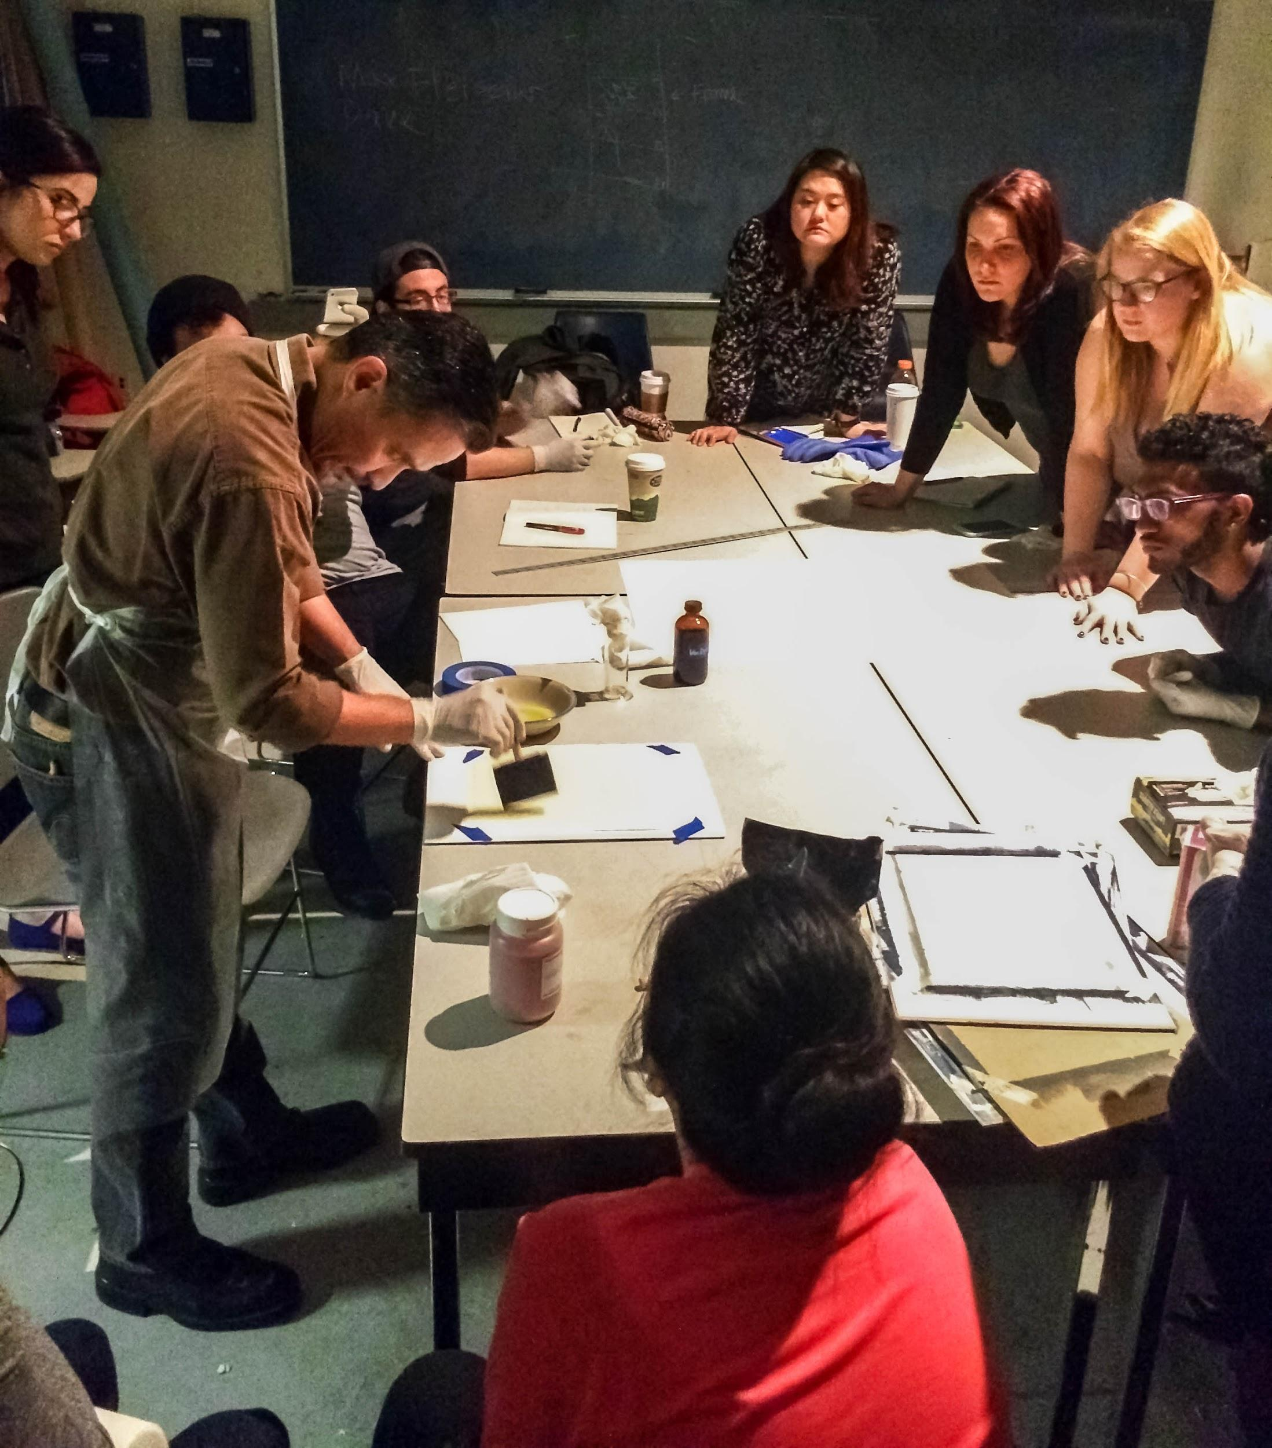
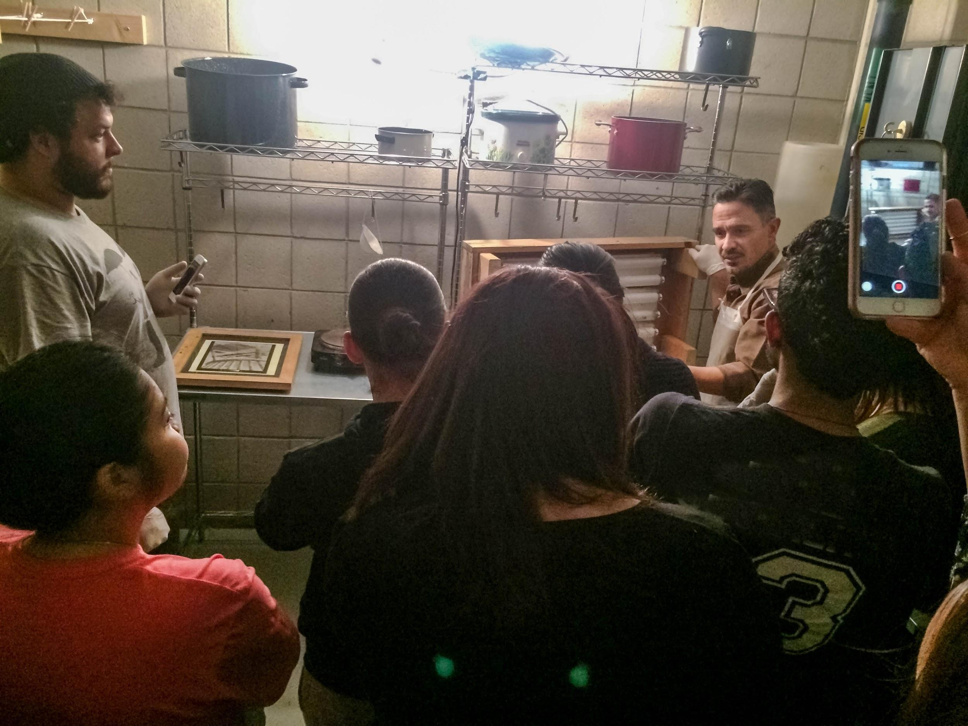
Photography & Imaging Majors
at work in
Prof. Tony Gonzalez full color digital gum bichromate alternative process course

Slide 22
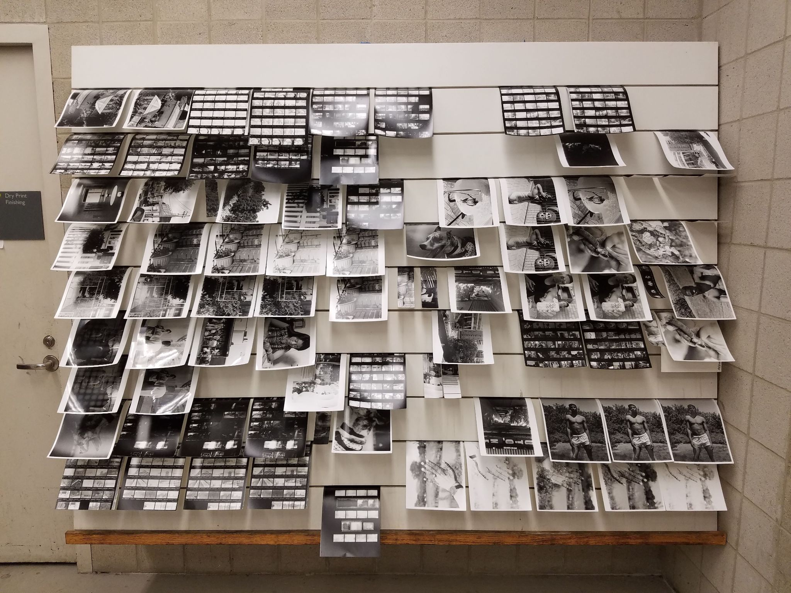
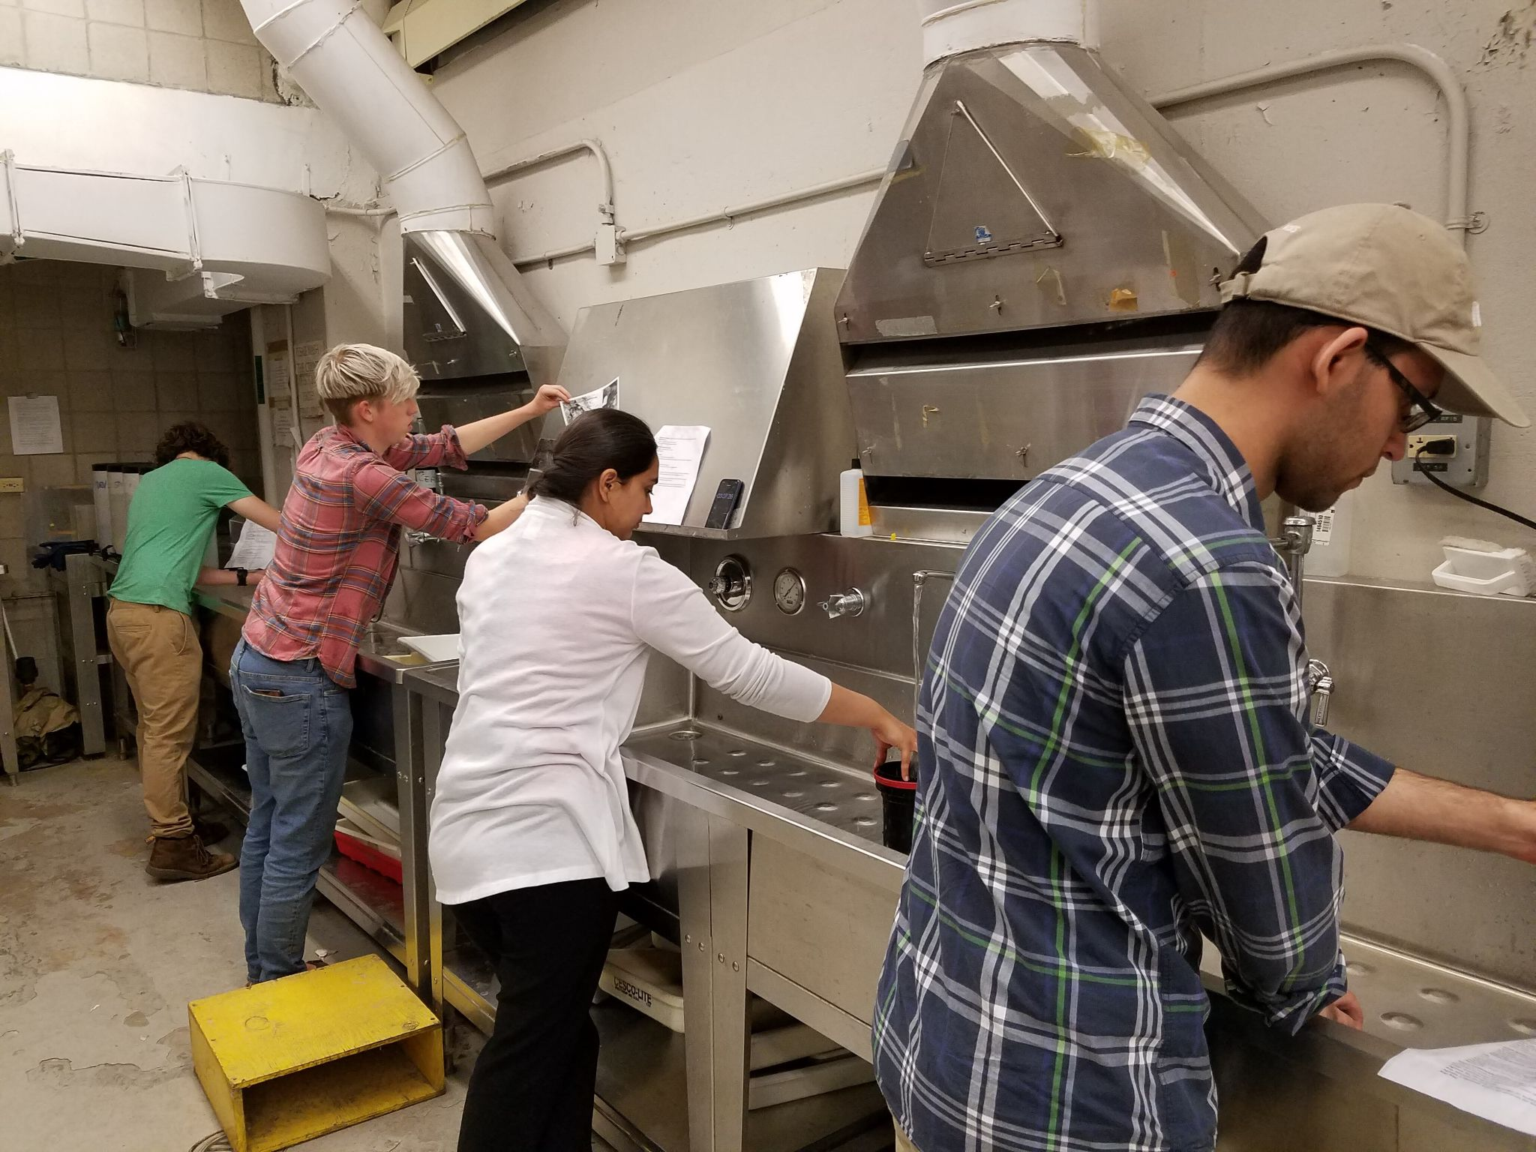
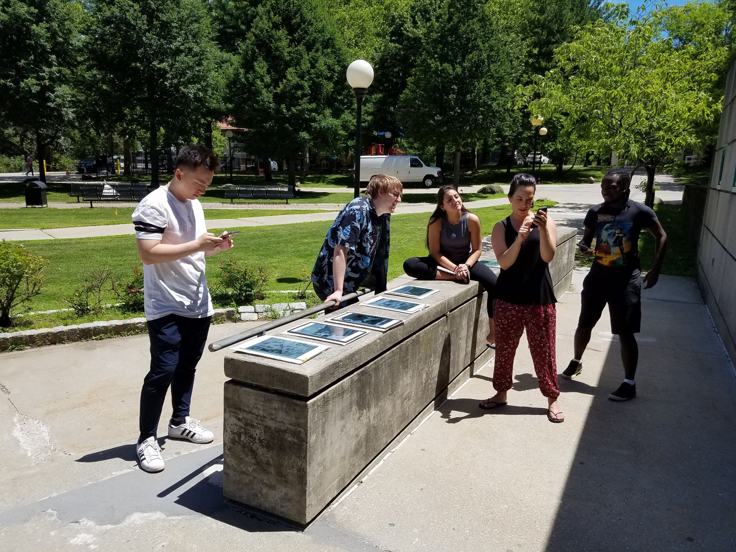
Photography & Imaging students at work in the darkroom and outside making cyanotypes

Slide 23
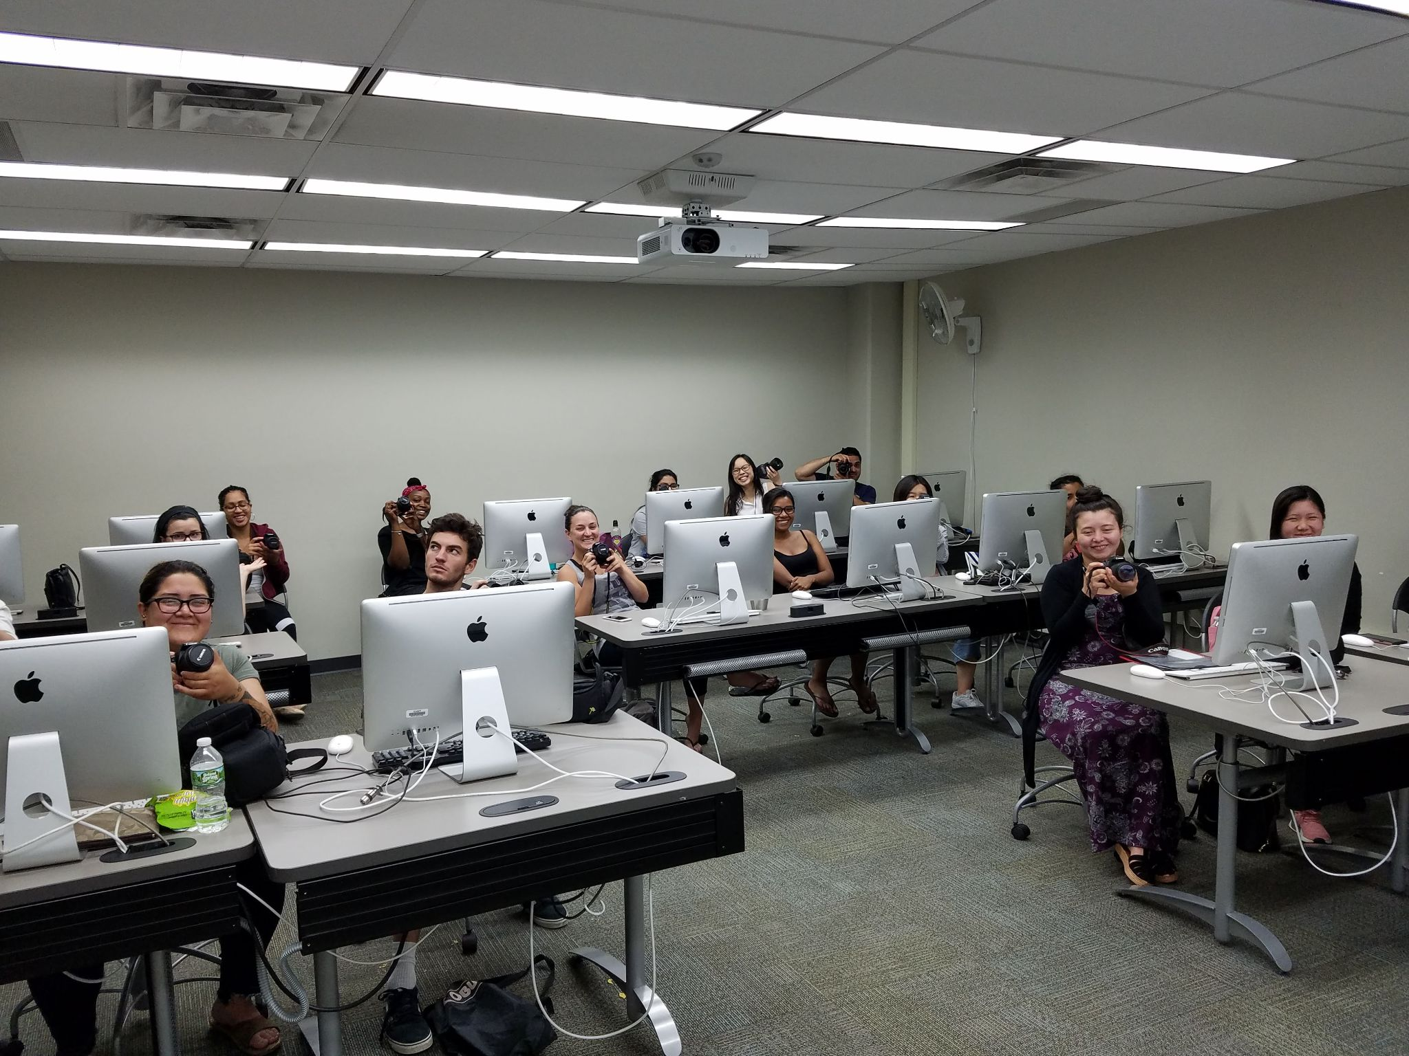
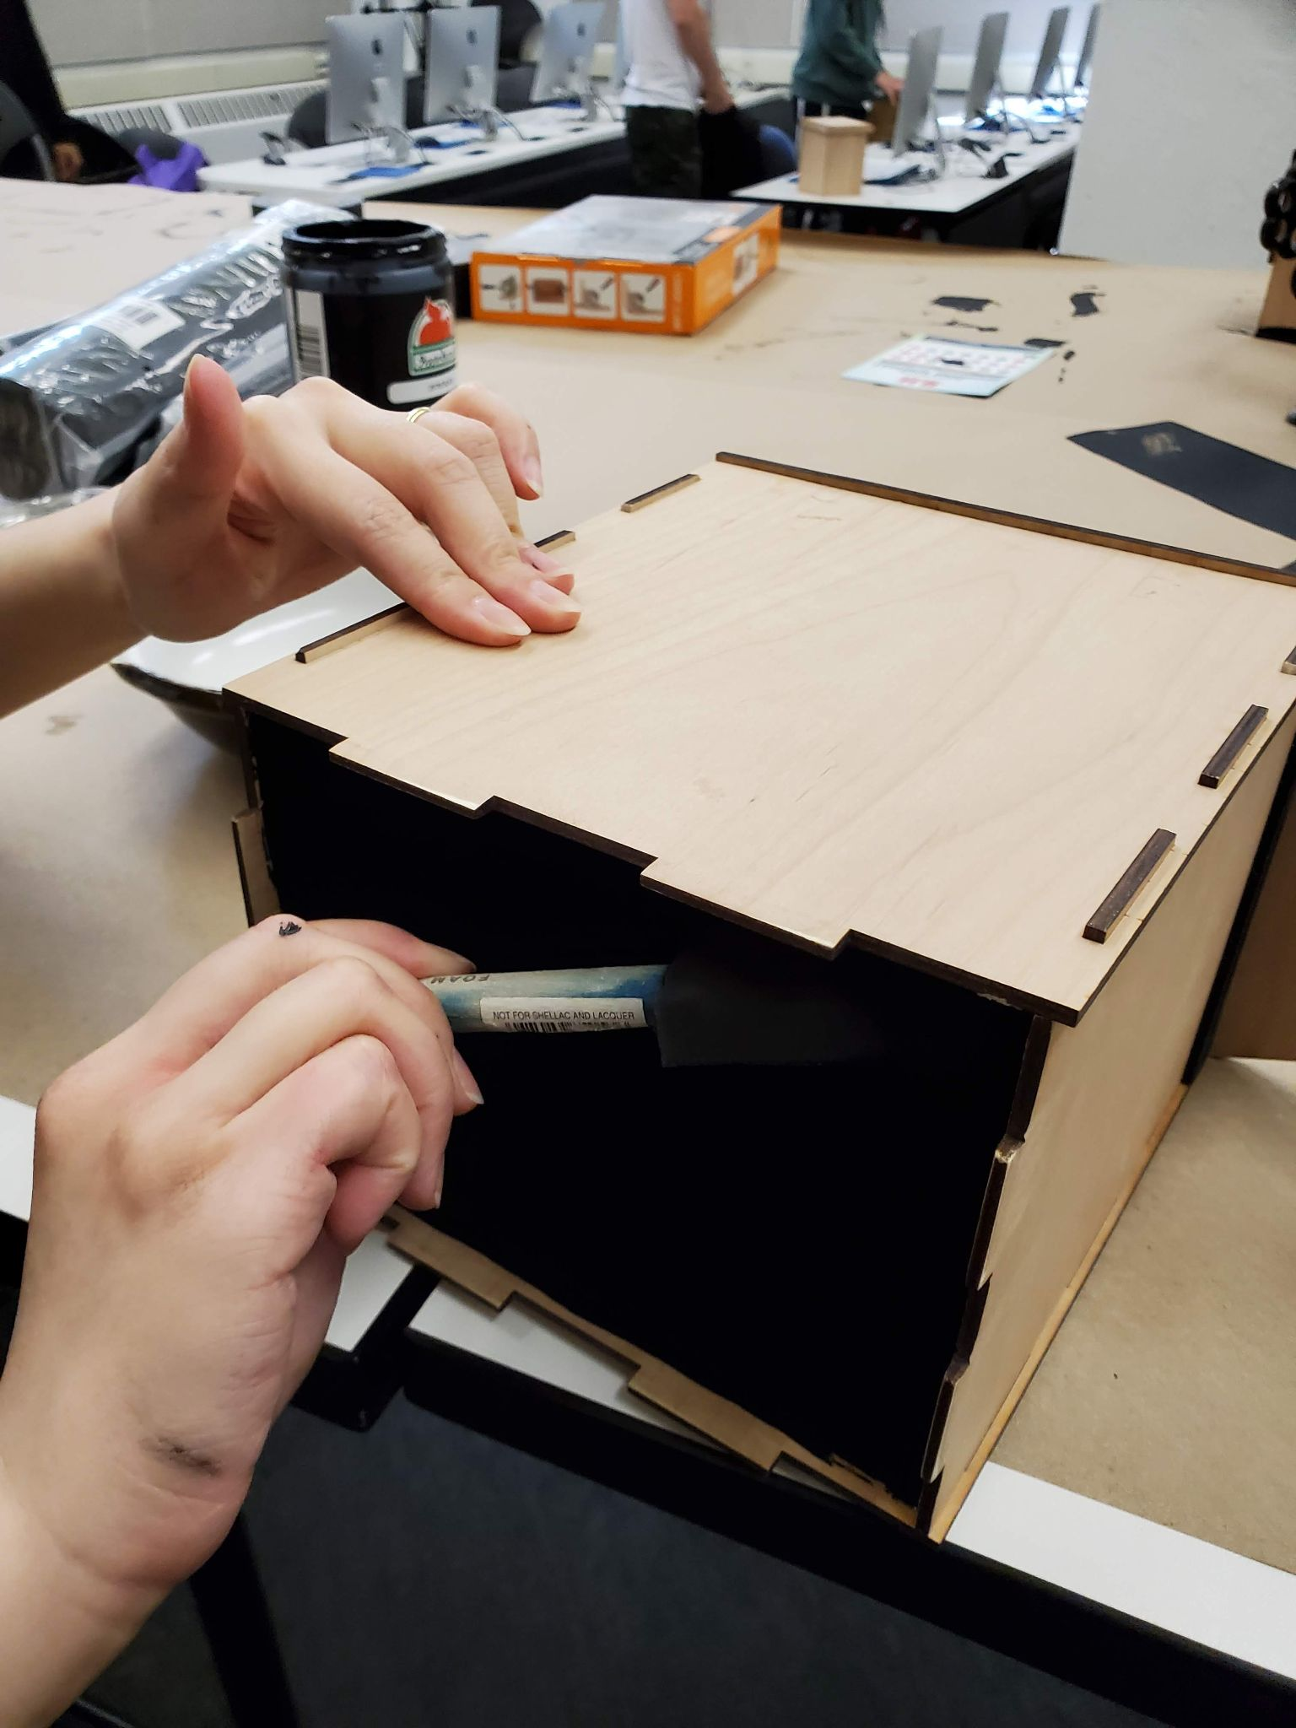
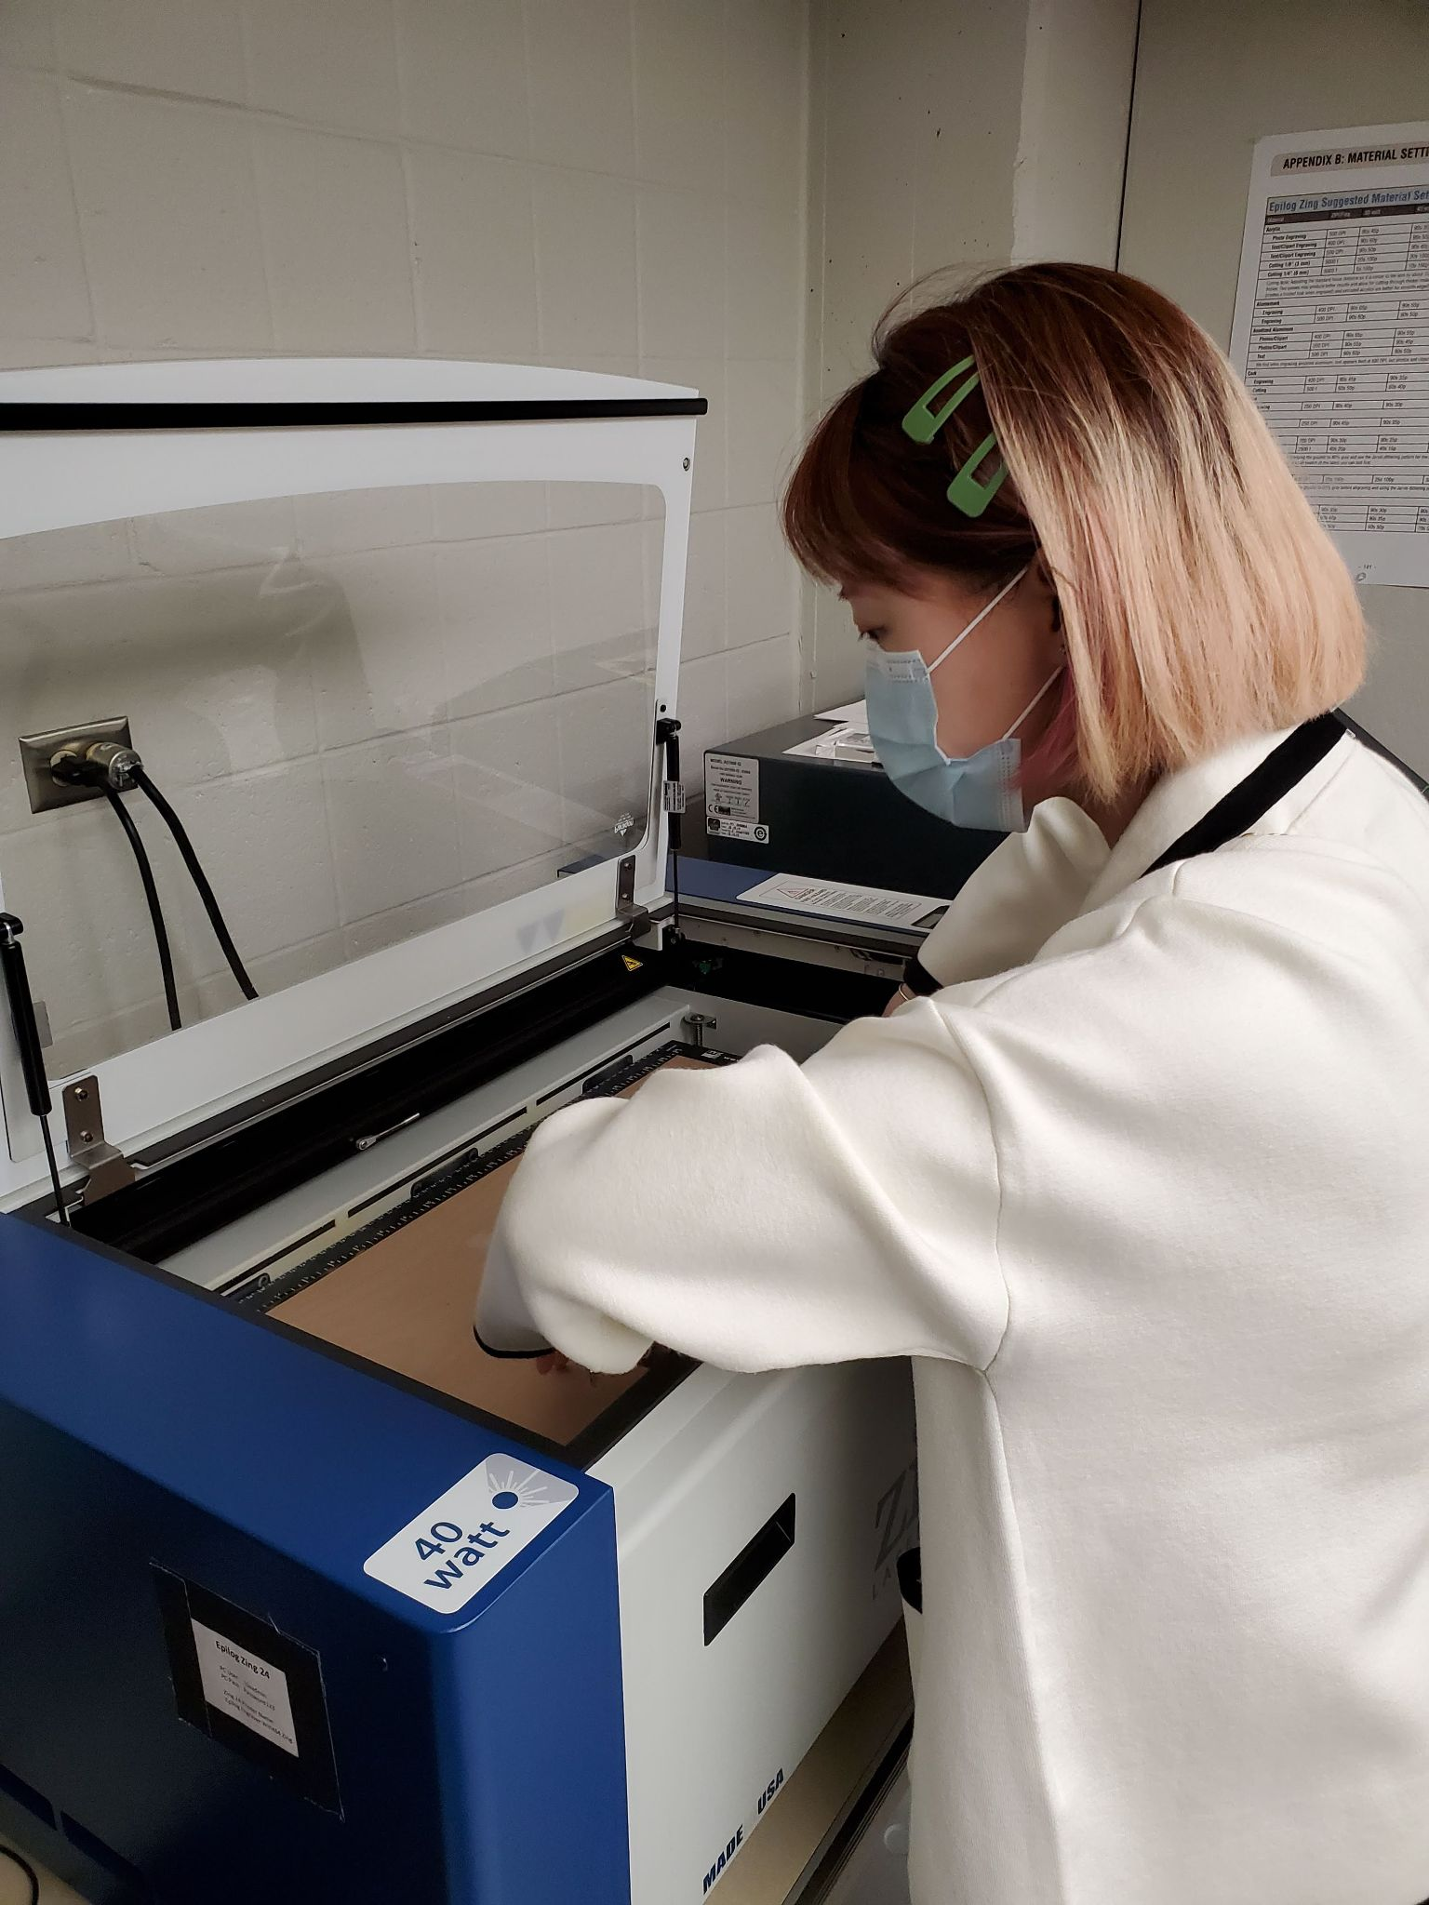
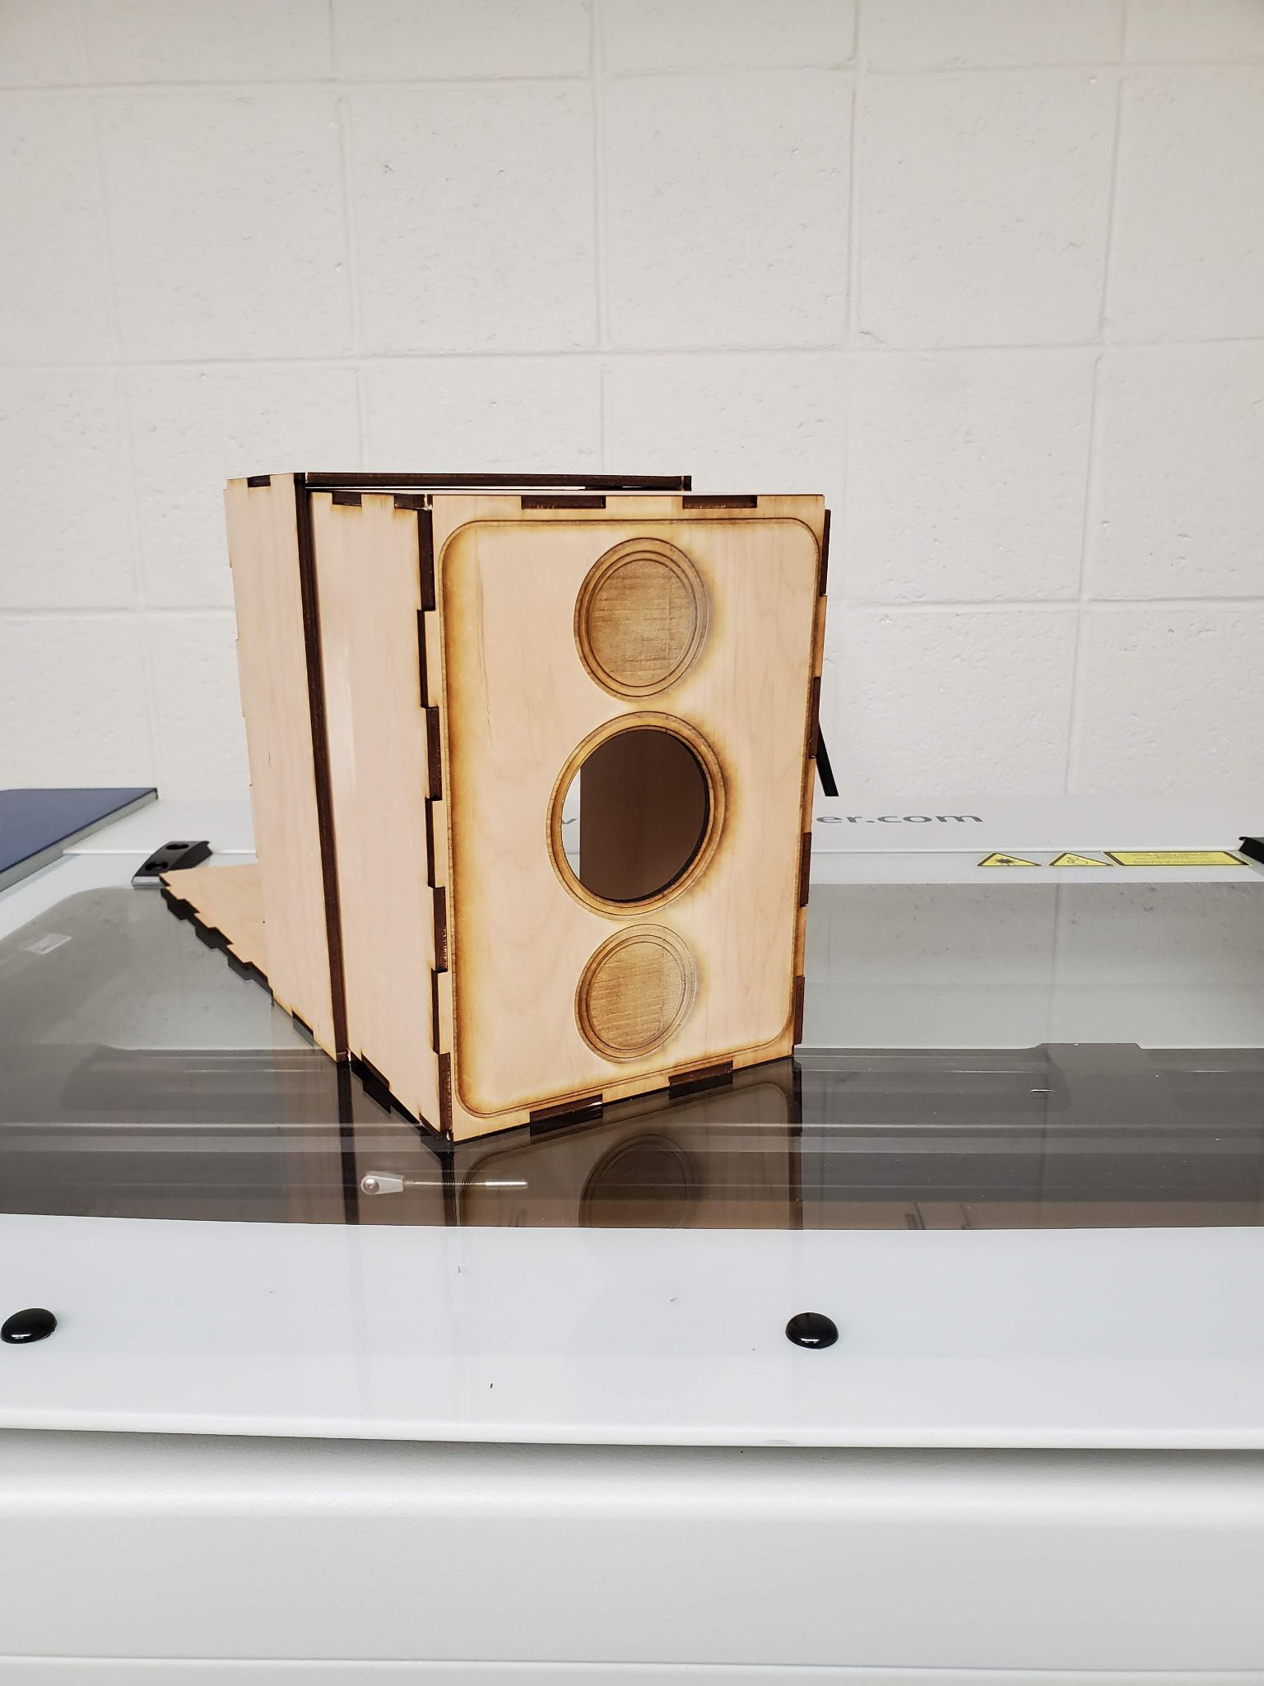
Photography & Imaging Majors at work in one of our computer labs - designing and fabricating their own digital pinhole cameras using a laser cutter amongst other new technology.

Slide 24
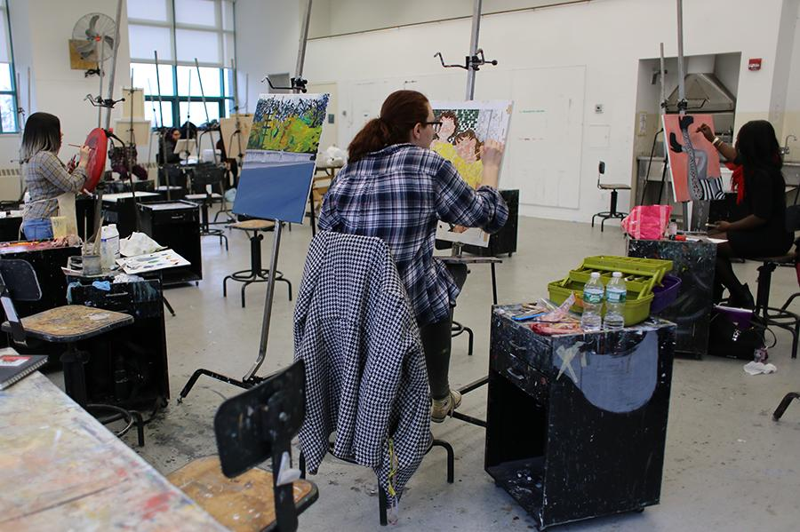
Painting studio

Slide 25
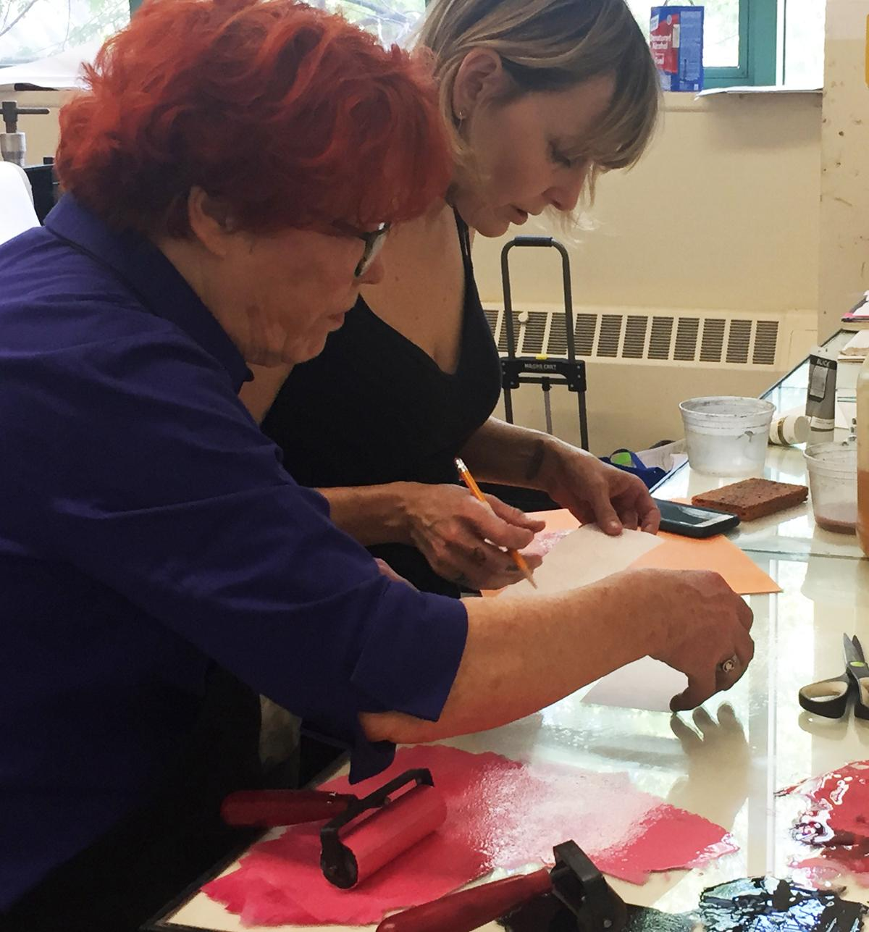
Printmaking Studio

Slide 26
Digital Imaging & Digital Fabrication Labs
Queens College Also has a Makerspace located in the Rosenthal Library and open to all students.

Slide 27
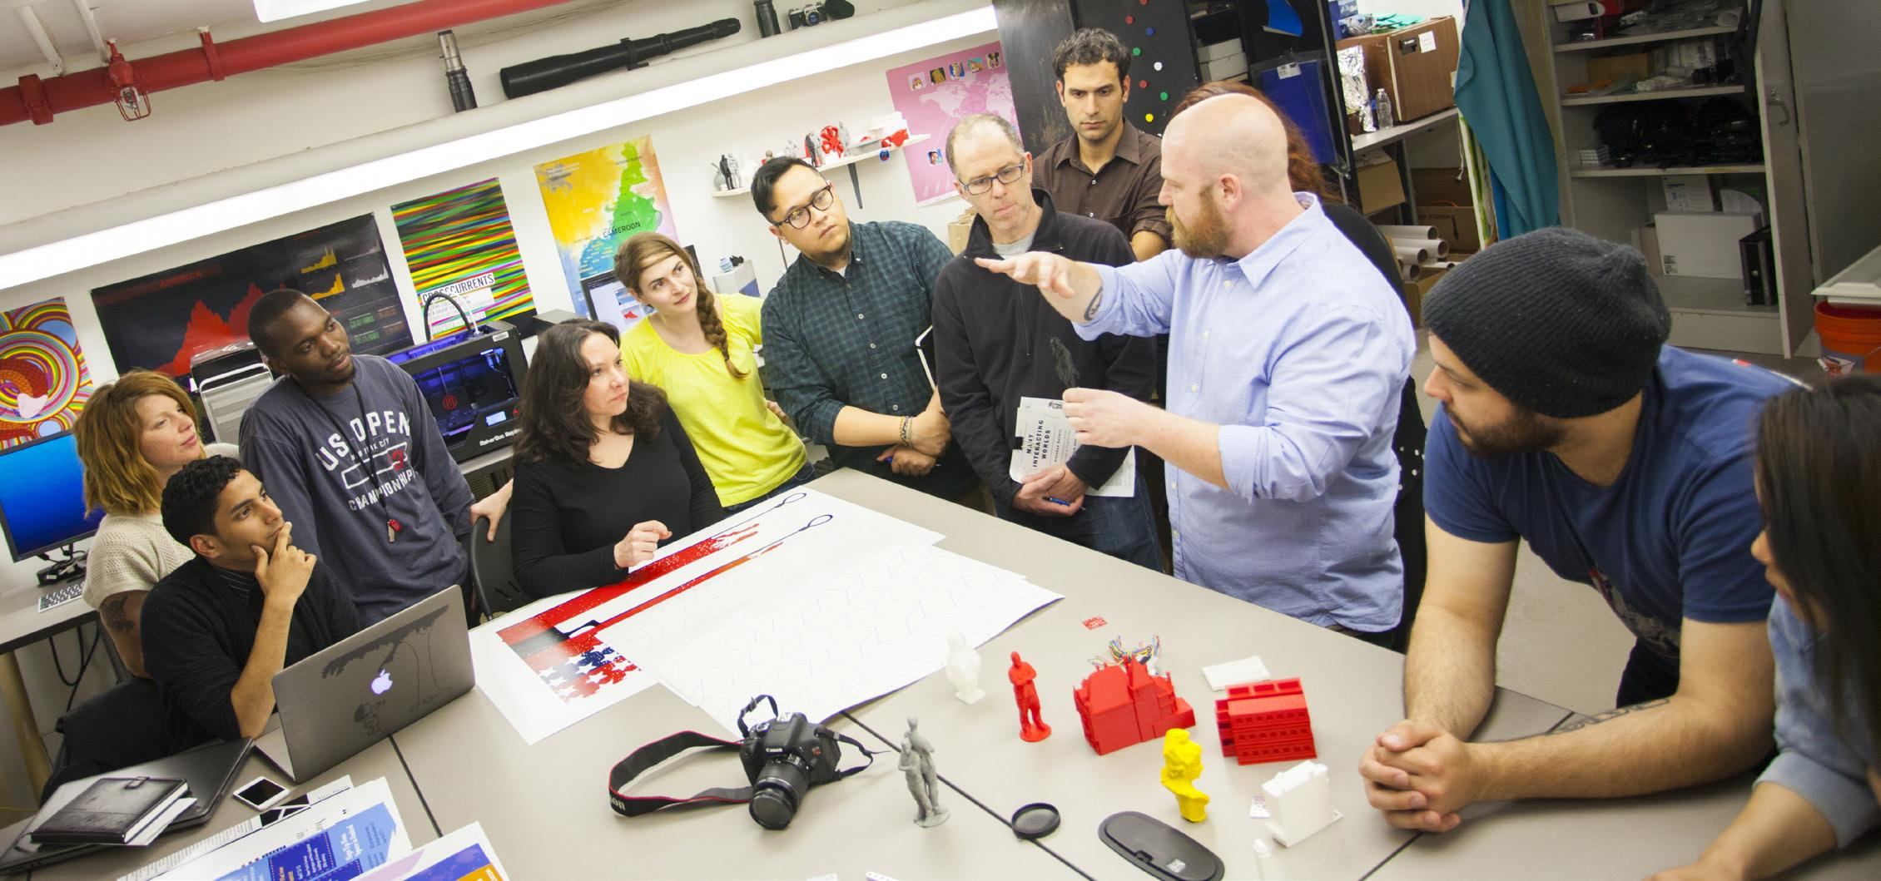
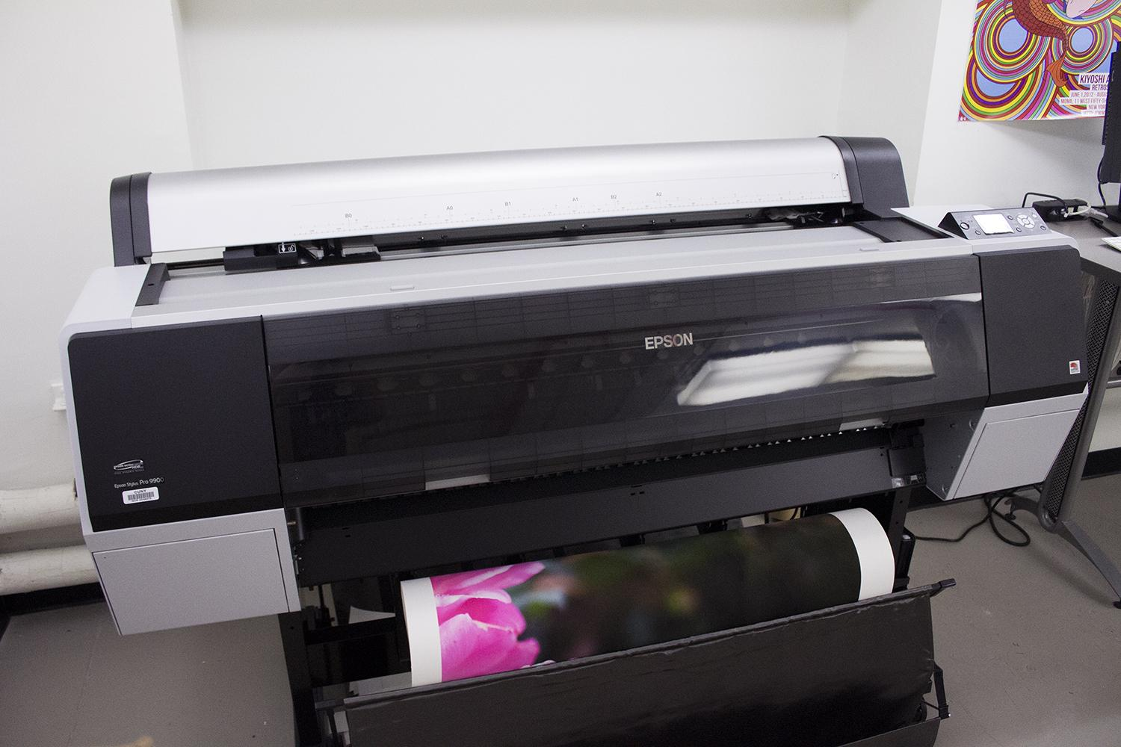
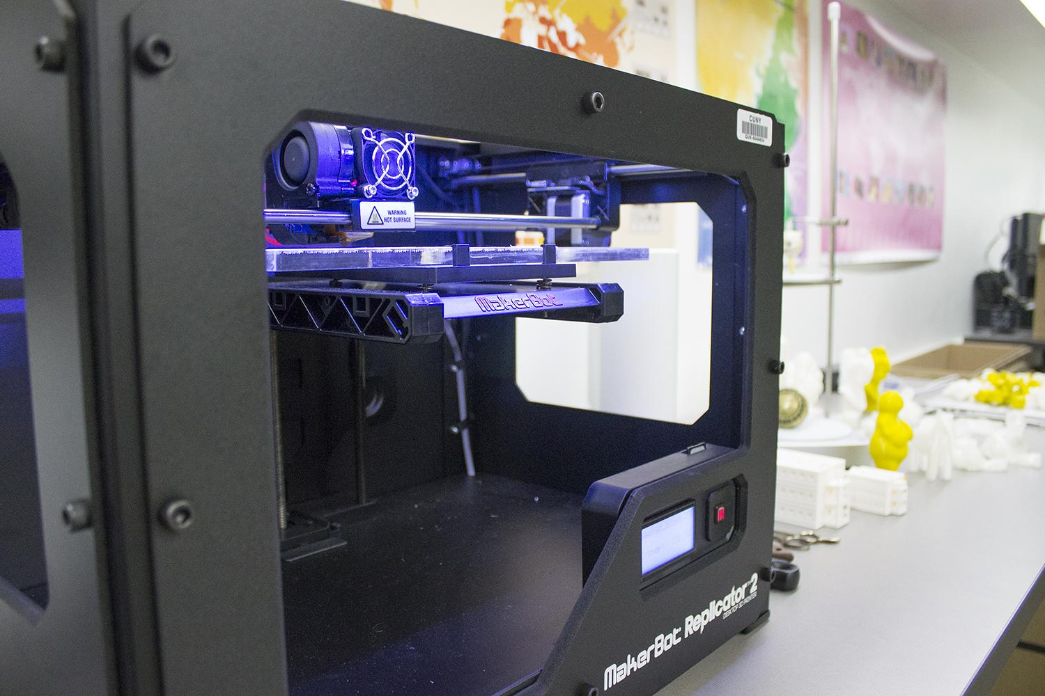
Prof. Matt Greco teaching in our Digital Imaging Lab

Slide 28
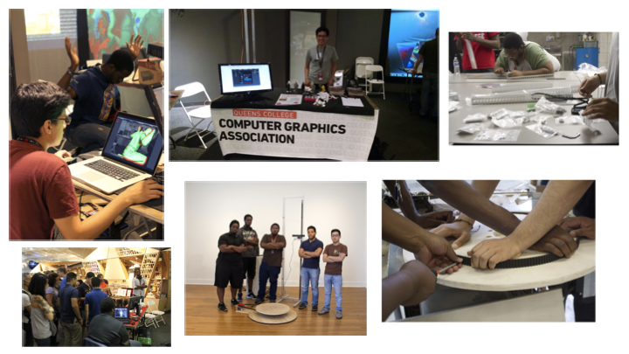
Students in Queens College Club - Computer Graphics Association - that is made up of Computer Science and Art students - designed, fabricated, and operated 3D scanner able to scan a full body, made from hacked Xbox Kinect. Exhibited at Maker Faire at The NY Hall of Science where they won “Best in Class” - Two members from this club now work as engineers at Google.

Slide 29
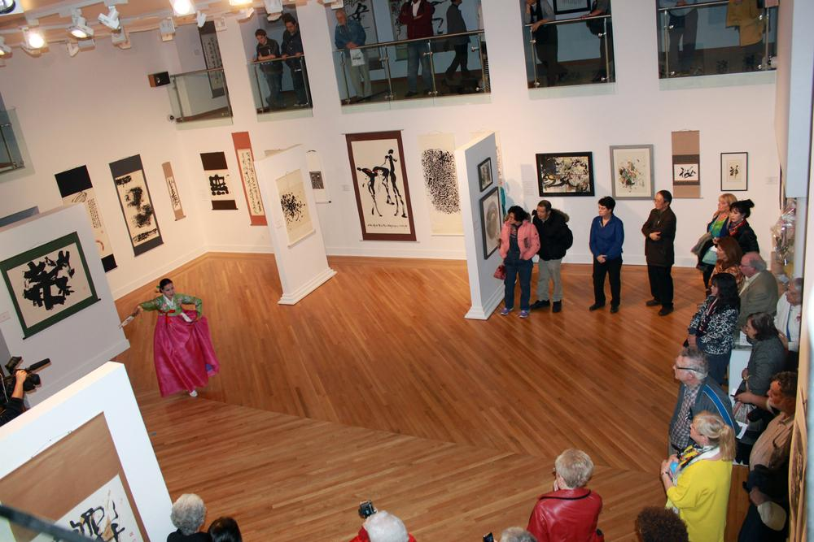
Performance at the Godwin-Ternbach Museum, Klapper Hall

Slide 30
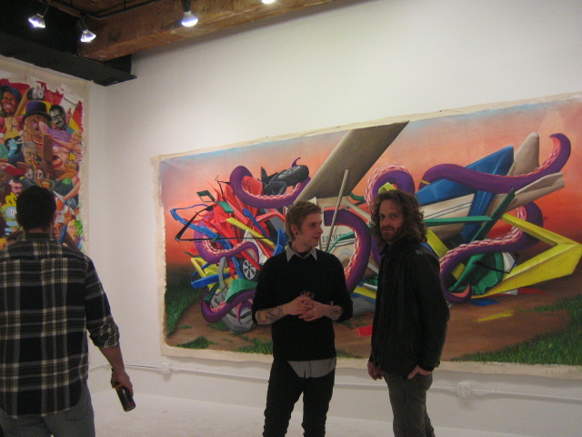
Off-Campus MFA Thesis Exhibition - Matt Palmer

Slide 31
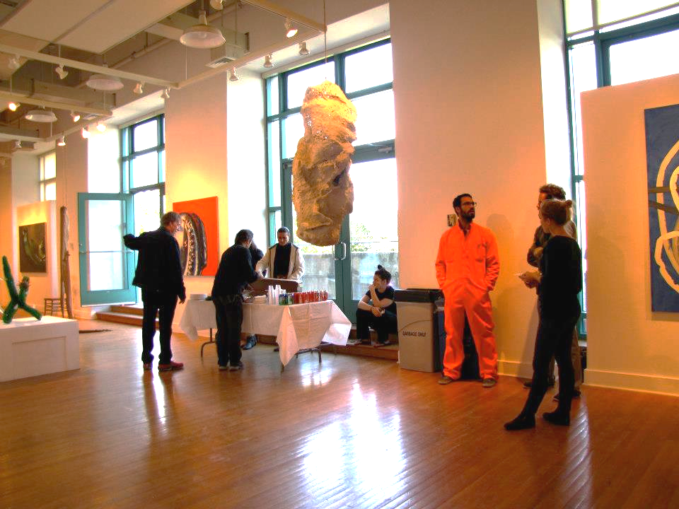
Klapper Hall Art Gallery

Slide 32
Graduate Student Anthony Hamboussi with Brian Rosa Photo Exhibition Klapper Hall Art Gallery

Slide 33
Klapper Hall Student Art Gallery

Slide 34
Klapper Hall Student Art Gallery
graduate exhibition installation in progress

Slide 35
Henrey Kielmanowicz
Thesis Exhibition
in-progress

Slide 37
Drawing-Performance by Uno Nam and Tara Homasi in Klapper Hall Seminar Space

Slide 38
Performance Piece by Julian Philips MFA

Slide 39
MFA Thesis Lecture Klapper Hall Art Gallery

Slide 40
Flushing Queens, NYC

Slide 41
Professor Glenn Goldberg

Slide 42
Professor Chloë Bass
B

Slide 43
The work of Painting Faculty Member Kurt Kauper

Slide 44
Professor Debra Priestly discussing student projects

Slide 45
Professor Tyrone Mitchell

Slide 46
Professor Tony Gonzalez
Professor Tony Gonzalez

Slide 47
Professor Sin-Ying Ho in her studio in China

Slide 48
Professor Matt Greco with students on a trip to MoMA

Slide 49
Professor Michael Nelson on an archeological dig in Israel with students

Slide 50
Professor Warren Woodfin Art Historian

Slide 51
Professor Lawrence Waldron Art History

Slide 52
Professor Edward Powers Art History

Slide 53
Professor Greg Sholette hosting a lunch-break conversation in Geneva Switzerland

Slide 54
Social Practice Queens (SPQ)

Slide 55
Professor Kurt Kauper at the MoMA

Slide 57
For academic year 2019-2020, the undergraduate tuition & fees at CUNY Queens College is $7,538 for New York residents and $15,488 for out-of-state students.
The undergraduate 2020-2021 estimated tuition & fees for Queens College is $7,743 for New York residents and $15,983 for out-of-state students.
MAJORS:
- Studio Art BFA (72 Credits)
- Photography & Imaging BFA (63 Credits)
- Design BFA (63 Credits)
- Art History BA
- Art Education
MFA Studio Art
MA Art History
Post Cert in Social Practice
OFFICE INFORMATION
Klapper Hall Rm. 172
Phone: (718) 997-4800
Fax: (718) 997-4835
To contact, email art@qc.cuny.edu
https://www.qc.cuny.edu
http://art.qc.cuny.edu/

Slide 58
http://www.socialpracticequeens.org/

