Slide 1
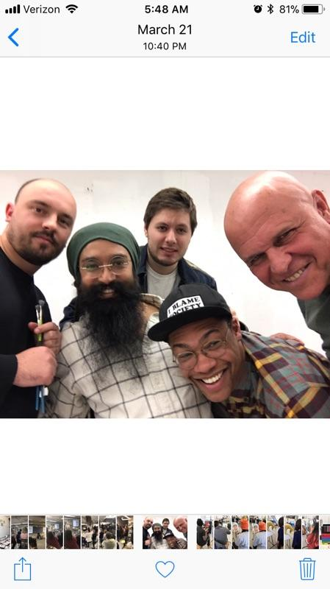
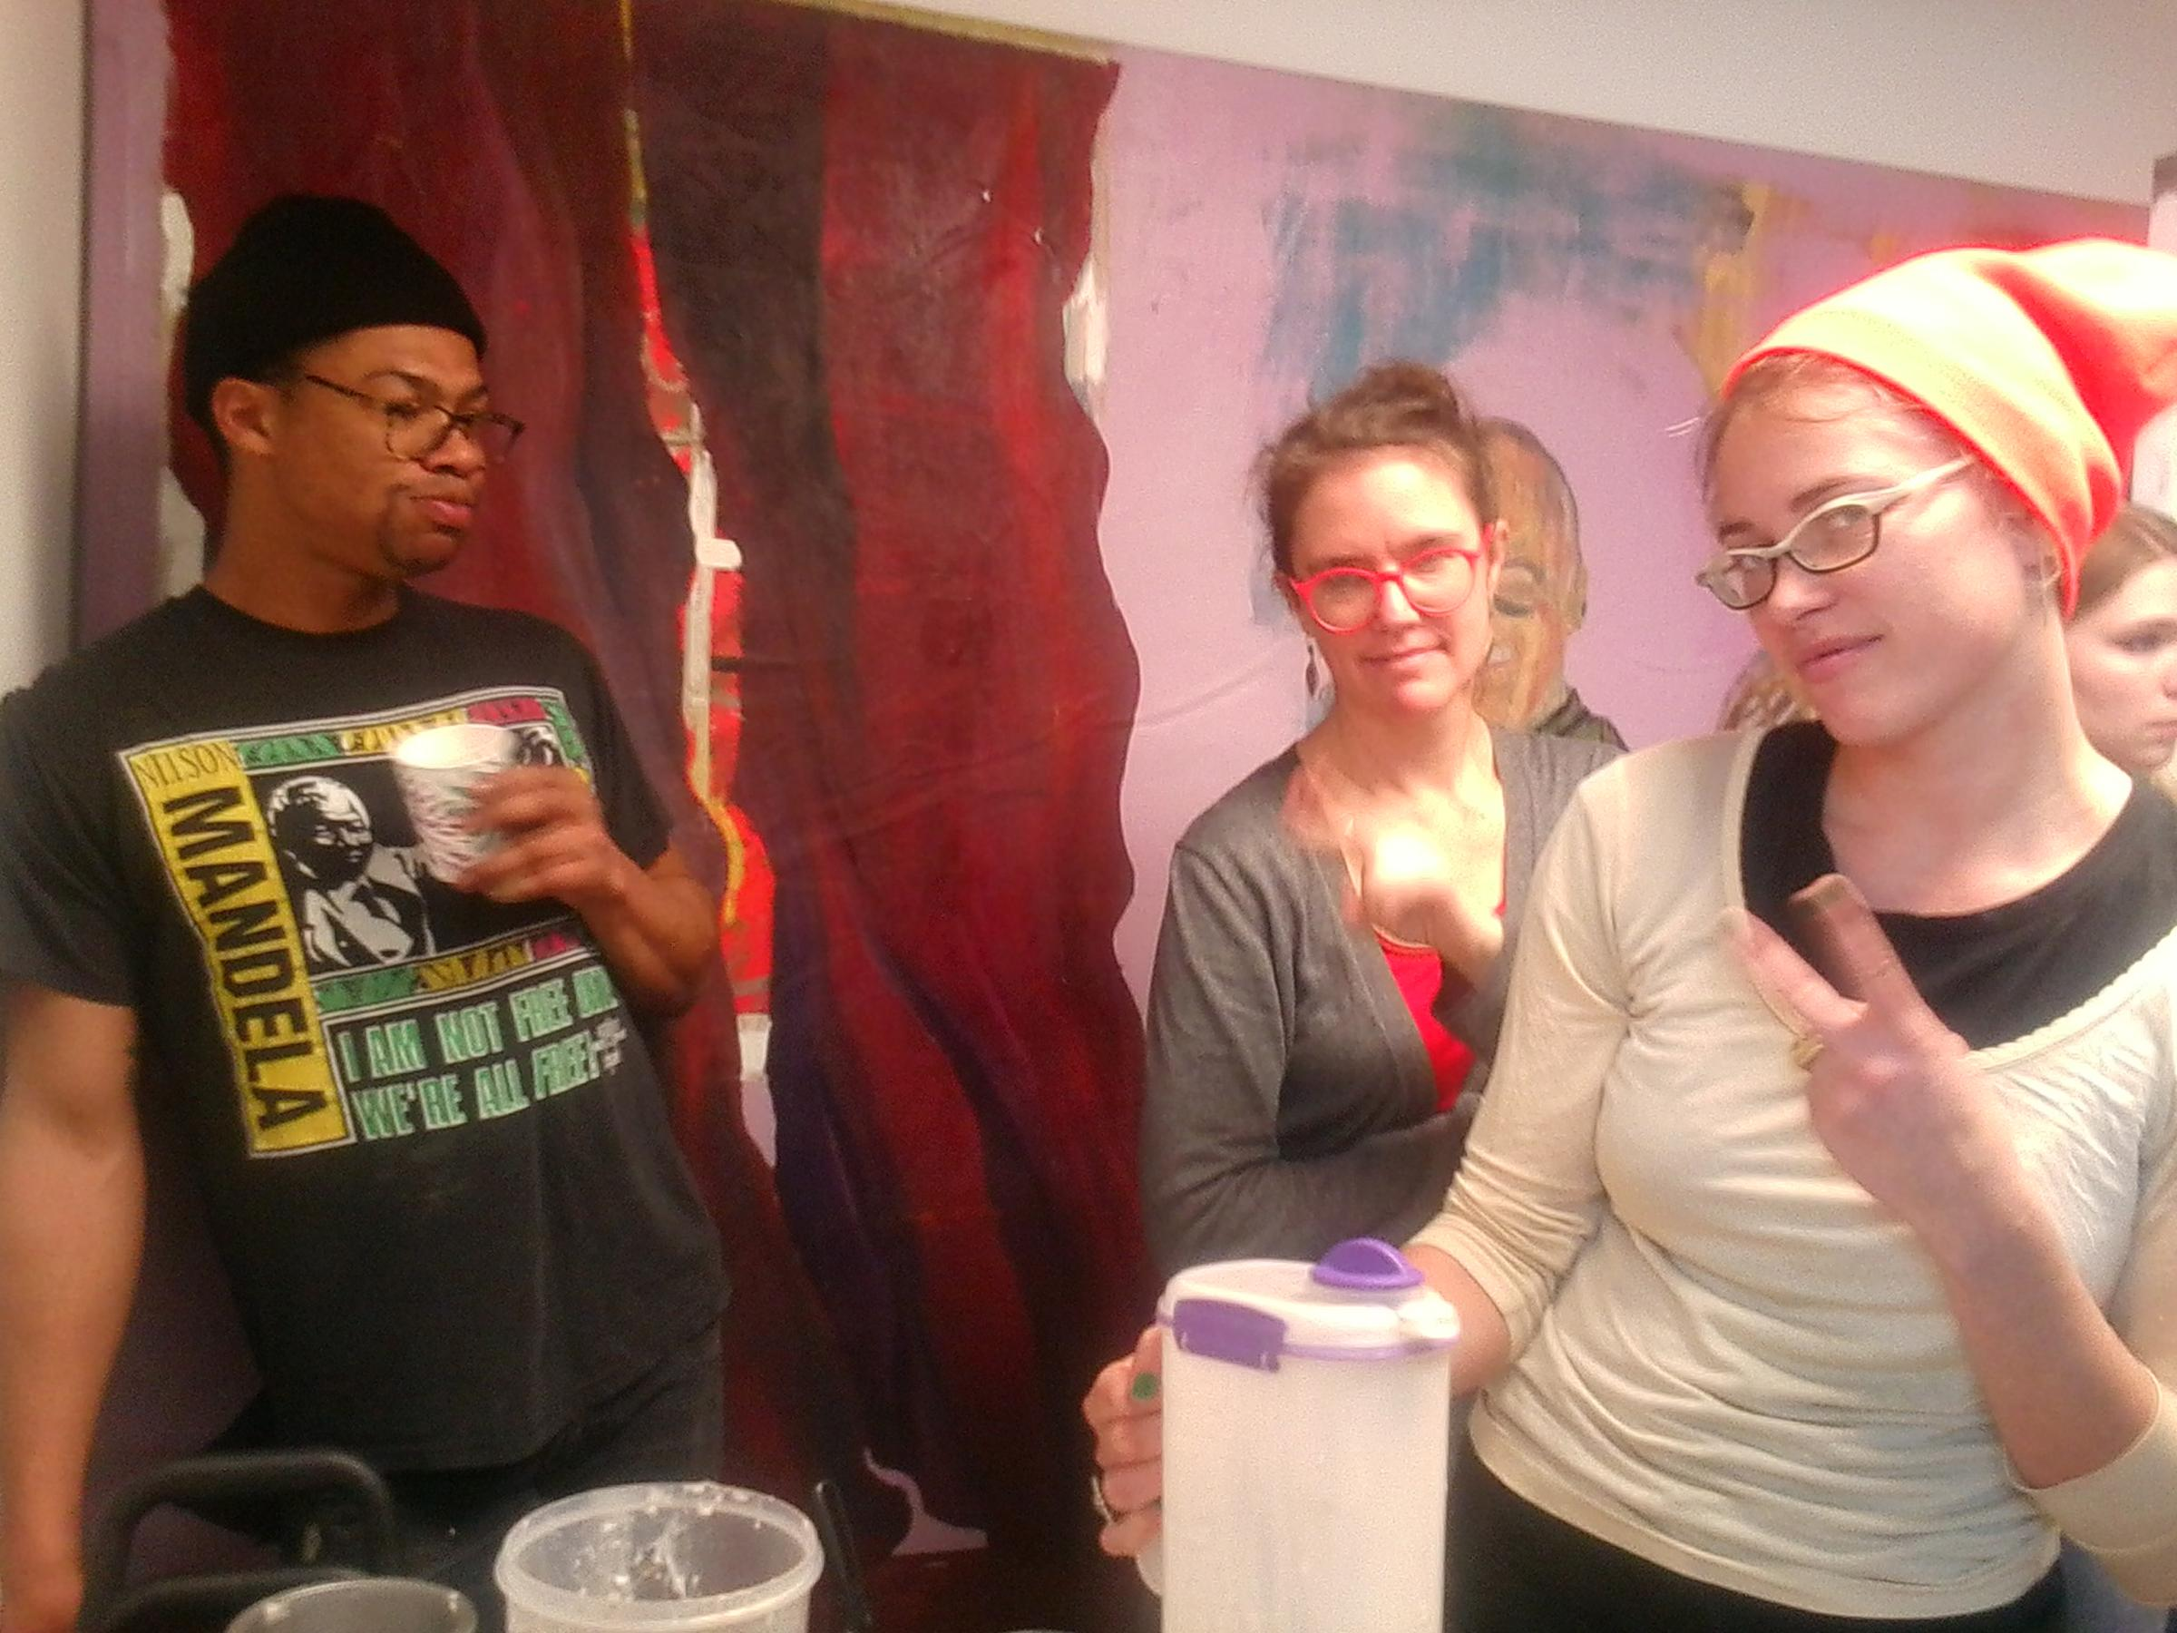

Slide 2
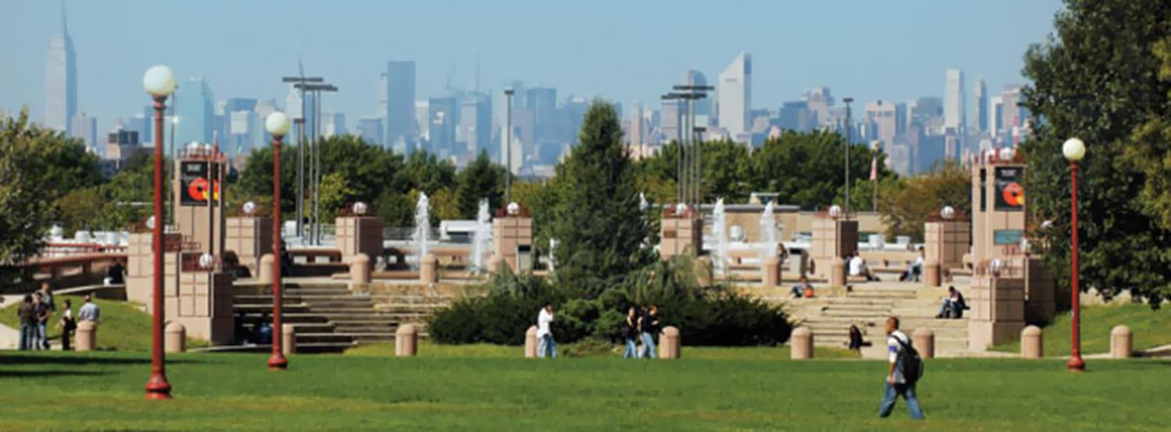
Queens College CUNY
The View From Queens College Campus Quad!
Space, Freedom, Proximity, & Cost

Slide 3
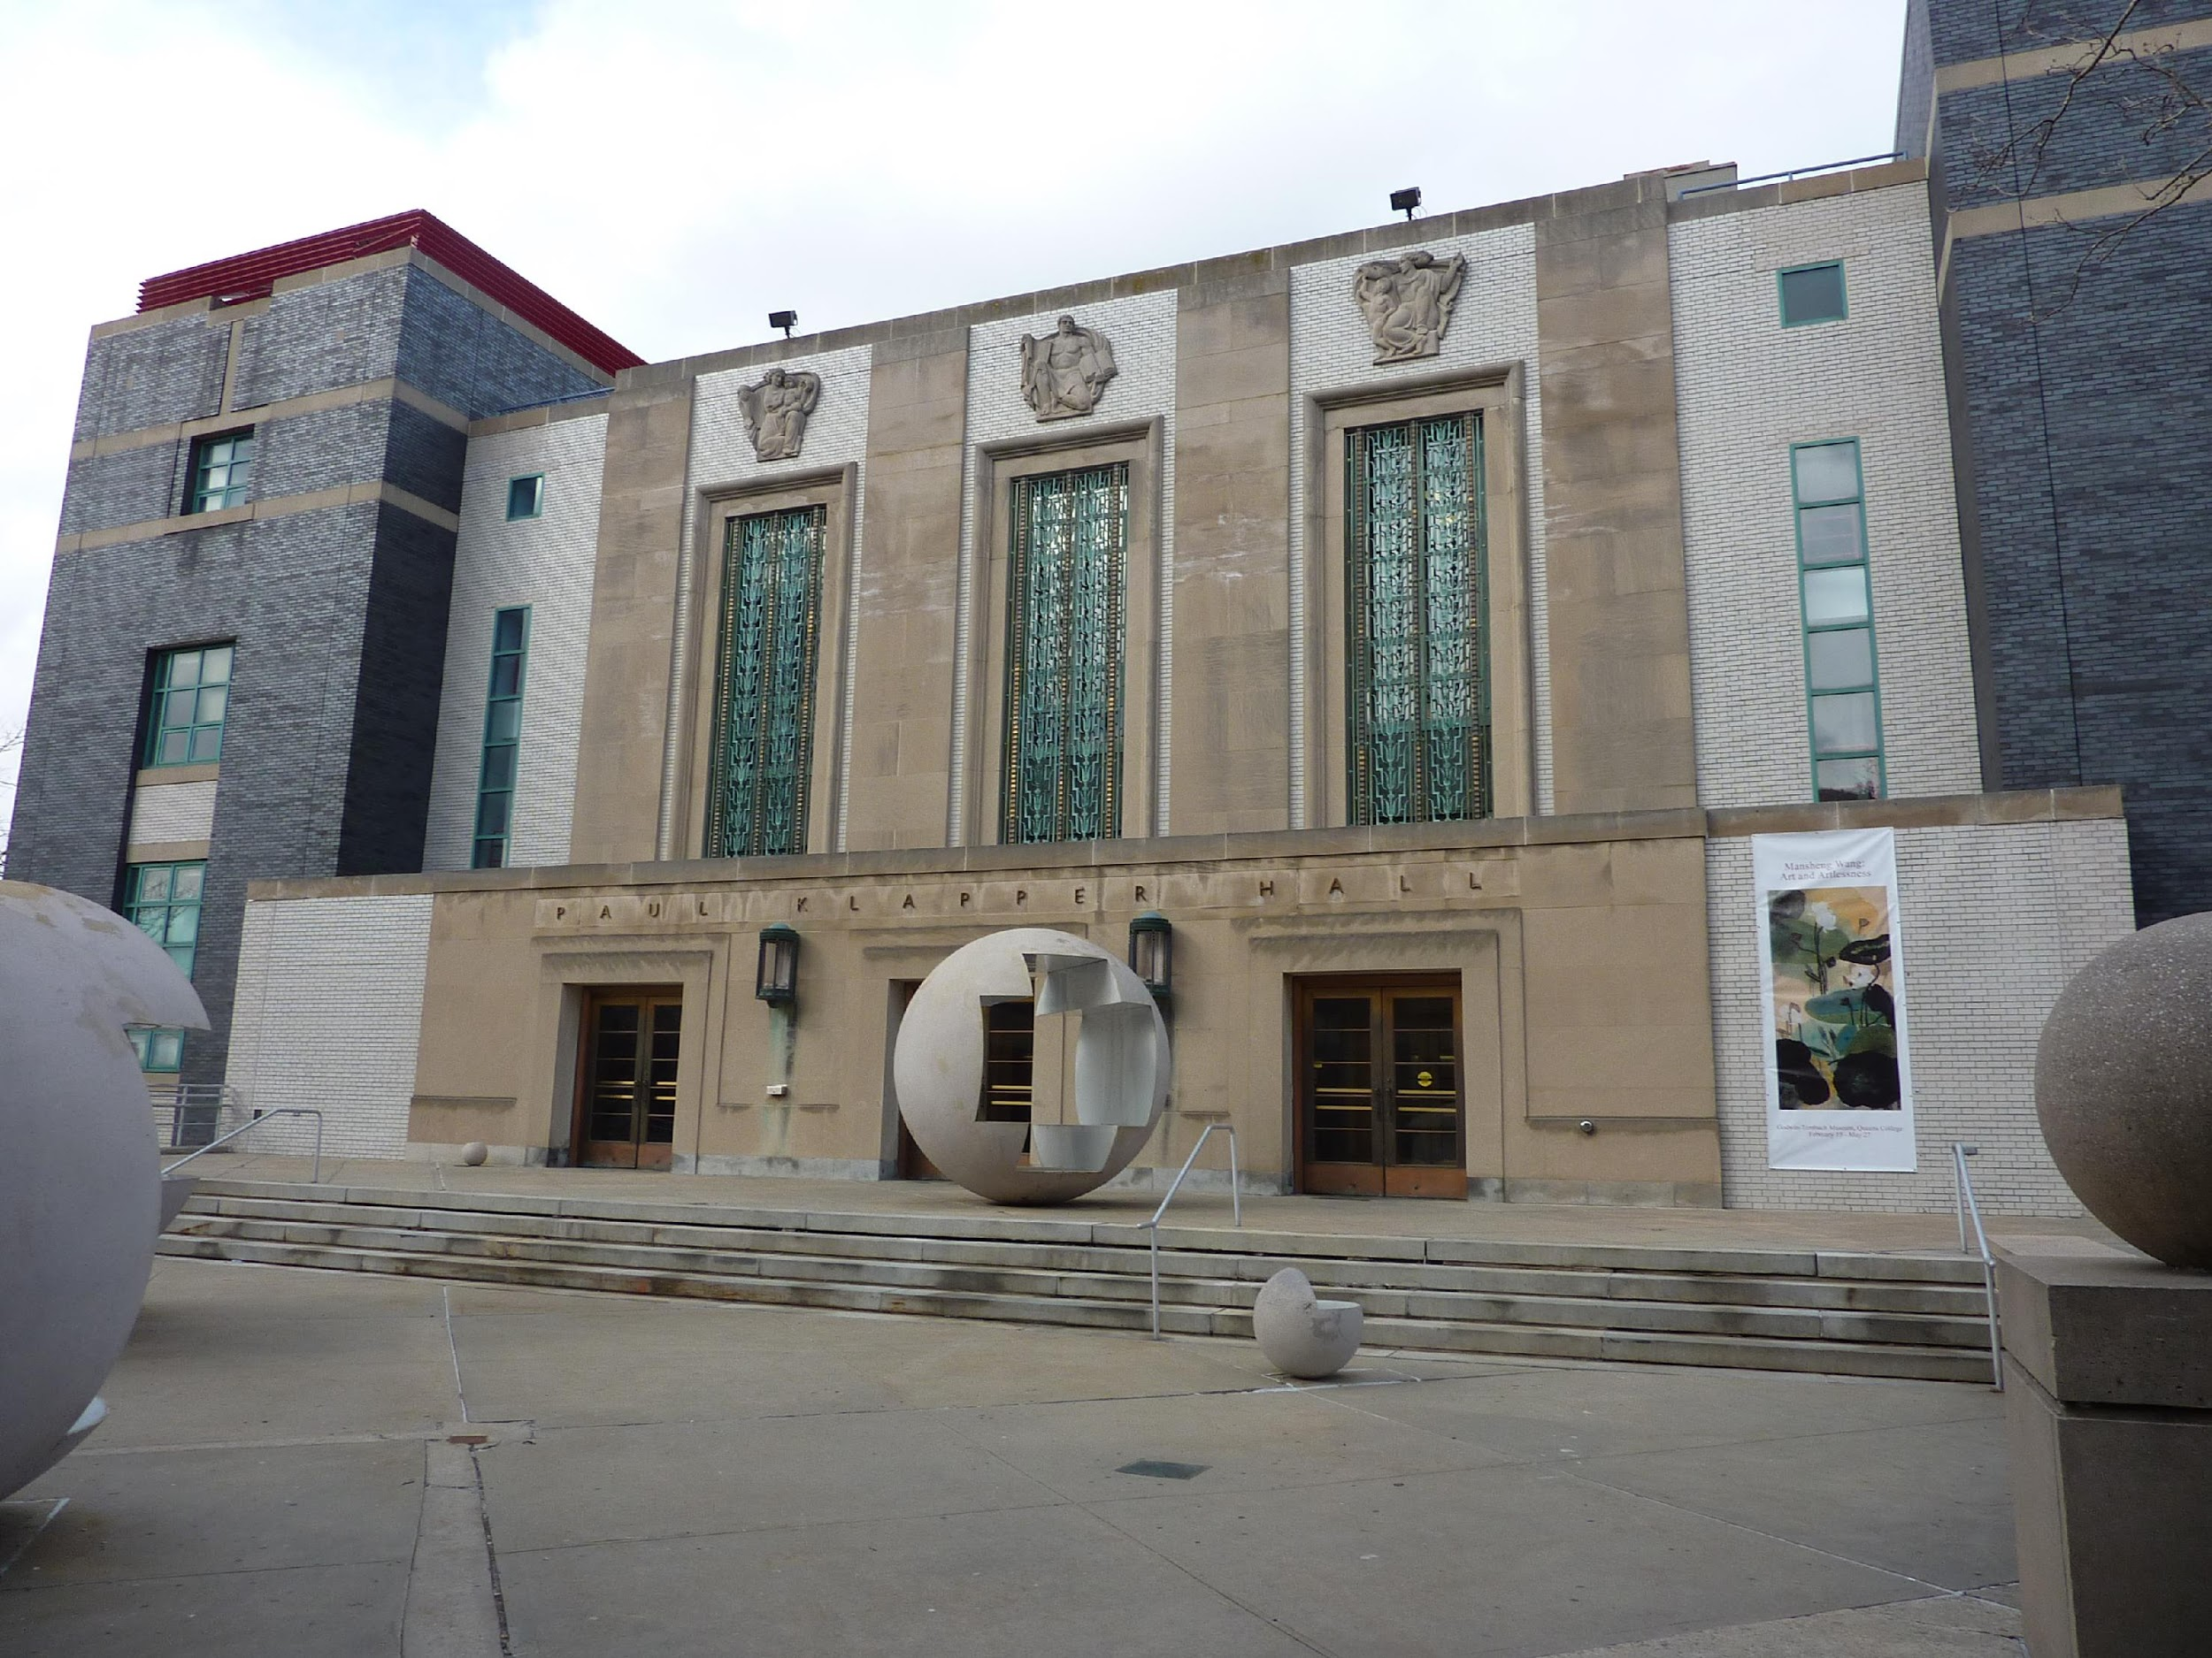
Klapper Hall
Art Department
with sculptures by Vito Acconci

Slide 4
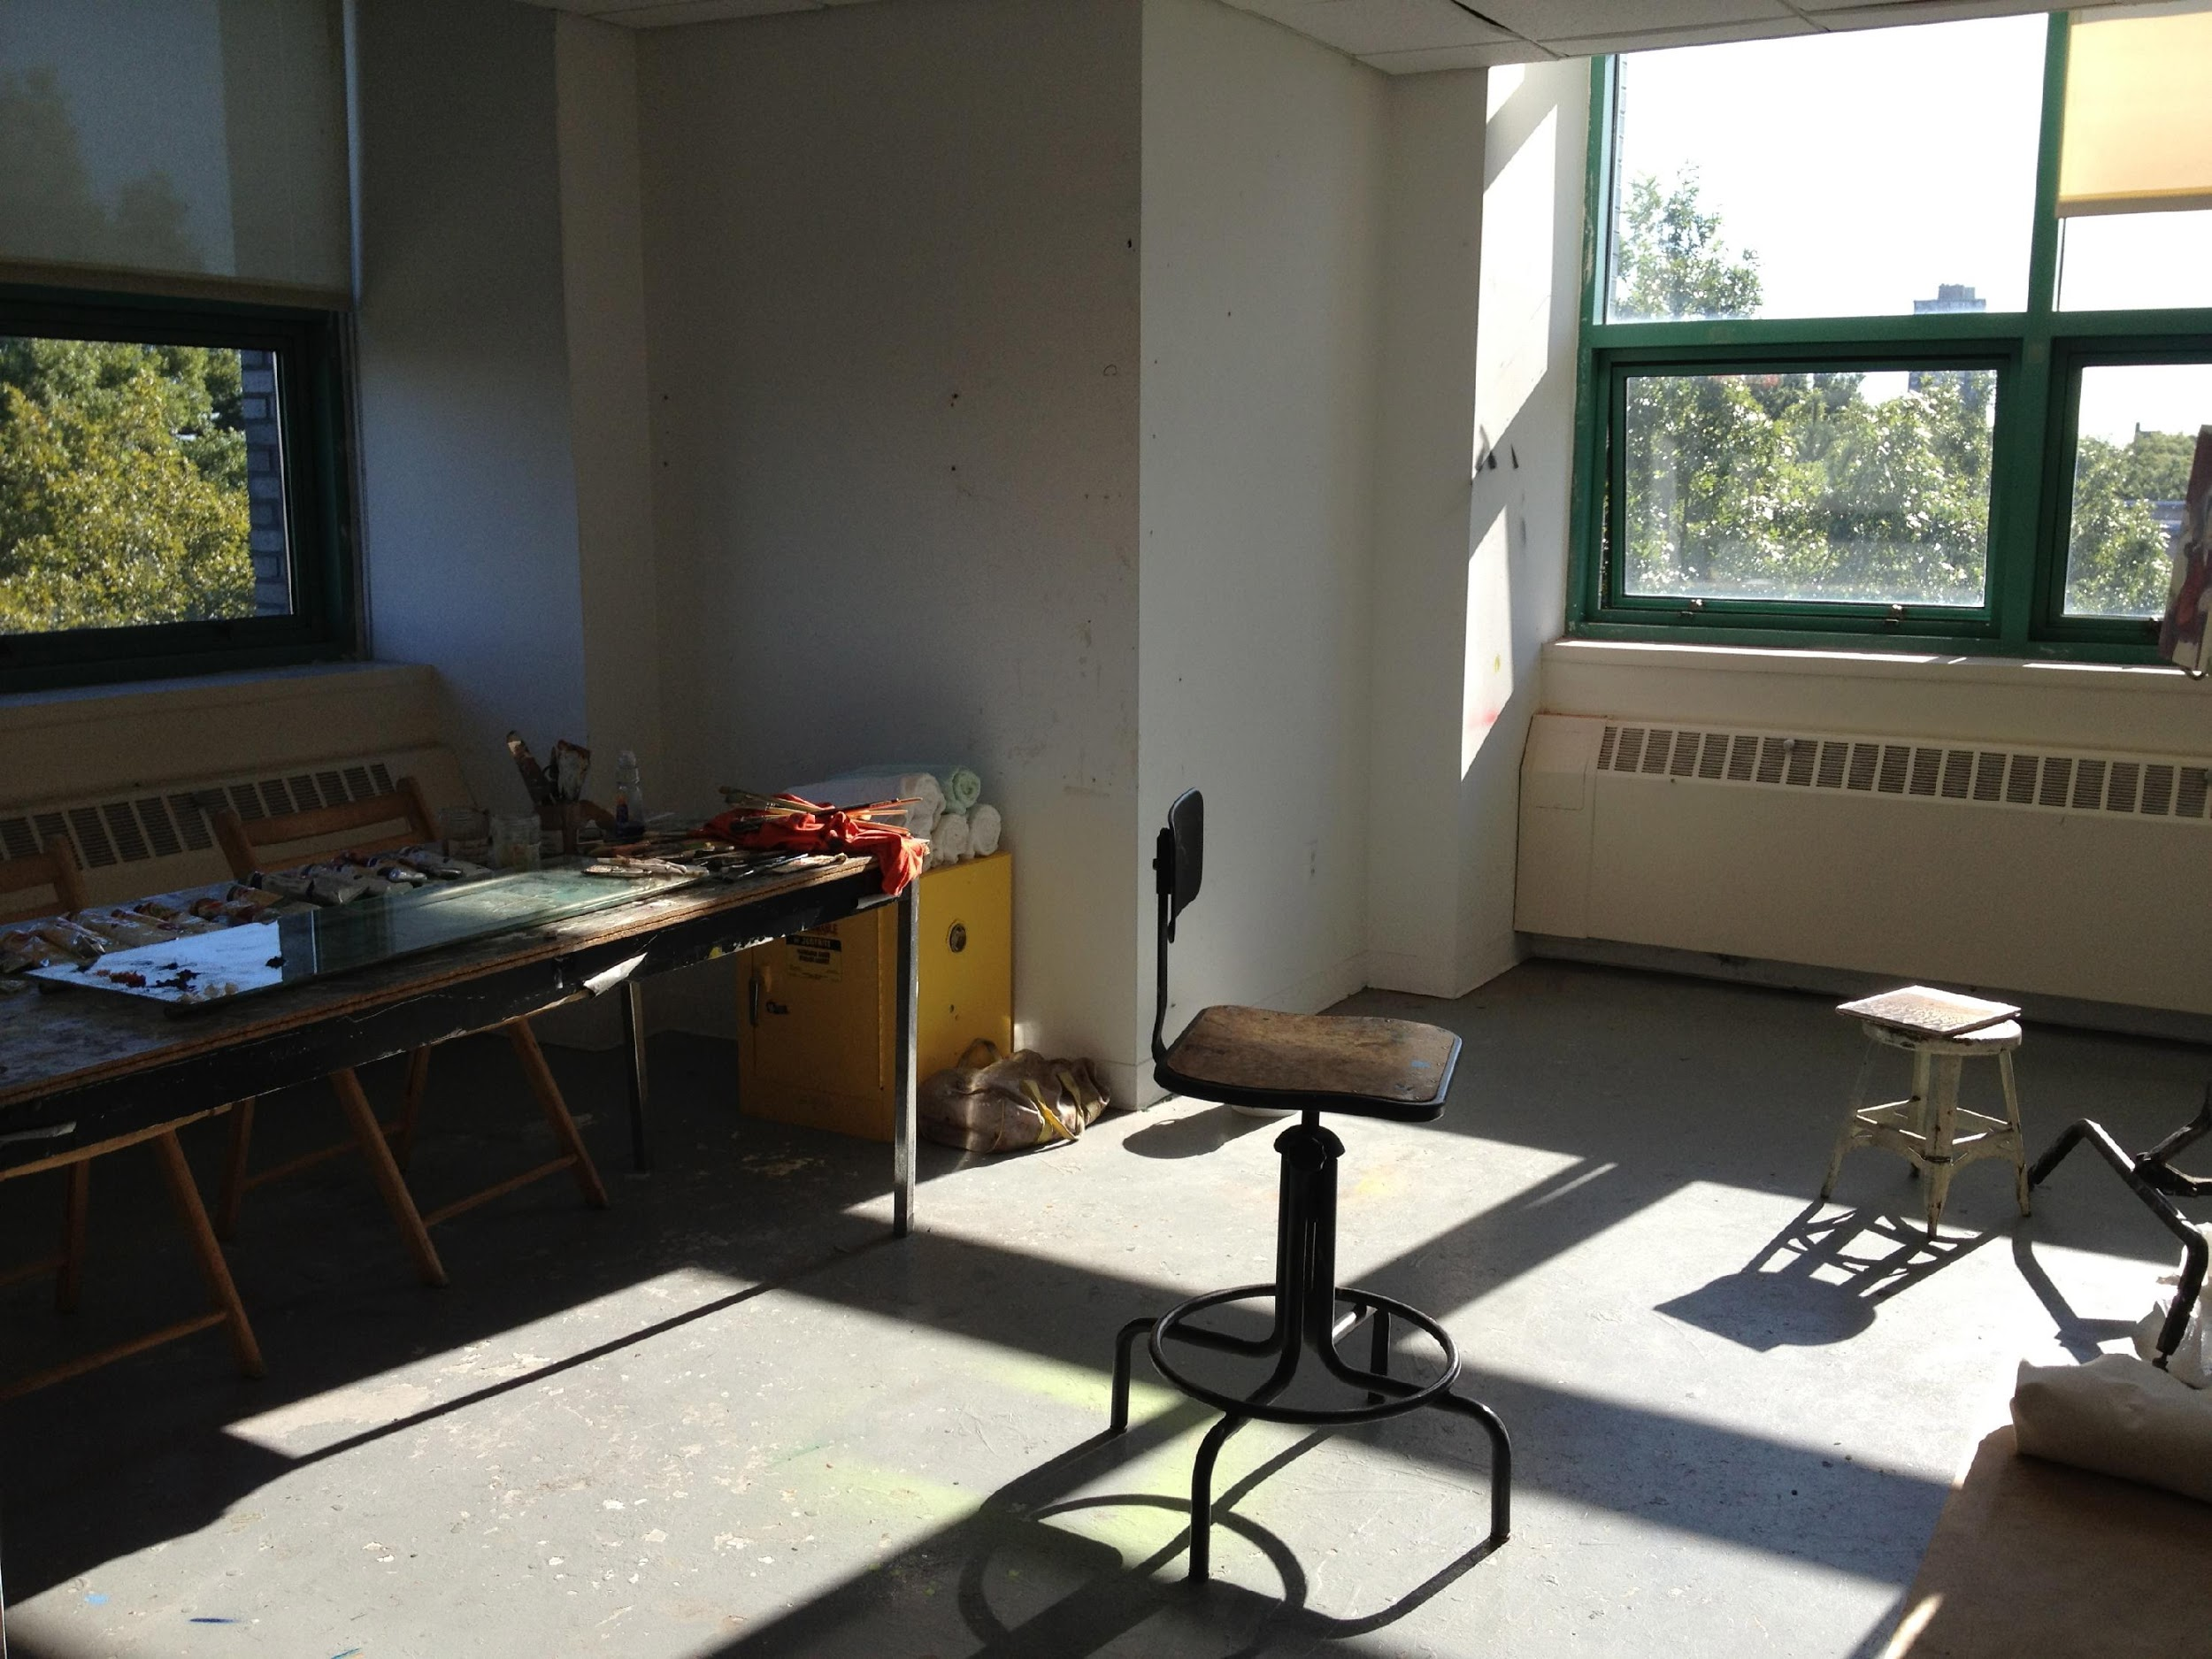
Shared Studio Space (BFA)

Slide 5
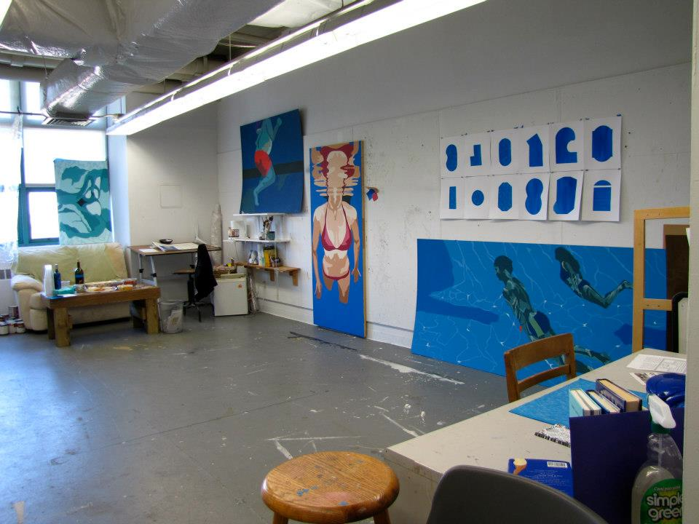
Private Studio Space (MFA)

Slide 6
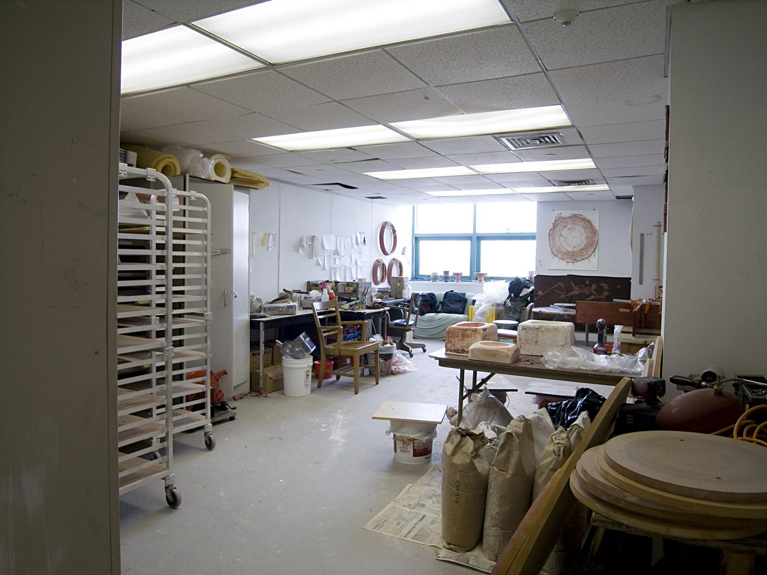

Slide 7
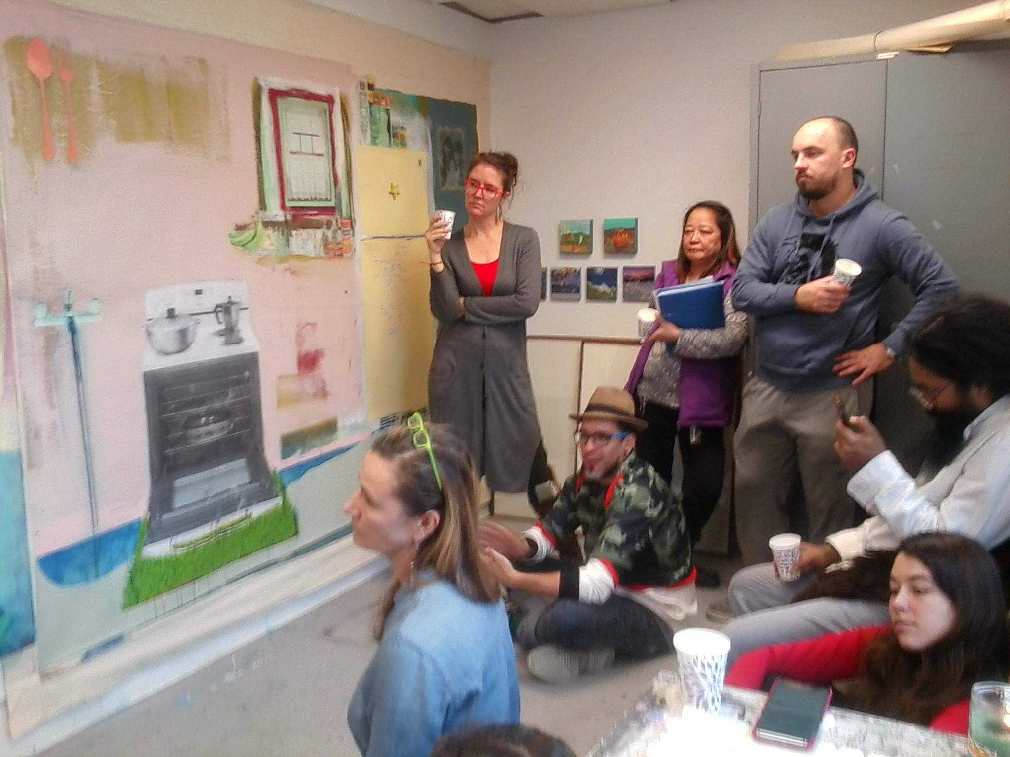
Group Crit / Studio Visits with
Irish artist Elaine Byrne

Slide 8
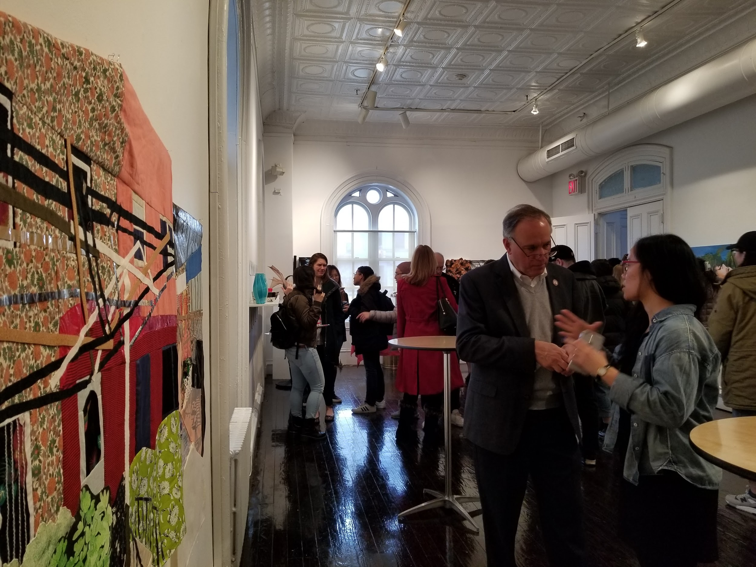
Art Department Biennial Exhibition
Flushing Town Hall (BFA/MFA)

Slide 9
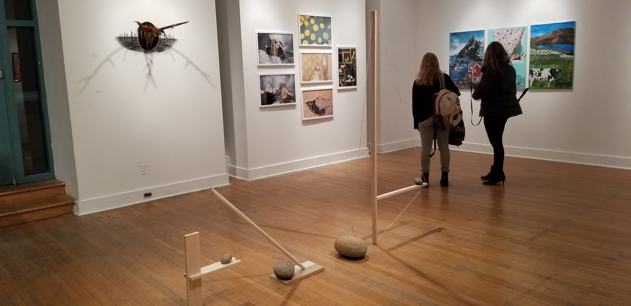
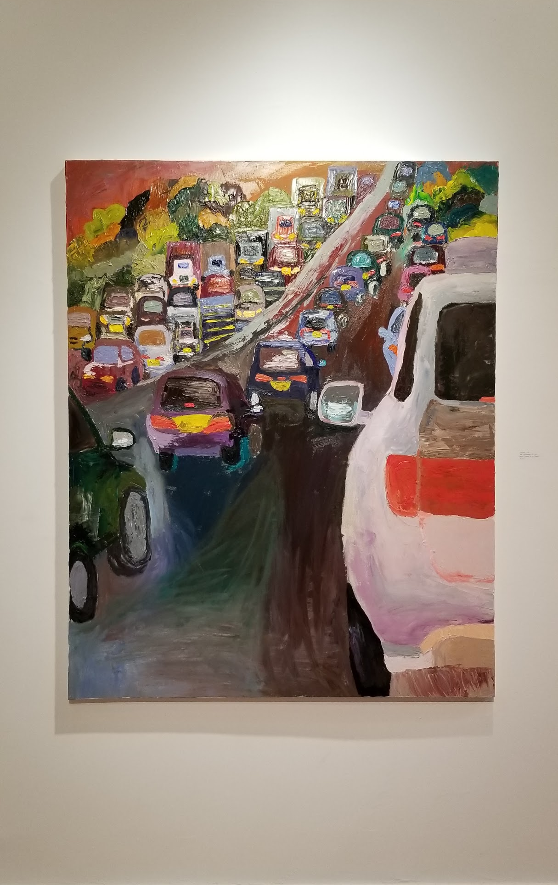
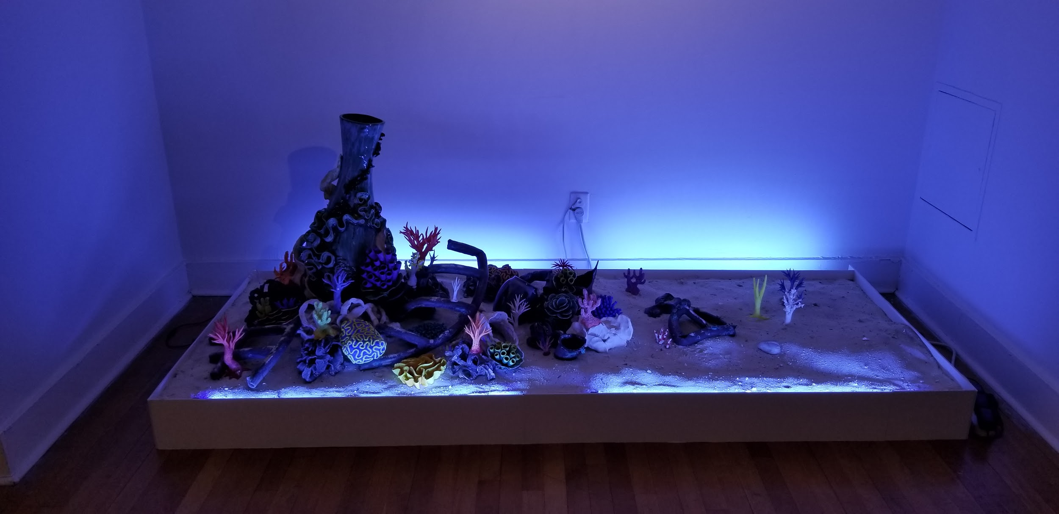
Senior Project Exhibition
Klapper Hall Gallery

Slide 10
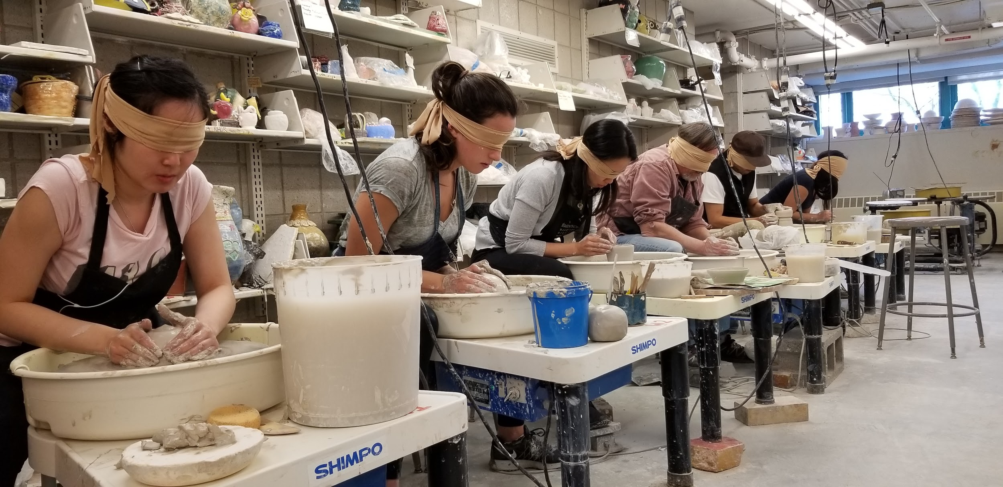
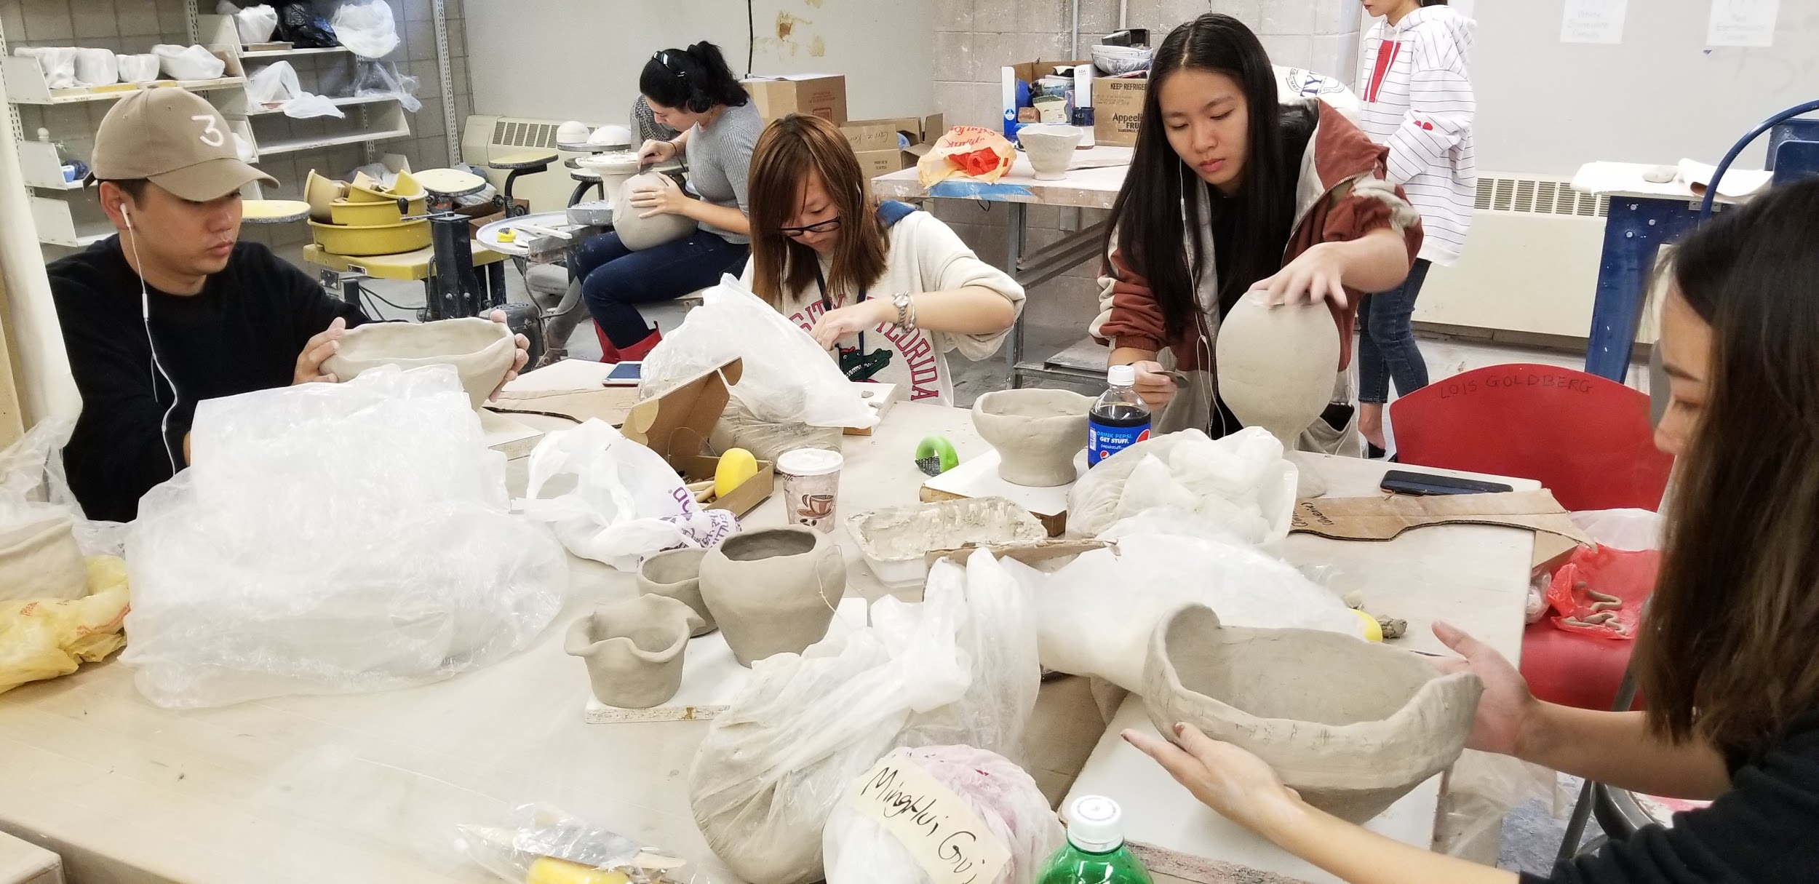
Ceramics Studio

Slide 11
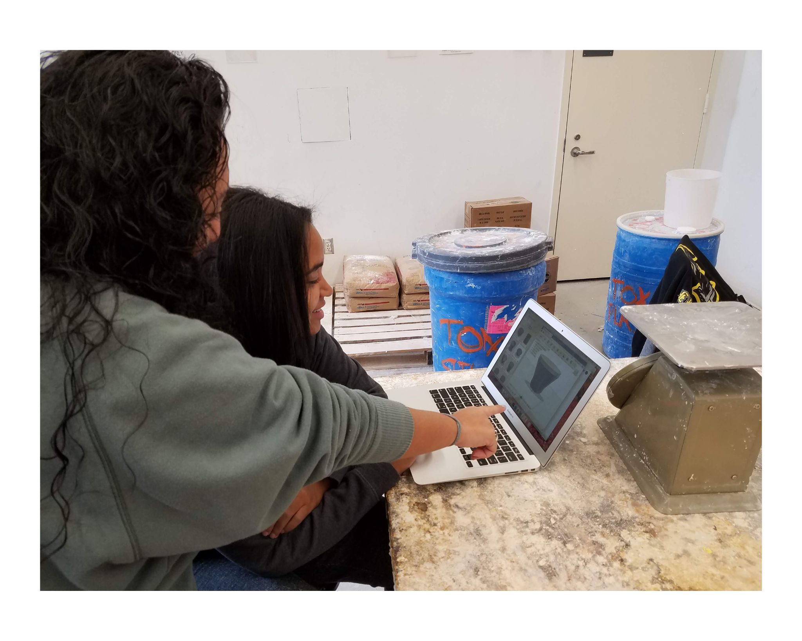
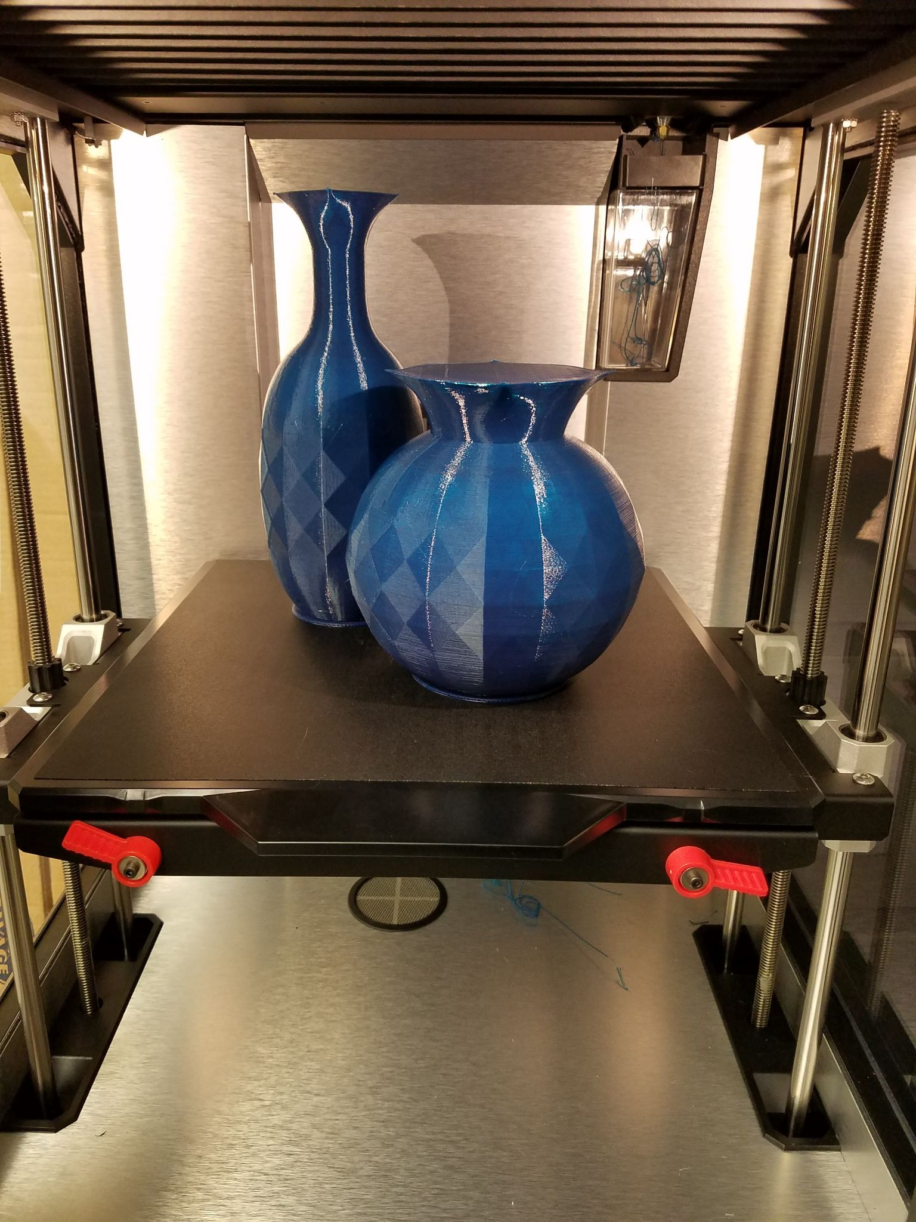
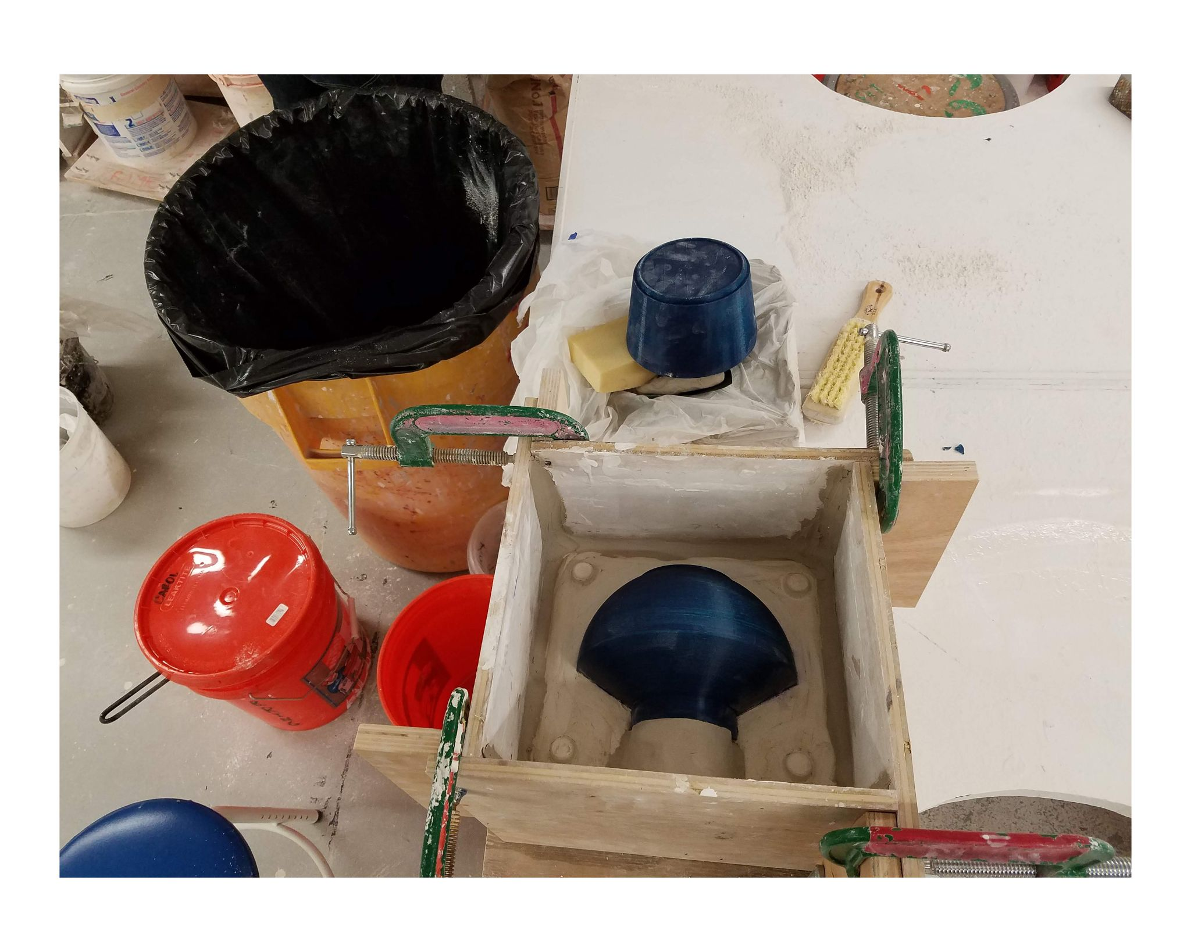
3D Printing & Mold Making

Slide 12
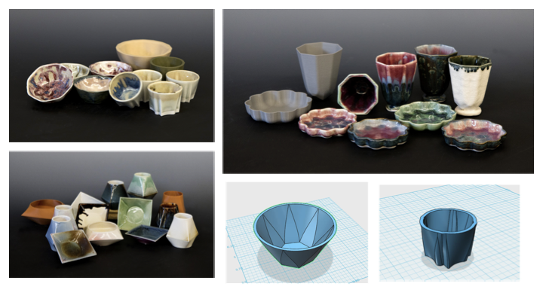
Student Work from
3D Modeling, Printing, & Slipcasting Course

Slide 13
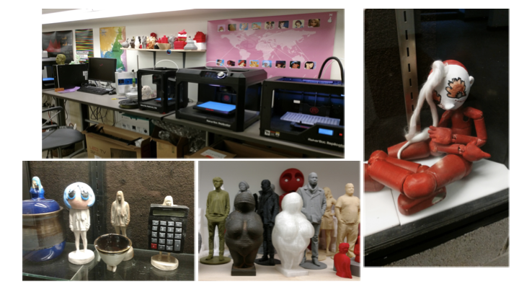
3D Printing & 3D Scanning Facilities - Ceramic and Bronze work produced using new 3D printing and scanning technologies.
Examples of ceramic slip casting and examples of translation of materials - original to 3D scan to 3D print then invested and cast in bronze.

Slide 14
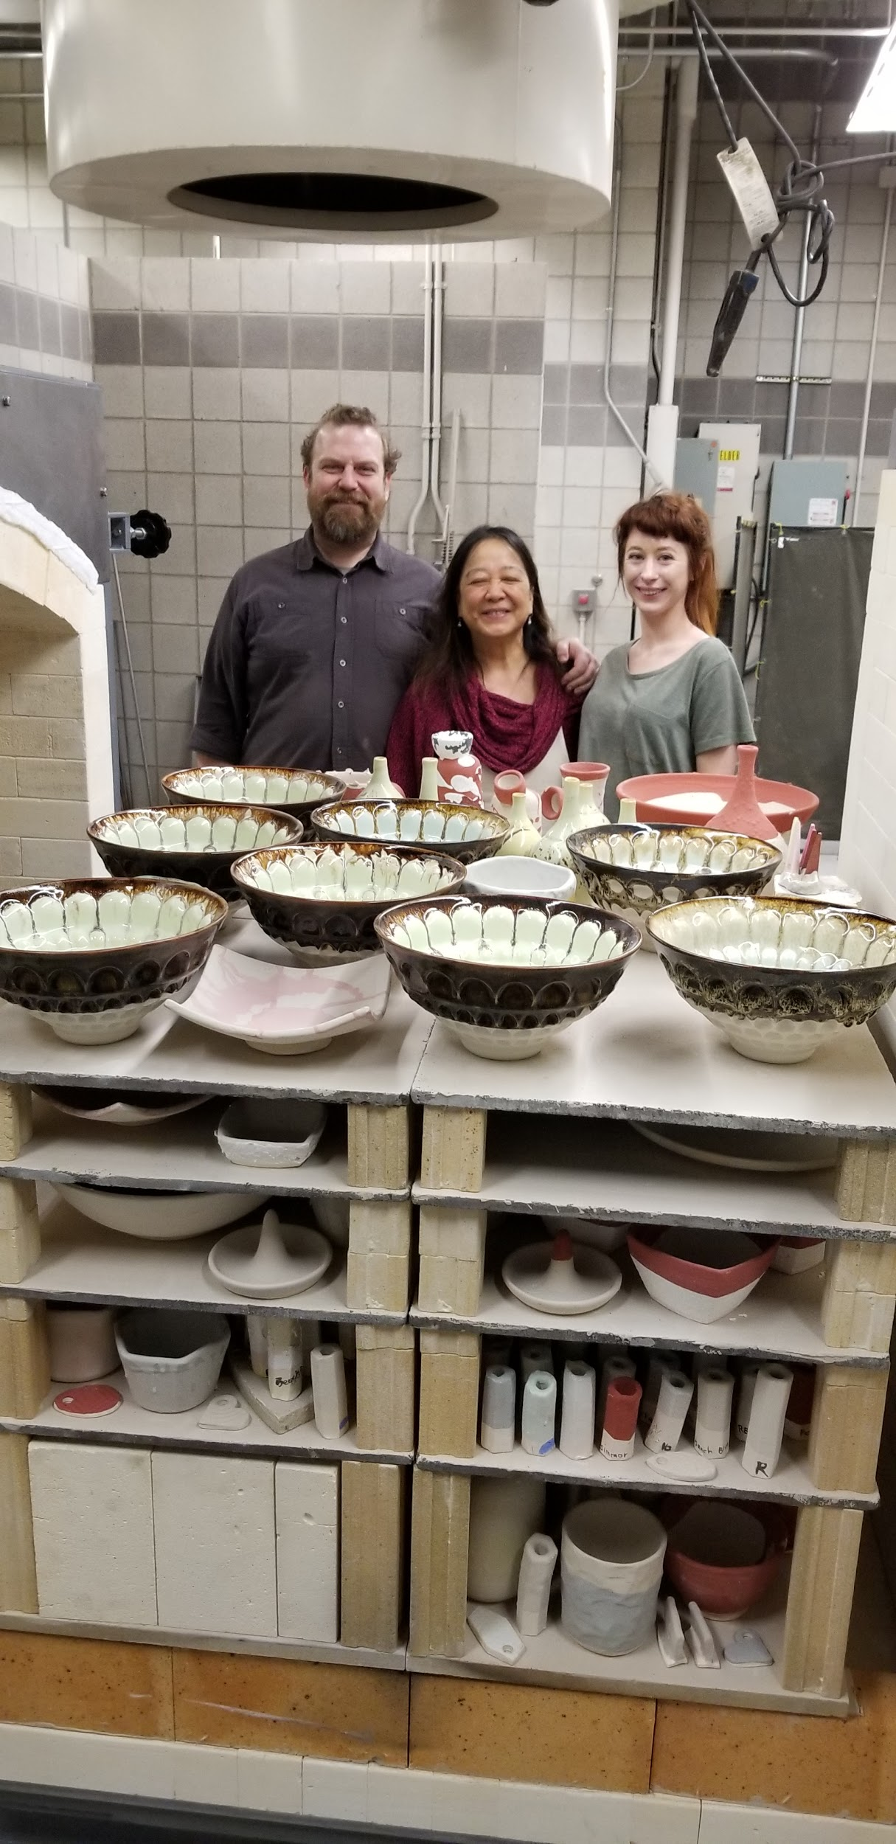
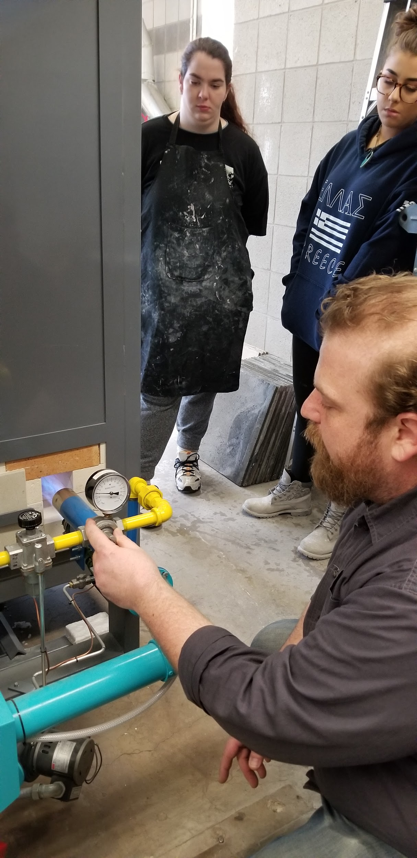
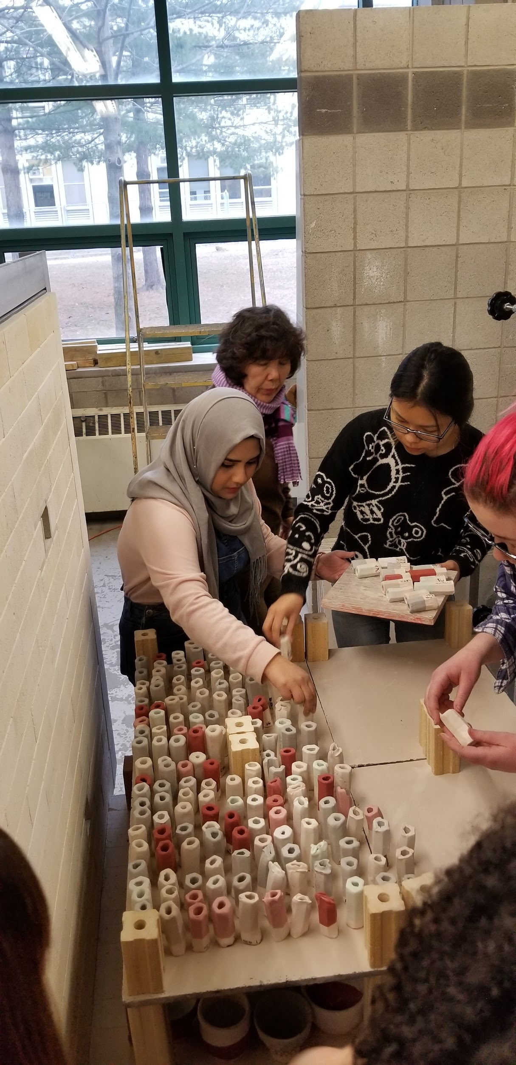
Gas Kiln Firing – Glaze Testing

Slide 15
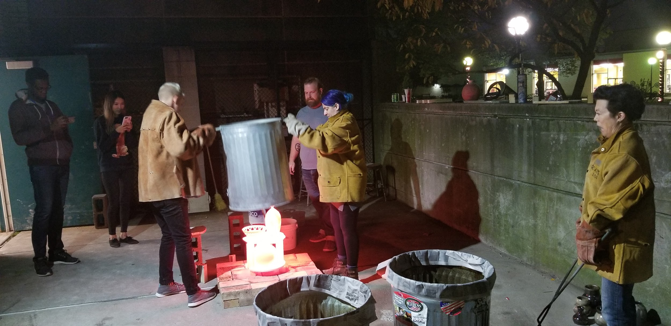
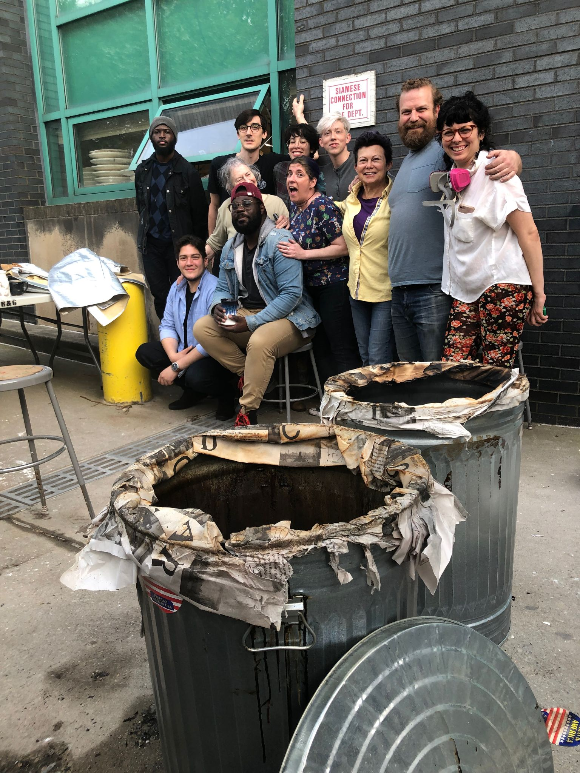
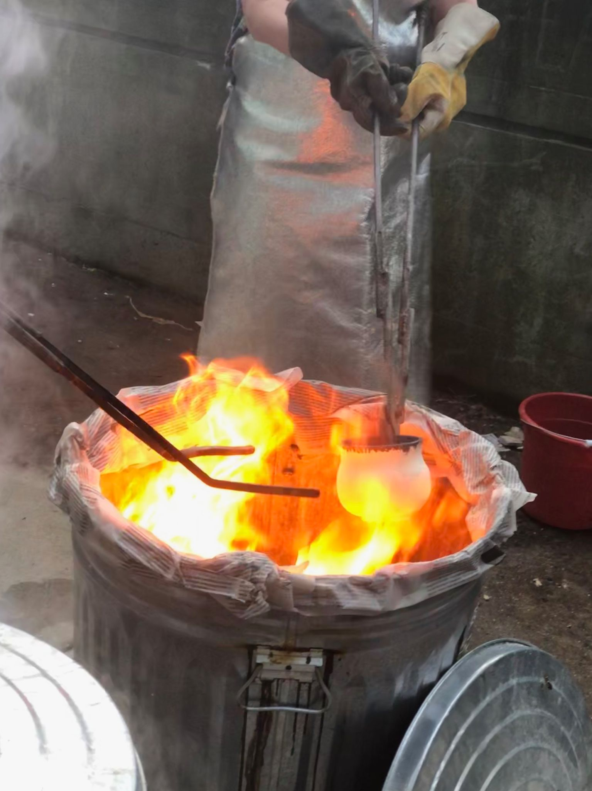
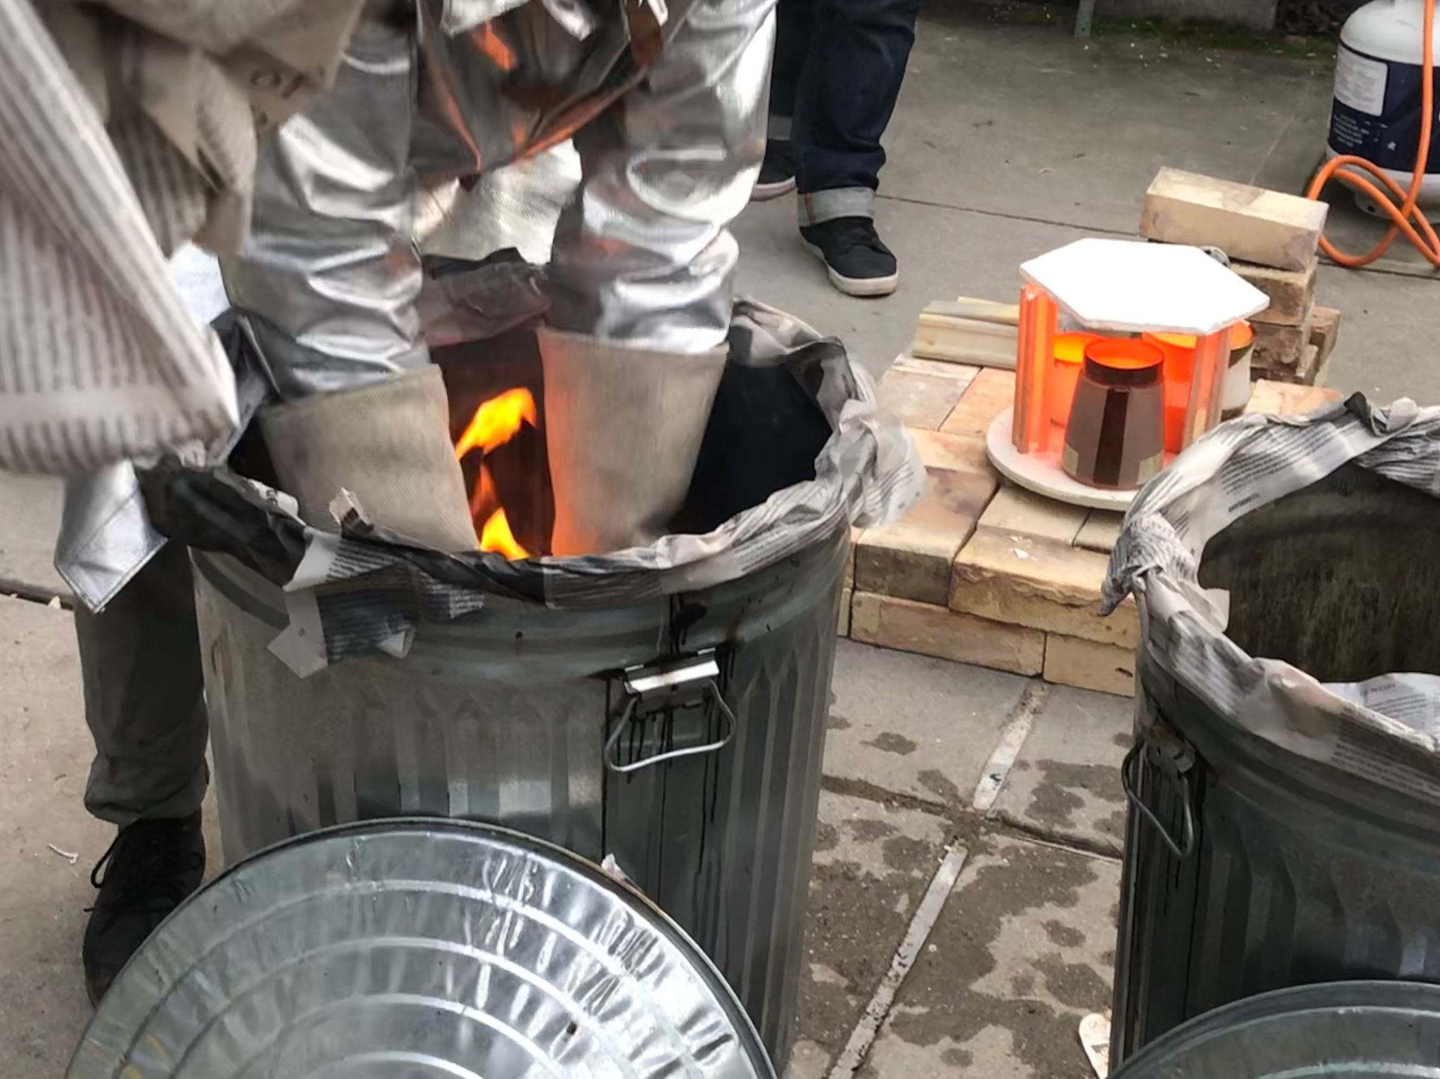
Ceramics Program Raku Firing

Slide 16
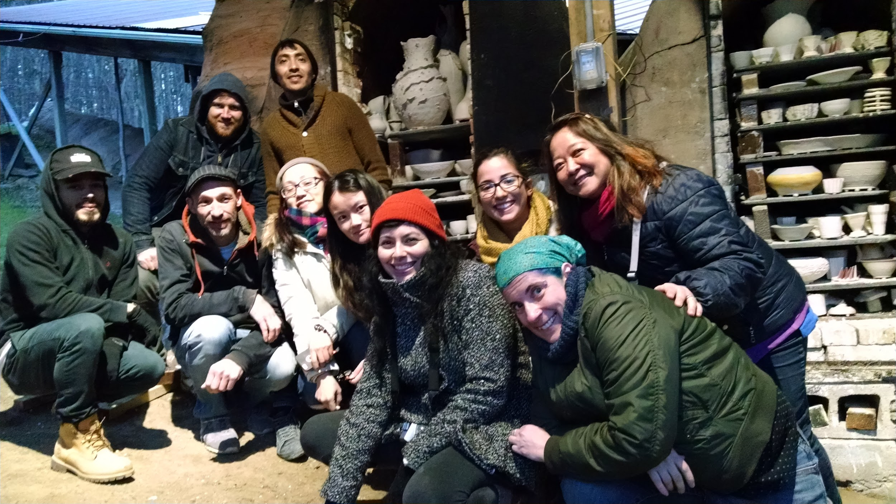
Ceramic Program Offsite Wood/Salt Firing Peter’s Valley

Slide 17
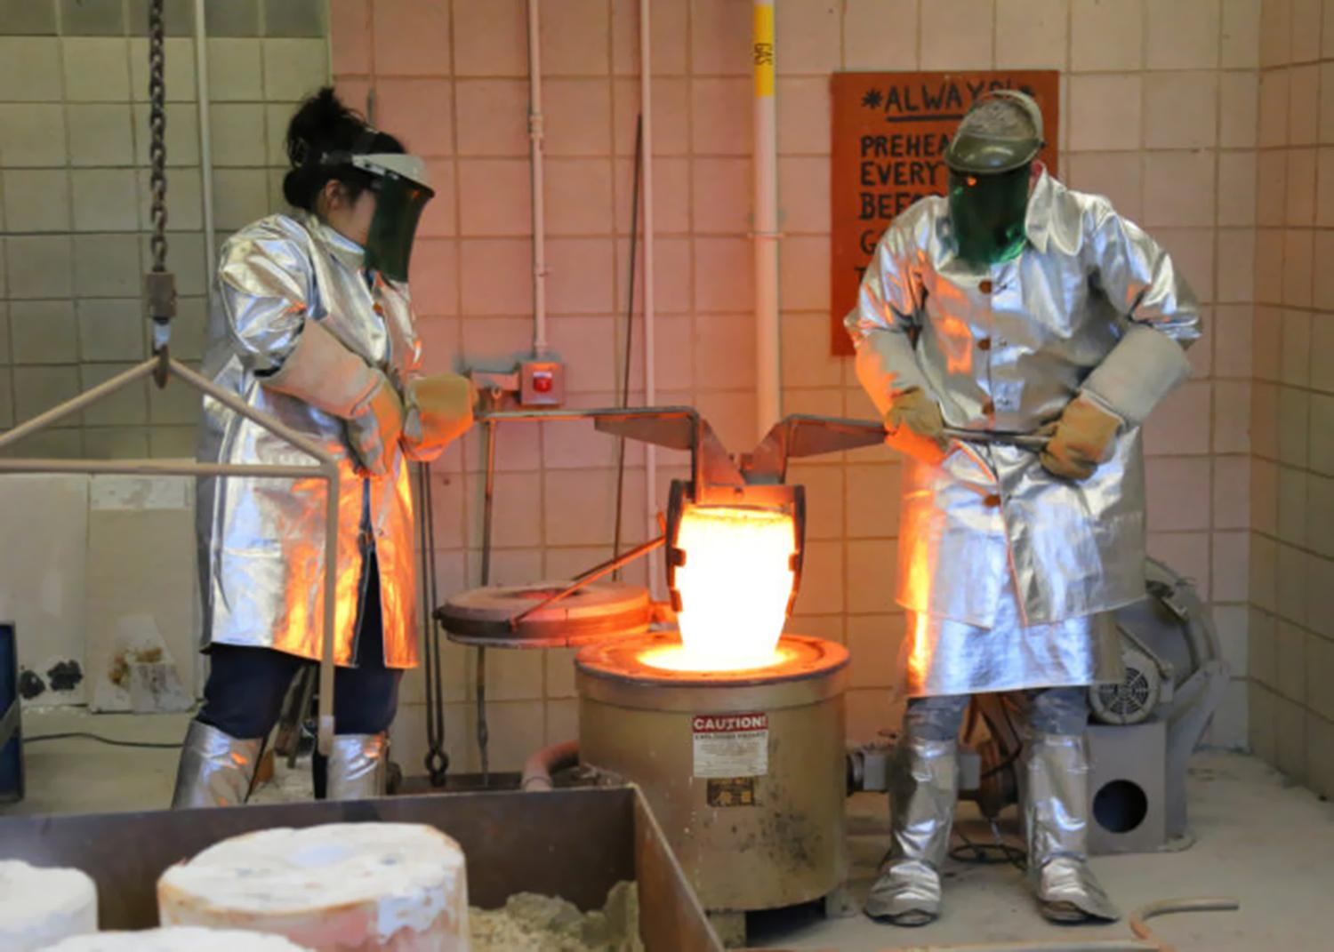
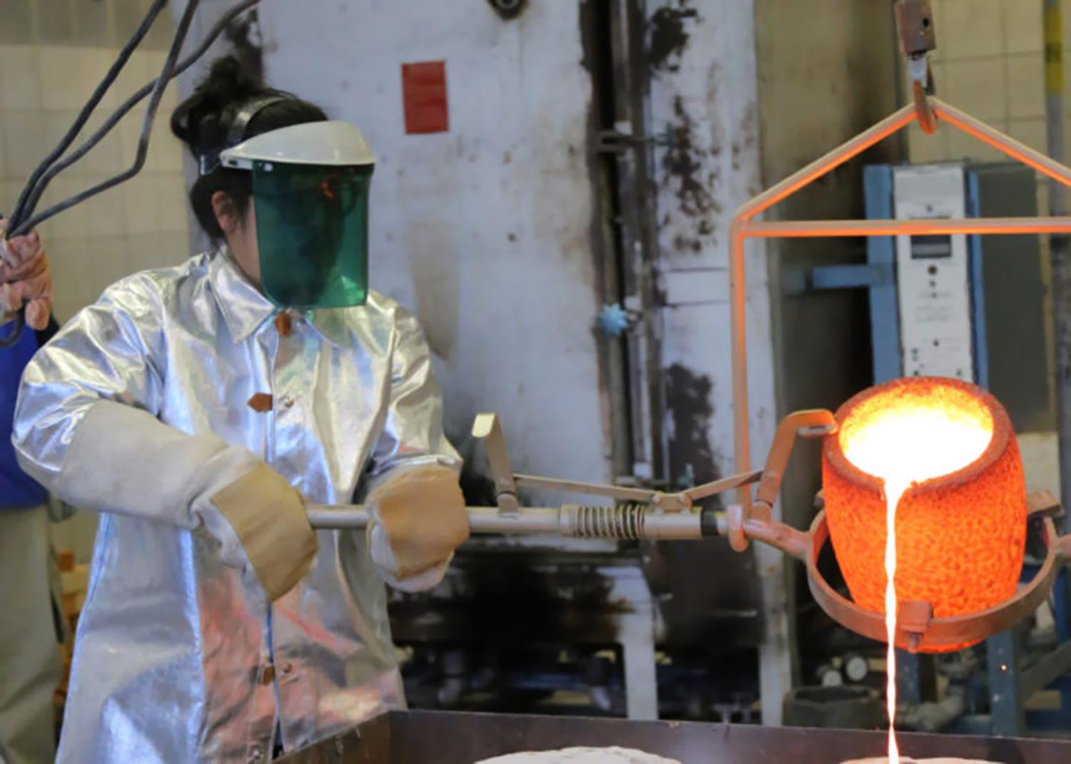
On-site Bronze Foundry

Slide 18
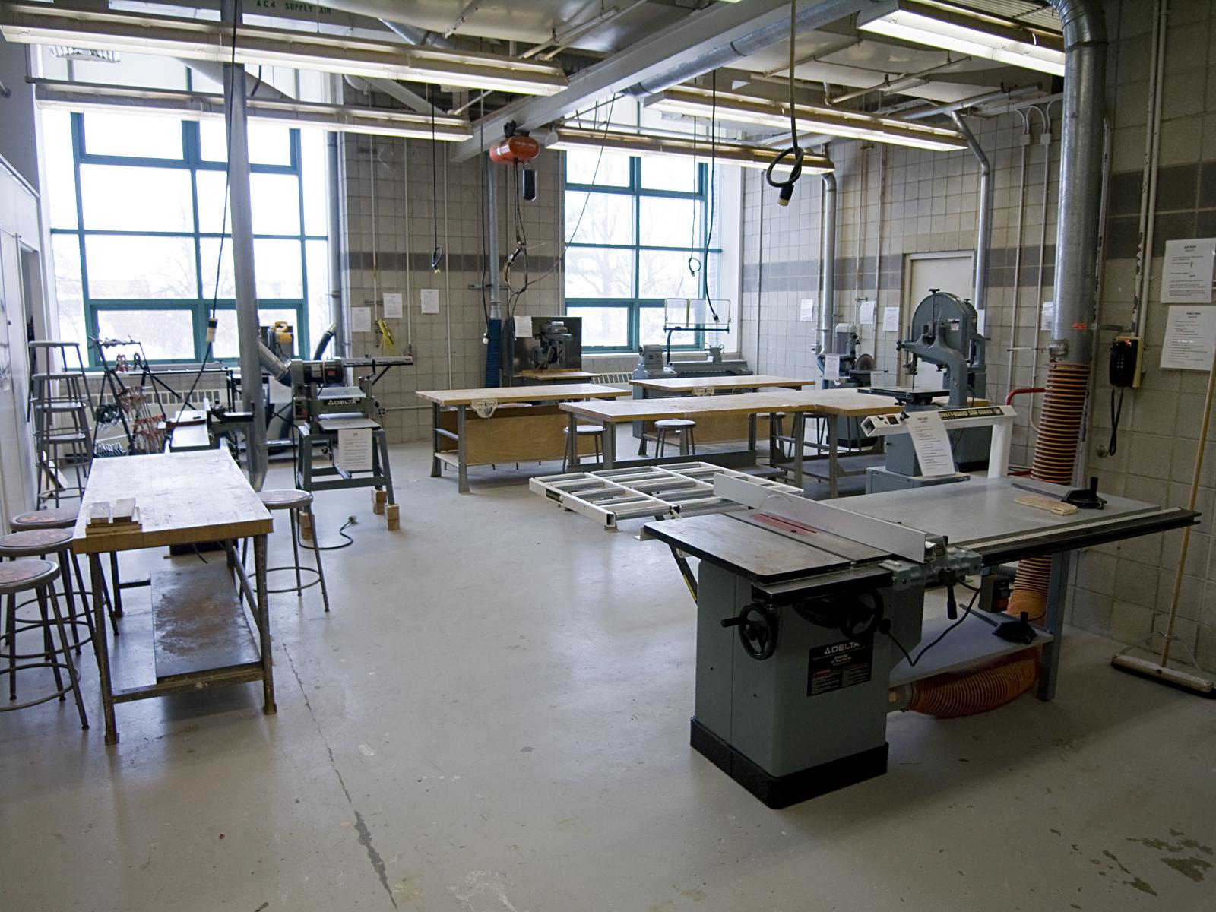
One of two wood shops
Klapper Hall, QC

Slide 19
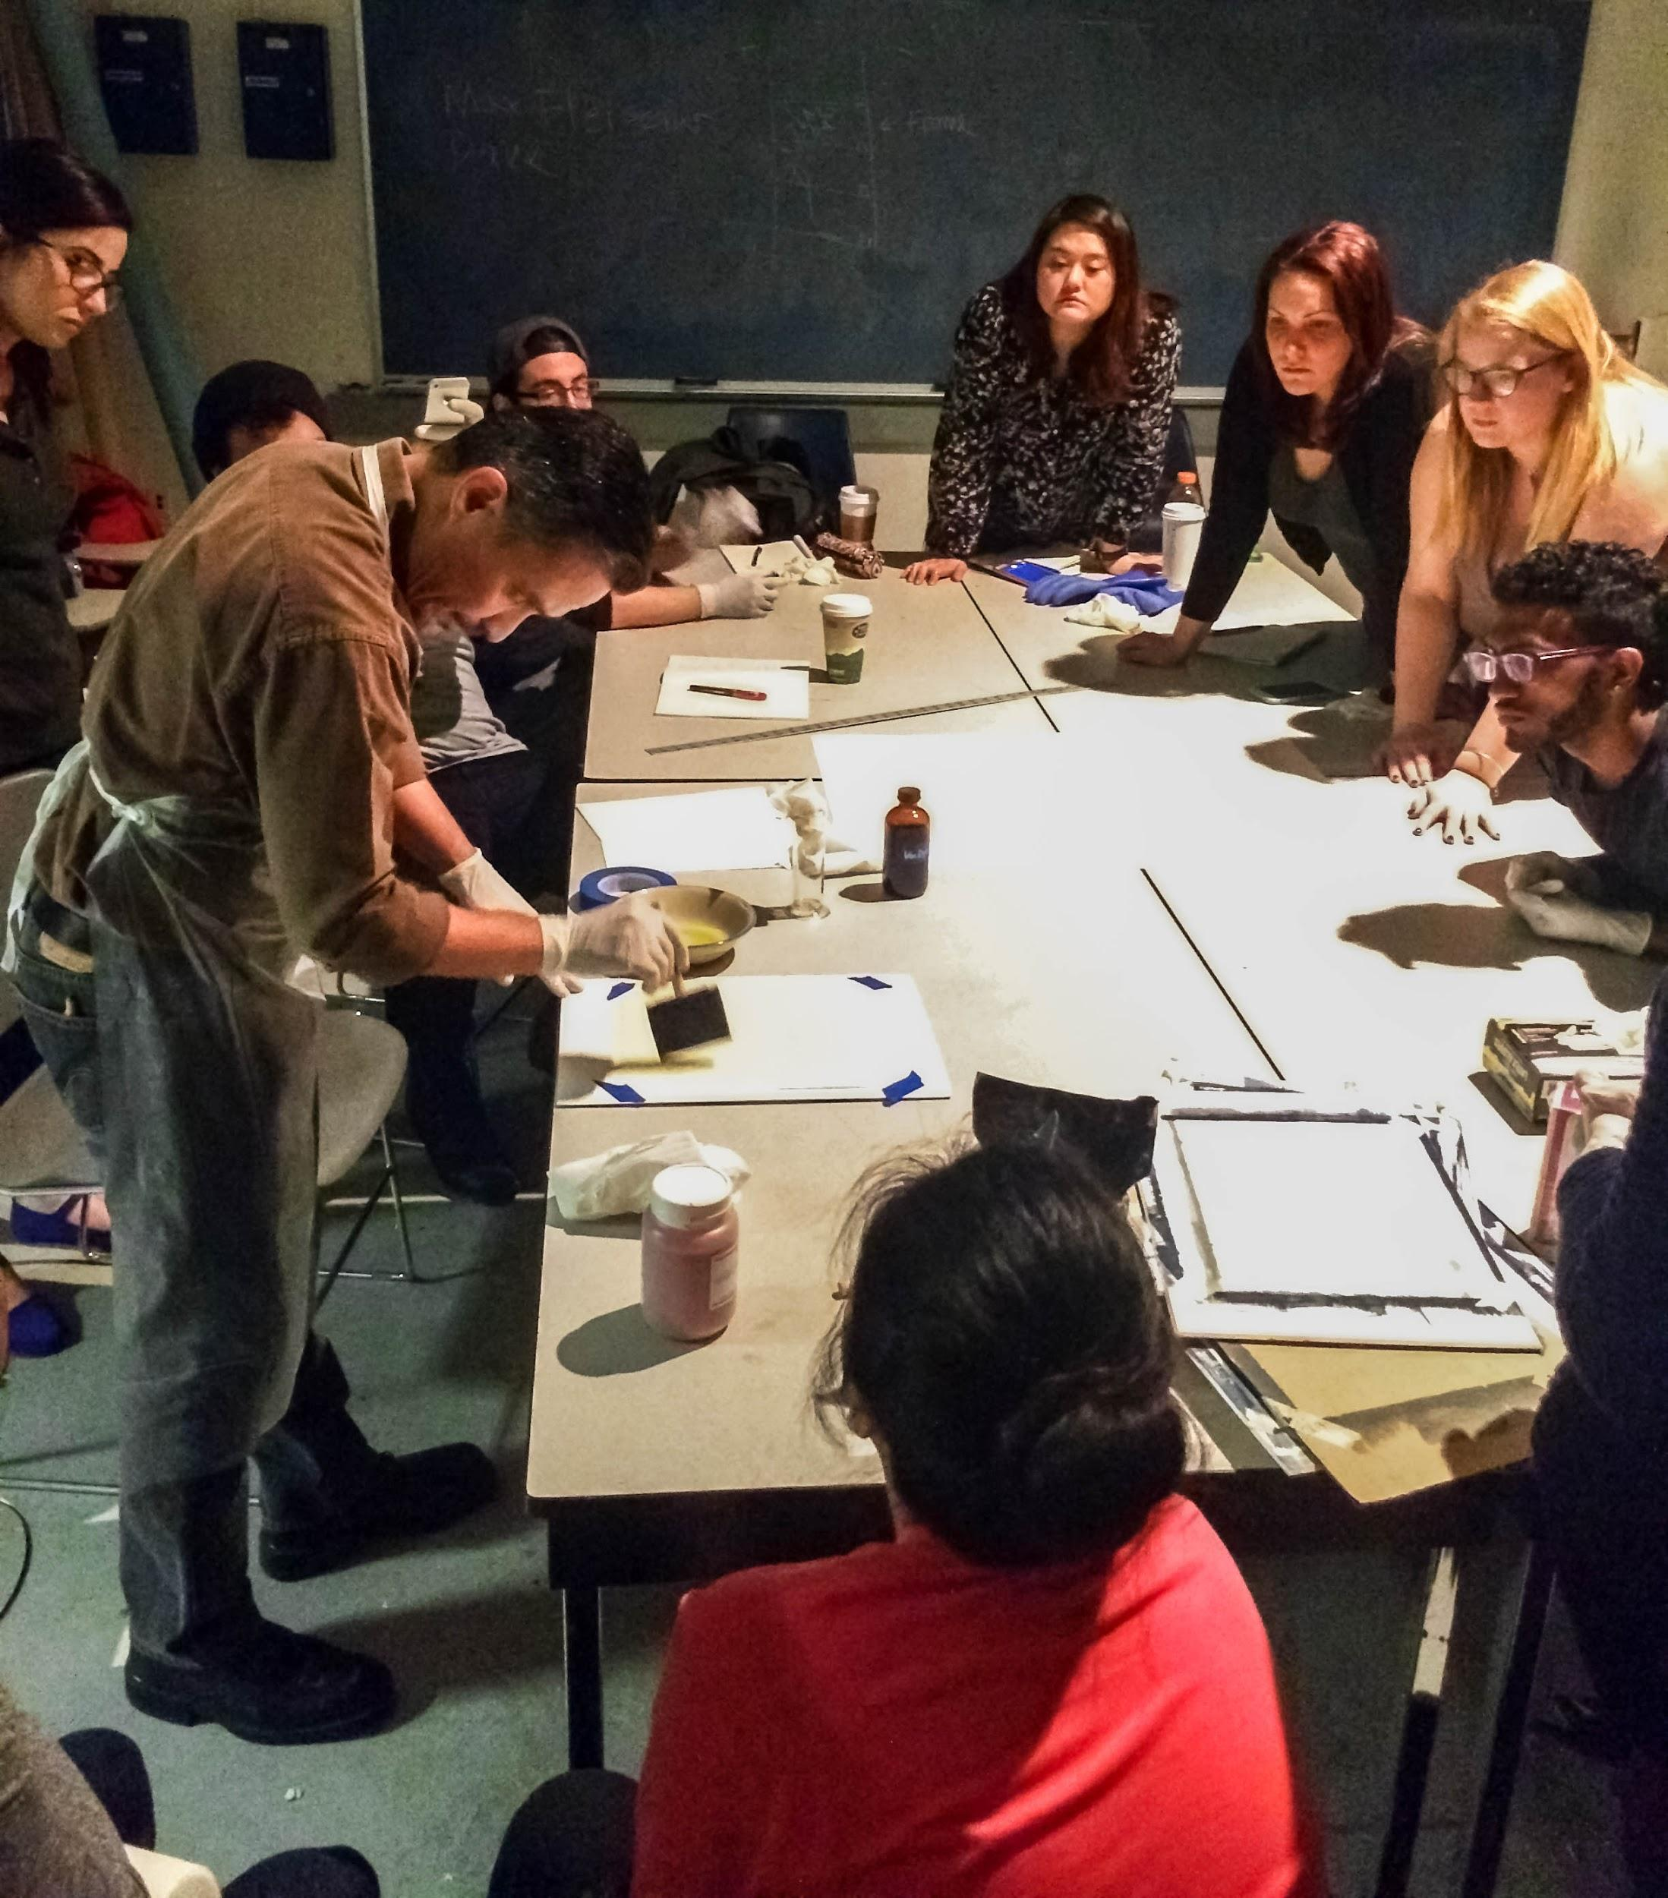
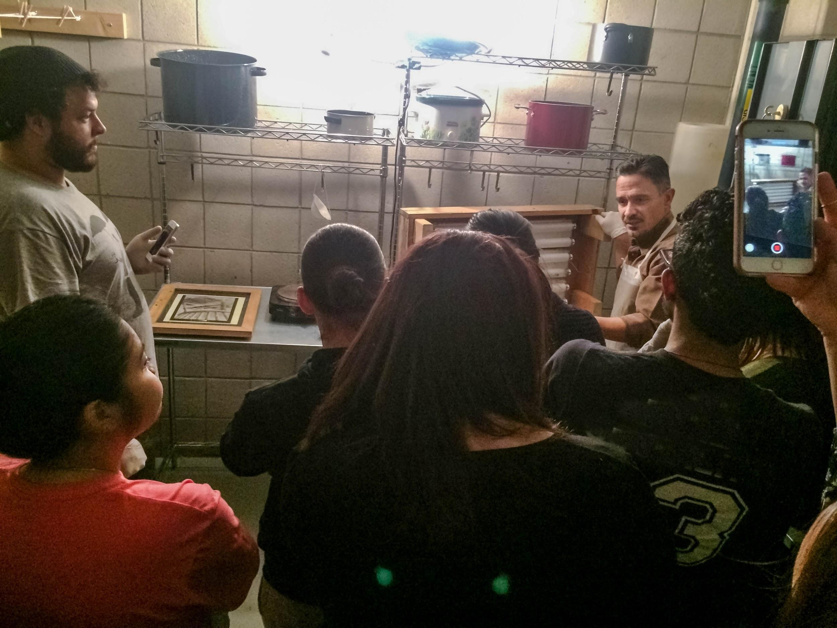
Photography & Imaging Majors
at work in
Prof. Tony Gonzalez full color digital gum bichromate alternative process course

Slide 20
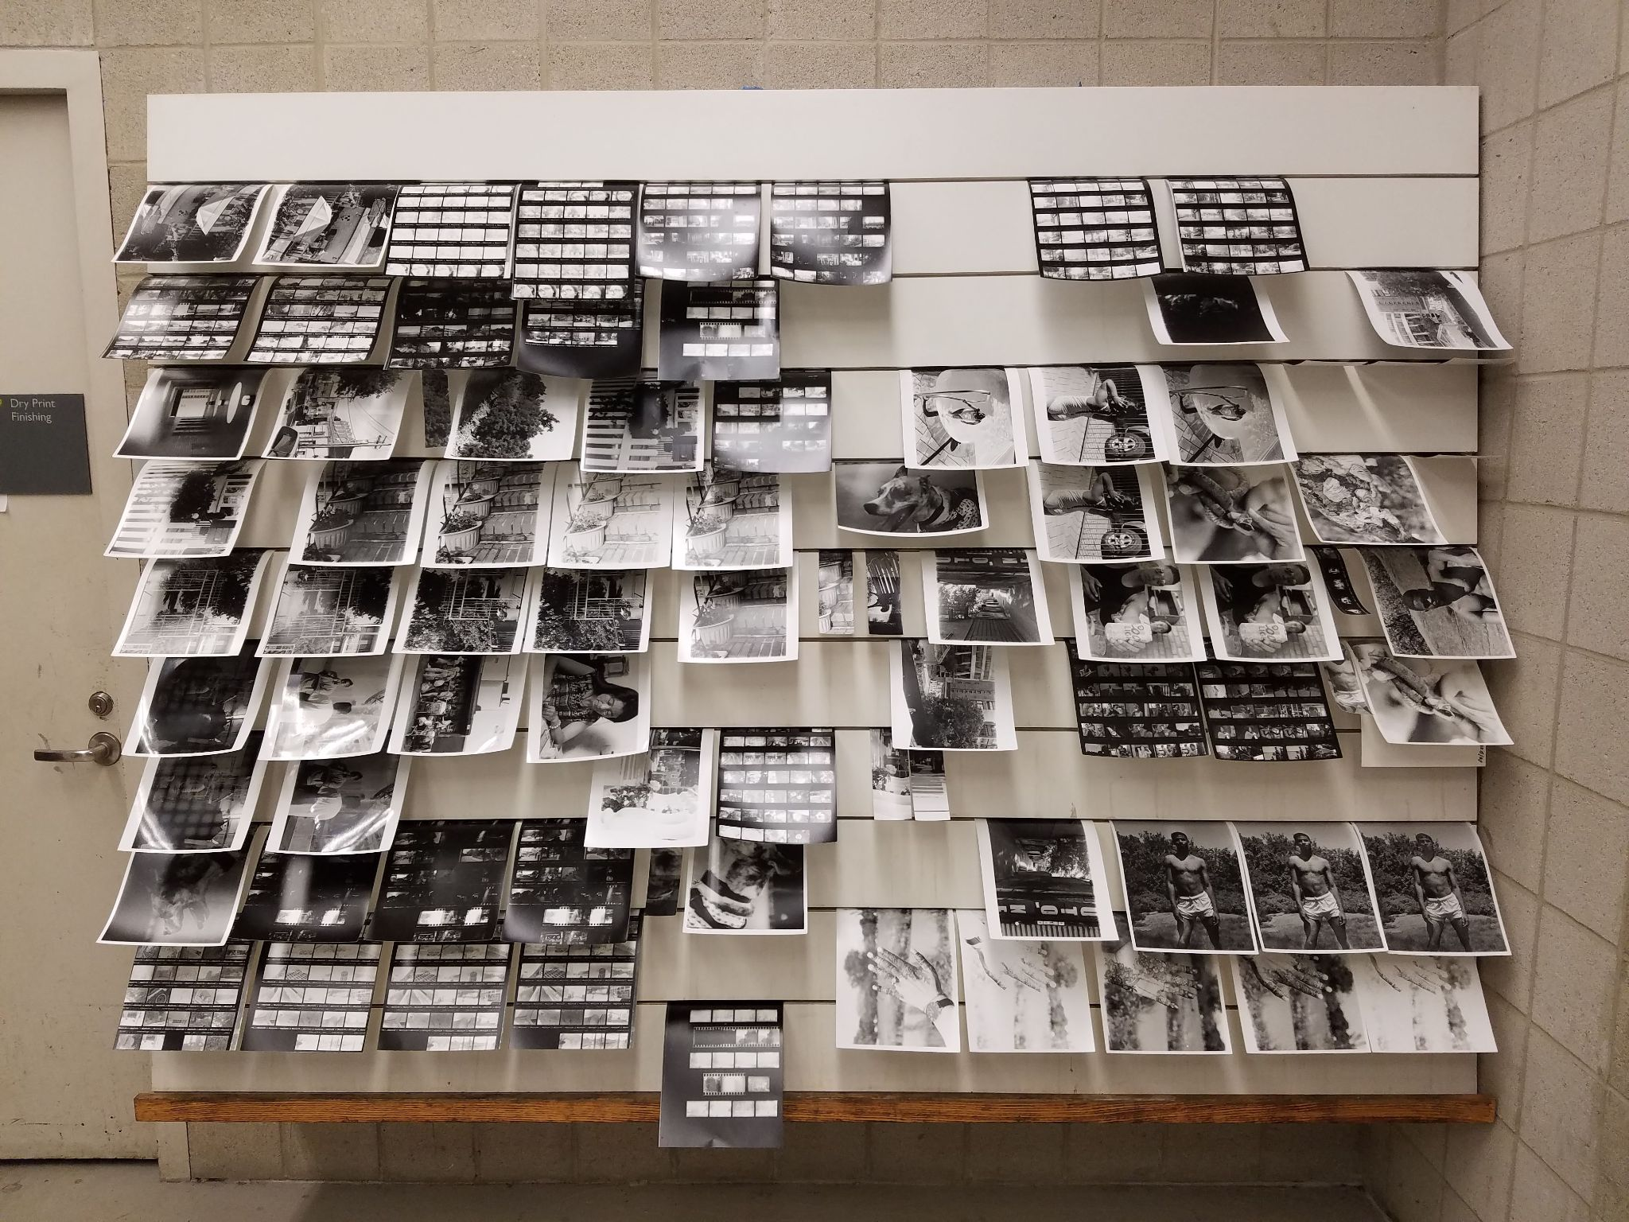
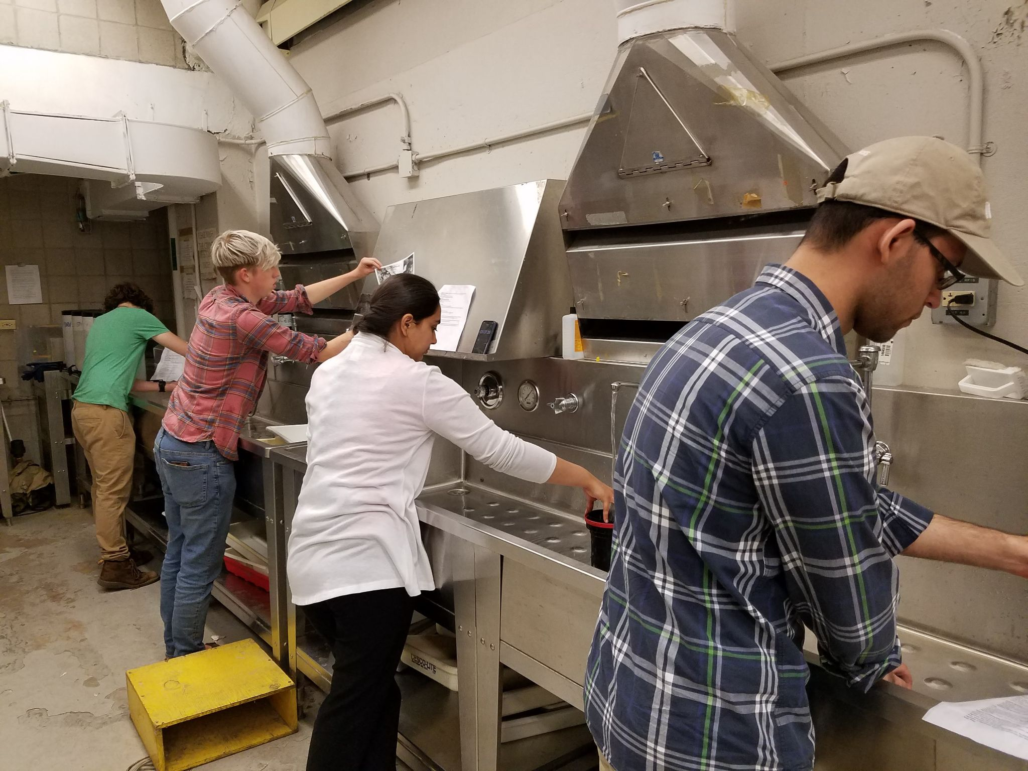
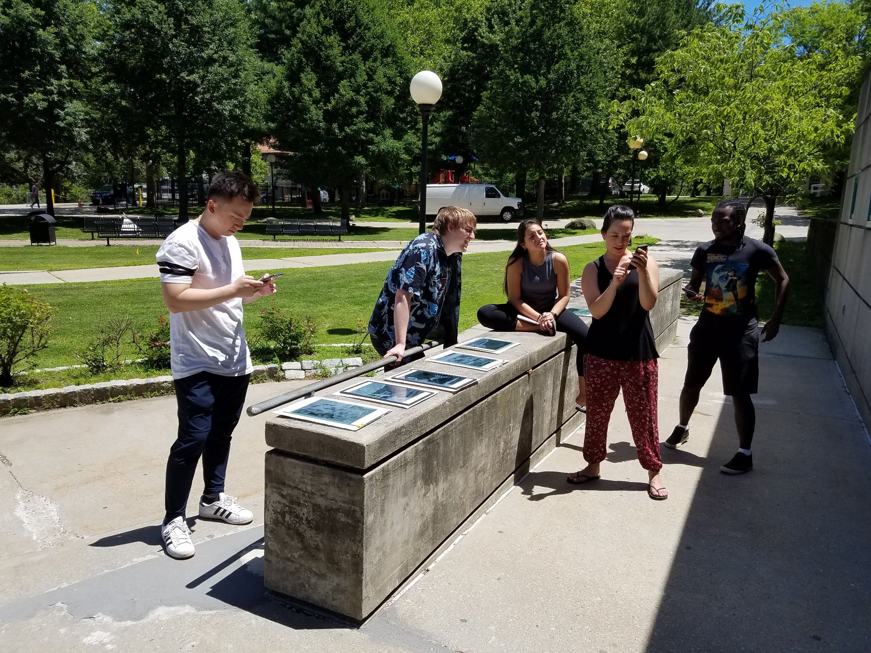
Photography & Imaging students at work in the darkroom and outside making cyanotypes

Slide 21
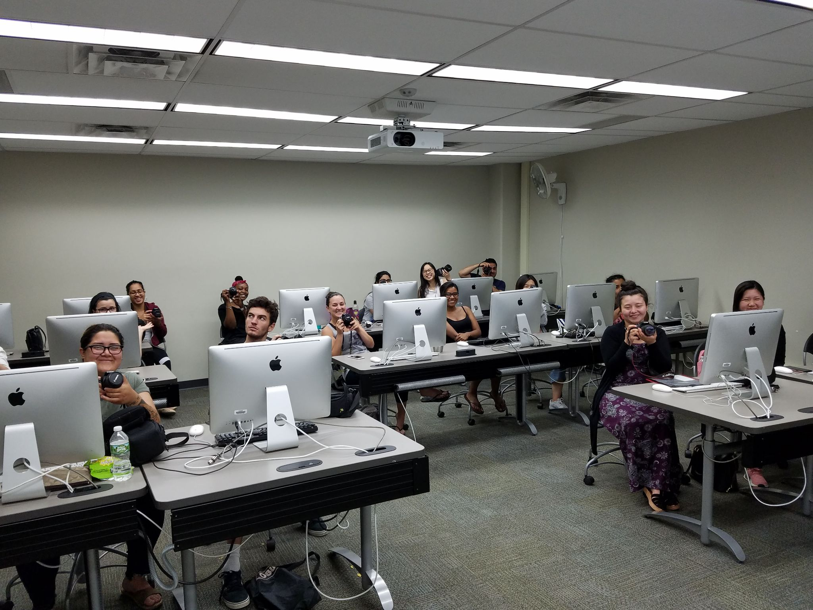
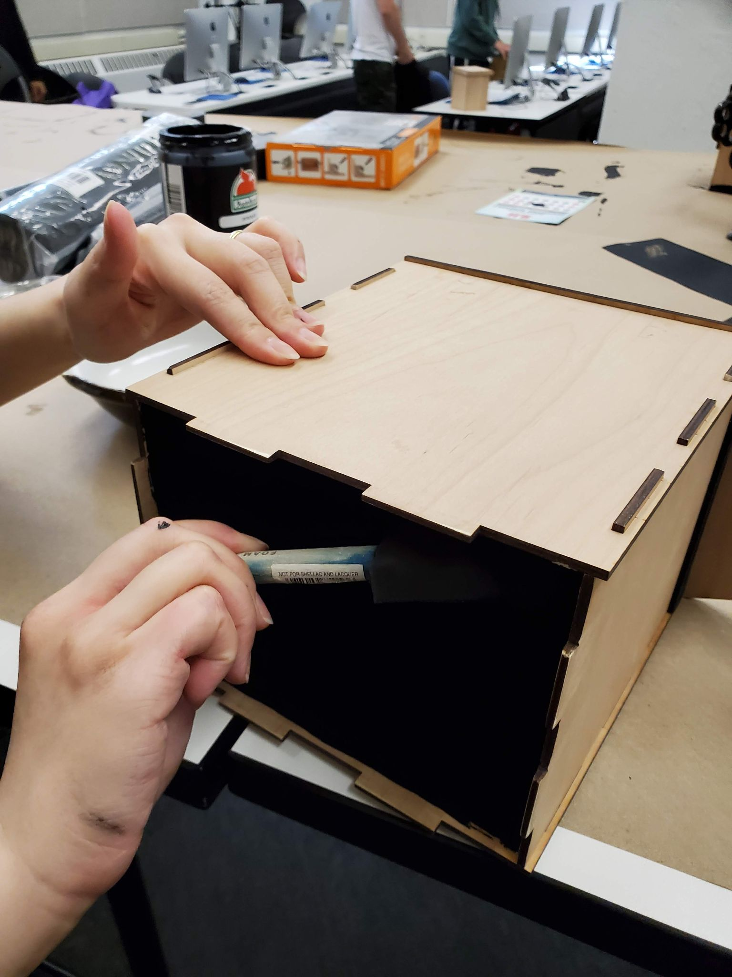
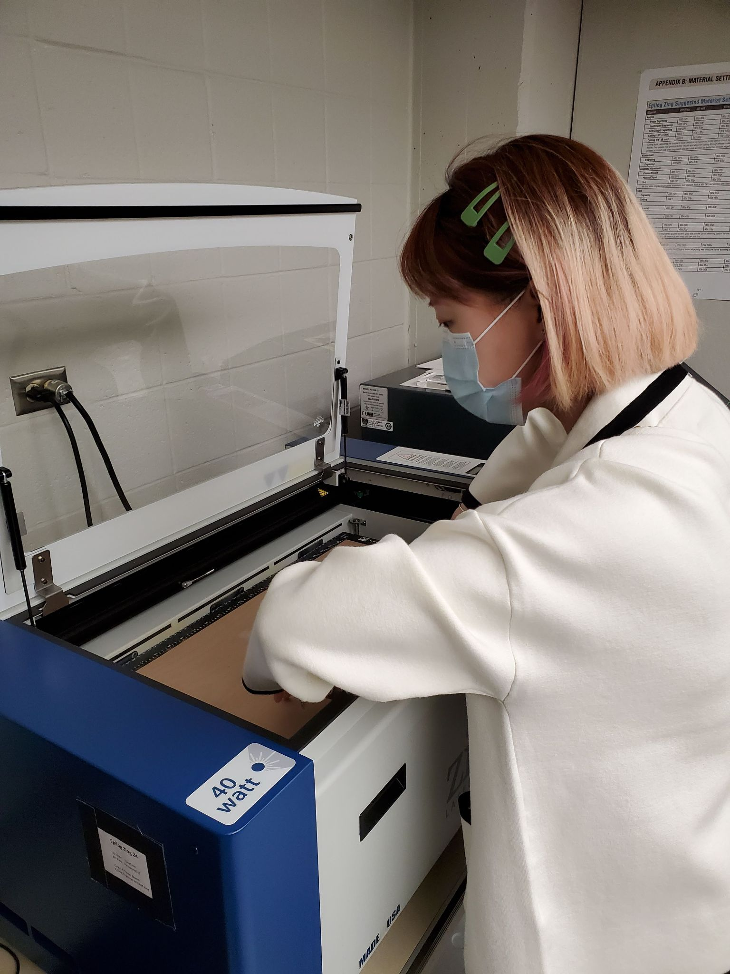
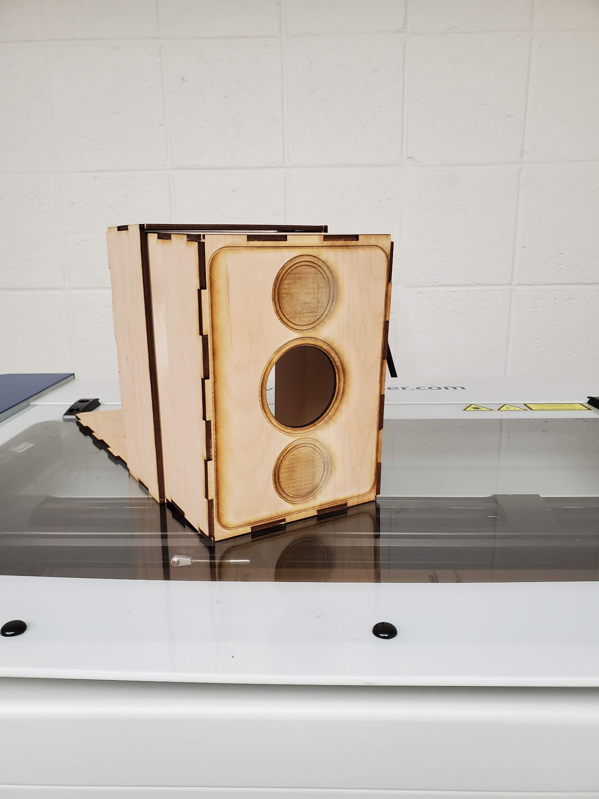
Photography & Imaging Majors at work in one of our computer labs - designing and fabricating their own digital pinhole cameras using a laser cutter amongst other new technology.

Slide 22
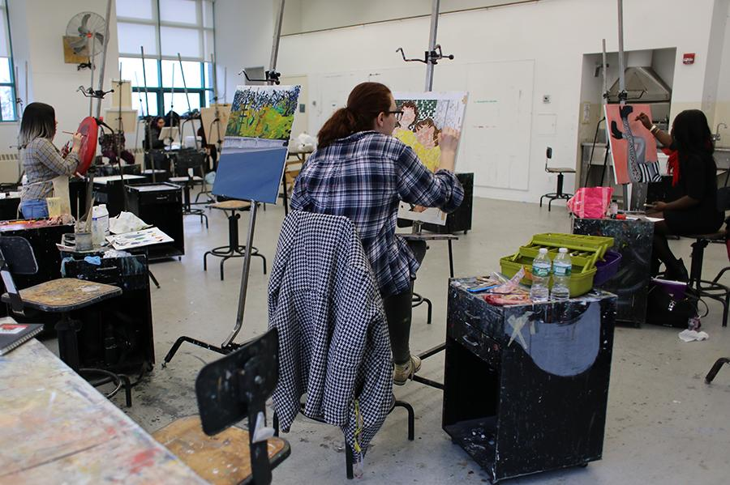
Painting studio

Slide 23
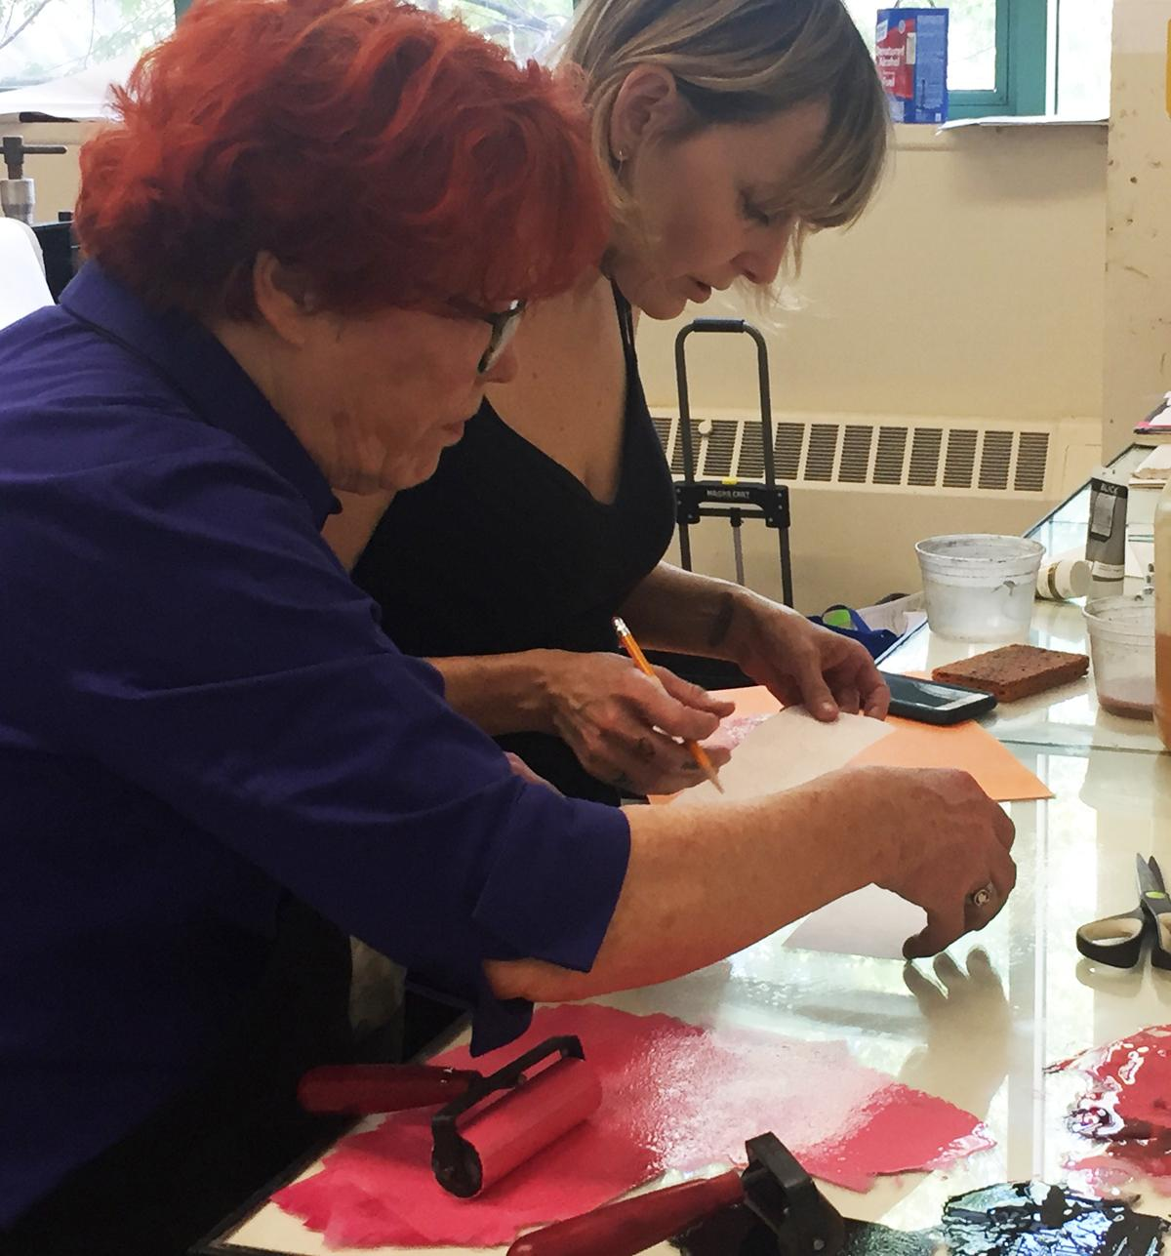
Printmaking Studio

Slide 24
Digital Imaging & Digital Fabrication Labs
Queens College also has a Makerspace located
in the Rosenthal Library and open to all students.

Slide 25
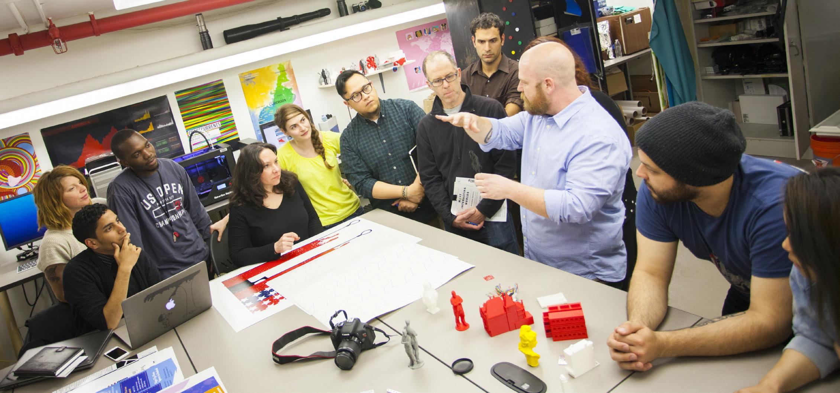
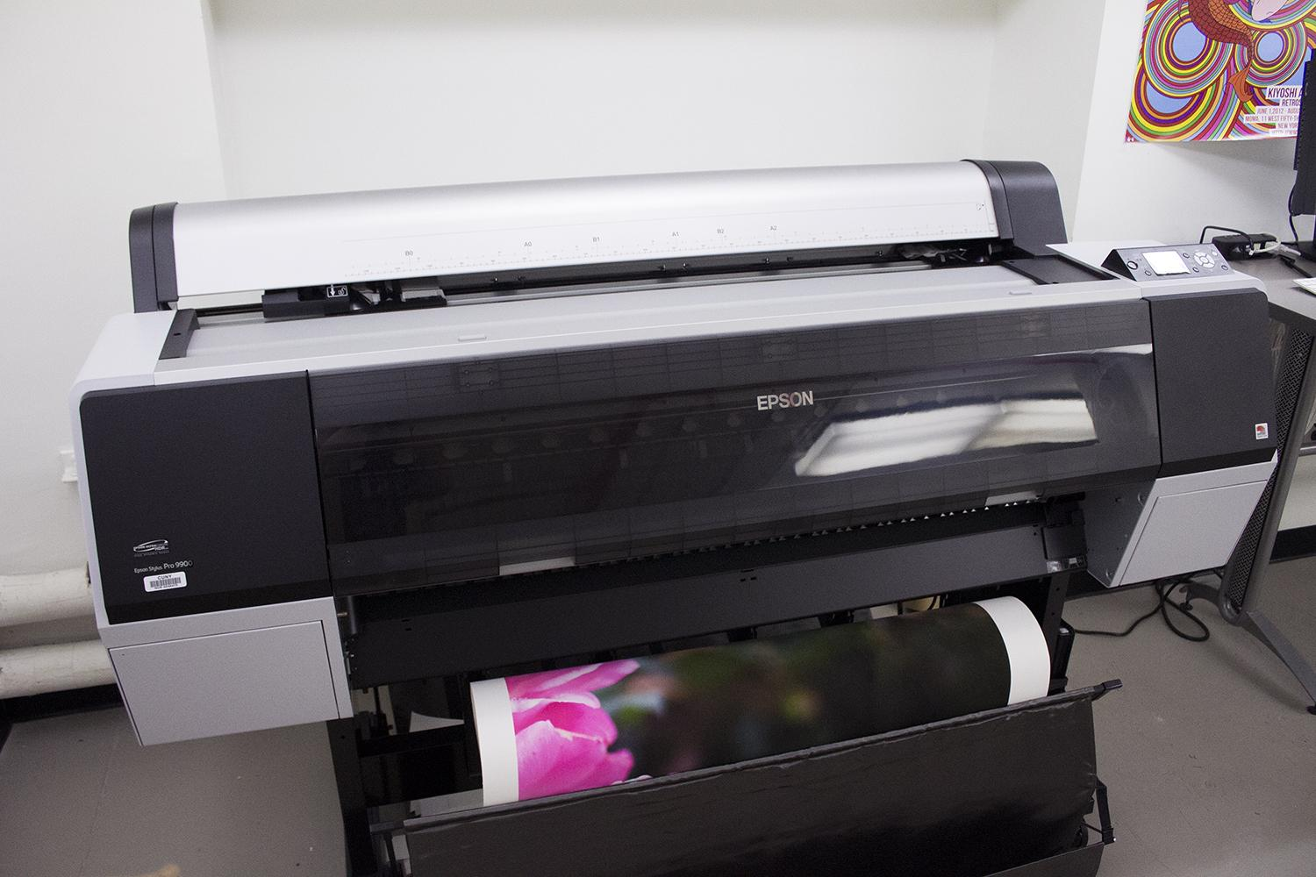
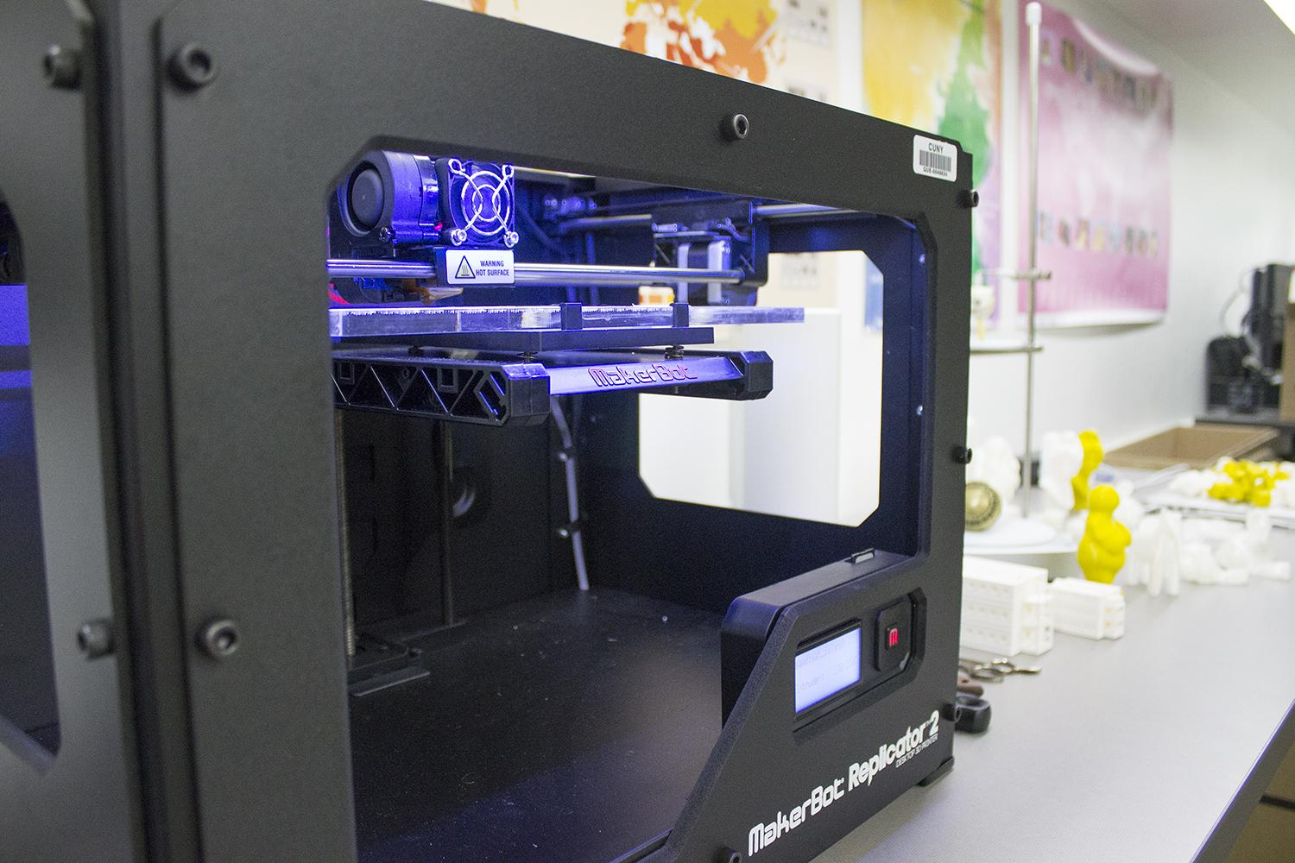
Klapper Digital Imaging Lab

Slide 26
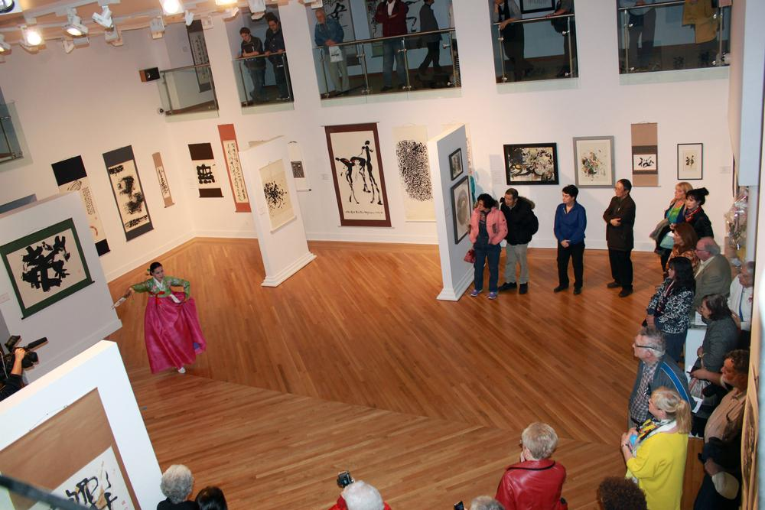
Performance at the
Godwin-Ternbach Museum
Klapper Hall

Slide 27
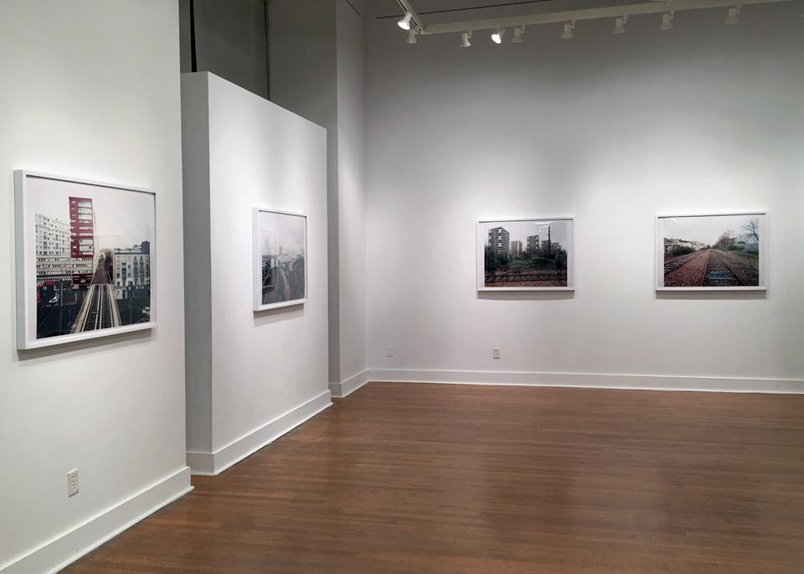
Klapper Hall Art Gallery

Slide 28
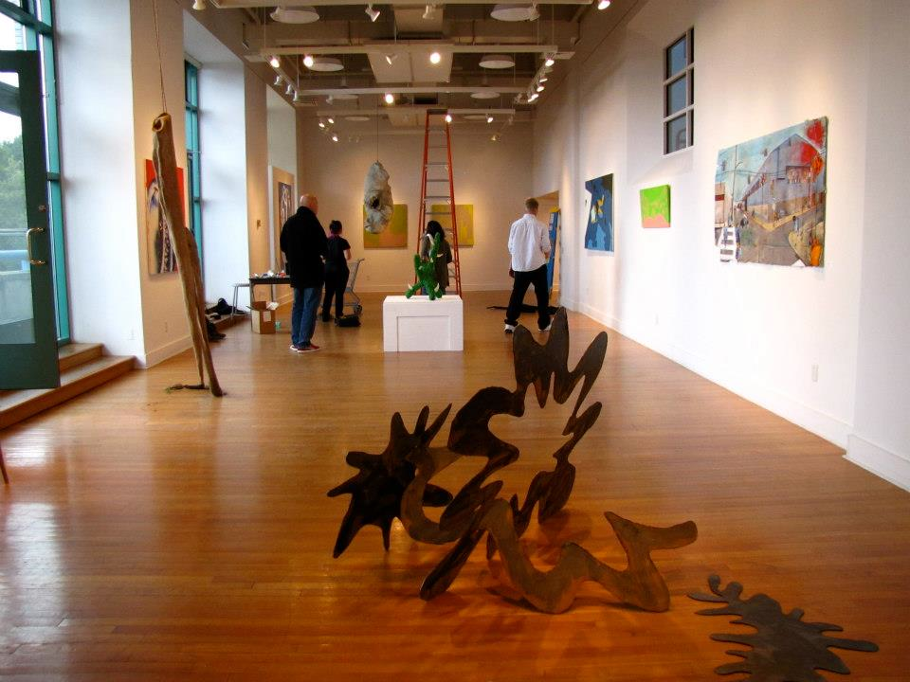
Klapper Hall Art Gallery

Slide 29
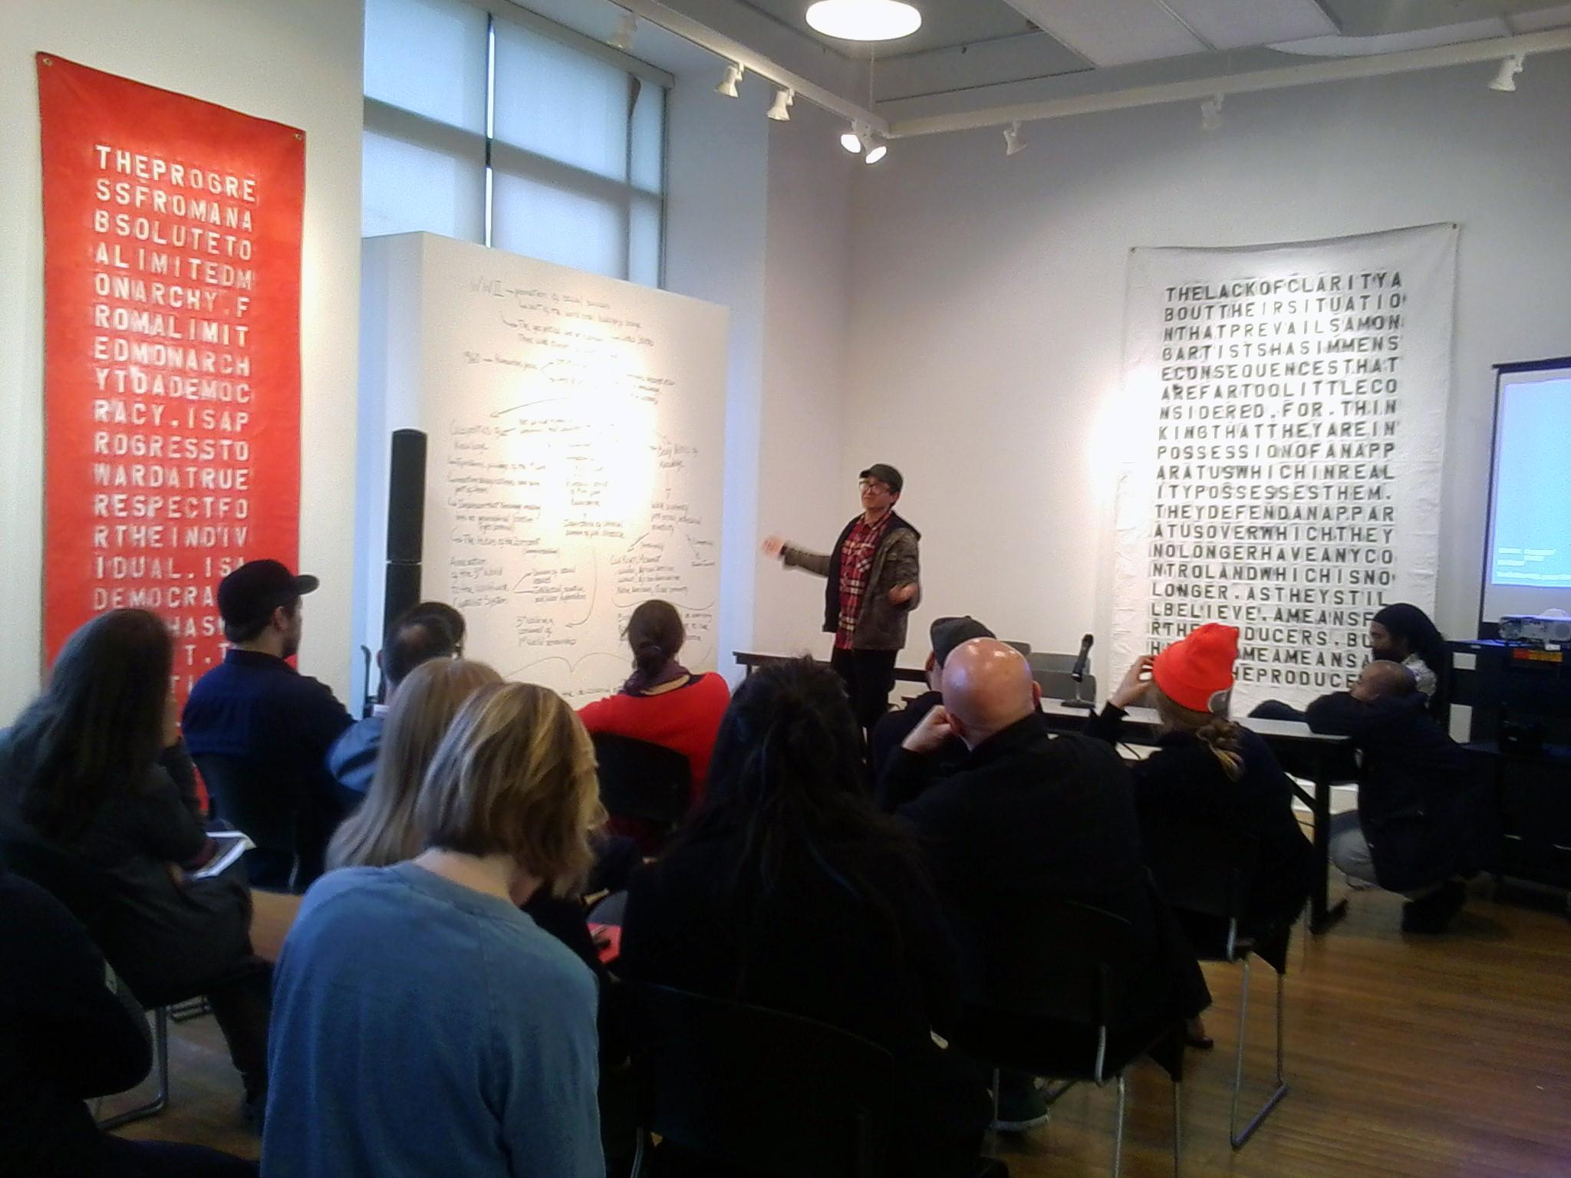
Klapper Hall Art Gallery

Slide 30
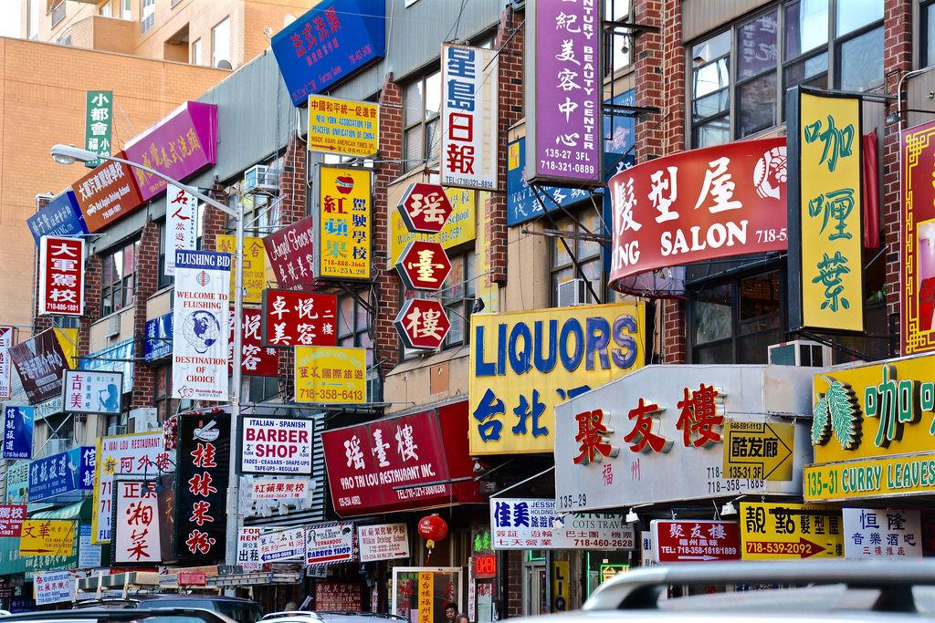
Flushing Queens, NYC

Slide 31
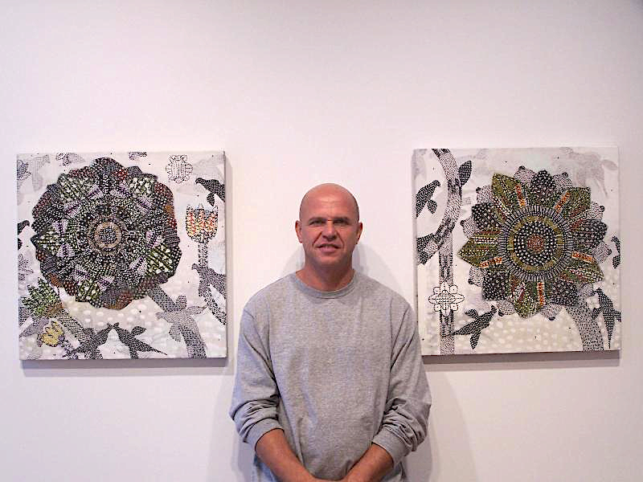
Professor Glenn Goldberg

Slide 32
Professor Chloë Bass

Slide 33
Professor Kurt Kauper

Slide 34
Professor
Debra Priestly

Slide 35
Professor Tyrone Mitchell

Slide 36
Professor Tony Gonzalez
Professor
Tony Gonzalez

Slide 37
Professor Sin-Ying Ho

Slide 38
Professor Matt Greco

Slide 39
Professor Michael Nelson

Slide 40
Professor
Warren Woodfin

Slide 41
Professor Lawrence Waldron

Slide 42
Professor Edward Powers

Slide 43
Social Practice Queens (SPQ)

Slide 45
For academic year 2022-2023
Undergraduate tuition & fees at Queens College CUNY:
$7,538 for New York residents
$15,488 for out-of-state students
MAJORS:
- Studio Art BFA (72 Credits)
- Photography & Imaging BFA (63 Credits)
- Design BFA (63 Credits)
- Art History BA
- Art Education
MFA Studio Art
MA Art History
Post Cert in Social Practice
OFFICE INFORMATION
Klapper Hall Rm. 172
Phone: (718) 997-4800
Fax: (718) 997-4835
To contact, email art@qc.cuny.edu
https://www.qc.cuny.edu
http://art.qc.cuny.edu/
http://www.socialpracticequeens.org/

