Slide 1
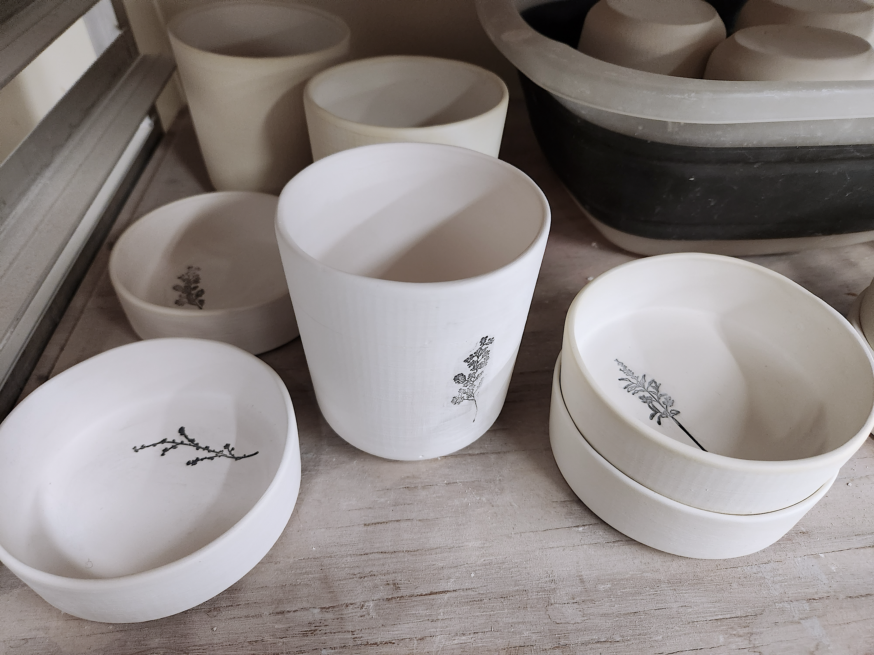
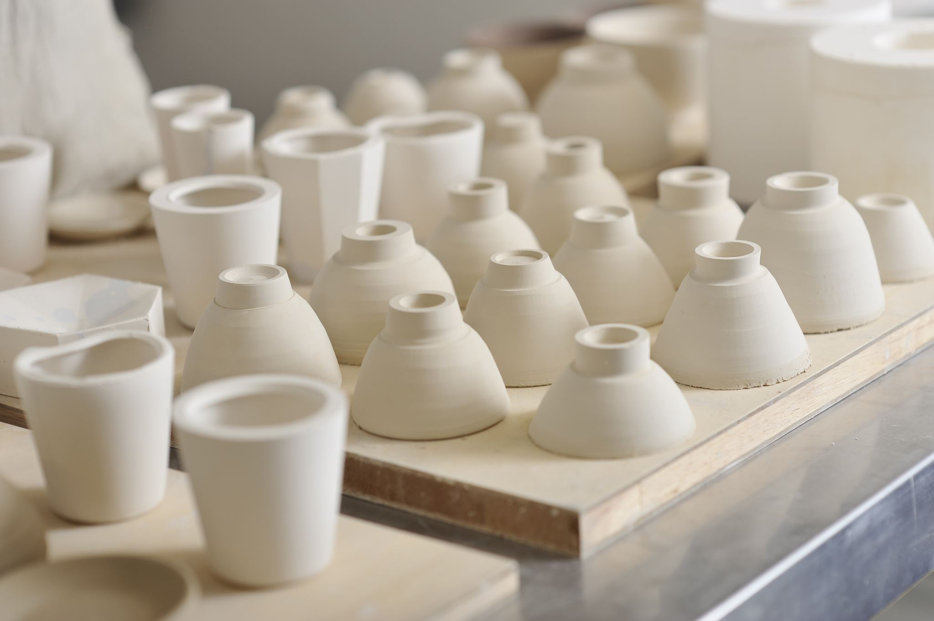
Ceramic Basics

Slide 2
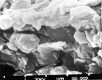
What is Clay?
Clay is a fine-grained natural rock or soil material that combines one or more clay minerals with traces of metal oxides and organic matter.

Slide 3
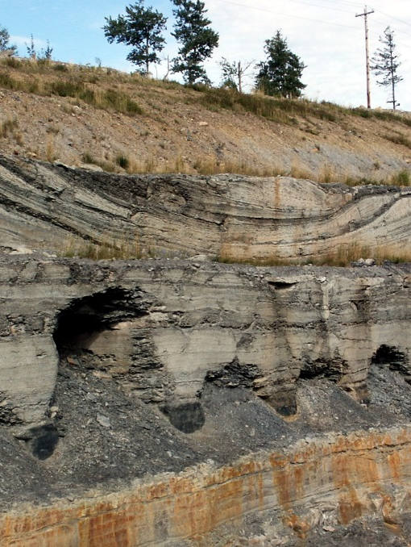
How is it Made?
Clay is made through natural processes of erosion and weathering of rocks. Different clays come from the erosion of different types of rocks.

Slide 4
Why is Clay Unique?
Unlike mud or sand clay is unique in its physical properties. Clay is malleable (which means you can squish and squeeze it into a shape, and it will retain that shape) because of its ability to retain water. In ceramics we call this property of clay “plastic.”
When clay is subjected to heat it undergoes a physical/chemical change that hardens the clay into “ceramic,” when clay has become hardened by heat, we call it “fired.”
This ability of clay to be plastic when wet and be hardened by fire is one of the unique aspects of clay.

Slide 5
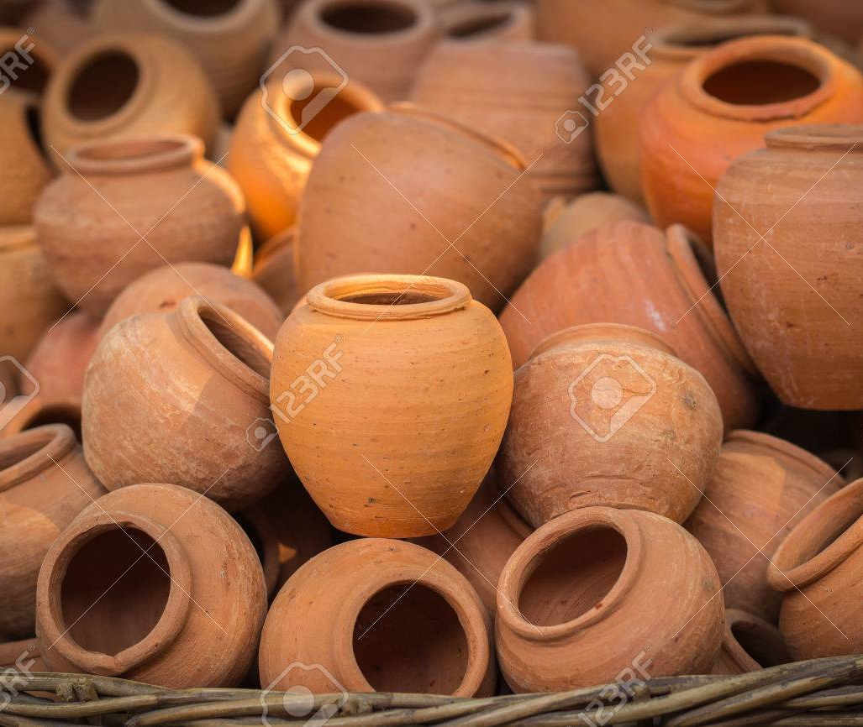
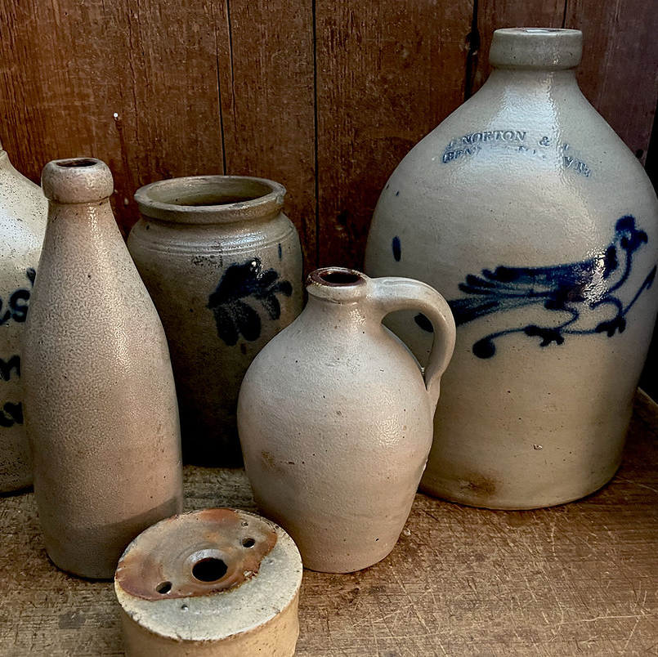
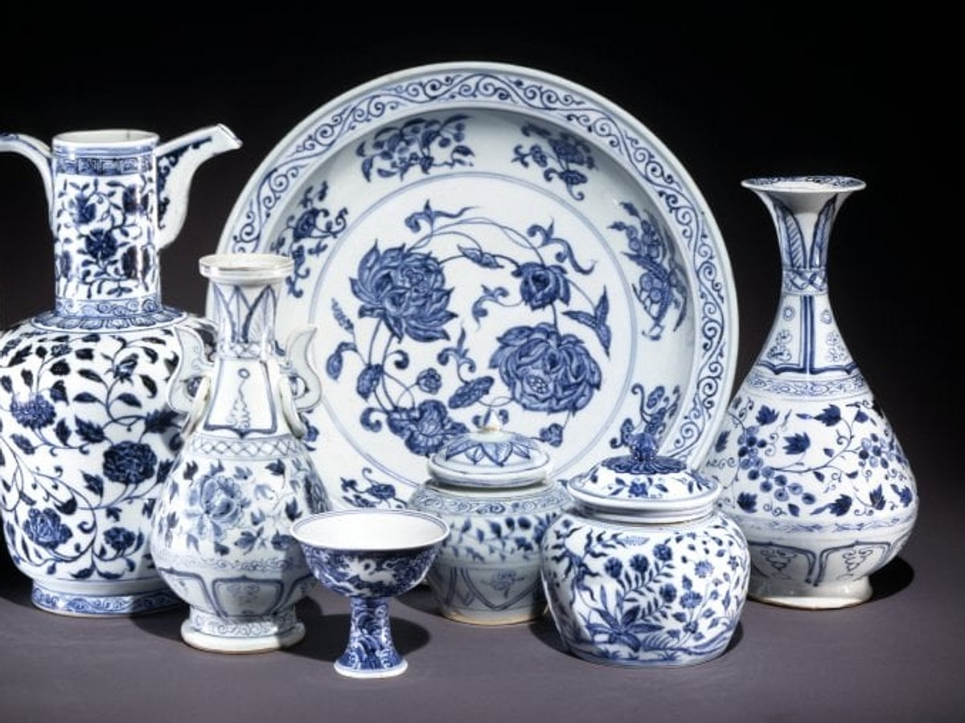
Types of Clays
There are many
scientific categories for
clay (kaolinite,
montmorillonite,
smectite, illite) but for
our purposes there
are fewer and more
broad categories:
-Earthenware
-Stoneware
-Porcelain

Slide 6
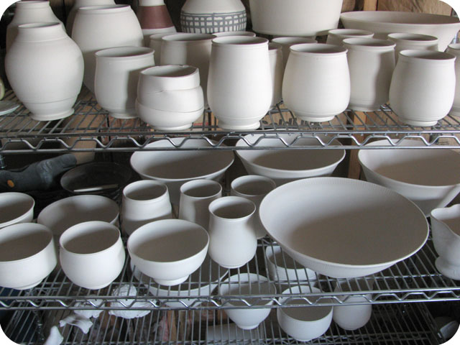
States of Clay
Clay has a few different stages it goes through before it becomes a final finished fired piece of ceramics. It is critical that the stages be followed in the correct order:
Greenware:
- Green (wet)
- Leather Hard
- Bone Dry
Bisqueware (first firing)
Glazeware (second firing)

Slide 7
States of Clay
Bisqueware:
Fired to a lower temp then glaze firing, less brittle then greenware, still porous
Glazeware:
Fired to top temp, vitrified (most dense), nonporous, glassy, colored finish. Glaze colors come from chemical reactions not pigments.
Green/Red – copper
Blue – cobalt
Yellow – rutile
Red Brown/Black – iron oxide
Glaze can be applied by brushing, dipping, or spraying.
“When applying glaze you’re either puttin’ it on or takin’ it off”

Slide 8
Cone Temps
In ceramic work it is critical that clay be fired to the correct temperature in a kiln. Those temperatures are determined by the clay body and/or the glaze. Close attention needs to be paid to the clay bodies cone and the glaze cone. Firing at the wrong temp (too high or too low) will cause the firing to fail.
Cone temps are divided into 3 main categories:
-Low fire (cone 04-05)
-Mid range (cone 6)
-High fire (cone 9-10)
For ease-of-use temperatures in ceramics are described by a cone number. Cone numbers can be translated to temperature using a cone chart.

Slide 9
Cone Chart

Slide 10
Cone Temps
Clay wants to be fired to its top temperature which will make it “vitrified” and therefore most dense and durable. Glaze wants to be fired to the precise temperature so that the chemicals in the glaze react appropriately.
Be aware of the cone number of your clay which signifies its top temperature. In this course we are using a cone 10 porcelain.
You can fire clay to a lower temp but NEVER a higher temp - then it is designed for.
Glazes need to be fired to a precise temperature.

Slide 11
Our Course
Cone 10 Porcelain Slip:
Bisque fire to cone 04-05
Can use any glaze
PAY ATTENTION TO THE CONE NUMBER OF GLAZE USED!
Glaze fire to the correct cone number for that glaze
DO NOT GLAZE BOTTOM
Ware that is ready for firing must be put on correct rack.
DOUBLE CHECK TO AVOID DISASTER!

