Slide 1

What in the
Tamagatchi
Is 3D Printing!?

Slide 2
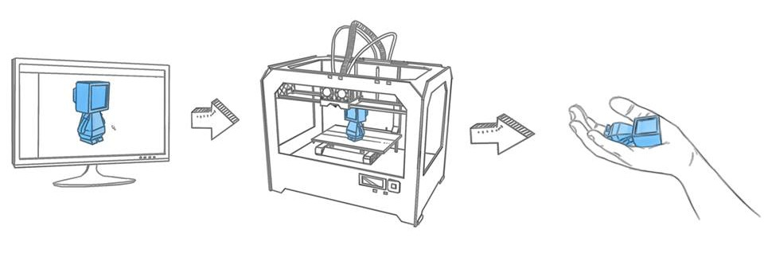
3D printing is an additive manufacturing process that creates 3-dimensional objects from 3-dimensional digital information.
3-dimensional digital models are “sliced” into many 2-dimensional cross-sections that are then “printed” one on top of the other.
There are other 3D printers that are a subtractive manufacturing process (CNC, milling) but these are usually considered a separate group and are often referred to as “machining.”

Slide 3

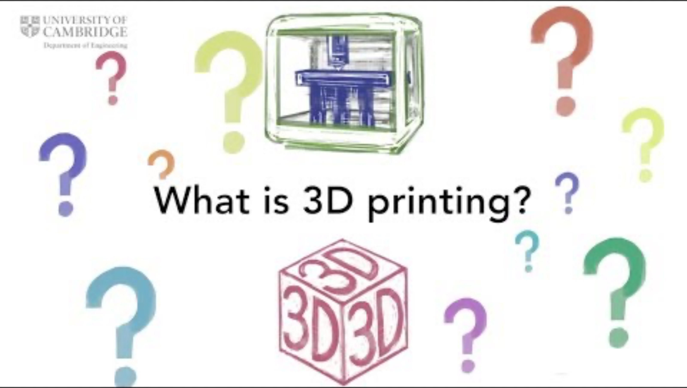
Let’s see how this all works…
https://www.youtube.com/watch?v=bcTzyx35odY

Slide 4
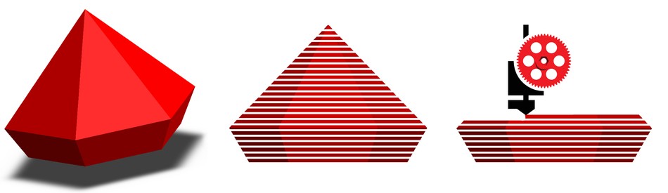
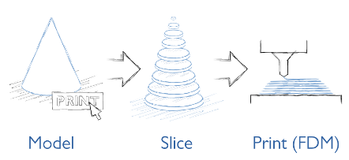
3D printing software slices the model into many “2D” cross-sections:
The 3D printer then lays down each layer in plastic to recreate the object.

Slide 5
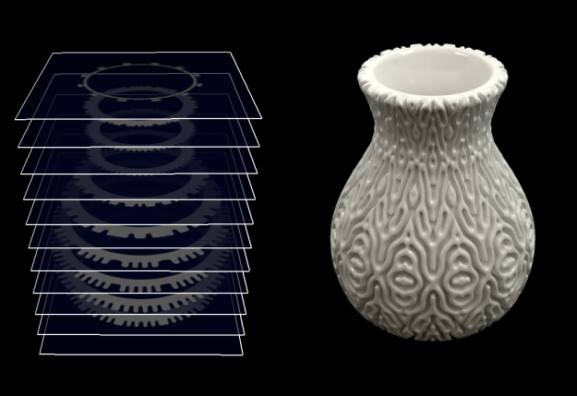

Slide 6
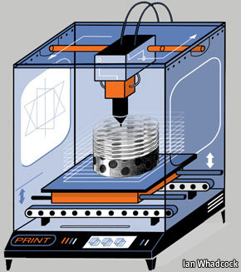
Once the 3D model is sliced the data is sent to a 3D printer which recreates the object one layer at a time, stacking consecutive layers atop one another.
The most common 3D printers (Cartesian) move along 3 axis – X,Y, and Z
X- left to right
Y- back and forth
Z - up and down

Slide 7
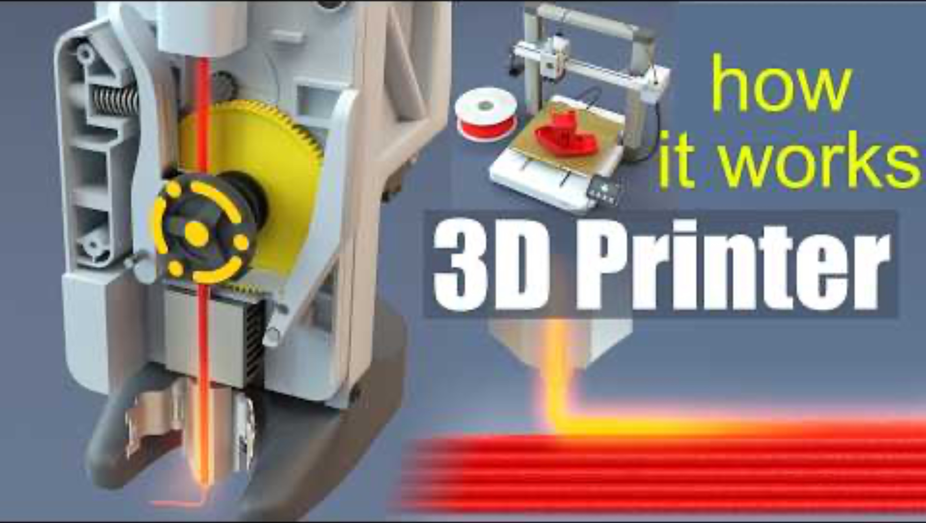
Let’s see how this all works… https://www.youtube.com/watch?v=f94CnlQ0eq4

Slide 8
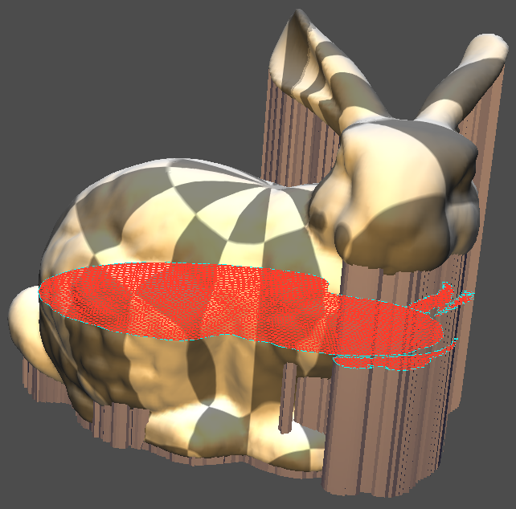

Slide 9
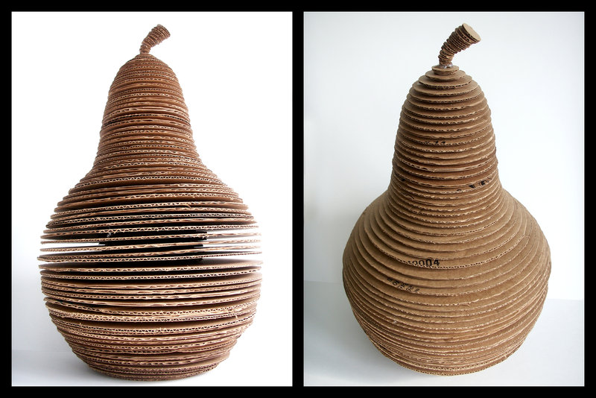

Slide 10
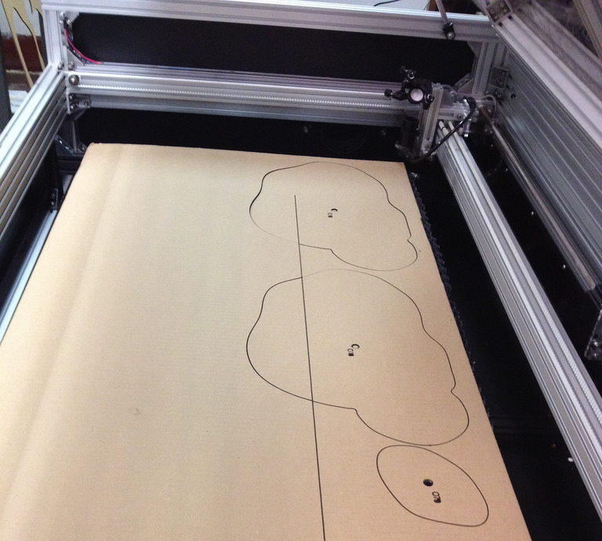
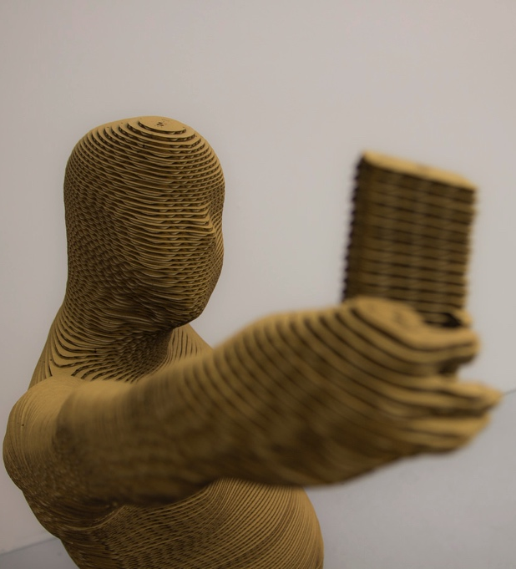
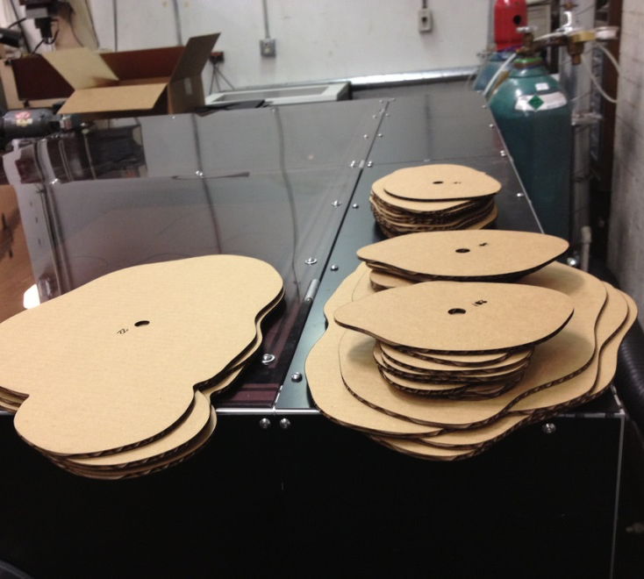

Slide 11
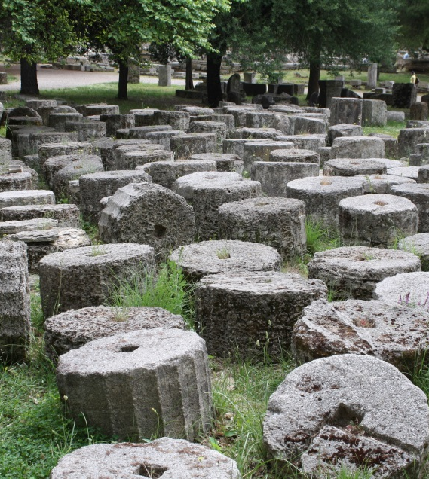
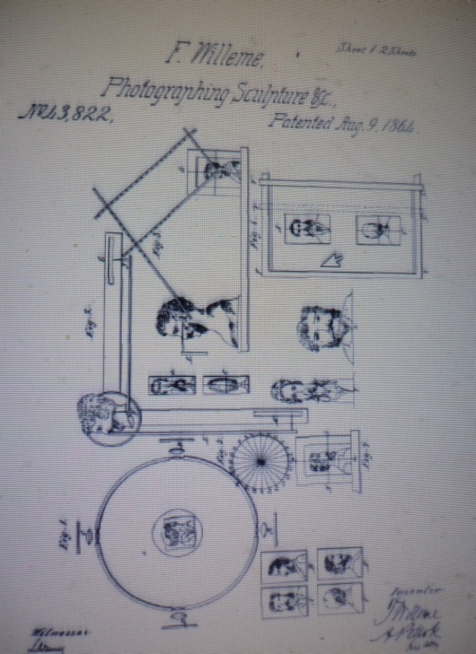
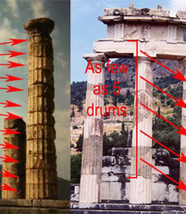
Where Did This Come From? When Was It Invented?
The “idea” of 3D printing has
existed for centuries, millennia
maybe.
If you look at how
ancient Greeks built
columns or look at
François Willème’s 1806
work on “Photosculpture”
you can see the beginnings
of the idea.

Slide 12
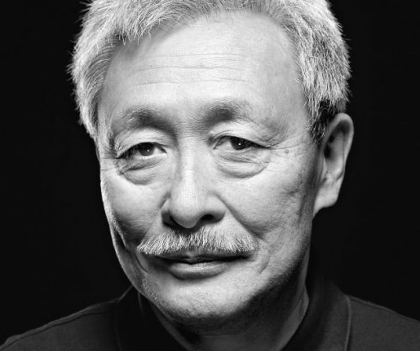
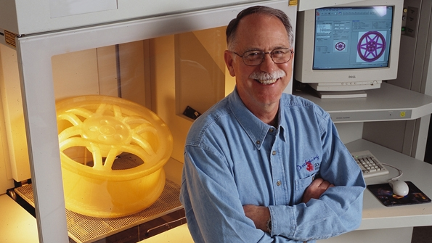
Origin Story - Heroes
1981 - Hideo Kodama of Nagoya Municipal Industrial Research Institute in Japan was first to publish paper outlining a working 3D printer.
3D printing or “rapid prototyping” is used in manufacturing to create models and prototypes quickly. Although traditional manufacturing processes, like injection molding, are cheaper per unit they are expensive and time consuming to setup (called “tooling”) and so a quick alternative was needed.
1984 – Charles “Chuck” Hull of 3D Systems develops first prototype 3D printer. He called it stereolithography and developed the STL file format widely used today.

Slide 13
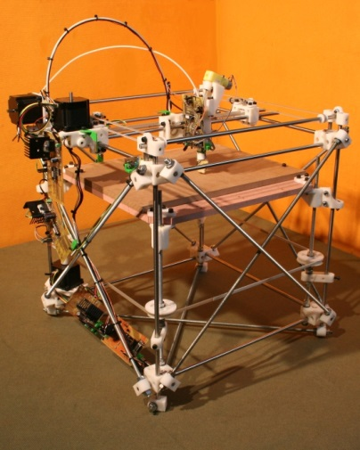
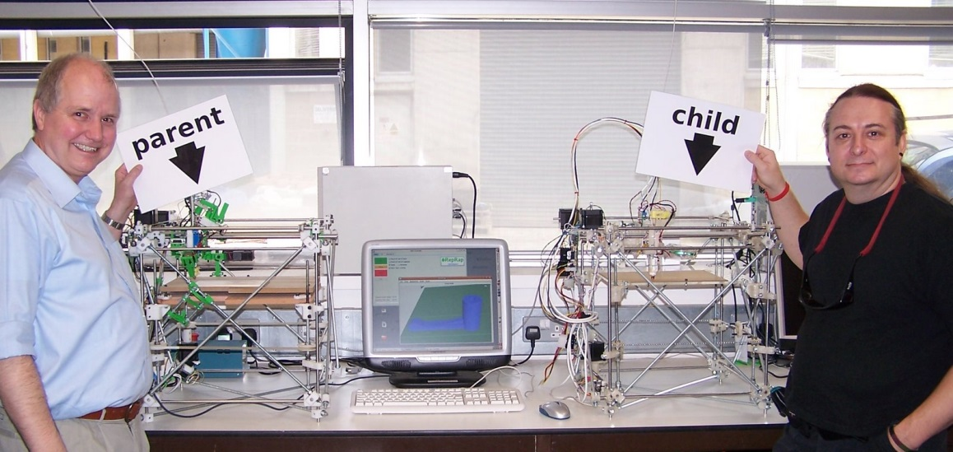
Why am I hearing so much about this lately?
RepRap Project: Adrian Bowyer
2005 - A collaborative challenge to create a self-replicating machine!
Help Us Neo!
Using 3D printed parts, other commonly found components, and open-source software a 3D printer printed itself (kinda).
Up until this point 3D printing was expensive and, for the most part, available only to the manufacturing industry.
Beside the RepRap project what else made it more available?
Cheaper tech
Patent expiration
Open-source software

Slide 14
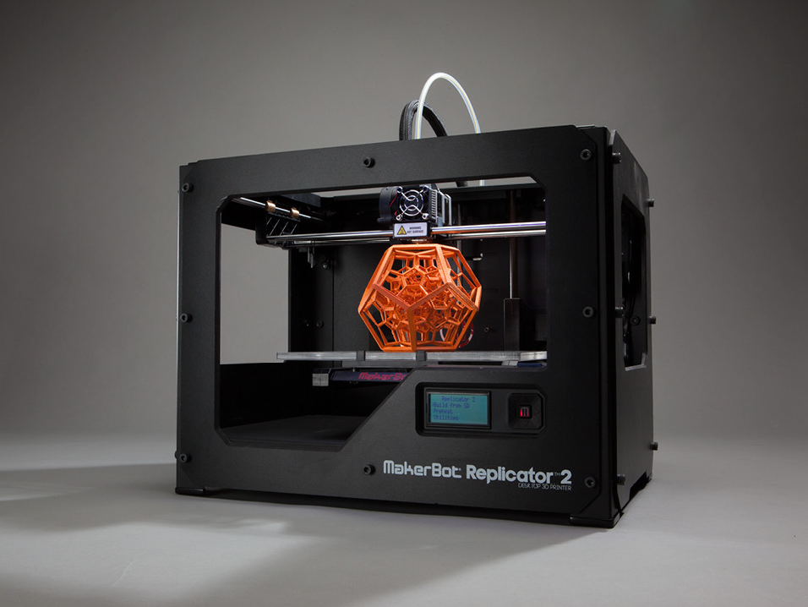
2009 -Yeah Makerbot!!! 3D Printers for Everyone!!
Building on knowledge gained from the RepRap Project.

Slide 15
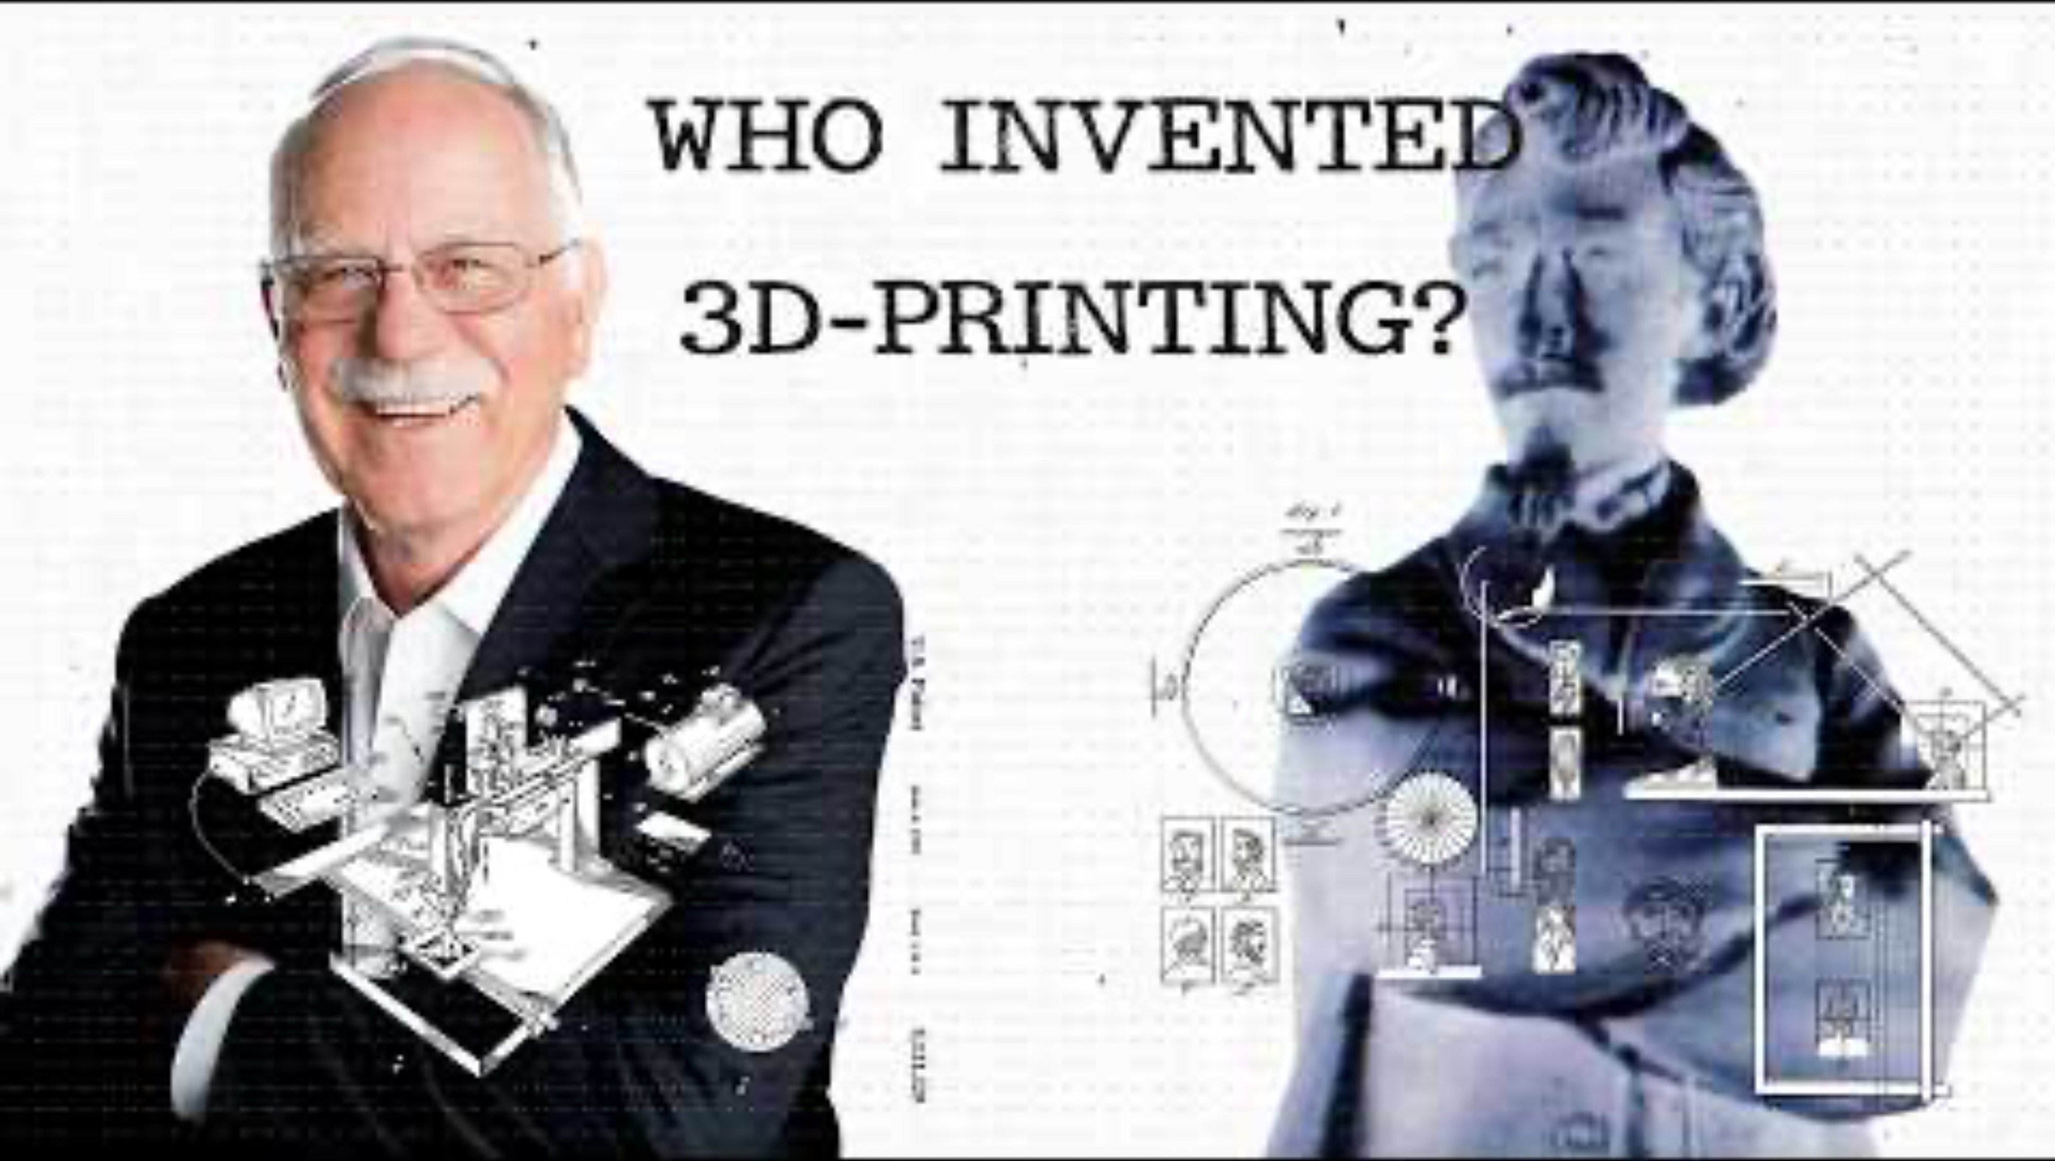
Let’s look at this more closely…
https://www.youtube.com/watch?v=pEJBXBa5m-w

Slide 16
SLA – Stereolithography UV light used to cure (harden) photosensitive resins or “photopolymers.”
FDM, FFF, PJP – Fused Deposition Modeling, Fused Filament Fabrication, Plastic Jet Printing Melted plastic filament pushed through a nozzle or “extruder.” Common plastics are ABS (acrylonitrile butadiene styrene, Legos) and PLA (polylactic acid, a bioplastic and the kind we will use in this course)
SLS - Selective Laser Sintering Powered Bed is most common, a granular bed of materials are selectively fused together by a laser. Various materials - metal alloys, metal powders, thermoplastics, and ceramic powders are available.
Variations of 3D Printing Technology

Slide 17
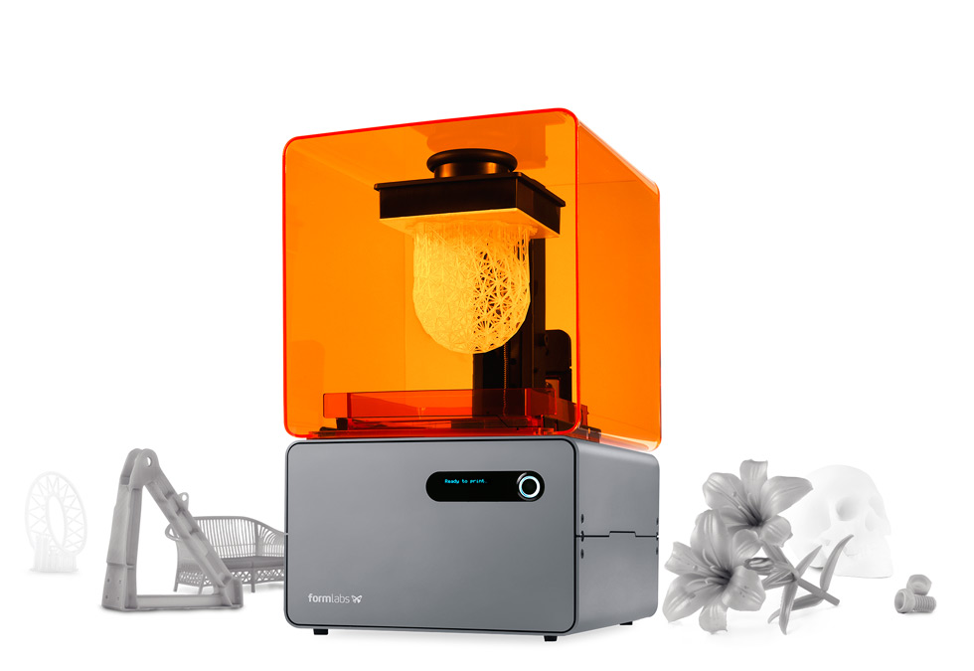
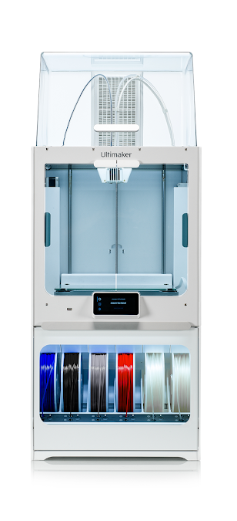
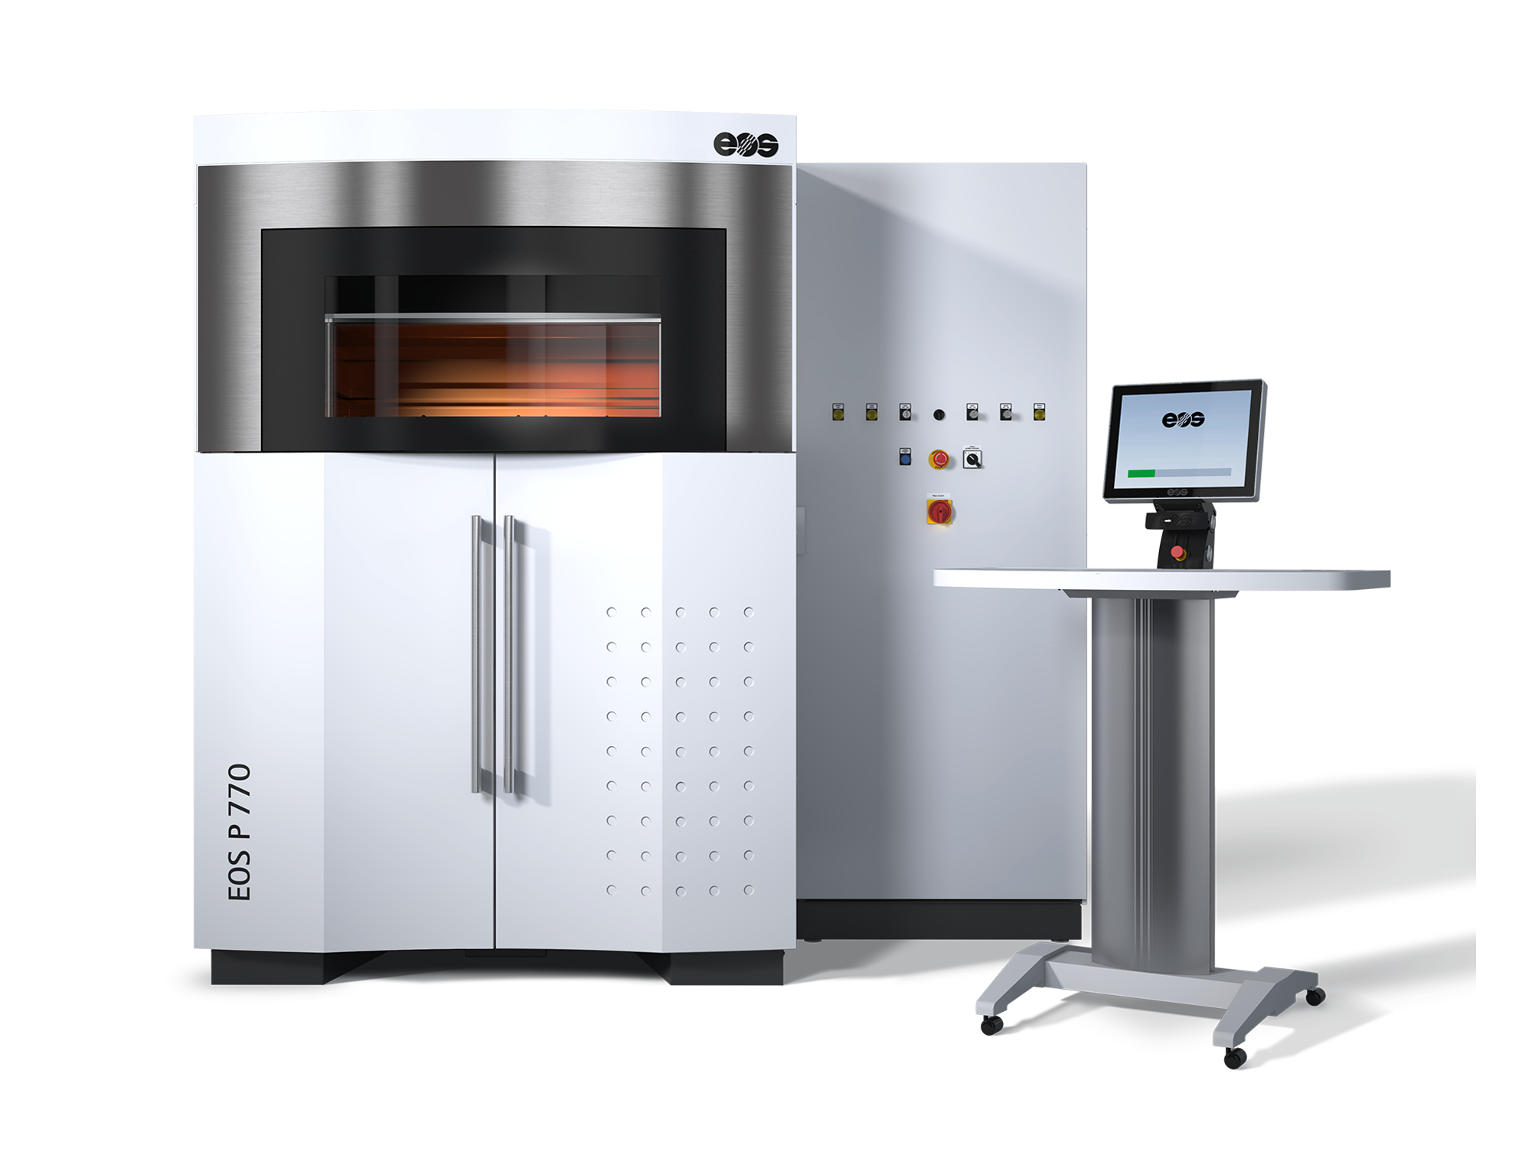
STL - Stereolithography
FDM - Fused Deposition Modeling
SLS - Selective Laser
Sintering

Slide 18
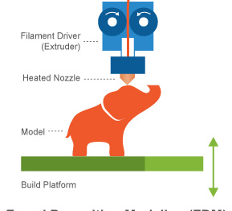
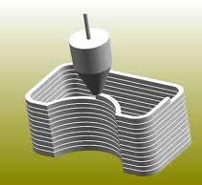
FDM - Fused Deposition Modeling

Slide 19
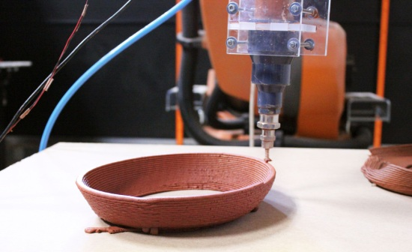

Slide 20
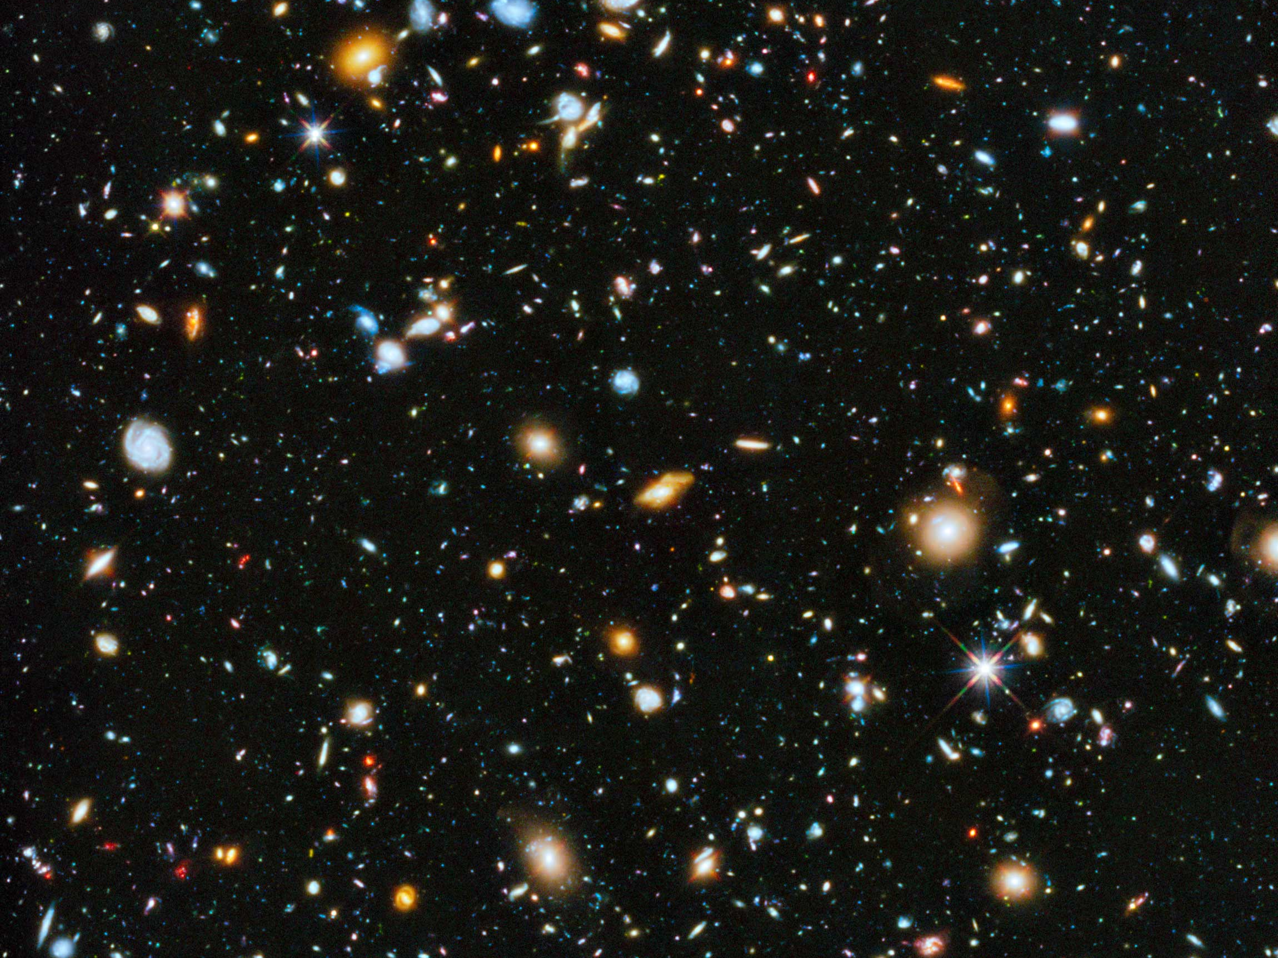
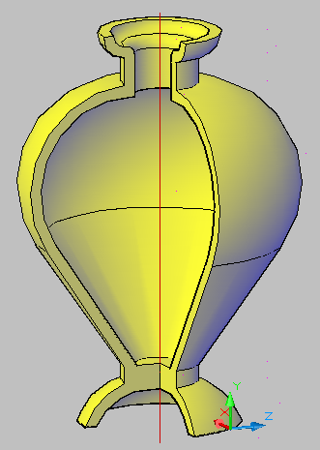
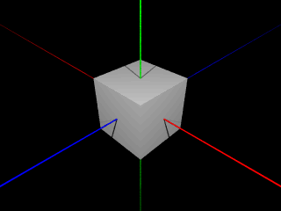
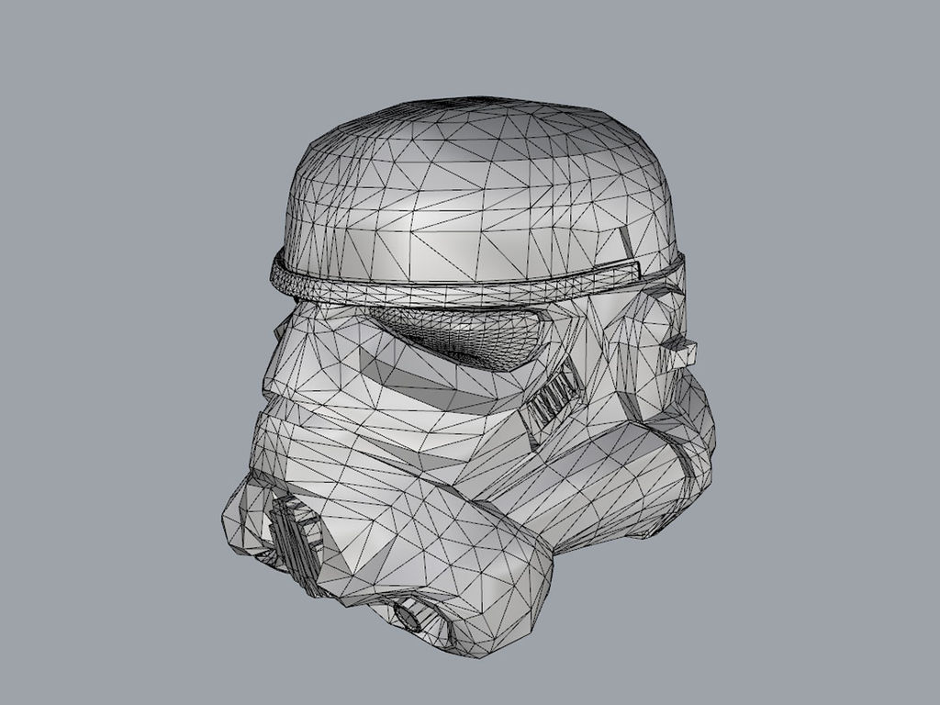

First, you start with a 3D model – You can create it in 3D software, scan an object with a 3D scanner, or download an already made file.

Slide 21
Creating 3D Models
CAD/CAM – Computer Aided Design/Computer Aided Modeling
Solids vs. Meshes - modeling in solids is advantageous for 3D printing
since models will more likely be manifold (no holes). Mesh modeling is more common in animation and game design.
All models become meshes when saved for 3D printing.
Solid Modelers:
AutoCAD
Fusion 360
Sketch Up
TinkerCAD
Mesh Modelers:
Blender
Rhyno
Z Brush
Parametric Modelers: using a set of mathematical rules to define an object

Slide 22
Mesh: made up of points, vertices, edges, and faces.
All triangles –
Triangulation

Slide 23
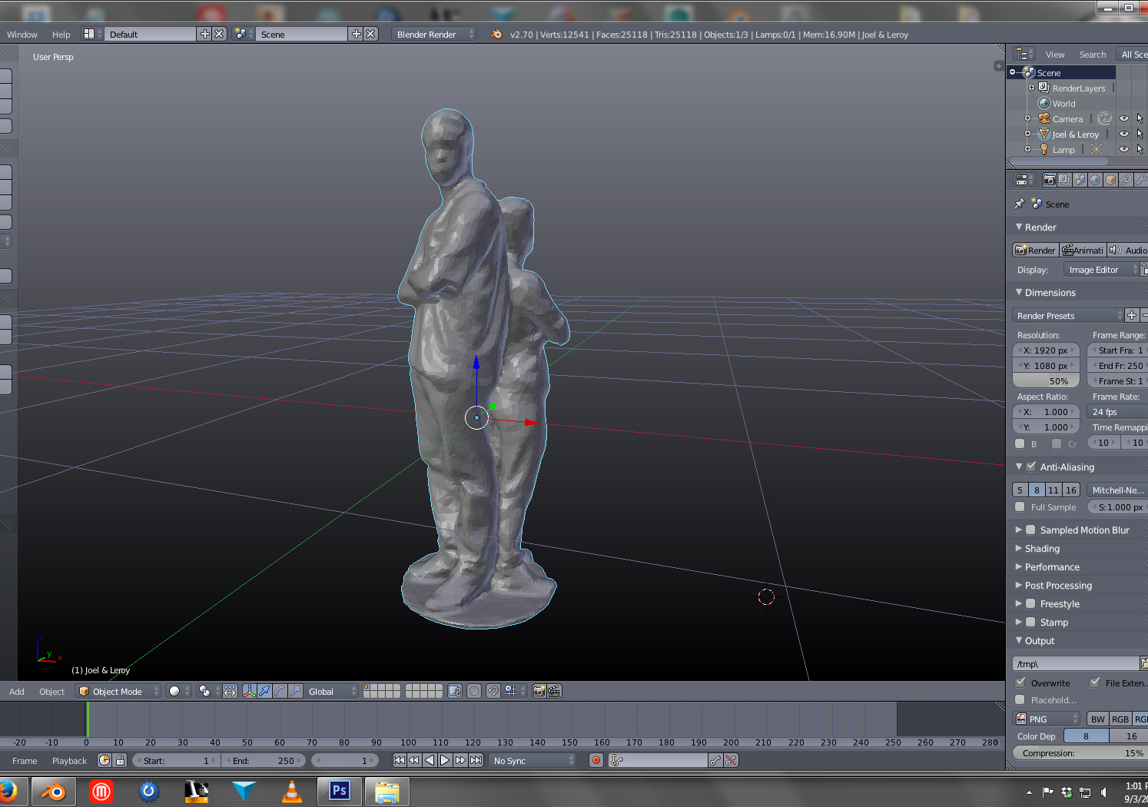

Slide 24
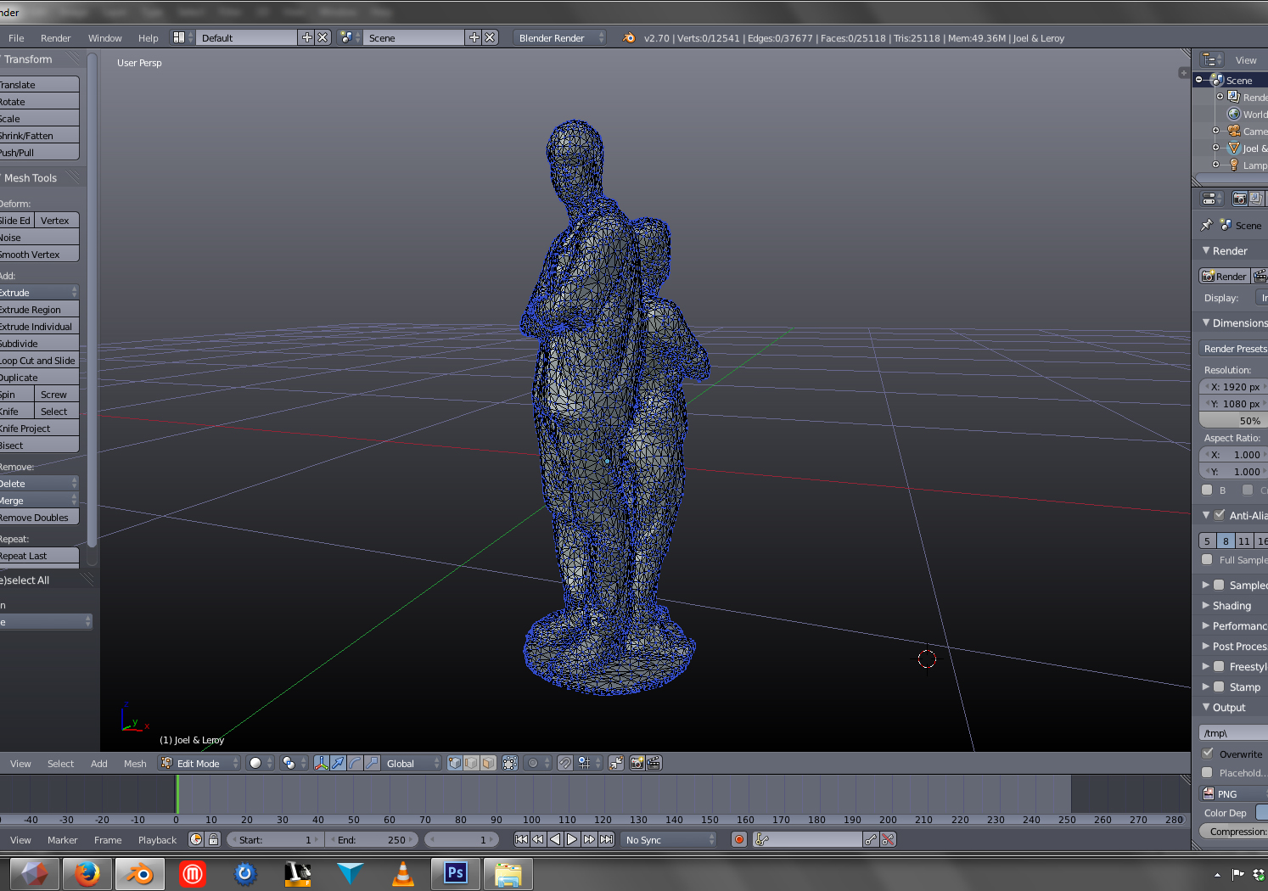

Slide 25
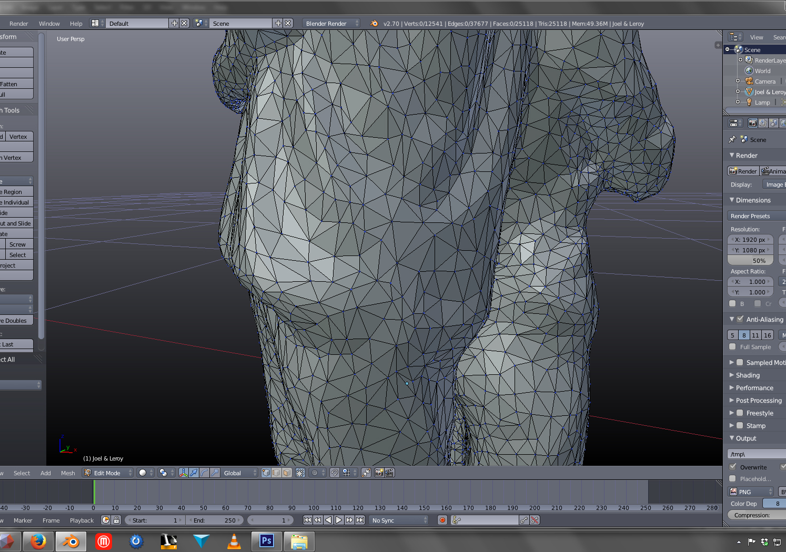

Slide 26
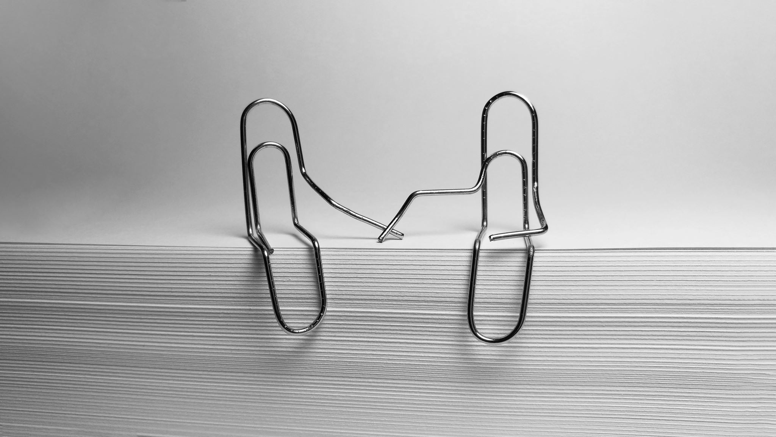
Preparing you files for 3D Printing
Files Must Be:
STL or OBJ format
Manifold
(watertight, no
holes)
Files Cannot Have:
Overhangs
Loose Faces
Inverted Normals
Intersecting
Geometry

Slide 27
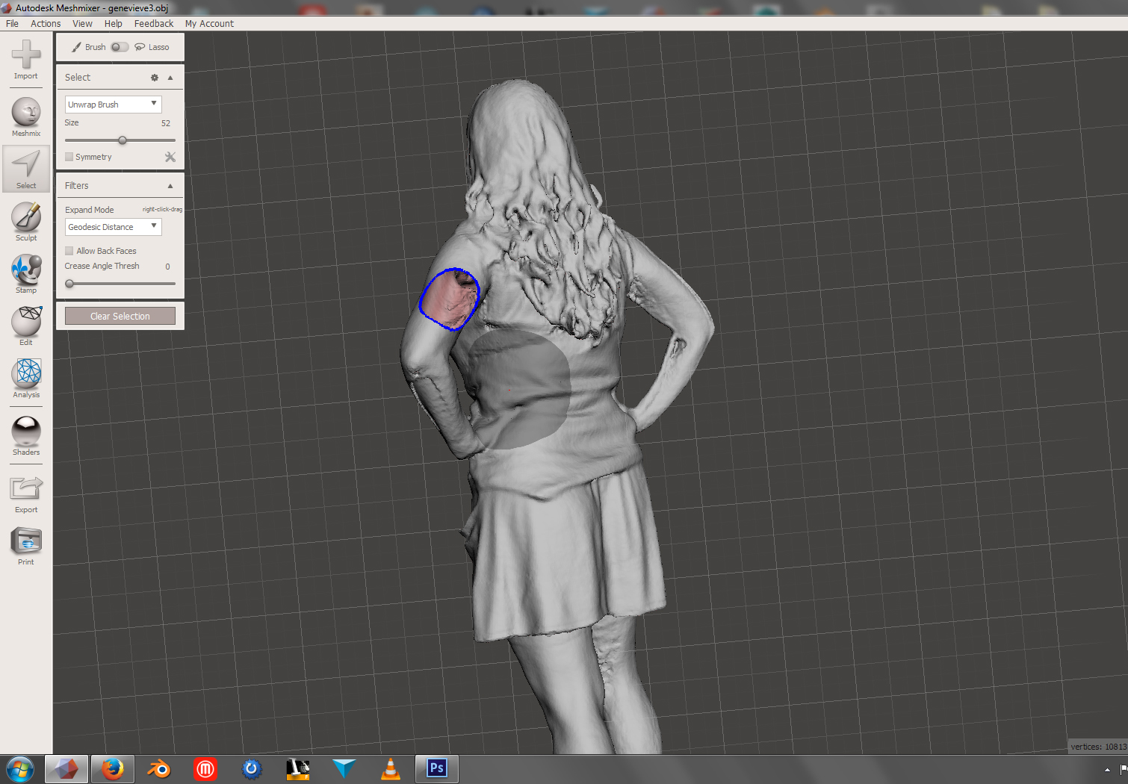
Manifold Models - aka Watertight aka Has No Holes

Slide 28
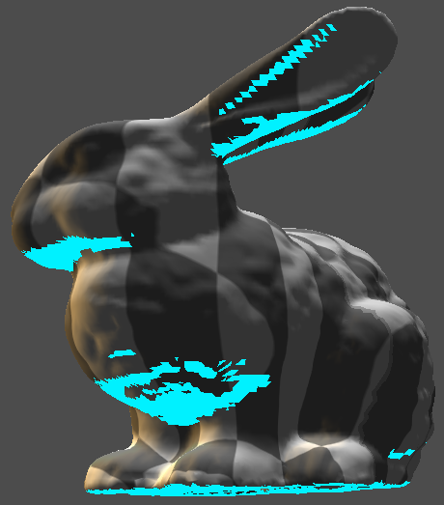
Overhangs & Supports

Slide 29


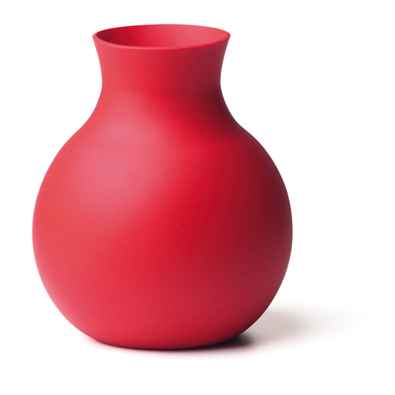

When modeling your cup and bowl remember:
One Part Mold:
No Undercuts
Flares Out at Top
Two Part Mold: Has Undercuts

Slide 30
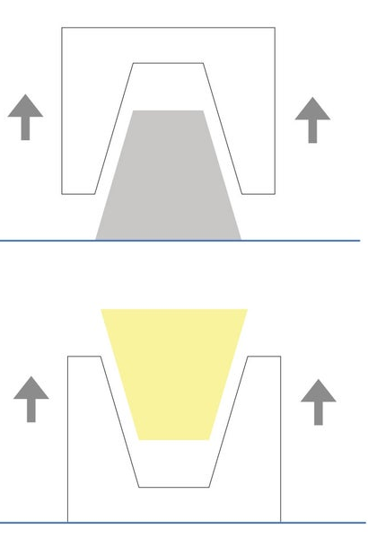
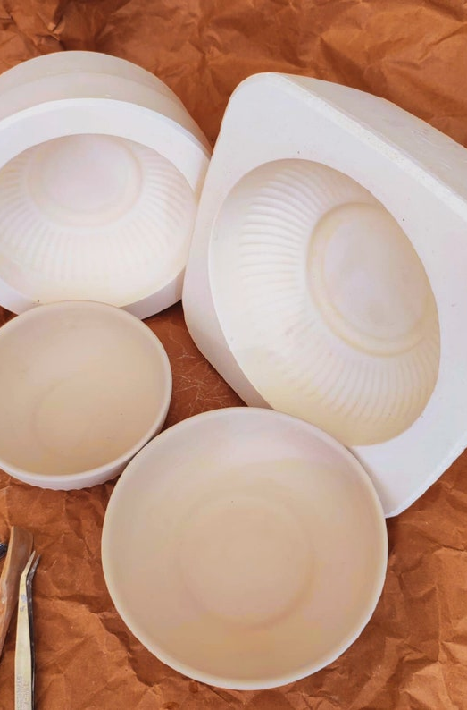
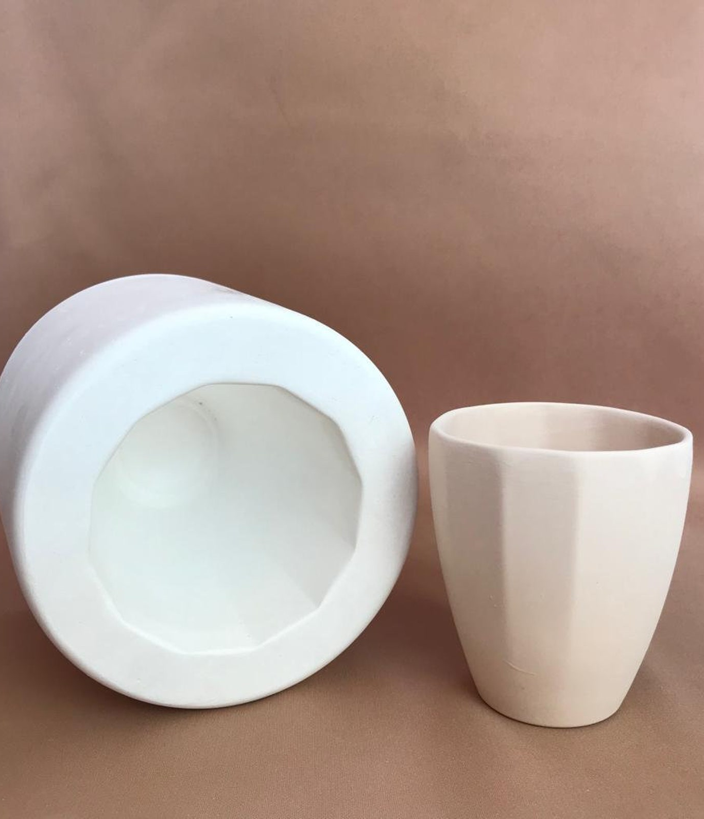
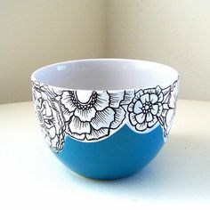
One Part Molds:
Single piece plaster mold
No overhangs or undercuts

Slide 31
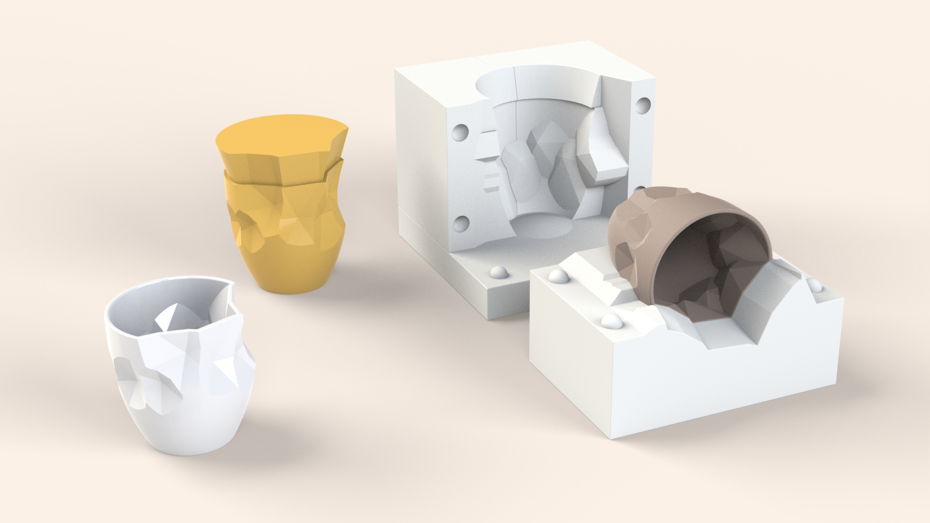
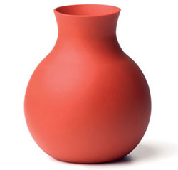
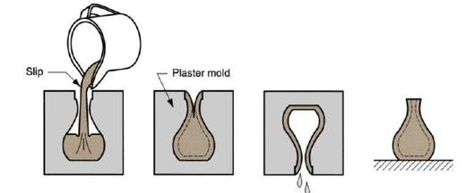
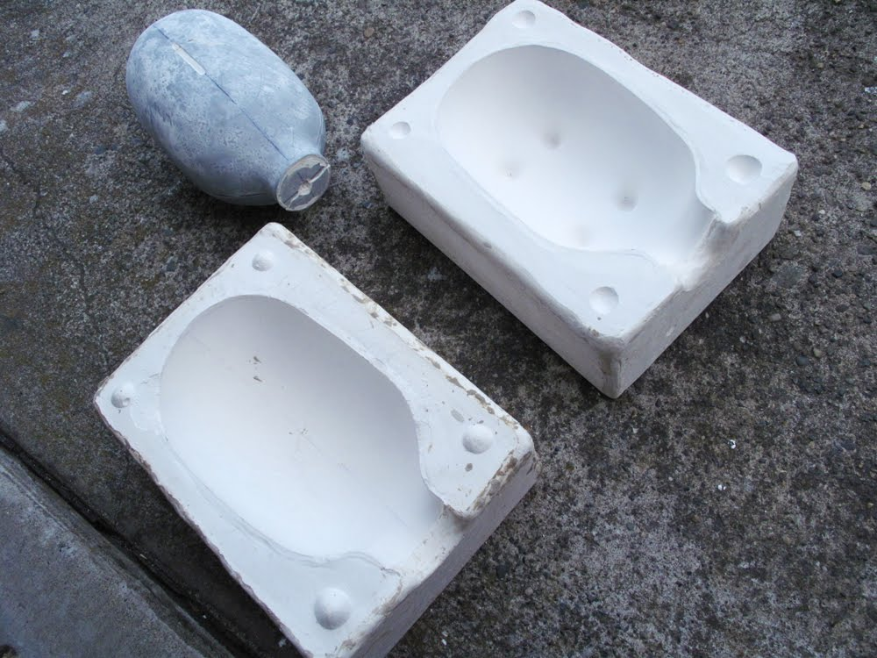
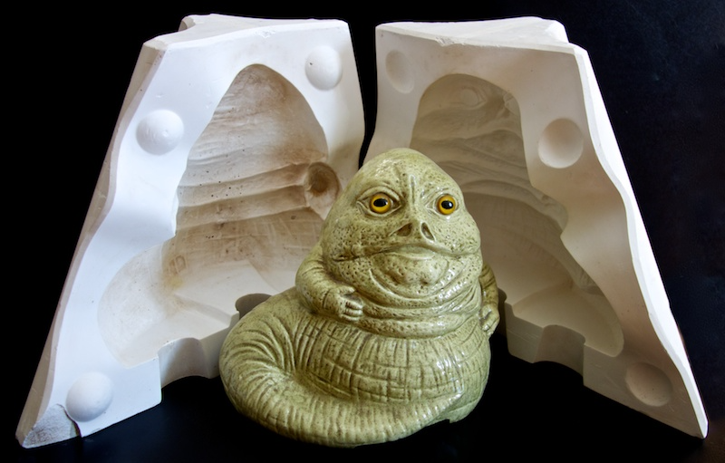
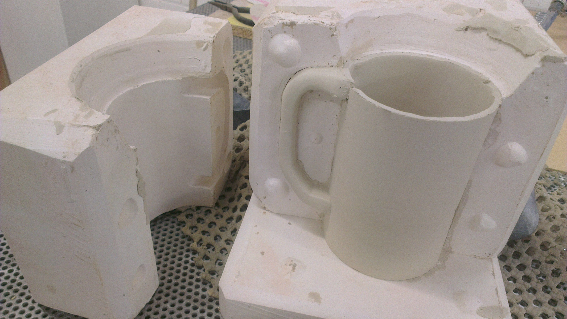
Two Part Molds:
Two pieces of plaster
Can have overhangs and undercuts

Slide 32
