Slide 1
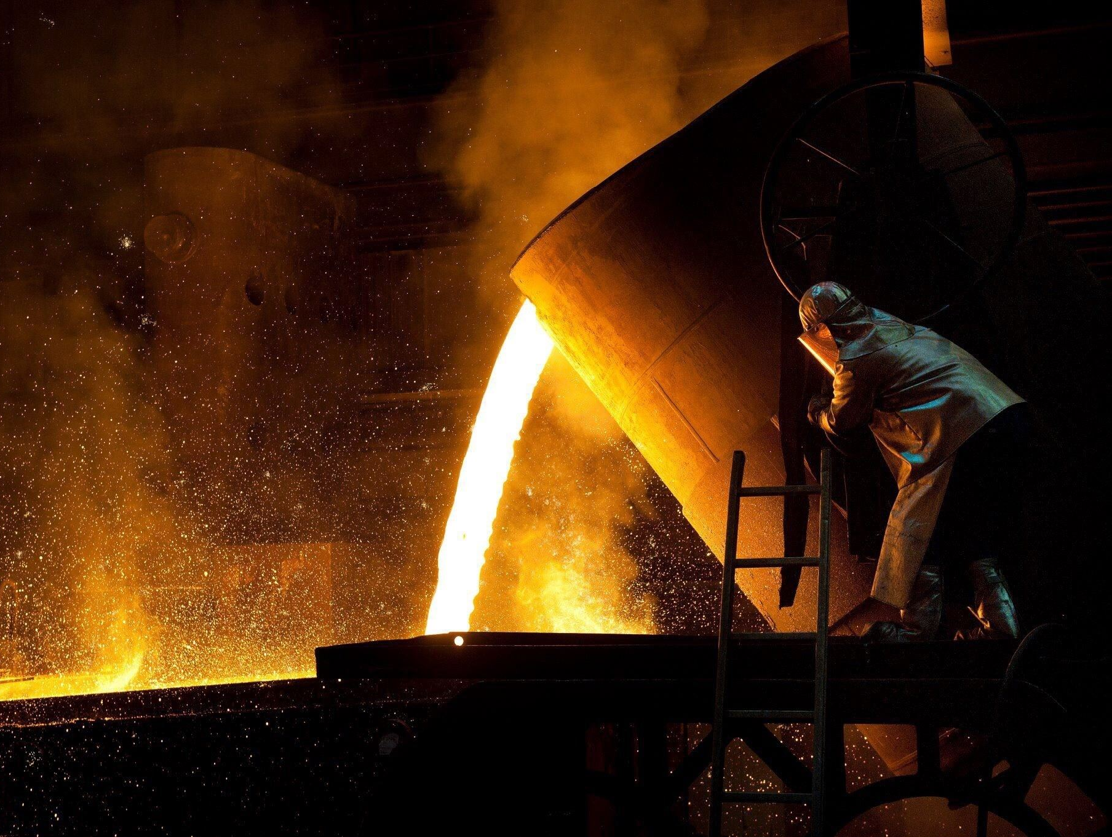
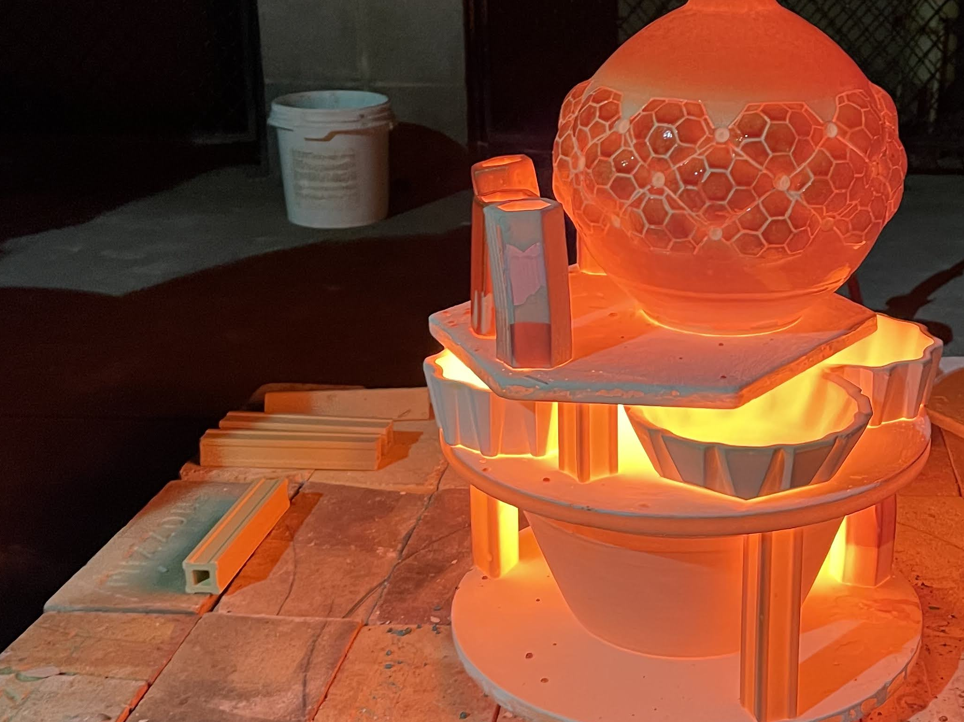
Mold Making & Slip Casting

Slide 2
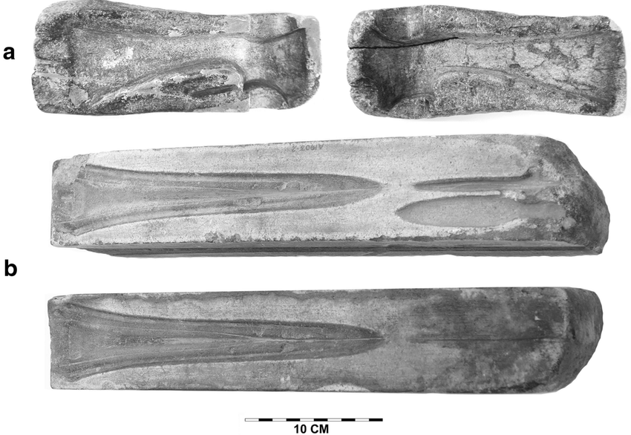
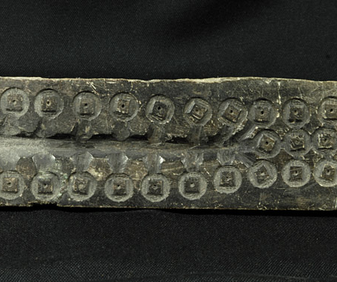
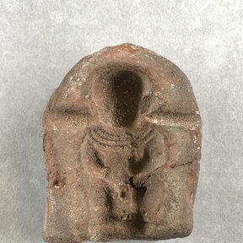
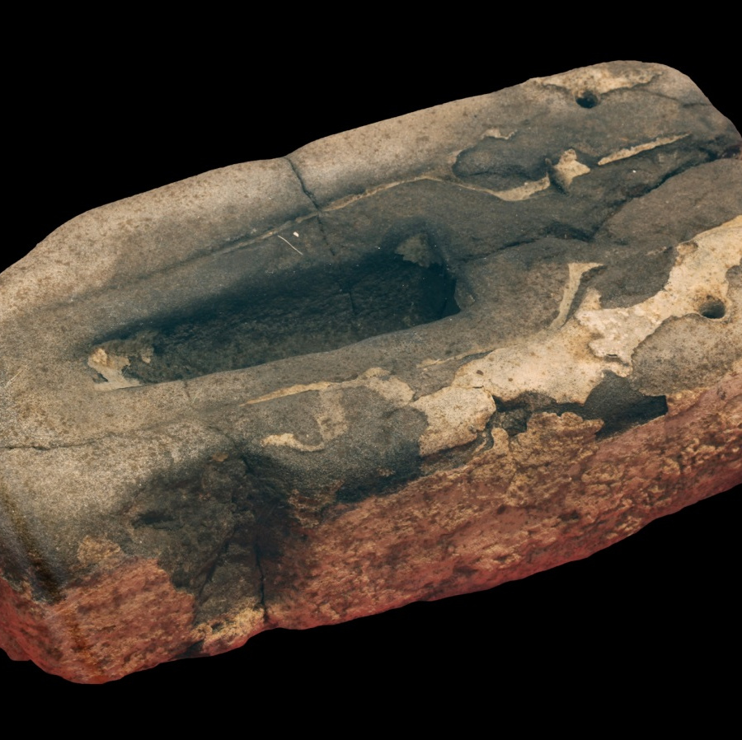
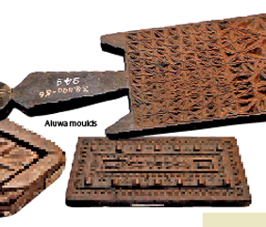
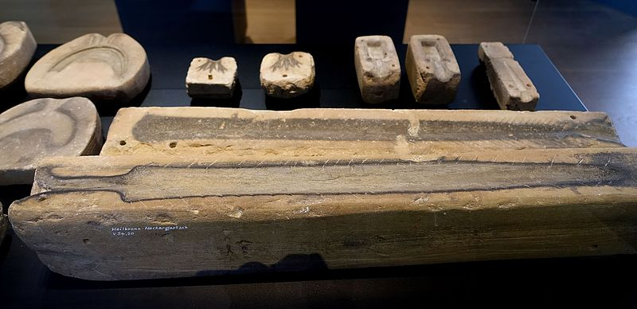
Mold Making
A 6000-year-old manufacturing process using liquid or pliable materials formed around a frame or in a mold.
A mold (or hollowed out form) in the negative shape of an object is made. Then material is poured or pressed into the mold and left to harden. The resulting positive form is called a casting.
Humans have used molds and hollow cavities to shape liquid materials into solid objects since early Mesopotamian and Bronze Age civilizations.
Notes:
Spear head mold, bronze age, 4000 years old, sword mold, bronze age, 3000 yrs old, Egyptian figure mold, 2400 yrs old, sword and ax molds Roman, middle bronze age, 3000 yrs old, coin mold, Chinese, 2500 yrs old, sri lankan flour molds, 500 yrs old

Slide 3
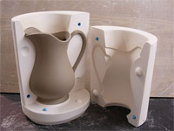
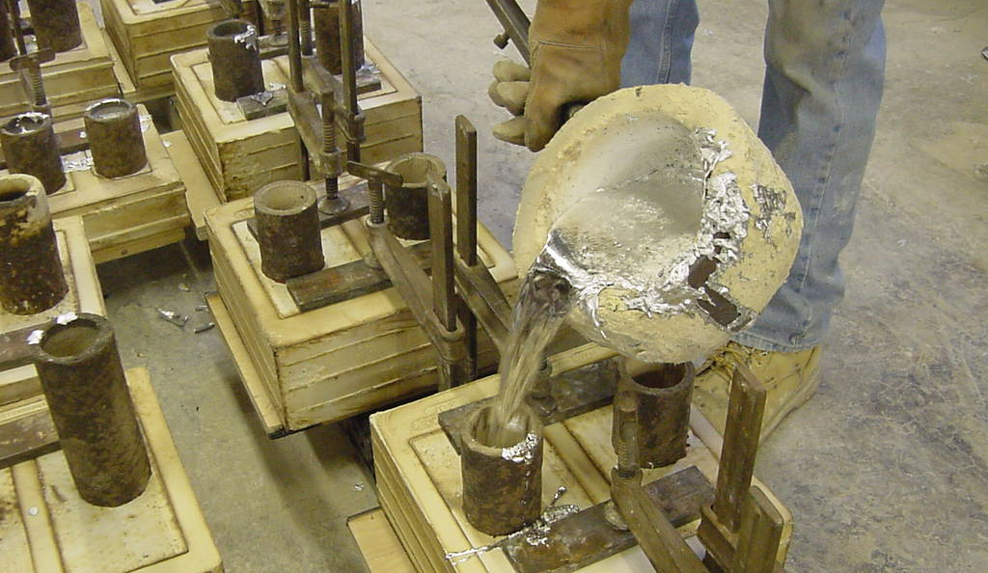
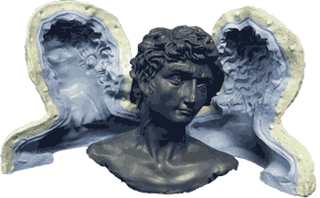
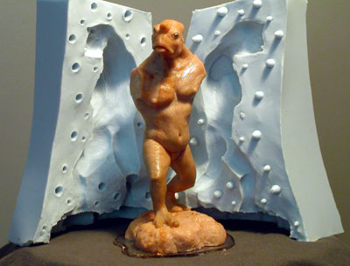

Slide 4
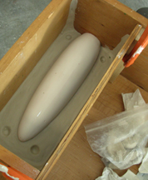
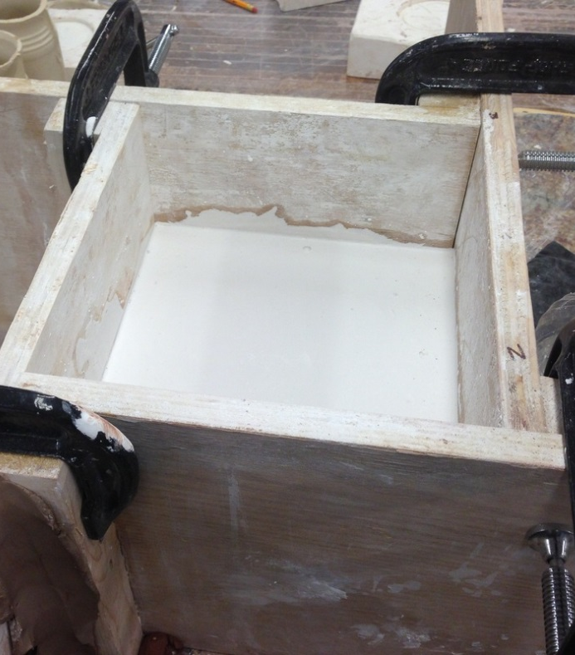
Common Techniques for Making Plaster Molds
- Cottle Boards

Slide 5
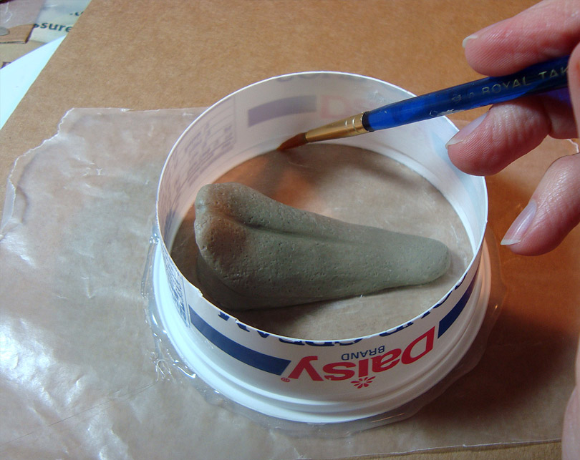
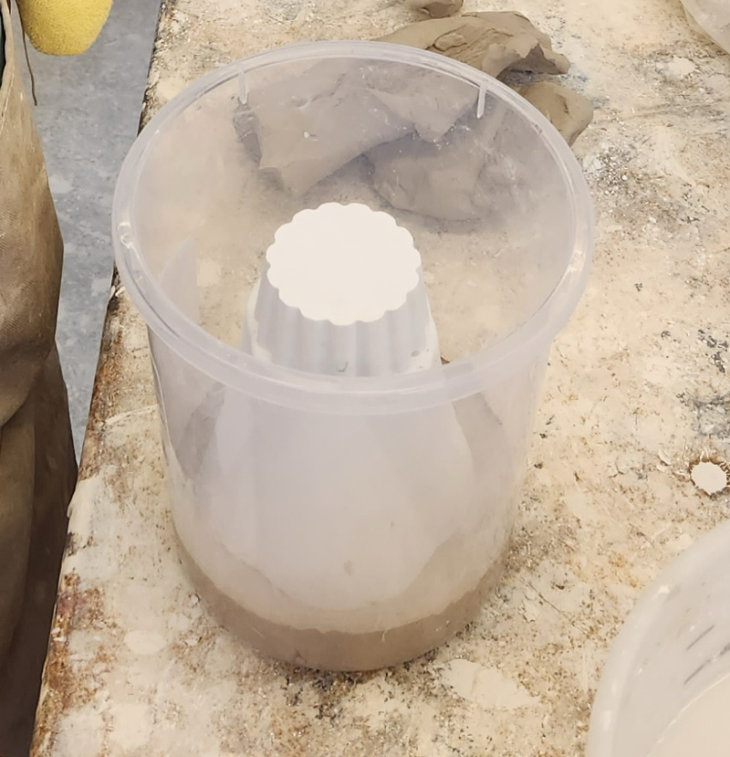
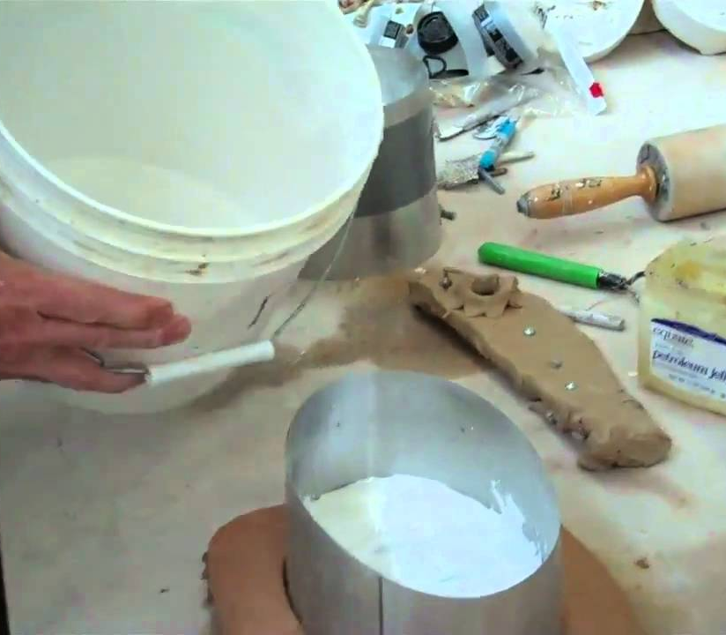
You can use a plastic container, or bucket, or sheet metal to make your “cottles.”

Slide 6
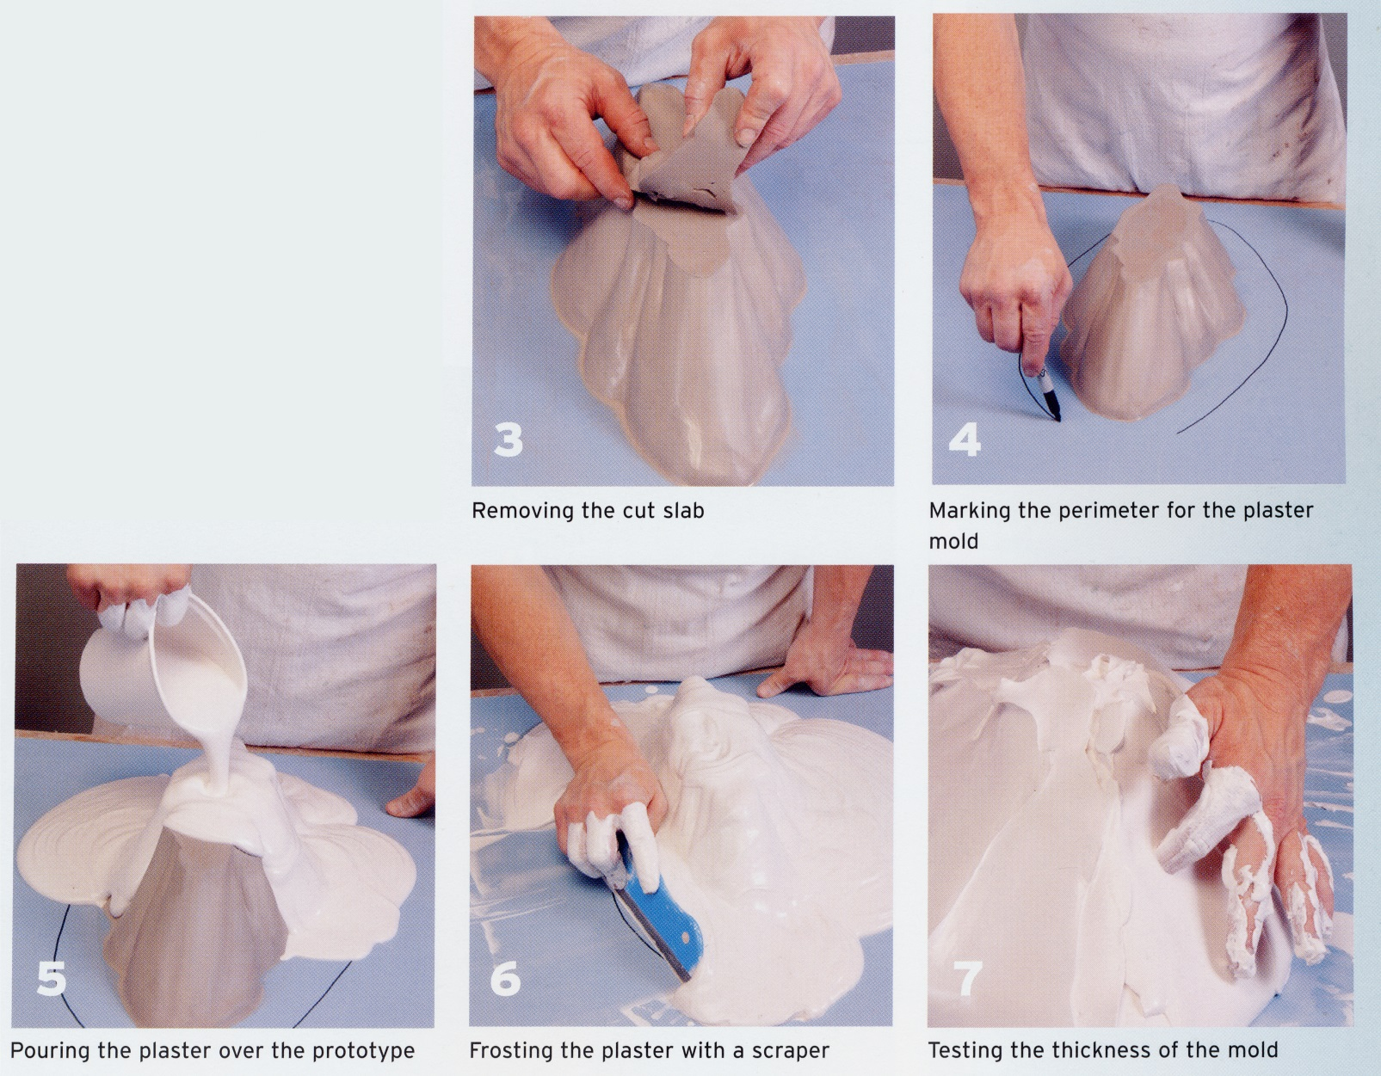
Frosting:
Let your plaster get to the consistency of cream cheese and “frost” your model like a cake.
(From Andrew Martin’s book)

Slide 7
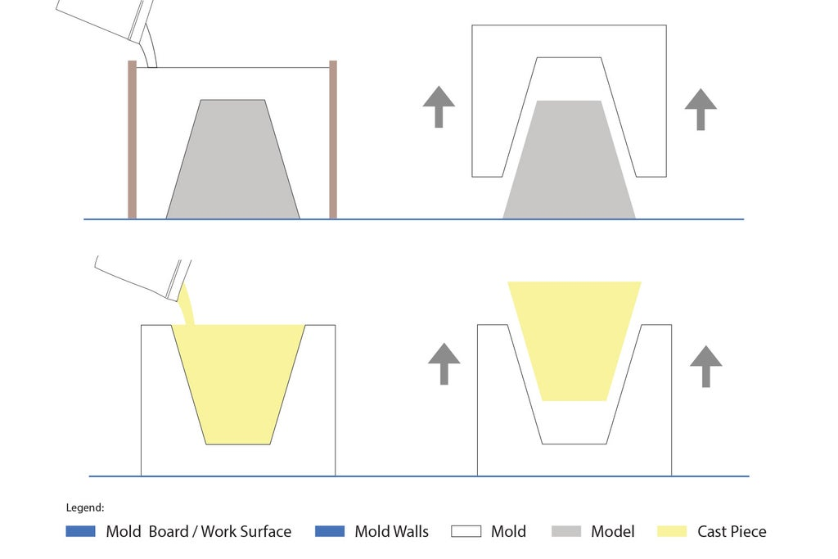
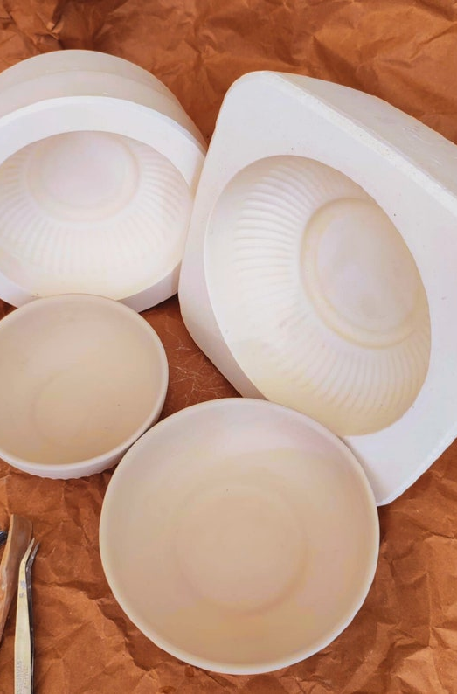
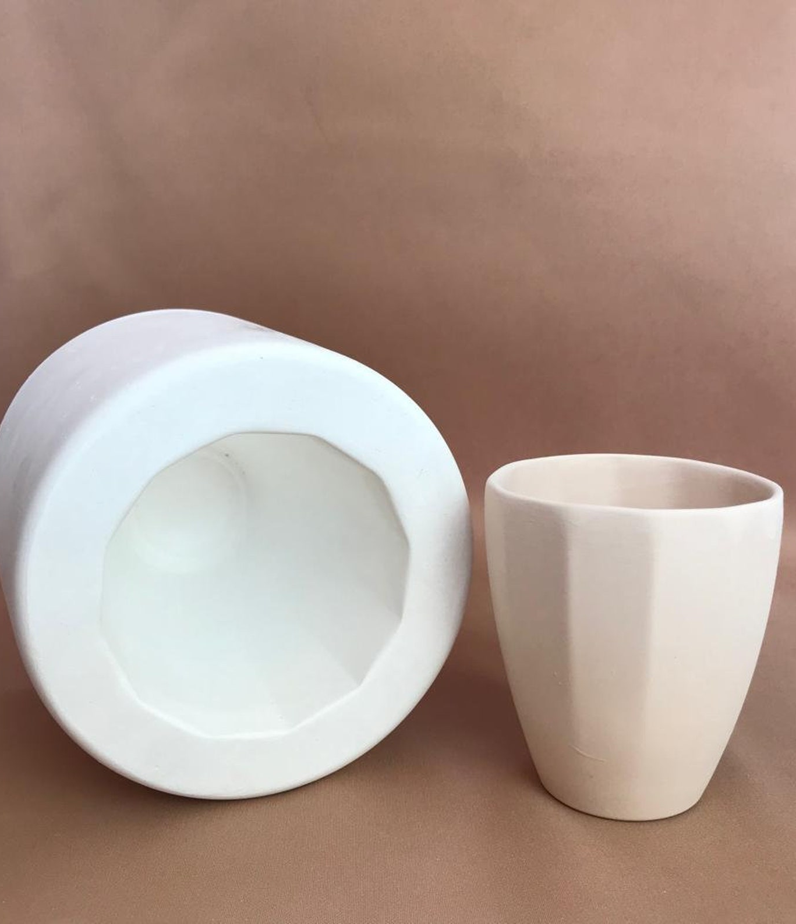
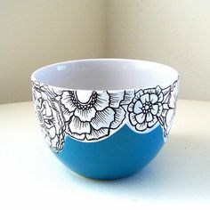
One Part Molds:
Single piece plaster mold
No overhangs or undercuts

Slide 8
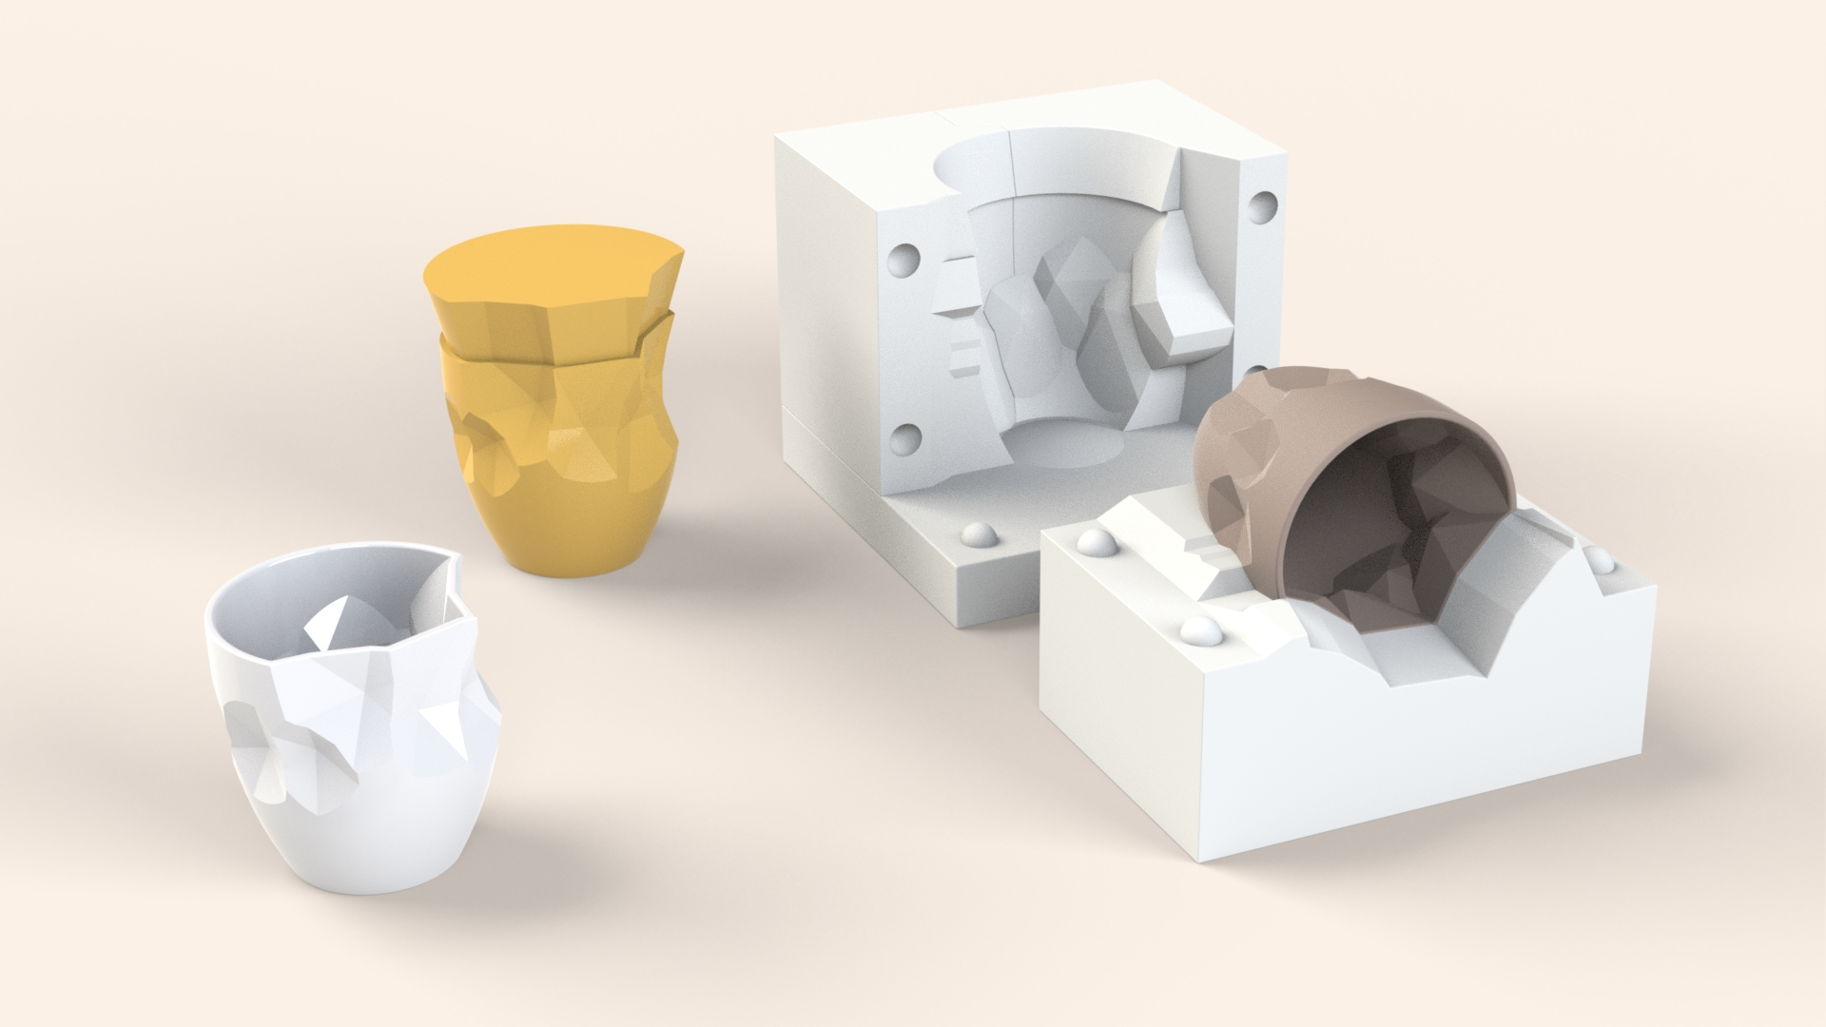
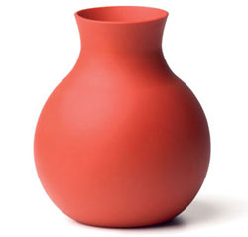
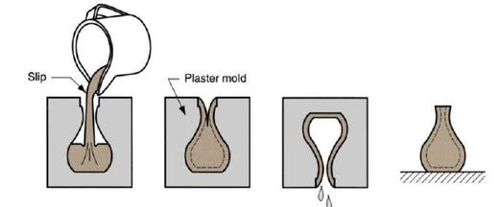
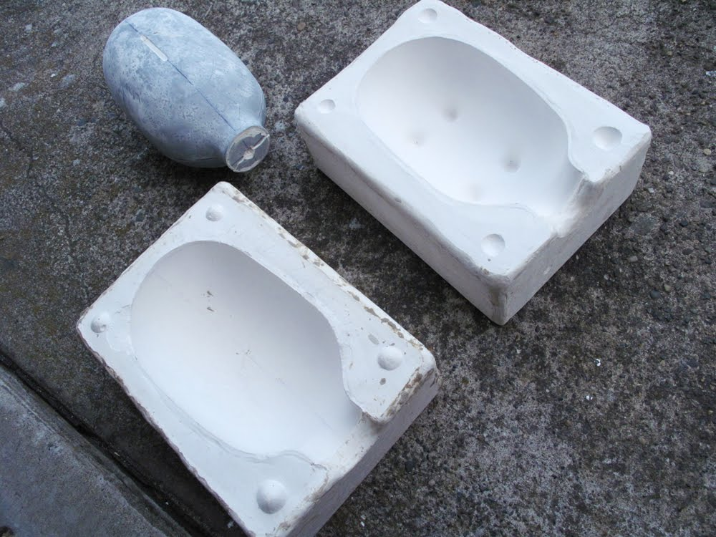
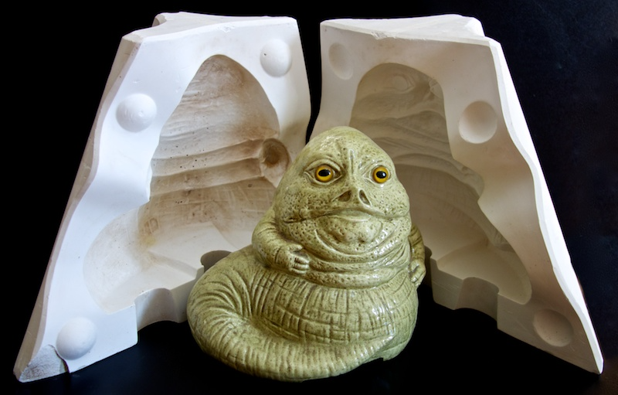
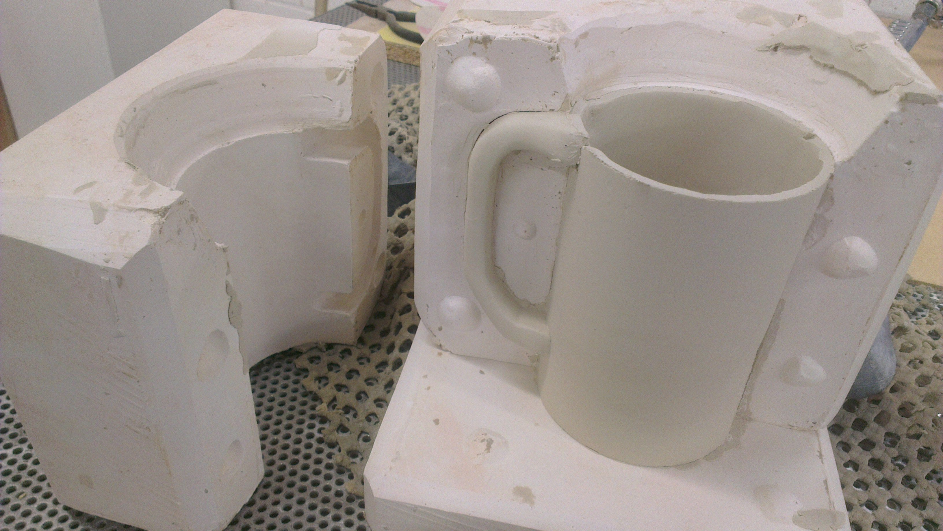
Two Part Molds:
Two pieces of plaster
Can have overhangs and undercuts

Slide 9

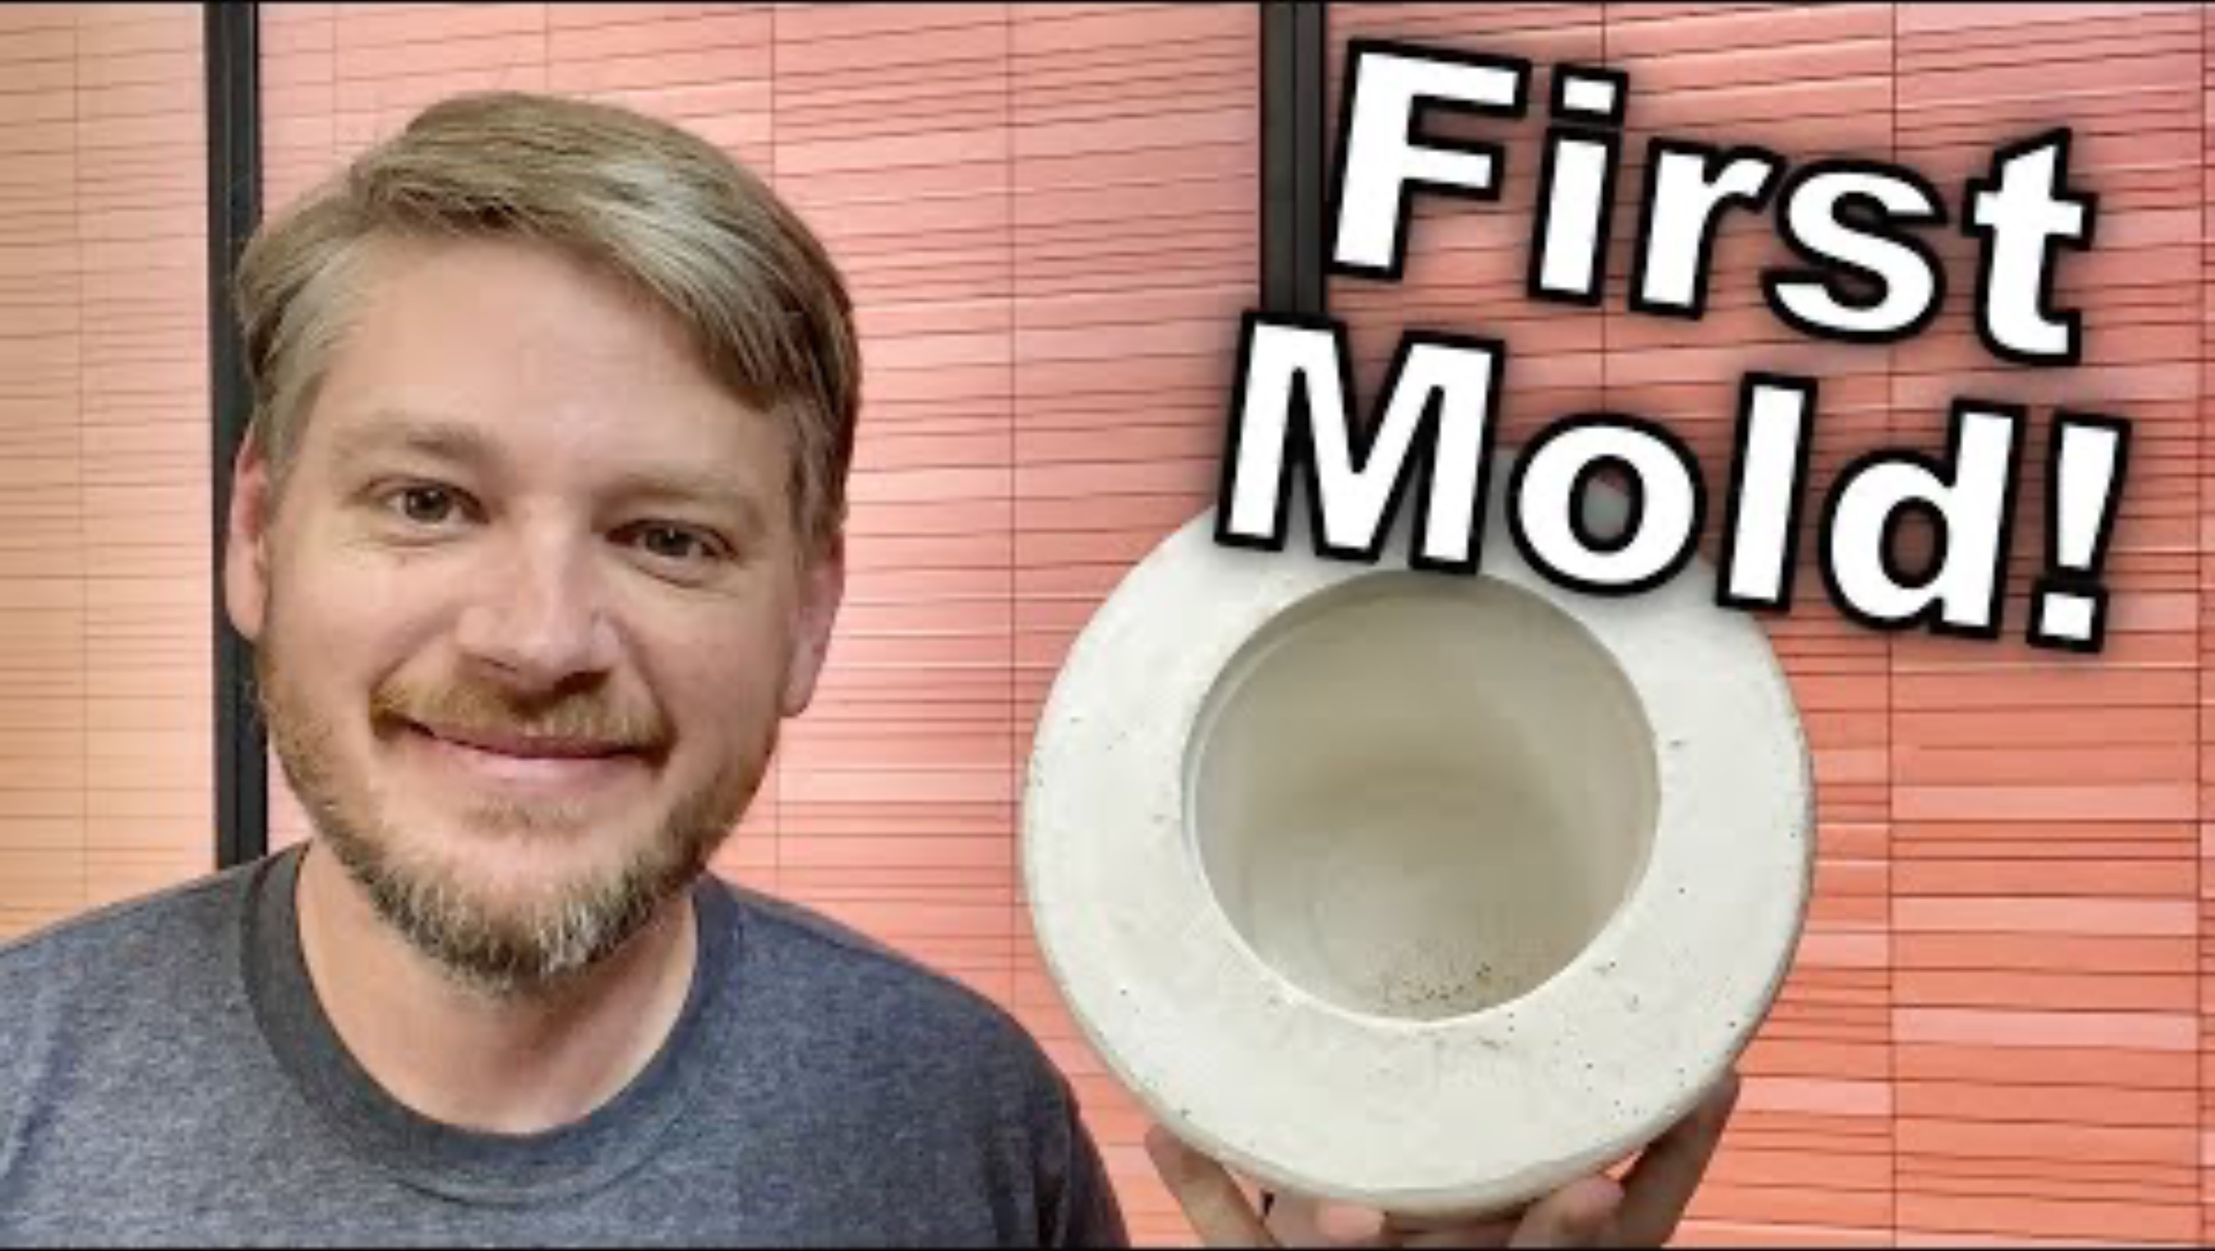
Let’s see how this all works…
https://www.youtube.com/watch?v=puCgsxcH1_w

Slide 10
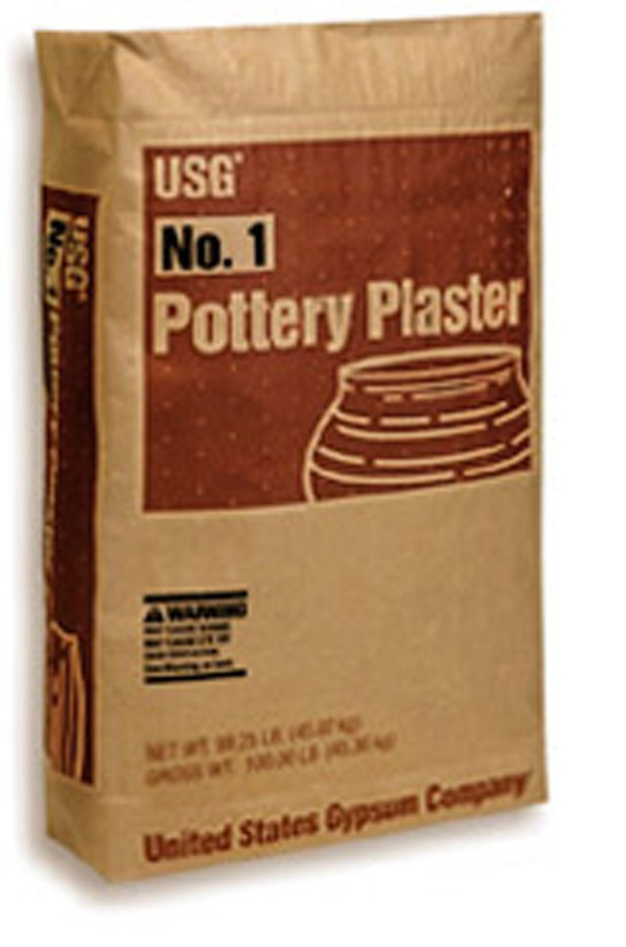
USG No. 1 Pottery Plaster
Gypsum plaster or “Plaster of Paris” is a powdered soft sulfate mineral (gypsum) that hardens once mixed with H20.
We will use USG No.1 Pottery Plaster to make our molds.
Plaster must be mixed correctly for it to be used in the slip casting process. If the plaster is too dense or too porous the capillary action required for casting won’t work.
Plaster starts to “set up” (harden) as soon as it is mixed

Slide 11
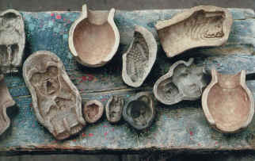

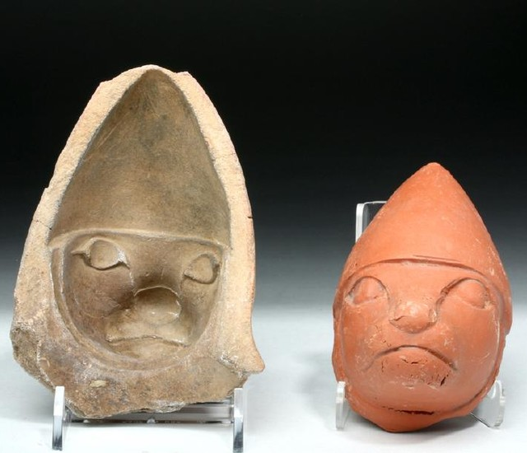
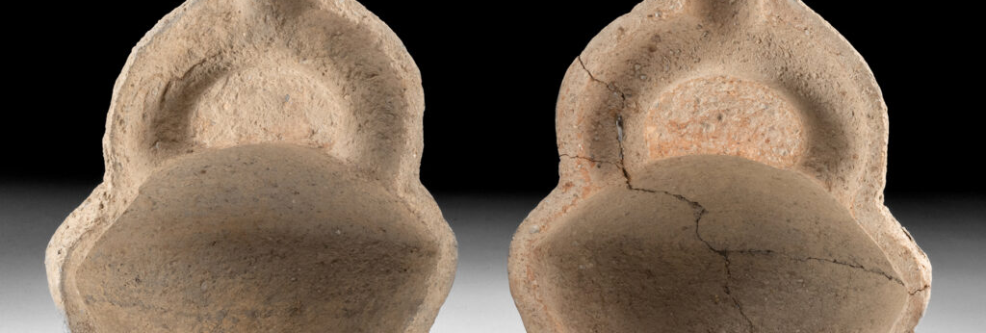
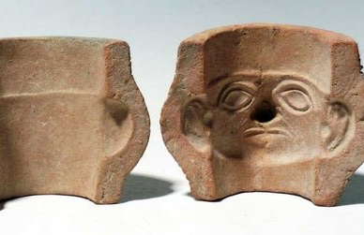
Slip Casting
Slip casting is an ancient manufacturing process used for the mass-production of ceramic objects.
Notes:
Terra cotta warriors, China, 230bc, Peruvian Moche people molds 400-700bc,

Slide 12
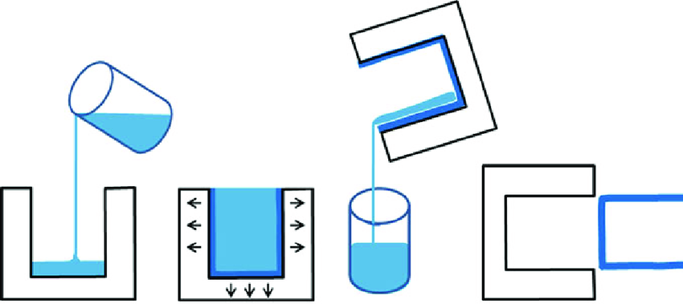

Slide 13
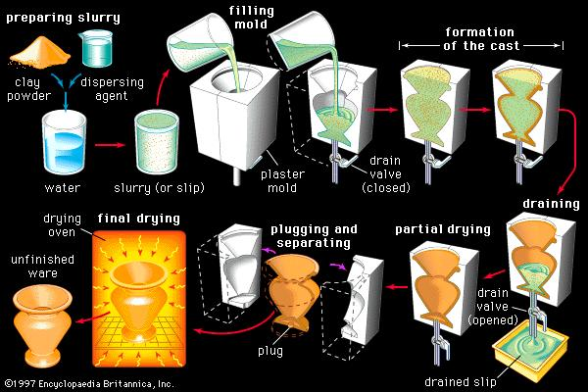
Slip Casting Process

Slide 14
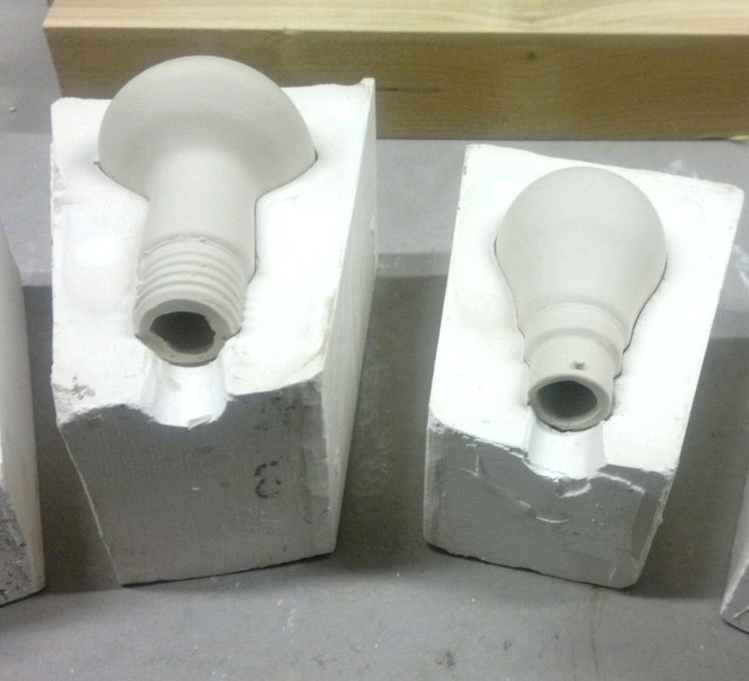
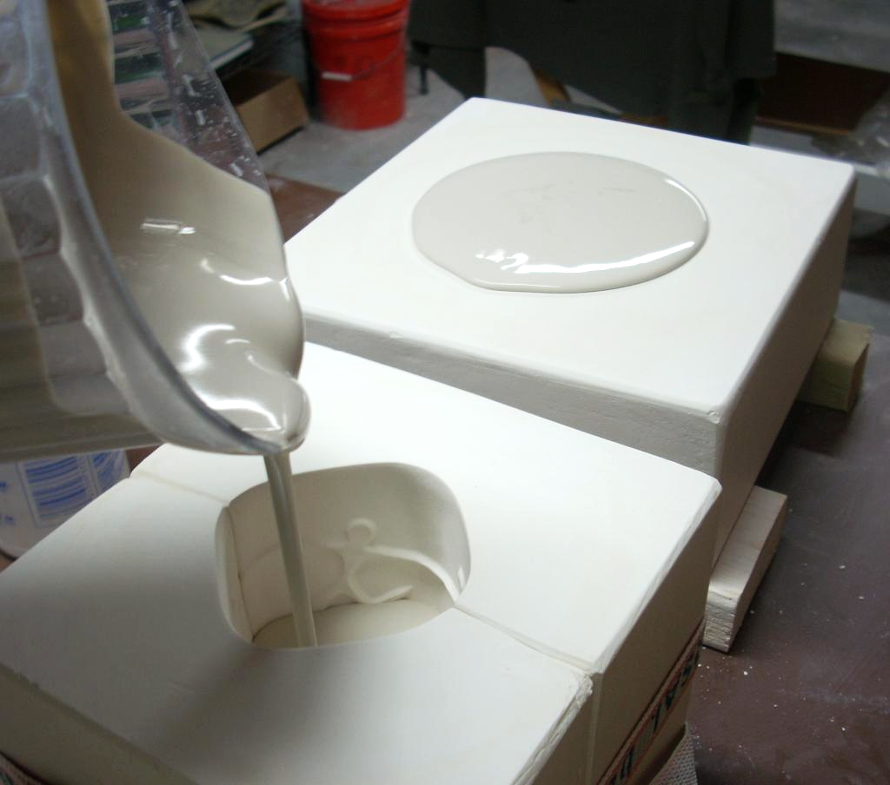
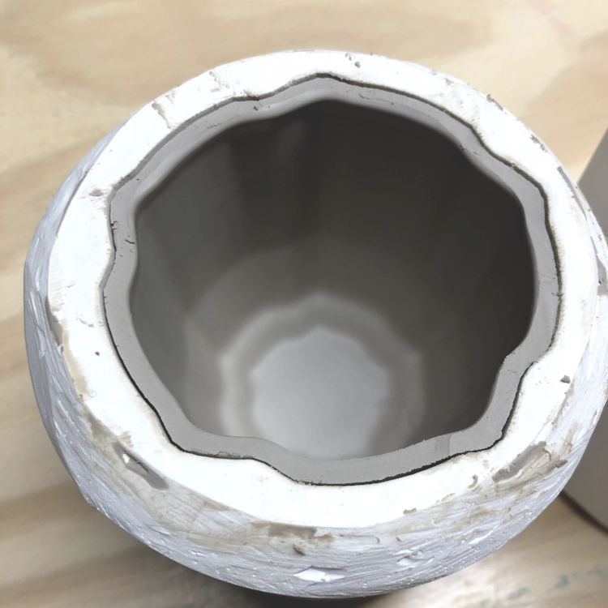
Slip Casting Process
Slip is poured into a plaster mold wherein the plaster sucks the water out of the slip and the slip begins to solidify around the outside. Once a thickness is achieved the remaining slip is poured out. After some time, the casting in the mold hardens and can be removed.

Slide 15
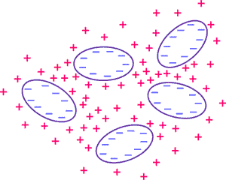
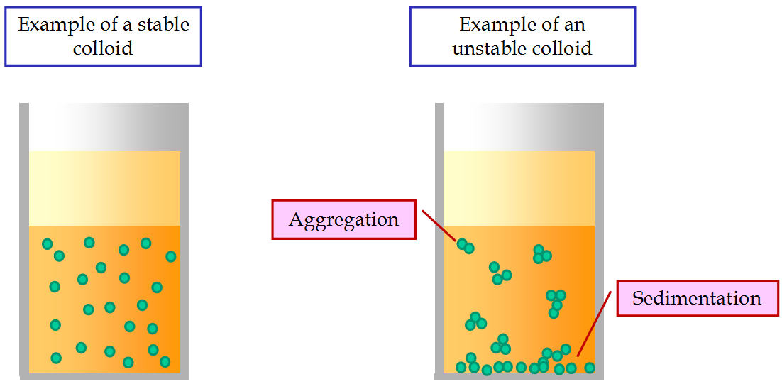
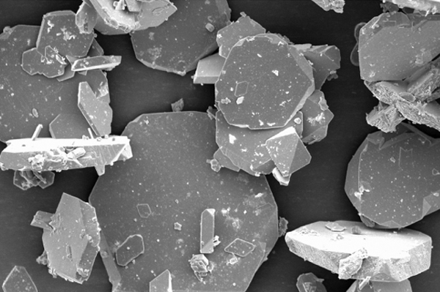
Deflocculant
Slip contains a deflocculant which prevents the clay particles from sticking together. Because of this slip can be mixed using very little H2O which is critical to its function.
Deflocculants hold materials in suspension, preventing them from clumping together. It is critical that the clay particles be held in suspension in slip, it is what allows slip to have liquid properties with the minimum amount of H2O added.

Slide 16
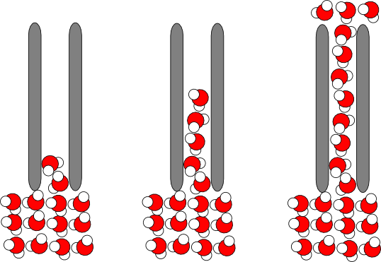
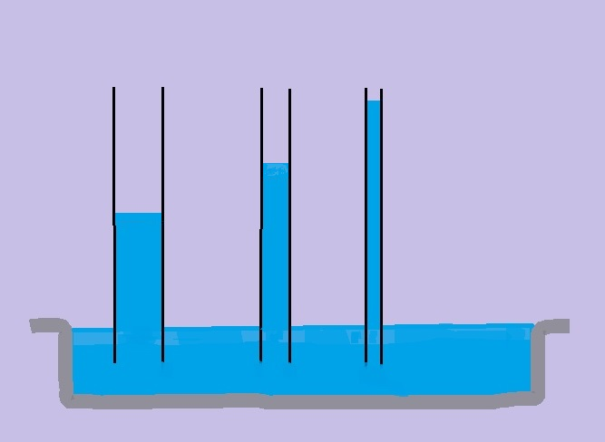
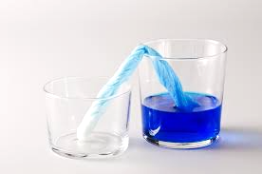
Capillary Action
Slip casting relies entirely on the capillary action of plaster.
Capillary action is the ability of liquids to flow in narrow spaces without or even against external forces. Like paper towels sucking up a spill.

Slide 17
